Slide 1
Psalm 144:1-4
Blessed be the Lord, my rock,
who trains my hands for war,
and my fingers for battle;
² he is my steadfast love and my fortress,
my stronghold and my deliverer,
my shield and he in whom I take refuge,
who subdues peoples^{[a]} under me.
³ O Lord, what is man that you regard him,
or the son of man that you think of him?
⁴ Man is like a breath;
his days are like a passing shadow.

Slide 2
Prayer Prompts
Reverence: Thank you for being my stronghold when….
Response: Lord, I confess that I need to trust Your righteous character instead of…
Requests: Loving Father, rescue me from the grasp of…
Readiness: Relying on You as our stronghold, prepare us for battle as we face…

Slide 3


Slide 4
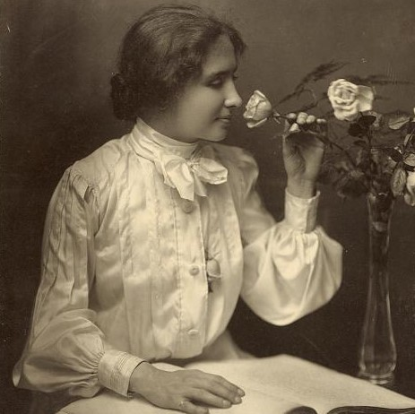
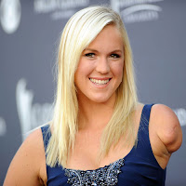
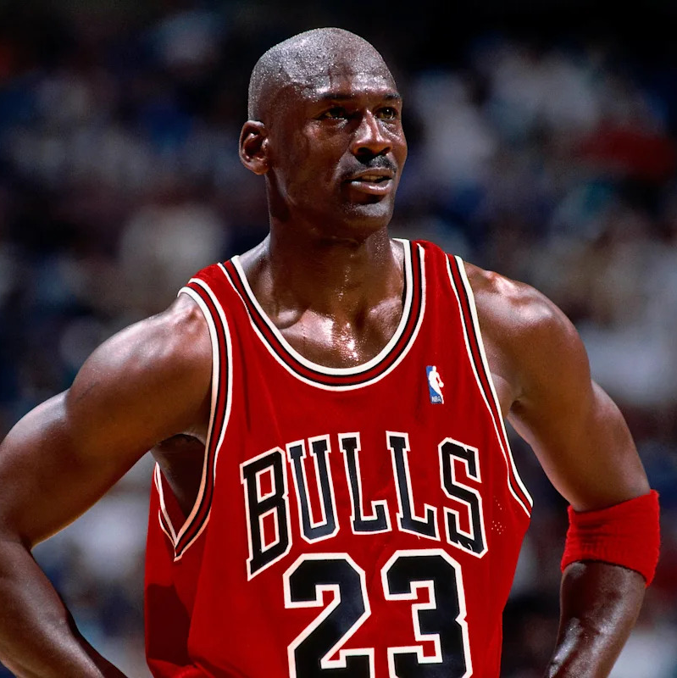

This Photo by Unknown Author is licensed under CC BY-NC-ND
This Photo by Unknown Author is licensed under CC BY

Slide 5
God always provides for and protects those who give their lives to Him by faith, providentially leading them from this life to the next.

Slide 6
A resilient faith begins with God’s will becoming our will.

Slide 7
When your walking in God’s will you will always be where God is!

Slide 8
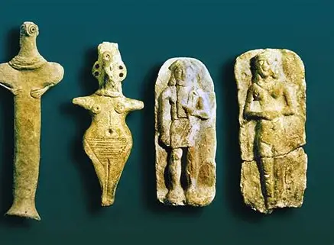
Teraphim

Slide 9
Jacob chose to follow God with nothing more than a command and promise.

Slide 10
A resilient faith is built out of our faith in the power and faithfulness of the promise giver.

Slide 11
God’s promises have no expiration dates only fulfilment dates.

