Slide 1



BELIEVE
WE
BEREA
BAPTIST
CHURCH

Slide 2
STATEMENT OF FAITH
The Canadian Baptists of Western Canada accept wholeheartedly the revelation of God given in the Scriptures of the Old and New Testaments and confess the faith therein set forth. We here explicitly assert the doctrines which we regard as crucial to the understanding and proclamation of the Gospel and to practical Christian living

Slide 3

The justification of the sinner by the grace of God through faith alone in Christ crucified and risen from the dead.
WE BELIEVE IN
WE BELIEVE IN

Slide 4
Salvation by grace through faith
WE BELIEVE IN
WE BELIEVE IN

Slide 5
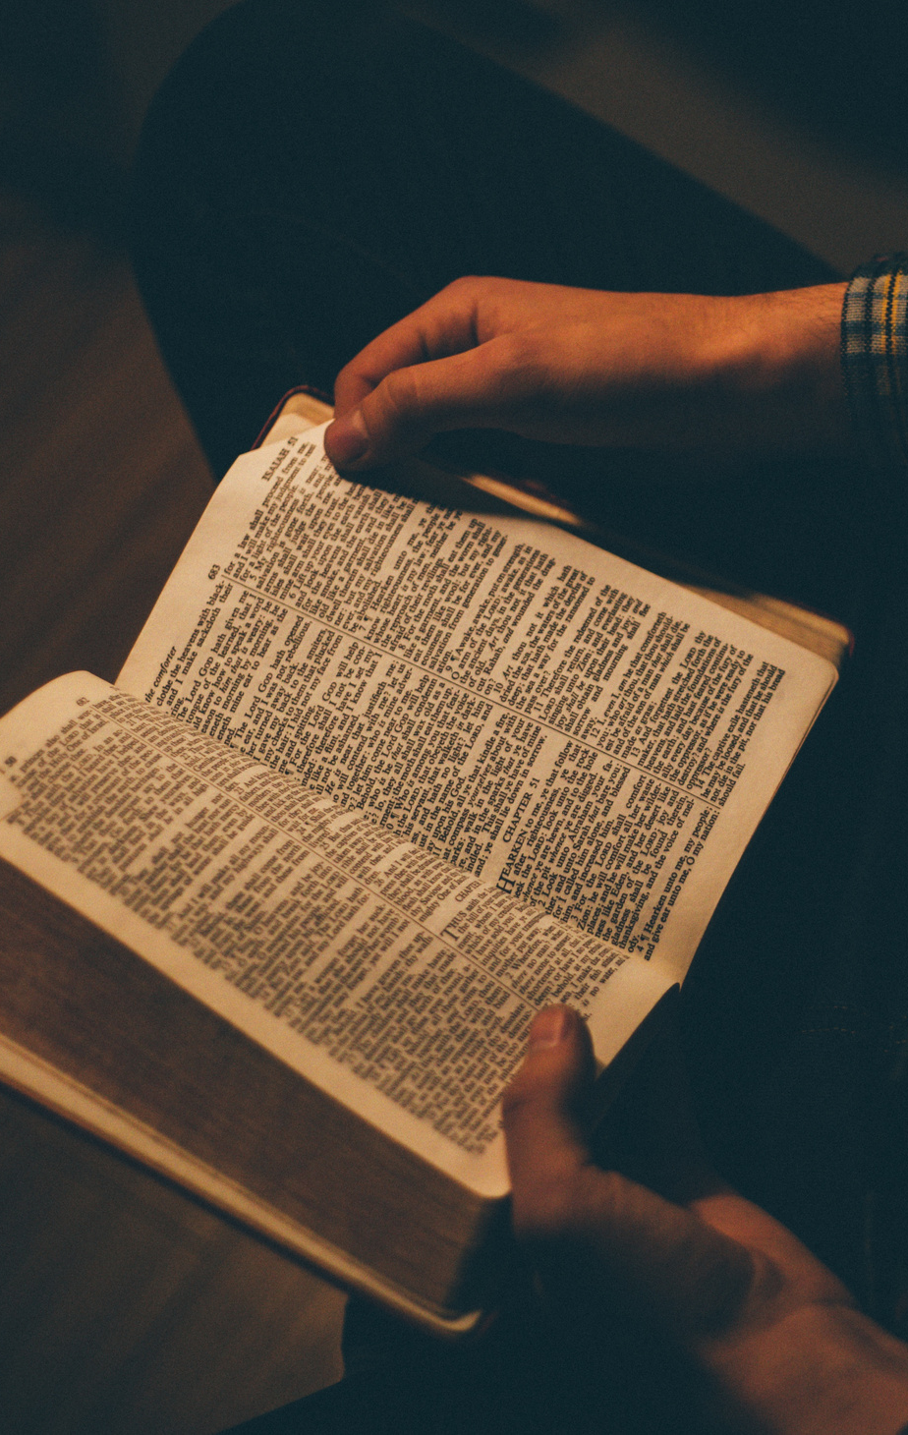
Grace through Faith

Slide 6
Romans 3:21-22a
But now, apart from the law, the righteousness of God has been revealed, as attested by the Law and the Prophets. And this righteousness from God comes through faith in Jesus Christ to all who believe.

Slide 7
Romans 3:21-22a
But now, apart from the law, the righteousness of God has been revealed, as attested by the Law and the Prophets. And this righteousness from God comes through faith in Jesus Christ to all who believe.

Slide 8
Romans 3:21-22a
But now, apart from the law, the righteousness of God has been revealed, as attested by the Law and the Prophets. And this righteousness from God comes through faith in Jesus Christ to all who believe.

Slide 9
Romans 3:22b-24
There is no distinction, for all have sinned and fall short of the glory of God, and are justified freely by His grace through the redemption that is in Christ Jesus.

Slide 10
Romans 3:22b-24
There is no distinction, for all have sinned and fall short of the glory of God, and are justified freely by His grace through the redemption that is in Christ Jesus.

Slide 11
Romans 3:25
God presented Him as the atoning sacrifice through faith in His blood, in order to demonstrate His righteousness, because in His forbearance He had passed over the sins committed beforehand.

Slide 12
Romans 3:26
He did this to demonstrate His righteousness at the present time, so as to be just and to justify the one who has faith in Jesus.

Slide 13
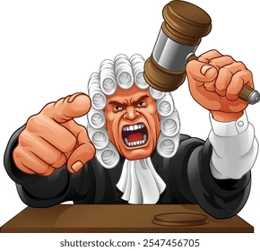

Slide 14
Confession and Assurance

Slide 15
Romans 10:8-10
But what does it say? “The word is near you; it is in your mouth and in your heart,” that is, the word of faith we are proclaiming: that if you confess with your mouth, “Jesus is Lord,” and believe in your heart that God raised Him from the dead, you will be saved. For with your heart you believe and are justified, and with your mouth you confess and are saved.

Slide 16
Romans 10:8-10
But what does it say? “The word is near you; it is in your mouth and in your heart,” that is, the word of faith we are proclaiming: that if you confess with your mouth, “Jesus is Lord,” and believe in your heart that God raised Him from the dead, you will be saved. For with your heart you believe and are justified, and with your mouth you confess and are saved.

Slide 17
Romans 10:11-13
It is just as the Scripture says: “Anyone who believes in Him will never be put to shame.” For there is not difference between Jew or Greek: The same Lord is Lord of all, and gives richly to all who call on Him, for, “Everyone who calls on the name of the Lord will be saved.”

Slide 18
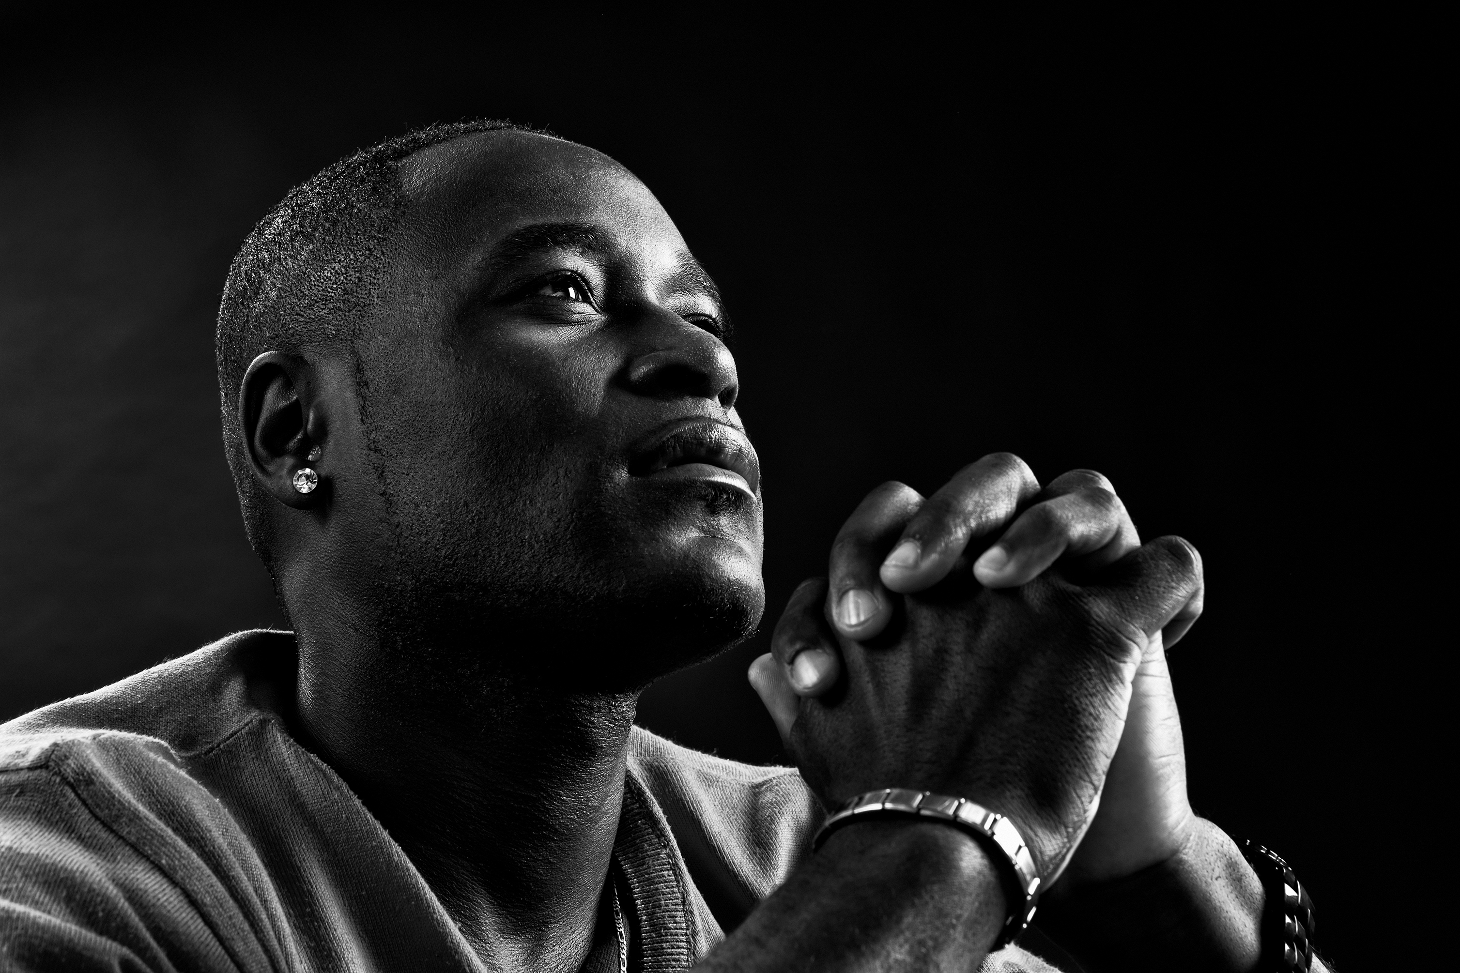

Slide 19
God’s Love in Christ

Slide 20
John 3:14-15
Just as Moses lifted up the snake in the wilderness, so the Son of Man must be lifted up, that everyone who believes in Him may have eternal life.

Slide 21
John 3:16
For God so loved the world that He gave His one and only Son, that everyone who believes in Him shall not perish but have eternal life.

Slide 22
John 3:17-18
For God did not send His Son into the world to condemn the world, but to save the world through Him. Whoever believes in Him is not condemned, but whoever does not believe has already been condemned, because he has not believed in the name of God’s one and only Son.

Slide 23
John 3:17-18
For God did not send His Son into the world to condemn the world, but to save the world through Him. Whoever believes in Him is not condemned, but whoever does not believe has already been condemned, because he has not believed in the name of God’s one and only Son.

Slide 24
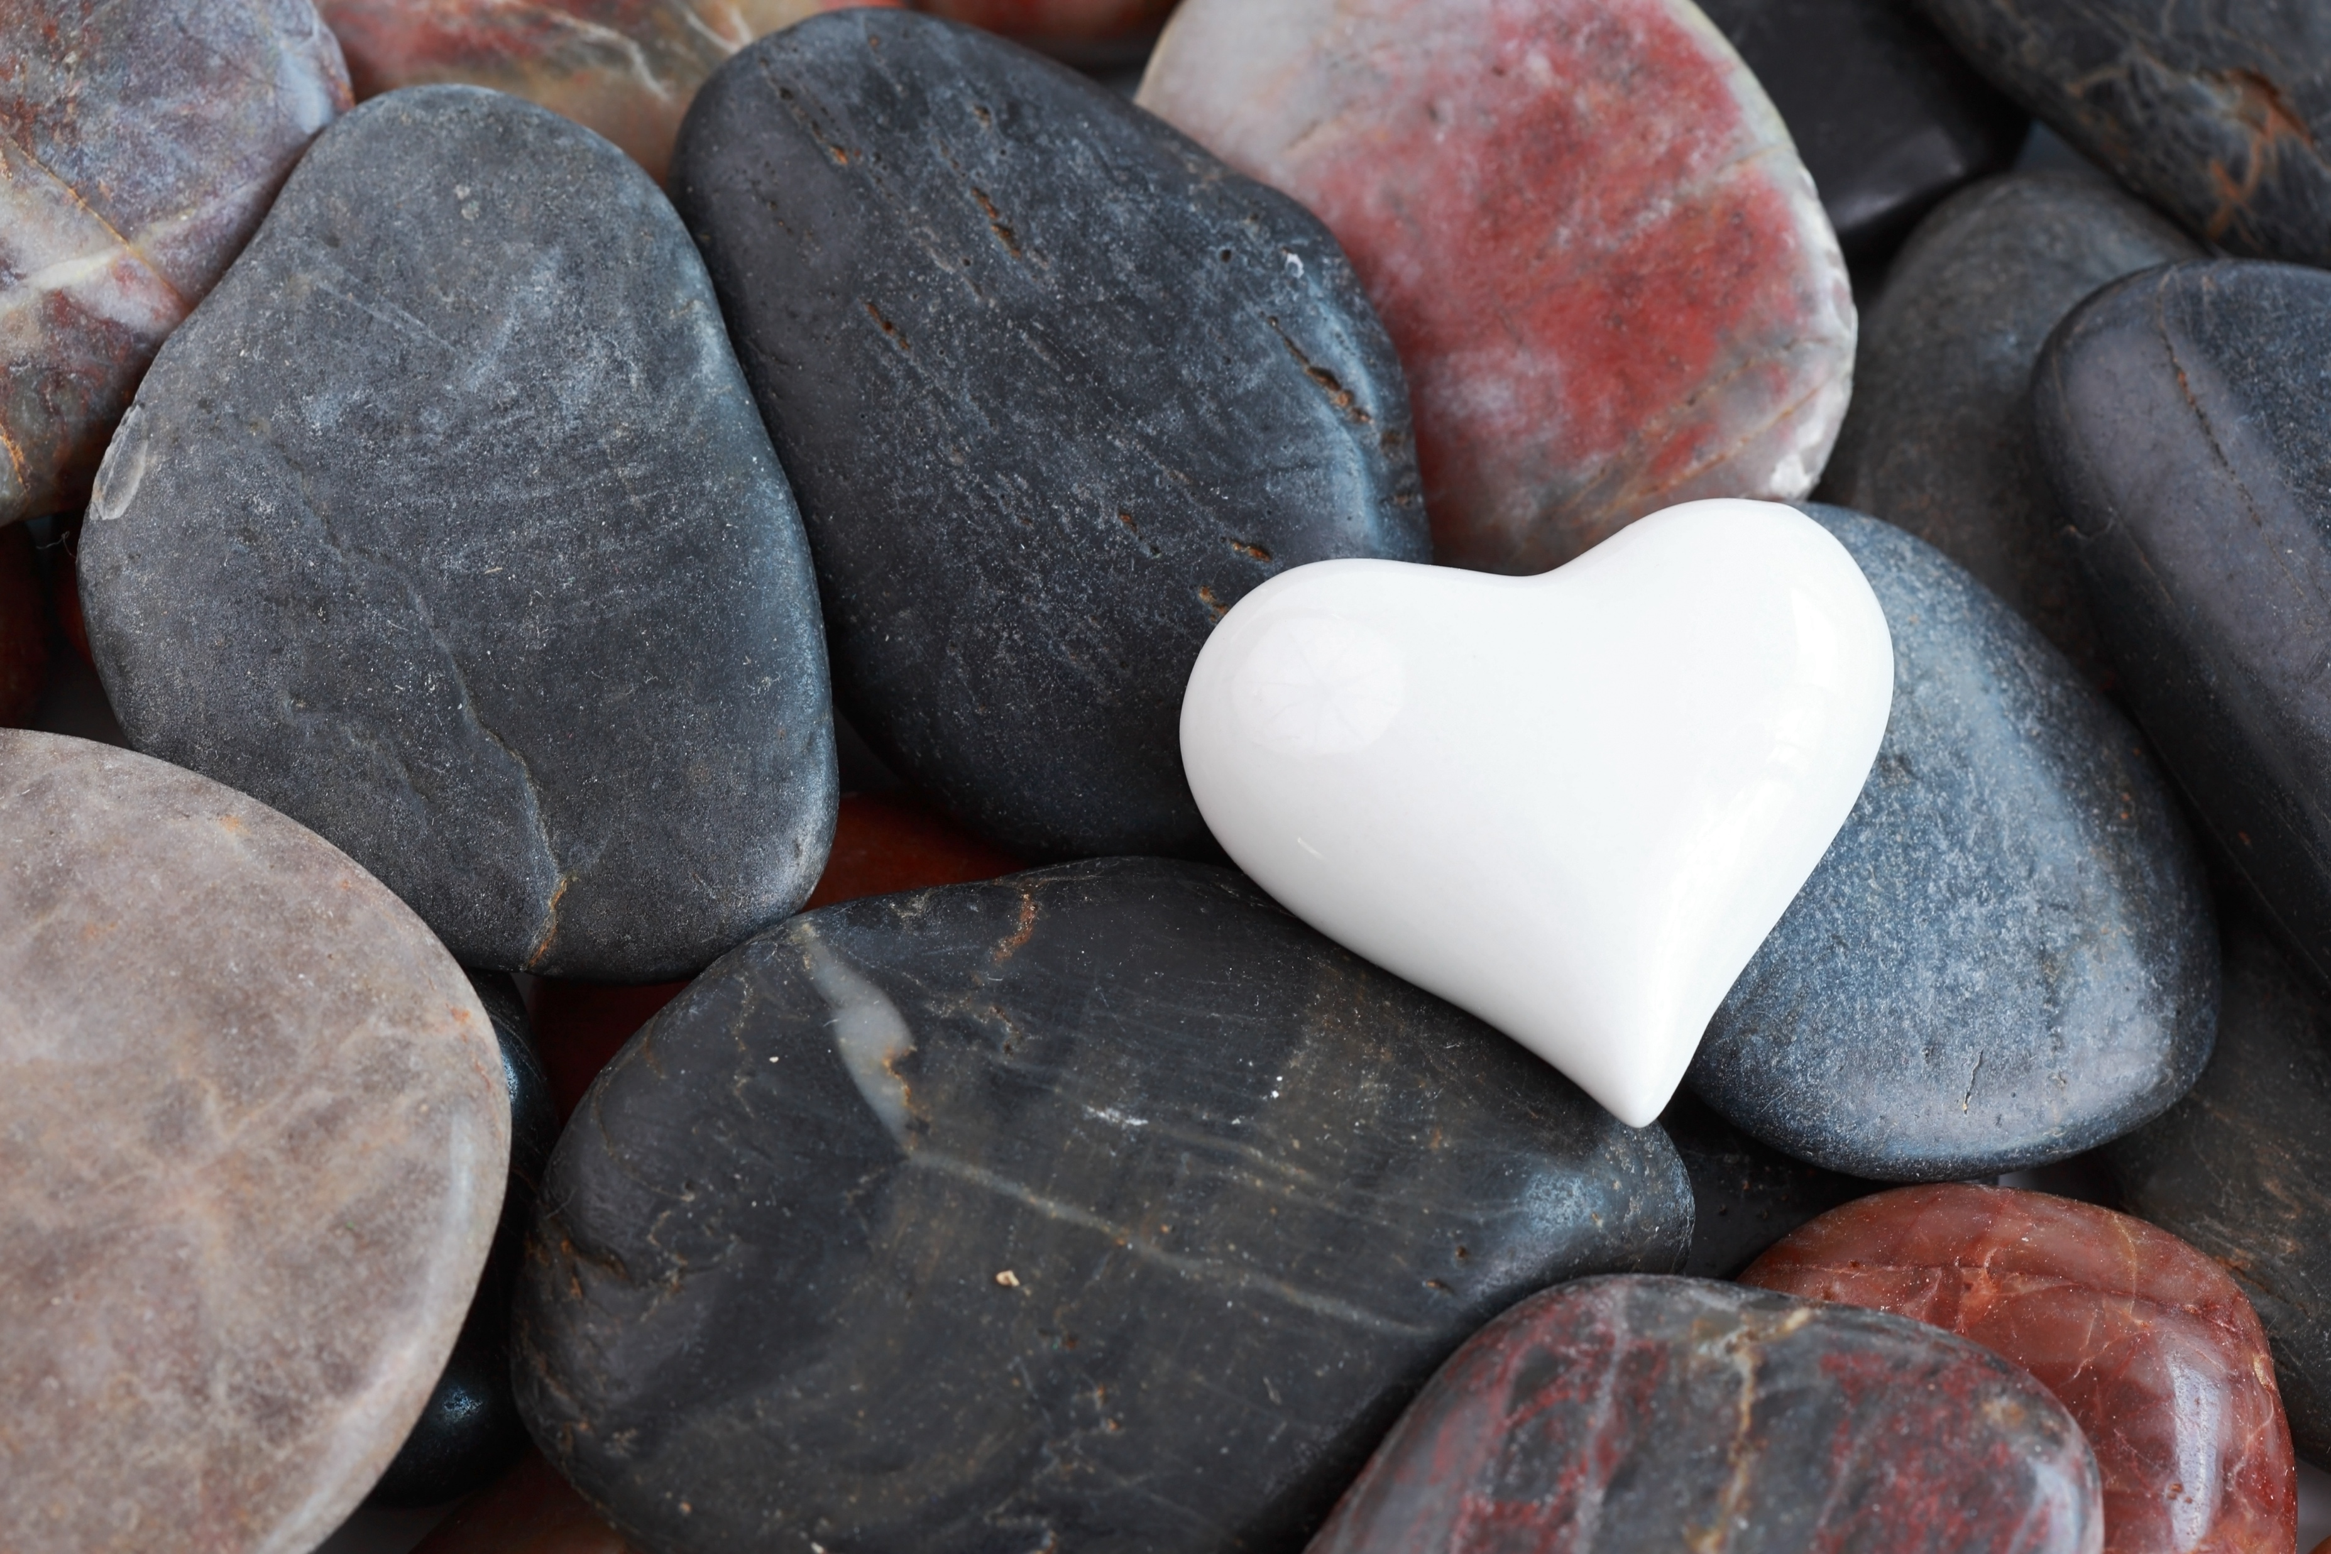

Slide 25
Romans Road

Slide 26
Romans 3:23
For all have sinned and fall short of the glory of God

Slide 27
Romans 5:8
But God proves His love for us in this: While we were still sinners, Christ died for us.

Slide 28
Romans 6:23
For the wages of sin is death, but the gift of God is eternal life in Christ Jesus our Lord.

Slide 29
Romans 8:1
Therefore, there is now no condemnation for those who are in Christ Jesus.

Slide 30
Romans 10:9
That if you confess with your mouth, “Jesus is Lord,” and believe in your heart that God raised Him from the dead, you will be saved.

Slide 31
