Slide 1

Overcoming a Counterfeit Kingdom
Michael Christie

Slide 2

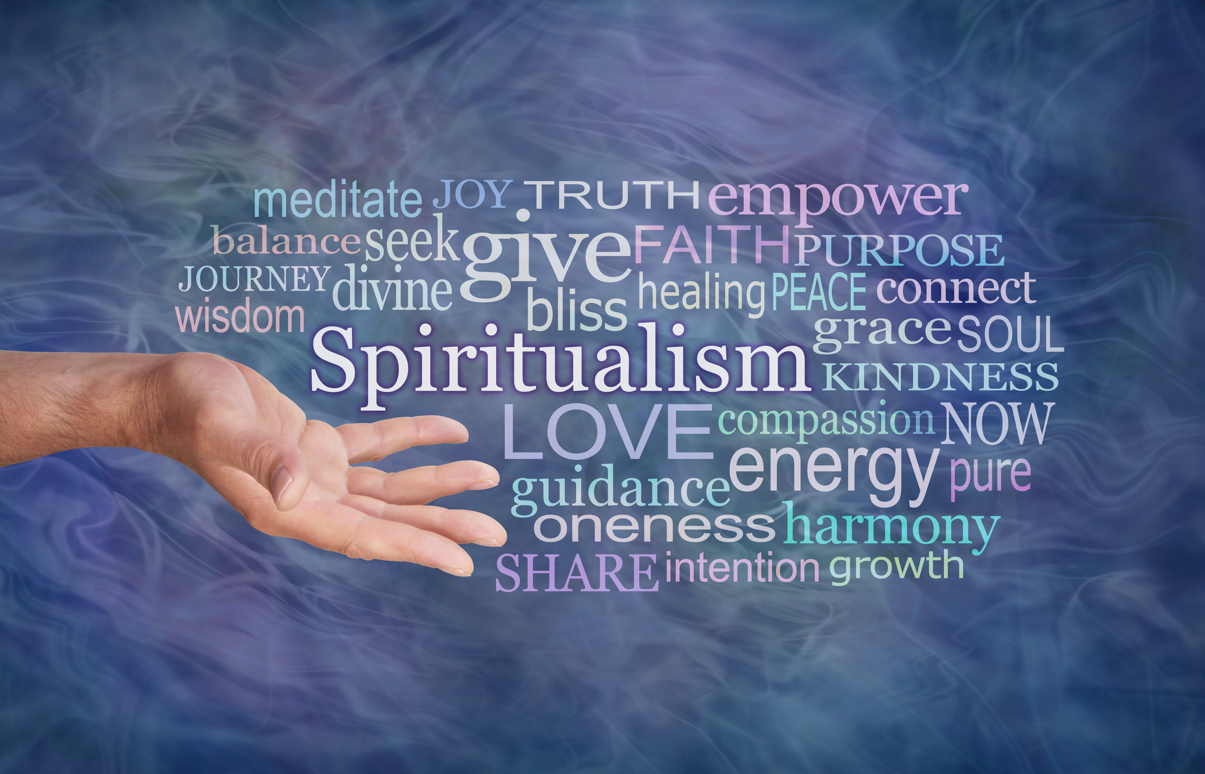

Slide 3
It should always be noted that the more excellent something is the more likely it will be imitated. There are many false diamonds and rubies, but who goes about making counterfeit pebbles? … So it is with Christian virtues and graces. The devil and men's own deceitful hearts tend to imitate those things that have the highest value.
- JONATHAN EDWARDS
Religious Affections

Slide 4
ACTS 8:4-24
⁴ Those who had been scattered preached the word wherever they went. ⁵ Philip went down to a city in Samaria and proclaimed the Messiah there. ⁶ When the crowds heard Philip and saw the signs he performed, they all paid close attention to what he said. ⁷ For with shrieks, impure spirits came out of many, and many who were paralyzed or lame were healed.

Slide 5
⁸ So there was great joy in that city.
⁹ Now for some time a man named Simon had practiced sorcery in the city and amazed all the people of Samaria.
He boasted that he was someone great, ¹⁰ and all the people, both high and low, gave him their attention and exclaimed, “This man is rightly called the Great Power of God.” ¹¹ They followed him because he had amazed them for a long time with his sorcery.

Slide 6
¹² But when they believed Philip as he proclaimed the good news of the kingdom of God and the name of Jesus Christ, they were baptized, both men and women.
¹³ Simon himself believed and was baptized. And he followed Philip everywhere, astonished by the great signs and miracles he saw.
¹⁴ When the apostles in Jerusalem heard that Samaria had accepted the word of God, they sent Peter and John to Samaria.

Slide 7
¹⁵ When they arrived, they prayed for the new believers there that they might receive the Holy Spirit, ¹⁶ because the Holy Spirit had not yet come on any of them; they had simply been baptized in the name of the Lord Jesus.
¹⁷ Then Peter and John placed their hands on them, and they received the Holy Spirit.

Slide 8
¹⁸ When Simon saw that the Spirit was given at the laying on of the apostles’ hands, he offered them money ¹⁹ and said, “Give me also this ability so that everyone on whom I lay my hands may receive the Holy Spirit.”
²⁰ Peter answered: “May your money perish with you, because you thought you could buy the gift of God with money!

Slide 9
²¹ You have no part or share in this ministry, because your heart is not right before God. ²² Repent of this wickedness and pray to the Lord in the hope that he may forgive you for having such a thought in your heart. ²³ For I see that you are full of bitterness and captive to sin.”
²⁴ Then Simon answered, “Pray to the Lord for me so that nothing you have said may happen to me.”

Slide 10
Counter the Culture
Philip went down to a city in Samaria and proclaimed the Messiah there. When the crowds heard Philip and saw the signs he performed, they all paid close attention to what he said. For with shrieks, impure spirits came out of many, and many who were paralysed or lame were healed.
- ACTS 8:5-7

Slide 11
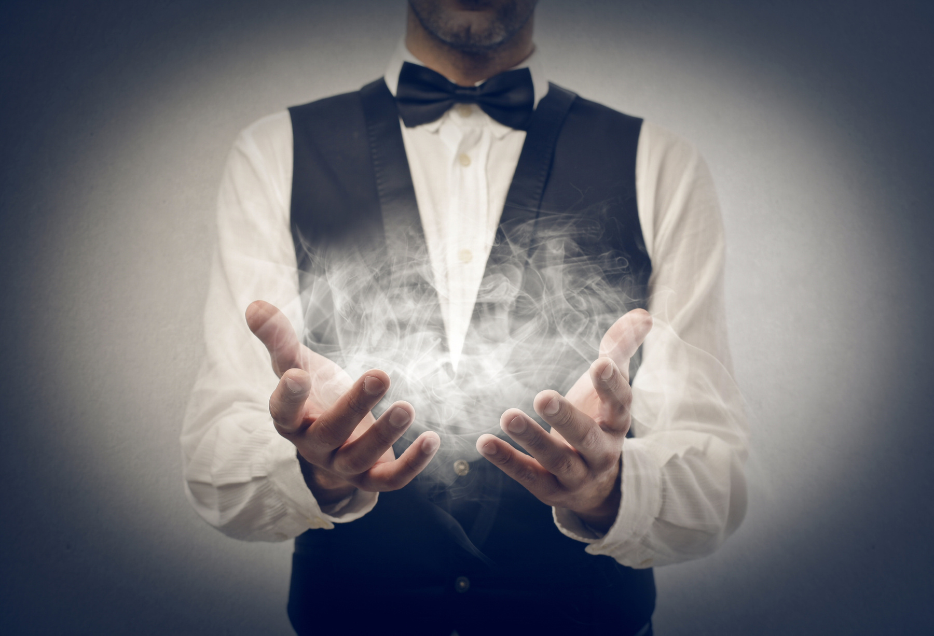

Slide 12
I am the vine; you are the branches. If you remain in me and I in you, you will bear much fruit; apart from me you can do nothing.
- JOHN 15:5

Slide 13
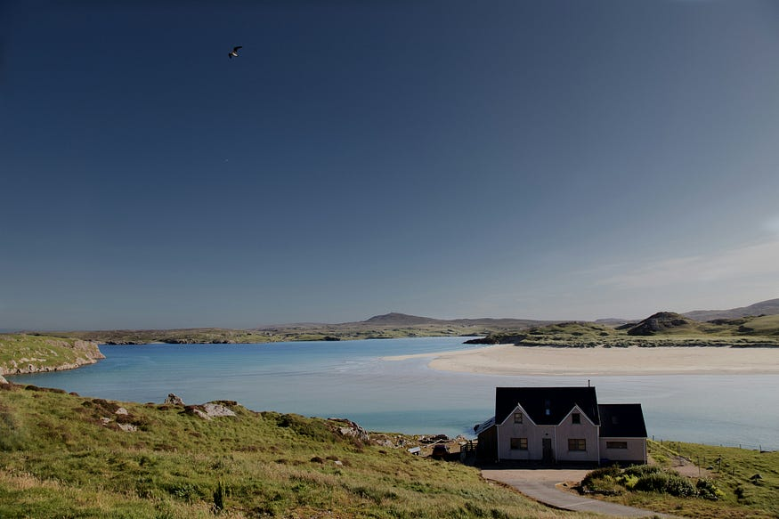
Photo by Paolo Chiabrando on Unsplash

Slide 14
Conform the Heart
Simon himself believed and was baptized… When Simon saw that the Spirit was given at the laying on of the apostles’ hands, he offered them money and said, “Give me also this ability so that everyone on whom I lay my hands may receive the Holy Spirit.” Peter answered: “May your money perish with you, because you thought you could buy the gift of God with money! You have no part or share in this ministry, because your heart is not right before God. Repent of this wickedness and pray to the Lord in the hope that he may forgive you...
- ACTS 8:13, 18-22

Slide 15
For it is by grace you have been saved, through faith—and this is not from yourselves, it is the gift of God— not by works, so that no one can boast.
- EPHESIANS 2:8-9

Slide 16
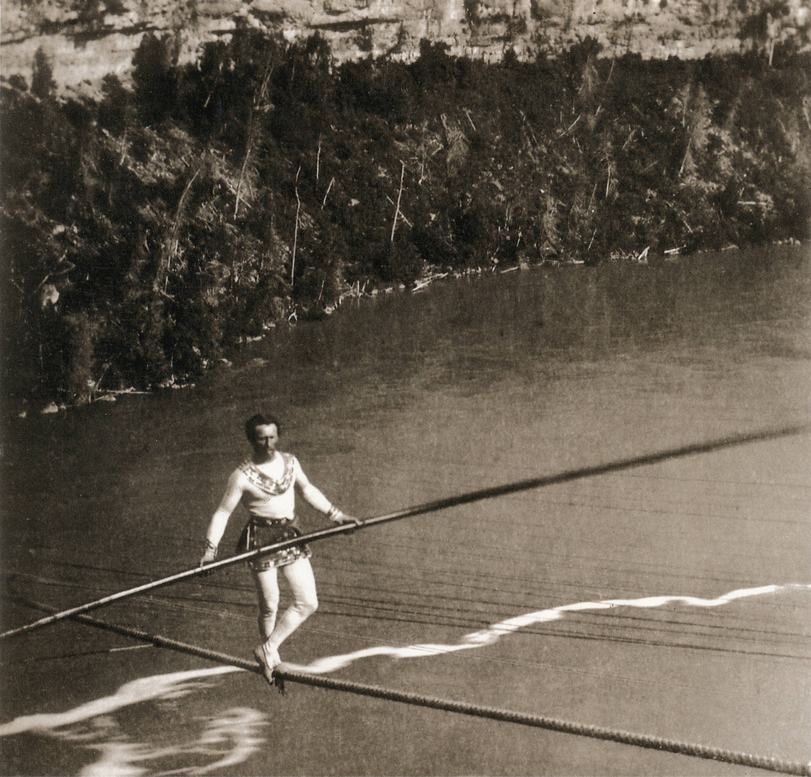

Slide 17
Deep down inside, every one of our hearts is saying, ‘If I have money, if I have approval, if I have power, if I have comfort, if I have control, if I have romance…’ Every one of our hearts needs that deeper conversion from our idols to the Living God.
- TIM KELLER
A Vision for a Gospel-Centred Life

Slide 18
Change the City
So there was great joy in that city.
- ACTS 8:8

Slide 19
When the righteous prosper,
the city rejoices.
- PROVERBS 11:10

Slide 20
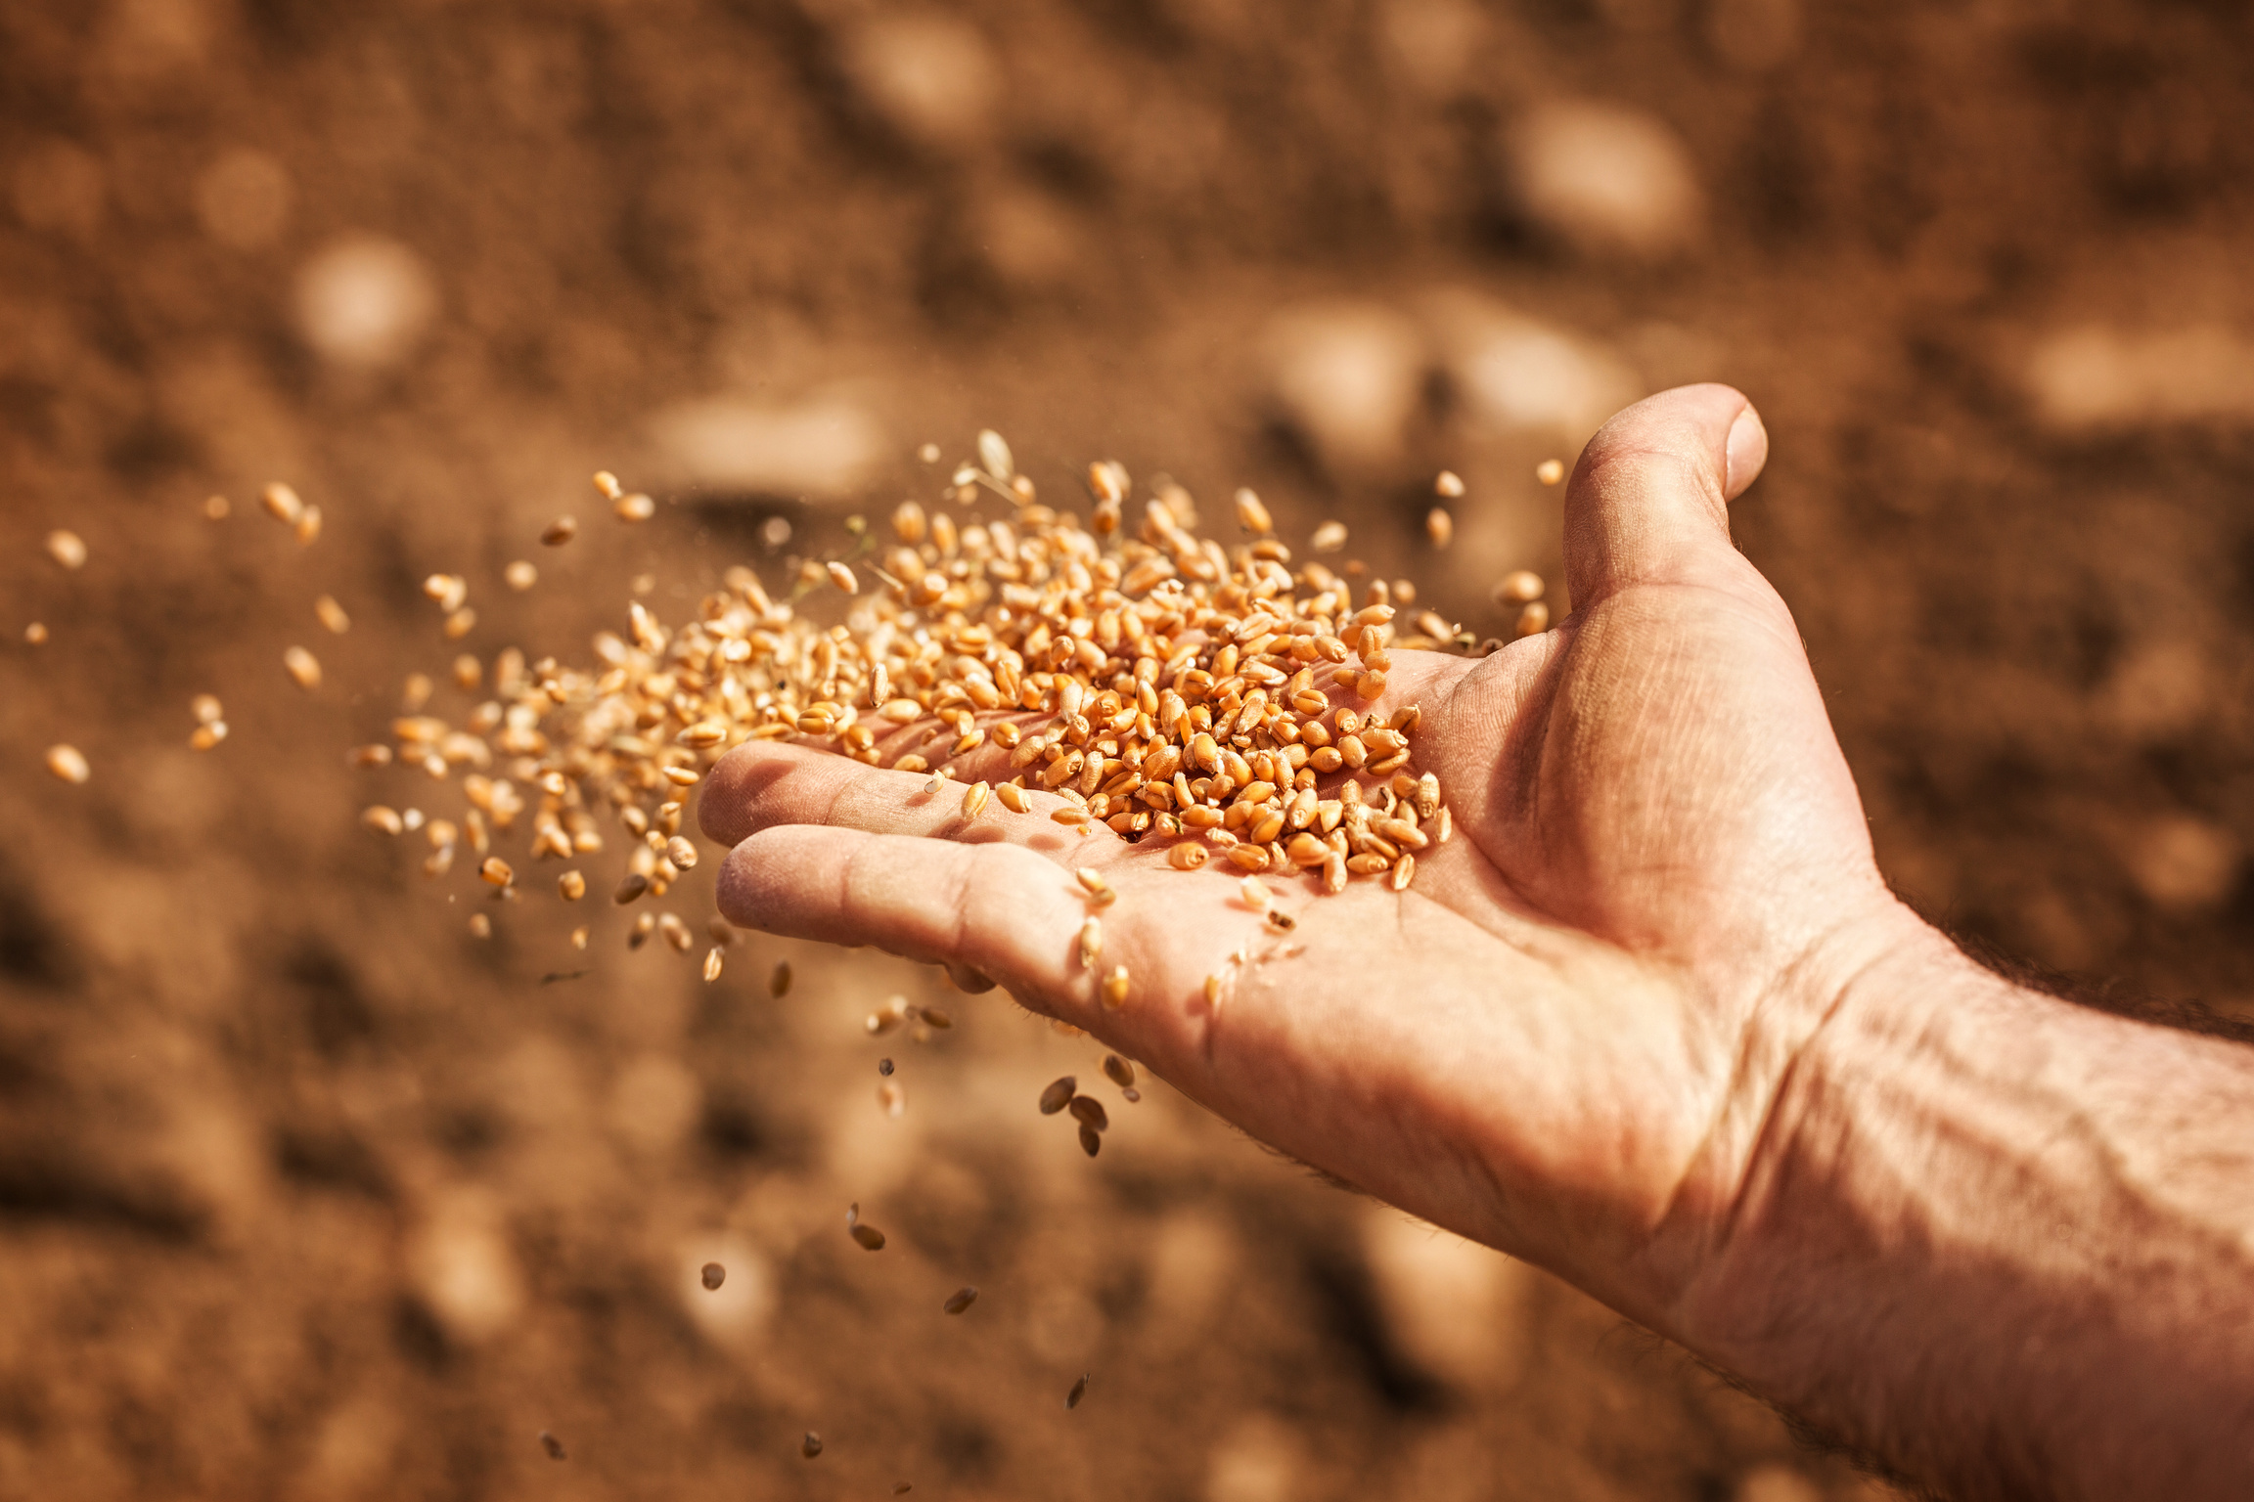

Slide 21
