Slide 1
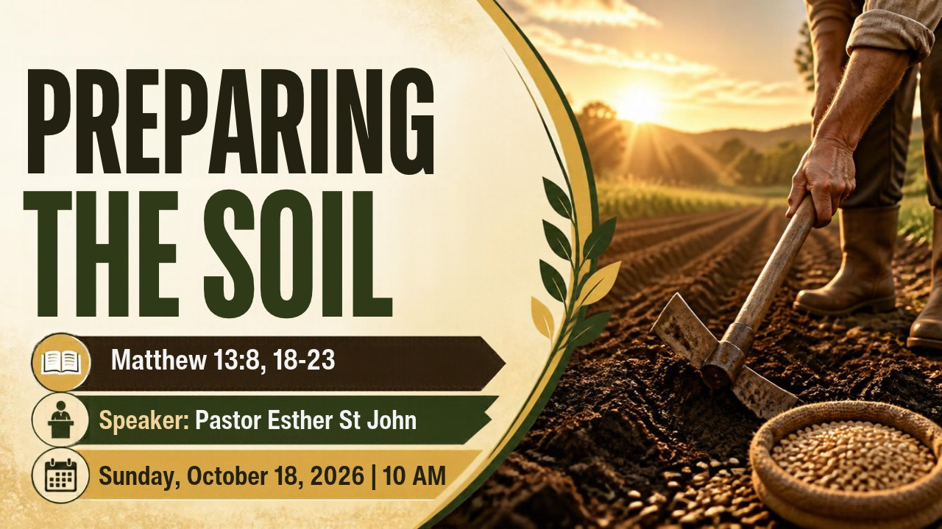

Slide 2



Scripture:
MATTHEW 13:

Slide 3
INTRODUCTION
"Seedtime and Harvest" is one of the foundational principle of life. Jesus used it in the parable of the Sower.
He used many parables to teach about the kingdom heaven and those who desire to know the true meaning beyond the surface would seek Him to know.
Examples of Seeking to Know More
The Rich Young Ruler was a wealthy and influential man who asked Jesus what he must do to inherit eternal life and enter the kingdom of God. (Matthew 19:16–30, Mark 10:17–31, and Luke 18:18–30.)

Slide 4
INTRODUCTION (cont)
Examples of Seeking to Know More:
Nicodemus, a Pharisee and a member of the Sanhedrin (the Jewish ruling council) visited Jesus secretly under the cover of night. On the question of Rebirth; Jesus told him, "No one can see the kingdom of God unless they are born again" (or "born from above"). This was speaking of a spiritual rebirth (St. John 3:1-8).
Sowing seeds into soil naturally leads to the expectation of a harvest. In both farming and spiritual/moral metaphor, you plant a specific seed expecting that kind of plant result in return.

Slide 5
INTRODUCTION (cont)
Examples of Seeking to Know More:
This principle operates in the natural world and provides a powerful spiritual lesson about the condition of the human heart.
In the natural world, a farmer plants physical seeds in the ground. The principle of the kingdom of heaven, God plants His Word in the hearts of people. Both involve planting, receiving, growth, cultivation, and fruitfulness

Slide 6
A. Good Soil is not accidental, it is cultivated.
Preparation
The core purpose of preparation is to build readiness, reduce uncertainty, and maximize your ability to succeed when facing a task, challenge, or opportunity.
Spiritually, its a heart of readiness to receive God's Word and readiness to protect or guard the Word in our lives.
Soil Preparation is the preliminary work done before planting seeds or setting out plants. Its getting the soil ready for a new crop by clearing debris or loosen the dense soil.

Slide 7
B. How to Prepare the heart
To prepare your heart to receive the Word of God, the Bible emphasizes cultivating humility, putting away sin, praying for understanding, and approaching Scripture with an active and obedient posture.
James 1:21
“Therefore, put away all filthiness and rampant wickedness and receive with meekness the implanted word, which is able to save your souls.”
This is telling us lay aside sin and welcome God’s Word with a gentle, humble spirit.
Ezra 7:10
“For Ezra had set his heart to study the Law of the Lord, and to do it and to teach his statutes and rules in Israel.”
It's an intentionally setting and directing your heart toward studying, obeying, and sharing God's truth.
Proverbs 4:23

Slide 8
B. How to Prepare the heart (cont)
Proverbs 4:23
””O Lord, you hear the desire of the afflicted; you will strengthen their heart; you will incline your ear.”
This recognize that God is the one who ultimately prepares and strengthens the heart of the humble.
Mark 4:20
“And those are the ones sown on the good soil: the ones who hear the word and accept it and bear fruit, thirtyfold and sixtyfold and a hundredfold.”
This speaks of preparing the "soil" of your heart to be receptive, unlike hardened soil, rocky soil, or weed-choked ground.

Slide 9
C. Cultivation Process
Cultivation is the ongoing process of growing and nurturing crops throughout their lifecycle.
Spiritual cultivation, is the ongoing process of the Word having a readiness of heart to receive and putting the WORD of God into practice.
Main Goal of Cultivation:
To create a clean, aerated, and stable environment that allows roots to penetrate easily and water to drain properly.

Slide 10
D. How to Cultivate the Soil of Heart
1. Weeds removal
Weeds represent things that compete with God's Word, such as bitterness, unforgiveness, pride, fear, and worldly distractions.
Scripture: Hebrews 12:1(Niv) — “Lay aside every weight and the sin that hinders us.”
"Therefore, since we are surrounded by such a great cloud of witnesses, let us throw off everything that hinders and the sin that so easily entangles. And let us run with perseverance the race marked out for us”
The heroes of faith from the previous chapter watch us like a crowd in a stadium. They encourage us by their example.
These things trap us and slow us down.
We must keep going. Life is a long race, and God gives us the strength to finish it.

Slide 11
D. How to Cultivate the Soil of Heart (cont)
2. Breakup Hard ground
A hardened heart resists correction and becomes unwilling to listen. Prayer, repentance, humility, and surrender help us become receptive to God's voice.
Scripture: Hosea 10:12 — “Break up your fallow ground.”
"Sow righteousness for yourselves, reap the fruit of unfailing love, and break up your unplowed ground; for it is time to seek the LORD, until he comes and showers his righteousness on you."

Slide 12
D. How to Cultivate the Soil of Heart (cont)
3. The Seed watered Consistently
God's Word must be received continually, not occasionally. The Word, prayer, worship, and fellowship help nurture spiritual growth.
Scripture: Psalm 1:2–3 — The person who delights in God's law is like a tree planted by streams of water. "but whose delight is in the law of the Lord,
and who meditates on his law day and night.
That person is like a tree planted by streams of water, which yields its fruit in season and whose leaf does not wither—whatever they do prospers."

Slide 13
D. How to Cultivate the Soil of Heart (cont)
4. Practice Obedience
Hearing the Word is not enough. We must put it into practice. Obedience allows the truth we receive to influence our character, decisions, relationships, and service.
Scripture: James 1:22 — “Be doers of the Word, and not hearers only.
Do not merely listen to the word and so deceive yourselves. Do what it says."
Bring your heart to God that is ready to receive, his Word seed that guarantees a harvest.
Just as a farmer must prepare the ground before planting seeds, we must prepare our hearts to receive God's Word, grow spiritually, and produce lasting fruit.
Cultivation means preparing, developing, and caring for something so that it can grow and become fruitful.

Slide 14
D. How to Cultivate the Soil of Heart (cont)
4. Practice Obedience
A. In farming:
Cultivation is the process of working and caring for the soil to create good conditions for plants to grow.
B. In a person's life:
Cultivation means intentionally developing something through attention, care, and practice.
C. Spiritually cultivating your heart
means preparing and caring for your heart so that God's Word can take root, grow, and produce fruit.

Slide 15
D. How to Cultivate the Soil of Heart (cont)
The condition of the soil affects what happens to the seed. The soil does matter.
We can't expect soil to produce good fruit if we have not prepared and cultivated the soil for it.
Matthew 7:18, A good tree cannot bear bad fruit, nor can a bad tree bear good fruit.”
Matthew 12:33, Either make the tree good and its fruit good, or make the tree bad and its fruit bad; for the tree is known by its fruit.”
From seed to harvest, its totally dependent on the soil’s condition!

Slide 16
CONCLUSION
What type of soil is your heart?
Is it the Wayside Soil, the Rocky Soil or the Thorny Soil. It can be changed today.
Do you want a heart that will produce God's kingdom harvest?
Good news! The soil can be changed to the right condition, the right soil Ph., by removing what chokes the seed from being fruitful. We can ask the God for his help to change our heart soil.
Ezekiel 36:26(NIV), the prophet Ezekiel spoke these words to the people of Israel during the Babylonian exile. Jerusalem had fallen, the temple was destroyed, and the nation was displaced because of their heart condition.
"I will give you a new heart and put a new spirit in you; I will remove from you your heart of stone and give you a heart of flesh."

Slide 17
CONCLUSION (cont)
Ezekiel 11:19(NIV), "I will give them an undivided heart and put a new spirit in them; I will remove from them their heart of stone and give them a heart of flesh."
God promises to transform a person's inner nature, replacing a stubborn, hardened, and rebellious attitude ("heart of stone") with a soft, responsive, and obedient spirit ("heart of flesh").
God is looking for the good soil, fertile hearts for the seed of His Word to flourish in. All that He needs is a heart that is open, in constant readiness to receive and protect the seed of the Word in your heart.
Bring your heart soil to God that is ready to receive, His Word seed that guarantees a harvest.

