Slide 1
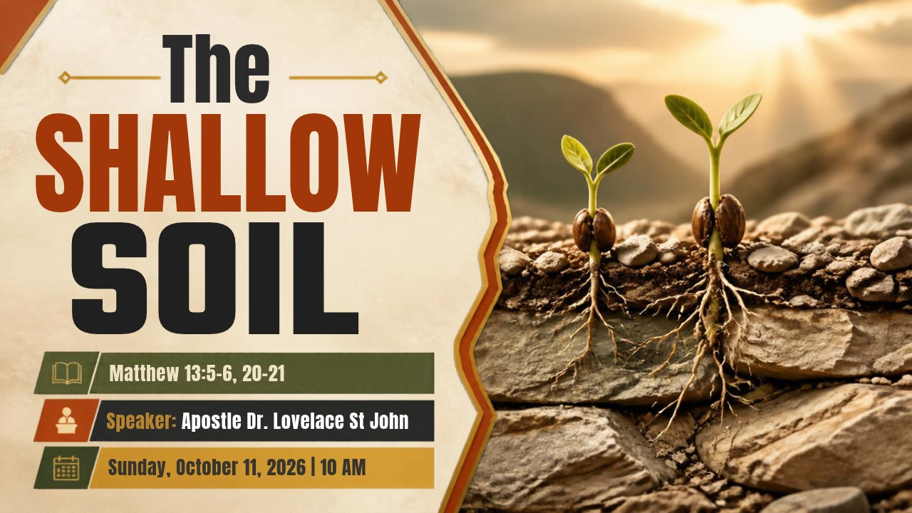


Slide 2



Scripture:
MATTHEW 13: 5 – 6, 20 – 21

Slide 3
INTRODUCTION
Shallowness Cannot Survive the Heat.
It is easy to love God when the atmosphere is thick with inspiration, and the human heart naturally leaps to receive it.
When faith is built primarily on the surface of feeling, it thrives in the warmth of the gathered crowd, but it shrivels the moment the music fades.

Slide 4
INTRODUCTION cont
Shallowness Cannot Survive the Heat.
The shallow ground is tender on top, but it is rocky underneath.
In the sanctuary moment, your joy feels unshakeable. But as the last song ends, as everything returns to normal, the world outside waits, indifferent to the feeling that felt so real to you just moments ago.

Slide 5
INTRODUCTION cont
The true test of the Kingdom seed never happens while the band is playing; it happens when the heat rises.
Today, We are putting our shovel into the soil of the heart. We are going to expose the hard rock underneath the shallow dirt, and we are going to learn what it takes to build a faith that stands when everything around you burns.

Slide 6
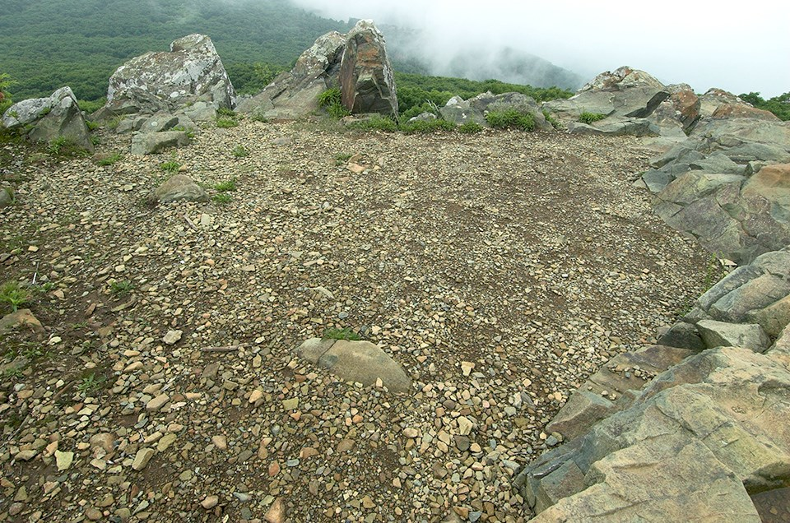
Shallowness Cannot Survive the Heat.
Joy that has no root will not survive the heat. God is not looking for a faith that feels deep for an hour; He is looking for a faith that goes deep for a lifetime.

Slide 7
1. The Seed Received with Joy
But he who received the seed on stony places, this is he who hears the word and immediately receives it with joy (Matthew 13:20)
A. The Joy Is Real.
Scripture is full of holy joy. David danced before the Lord with all his might (2 Samuel 6:14).
The Psalms tell us to "make a joyful noise unto the Lord" (Psalm 100:1).

Slide 8
The Seed Received with Joy con’t
The angels announced "good tidings of great joy" (Luke 2:10).
Joy is not the problem. The problem with the shallow soil is not what it has. The problem is what it lacks. It has the joy. It lacks the depth.
B. Don’t allow the Atmosphere to Carry You Farther Than Your Roots Can
It is easy to love God in the moment.
It is easy to love God when the atmosphere does the lifting.

Slide 9
C. The Peril of Mistaking a Moment for a Foundation
Peter on the Mount of Transfiguration (Matthew 17:1–8). He sees the glory, hears the voice, and says, "Lord, it is good for us to be here. Let us build three tabernacles." He wants to stay on the mountain. That is the instinct of the shallow soil: to build a dwelling around the feeling.

Slide 10
C. The Peril of Mistaking a Moment for a Foundation (cont)
Jesus does not let him stay. He leads them back down the mountain, into the valley, where a child is suffering and a father is desperate.
The glory was real, but it was not given so that Peter could live on a peak. It was given to prepare him for the valley.

Slide 11
2. The Root That Was Missing.
Some fell on stony places, where they did not have much earth; and they immediately sprang up because they had no depth of earth. 6 But when the sun was up they were scorched, and because they had no root they withered away. (Matthew 13:5–6)
A. Notice the Order: It Sprang Up Before It Sank Down
It was fast. It was visible. It was impressive.

Slide 12
A. Notice the Order: It Sprang Up Before It Sank Down (cont)
But they had no deepness of earth." The speed was not a sign of strength.
The speed was a symptom of shallowness.
We are a generation that measures spiritual health by what is visible: how fast, how loud, how emotional, how public.

Slide 13
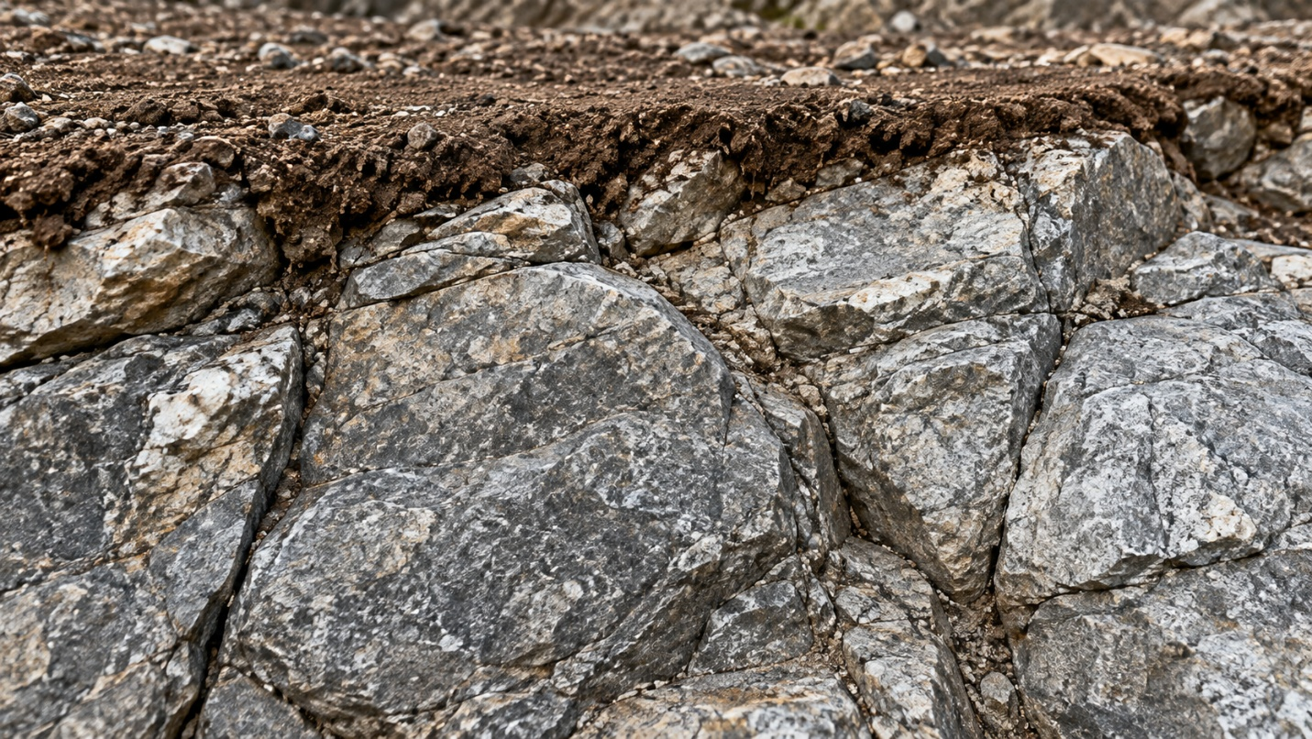
B. The Tender Ground Over a Hard Rock
In Galilee this was a thin layer of earth lying over a shelf of limestone bedrock. On top, the soil looked rich and dark. Everything looked right on the surface.

Slide 14
C. What Scripture Says About Roots
Psalm 1:3.
Notice: planted, near the water, fruit in season. Not instant fruit. Seasoned fruit.
Jeremiah 17:7–8
The rooted tree still experiences the heat. The promise is not the absence of heat, but the absence of fear in the heat, because the roots are in the river.
Colossians 2:6–7.
Receiving is the beginning. Walking and being rooted is the continuation.
Never lets receiving be the end of the story.

Slide 15
3. The Heat Reveals
Yet he has no root in himself but endures only for a while. For when tribulation or persecution arises because of the word, immediately he stumbles.
(Matthew 13:21)
A. The Sun Is Not the Enemy. It Is the Examiner.
The sun did not kill the seed. The same sun that scorched the shallow plant made the deep plant flourish.
Heat is not the cause of the withering; heat is the revealer of what was already true underneath.
"Yet hath he not root in himself." The trouble was never first the trial. The trouble was the missing root. The trial only exposed it.

Slide 16
3. The Heat Reveals
B. Heat Arrives: Many Times Quietly and Ordinarily
We often imagine the heat as something dramatic: But for most of us, the heat arrives in plainer clothes.
The friction of daily life.
The marriage that is harder than you thought.
The job that drains you.

Slide 17
3. The Heat Reveals (cont)
The friction of daily life.
The child who will not listen.
The lingering disappointment.
The door that closed.
The promotion that went to someone else.
The prayer you prayed for years that was never answered the way you asked.

Slide 18
3. The Heat Reveals (cont)
The friction of daily life.
The whisper of doubt.
The quiet weight of unanswered prayers.
The long season of silence when heaven seems to say nothing, and you begin to wonder if anyone is there.

Slide 19
3. The Heat Reveals
The friction of daily life.
Pressure because of the Word.
The coworker who mocks.
The family that does not understand.
The cost of standing for what Scripture says when the culture says otherwise.

Slide 20
C. A Faith With No Root Reacts to Every Change in Temperature
A rootless faith is a reactive faith. It rises and falls with circumstance.
"by and by he is offended." The Greek word is skandalizo, the root of our word scandal.
It means to stumble, to be tripped up, to take offense at God Himself.

Slide 21
C. A Faith With No Root Reacts to Every Change in Temperature (cont)
The shallow soil does not usually fall because of a great sin. It falls because it is offended at the way God is handling its life.
John the Baptist - (Matthew 11:11)
Even a great man can be tempted to stumble when the heat is on and the answers are slow.

Slide 22
D. What Heat Does in the Hands of God
God does not send the heat to destroy you; He allows it to deepen you.
James 1:2–4.
1 Peter 1:6–7.
Romans 5:3–5. "Tribulation worketh patience; and patience, experience; and experience, hope: and hope maketh not ashamed."
Hope is at the end of the heat, not the beginning.

Slide 23
4. The Plow of the Spirit
Sow for yourselves righteousness; Reap in mercy; Break up your fallow ground, For it is time to seek the Lord, Till He comes and rains righteousness on you. (Hosea 10:12)
A. Endurance Is Built Underground
Endurance is not built on high energy or temporary inspiration.

Slide 24
A. Endurance Is Built Underground (cont)
Endurance is not built on high energy or temporary inspiration.
Endurance is built underground, in the dark, where no one is watching and there is no applause
In the seasons where you keep showing up to prayer even when you do not feel anything.
In the mornings where you keep opening the Word even when it does not move you that day.

Slide 25
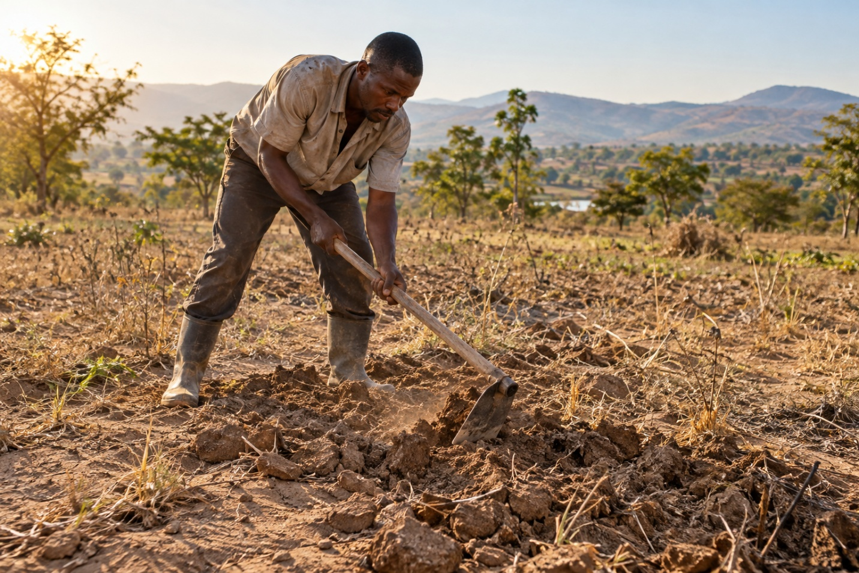
B. The Holy Spirit Must Plow Deeper Than Our Feelings
The breaking of the rock requires a different kind of encounter, one that goes beyond the stirrings. It requires allowing the Holy Spirit to plow deeper than our temporary feelings, breaking up the hidden places where we hold back, where we refuse to let the truth take firm.

Slide 26
CONCLUSION
The seed was received with joy.
That joy is good, but joy alone is not a foundation.
The root was missing.
Beneath the tender surface was a hard place that never surrendered, and growth without depth cannot last.
The heat revealed it.
Trials do not create the weakness; they expose it, and in God's hands they also deepen us.
The Spirit's plow makes the way for roots.
Endurance is built in the hidden places, by abiding, by obeying when the feeling has gone.

