Slide 1
Welcome to Holy Hermits Online Worship
20th Sunday after Pentecost
Today we are remembering
Thérèse of Lisieux
Service Prep: Paul | Chat Host: Rachel | Fellowship: Lauren
Music: Paul | Welcomer: Chris | Safety Officer: Rachel
Proof-reader: Viki | Leader: Jeremy | Attendance: Rachel
Broadcaster: Barry | Cantor: Kieron | Preacher: Lauren
Backup Broadcaster: Lauren | First Reader: Phil | Deacon: Lauren
Zoom Buttons: Rachel | Second Reader: Viki | Priest: Jamee
Notes:
Please try to keep all fonts size 28 with 1.5 spacing so that it is easier for people to read
Readers with an ‘*’ after their name in the roster are down to pre-record, please include ‘*’ in the slide

Slide 2






Hospitality
Leader:
Please mute for the service unless invited to offer your voice as part of the service ministry
Have the video camera on or off and turn the volume and brightness up or down on your device if things are too loud 🔉🔊or too bright🔅🔆
Our Cantor acts as our voice, offering the responses, in Bold Text, which we say together
Feel welcome to use the chat and reaction emojis 👍
🙏 Please take care of yourself in this space. 🙏 Come and go as you need
😴 It is great to take rest in this space, so falling asleep is also OK 😴
👂️ Remember, pastoral care is available to all in the community, if you'd like to speak to someone about anything spiritual. ❤️ Visit the help page at the website to reach out 🌐
Our Being Together ethos and safeguarding practices can also be accessed on the website 🫶​
🙌 Come as you are – we are all here together! 🙌
Notes:
Used Lent 2022

Slide 3
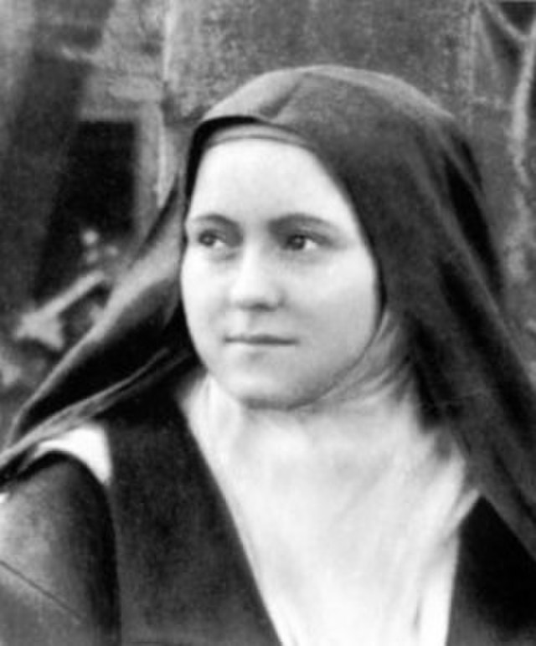
Leader: Our Holy Hermit today is Thérèse of Lisieux
Thérèse was born in Alençon, France on 2 January, 1873, the daughter of a devout Catholic couple. Thérèse was a sickly child from birth. Her mother died when she was 4, and her responsible older sister entered a convent within a few years. Thérèse became seriously ill, but prayed and had a vision of Mary and was healed.
Continues…
Notes:
Please try to keep this to around 100 words.

Slide 4
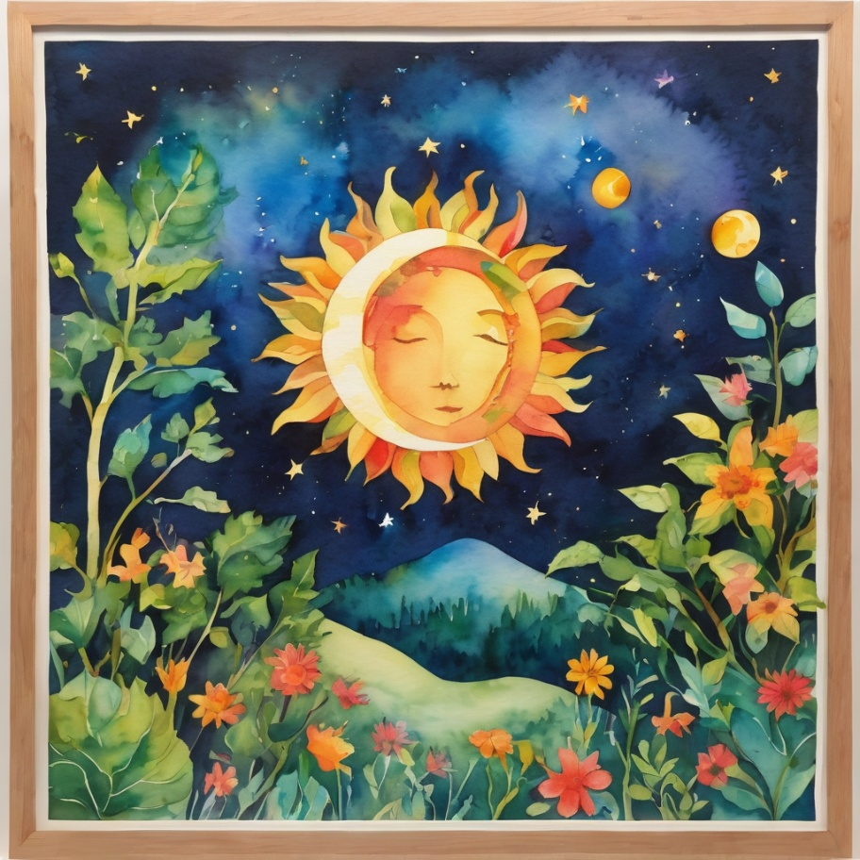
She finally took the habit on 10 January 1889. After their father’s death in 1894, the youngest sister also entered the same convent. Thérèse accepted the hardships of her status as a novice gladly as a Carmelite.
In 1896 at the age of only 23, Thérèse began to cough up blood. She had already started writing in a journal and continued during her illness, believing that it may help those on earth after her death.
To read more about our hermits click the link​​ in the send out

Slide 5
Invitation
Leader: As we come into worship let’s take a few deep breaths,
Let go of anything that isn’t serving us,
And become aware of God’s presence here with us.
Opening Music: Partita on ‘Azmon’ https://youtu.be/y8IEy8Z5IKM

Slide 6
Leader and Cantor unmute
The Greeting
Leader: The grace of the Lord Jesus Christ,
and the love of God,
and the fellowship of the Holy Spirit,
be with you all.
All: And also with you.

Slide 7
Gathering Prayer
Leader:
‘Let us praise the Lord, for he is good, his steadfast love
endures forever.’
God patiently calls us back from worshipping idols of our
own making.
Let us come and hear God’s call,
come to worship humbly and sincerely.
Notes:
Use Call to Worship Prayer https://www.rootsontheweb.com

Slide 8
Gathering Prayer
All: We come to worship you, Lord,
not a god of stone or gold who cannot listen to our prayers,
but a God who draws close to us as we draw near to you.
Through Jesus, you forgive our half-heartedness
and offer us your gracious love.
Thank you for who you are. Amen.
Notes:
Use gathering prayer - Roots

Slide 9
Sentence
Leader: I invite our Cantor to proclaim the sentence for today.
Cantor: This is our God for whom we have waited; let us be glad and rejoice in his salvation. Isaiah 25.9
Notes:
From Epray – ensure the text is black and font size is 28

Slide 10
Prayer of Approach
Leader: We pray the prayer of approach together
All: Glorious Trinity,
we come to you today in awe and thanks to worship you;
you who are alive and active not inanimate and cold.
Creator God, accept our praise;
Lord Jesus, inspire our discipleship;
Continues…
Notes:
Prayer of Approach from Roots

Slide 11
Prayer of Approach
Holy Spirit, empower our lives,
that we might reflect your wisdom and your creativity,
standing firm when we are certain of your call,
changing our stance when we must reconsider our choices.
To your glory. Amen.

Slide 12
Leader unmutes
Our first Hymn
Teach me, my God and King
https://youtu.be/N9ykXQ7euL8
We stay on mute
Leader mutes

Slide 13
The Deacon or LA introduces the Confession​
God is steadfast in love and infinite in mercy, welcoming sinners and inviting them to the Lord's table.
Silence may be kept.​
Let us confess our sins in penitence and faith, with a sincere and a true heart.
Notes:
Epray – has seasonal variation

Slide 14
All: ​Merciful God, our maker and our judge, ​
we have sinned against you ​in thought, word, and deed, ​
and in what we have failed to do: ​
we have not loved you with our whole heart; ​
we have not loved our neighbours as ourselves; ​
we repent, and are sorry for all our sins.​
Father, forgive us. Strengthen us to love and obey you
in newness of life; ​through Jesus Christ our Lord. ​
Amen.​

Slide 15
The Priest offers the Absolution​
​
Almighty God who has promised forgiveness to all who turn to God in faith; pardon you and set you free from all your sins, strengthen you in all goodness and keep you in eternal life, through Jesus Christ our Lord. ​
Amen. ​
Notes:
For no priest use:
Words of Assurance offered by the Deacon or LA
These words of assurance from the First Letter of John declare that:
If anyone sins, we have an advocate with the Father, Jesus Christ the righteous. He is the perfect offering for our sin, and not for ours only, but for the sins of the whole world.
(1 John 2: 1-2)
In this is love, not that we loved God, but that he loved us and sent his Son to be the perfect offering for our sins.
(1 John 4:10)
For when there’s a priest:
The Priest offers the Absolution​
​
Almighty God who has promised forgiveness to all who turn to God in faith; pardon you and set you free from all your sins, strengthen you in all goodness and keep you in eternal life, through Jesus Christ our Lord. ​
Amen. ​

Slide 16
Collect
Leader: Saving and healing God, you have promised
that those who have died with Christ shall live with him:
grant us grace to be continually thankful for all you have done for us,
and in that thankfulness
to be eager to serve and live for others,
so that we and all your children may rejoice in your salvation;
through Jesus Christ our Lord, who lives and reigns with you and the Holy Spirit, one God, now and for ever. Amen.
Notes:
From Epray – ensure the text is black and font size is 28

Slide 17
The 1st reader unmutes
Leader: I invite the 1st reader to unmute and offer the 1st lesson when ready.
Reader 1: The 1st Reading is from Exodus 32.1-14
¹ When the people saw that Moses delayed to come down from the mountain, the people gathered around Aaron and said to him, ‘Come, make gods for us, who shall go before us; as for this Moses, the man who brought us up out of the land of Egypt, we do not know what has become of him.’ ² Aaron said to them, ‘Take off the gold rings that are on the ears of your wives, your sons, and your daughters, and bring them to me.’
Continue…
Notes:
Youtube link for reading if needed:
If the 1st reading is recorded change the introduction to “Leader: We will now listen to the first reading”
(Normal introduction: “I invite the 1st reader to unmute and offer the 1st lesson when ready”)
** Note the Cantor still responds with “Thanks be to God” at the conclusion of the reading even if the reading is recorded
From Epray – ensure the text is black and font size is 28

Slide 18
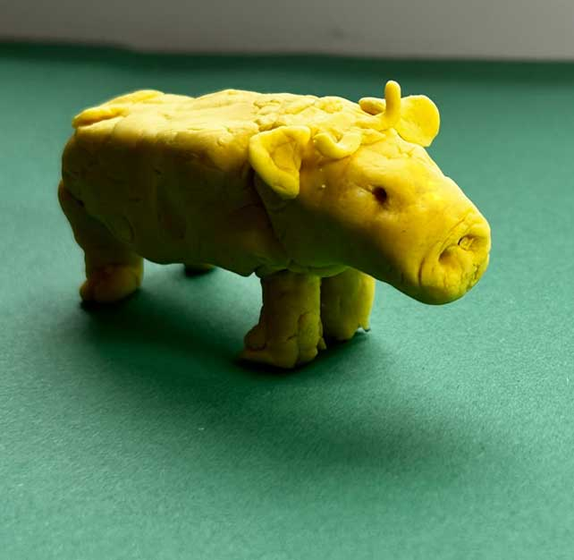
³ So all the people took off the gold rings from their ears, and brought them to Aaron. ⁴ He took the gold from them, formed it in a mould, and cast an image of a calf; and they said, ‘These are your gods, O Israel, who brought you up out of the land of Egypt!’
⁵ When Aaron saw this, he built an altar before it; and Aaron made proclamation and said, ‘Tomorrow shall be a festival to the Lord .’ ⁶ They rose early the next day, and offered burnt-offerings and brought sacrifices of well-being; and the people sat down to eat and drink, and rose up to revel.
Continue…

Slide 19
⁷ The Lord said to Moses, ‘Go down at once! Your people, whom you brought up out of the land of Egypt, have acted perversely; ⁸ they have been quick to turn aside from the way that I commanded them; they have cast for themselves an image of a calf, and have worshipped it and sacrificed to it, and said, “These are your gods, O Israel, who brought you up out of the land of Egypt!” ’ ⁹ The Lord said to Moses, ‘I have seen this people, how stiff-necked they are. ¹⁰ Now let me alone, so that my wrath may burn hot against them and I may consume them; and of you I will make a great nation.’
Continue…

Slide 20
¹¹ But Moses implored the Lord his God, and said, ‘O Lord , why does your wrath burn hot against your people, whom you brought out of the land of Egypt with great power and with a mighty hand? ¹² Why should the Egyptians say, “It was with evil intent that he brought them out to kill them in the mountains, and to consume them from the face of the earth”? Turn from your fierce wrath; change your mind and do not bring disaster on your people.
Continue…

Slide 21
¹³ Remember Abraham, Isaac, and Israel, your servants, how you swore to them by your own self, saying to them, “I will multiply your descendants like the stars of heaven, and all this land that I have promised I will give to your descendants, and they shall inherit it for ever.” ’
¹⁴ And the Lord changed his mind about the disaster that he planned to bring on his people.
For the word of the Lord. Thanks be to God.​

Slide 22
The Leader will lead the Psalm
Leader: We now say the psalm antiphonally, we will all respond with our cantor as our voice.
Psalm 106.
1-6, 20-24
¹ Praise the Lord;
O give thanks to the Lord, for he is good:
and his mercy endures for ever.
² Who can express the mighty acts of the Lord:
or fully voice his praise?
Continue…
Notes:
From Epray – ensure the text is black and font size is 28
If the 1st reading is recorded please:
add The Leader will lead the Psalm to the top left of the screen in the liturgical colour
change the introduction to the Psalm to “Leader: We now say the psalm antiphonally, we will all respond with our cantor as our voice.”
- Normal introduction: “We now say the psalm antiphonally, I invite the first reader to lead, and we will all respond with our cantor as our voice.”

Slide 23
³ Blessed are those who act according to justice:
who at all times do the right.
⁴ Remember me, O Lord,
when you visit your people with your favour:
and come to me also with your salvation,
⁵ That I may see the prosperity of your chosen:
that I may rejoice with the rejoicing of your people,
and exult with those who are your own.
Continue…

Slide 24
⁶ We have sinned like our ancestors:
we have acted perversely and done wrong.
²⁰ At Horeb they made themselves a calf:
and bowed down in worship to an image.
²¹ And so they exchanged the glory of God:
for the likeness of an ox that eats hay.
Continue…

Slide 25
²² They forgot God who was their saviour:
that had done such great things in Egypt,
²³ Who had worked his wonders in the land of Ham:
and his terrible deeds at the Red Sea.
²⁴ Therefore he thought to destroy them:
had not Moses his servant stood before him in the breach,
to turn away his wrath from destroying them.

Slide 26
The 2nd reader unmutes
Leader: I invite the 2nd reader to unmute and offer the 2nd reading when ready.
Reader 2: The 2nd Reading is from Philippians 4
¹ Therefore, my brothers and sisters, whom I love and long for, my joy and crown, stand firm in the Lord in this way, my beloved. ² I urge Euodia and I urge Syntyche to be of the same mind in the Lord. ³ Yes, and I ask you also, my loyal companion, help these women, for they have struggled beside me in the work of the gospel, together with Clement and the rest of my co-workers,
Continue…
Notes:
From Epray – ensure the text is black and font size is 28

Slide 27
whose names are in the book of life. ⁴ Rejoice in the Lord always; again I will say, Rejoice. ⁵ Let your gentleness be known to everyone. The Lord is near. ⁶ Do not worry about anything, but in everything by prayer and supplication with thanksgiving let your requests be made known to God. ⁷ And the peace of God, which surpasses all understanding, will guard your hearts and your minds in Christ Jesus. ⁸ Finally, beloved, whatever is true, whatever is honourable, whatever is just, whatever is pure, whatever is pleasing, whatever is commendable, if there is any excellence and if there is anything worthy of praise, think about these things.
Continue…

Slide 28
⁹ Keep on doing the things that you have learned and received and heard and seen in me, and the God of peace will be with you. ¹⁰ I rejoice in the Lord greatly that now at last you have revived your concern for me; indeed, you were concerned for me, but had no opportunity to show it. ¹¹ Not that I am referring to being in need; for I have learned to be content with whatever I have. ¹² I know what it is to have little, and I know what it is to have plenty. In any and all circumstances I have learned the secret of being well-fed and of going hungry, of having plenty and of being in need.
Continue…

Slide 29
¹³ I can do all things through him who strengthens me. ¹⁴ In any case, it was kind of you to share my distress. ¹⁵ You Philippians indeed know that in the early days of the gospel, when I left Macedonia, no church shared with me in the matter of giving and receiving, except you alone. ¹⁶ For even when I was in Thessalonica, you sent me help for my needs more than once. ¹⁷ Not that I seek the gift, but I seek the profit that accumulates to your account. ¹⁸ I have been paid in full and have more than enough; I am fully satisfied, now that I have received from Epaphroditus the gifts you sent, a fragrant offering, a sacrifice acceptable and pleasing to God.
Continue…

Slide 30
¹⁹ And my God will fully satisfy every need of yours according to his riches in glory in Christ Jesus. ²⁰ To our God and Father be glory for ever and ever. Amen. ²¹ Greet every saint in Christ Jesus. The friends who are with me greet you. ²² All the saints greet you, especially those of the emperor’s household. ²³ The grace of the Lord Jesus Christ be with your spirit.
For the word of the Lord. Thanks be to God.​

Slide 31

We pause before
​the Gospel ​​

Slide 32
Deacon: The Gospel of our Lord Jesus Christ according to St Matthew Chapter 22 beginning at the 1st verse.
All: Glory to you Lord Jesus Christ.
¹ Once more Jesus spoke to them in parables, saying: ² ‘The kingdom of heaven may be compared to a king who gave a wedding banquet for his son. ³ He sent his slaves to call those who had been invited to the wedding banquet, but they would not come. ⁴ Again he sent other slaves, saying, “Tell those who have been invited: Look, I have prepared my dinner, my oxen and my fat calves have been slaughtered, and everything is ready;
Continue…
Notes:
From Epray – ensure the text is black and font size is 28
Please note that there is a different introduction and final response if this is lay led

Slide 33
come to the wedding banquet.” ⁵ But they made light of it and went away, one to his farm, another to his business, ⁶ while the rest seized his slaves, maltreated them, and killed them. 7 The king was enraged. He sent his troops, destroyed those murderers, and burned their city. ⁸ Then he said to his slaves, “The wedding is ready, but those invited were not worthy. ⁹ Go therefore into the main streets, and invite everyone you find to the wedding banquet.” ¹⁰ Those slaves went out into the streets and gathered all whom they found, both good and bad; so the wedding hall was filled with guests.
Continue…

Slide 34
¹¹ ‘But when the king came in to see the guests, he noticed a man there who was not wearing a wedding robe, ¹² and he said to him, “Friend, how did you get in here without a wedding robe?” And he was speechless. ¹³ Then the king said to the attendants, “Bind him hand and foot, and throw him into the outer darkness, where there will be weeping and gnashing of teeth.” ¹⁴ For many are called, but few are chosen.’
This is the Gospel of the Lord. Praise to you Lord Jesus Christ.

Slide 35
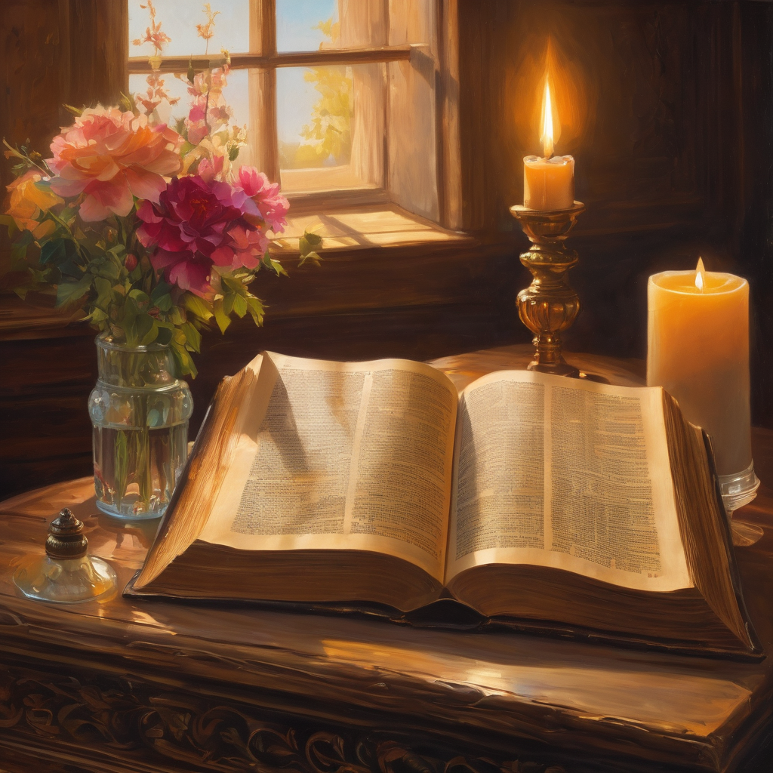
We pause
after ​the Gospel ​​

Slide 36
Leader: The Sermon is recorded to YouTube for sharing later.
Only the preacher's video and audio will be recorded.
The chat and other participants' feeds remain out of sight of the recording.
Leader and Cantor mute
Broadcaster exits screenshare
Preacher unmutes
Zoom buttons ”pins” preacher’s screen + selects “record to the cloud”
Sermon

Slide 37
Leader unmutes
Our next Hymn
He brought me to His
Banqueting Table
https://youtu.be/Rh6Bmx-M5jY
We stay on mute
Leader mutes

Slide 38
The Leader and Cantor unmute
The Greeting of Peace
Leader: We are the body of Christ
All: God’s Spirit is with us
Leader: The peace of the Lord be always with you.
All: And also with you.
Leader: A sign of peace may be exchanged
You may like to type 'Peace' into the chat, use the 'raise hand’ or other reaction buttons, or just simply wave via the screen with your video turned on
(Broadcaster exits shared screen for a few moments for the exchange of peace)

Slide 39
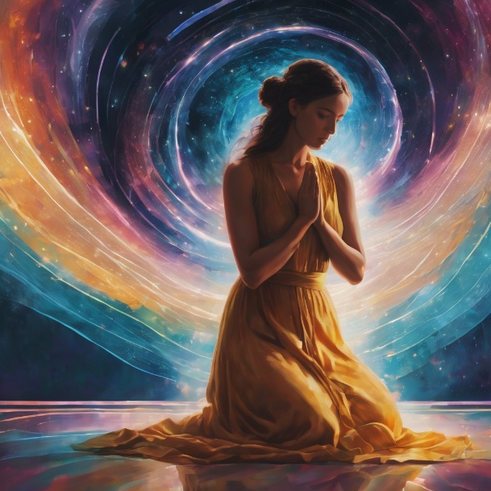
Prayer of Thanksgiving before Intercessions
Leader: As we enter prayer, I invite the second reader to unmute to lead our intercessions following the prayer of thanksgiving on the next slide. Please feel free to change your body position as you need.
Continue…

Slide 40
Leader: Eternal God,
your people made a calf, you were angry – not half!
But Moses pleaded their case, and your response was grace.
And we are just the same,
dishonouring your name with our idols and our pride.
But you don’t cast aside, you let us start again.
Thank you, Lord. Amen.
Notes:
Prayer of praise and thanksgiving from Roots

Slide 41
Intercessions
Reader 2: We pray for creation and communities we share our lives with. We pause for a few moments to name either in our hearts, or out loud, or in the chat, those environments and communities we bring to the Lord in prayer.
PAUSE…
Continue…

Slide 42
Intercessions
Reader 2: We entrust to you the community of Holy Hermits Online and our ministry partners:
Prosper the work of our hands and show us the way to your new creation.
Creator God, Hear our prayer.
St John's Cathedral Brisbane The Anglican Diocese of Southern Queensland St Gabriel’s, Carindale Benedictus Contemplative Church, Canberra Anglican Focus and Tithe.ly

Slide 43
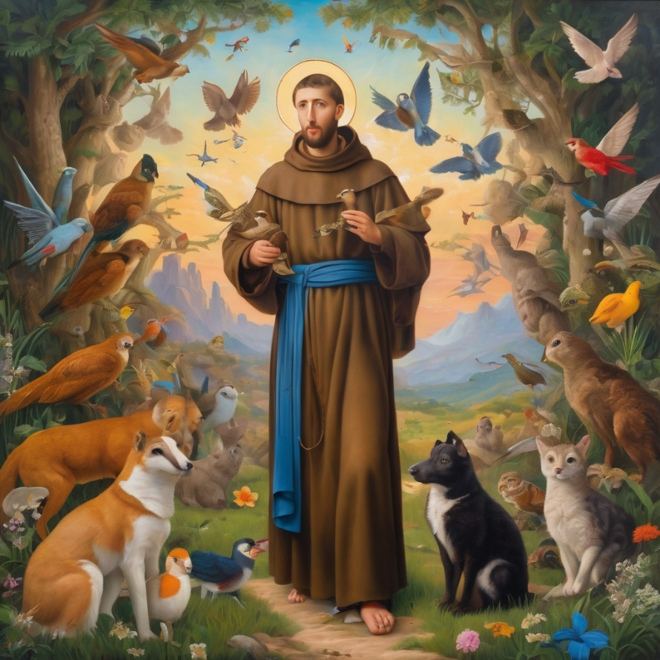
Reader 2: Loving Creator, we entrust to you all animals, especially those who are sick, anxious, ageing, lost, at risk, lonely, sad, hungry, in pain, homeless, abused, living in fear, encountering violence of any kind, in need of comfort, rehabilitation or transformation.

Slide 44
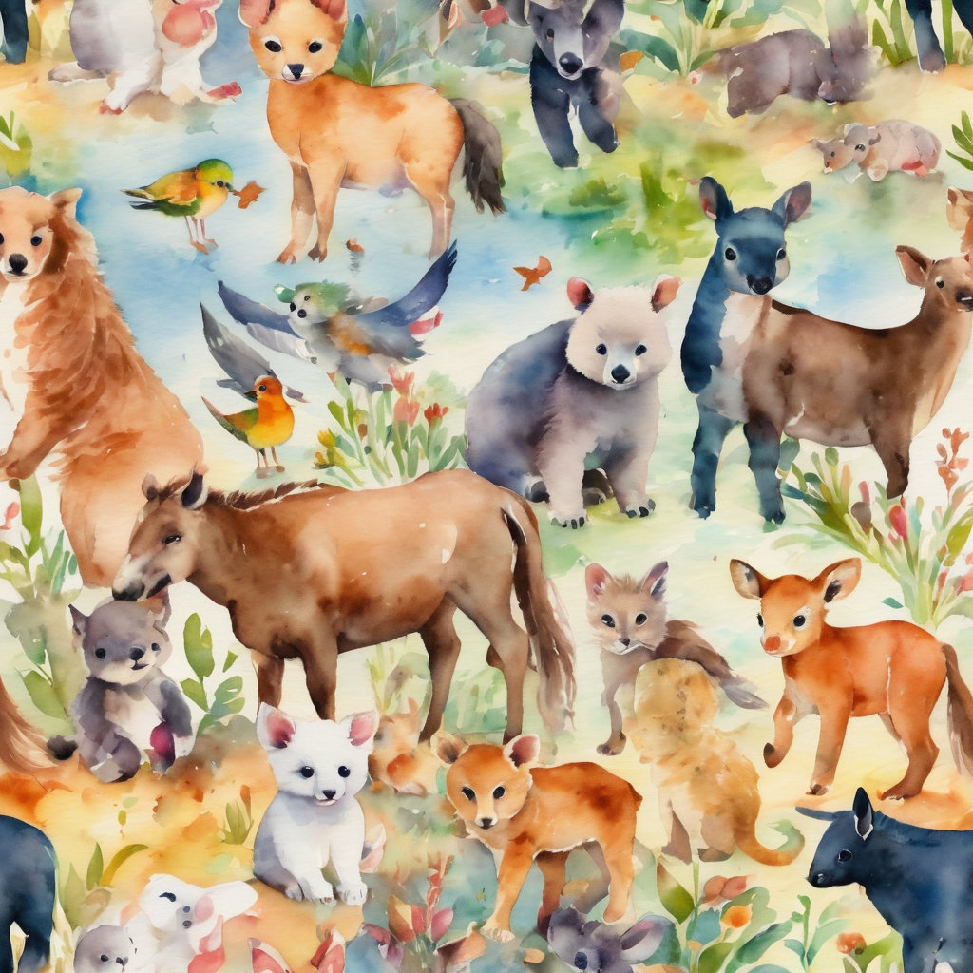
Reader 2: We invite your loving compassion for:
We name in our hearts, out loud or in the chat,
the animals we bring to the Lord in prayer. PAUSE…
Jasmine, ​
Leese(y), ​
Sid, Toots & Lulu​
Polly and Suki​
Fred, George & Percy​
Koshka ​
Jax
Lambert ​​
Kala, Nigel & Little One ​​
Toby​​
Taco​​
Paddy ​​
Rosie​
Squealer

Slide 45
Reader 2: Eternal Trinity of Love, we uphold to you the people we love and carry cares for:
Kerry, Les & Jake​ Julie, Ray, Tracey & Shane​ Mark, Desley & Bob ​​​ Rachel, Mervyn & Gillian​ ​​Rev'd Shane & Janette​​​ Alecia, Martin & Aidan​​​ Kirsten, Greg, Daphne & Beau ​ Bill & Marjorie​​​ Aaron & Andrea​ Liz’s Godchildren​ Matthew & Nicholas​ | ​​Dilys​ Dr Julie ​​​ Ruth​​​ Phil​​ May​ Susan​ Tanya​​ Neva​ Kathy​ ​Gayanne​ Tina​ | Alan & Gaylene​​ Jess & Leah ​​​ Barry & Gwen​ Bob & Di​​ Pat & Julie​ Paul & Darhon​ Judy & Mary​ Barry & Paul​ Miriam​ Lorelei​ Nettie​

Slide 46
Reader 2:
We name in our hearts, out loud or in the chat, those we bring to the Lord in prayer.
PAUSE…
We entrust to you those who have died, those who have died peacefully and those who have died tragically, the old and the young. Receive them into your Kingdom. Lord in your mercy, Hear our prayers. Amen.

Slide 47
Pray Daily Cycle of Prayer
Leader: Loving God, joining with the Church in our cycle of prayer, we ask your blessings on:
The Anglican Church of Burundi
The Diocese of Gippsland: †Richard; Clergy and People
The Parish of Indooroopilly: Sue, Howard, Valerie, †Rob, Richard, Shane, Marian
Sudanese & South Sudanese Congregations in Anglican Church Southern QLD (ACSQ): Bishop Daniel
Continue…
Notes:
anglicanfocus.org.au/category/front-page/spirituality/pray-daily/
Please only include the first names of those we pray for

Slide 48
Pray Daily Cycle of Prayer
EPIC Assist
St Hilda’s School, Southport: Principal Virginia; Lay Chaplains Naomi & Paul; Chair of School Council Wendy Henning; members of School Council; staff & students

Slide 49
Commitment Prayer of the Week
Leader: Our commitment prayer for the week is for the Deliverance Ministry Team.
Come Holy Spirit and make the hearts of your servants, Reverend Claye and the deliverance ministry team, your dwelling place and home. May darkness be dispelled by your light, and troubles calmed by your peace.
Lord Jesus, we ask that you protect, guide and strengthen them, and all whom they encounter. Give them courage, ability, wisdom and discernment.
Continue…
Notes:
Link to prayer group ministry page for weekly commitment prayer https://holyhermits.com.au/ministries/prayer-group

Slide 50
Surround them with sound advice and support, that they may have
insight and discretion. Drawing on the Holy Spirit may they be strong
in vocation and trust in you.
We pray for those in need of healing and their ongoing relationship
with you, as they journey towards the fullness and freedom of
eternal life. May all evil and pain be transformed through the
suffering of Christ and all dying glorified by your risen life.
Amen.

Slide 51
Devotions

Slide 52
Hermit Wisdom - Thérèse of Lisieux
“Remember that nothing is small in the eyes of God. Do all that you do with love.”
“The closer one approaches to God, the simpler one becomes.”
“Our Lord does not look so much at the greatness of our actions, or even at their difficulty, as at the love with which we do them.”
“I (pray) like children who do not know how to read, I say very simply to God what I wish to say, without composing beautiful sentences, and He always understands me.”
Notes:
Pick 3 shorter or 2 longer sayings

Slide 53
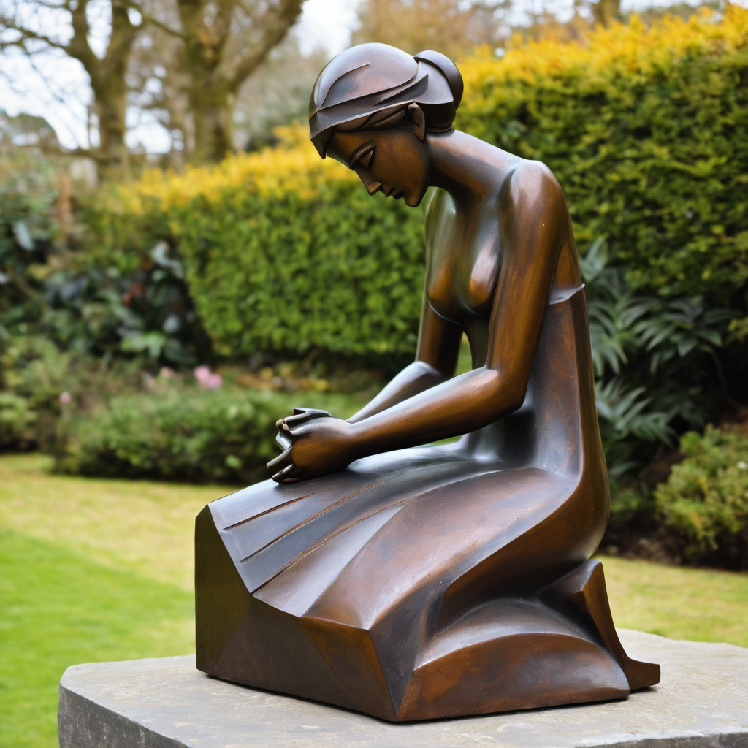
​
Leader: ​As we enter a few minutes of silence together, you are invited to pray the prayer of adoration on the next slide and/or spend this time in contemplation. ​
The Spiritual Communion prayer follows on the slide after that.
Let us be still.
Leader and Cantor Mute.
Continue…

Slide 54
God of all time and all places:
You are a kind God, a generous God, a merciful God.
You are our kind of God.
You are a holy God, a loving God, a creative God.
You are our kind of God.
You are an approachable God, a just God, a joyful God.
You are our kind of God.
You are a challenging God, a fair God, a compassionate God.
You are our kind of God.
And we worship you now in Jesus’ name. Amen.
​
Notes:
Prayer for all ages - Roots

Slide 55

  Oh, my Lord Jesus I turn to you present at the Altar and in the Tabernacle. I believe that you are present in the Holy Sacrament of your most Sacred Body and Blood. I love you above all things and I desire to receive you into my Soul. I cannot at this moment receive you Sacramentally in Holy Communion. Come spiritually into my heart. Purify it, Sanctify it. Render my heart like your own heart. I embrace you as if you were already there and unite myself wholly with you. Never permit me to be separated from you. Lord, I am not worthy to receive you, but only say the word and I shall be healed. Amen
Making a Spiritual Communion
(Prayed in silence)
Notes:
Spiritual Communion Slide – Please do not change the prayer
Can change colour of background and title to match liturgical colour. You may also like to change the picture.

Slide 56
Leader unmutes
Our final song is
Gracious Invitation
https://youtu.be/KIxfC64VDYsi
​We stay on mute
Leader and Cantor mute

Slide 57
Leader and cantor unmute
Sending Prayer
Leader: We pray our sending prayer together.
All: Lord, help us to acknowledge you
in everything we do.
May we honour you in what we do and what we say,
as people who put you first, middle and last,
everywhere and always. Amen.
Notes:
Use Sending Prayer from Roots

Slide 58
The Benediction
Leader: Let us all invite God’s blessings together,
All: May the Lord bless us and keep us.
May the Lord’s face shine upon us and be gracious to us.
May the Lord’s countenance be lifted upon us,
and bring us peace.
Amen

Slide 59
Notices
After worship today join us for our 6th Birthday Celebration @ 11am
Wednesday Study Group is on a break until 11th November
Next Sunday is our Teddy Bear Service @ 9am
and Virtual Chapel Workshop with Angie @ 11am
See HHO Events page for further upcoming events HHO Events
Notes:
Up coming events can be added from the HHO event page/calendar

Slide 60

Leader: If you are carrying something heavy, seeking prayer, or simply would like to talk with someone, pastoral care is available to all in the community.
You can contact Rev’d Lauren 💌lauren.martin@anglicanchurchsq.org.au
☎️ 0415260599
💌 holyhermits@anglicanchurchsq.org.au
❤️ or visit the help page at the website to reach out 🌐

Slide 61
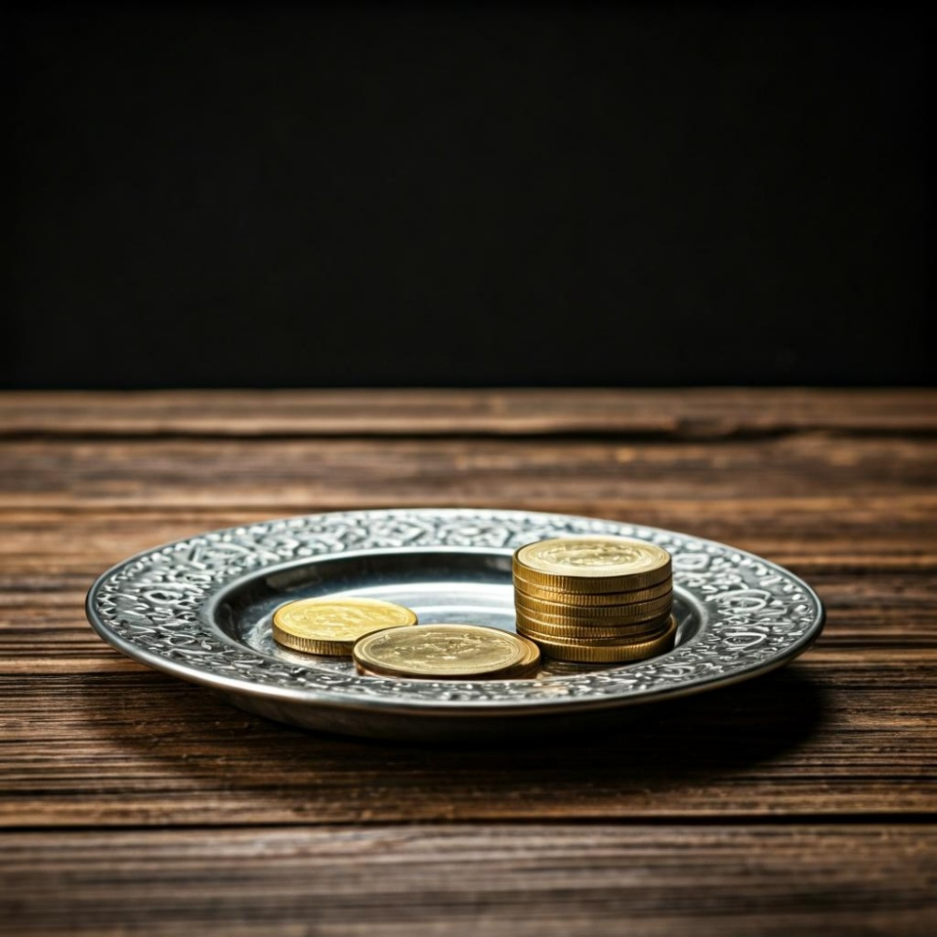
Leader: Thank you for your regular gifts to this ministry. Offerings are most welcome via:
The HHO App
Direct Debit
International Direct Debit
Please consider a one-off donation
or leaving a legacy in your Will
For further information go to HHO give page
https://holyhermits.com.au/give

Slide 62
Serving next week
18th October 2026
21st Sunday after Pentecost
9:00 am AEST
Service Prep: Kris | Chat Host: Viki | Fellowship: Julie
Music: Wiggles | Welcomer: Julie | Safety Officer: Chris
Proof-reader: Viki | Leader: Julie | Attendance: Viki
Broadcaster: Paul | Cantor: Margo | Preacher: Jamee
Backup Broadcaster: Lauren | First Reader: Paul | Deacon: Lauren
Zoom Buttons: Viki | Second Reader: Jeremy | Priest: Jamee
Thank you for your ministry gifts
New Servers always welcome!
Please email Rev’d Lauren to get involved
holyhermits@anglicanchurchsq.org.au

Slide 63
The Dismissal
Leader: I invite everyone to unmute for the Dismissal
Leader: Go in peace to love and serve the Lord.
All: In the name of Christ, Amen.

Slide 64
Fellowship
Thank you, Lauren for leading Fellowship
Please feel welcome to linger or pop a message in the chat and head off when you are ready.​
Extra resources developed
by Roots on the Web
Images from Padlet & Roots on the Web

