Slide 1


Slide 2
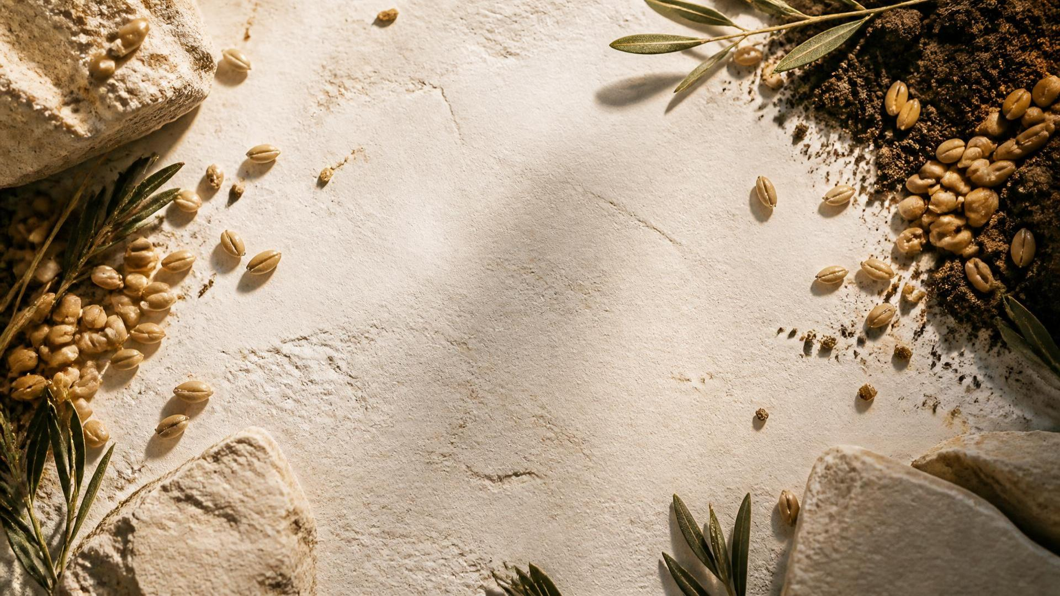
KEY SCRIPTURE · GALATIANS 6:7
03
“Do not be deceived: God cannot be mocked.
A man reaps what he sows.”
GALATIANS 6:7 · NIV

Slide 3
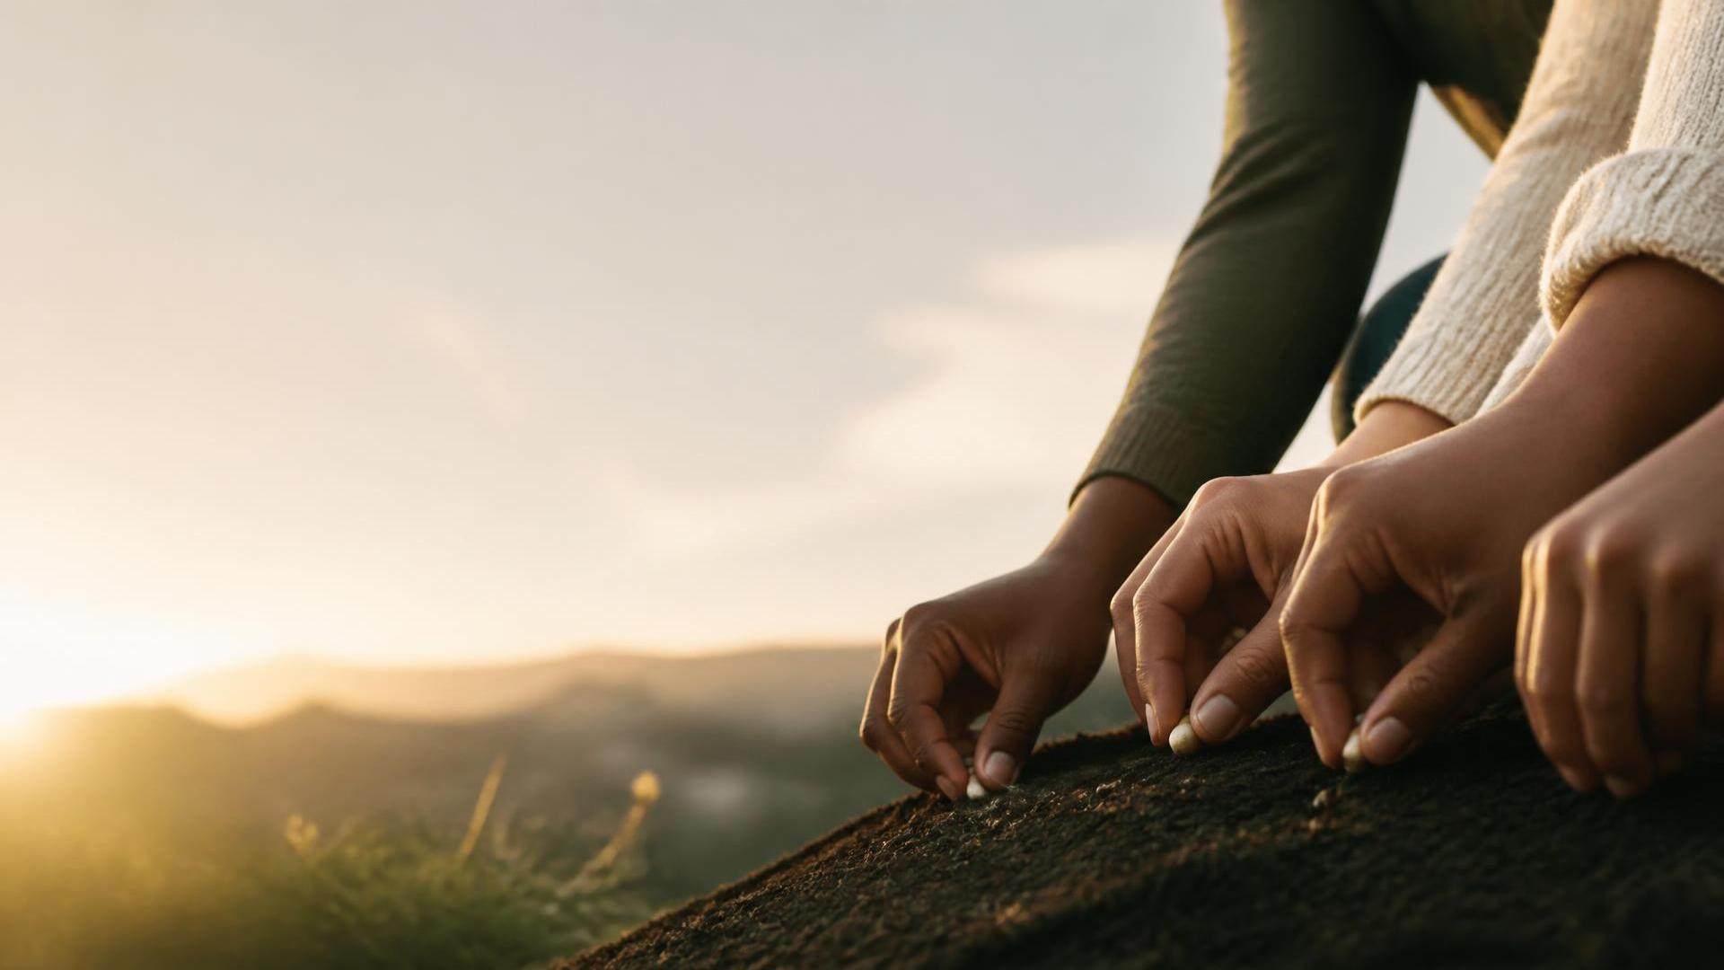
The SOWER

Slide 4
THE SOWER
1 - KNOW WHAT YOU'RE CARRYING
  Before you can plant something, you have to recognize that you actually have something worth planting.
  Stop looking at what you have as ordinary just because it's familiar to you.
  What is natural to you may be valuable to somebody else.
    Your experience could help someone.
    Your access could open a door for someone.
    Your story could give someone hope.
  Sometimes you don't recognize the potential of what you carry because you've been carrying it for so long.

Slide 5
THE SOWER
2 - CHOOSE YOUR SOIL
  Where will what I'm carrying have the opportunity to produce?
  This isn't about deciding that certain people aren't valuable;
  It's about understanding that different soil produces different outcomes.
  You can have good seed and still have a poor harvest if you continually plant in the wrong places.

Slide 6
THE SOWER
3 - DISCERN THE SEASON
  Farmers understand something we struggle with:
  You cannot plant everything all the time.
    There are seasons for planting.
    Seasons for cultivating.
    Seasons for waiting.
    Seasons for harvesting.
  You don't have to force a harvest because everybody else seems to be harvesting.
  Don't confuse delay with denial.

Slide 7
THE SOWER
PHILIP
THE SOWER WHO RECOGNIZED THE SOIL
Acts 8:26–39
  Philip encounters the Ethiopian official reading Isaiah.
  Philip asks him whether he understands what he's reading.
  The man admits he needs someone to explain it.

Slide 8
The SEED

Slide 9
THE SEED
1 - A SEED CANNOT GROW IF IT REFUSES TO BE PLANTED
  A seed has incredible potential.
  But potential sitting in your hand is still just potential.
  A seed has to surrender its current position to enter its next stage.
  The seed has to leave the hand, It has to enter the ground.
  You can't grow into everything God has for you while refusing every place He plants you.

Slide 10
THE SEED
2 - DON'T LIVE SHALLOW
  A seed that doesn't establish deep roots is vulnerable.
  It can be disturbed by:
    weather/animals
    external pressure/unexpected circumstances
  Things will happen that you didn't plan for.
    Disappointment/Rejection/Failure.
    Temptation/Pressure.
    Change/Loss/Confusion.
  Don't just grow taller. Grow deeper.

Slide 11
THE SEED
3 - LET THE SHELL BREAK
  A seed doesn't simply sit underground waiting to become a tree.
  Spiritually, there are things God has placed inside you that won't come out while you're committed to living the version of yourself you're comfortable with.
  Sometimes your pride has to break, fear has to break, old identity has to break, comfort has to break, self-reliance has to break.

Slide 12
THE SEED
4 - YOU NEED THE RIGHT FARMER
  The seed doesn't understand everything about the soil.
  The seed trusts the farmer with what the seed cannot see.
  There will be seasons where you're asking:
  “God, why am I here?”, “Why isn't this happening faster?”
  “Why did You let this happen?”, “Why does this season feel so difficult?”
  But you can still say: “I trust the Farmer.”
  Because God knows:
    where you're planted, what you're becoming
    what needs to develop, what needs to come out
  You don't have to understand the soil to trust the Farmer.

Slide 13
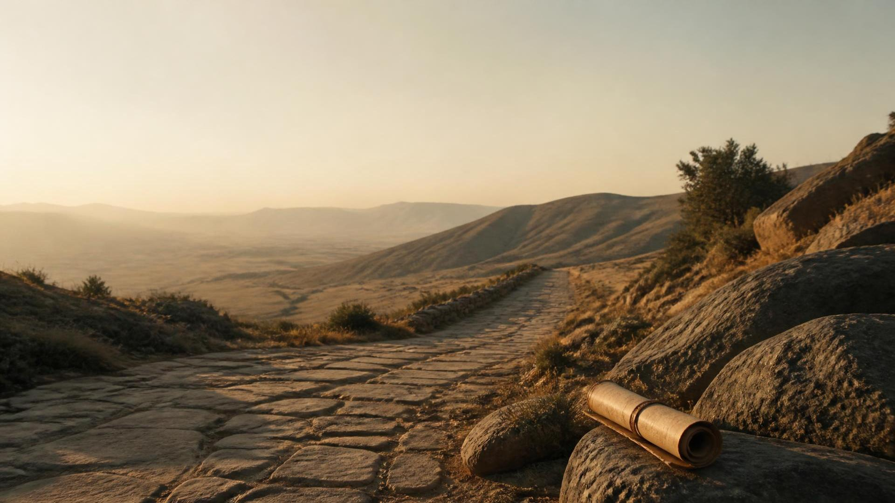
TWO KEYS TO MOVE FORWARD

Slide 14
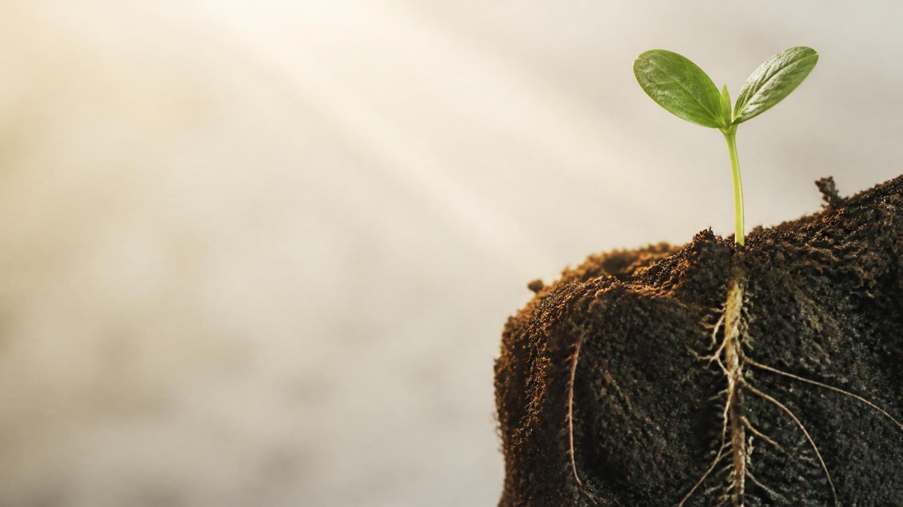
KEY POINT 01
CHECK THE SOIL
BEFORE YOU SOW
  As the Sower:
  Ask: “Is this where God wants me to plant what He's given me?”
  As the Seed:
  Ask: “Is this where God has planted me, and am I actually taking root?”

Slide 15
KEY POINT 02
11
PLANT WHAT YOU
WANT TO SEE GROW
  As the Sower:
    If you want encouragement → plant encouragement.
    If you want opportunity → create opportunity.
    If you want people to believe in your generation → believe in somebody.
  As the Seed:
  Don't just ask: “What am I getting from this season?”
  Ask: “What is this season growing in me?”
  Because what grows in you eventually becomes what grows through you.

Slide 16
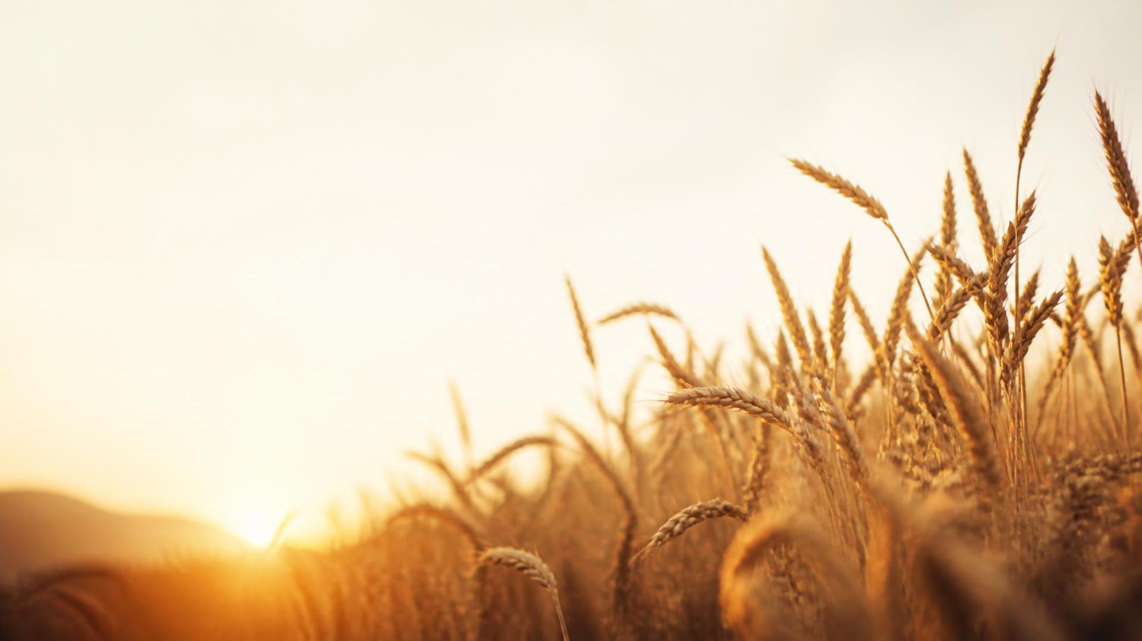
CLOSING ENCOURAGEMENT
DON’T WASTE
WHAT GOD PUT
IN YOU
Be intentional. Sow well. Trust God for the harvest.

