Slide 1
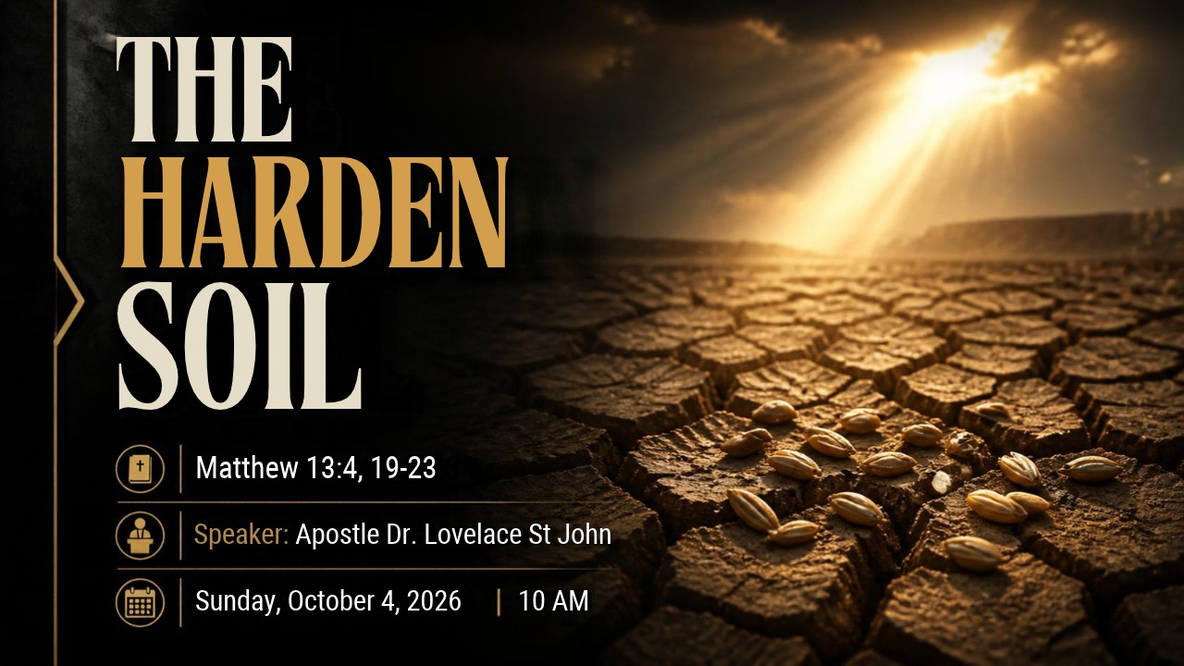

Slide 2



Scripture:
MATTHEW 13: 4, 19

Slide 3
INTRODUCTION
The Ground That Drinks Nothing
The Sahel, not the Sahara, is the band of dry savanna that runs the width of Africa south of the Sahara desert, from Senegal to Sudan.
The rains come there in a single season. They arrive in torrents.
The rain comes. It comes hard, the very rain they prayed for. And the ground cannot drink it.
Water runs off the sealed surface and gathers in the low places.
Everything needed for life was falling from above. But nothing could get in.

Slide 4
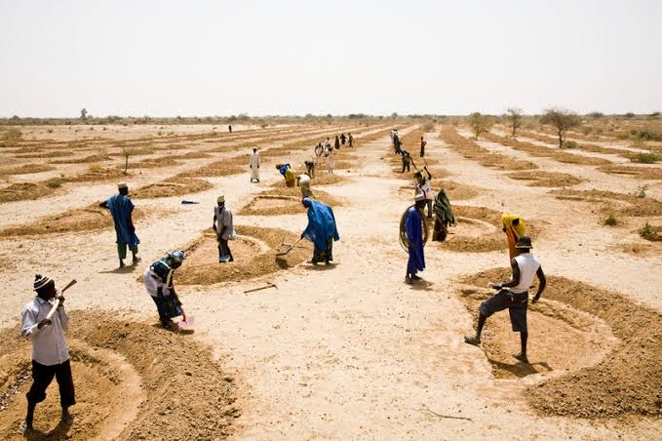
The Ground That Drinks Nothing
In regions like Niger, Burkina Faso, and Mali, intense heat and foot traffic compact the topsoil into a cement-like crust.

Slide 5
The Ground That Drinks Nothing (cont)
When sudden rains fall, the water simply sweeps across the surface without sinking in, creating massive runoff and leaving the land just as dry as before.
Farmers dig these semi-circular earthen basins.
Catching the Runoff: The crescent-shaped ridge acts as a barrier that slows down and traps surface runoff water.

Slide 6
The Ground That Drinks Nothing (cont)
Forcing Infiltration: Instead of flowing away, water collects inside the half-moon basin, giving it the time it needs to slowly soak deep into the hardened ground.
Restoring Life: Organic matter and seeds accumulate at the center of the crescent, allowing crops, grass, and trees to grow even in hyper-arid conditions.

Slide 7
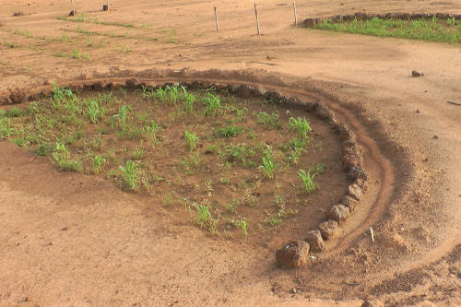
2. THAT IS WHERE WE MEET GIDEON.
In the Sahel, when the ground gets hard, farmers take tools to the ground. They carve out half-moon basins, deliberate breaks in the soil designed to interrupt the runoff. When the rains fall, the crescent holds the water in place long enough for the earth to surrender and drink.

Slide 8
I. The Ground That Stopped Receiving - Matthew 13:19
It is described as path soil, ground that has simply been walked on.
That is the hardest thing about a hardened heart. It rarely hardens all at once.
The path is where life has been worn smooth by traffic. Years of feet. Years of coming and going. Years of the same road walked without ever stopping on it. Soil that was once soft and responsive becomes packed down, resistant, closed.

Slide 9
The Forces That Make a Path Hard:
Foot traffic. In the heart, it is familiarity. A truth heard a hundred times can stop being a truth you receive and become only a thing you already know.
Drought. Long seasons with no rain. A soul that has been through a long dry spell without seeking God in it comes out of that spell harder than it went in.

Slide 10
The Forces That Make a Path Hard (cont)
Neglect and stripping. A heart loses its protective practices of prayer, confession, meditating.
Repetition without reflection. Hearing the same words, saying the same responses, while never once letting any of it get below the surface, that is how a soul becomes a pathway.

Slide 11
2. Closed In The Midst of Rain
The Sower had gone out. The seed was good. The season was right. The problem was entirely on the receiving end.
More rain is not the same thing as more water received. A crusted surface can be rained on generously and drink almost nothing.

Slide 12
2. Closed In The Midst of Rain (cont)
The rain was present. The seed was present. And the ground stayed exactly as hard as it was before
A heart can be closed in the very midst of spiritual rain. It can sit under the preaching of the Word, week after week, and receive nothing, because receiving is something the ground must do.

Slide 13
2. Closed In The Midst of Rain (cont)
Rain cannot do it alone. The seed cannot force its way in. God has chosen, in His ordinary work, to grow His kingdom through soil that yields.
So, a hard heart is not a heart untouched by God's provision. It is a heart that has been given everything and has taken nothing.

Slide 14
2. Closed In The Midst of Rain (cont)
A person can be near everything and receive nothing.
That is the danger of the hardened heart. It is not distance from God that condemns it. It is proximity to God that makes its hardness so perilous, because nearness creates the illusion of reception.

Slide 15
3. Why Hardness Is So Dangerous
1. Hardness forfeits the seed itself.
There is no neutral end for the Word of God in a life. It either gets in, or it gets taken.
2. Hardness compounds.
Soil does not soften itself. Hardness is a habit, and habits deepen. The very act of hearing without receiving trains the heart in the practice of hearing without receiving.

Slide 16
Why Hardness Is So Dangerous (cont)
3. It gets worse even while conditions improve.
A heart can sit in the best spiritual environment of its life, good preaching, warm fellowship, a season of blessing, and remain unchanged, because improvement around it is not the same as repentance within it.

Slide 17
4. Hardness is invisible to the one who has it.
The hardened heart rarely knows itself hardened.
Jesus' diagnosis here is not that His hearers were critics of the Word. It is that they simply did not understand it and therefore did not receive it.
5. Hardness leaves the "ditch" as its only destination.
When ground cannot drink, the rain has to go somewhere. It runs into the low places. What the heart refuses spills elsewhere, into distraction, into bitterness, into some other consuming thing.

Slide 18
CONCLUSION
Jesus names this soil at all is evidence that He is calling people out of it. He does not tell this story to describe an inescapable condition. He tells it because paths can be broken up.
"Break up your unplowed ground; for it is time to seek the Lord, until he comes and showers his righteousness on you." (Hosea 10:12)

Slide 19
CONCLUSION (cont)
The Sahel proves the promise is not empty. The crusted ground of the region was not beyond rescue, and farmers proved it with their hands: digging through the seal before the rains came, breaking the surface deliberately so the water could finally enter. Where they did, the ground that had been written off as dead yielded a harvest.
Every time God speaks and we resist, the ground packs a little tighter.

Slide 20
CONCLUSION (cont)
Think of Pharaoh. In the early plagues the text says Pharaoh hardened his own heart. Later it says God hardened Pharaoh's heart. That is a sobering progression: resist long enough, and resistance becomes the shape of the soul.
The first "no" is a choice. The hundredth "no" is a condition.
Proverbs 29:1 says, "He, that being often reproved hardeneth his neck, shall suddenly be destroyed, and that without remedy."
Notice the word "suddenly." The hardening was slow, but the breaking comes fast.

