Slide 1

The Movement Grows
Robyn Christie

Slide 2
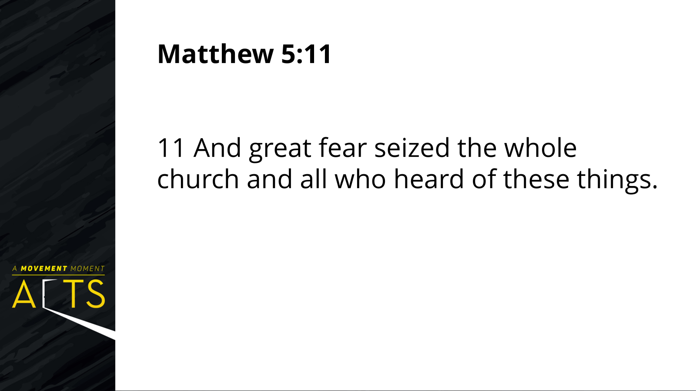

Slide 3

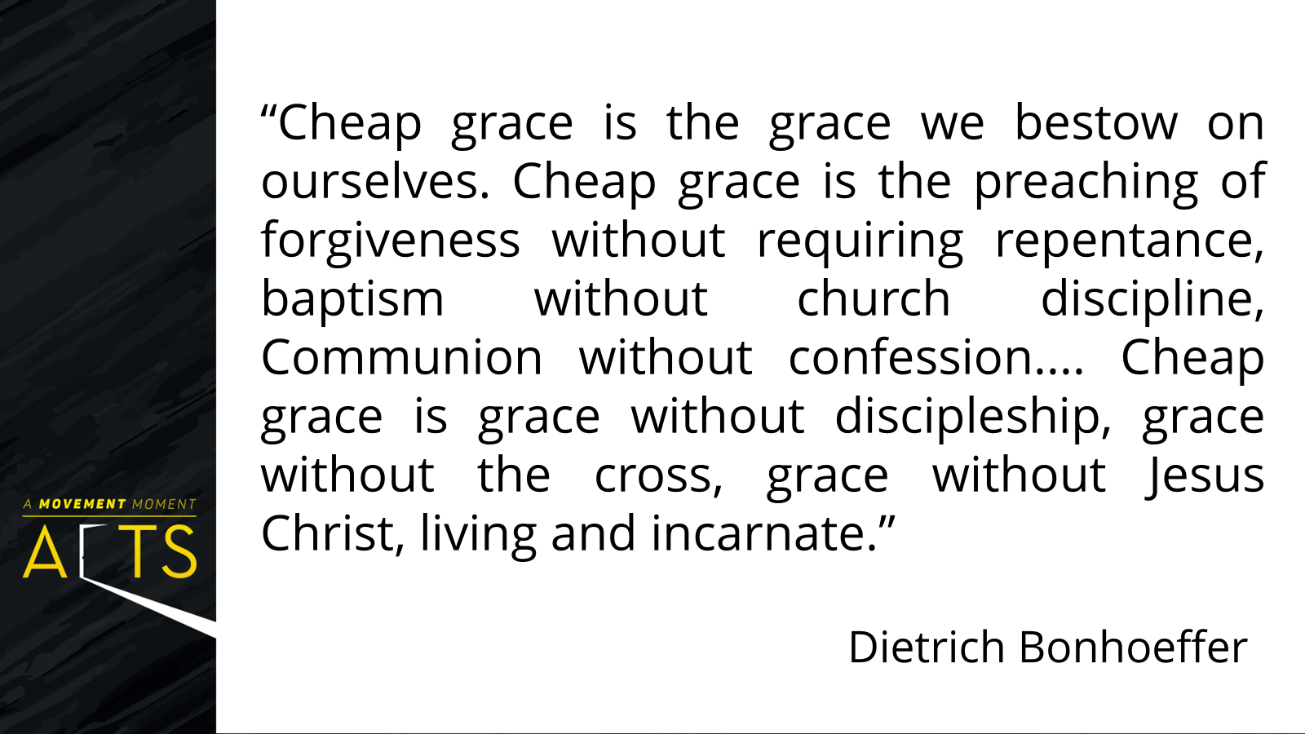

Slide 4
Acts 5: 12 -16
12 Now many signs and wonders were done among the people through the apostles. And they were all together in Solomon’s Portico.
13 None of the rest dared to join them, but the people held them in high esteem. 14 Yet more than ever believers were added to the Lord, great numbers of both men and women

Slide 5
15 so that they even carried out the sick into the streets, and laid them on cots and mats, in order that Peter’s shadow might fall on some of them as he came by.
16 A great number of people would also gather from the towns around Jerusalem, bringing the sick and those tormented by unclean spirits, and they were all cured.

Slide 6
Their everyday life was demonstrating the life they saw in Jesus.
They were together.
3. They were fruitful – the word spread.

Slide 7
Acts 5:12
12 Now many signs and wonders were done among the people through the apostles. And they were all together in Solomon’s Portico.

Slide 8
Acts 4: 29 -30
“29 Now, Lord, consider their threats and enable your servants to speak your word with great boldness. 30 Stretch out your hand to heal and perform signs and wonders through the name of your holy servant Jesus.”

Slide 9
Matthew 9:35
35 Then Jesus went about all the cities and villages, teaching in their synagogues, and proclaiming the good news of the kingdom, and curing every disease and every sickness.

Slide 10
Matthew 10:1,7-8
1Then Jesus summoned his twelve disciples and gave them authority over unclean spirits, to cast them out, and to cure every disease and every sickness.
7 As you go, proclaim the good news, “The kingdom of heaven has come near.” 8 Cure the sick, raise the dead, cleanse the lepers, cast out demons. You received without payment; give without payment.

Slide 11
John 13:34 -35
34 “A new command I give you: Love one another. As I have loved you, so you must love one another. 35 By this everyone will know that you are my disciples, if you love one another.”

Slide 12
Ephesians 1:18 -20
18 I pray that the eyes of your heart may be enlightened in order that you may know the hope to which he has called you, the riches of his glorious inheritance in his holy people, 19 and his incomparably great power for us who believe. That power is the same as the mighty strength
20 he exerted when he raised Christ from the dead and seated him at his right hand in the heavenly realms,

Slide 13
2 Peter 1:3
3 His divine power has given us
everything we need for a godly life
through our knowledge of him who
called us by his own glory and goodness.

Slide 14
2 Peter 3:18
18 But grow in the grace and knowledge of our Lord and Savior Jesus Christ. To him be glory both now and forever! Amen.

Slide 15
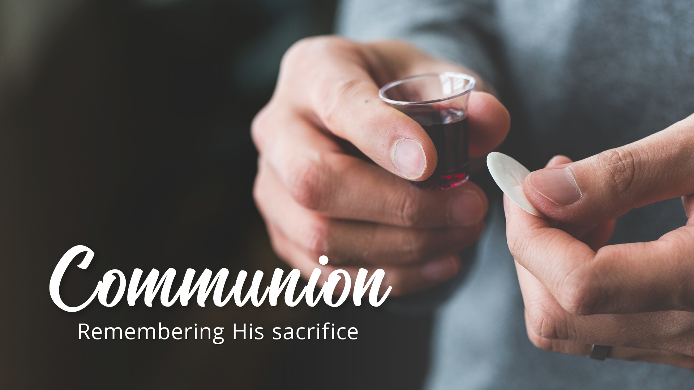

Slide 16


