Slide 1


Slide 2
1 Now there was a man at Caesarea named Cornelius, a centurion of what was called the Italian cohort,
Acts 10:1
NASB

Slide 3
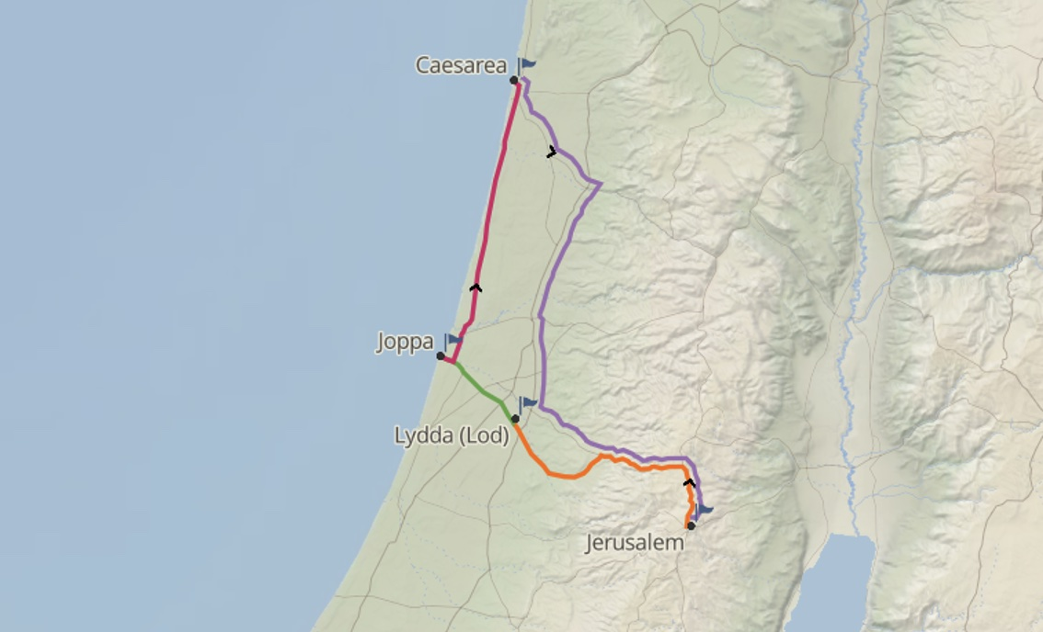

Slide 4
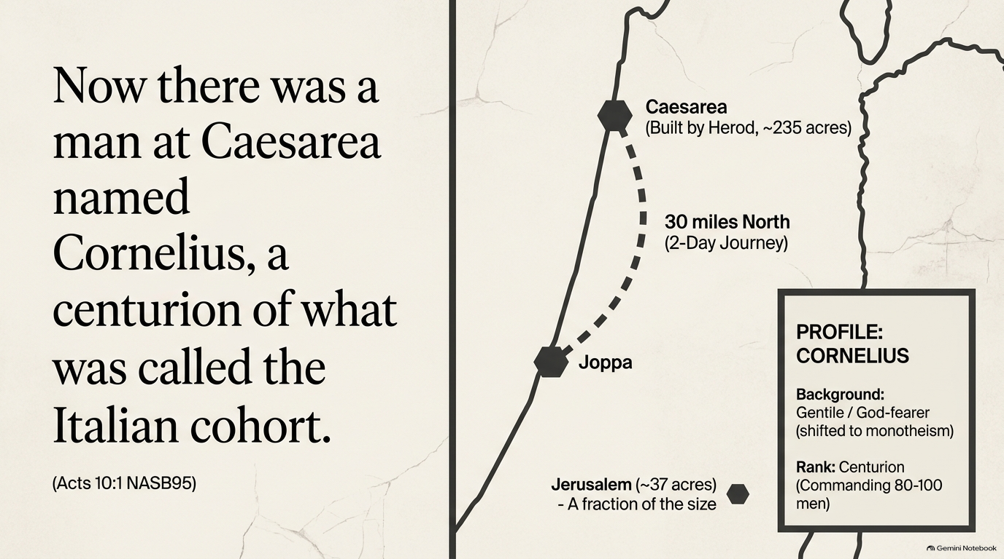

Slide 5
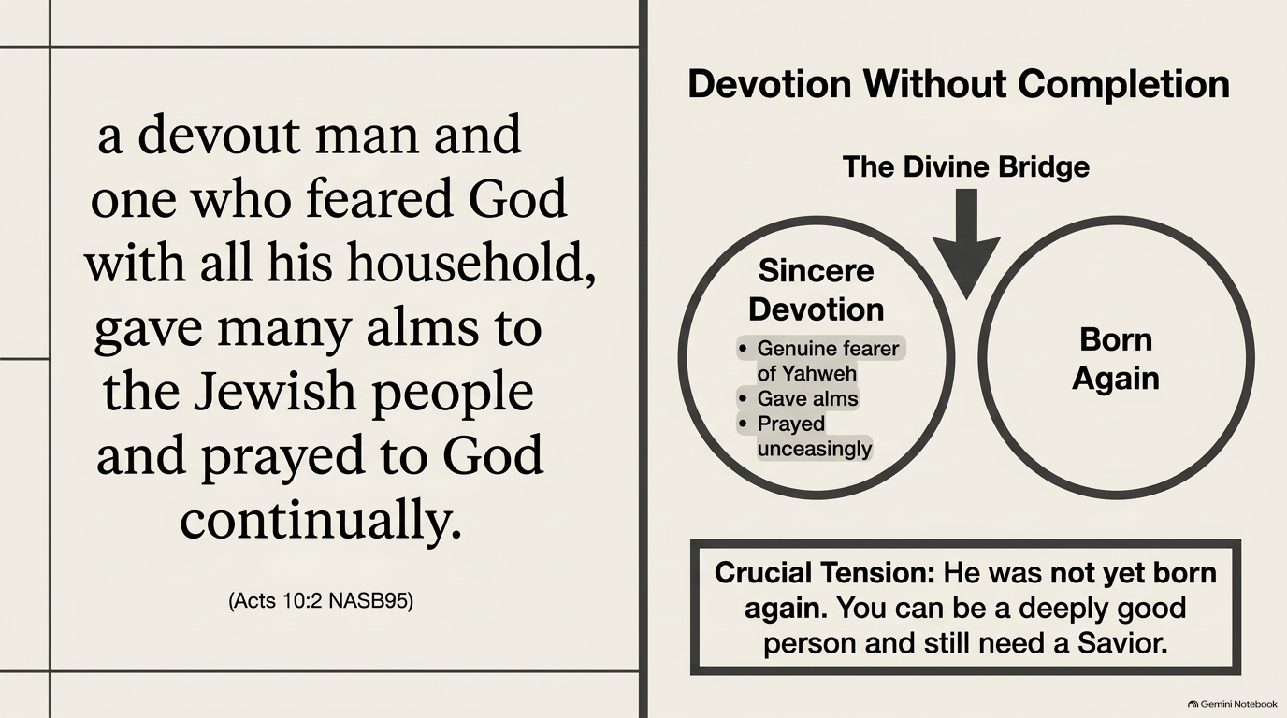

Slide 6
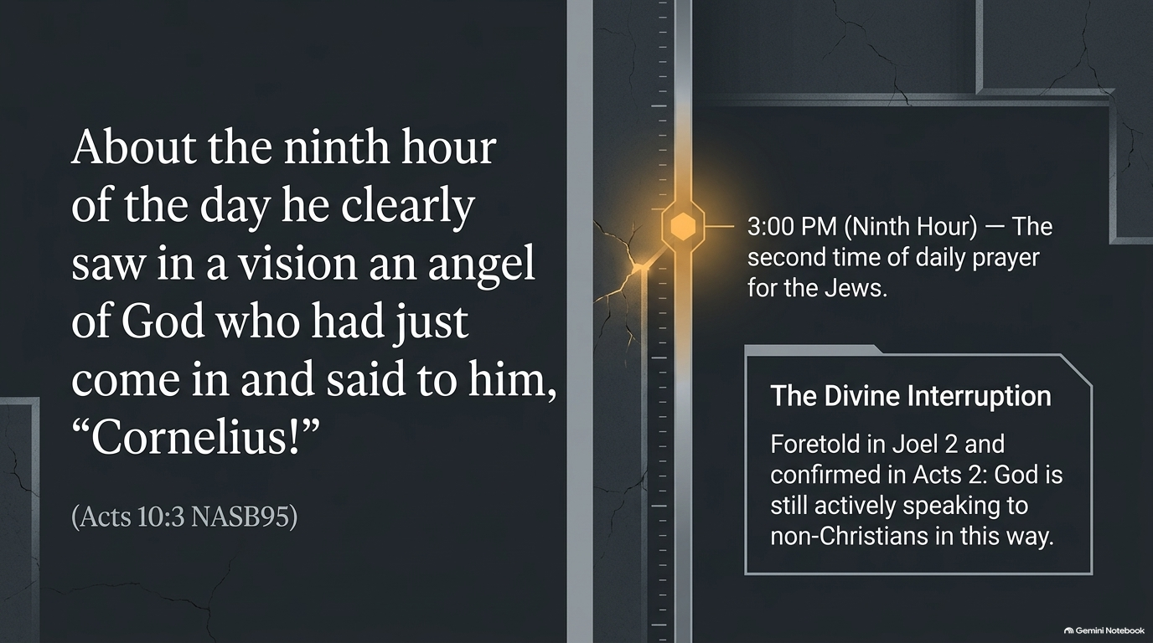

Slide 7
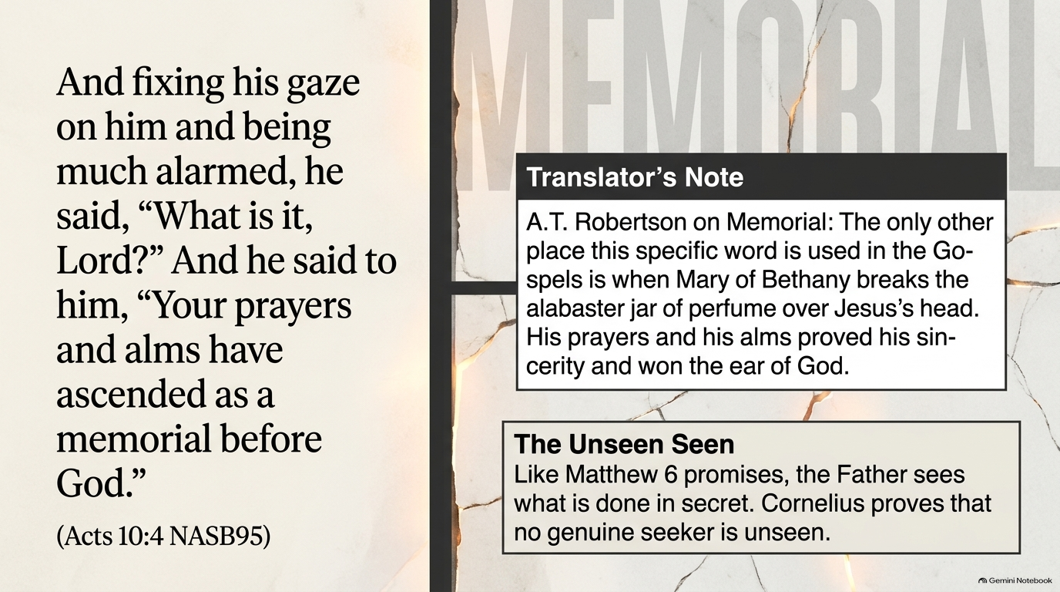

Slide 8
It simply means that Cornelius’s devotion to God was acceptable and pleasing to God, and God’s most valuable response was to lead him into further truth
Evangelical Commentary on the Bible

Slide 9
It is in our time with God that we gain insight from Him

Slide 10
13 ‘You will seek Me and find Me when you search for Me with all your heart.
Jeremiah 29:13
NASB95

Slide 11
3 ‘Call to Me and I will answer you, and I will tell you great and mighty things, which you do not know.’
Jeremiah 33:3
NASB95

Slide 12
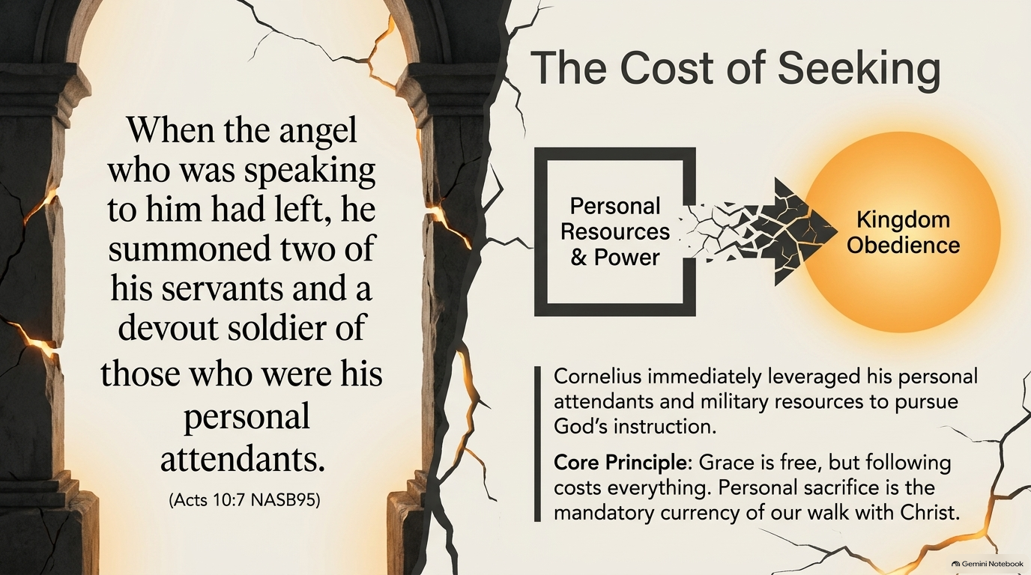

Slide 13
Personal sacrifice is necessary in our walks with Christ

Slide 14
Grace & Sovereignty of God in Salvation
This incident of Cornelius also illustrates the grace and sovereignty of God in salvation. Paul explains it well in Romans 10:13–15: All who call upon the name of the Lord can be saved, but knowledge of the One on whom they call must precede their calling on him, and knowledge must come by hearing about him, and hearing must come by someone preaching, and preaching cannot occur until God sends someone. Thus God sends Peter; for God has committed himself to reach all those who might call on him. -
Evangelical Commentary on the Bible

Slide 15
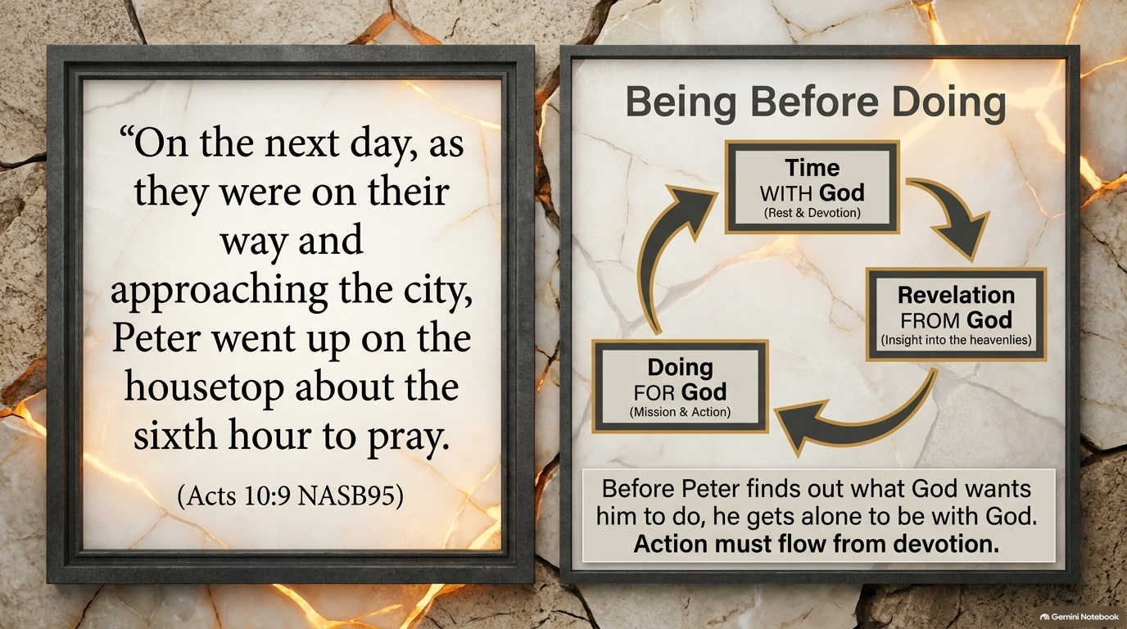

Slide 16
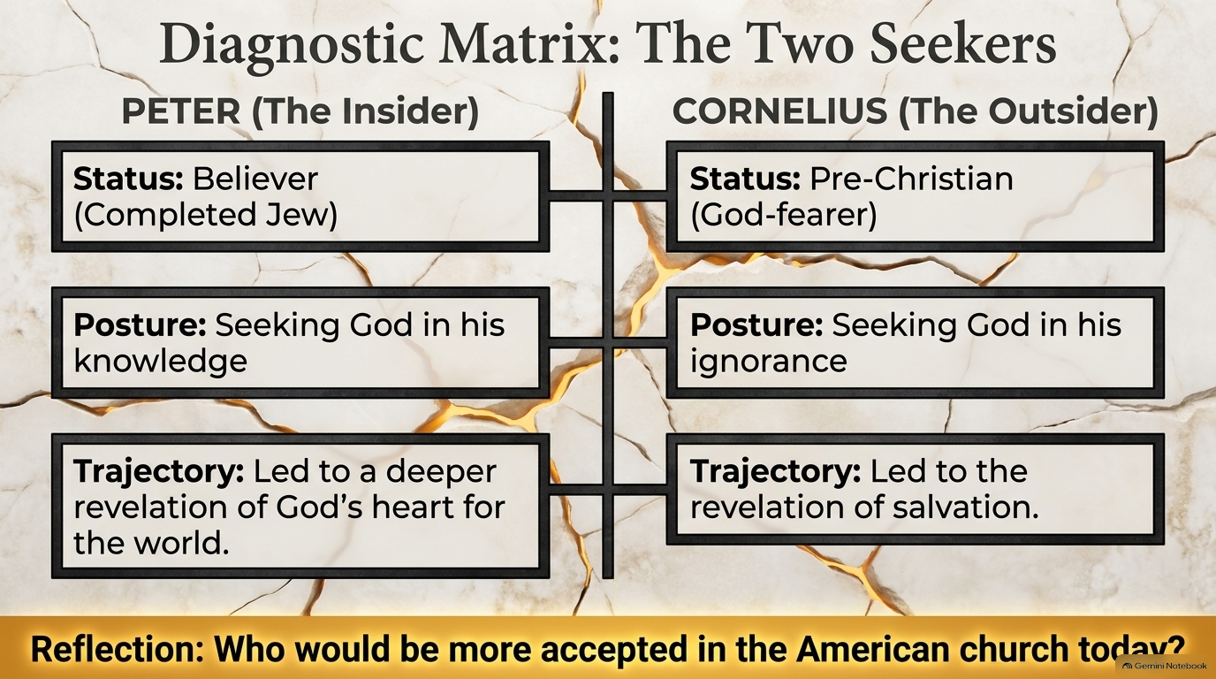

Slide 17
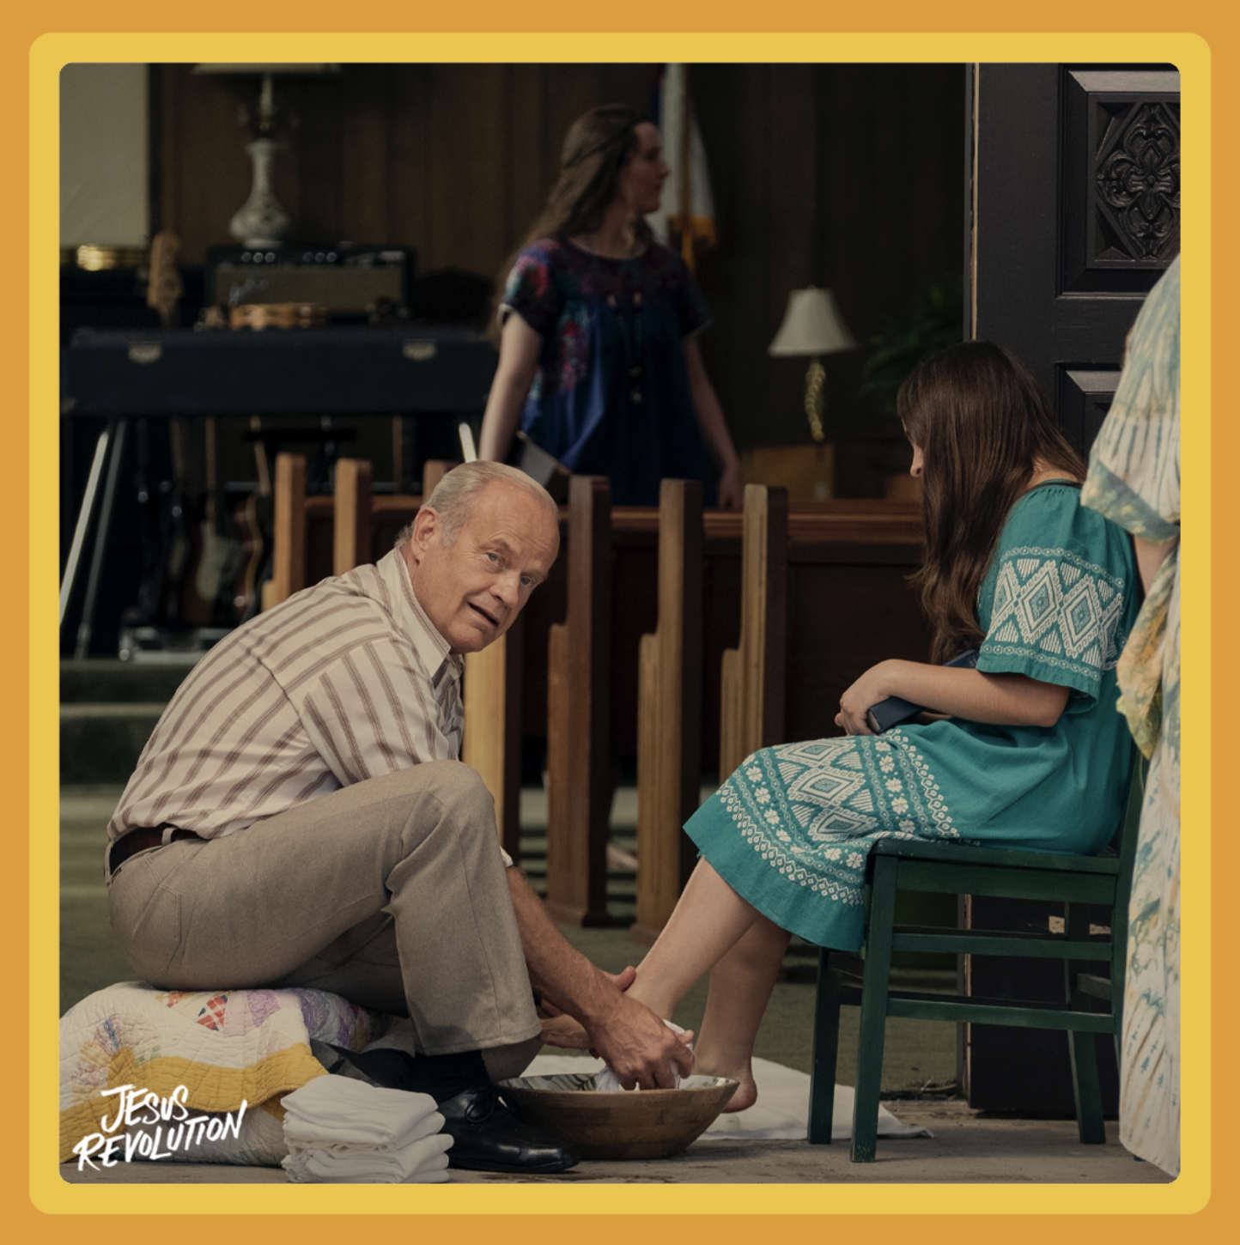
God Seekers
Jesus Revolution

Slide 18
20 If someone says, “I love God,” and hates his brother, he is a liar; for the one who does not love his brother whom he has seen, cannot love God whom he has not seen.
1 John 4:20
NASB95

Slide 19
35 “By this all men will know that you are My disciples, if you have love for one another.”
John 13:35
NASB95

Slide 20
36 Seeing the people, He felt compassion for them, because they were distressed and dispirited like sheep without a shepherd.
Matthew 9:36
NASB95

Slide 21
Prejudice
Are you moved with compassion or are you moved to build a wall?

Slide 22
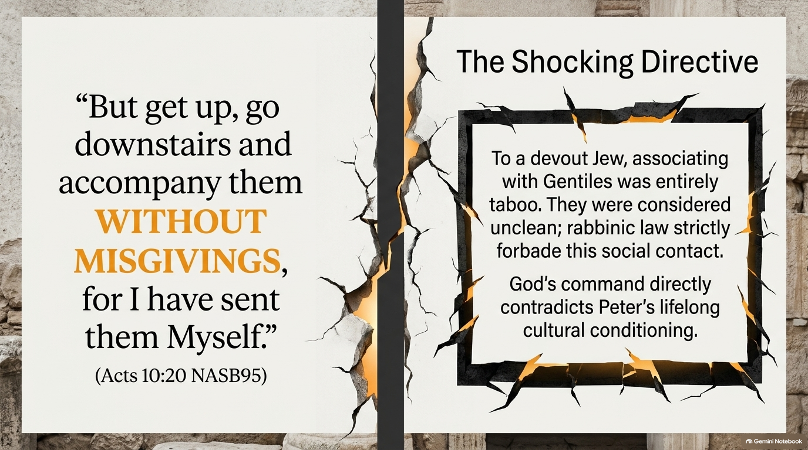

Slide 23
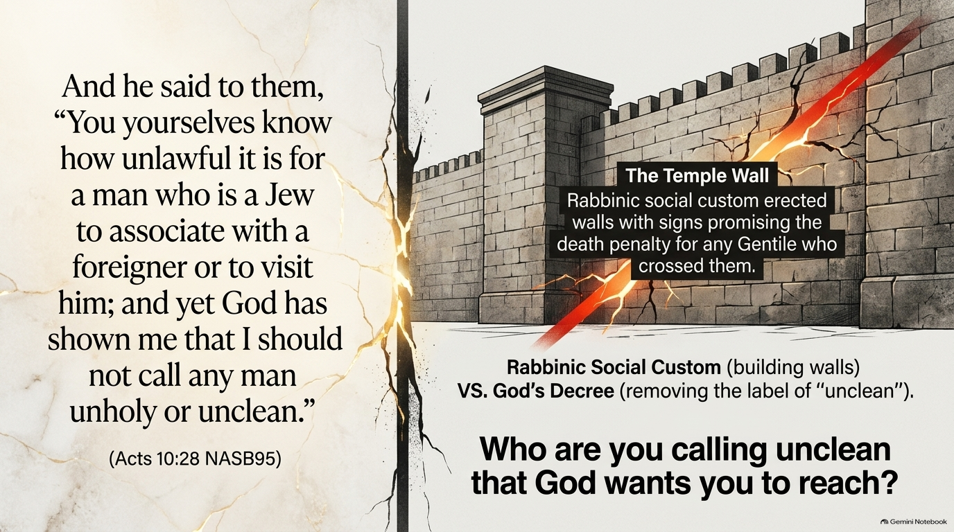

Slide 24
But there is no O.T. regulation forbidding such social contact with Gentiles, though the rabbis had added it and had made it binding by custom. There is nothing more binding on the average person than social custom.
Word Pictures in the New Testament

Slide 26
God Overcame Peter’s Prejudice
29 “That is why I came without even raising any objection when I was sent for. So I ask for what reason you have sent for me.”
Acts 10:29
NASB95

Slide 27
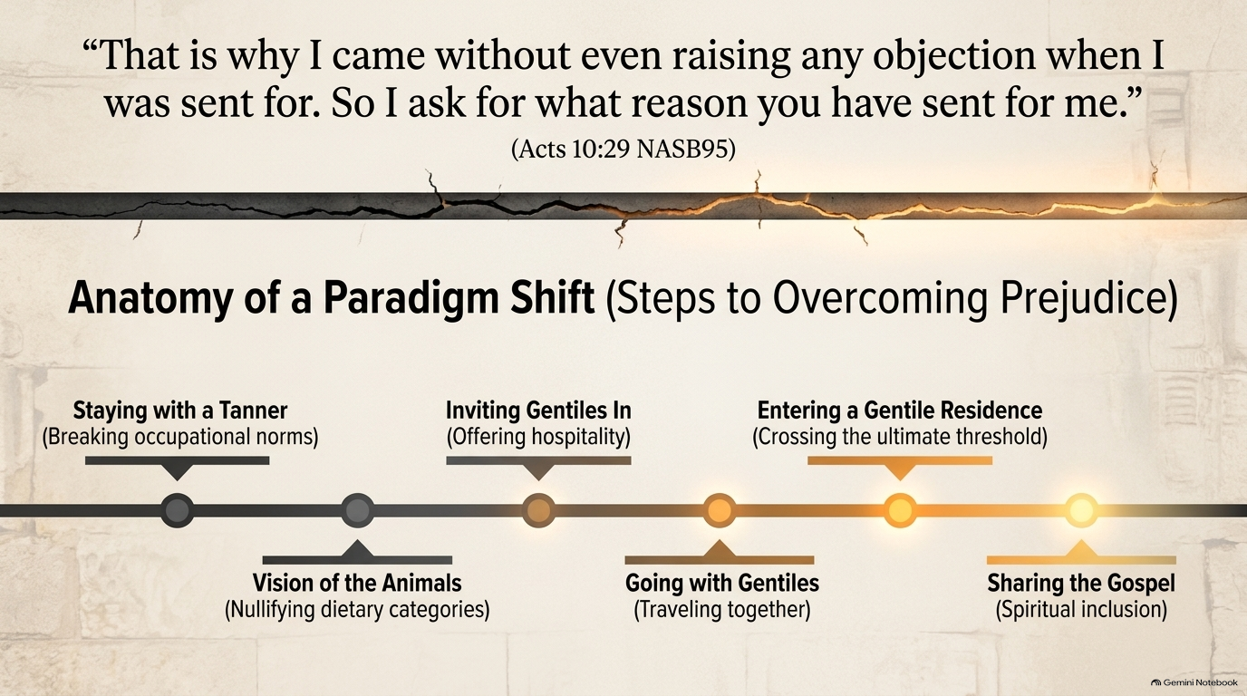

Slide 28
33 “So I sent for you immediately, and you have been kind enough to come. Now then, we are all here present before God to hear all that you have been commanded by the Lord.”
Acts 10:33
NASB95

Slide 29
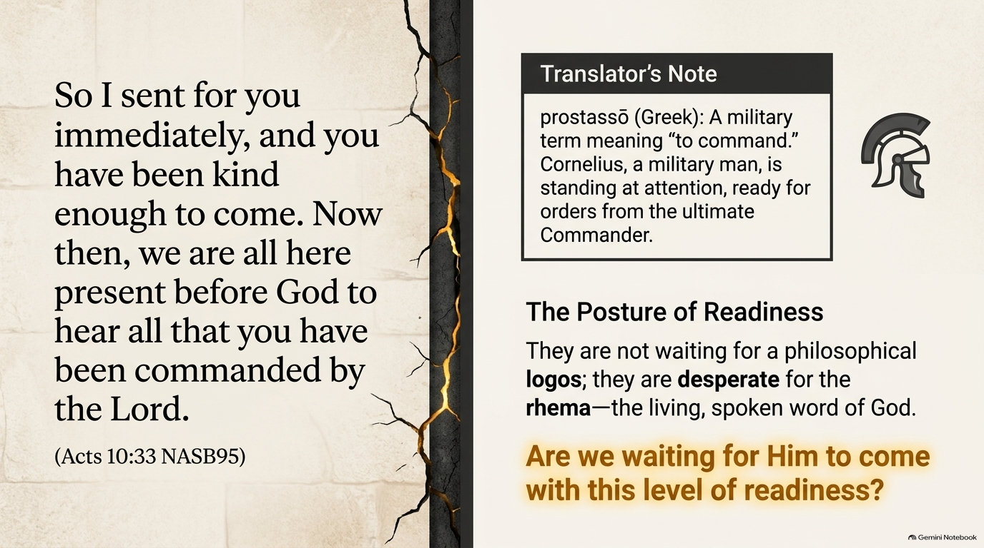

Slide 30
34 Opening his mouth, Peter said:
“I most certainly understand now that God is not one to show partiality,
Acts 10:34
NASB95

Slide 31
35 but in every nation the man who fears Him and does what is right is welcome to Him.
Acts 10:35
NASB95

Slide 32
That is to say, a Gentile would not have to become a Jew in order to become a Christian...
Word Pictures in the New Testament

Slide 33
9 The Lord is not slow about His promise, as some count slowness, but is patient toward you, not wishing for any to perish but for all to come to repentance.
2 Peter 3:9
NASB95

Slide 34
Global/Universal Vision of God: this means God wishes for the salvation of those against whom we are prejudiced

Slide 35
