Slide 1
Welcome to Holy Hermits Online Worship
17th Sunday after Pentecost
Today, we are celebrating
The Season of Creation
Service Prep: Lauren | Chat Host: Rachel | Fellowship: Lauren
Music: Lauren | Welcomer: Chris | Safety Officer: Rachel
Proof-reader: Chris | Leader: Jeremy | Attendance: Rachel
Broadcaster: Barry | Cantor: Julie | Preacher: Lauren
Backup Broadcaster: Lauren | First Reader: Phil | Deacon: Lauren
Zoom Buttons: Rachel | Second Reader: Margo | Priest: N/A
Notes:
Please try to keep all fonts size 28 with 1.5 spacing so that it is easier for people to read
Readers with an ‘*’ after their name in the roster are down to pre-record, please include ‘*’ in the slide

Slide 2






Hospitality
Leader:
Please mute for the service unless invited to offer your voice as part of the service ministry
Have the video camera on or off and turn the volume and brightness up or down on your device if things are too loud 🔉🔊or too bright🔅🔆
Our Cantor acts as our voice, offering the responses, in Bold Text, which we say together
Feel welcome to use the chat and reaction emojis 👍
🙏 Please take care of yourself in this space. 🙏 Come and go as you need
😴 It is great to take rest in this space, so falling asleep is also OK 😴
👂️ Remember, pastoral care is available to all in the community, if you'd like to speak to someone about anything spiritual. ❤️ Visit the help page at the website to reach out 🌐
Our Being Together ethos and safeguarding practices can also be accessed on the website 🫶​
🙌 Come as you are – we are all here together! 🙌
Notes:
Used Lent 2022

Slide 3
Invitation
Leader: As we come into worship let’s take a few
deep breaths,
Let go of anything that isn’t serving us,
And become aware of God’s presence here with us.
Opening Music: Nature’s Tranquillity
https://www.youtube.com/watch?v=ZR-wSsx-j9c

Slide 4
Leader and Cantor unmute
The Greeting
Leader:
The grace of the Lord Jesus Christ,
and the love of God,
and the fellowship of the Holy Spirit,
be with you all.
All: And also with you.

Slide 5
Gathering Prayer
Leader:
Come and speak with our God who listens.
Come and meet Jesus who speaks on our behalf.
Come and hear the God who answers.
Come and receive the Spirit who helps us.
Notes:
Use Call to Worship Prayer https://www.rootsontheweb.com

Slide 6
Gathering Prayer
All:
Lord, we come together here to be with you.
We thank you for listening to us.
Help us to listen to others
and to speak up for those who can’t speak for themselves.
In the name of Jesus, who speaks up for us.
Amen.
Notes:
Use gathering prayer - Roots

Slide 7
Sentence
Leader: I invite our Cantor to proclaim the sentence for today.
Cantor: Come, let us return to the Lord, that we may live before him.
Hosea 6.1a, 2b
Notes:
From Epray – ensure the text is black and font size is 28

Slide 8
Prayer of Approach
Leader: We pray the prayer of approach together
All: Living Lord, we have come from many different places
with many different needs,
but we gather as one to receive your teaching,
to reflect on your deeds,
to praise you for faithfulness,
and to pray together for our world.
In Jesus’ name. Amen.
Notes:
Prayer of Approach from Roots

Slide 9
Leader unmutes
Our first Hymn
All Creatures of Our God and King
https://www.youtube.com/watch?v=kJRqM45Y8Gk
We stay on mute
Leader mutes

Slide 10
The Deacon or LA introduces the Confession​
God is steadfast in love and infinite in mercy, welcoming sinners and inviting them to the Lord's table.
Silence may be kept.​
Let us confess our sins in penitence and faith, with a sincere and a true heart.
Notes:
Epray – has seasonal variation

Slide 11
All: ​Merciful God, our maker and our judge, ​
we have sinned against you ​in thought, word, and deed, ​
and in what we have failed to do: ​
we have not loved you with our whole heart; ​
we have not loved our neighbours as ourselves; ​
we repent, and are sorry for all our sins.​
Father, forgive us. Strengthen us to love and obey you
in newness of life; ​through Jesus Christ our Lord. ​
Amen.​

Slide 12
Words of Assurance offered by the Deacon or LA
These words of assurance from the First Letter of John declare that:
If anyone sins, we have an advocate with the Father, Jesus Christ the righteous. He is the perfect offering for our sin, and not for ours only, but for the sins of the whole world.
(1 John 2: 1-2)
In this is love, not that we loved God, but that he loved us and sent his Son to be the perfect offering for our sins.
(1 John 4:10)

Slide 13
Collect
Leader: Grant, O merciful God,
that your people may have that mind that was in Christ Jesus,
who emptied himself, and took the form of a servant,
and in humility became obedient even to death.
For you have highly exalted him
and bestowed on him the name that is above every name,
Jesus Christ, the Lord;
who lives and reigns with you and the Holy Spirit,
one God, in everlasting glory. Amen.
Notes:
From Epray – ensure the text is black and font size is 28

Slide 14
The 1st reader unmutes
Leader: “I invite the 1st reader to unmute and offer the 1st lesson when ready.
Reader 1: The 1st Reading is from Exodus 17.1-7
¹ From the wilderness of Sin the whole congregation of the Israelites journeyed by stages, as the Lord commanded. They camped at Rephidim, but there was no water for the people to drink. ² The people quarrelled with Moses, and said, ‘Give us water to drink.’ Moses said to them, ‘Why do you quarrel with me? Why do you test the Lord ?’
Continue…
Notes:
Youtube link for reading if needed:
If the 1st reading is recorded change the introduction to “Leader: We will now listen to the first reading”
(Normal introduction: “I invite the 1st reader to unmute and offer the 1st lesson when ready”)
** Note the Cantor still responds with “Thanks be to God” at the conclusion of the reading even if the reading is recorded
From Epray – ensure the text is black and font size is 28

Slide 15
³ But the people thirsted there for water; and the people complained against Moses and said, ‘Why did you bring us out of Egypt, to kill us and our children and livestock with thirst?’ ⁴ So Moses cried out to the Lord , ‘What shall I do with this people? They are almost ready to stone me.’ ⁵ The Lord said to Moses, ‘Go on ahead of the people, and take some of the elders of Israel with you; take in your hand the staff with which you struck the Nile, and go.
Continue…

Slide 16
⁶ I will be standing there in front of you on the rock at Horeb. Strike the rock, and water will come out of it, so that the people may drink.’ Moses did so, in the sight of the elders of Israel. ⁷ He called the place Massah and Meribah, because the Israelites quarrelled and tested the Lord , saying, ‘Is the Lord among us or not?’
For the word of the Lord. Thanks be to God.​

Slide 17
The Leader will lead the Psalm
Leader: We now say the psalm antiphonally, we will all respond with our cantor as our voice.
Psalm 78.1-4; 78.11-16
¹ Give heed to my teaching, O my people:
incline your ears to the words of my mouth;
² For I will open my mouth in a parable:
and expound the mysteries of former times.
³ What we have heard and known:
what our forebears have told us,
Continue…
Notes:
From Epray – ensure the text is black and font size is 28
If the 1st reading is recorded please:
add The Leader will lead the Psalm to the top left of the screen in the liturgical colour
change the introduction to the Psalm to “Leader: We now say the psalm antiphonally, we will all respond with our cantor as our voice.”
- Normal introduction: “We now say the psalm antiphonally, I invite the first reader to lead, and we will all respond with our cantor as our voice.”

Slide 18
⁴ We will not hide from their children,
but declare to a generation yet to come:
the praiseworthy acts of the Lord,
his mighty and wonderful works.
¹¹ For he did marvellous things
in the sight of their ancestors:
in the land of Egypt, in the country of Zoan.
Continue…

Slide 19
¹² He divided the sea and let them pass through:
he made the waters stand up in a heap.
¹³ In the daytime he led them with a cloud:
and all night long with the light of fire.
¹⁴ He cleft rocks in the wilderness:
and gave them drink in abundance
as from springs of water.
Continue…

Slide 20
¹⁵ He brought streams out of the rock:
and caused the waters to flow down like rivers.
¹⁶ But for all this they sinned yet more against him:
and rebelled against the Most High in the desert.

Slide 21
The 2nd reader unmutes
Leader: I invite the 2nd reader to unmute and offer the 2nd reading when ready.
Reader 2: The 2nd Reading is from Philippians 2
¹ If then there is any encouragement in Christ, any consolation from love, any sharing in the Spirit, any compassion and sympathy, ² make my joy complete: be of the same mind, having the same love, being in full accord and of one mind. ³ Do nothing from selfish ambition or conceit, but in humility regard others as better than yourselves.
Continue…
Notes:
From Epray – ensure the text is black and font size is 28

Slide 22
⁴ Let each of you look not to your own interests, but to the interests of others. ⁵ Let the same mind be in you that was in Christ Jesus,
⁶ who, though he was in the form of God,
did not regard equality with God
as something to be exploited,
⁷ but emptied himself,
taking the form of a slave,
being born in human likeness.
Continue…

Slide 23
And being found in human form,
⁸ he humbled himself
and became obedient to the point of death—
even death on a cross.
⁹ Therefore God also highly exalted him
and gave him the name
that is above every name,
¹⁰ so that at the name of Jesus
every knee should bend,
in heaven and on earth and under the earth,
Continue…

Slide 24
¹¹ and every tongue should confess
that Jesus Christ is Lord,
to the glory of God the Father.
¹² Therefore, my beloved, just as you have always obeyed me, not only in my presence, but much more now in my absence, work out your own salvation with fear and trembling; ¹³ for it is God who is at work in you, enabling you both to will and to work for his good pleasure.
¹⁴ Do all things without murmuring and arguing,
Continue…

Slide 25
¹⁵ so that you may be blameless and innocent, children of God without blemish in the midst of a crooked and perverse generation, in which you shine like stars in the world. ¹⁶ It is by your holding fast to the word of life that I can boast on the day of Christ that I did not run in vain or labour in vain.
¹⁷ But even if I am being poured out as a libation over the sacrifice and the offering of your faith, I am glad and rejoice with all of you— ¹⁸ and in the same way you also must be glad and rejoice with me.
Continue…

Slide 26
¹⁹ I hope in the Lord Jesus to send Timothy to you soon, so that I may be cheered by news of you. ²⁰ I have no one like him who will be genuinely concerned for your welfare. ²¹ All of them are seeking their own interests, not those of Jesus Christ. ²² But Timothy’s worth you know, how like a son with a father he has served with me in the work of the gospel. ²³ I hope therefore to send him as soon as I see how things go with me; ²⁴ and I trust in the Lord that I will also come soon.
Continue…

Slide 27
²⁵ Still, I think it necessary to send to you Epaphroditus—my brother and co-worker and fellow-soldier, your messenger and minister to my need; ²⁶ for he has been longing for all of you, and has been distressed because you heard that he was ill. ²⁷ He was indeed so ill that he nearly died. But God had mercy on him, and not only on him but on me also, so that I would not have one sorrow after another. ²⁸ I am the more eager to send him, therefore, in order that you may rejoice at seeing him again, and that I may be less anxious.
Continue…

Slide 28
²⁹ Welcome him then in the Lord with all joy, and honour such people, ³⁰ because he came close to death for the work of Christ, risking his life to make up for those services that you could not give me.
For the word of the Lord. Thanks be to God.​

Slide 29

We pause before
​the Gospel ​​

Slide 30
Deacon: The Gospel of our Lord Jesus Christ according to St Matthew Chapter 21 beginning at the 23rd verse.
All: Glory to you Lord Jesus Christ.
²³ When he entered the temple, the chief priests and the elders of the people came to him as he was teaching, and said, ‘By what authority are you doing these things, and who gave you this authority?’ ²⁴ Jesus said to them, ‘I will also ask you one question; if you tell me the answer, then I will also tell you by what authority I do these things.
Continue…
Notes:
From Epray – ensure the text is black and font size is 28
Please note that there is a different introduction and final response if this is lay led

Slide 31
²⁵ Did the baptism of John come from heaven, or was it of human origin?’ And they argued with one another, ‘If we say, “From heaven”, he will say to us, “Why then did you not believe him?” ²⁶ But if we say, “Of human origin”, we are afraid of the crowd; for all regard John as a prophet.’ ²⁷ So they answered Jesus, ‘We do not know.’ And he said to them, ‘Neither will I tell you by what authority I am doing these things. ²⁸ ‘What do you think? A man had two sons; he went to the first and said, “Son, go and work in the vineyard today.” ²⁹ He answered, “I will not”; but later he changed his mind and went.
Continue…

Slide 32
³⁰ The father went to the second and said the same; and he answered, “I go, sir”; but he did not go. ³¹ Which of the two did the will of his father?’ They said, ‘The first.’ Jesus said to them, ‘Truly I tell you, the tax-collectors and the prostitutes are going into the kingdom of God ahead of you. ³² For John came to you in the way of righteousness and you did not believe him, but the tax-collectors and the prostitutes believed him; and even after you saw it, you did not change your minds and believe him.
This is the Gospel of the Lord. Praise to you Lord Jesus Christ.

Slide 33
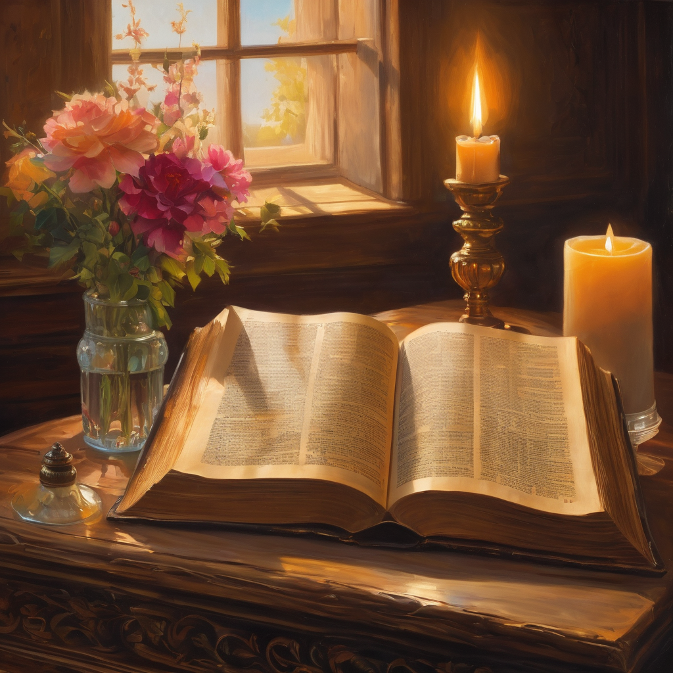
We pause
after ​the Gospel ​​

Slide 34
Leader: The Sermon is recorded to YouTube for sharing later.
Only the preacher's video and audio will be recorded.
The chat and other participants' feeds remain out of sight of the recording.
Leader and Cantor mute
Broadcaster exits screenshare
Preacher unmutes
Zoom buttons ”pins” preacher’s screen + selects “record to the cloud”
Sermon

Slide 35
Leader unmutes
Our next Hymn
As the Deer Pants for the Water
https://www.youtube.com/watch?v=peZudXt9faU
We stay on mute
Leader mutes

Slide 36
The Leader and Cantor unmute
The Greeting of Peace
Leader: We are the body of Christ
All: God’s Spirit is with us
Leader: The peace of the Lord be always with you.
All: And also with you.
Leader: A sign of peace may be exchanged
You may like to type 'Peace' into the chat, use the 'raise hand’ or other reaction buttons, or just simply wave via the screen with your video turned on
(Broadcaster exits shared screen for a few moments for the exchange of peace)

Slide 37
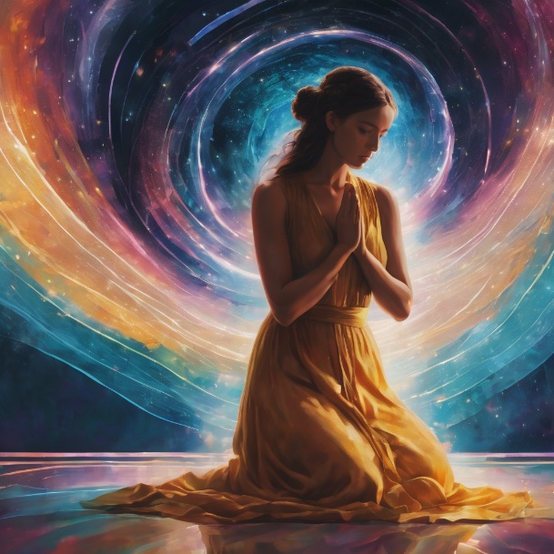
Prayer of Thanksgiving before Intercessions
Leader: As we enter prayer, I invite the second reader to unmute to lead our intercessions following the prayer of thanksgiving on the next slide. Please feel free to change your body position as you need.
Continue…

Slide 38
Leader: God of the past and the present,
we stand in awe and gratitude before you.
When we complain, you don’t condemn,
but confer on us fresh blessings.
When our lives hit rocky places,
you bring freshness and hope.
When we feel your absence,
you surprise us with your living presence,
through the power of your Word, through the witness
of your prophets and through your Son, Jesus Christ. Amen.
Notes:
Prayer of praise and thanksgiving from Roots (if it’s too long still add it and it will be sorted out ☺)

Slide 39
Intercessions
Reader 2: We pray for creation and communities we share our lives with. We pause for a few moments to name either in our hearts, or out loud, or in the chat, those environments and communities we bring to the Lord in prayer.
PAUSE…
Continue…

Slide 40
Intercessions
Reader 2: We entrust to you the community of Holy Hermits Online and our ministry partners:
Prosper the work of our hands and show us the way to your new creation.
Creator God, Hear our prayer.
St John's Cathedral Brisbane The Anglican Diocese of Southern Queensland St Gabriel’s, Carindale Benedictus Contemplative Church, Canberra Anglican Focus and Tithe.ly

Slide 41
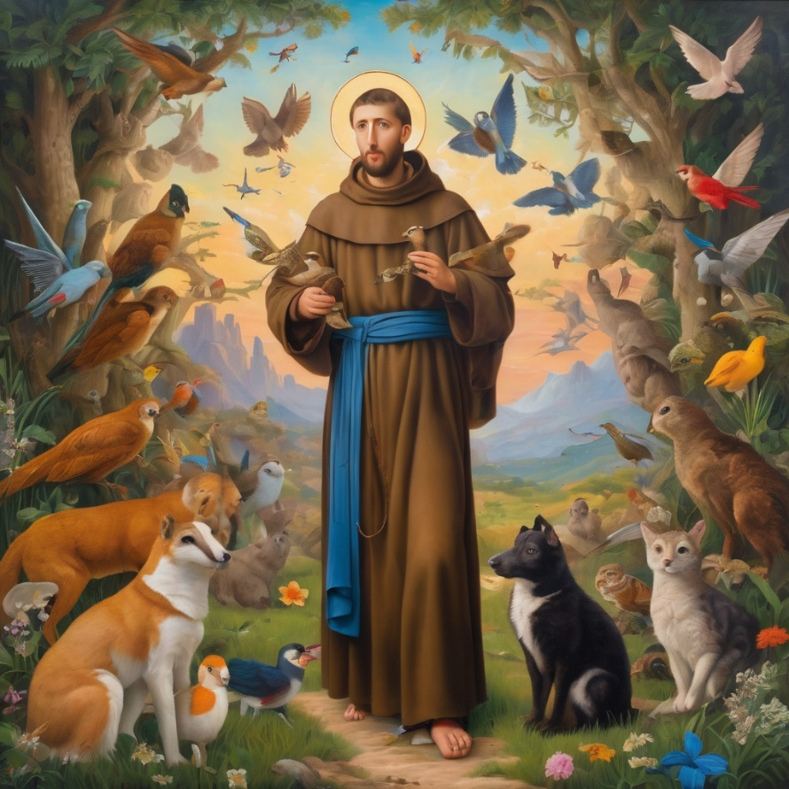
Reader 2: Loving Creator, we entrust to you all animals, especially those who are sick, anxious, ageing, lost, at risk, lonely, sad, hungry, in pain, homeless, abused, living in fear, encountering violence of any kind, in need of comfort, rehabilitation or transformation.

Slide 42
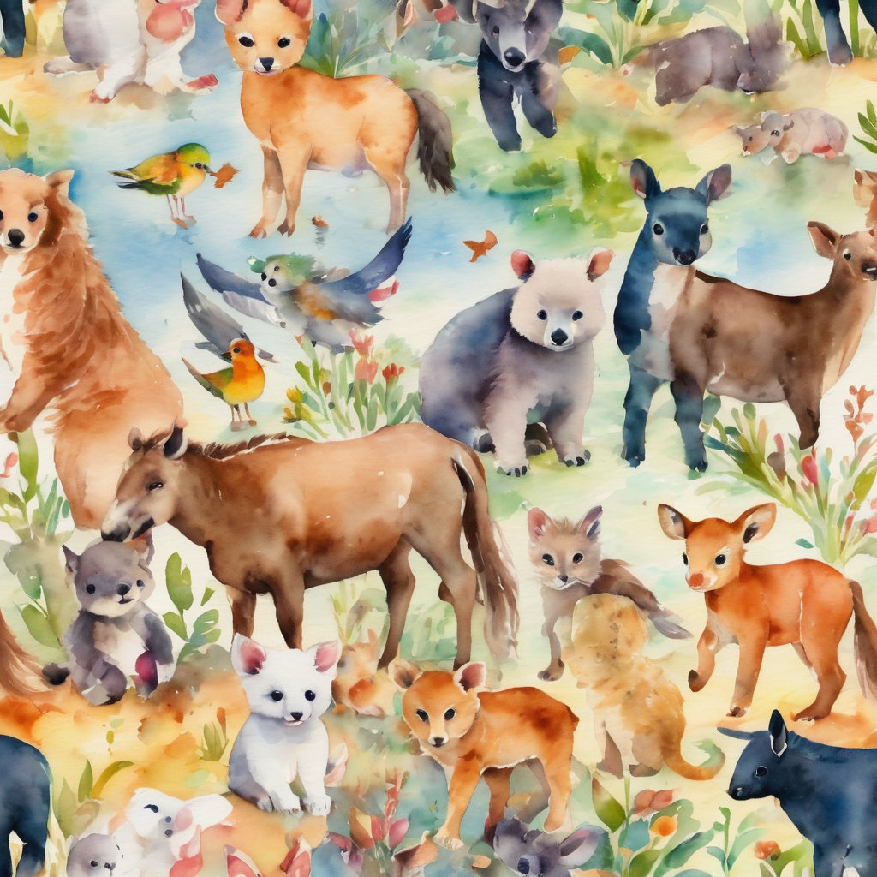
Reader 2: We invite your loving compassion for:
We name in our hearts, out loud or in the chat,
the animals we bring to the Lord in prayer. PAUSE…
Jasmine, ​
Leese(y), ​
Sid, Toots & Lulu​
Polly and Suki​
Fred, George & Percy​
Koshka ​
Jax
Lambert ​​
Kala, Nigel & Little One ​​
Toby​​
Taco​​
Paddy ​​
Rosie​

Slide 43
Reader 2: Eternal Trinity of Love, we uphold to you the people we love and carry cares for:
Kerry, Les & Jake Julie, Ray, Tracey & Shane Mark, Desley & Bob ​​ Rachel, Mervyn & Gillian ​​Rev'd Shane & Janette​​ Alecia, Martin & Aidan​​ Kirsten, Greg, Daphne & Beau Bill & Marjorie​​ Aaron & Andrea Liz’s Godchildren Matthew & Nicholas Liz | Barry​​ Dr Julie ​​ Ruth​​ Phil​ May Susan Tanya​ Neva Kathy ​Gayanne Tina Dilys | ​​ | Alan & Gaylene​ Jess & Leah ​​ Barry & Gwen Bob & Di​ Pat & Julie Paul & Darhon Judy & Mary Miriam Lorelei Nettie Dean Peter Rev’d Ann

Slide 44
Reader 2:
We name in our hearts, out loud or in the chat, those we bring to the Lord in prayer.
PAUSE…
We entrust to you those who have died, those who have died peacefully and those who have died tragically, the old and the young. Receive them into your Kingdom. Lord in your mercy, Hear our prayers. Amen.

Slide 45
Pray Daily Cycle of Prayer
Leader: Loving God, joining with the Church in our cycle of prayer, we ask your blessings on:
The Church of Bangladesh
The Diocese of Willochra: †Jeremy; Clergy and People
The Parish of Gayndah
AnglicareSQ Out of Home Care, Central Region – Fraser & Gympie Residential
Notes:
anglicanfocus.org.au/category/front-page/spirituality/pray-daily/
Please only include the first names of those we pray for

Slide 46
Commitment Prayer of the Week
Leader: Our commitment prayer for the week for Lay ministry.
God of love, pour out your Holy Spirit on our lay ministry at Holy Hermits Online.​​
​Bless those who offer their ministry gifts as cantors, readers, prayer writers, Liturgical Assistants, lay leaders, service prep team members, broadcasters, proof-readers, welcomers, tech supporters, fellowship leaders, the ministry task-groups and helpers in any way. We pray each one feels encouraged to continue serving you.​​
Notes:
Link to prayer group ministry page for weekly commitment prayer Prayer Group | Ministries | Holy Hermits Online https://holyhermits.com.au/ministries/prayer-group

Slide 47
Give courage to those who hear your voice and offer their ministry gifts so that they too can serve you in the future.​​
​Thank you for your rich blessings on our community.​​
​In Jesus' name we pray. ​
Amen.​
Notes:
Link to prayer group ministry page for weekly commitment prayer Prayer Group | Ministries | Holy Hermits Online https://holyhermits.com.au/ministries/prayer-group

Slide 48
Leader: Let us pray together the prayer which Jesus gave us saying:
All: Our Father in heaven, hallowed be your name,
your kingdom come, your will be done, on earth as in heaven.
Give us today our daily bread.
Forgive us our sins
as we forgive those who sin against us.
Save us from the time of trial and deliver us from evil.
For the kingdom, the power, and the glory are yours
now and for ever.
Amen.

Slide 49
Devotions

Slide 50
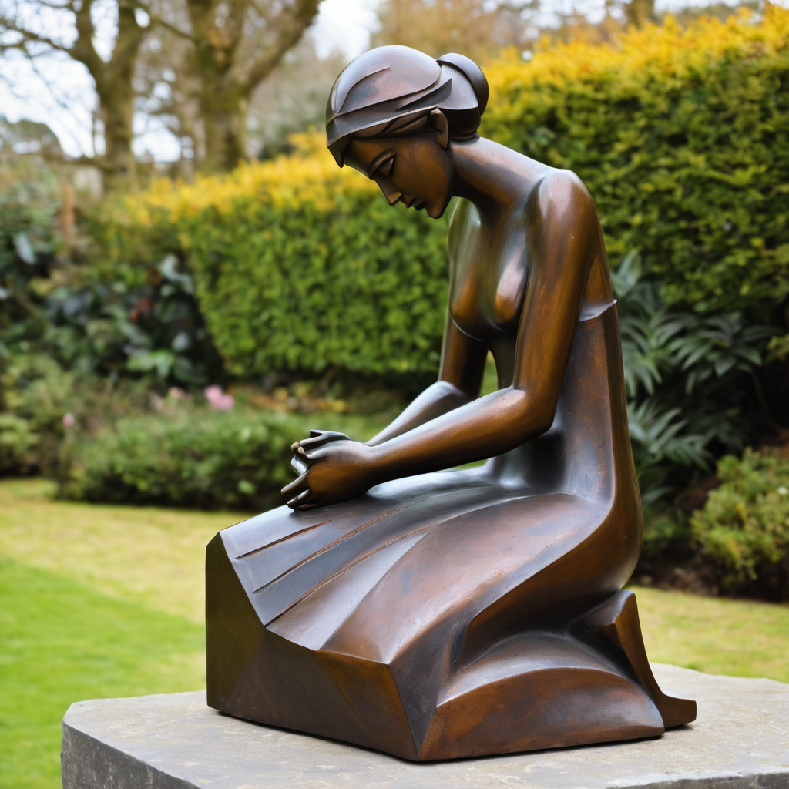
​
Leader: ​As we enter a few minutes of silence together, you are invited to pray the prayer of adoration on the next slide and/or spend this time in contemplation. ​
The Spiritual Communion prayer follows on the slide after that.
Let us be still.
Leader and Cantor Mute.
Continue…

Slide 51
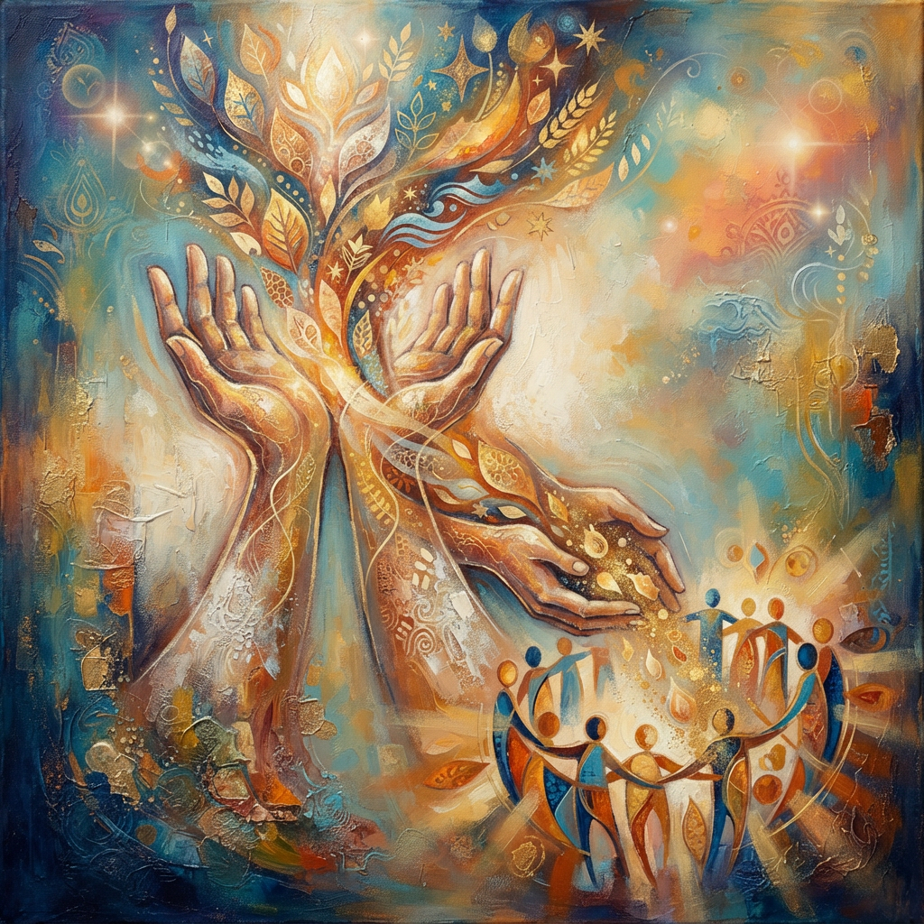
​
God,
thank you for all you give us.
Help us to remember all you put in our hands.
Would we be people who share what we have with others,
and to show people who you are. Amen.
Notes:
Prayer for all ages from Roots

Slide 52

  Oh, my Lord Jesus I turn to you present at the Altar and in the Tabernacle. I believe that you are present in the Holy Sacrament of your most Sacred Body and Blood. I love you above all things and I desire to receive you into my Soul. I cannot at this moment receive you Sacramentally in Holy Communion. Come spiritually into my heart. Purify it, Sanctify it. Render my heart like your own heart. I embrace you as if you were already there and unite myself wholly with you. Never permit me to be separated from you. Lord, I am not worthy to receive you, but only say the word and I shall be healed. Amen
Making a Spiritual Communion
(Prayed in silence)
Notes:
Spiritual Communion Slide – Please do not change the prayer
Can change colour of background and title to match liturgical colour. You may also like to change the picture.

Slide 53
Leader unmutes
Our final song is
Guide me, O thou great Redeemer
https://www.youtube.com/watch?v=CgTvSAMp4Ec
We stay on mute
Leader mutes

Slide 54
Leader and cantor unmute
Sending Prayer
Leader: We pray our sending prayer together.
All: God,
as we go out from this place,
help us to remember all the good things you have given us.
Would we be people who show others your goodness,
just as Moses and Jesus did.
As bridge-builders, mediators and intercessors,
would we bring God’s kingdom on earth. Amen.
Notes:
Use Sending Prayer from Roots

Slide 55
The Benediction
Leader: Let us all invite God’s blessings together,
All: May the road rise up to meet us,
may the wind be always at our backs,
may the sun shine warm upon our faces,
and the rains fall soft upon our fields;
and until we meet again,
may God hold us in the palm of his hand. Amen.
Notes:
We have a different benediction for our birthday (we will keep using this through the Season of Creation)
The Normal Benediction:
May the Lord bless us and keep us.
May the Lord’s face shine upon us and be gracious to us.
May the Lord’s countenance be lifted upon us,
and bring us peace.
Amen

Slide 56
Notices
Earth, Our Original Monastery Wednesday @ 6pm. We continue our contemplative prayer series.
Today we say farewell to Dean Peter and Rev’d Ann from St John’s Cathedral. See the Cathedral site for more information on events.
Next Sunday is our Animal Blessing. Please send in photos of your pets to be included in the worship slides.
Next Sunday we welcome back Rev’d Jamee from maternity leave.
See HHO Events page for further upcoming events HHO Events
Notes:
Up coming events can be added from the HHO event page/calendar

Slide 57

Leader: If you are carrying something heavy, seeking prayer, or simply would like to talk with someone, pastoral care is available to all in the community.
You can contact Rev’d Lauren 💌lauren.martin@anglicanchurchsq.org.au
☎️ 0415260599
💌 holyhermits@anglicanchurchsq.org.au
❤️ or visit the help page at the website to reach out 🌐

Slide 58
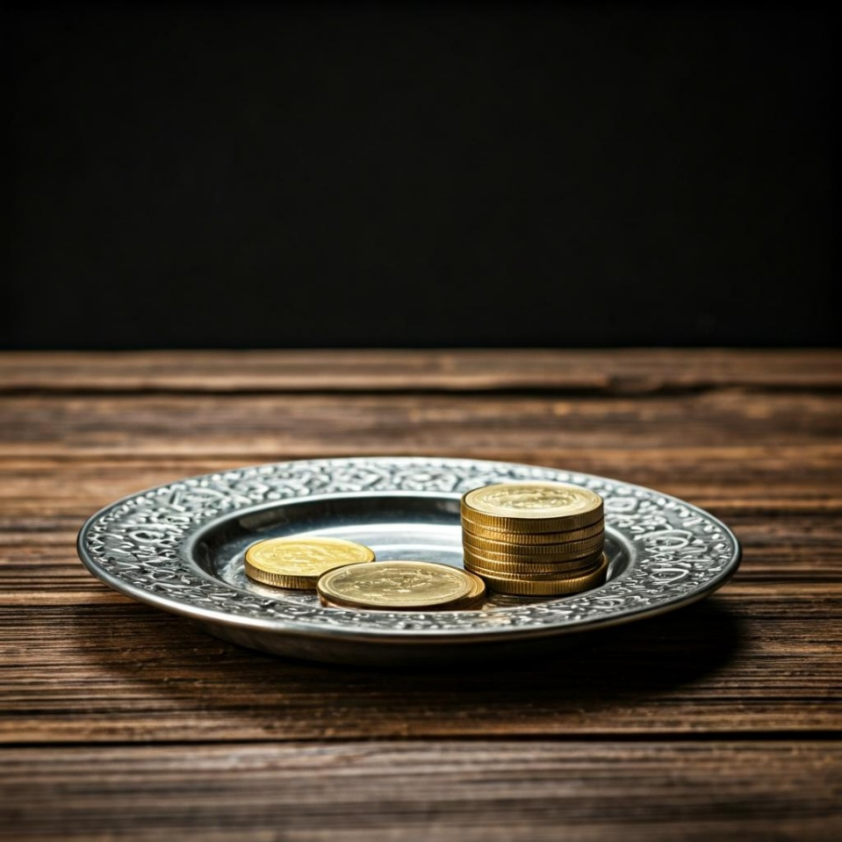
Leader: Thank you for your regular gifts to this ministry. Offerings are most welcome via:
The HHO App
Direct Debit
International Direct Debit
Please consider a one-off donation
or leaving a legacy in your Will
For further information go to HHO give page https://holyhermits.com.au/give

Slide 59
Serving next week
27 September 2026
18th Sunday after Pentecost
9:00 am AEST
Service Prep: Lauren | Chat Host: Viki | Fellowship: Jamee
Music: Lauren | Welcomer: Julie | Safety Officer: Chris
Proof-reader: Kris | Leader: Julie | Attendance: Viki
Broadcaster: Lauren | Cantor: Barry | Preacher: Jamee
Backup Broadcaster: Paul | First Reader: Bob | Deacon: Lauren
Zoom Buttons: Viki | Second Reader: Helen | Priest: Jamee
Thank you for your ministry gifts
New Servers always welcome!
Please email Rev’d Lauren to get involved
holyhermits@anglicanchurchsq.org.au

Slide 60
Leader and All may unmute
The Dismissal
Leader: I invite everyone to unmute for the Dismissal
Leader: Go in peace to love and serve the Lord.
All: In the name of Christ, Amen.

Slide 61
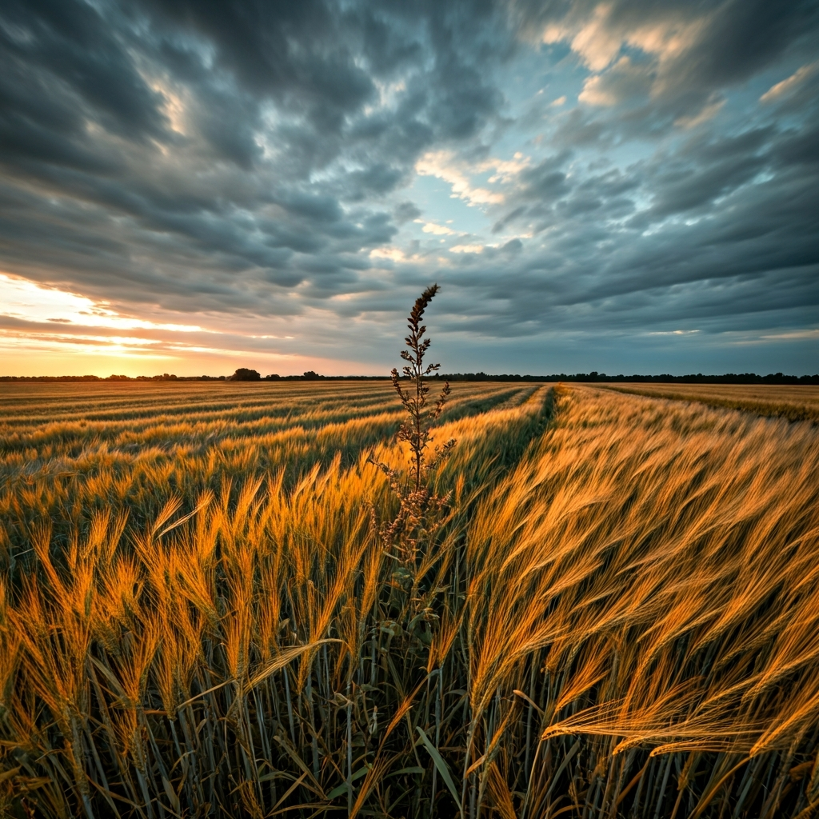

Fellowship
Thank you, Lauren for leading Fellowship
Please feel welcome to linger or pop a message in the chat and head off when you are ready.​
Extra resources developed
by Roots on the Web
Images from Padlet
Notes:
Please ensure high level of contrast for the fellowship text block to make it easier for people to read

