Slide 1
Welcome to Holy Hermits Online Worship
17th Sunday after Pentecost
Today, we are celebrating
The Season of Creation
Service Prep: Kristine | Chat Host: Viki | Fellowship: Lauren
Music: Wiggles 🐶 | Welcomer: Julie | Safety Officer: Chris
Proof-reader: Viki | Leader: Julie | Attendance: Viki
Broadcaster: Paul | Cantor: Jeremy | Preacher: Lauren
Backup Broadcaster: Barry | First Reader: Grant * | Deacon: Lauren
Zoom Buttons: Viki | Second Reader: Barry | Priest: N/A
Notes:
Please try to keep all fonts size 28 with 1.5 spacing so that it is easier for people to read
Readers with an ‘*’ after their name in the roster are down to pre-record, please include ‘*’ in the slide

Slide 2






Hospitality
Leader:
Please mute for the service unless invited to offer your voice as part of the service ministry
Have the video camera on or off and turn the volume and brightness up or down on your device if things are too loud 🔉🔊or too bright🔅🔆
Our Cantor acts as our voice, offering the responses, in Bold Text, which we say together
Feel welcome to use the chat and reaction emojis 👍
🙏 Please take care of yourself in this space. 🙏 Come and go as you need
😴 It is great to take rest in this space, so falling asleep is also OK 😴
👂️ Remember, pastoral care is available to all in the community, if you'd like to speak to someone about anything spiritual. ❤️ Visit the help page at the website to reach out 🌐
Our Being Together ethos and safeguarding practices can also be accessed on the website 🫶​
🙌 Come as you are – we are all here together! 🙌
Notes:
Used Lent 2022

Slide 3
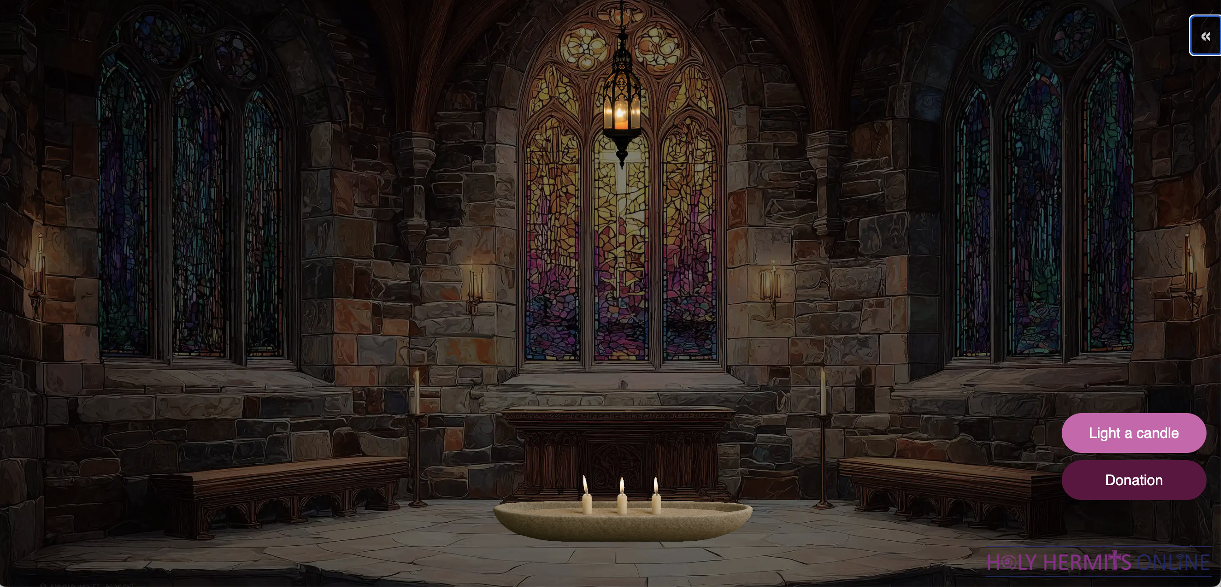
Digital Chapel: Sanctuary Lamp of Remembrance
Leader: Our digital chapel sanctuary lamp is lit in celebration this week. Happy Birthday Wiggles, 14 today, 20th September 2026! Have a lovely day and enjoy your roast chicken dinner with Mash, Star and Asta.
https://holy-hermits-online-chapel.org/
Notes:
Link to prayer group ministry page for weekly commitment prayer https://holyhermits.com.au/ministries/prayer-group

Slide 4
Invitation
Leader: As we come into worship let’s take a few
deep breaths,
Let go of anything that isn’t serving us,
And become aware of God’s presence here with us.
Opening Music: Be Still: Stilling tide and sunrise
https://vimeo.com/744869541

Slide 5
Leader and Cantor unmute
The Greeting
Leader:
The grace of the Lord Jesus Christ,
and the love of God,
and the fellowship of the Holy Spirit,
be with you all.
All: And also with you.

Slide 6
Gathering Prayer
Leader:
As Moses and the people were fed with manna,
so we gather to be fed by the Bread of Life.
As God sent them water in the desert,
so we gather to be refreshed by the Water of Life.
As God spoke to them through Moses and the prophets,
so we gather to hear the Word of God.
Notes:
Use Call to Worship Prayer https://www.rootsontheweb.com

Slide 7
Gathering Prayer
All:
Generous God,
we gather to thank you for our daily food.
God our protector,
we come to put our trust in you.
God of justice,
we are here to seek your guidance
and rejoice in your love for us.
Amen.
Notes:
Use gathering prayer - Roots

Slide 8
Sentence
Leader: I invite our Cantor to proclaim the sentence for today.
Cantor: By grace you have been saved through faith, and this is not your own doing; it is the gift of God.
Ephesians 2.8–9
Notes:
From Epray – ensure the text is black and font size is 28

Slide 9
Prayer of Approach
Leader: We pray the prayer of approach together
All: Holy God,
it is enough for us to be here in this moment,
to receive from you all that we need for fulfilment,
to give to you all that we cherish and love.
We celebrate that with you in our lives, we are rich;
with you as our guide, we are blessed.
To you be all glory. In Jesus’ name. Amen.
Notes:
Prayer of Approach from Roots

Slide 10
Leader unmutes
Our first Hymn
Morning Has Broken
https://www.youtube.com/watch?v=0JI5ezln1nE
We stay on mute
Leader mutes

Slide 11
The Deacon or LA introduces the Confession​
God is steadfast in love and infinite in mercy, welcoming sinners and inviting them to the Lord's table.
Silence may be kept.​
Let us confess our sins in penitence and faith, with a sincere and a true heart.
Notes:
Epray – has seasonal variation

Slide 12
All: ​Merciful God, our maker and our judge, ​
we have sinned against you ​in thought, word, and deed, ​
and in what we have failed to do: ​
we have not loved you with our whole heart; ​
we have not loved our neighbours as ourselves; ​
we repent, and are sorry for all our sins.​
Father, forgive us. Strengthen us to love and obey you
in newness of life; ​through Jesus Christ our Lord. ​
Amen.​

Slide 13
Words of Assurance offered by the Deacon or LA
These words of assurance from the First Letter of John declare that:
If anyone sins, we have an advocate with the Father, Jesus Christ the righteous. He is the perfect offering for our sin, and not for ours only, but for the sins of the whole world.
(1 John 2: 1-2)
In this is love, not that we loved God, but that he loved us and sent his Son to be the perfect offering for our sins.
(1 John 4:10)

Slide 14
Collect
Leader: Loving and righteous God,
your boundless generosity exceeds
all that we can desire or deserve,
and you give to the last worker all you promised to the first:
liberate us from all jealousy and greed,
that we may be free to love and serve others,
and in your service may find our true reward;
through Jesus Christ our Lord. Amen.
Notes:
From Epray – ensure the text is black and font size is 28

Slide 15

The 1st reader unmutes
Leader: We will now listen to the first reading.
Reader 1: The 1st Reading is from Exodus 16.2-15
² The whole congregation of the Israelites complained against Moses and Aaron in the wilderness. ³ The Israelites said to them, ‘If only we had died by the hand of the Lord in the land of Egypt, when we sat by the fleshpots and ate our fill of bread; for you have brought us out into this wilderness to kill this whole assembly with hunger.’ ⁴ Then the Lord said to Moses, ‘I am going to rain bread from heaven for you,
Continue…
Notes:
Youtube link for reading if needed: https://youtu.be/rNG_uwxGBVQ
If the 1st reading is recorded change the introduction to “Leader: We will now listen to the first reading”
(Normal introduction: “I invite the 1st reader to unmute and offer the 1st lesson when ready”)
** Note the Cantor still responds with “Thanks be to God” at the conclusion of the reading even if the reading is recorded
From Epray – ensure the text is black and font size is 28

Slide 16
and each day the people shall go out and gather enough for that day. In that way I will test them, whether they will follow my instruction or not. ⁵ On the sixth day, when they prepare what they bring in, it will be twice as much as they gather on other days.’ ⁶ So Moses and Aaron said to all the Israelites, ‘In the evening you shall know that it was the Lord who brought you out of the land of Egypt, ⁷ and in the morning you shall see the glory of the Lord , because he has heard your complaining against the Lord. For what are we, that you complain against us?’ ⁸ And Moses said, ‘When the Lord gives you meat to eat in the evening
Continue…

Slide 17
and your fill of bread in the morning, because the Lord has heard the complaining that you utter against him—what are we? Your complaining is not against us but against the Lord .’ ⁹ Then Moses said to Aaron, ‘Say to the whole congregation of the Israelites, “Draw near to the Lord , for he has heard your complaining.” ’ ¹⁰ And as Aaron spoke to the whole congregation of the Israelites, they looked towards the wilderness, and the glory of the Lord appeared in the cloud. ¹¹ The Lord spoke to Moses and said, ¹² ‘I have heard the complaining of the Israelites;
Continue…

Slide 18
say to them, “At twilight you shall eat meat, and in the morning you shall have your fill of bread; then you shall know that I am the Lord your God.” ¹³ In the evening quails came up and covered the camp; and in the morning there was a layer of dew around the camp. ¹⁴ When the layer of dew lifted, there on the surface of the wilderness was a fine flaky substance, as fine as frost on the ground. ¹⁵ When the Israelites saw it, they said to one another, ‘What is it?’ For they did not know what it was. Moses said to them, ‘It is the bread that the Lord has given you to eat.
For the word of the Lord. Thanks be to God.​

Slide 19
The Leader will lead the Psalm
Leader: We now say the psalm antiphonally, we will all respond with our cantor as our voice.
¹ O give thanks to the Lord and call upon his name:
tell among the peoples what things he has done.
² Sing to him, O sing praises:
and be telling of all his marvellous works.
³ Exult in his holy name:
and let those that seek the Lord be joyful in heart.
Psalm 105
1-6;
37-45
Continue…
Notes:
From Epray – ensure the text is black and font size is 28
If the 1st reading is recorded please:
add The Leader will lead the Psalm to the top left of the screen in the liturgical colour
change the introduction to the Psalm to “Leader: We now say the psalm antiphonally, we will all respond with our cantor as our voice.”
- Normal introduction: “We now say the psalm antiphonally, I invite the first reader to lead, and we will all respond with our cantor as our voice.”

Slide 20
⁴ Seek the Lord and his strength:
O seek his face continually.
⁵ Call to mind what wonders he has done:
his marvellous acts, and the judgements of his mouth,
⁶ O seed of Abraham his servant:
O children of Jacob his chosen one.
³⁷ He brought Israel out with silver and with gold:
and not one among their tribes was seen to stumble.
Continue…

Slide 21
³⁸ Egypt was glad at their going:
for dread of Israel had fallen upon them.
³⁹ He spread out a cloud for a covering:
and fire to lighten the night.
⁴⁰ The people asked, and he brought them quails:
and satisfied them with the bread from heaven.
⁴¹ He opened a rock, so that the waters gushed:
and ran in the parched land like a river.
Continue…

Slide 22
⁴² For he had remembered his holy word:
that he gave to Abraham his servant.
⁴³ So he led out his people with rejoicing:
his chosen ones with shouts of joy;
⁴⁴ He gave them the land of the nations:
and they took possession of the fruit
for which other peoples had toiled,
⁴⁵ So that they might keep his statutes:
and faithfully obey his laws. O praise the Lord.

Slide 23
The 2nd reader unmutes
Leader: I invite the 2nd reader to unmute and offer the 2nd reading when ready.
Reader 2: The 2nd Reading is from Philippians 1
¹ Paul and Timothy, servants of Christ Jesus, To all the saints in Christ Jesus who are in Philippi, with the bishops and deacons: ² Grace to you and peace from God our Father and the Lord Jesus Christ. ³ I thank my God every time I remember you, ⁴ constantly praying with joy in every one of my prayers for all of you, ⁵ because of your sharing in the gospel from the first day until now.
Continue…
Notes:
From Epray – ensure the text is black and font size is 28

Slide 24
⁶ I am confident of this, that the one who began a good work among you will bring it to completion by the day of Jesus Christ. ⁷ It is right for me to think this way about all of you, because you hold me in your heart, for all of you share in God’s grace with me, both in my imprisonment and in the defence and confirmation of the gospel. ⁸ For God is my witness, how I long for all of you with the compassion of Christ Jesus. ⁹ And this is my prayer, that your love may overflow more and more with knowledge and full insight ¹⁰ to help you to determine what is best, so that on the day of Christ you may be pure and blameless,
Continue…

Slide 25
¹¹ having produced the harvest of righteousness that comes through Jesus Christ for the glory and praise of God. ¹² I want you to know, beloved, that what has happened to me has actually helped to spread the gospel, ¹³ so that it has become known throughout the whole imperial guard and to everyone else that my imprisonment is for Christ; ¹⁴ and most of the brothers and sisters, having been made confident in the Lord by my imprisonment, dare to speak the word with greater boldness and without fear. ¹⁵ Some proclaim Christ from envy and rivalry, but others from goodwill. ¹⁶ These proclaim Christ out of love,
Continue…

Slide 26
knowing that I have been put here for the defence of the gospel; ¹⁷ the others proclaim Christ out of selfish ambition, not sincerely but intending to increase my suffering in my imprisonment. ¹⁸ What does it matter? Just this, that Christ is proclaimed in every way, whether out of false motives or true; and in that I rejoice. Yes, and I will continue to rejoice, ¹⁹ for I know that through your prayers and the help of the Spirit of Jesus Christ this will result in my deliverance. ²⁰ It is my eager expectation and hope that I will not be put to shame in any way, but that by my speaking with all boldness,
Continue…

Slide 27
Christ will be exalted now as always in my body, whether by life or by death. ²¹ For to me, living is Christ and dying is gain. ²² If I am to live in the flesh, that means fruitful labour for me; and I do not know which I prefer. ²³ I am hard pressed between the two: my desire is to depart and be with Christ, for that is far better; ²⁴ but to remain in the flesh is more necessary for you. ²⁵ Since I am convinced of this, I know that I will remain and continue with all of you for your progress and joy in faith, ²⁶ so that I may share abundantly in your boasting in Christ Jesus when I come to you again.
Continue…

Slide 28
²⁷ Only, live your life in a manner worthy of the gospel of Christ, so that, whether I come and see you or am absent and hear about you, I will know that you are standing firm in one spirit, striving side by side with one mind for the faith of the gospel, ²⁸ and are in no way intimidated by your opponents. For them this is evidence of their destruction, but of your salvation. And this is God’s doing. ²⁹ For he has graciously granted you the privilege not only of believing in Christ, but of suffering for him as well— ³⁰ since you are having the same struggle that you saw I had and now hear that I still have.
For the word of the Lord. Thanks be to God.​

Slide 29

We pause before
​the Gospel ​​

Slide 30
Deacon: The Gospel of our Lord Jesus Christ according to St Matthew Chapter 20 beginning at the 1st verse.
All: Glory to you Lord Jesus Christ.
¹ ‘For the kingdom of heaven is like a landowner who went out early in the morning to hire labourers for his vineyard. ² After agreeing with the labourers for the usual daily wage, he sent them into his vineyard. ³ When he went out about nine o’clock, he saw others standing idle in the market-place; ⁴ and he said to them, “You also go into the vineyard, and I will pay you whatever is right.” So they went.
Continue…
Notes:
From Epray – ensure the text is black and font size is 28
Please note that there is a different introduction and final response if this is lay led

Slide 31
⁵ When he went out again about noon and about three o’clock, he did the same. ⁶ And about five o’clock he went out and found others standing around; and he said to them, “Why are you standing here idle all day?” ⁷ They said to him, “Because no one has hired us.” He said to them, “You also go into the vineyard.” ⁸ When evening came, the owner of the vineyard said to his manager, “Call the labourers and give them their pay, beginning with the last and then going to the first.” ⁹ When those hired about five o’clock came, each of them received the usual daily wage.
Continue…

Slide 32
¹⁰ Now when the first came, they thought they would receive more; but each of them also received the usual daily wage. ¹¹ And when they received it, they grumbled against the landowner, ¹² saying, “These last worked only one hour, and you have made them equal to us who have borne the burden of the day and the scorching heat.” ¹³ But he replied to one of them, “Friend, I am doing you no wrong; did you not agree with me for the usual daily wage? ¹⁴ Take what belongs to you and go; I choose to give to this last the same as I give to you.
Continue…

Slide 33
¹⁵ Am I not allowed to do what I choose with what belongs to me? Or are you envious because I am generous?” ¹⁶ So the last will be first, and the first will be last.’
This is the Gospel of the Lord. Praise to you Lord Jesus Christ.

Slide 34
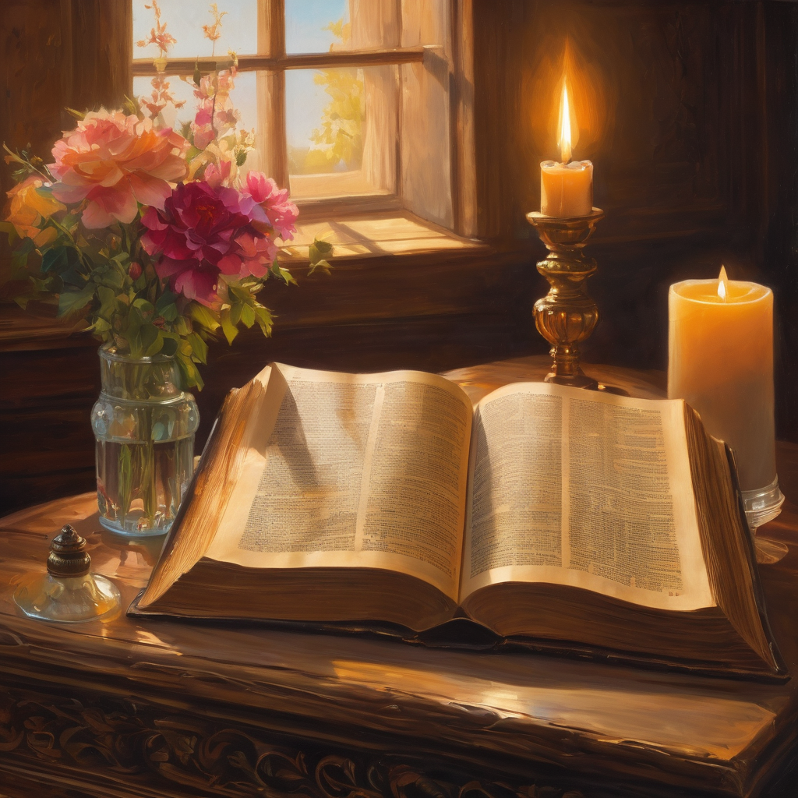
We pause
after ​the Gospel ​​

Slide 35
Leader: The Sermon is recorded to YouTube for sharing later.
Only the preacher's video and audio will be recorded.
The chat and other participants' feeds remain out of sight of the recording.
Leader and Cantor mute
Broadcaster exits screenshare
Preacher unmutes
Zoom buttons ”pins” preacher’s screen + selects “record to the cloud”
Sermon

Slide 36
Leader unmutes
Our next Hymn
Let the Earth Find Rest
https://www.youtube.com/watch?v=GXek70m6yFw
We stay on mute
Leader mutes

Slide 37
The Leader and Cantor unmute
The Greeting of Peace
Leader: We are the body of Christ
All: God’s Spirit is with us
Leader: The peace of the Lord be always with you.
All: And also with you.
Leader: A sign of peace may be exchanged
You may like to type 'Peace' into the chat, use the 'raise hand’ or other reaction buttons, or just simply wave via the screen with your video turned on
(Broadcaster exits shared screen for a few moments for the exchange of peace)

Slide 38
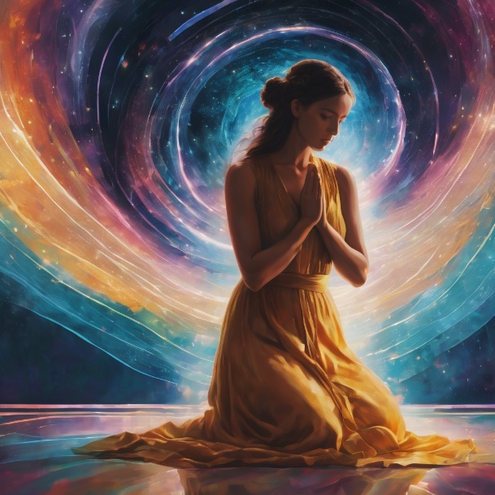
Prayer of Thanksgiving before Intercessions
Leader: As we enter prayer, I invite the second reader to unmute to lead our intercessions following the prayer of thanksgiving on the next slide. Please feel free to change your body position as you need.
Continue…

Slide 39
Leader: God of each moment and each day,
thank you for giving us enough.
Your love is enough.
Your forgiveness is enough.
Your promises are enough.
Your guidance is enough.
Your presence with us is enough.
We praise you and trust you and give ourselves to you,
knowing that with you we are enough. Amen.
Notes:
Prayer of praise and thanksgiving from Roots (if it’s too long still add it and it will be sorted out ☺)

Slide 40
Intercessions
Reader 2: We pray for creation and communities we share our lives with. We pause for a few moments to name either in our hearts, or out loud, or in the chat, those environments and communities we bring to the Lord in prayer.
PAUSE…
Continue…

Slide 41
Intercessions
Reader 2: We entrust to you the community of Holy Hermits Online and our ministry partners:
Prosper the work of our hands and show us the way to your new creation.
Creator God, Hear our prayer.
St John's Cathedral Brisbane The Anglican Diocese of Southern Queensland St Gabriel’s, Carindale Benedictus Contemplative Church, Canberra Anglican Focus and Tithe.ly

Slide 42
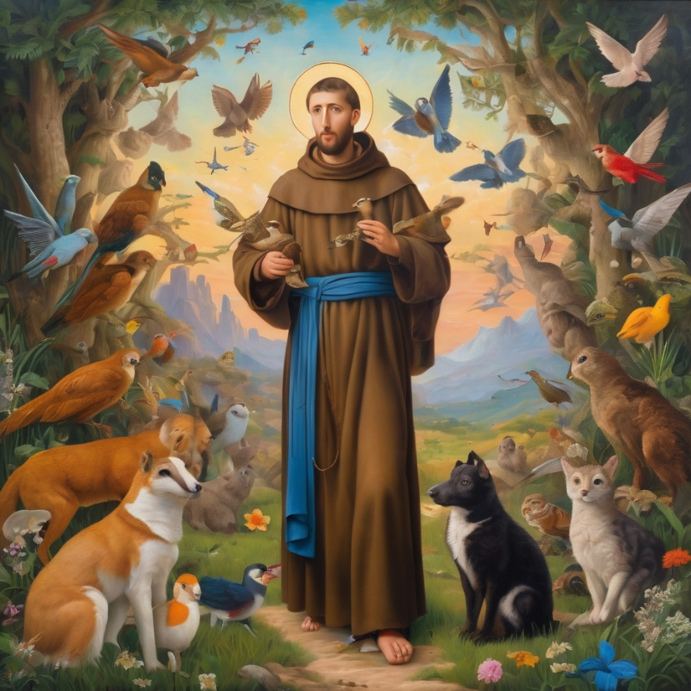
Reader 2: Loving Creator, we entrust to you all animals, especially those who are sick, anxious, ageing, lost, at risk, lonely, sad, hungry, in pain, homeless, abused, living in fear, encountering violence of any kind, in need of comfort, rehabilitation or transformation.

Slide 43
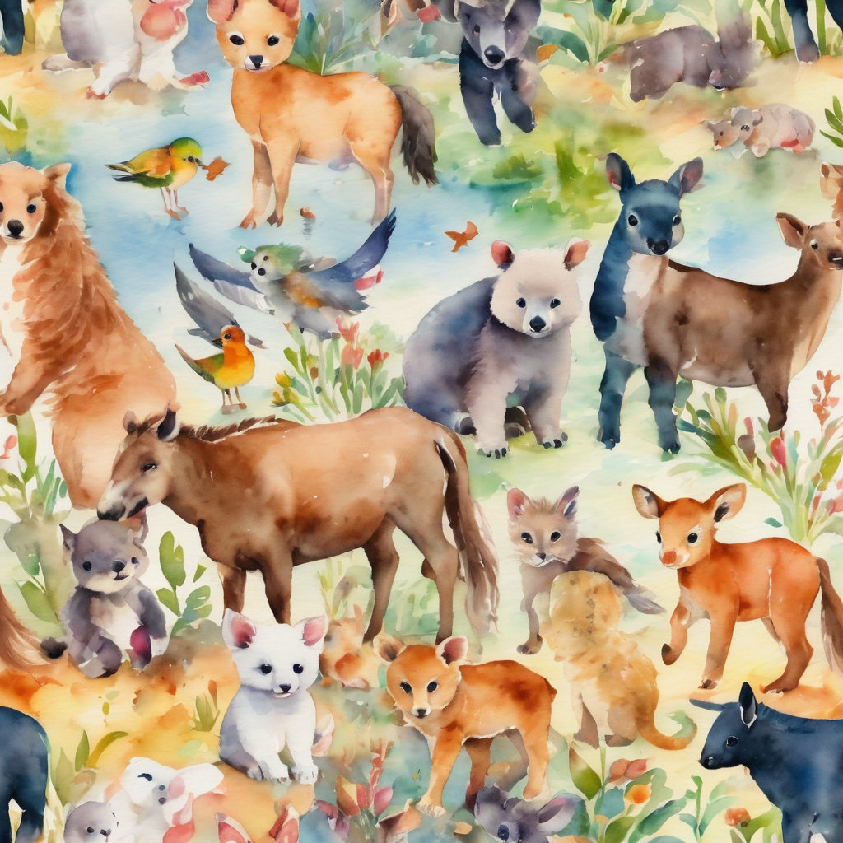
Reader 2: We invite your loving compassion for:
We name in our hearts, out loud or in the chat,
the animals we bring to the Lord in prayer. PAUSE…
Jasmine, ​
Leese(y), ​
Sid, Toots & Lulu​
Polly and Suki​
Fred, George & Percy​
Koshka ​
Jax
Lambert ​​
Kala, Nigel & Little One ​​
Toby​​
Taco​​
Paddy ​​
Rosie​

Slide 44
Reader 2: Eternal Trinity of Love, we uphold to you the people we love and carry cares for:
Kerry, Les & Jake Julie, Ray, Tracey & Shane Mark, Desley & Bob ​​ Rachel, Mervyn & Gillian ​​Rev'd Shane & Janette​​ Alecia, Martin & Aidan​​ Kirsten, Greg, Daphne & Beau Bill & Marjorie​​ Aaron & Andrea Liz’s Godchildren Matthew & Nicholas Liz | Barry​​ Dr Julie ​​ Ruth​​ Phil​ May Susan Tanya​ Neva Kathy ​Gayanne Tina | ​​ | Alan & Gaylene​ Jess & Leah ​​ Barry & Gwen Bob & Di​ Pat & Julie Paul & Darhon Judy & Mary Dilys Miriam Lorelei Nettie

Slide 45
Reader 2:
We name in our hearts, out loud or in the chat, those we bring to the Lord in prayer.
PAUSE…
We entrust to you those who have died, those who have died peacefully and those who have died tragically, the old and the young. Receive them into your Kingdom. Lord in your mercy, Hear our prayers. Amen.

Slide 46
Pray Daily Cycle of Prayer
Leader: Loving God, joining with the Church in our cycle of prayer, we ask your blessings on:
The Diocese of Anglican Church of Australia
The Diocese of Riverina: Vacant; Clergy and People
The Parish of East Brisbane: Paul, Cecilie
Men’s Sheds
West Moreton Anglican College, Karrabin: Principal – Andrew; Chaplain – Jane; Chair of College Council – Bruce; members of School Council; staff & students
Notes:
anglicanfocus.org.au/category/front-page/spirituality/pray-daily/
Please only include the first names of those we pray for

Slide 47
Commitment Prayer of the Week
Leader: Our commitment prayer for the week is People on Need.
God who gives shelter, we give thanks for opportunities to offer support and prayers for those that are struggling at this time to put a permanent roof over their heads and to shelter those they love.​​​​
Please shine a light on homelessness for the people and animals experiencing this and provide a way for homes to be found and others to help, especially governments and churches.​​​​
Please protect all living rough and give safety and security to families and young people, and those who are supporting them.​​​​
Notes:
Link to prayer group ministry page for weekly commitment prayer Prayer Group | Ministries | Holy Hermits Online https://holyhermits.com.au/ministries/prayer-group

Slide 48
Please help us channel and inspire the hospitality that Jesus and his followers sought and encouraged in their day, and especially strengthen those already offering this ministry.​​​​
Awaken compassion in the hearts of all people to reach out with a loving hand. When we feel disheartened by this unfolding situation, please refocus our energies to keep praying and finding small ways to help so we don't feel so overwhelmed.​​​​
Usher in a wave of change for systems to be transformed and ways made for large scale transformation. Amen.​
Notes:
Link to prayer group ministry page for weekly commitment prayer Prayer Group | Ministries | Holy Hermits Online https://holyhermits.com.au/ministries/prayer-group

Slide 49
Leader: Let us pray together the prayer which Jesus gave us saying:
All: Our Father in heaven, hallowed be your name,
your kingdom come, your will be done, on earth as in heaven.
Give us today our daily bread.
Forgive us our sins
as we forgive those who sin against us.
Save us from the time of trial and deliver us from evil.
For the kingdom, the power, and the glory are yours
now and for ever.
Amen.

Slide 50
Devotions

Slide 51
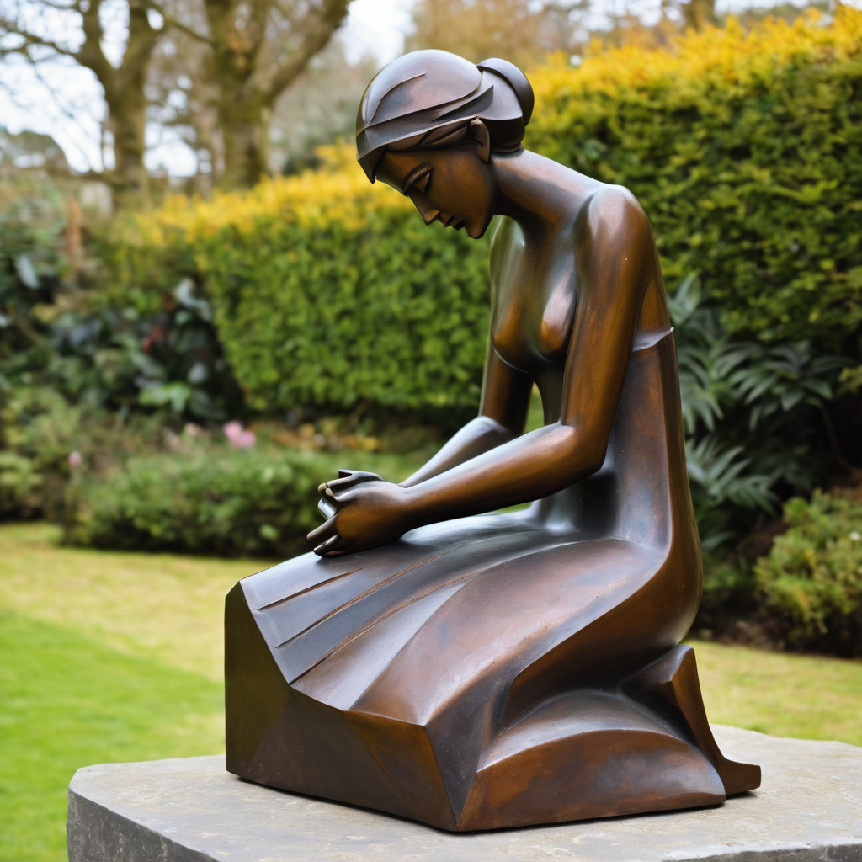
​
Leader: ​As we enter a few minutes of silence together, you are invited to pray the prayer of adoration on the next slide and/or spend this time in contemplation. ​
The Spiritual Communion prayer follows on the slide after that.
Let us be still.
Leader and Cantor Mute.
Continue…

Slide 52
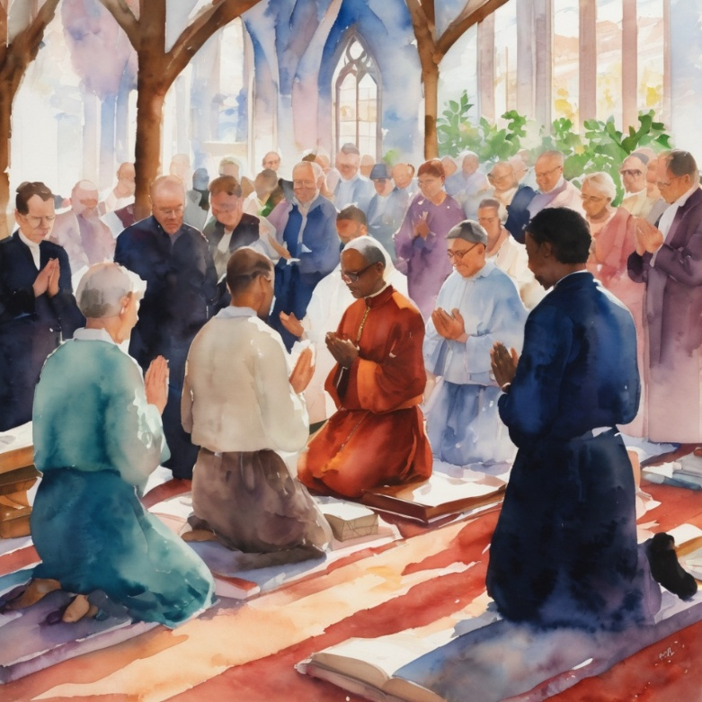
Thanks for our Mother Earth who sustains us.
Thanks for the rivers for water to drink.
Thanks for the farmers and crops that feed us.
Thanks for sun for warmth and light.
Thank you, God, for everything.
Amen.
​
Notes:
Prayer for all ages from Roots

Slide 53

  Oh, my Lord Jesus I turn to you present at the Altar and in the Tabernacle. I believe that you are present in the Holy Sacrament of your most Sacred Body and Blood. I love you above all things and I desire to receive you into my Soul. I cannot at this moment receive you Sacramentally in Holy Communion. Come spiritually into my heart. Purify it, Sanctify it. Render my heart like your own heart. I embrace you as if you were already there and unite myself wholly with you. Never permit me to be separated from you. Lord, I am not worthy to receive you, but only say the word and I shall be healed. Amen
Making a Spiritual Communion
(Prayed in silence)
Notes:
Spiritual Communion Slide – Please do not change the prayer
Can change colour of background and title to match liturgical colour. You may also like to change the picture.

Slide 54
Leader unmutes
Our final song is
For the Beauty of the Earth
https://www.youtube.com/watch?v=gvM7AUmdezA
We stay on mute
Leader mutes

Slide 55
Leader and cantor unmute
Sending Prayer
Leader: We pray our sending prayer together.
All: May God our provider bless us,
giving us just what we need.
May God the Son bless us,
being our bread of life.
May God the Spirit bless us,
fuelling us to bless the world.
Amen.
Notes:
Use Sending Prayer from Roots

Slide 56
The Benediction
Leader: Let us all invite God’s blessings together,
All: May the road rise up to meet us,
may the wind be always at our backs,
may the sun shine warm upon our faces,
and the rains fall soft upon our fields;
and until we meet again,
may God hold us in the palm of his hand. Amen.
Notes:
We have a different benediction for our birthday (we will keep using this through the Season of Creation)
The Normal Benediction:
May the Lord bless us and keep us.
May the Lord’s face shine upon us and be gracious to us.
May the Lord’s countenance be lifted upon us,
and bring us peace.
Amen

Slide 57
Notices
Earth, Our Original Monastery Wednesday @ 6pm. Continuing our contemplative prayer series. All are welcome to attend.
This Sunday is Contemplative Service Workshop @ 11am
See HHO Events page for further upcoming events HHO Events
Notes:
Up coming events can be added from the HHO event page/calendar

Slide 58

Leader: If you are carrying something heavy, seeking prayer, or simply would like to talk with someone, pastoral care is available to all in the community.
You can contact Rev’d Lauren 💌lauren.martin@anglicanchurchsq.org.au
☎️ 0415260599
💌 holyhermits@anglicanchurchsq.org.au
❤️ or visit the help page at the website to reach out 🌐

Slide 59
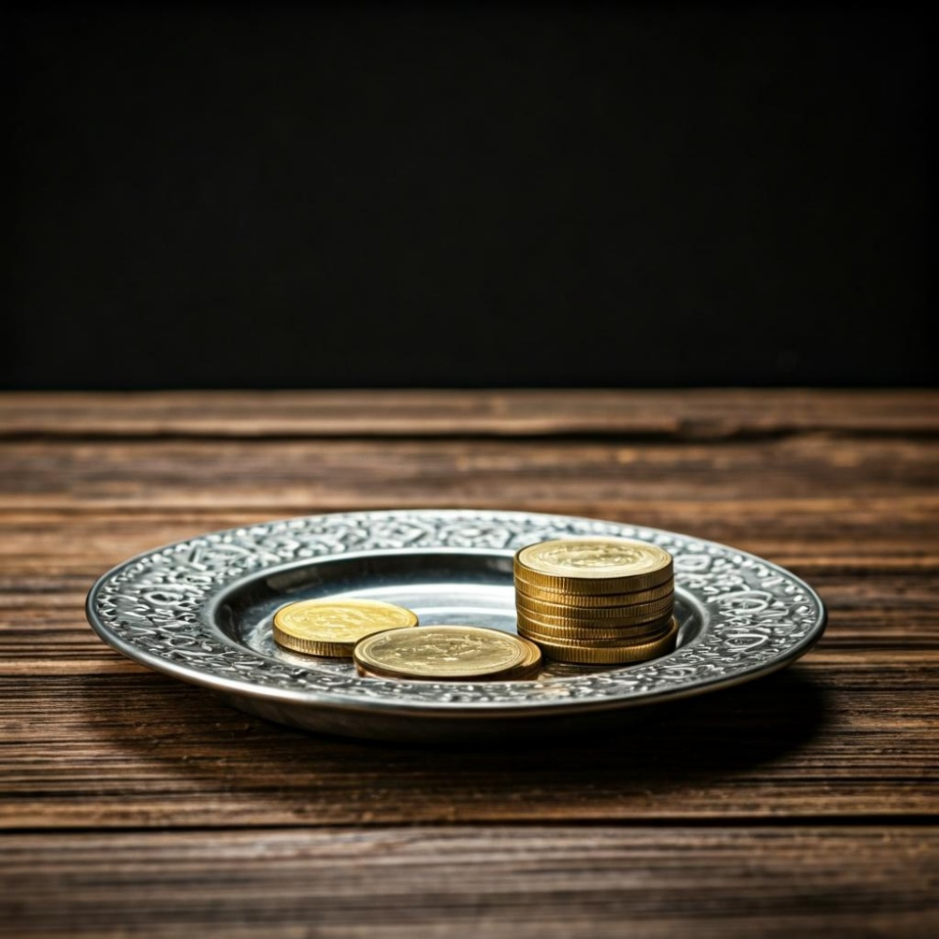
Leader: Thank you for your regular gifts to this ministry. Offerings are most welcome via:
The HHO App
Direct Debit
International Direct Debit
Please consider a one-off donation
or leaving a legacy in your Will
For further information go to HHO give page https://holyhermits.com.au/give

Slide 60
Serving next week
27 September 2026
18th Sunday after Pentecost
9:00 am AEST
Service Prep: Lauren | Chat Host: Rachel | Fellowship: Lauren
Music: Lauren | Welcomer: Chris | Safety Officer: Rachel
Proof-reader: Chris | Leader: Jeremy | Attendance: Rachel
Broadcaster: Barry | Cantor: Julie | Preacher: Lauren
Backup Broadcaster: Lauren | First Reader: Phil | Deacon: Lauren
Zoom Buttons: Rachel | Second Reader: Barry | Priest: N/A
Thank you for your ministry gifts
New Servers always welcome!
Please email Rev’d Lauren to get involved
holyhermits@anglicanchurchsq.org.au

Slide 61
Leader and All may unmute
The Dismissal
Leader: I invite everyone to unmute for the Dismissal
Leader: Go in peace to love and serve the Lord.
All: In the name of Christ, Amen.

Slide 62

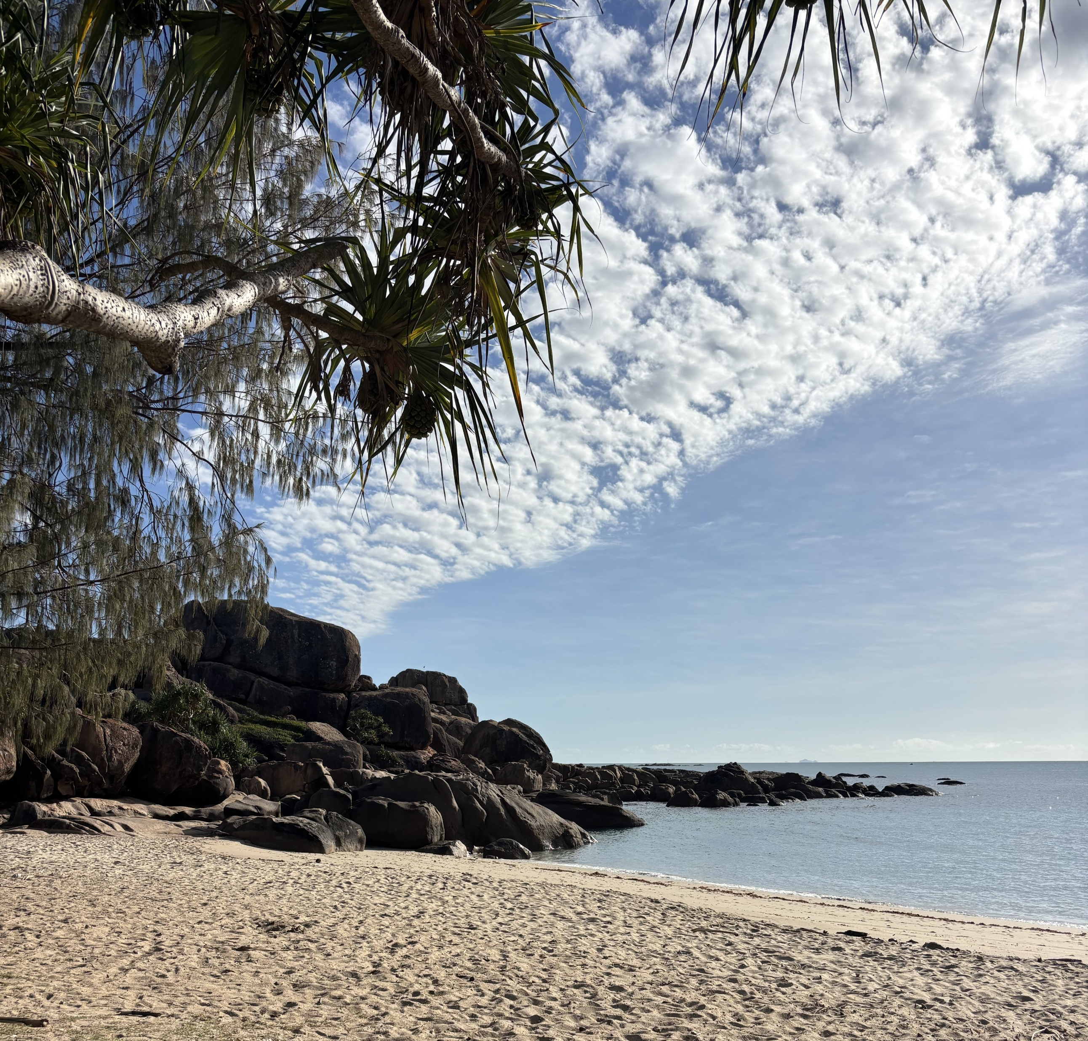

Fellowship
Thank you, Julie for leading Fellowship
Please feel welcome to linger or pop a message in the chat and head off when you are ready.​
Photo shows a beach landscape featuring cloud formations over a granite outcrop.
Extra resources developed
by Roots on the Web
Images from Padlet
This week our sanctuary lamp is lit in celebration of Wiggle’s 14th birthday 🥳
Notes:
Please ensure high level of contrast for the fellowship text block to make it easier for people to read

