Slide 1
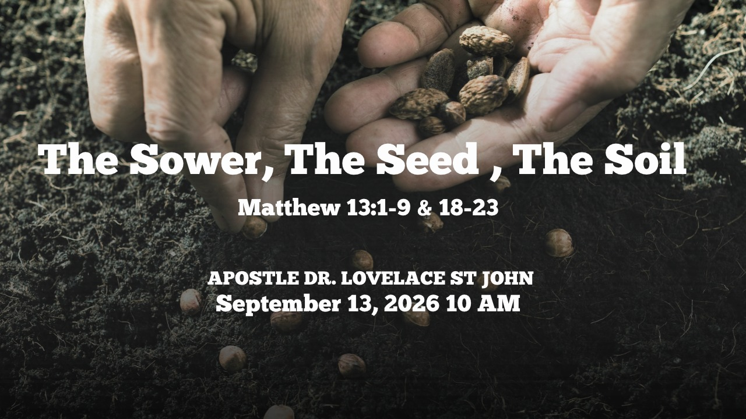

Slide 2



Scripture:
MATTHEW 13: 1 – 9 & 18 – 23

Slide 3
INTRODUCTION
THE SAME SEED, DIFFERENT RESULTS
The Sower had one kind of seed, but the seed fell on four different types of soil.
The seed did not change.
The Sower did not change.
The soil changed.
And because the soil changed, the results changed.
The seed is the Word of God and the different soils represent different responses to that Word.

Slide 4
THE SOWER
Matthew 13:3 — “Behold, a Sower went forth to sow.”
The first person we encounter is the Sower
A. The Sower is Generous and Impartial.
A biblical Sower scatters seed broadly without withholding it based on how promising the soil appears.

Slide 5
THE SOWER (cont)
"He who sows sparingly will also reap sparingly, and he who sows bountifully will also reap bountifully." 2 Corinthians 9:6
The Sower's responsibility is to release the seed.
Ecclesiastes 11:6: “In the morning sow thy seed, and in the evening withhold not thine hand…”
Keep sowing.

Slide 6
B. The Sower is Dependent on God for the Growth
While the Sower is responsible for planting, the Scripture emphasizes that the Sower cannot force the seed to grow.
"I planted, Apollos watered, but God gave the growth. So neither he who plants nor he who waters is anything, but only God who gives the growth."

Slide 7
B. The Sower is Dependent on God for the Growth (cont)
1 Corinthians 3:6–7
Our job is faithful sowing.
God's job is supernatural increase.
Don't become discouraged because you don't immediately see results.
A seed can be underground and still be working.

Slide 8
C. The Sower is Diligent and Persistent.
The Sower must overcome challenges.
Challenges: Harsh weather, birds stealing seed, or weeds choking out growth.
The Scripture encourages Sowers not to give up when results seem slow or difficult.
"And let us not grow weary of doing good, for in due season we will reap, if we do not give up." Galatians 6:9

Slide 9
2. THE SEED
Matthew 13:19 “When any one heareth the word of the kingdom…”
Jesus makes it clear that the seed represents the Word of God.
The seed is powerful because it contains life.

Slide 10
2. THE SEED (cont)
A. THE SEED IS GOOD
The problem in this parable is never the seed.
Jesus doesn't say the Sower had defective seed.
The Word of God is perfect.
Isaiah 55:11: “So shall my word be that goeth forth out of my mouth: it shall not return unto me void”
The Word carries God's purpose.

Slide 11
B. The Seed is Pure and Undefiled
The seed of God's Word is inherently untainted, perfect, and holy.
It does not carry error or deception, making it completely reliable for producing spiritual life and righteousness.
"The words of the Lord are pure words, like silver tried in a furnace of earth, purified seven times." Psalm 12:6

Slide 12
C. The Seed Must Be Given Time To Grow
Seeds don't become harvests overnight.
The process. Mark 4:28: “First the blade, then the ear, after that the full corn in the ear.”
Don't despise small beginnings.
A decision today can become life changing tomorrow.

Slide 13
C. The Seed Must Be Given Time To Grow (cont)
A prayer today can become breakthrough tomorrow.
A Word received today can produce fruit years from now.
Never underestimate what God can do with one Word planted in a receptive heart.

Slide 14
3. THE SOIL
Matthew 13:4, 19 “When any one heareth the word of the kingdom, and understandeth it not, then cometh the wicked one”
The first soil represents the hardened heart.
The seed lands on the surface but never gets inside.
A. THE WORD IS HEARD BUT NOT UNDERSTOOD
There is a difference between physical hearing and spiritual hearing.
The issue is not whether we have ears.
The issue is whether we have receptive hearts.

Slide 15
B. The Soil has Receptive Capacity
The primary function of soil in the parable is its ability to receive the seed.
The condition of the soil determines whether the seed can gain entry, take root, or be rejected immediately.
This reflects the openness, willingness, and humility of a person's heart toward God's truth.
"Receive with meekness the implanted word, which is able to save your souls." James 1:21

Slide 16
C. The Soil is Asses by it’s Depth and Vulnerability
Soil can be shallow, like the rocky ground, where there is only a thin layer of dirt over hard stone.
This represents a heart that responds with immediate emotional joy but lacks deep conviction or roots.
When trial, opposition, or persecution comes, the lack of depth causes the plant to wither quickly.
"As for what was sown on rocky ground, this is the one who hears the word and immediately receives it with joy, yet he has no root in himself, but endures for a while" Matthew 13:20–21

Slide 17
D. The Soil can be Susceptibility to Overgrowth and Distraction
Soil does not exist in a vacuum; it can be crowded by weeds and thorns that compete for sunlight, moisture, and nutrients.
Soil choked by thorns represents a heart overwhelmed by worldly cares, the deceitfulness of wealth, and physical pleasures, which choke out spiritual fruitfulness.
"And as for what fell among the thorns, they are those who hear, but as they go on their way they are choked by the cares and riches and pleasures of life, and their fruit does not mature." Luke 8:14

Slide 18
E. The Soil can be Responsiveness to Cultivation
Soil is not static; hard or thorn-filled ground can be cleared, tilled, and prepared to become healthy.
The Scripture often speaks of "breaking up unplowed ground" through repentance and self-examination so that the heart is ready to receive God's Word effectively.
"Sow for yourselves righteousness; reap steadfast love; break up your fallow ground, for it is the time to seek the Lord" Hosea 10:12

Slide 19
F. The Soil is able to Multiply Fruitfulness
When soil is "good“ meaning honest, clear, and deep, it nourishes the seed to its full potential.
The ultimate characteristic of good soil in Scripture is that it consistently produces a tangible, multiplying harvest of righteous character, good works, and spiritual maturity.
"But that on the good ground are they, which in an honest and good heart, having heard the word, keep it, and bring forth fruit with patience." Luke 8:15

Slide 20
CONCLUSION
“What kind of soil are you?”
“Are you a Hard soil?”
You hear, but the Word doesn't penetrate.
Shallow soil?
You receive with excitement, but you have no roots.
Thorny soil?
The Word is present, but the cares of life are choking it.
Good soil?
You hear, receive, understand, endure, and produce fruit.

