Slide 1
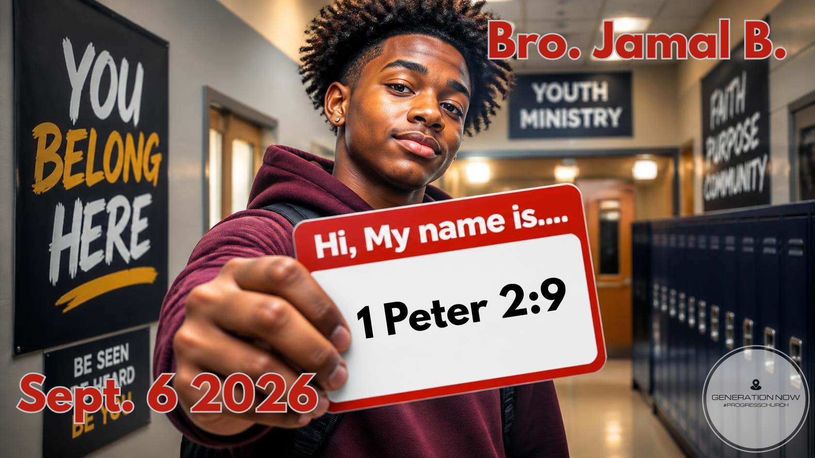

Slide 2

However, you are chosen people, a royal priesthood, a holy nation, people who belong to God. You were chosen to tell about the excellent qualities of God, who called you out of darkness into his marvelous light.
1 Peter 2:9 GW

Slide 3
Biblical Example - DANIEL

Slide 4
  Daniel was a young man who was taken to a new place called Babylon
  Everything around him was different
    New place
    New people
    New culture
    New expectations

Slide 5
Daniel 1:8 says:
“But Daniel resolved not to defile himself...”

Slide 6

DON'T LET LABELS BECOME THE IDENTITY

Slide 7
One of the most dangerous things you can do is let your identity become dependent on your environment
    If people celebrate you, you feel valuable
    If they reject you, you feel worthless
    If you succeed, you feel like somebody
    If you fail, you feel like nobody
    If you get invited, you feel accepted
    If you're left out, you question yourself

Slide 8
But Hebrews 13:8 says: “Jesus Christ is the same yesterday and today and forever.”
If you build your identity in something temporary, you will constantly have to rebuild yourself

Slide 9
  Your grades don't determine whether you're valuable
  Your popularity doesn't determine whether you're valuable
  Your appearance doesn't determine whether you're valuable
  Your mistakes don't determine whether you're valuable

Slide 10
God is the one who gives you your identity, you don't have to spend your life auditioning for worth

Slide 11

GET ROOTED BEFORE YOU GET RECOGNIZED

Slide 12
  A tree can only survive what happens above the ground because of what happens underneath the ground
    You see the branches
    God sees the roots
    You see the fruit
    God sees the foundation

Slide 13
  Sometimes we become frustrated because we want God to grow our branches while He's working on our roots
  We want influence
  God wants character
  We want visibility
  God wants integrity
  We want the platform
  God wants preparation

Slide 14
Colossians 2:6-7 says:
“Continue to live your lives in him, rooted and built up in him...”
ROOTS DETERMINE STABILITY

Slide 15
  Spiritually, you need roots.
    Roots in scripture
    Roots in prayer
    Roots in worship
    Roots in community
    Roots in obedience
    Roots in your relationship with Jesus

Slide 16
BUT THE TREE DOESN'T STOP AT THE ROOTS
  It grows
  Downward — deeper roots
  Upward — greater maturity
  Outward — greater influence

Slide 17
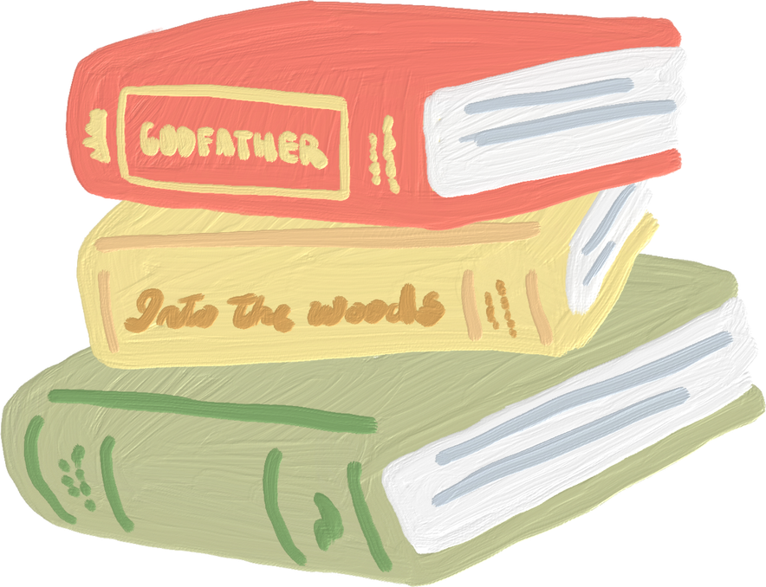
CARRYING THE NAME: THE COST OF BELONGING TO JESUS

Slide 18

He said to all of them, “Those who want to come with me must say no to the things they want, pick up their crosses every day, and follow me.
Luke 9:23 GW

Slide 19
Sometimes following Jesus isn't just about giving up something you have
Sometimes it's about giving up a version of yourself you've become comfortable being

Slide 20
  The version of you that always needs everybody to like you
  The version of you that gets angry and refuses to let things go
  The version of you that pretends everything is okay because you don't want anybody to know you're struggling
  Maybe it's the version of you that says, “That's just who I am

Slide 21
Following Jesus means allowing God to change the parts of you that don't look like Him
And sometimes that hurts because growth isn't always comfortable

Slide 22
  Sometimes God asks you to let go of something you've held onto for a long time
  Sometimes He asks you to walk away from something everybody else is walking toward
  Sometimes He asks you to say no when everybody else is saying yes
  Sometimes He asks you to forgive when you really want to hold onto the hurt
  Sometimes He asks you to stop trying to impress people who were never going to be satisfied anyway
  Sometimes following Jesus means choosing to be different

Slide 23
Following Jesus means I don't just give Him my behavior. I give Him my identity. I give Him the parts of me I've been protecting. I give Him the version of me that I've been trying so hard to maintain.
Are you willing to let the old version of you die so that God can develop the new version of you?

Slide 24
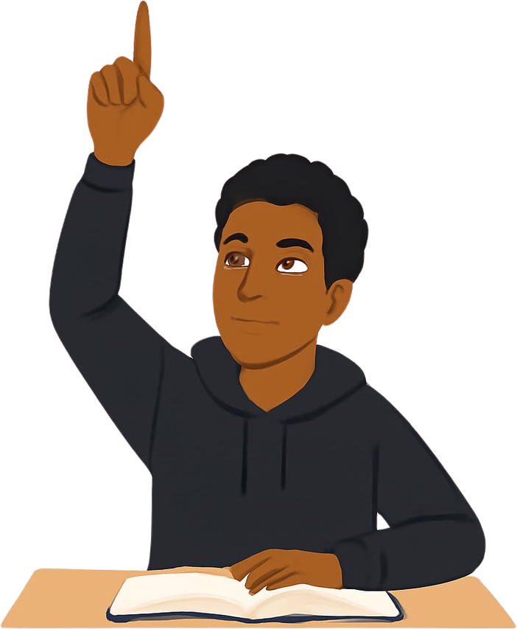
Two Keys To Move Forward

Slide 25
Seek God With Effort

Slide 26

  Being present isn't the same as being engaged.
  It's possible to come to church every Sunday and still not pursue God
    You can sit in the service without worshipping
    You can hear the Word without applying it
    You can know the songs without knowing the God you're singing about
  Seeking God takes effort

Slide 27
7 “Keep on asking, and you will receive what you ask for. Keep on seeking, and you will find. Keep on knocking, and the door will be opened to you. 8 For everyone who asks, receives. Everyone who seeks, finds. And to everyone who knocks, the door will be opened.
Matthew 7:7-8 NLT

Slide 28
Point Your Gifts In The Right Direction

Slide 29
Each one, as a good manager of God's different gifts, must use for the good of others the special gift he has received from God.
1 Peter 4:10 GNT

Slide 30
A tree doesn't eat its own fruit, it produces it for someone else

