Slide 1


Slide 2
Psalm 135:1-3
"Praise the Lord! Praise the name of the Lord, give praise, O servants of the Lord, who stand in the house of the Lord, in the courts of the house of our God! Praise the Lord, for the Lord is good; sing to his name, for it is pleasant!"

Slide 3
Prayer Prompts
Adoration: God you are worthy of all our praise and praise you today because You are….
Response: Lord, I confess that I sometimes loss sight of your goodness when I experience….
Requests: Lord give me the grace to sing of your goodness, even when…
Readiness: Lord keep my heart set on You, especially when I am tempted by…..

Slide 4
Divine Providence: God’s unceasing activity in the world to accomplish his will.

Slide 5
God’s providence works in tandem with the free will He has given man.

Slide 6
Are you able to recognize God’s divine activity in the world?

Slide 7
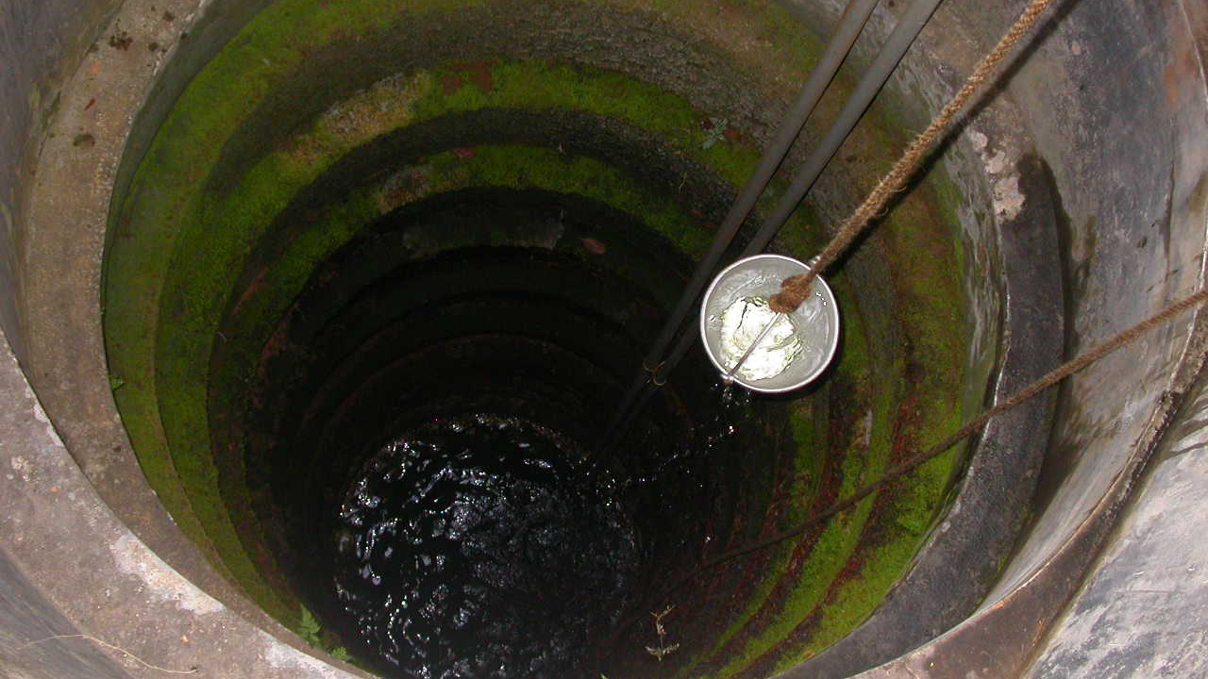
This Photo by Unknown Author is licensed under CC BY-SA

Slide 8
Though Jacob did not recognize it, the scene is unfolding according to God’s divine providence.

Slide 9
Discernment: the supernatural wisdom and knowledge of God that allows us to judge, perceive, and interpret the world in according to God’s will.

Slide 10
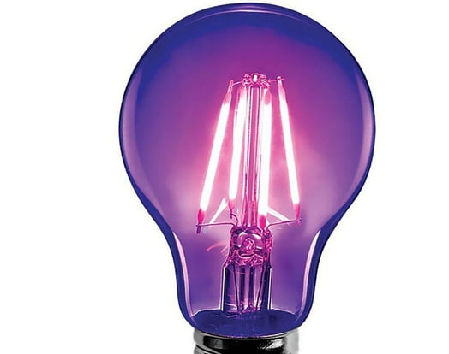

Slide 11
Spiritual discernment helps to keep us moving along the path God has planned for us.

Slide 12
Jacob was willing to suffer for the promise of marriage and the perceived happiness it would bring him.

Slide 13
The follower of Christ should both desire and pray for a growing discernment of the things of God.

