Slide 1
Psalm 139:13-16
¹³ For you formed my inward parts;
you knitted me together in my mother's womb.
¹⁴ I praise you, for I am fearfully and wonderfully made.^{[a]}
Wonderful are your works;
my soul knows it very well.
¹⁵ My frame was not hidden from you,
when I was being made in secret,
intricately woven in the depths of the earth.
¹⁶ Your eyes saw my unformed substance;
in your book were written, every one of them,
the days that were formed for me,
when as yet there was none of them.

Slide 2
Prayer Prompts
Adoration: God, You have created me just as I am and I love that you have made me ….
Response: I admit I have doubted Your plan for my life when…
Request: Search my heart today, O Lord, and show me if I am….
Readiness: Lord lead me in the way that is everlasting and pleasing to you as face this….

Slide 3
Service:
The use of one’s God given gifts, abilities, and passions for the glory of God and the building of His kingdom.

Slide 4
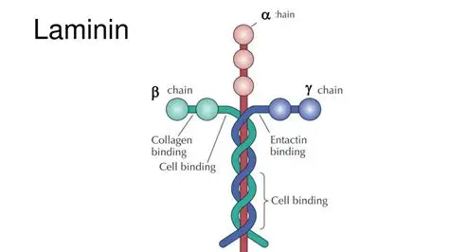

Slide 5
The church needs all it’s members to spiritually healthy and working together to be effective in the mission.

Slide 6
A diversity of spiritual giftings is essential to a healthy church.

Slide 7

The church needs what you bring to the table.

Slide 8
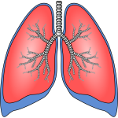
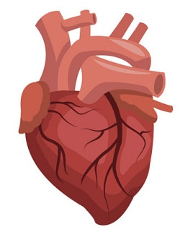
This Photo by Unknown Author is licensed under CC BY

Slide 9
The church needs every member operating in their giftings for maximum kingdom impact.

Slide 10
We are never more like Jesus than when we are serving others.

Slide 11
Serving requires surrender

Slide 12
Serving requires faithful endurance and spiritual discernment.

Slide 13
Service Requires rhythms of rest

