Slide 1

FAITH THAT LEADS THE
NEXT GENERATION

Slide 2
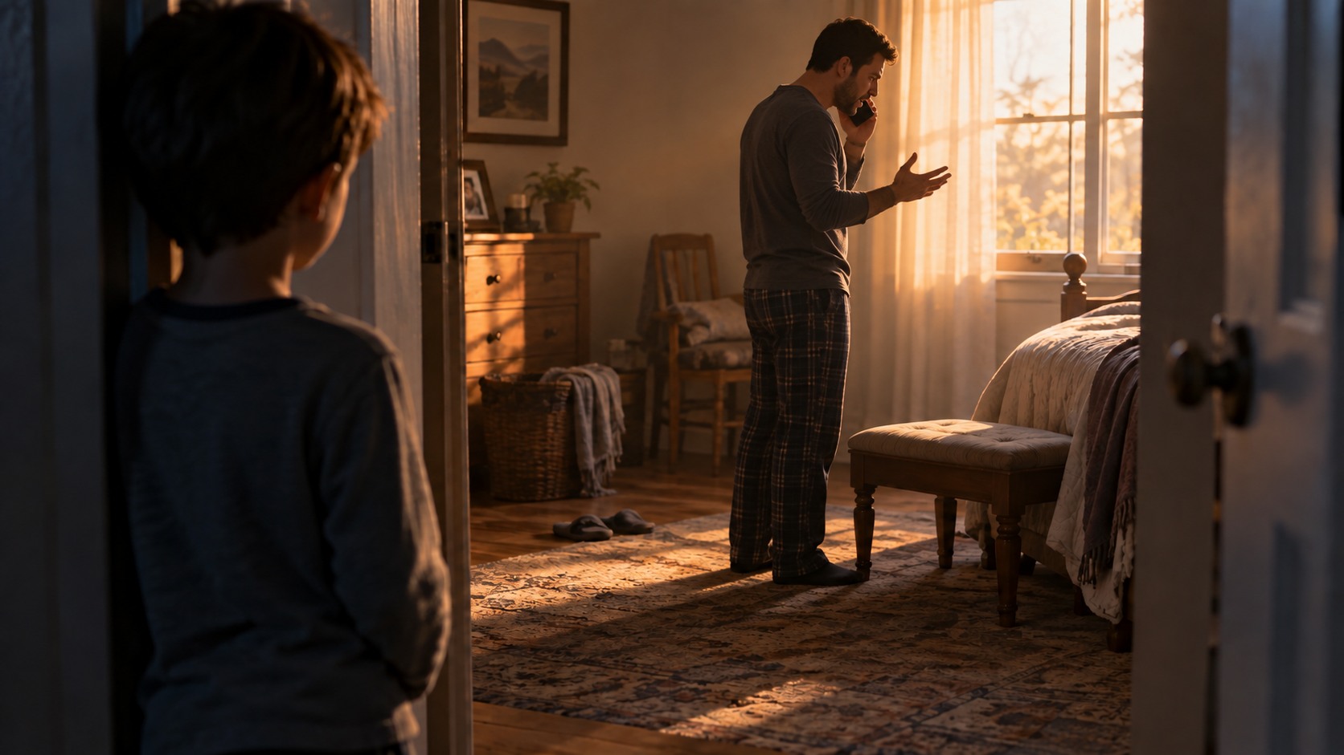

Slide 3
12 Let no one despise you for your youth, but set the believers
an example in speech, in conduct, in love, in faith, in purity.
13 Until I come, devote yourself to the public reading
of Scripture, to exhortation, to teaching.
14 Do not neglect the gift you have, which was given to you by prophecy
when the council of elders laid their hands on you.
15 Practice these things, immerse yourself in them, so that all may
see your progress.
16 Keep a close watch on yourself and on the teaching. Persist in this,
for by so doing you will save both yourself and your hearers.
1 Timothy 4:12-16

Slide 4
12 Let no one despise you for your youth, but set the believers
an example in speech, in conduct, in love, in faith, in purity.
13 Until I come, devote yourself to the public reading
of Scripture, to exhortation, to teaching.
14 Do not neglect the gift you have, which was given to you by prophecy
when the council of elders laid their hands on you.
15 Practice these things, immerse yourself in them, so that all may
see your progress.
16 Keep a close watch on yourself and on the teaching. Persist in this,
for by so doing you will save both yourself and your hearers.
1 Timothy 4:12-16

Slide 5
12 Let no one despise you for your youth, but set the believers
an example in speech, in conduct, in love, in faith, in purity.
13 Until I come, devote yourself to the public reading
of Scripture, to exhortation, to teaching.
14 Do not neglect the gift you have, which was given to you by prophecy
when the council of elders laid their hands on you.
15 Practice these things, immerse yourself in them, so that all may
see your progress.
16 Keep a close watch on yourself and on the teaching. Persist in this,
for by so doing you will save both yourself and your hearers.
1 Timothy 4:12-16

Slide 6
12 Let no one despise you for your youth, but set the believers
an example in speech, in conduct, in love, in faith, in purity.
13 Until I come, devote yourself to the public reading
of Scripture, to exhortation, to teaching.
14 Do not neglect the gift you have, which was given to you by prophecy
when the council of elders laid their hands on you.
15 Practice these things, immerse yourself in them, so that all may
see your progress.
16 Keep a close watch on yourself and on the teaching. Persist in this,
for by so doing you will save both yourself and your hearers.
1 Timothy 4:12-16

Slide 7
12 Let no one despise you for your youth, but set the believers
an example in speech, in conduct, in love, in faith, in purity.
13 Until I come, devote yourself to the public reading
of Scripture, to exhortation, to teaching.
14 Do not neglect the gift you have, which was given to you by prophecy
when the council of elders laid their hands on you.
15 Practice these things, immerse yourself in them, so that all may
see your progress.
16 Keep a close watch on yourself and on the teaching. Persist in this,
for by so doing you will save both yourself and your hearers.
1 Timothy 4:12-16

Slide 8

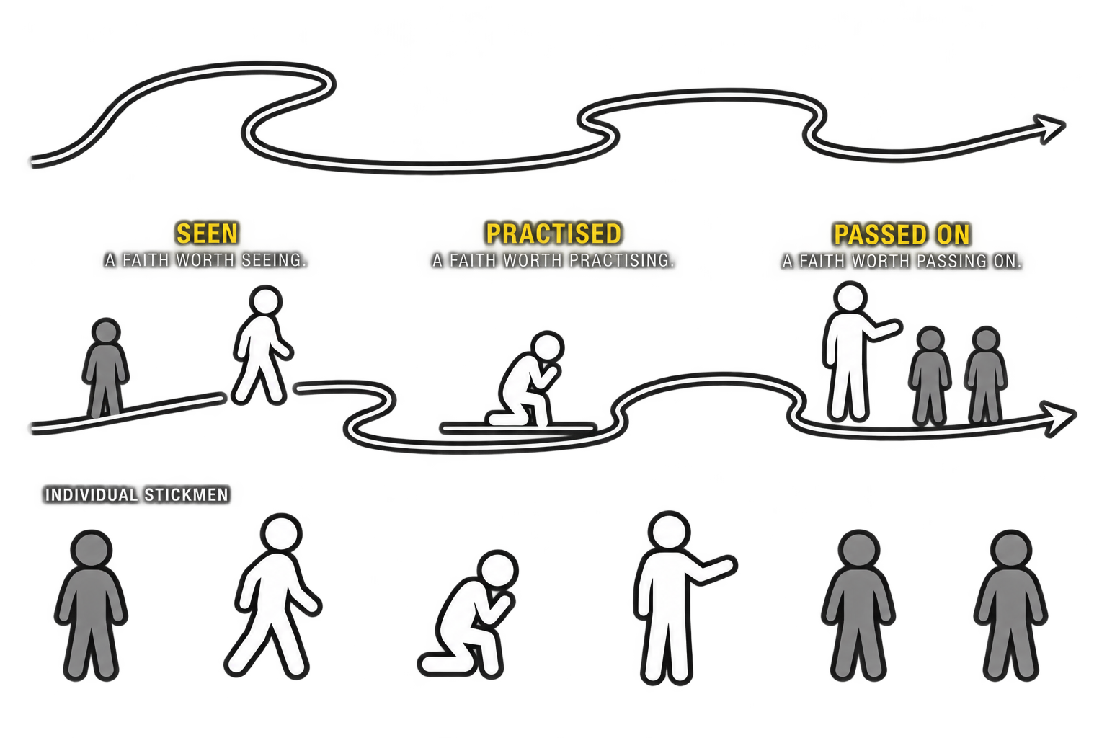
What does it look like to
live a faith
worth following?

Slide 9
A faith that is seen

Slide 10
12 Let no one despise you for your youth, but set the believers
an example in speech, in conduct, in love, in faith, in purity.
13 Until I come, devote yourself to the public reading
of Scripture, to exhortation, to teaching.
14 Do not neglect the gift you have, which was given to you by prophecy
when the council of elders laid their hands on you.
15 Practice these things, immerse yourself in them, so that all may
see your progress.
16 Keep a close watch on yourself and on the teaching. Persist in this,
for by so doing you will save both yourself and your hearers.
1 Timothy 4:12-16

Slide 11
12 Let no one despise you for your youth, but set the believers
an example in speech, in conduct, in love, in faith, in purity.
13 Until I come, devote yourself to the public reading
of Scripture, to exhortation, to teaching.
14 Do not neglect the gift you have, which was given to you by prophecy
when the council of elders laid their hands on you.
15 Practice these things, immerse yourself in them, so that all may
see your progress.
16 Keep a close watch on yourself and on the teaching. Persist in this,
for by so doing you will save both yourself and your hearers.
1 Timothy 4:12-16

Slide 12
12 Let no one despise you for your youth, but set the believers
an example in speech, in conduct, in love, in faith, in purity.
13 Until I come, devote yourself to the public reading
of Scripture, to exhortation, to teaching.
14 Do not neglect the gift you have, which was given to you by prophecy
when the council of elders laid their hands on you.
15 Practice these things, immerse yourself in them, so that all may
see your progress.
16 Keep a close watch on yourself and on the teaching. Persist in this,
for by so doing you will save both yourself and your hearers.
1 Timothy 4:12-16

Slide 13
12 Let no one despise you for your youth, but set the believers
an example in speech, in conduct, in love, in faith, in purity.
13 Until I come, devote yourself to the public reading
of Scripture, to exhortation, to teaching.
14 Do not neglect the gift you have, which was given to you by prophecy
when the council of elders laid their hands on you.
15 Practice these things, immerse yourself in them, so that all may
see your progress.
16 Keep a close watch on yourself and on the teaching. Persist in this,
for by so doing you will save both yourself and your hearers.
1 Timothy 4:12-16

Slide 14
12 Let no one despise you for your youth, but set the believers
an example in speech, in conduct, in love, in faith, in purity.
13 Until I come, devote yourself to the public reading
of Scripture, to exhortation, to teaching.
14 Do not neglect the gift you have, which was given to you by prophecy
when the council of elders laid their hands on you.
15 Practice these things, immerse yourself in them, so that all may
see your progress.
16 Keep a close watch on yourself and on the teaching. Persist in this,
for by so doing you will save both yourself and your hearers.
1 Timothy 4:12-16

Slide 15
12 Let no one despise you for your youth, but set the believers
an example in speech, in conduct, in love, in faith, in purity.
13 Until I come, devote yourself to the public reading
of Scripture, to exhortation, to teaching.
14 Do not neglect the gift you have, which was given to you by prophecy
when the council of elders laid their hands on you.
15 Practice these things, immerse yourself in them, so that all may
see your progress.
16 Keep a close watch on yourself and on the teaching. Persist in this,
for by so doing you will save both yourself and your hearers.
1 Timothy 4:12-16

Slide 16
12 Let no one despise you for your youth, but set the believers
an example in speech, in conduct, in love, in faith, in purity.
13 Until I come, devote yourself to the public reading
of Scripture, to exhortation, to teaching.
14 Do not neglect the gift you have, which was given to you by prophecy
when the council of elders laid their hands on you.
15 Practice these things, immerse yourself in them, so that all may
see your progress.
16 Keep a close watch on yourself and on the teaching. Persist in this,
for by so doing you will save both yourself and your hearers.
1 Timothy 4:12-16

Slide 17
A faith that is seen

Slide 18

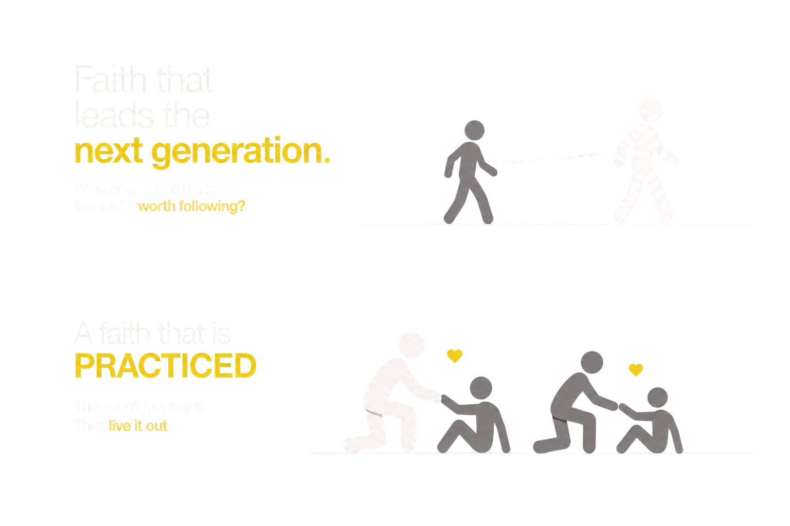
A faith that is seen
A faith that is practiced

Slide 19
12 Let no one despise you for your youth, but set the believers
an example in speech, in conduct, in love, in faith, in purity.
13 Until I come, devote yourself to the public reading
of Scripture, to exhortation, to teaching.
14 Do not neglect the gift you have, which was given to you by prophecy
when the council of elders laid their hands on you.
15 Practice these things, immerse yourself in them, so that all may
see your progress.
16 Keep a close watch on yourself and on the teaching. Persist in this,
for by so doing you will save both yourself and your hearers.
1 Timothy 4:12-16

Slide 20
12 Let no one despise you for your youth, but set the believers
an example in speech, in conduct, in love, in faith, in purity.
13 Until I come, devote yourself to the public reading
of Scripture, to exhortation, to teaching.
14 Do not neglect the gift you have, which was given to you by prophecy
when the council of elders laid their hands on you.
15 Practice these things, immerse yourself in them, so that all may
see your progress.
16 Keep a close watch on yourself and on the teaching. Persist in this,
for by so doing you will save both yourself and your hearers.
1 Timothy 4:12-16

Slide 21
12 Let no one despise you for your youth, but set the believers
an example in speech, in conduct, in love, in faith, in purity.
13 Until I come, devote yourself to the public reading
of Scripture, to exhortation, to teaching.
14 Do not neglect the gift you have, which was given to you by prophecy
when the council of elders laid their hands on you.
15 Practice these things, immerse yourself in them, so that all may
see your progress.
16 Keep a close watch on yourself and on the teaching. Persist in this,
for by so doing you will save both yourself and your hearers.
1 Timothy 4:12-16

Slide 22
12 Let no one despise you for your youth, but set the believers
an example in speech, in conduct, in love, in faith, in purity.
13 Until I come, devote yourself to the public reading
of Scripture, to exhortation, to teaching.
14 Do not neglect the gift you have, which was given to you by prophecy
when the council of elders laid their hands on you.
15 Practice these things, immerse yourself in them, so that all may
see your progress.
16 Keep a close watch on yourself and on the teaching. Persist in this,
for by so doing you will save both yourself and your hearers.
1 Timothy 4:12-16

Slide 23
12 Let no one despise you for your youth, but set the believers
an example in speech, in conduct, in love, in faith, in purity.
13 Until I come, devote yourself to the public reading
of Scripture, to exhortation, to teaching.
14 Do not neglect the gift you have, which was given to you by prophecy
when the council of elders laid their hands on you.
15 Practice these things, immerse yourself in them, so that all may
see your progress.
16 Keep a close watch on yourself and on the teaching. Persist in this,
for by so doing you will save both yourself and your hearers.
1 Timothy 4:12-16

Slide 24
12 Let no one despise you for your youth, but set the believers
an example in speech, in conduct, in love, in faith, in purity.
13 Until I come, devote yourself to the public reading
of Scripture, to exhortation, to teaching.
14 Do not neglect the gift you have, which was given to you by prophecy
when the council of elders laid their hands on you.
15 Practice these things, immerse yourself in them, so that all may
see your progress.
16 Keep a close watch on yourself and on the teaching. Persist in this,
for by so doing you will save both yourself and your hearers.
1 Timothy 4:12-16

Slide 25
12 Let no one despise you for your youth, but set the believers
an example in speech, in conduct, in love, in faith, in purity.
13 Until I come, devote yourself to the public reading
of Scripture, to exhortation, to teaching.
14 Do not neglect the gift you have, which was given to you by prophecy
when the council of elders laid their hands on you.
15 Practice these things, immerse yourself in them, so that all may
see your progress.
16 Keep a close watch on yourself and on the teaching. Persist in this,
for by so doing you will save both yourself and your hearers.
1 Timothy 4:12-16

Slide 26


0%
100%

Slide 27
0%
100%

Slide 28
0%
100%

Slide 29
0%
100%

Slide 30
A faith that is seen
A faith that is practiced

Slide 31
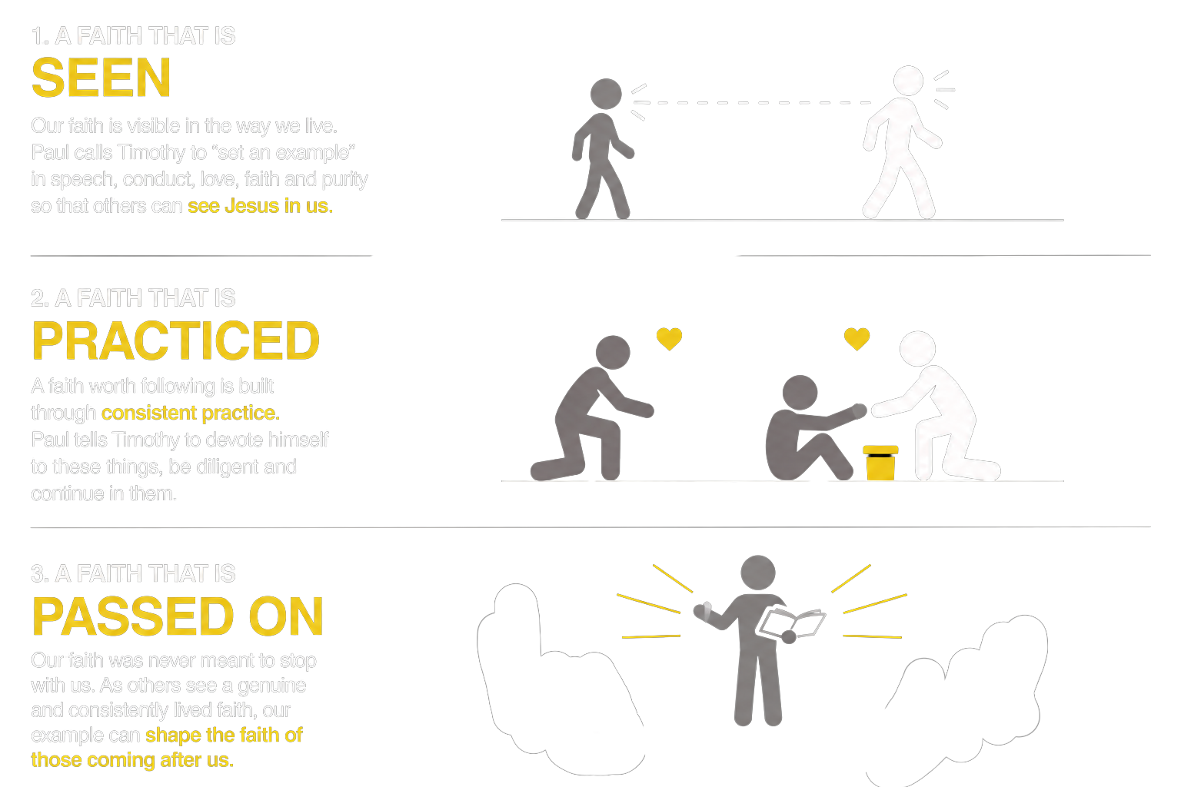

A faith that is seen
A faith that is practiced
A faith that is passed on

Slide 32
12 Let no one despise you for your youth, but set the believers
an example in speech, in conduct, in love, in faith, in purity.
13 Until I come, devote yourself to the public reading
of Scripture, to exhortation, to teaching.
14 Do not neglect the gift you have, which was given to you by prophecy
when the council of elders laid their hands on you.
15 Practice these things, immerse yourself in them, so that all may
see your progress.
16 Keep a close watch on yourself and on the teaching. Persist in this,
for by so doing you will save both yourself and your hearers.
1 Timothy 4:12-16

Slide 33
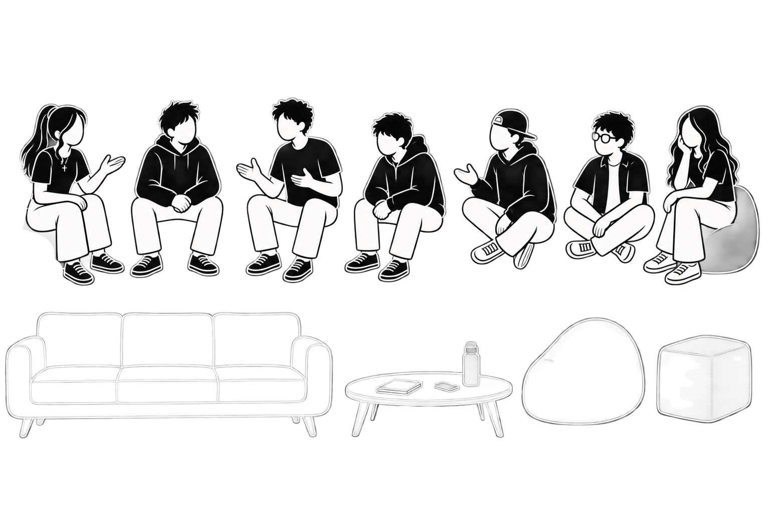
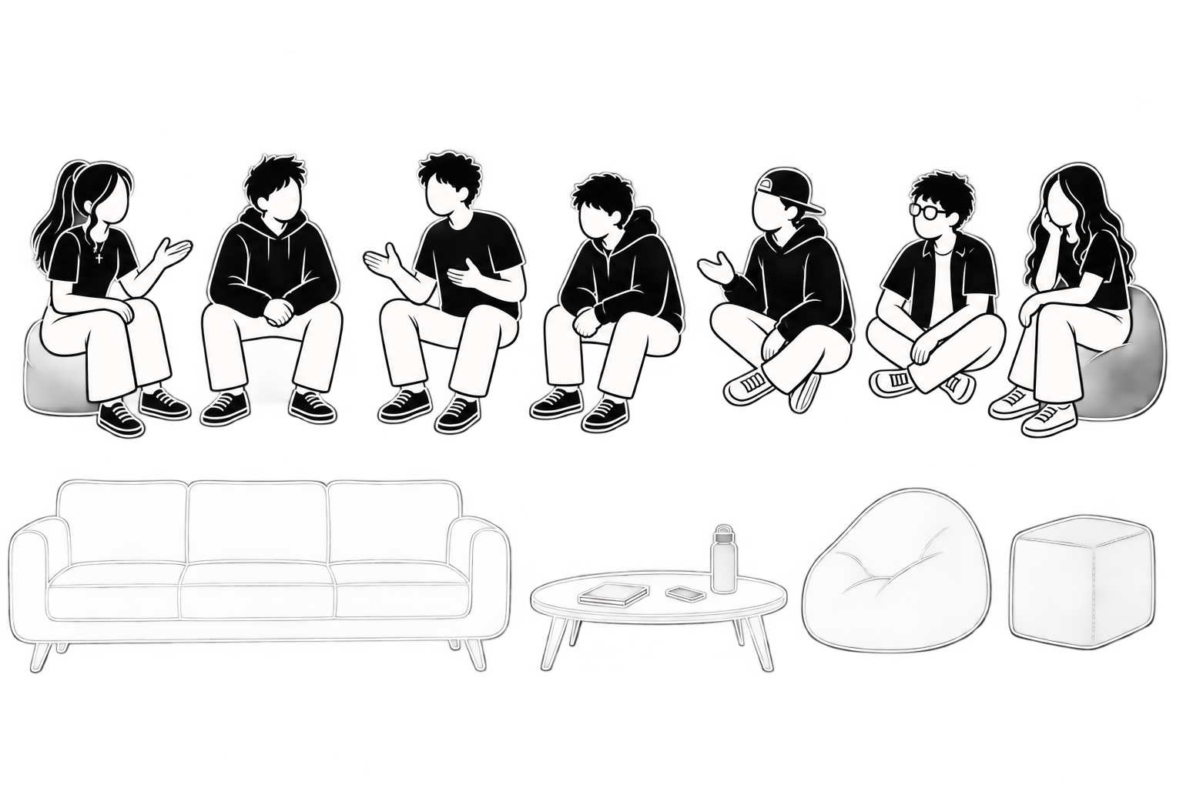


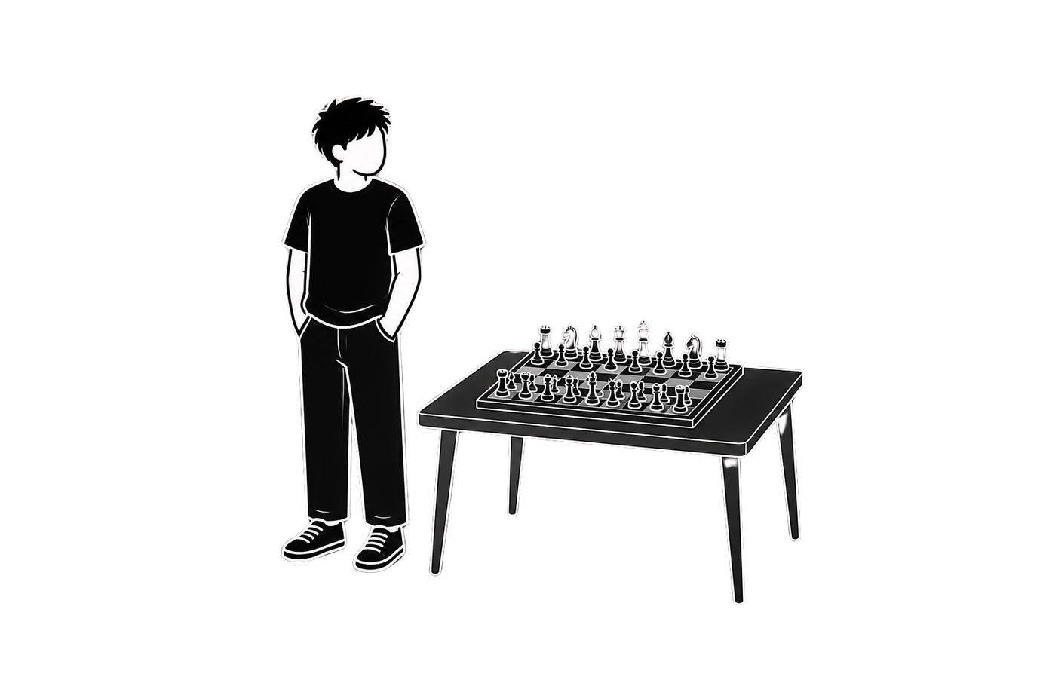
Adi

Slide 34
Adi
Kyran

Slide 35
Zahir
Adi
Kyran

Slide 36
Nathan
Zahir
Adi
Kyran

Slide 37
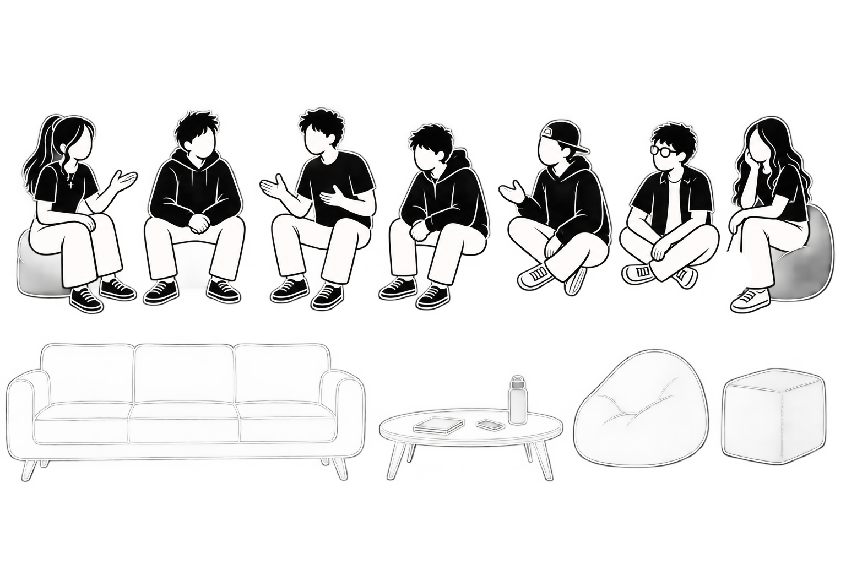
Nathan
Zahir
Adi
Kyran
Michael

Slide 38
Nathan
Zahir
Adi
Kyran
Michael
Jocelyn

Slide 39
Nathan
Justin
Zahir
Adi
Kyran
Michael
Jocelyn

Slide 40
I planted the seed, Apollos watered it, but God has been making it grow.
1 Corinthians 3:6

Slide 41
What does it look like to
live a faith
worth following?

Slide 42
A faith that is seen
A faith that is practiced
A faith that is passed on

Slide 43
For to this end we toil and strive, because we have our hope set on the living God, who is the Savior of all people, especially of those who believe.
1 Timothy 4:10

Slide 44
For to this end we toil and strive, because we have our hope set on the living God, who is the Savior of all people, especially of those who believe.
1 Timothy 4:10

Slide 45


