Slide 1


Slide 2
When the
Voices
Change

Slide 3
Joash was seven years old when he became king, and he reigned in Jerusalem forty years. His mother’s name was Zibiah; she was from Beersheba. ² Joash did what was right in the eyes of the Lord all the years of Jehoiada the priest.
2 Chronicles 24:1-3 NIV

Slide 4
³ Jehoiada chose two wives for him, and he had sons and daughters.
2 Chronicles 24:1-3 NIV

Slide 5
¹⁵ Now Jehoiada was old and full of years, and he died at the age of a hundred and thirty. ¹⁶ He was buried with the kings in the City of David, because of the good he had done in Israel for God and his temple.
2 Chronicles 24:15-18 NIV

Slide 6
¹⁷ After the death of Jehoiada, the officials of Judah came and paid homage
to the king,
and he listened to them.
2 Chronicles 24:15-18 NIV

Slide 7
¹⁸ They abandoned the temple of the Lord, the God of their ancestors, and worshiped Asherah poles and idols.
Because of their guilt, God’s anger
came on Judah and Jerusalem.
2 Chronicles 24:15-18 NIV

Slide 8
²⁰ Then the Spirit of God came on Zechariah son of Jehoiada the priest. He stood before the people and said, “This is what God says:
‘Why do you disobey the Lord’s commands? You will not prosper. Because you have forsaken the Lord, he has forsaken you.’”
2 Chronicles 24:20 NIV

Slide 9
Remember His Faithfulness

Slide 10
¹¹ But Jehosheba, the daughter of King Jehoram, took Joash son of Ahaziah and stole him away from among the royal princes who were about to be murdered and put him and his nurse in a bedroom.
2 Chronicles 22:11-12 NIV

Slide 11
she hid the child from Athaliah so she could not kill him. ¹² He remained hidden with them at the temple of God for six years while Athaliah ruled the land.
2 Chronicles 22:11-12 NIV

Slide 12
In the seventh year Jehoiada
showed his strength.
2 Chronicles 23:1 NIV

Slide 13
Jehoiada said to them,
“The king’s son shall reign,
as the Lord promised concerning
the descendants of David.
2 Chronicles 23:3 NIV

Slide 14
Know therefore that the Lord your God is God; he is the faithful God, keeping his covenant of love to a thousand generations of those who love him and keep his commandments.
Deuteronomy 7:9 NIV

Slide 15
¹¹ Jehoiada and his sons brought out the king’s son and put the crown on him; they presented him with a copy of the covenant and proclaimed him king. They anointed him and shouted, “Long live the king!”
2 Chronicles 23:11 NIV

Slide 16
Receive Wise Counsel

Slide 17
² Joash did what was right
in the eyes of the Lord
all the years of Jehoiada the priest.
2 Chronicles 24:2 NIV

Slide 18
Where there is no guidance
the people fall,
But in an abundance of counselors
there is victory.
Proverbs 11:14 NASB

Slide 19
One who walks with wise people
will be wise,
But a companion of fools
will suffer harm.
Proverbs 13:20 NASB

Slide 20
Keep God
as Your Treasure

Slide 21
¹⁷ After the death of Jehoiada,
the officials of Judah came
and paid homage to the king,
and he listened to them.
2 Chronicles 24:17 NIV

Slide 22
For where your treasure is,
there your heart will be also.
Matthew 6:21 NIV

Slide 23
Conclusion:
Joash reminds us the voices around us will change, but the voice and faithfulness of God never will. May we determine now that no matter who comes or goes, no matter what changes around us, God will remain
our treasure, our portion,
and the One we will follow.

Slide 24
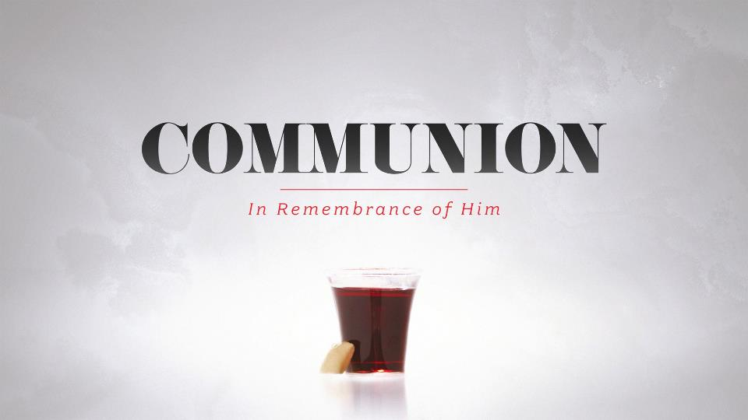

Slide 25


Slide 26


