Slide 1
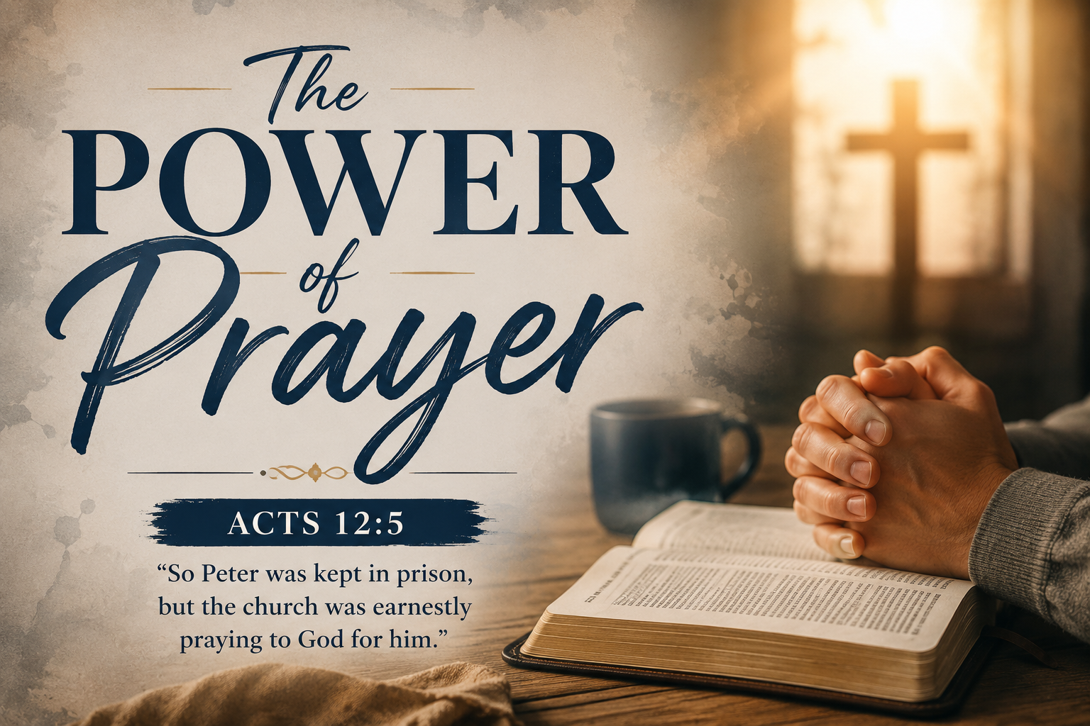

Slide 2

Acts 2:42
They devoted themselves to the apostle’s teaching and to fellowship, to the breaking of bread and to prayer.
Bible Facts
650 prayers
450 answered prayers
25+ times Jesus prayed

Slide 3
Acts 12:1-5
It was about this time that King Herod arrested some who belonged to the church, intending to persecute them. ² He had James, the brother of John, put to death with the sword. ³ When he saw that this met with approval among the Jews, he proceeded to seize Peter also. This happened during the Festival of Unleavened Bread. ⁴ After arresting him, he put him in prison, handing him over to be guarded by four squads of four soldiers each. Herod intended to bring him out for public trial after the Passover.
⁵ So Peter was kept in prison, but the church was earnestly praying to God for him.

Slide 4
While the Church Prayed
God Acted and Answered

Slide 5
1 Thessalonians 5:16-18
¹⁶ Rejoice always, ¹⁷ pray continually, ¹⁸ give thanks in all circumstances; for this is God’s will for you in Christ Jesus.

Slide 6
Romans 8:26-27
²⁶ In the same way, the Spirit helps us in our weakness. We do not know what we ought to pray for, but the Spirit himself intercedes for us through wordless groans. ²⁷ And he who searches our hearts knows the mind of the Spirit, because the Spirit intercedes for God’s people in accordance with the will of God.

Slide 7
1 Corinthians 12: 7-10
^{7 …}Therefore, in order to keep me from becoming conceited, I was given a thorn in my flesh, a messenger of Satan, to torment me. ⁸ Three times I pleaded with the Lord to take it away from me. ⁹ But he said to me, “My grace is sufficient for you, for my power is made perfect in weakness.” Therefore I will boast all the more gladly about my weaknesses, so that Christ’s power may rest on me. ¹⁰ That is why, for Christ’s sake, I delight in weaknesses, in insults, in hardships, in persecutions, in difficulties. For when I am weak, then I am strong.

Slide 8
Start Small
Pray Big

