Slide 1
Welcome to Holy Hermits Online Worship
15th Sunday after Pentecost
Today, we are celebrating
The Season of Creation
Service Prep: Lauren | Chat Host: Viki | Fellowship: Julie
Music: Lauren | Welcomer: Julie | Safety Officer: Chris
Proof-reader: Chris | Leader: Julie | Attendance: Viki
Broadcaster: Lauren | Cantor: Kieron | Preacher: Lauren
Backup Broadcaster: Barry | First Reader: Viki | Deacon: Lauren
Zoom Buttons: Viki | Second Reader: Vanessa | Priest: N/A
Notes:
Please try to keep all fonts size 28 with 1.5 spacing so that it is easier for people to read
Readers with an ‘*’ after their name in the roster are down to pre-record, please include ‘*’ in the slide

Slide 2






Hospitality
Leader:
Please mute for the service unless invited to offer your voice as part of the service ministry
Have the video camera on or off and turn the volume and brightness up or down on your device if things are too loud 🔉🔊or too bright🔅🔆
Our Cantor acts as our voice, offering the responses, in Bold Text, which we say together
Feel welcome to use the chat and reaction emojis 👍
🙏 Please take care of yourself in this space. 🙏 Come and go as you need
😴 It is great to take rest in this space, so falling asleep is also OK 😴
👂️ Remember, pastoral care is available to all in the community, if you'd like to speak to someone about anything spiritual. ❤️ Visit the help page at the website to reach out 🌐
Our Being Together ethos and safeguarding practices can also be accessed on the website 🫶​
🙌 Come as you are – we are all here together! 🙌
Notes:
Used Lent 2022

Slide 3

Leader: Today we celebrate Holy Hermits Online’s 6th birthday!
We will have a party soon, keep an eye out for more information.
Happy birthday everyone!
https://www.youtube.com/watch?v=-DRSruRMZ8o
Notes:
Only for this week ☺

Slide 4
Invitation
Leader: As we come into worship let’s take a few deep breaths,
Let go of anything that isn’t serving us,
And become aware of God’s presence here with us.
Opening Music: https://www.youtube.com/watch?v=4JIdRTHTS9M

Slide 5
Leader and Cantor unmute
The Greeting
Leader:
The grace of the Lord Jesus Christ,
and the love of God,
and the fellowship of the Holy Spirit,
be with you all.
All: And also with you.

Slide 6
Gathering Prayer
Leader:
Let’s get ready!
Let’s get ready to meet God here together.
Let’s get ready to listen to God’s Word.
Let’s get ready to explore God’s message.
Let’s get ready to pray for ourselves and the world.
Let’s get ready to worship!
Notes:
Use Call to Worship Prayer https://www.rootsontheweb.com

Slide 7
Gathering Prayer
All:
Lord, help us to sing a new song:
a song of love, not quarrelling;
a song of light, not darkness;
a song of joy, not sorrow.
Help us to remember your love for us,
as we praise you with music and dancing.
Amen.
Notes:
Use gathering prayer - Roots

Slide 8
Sentence
Leader: I invite our Cantor to proclaim the sentence for today.
Cantor:
‘Where two or three are gathered in my name,’ says the Lord, ‘I am there among them.’
Matthew 18.20
Notes:
From Epray – ensure the text is black and font size is 28

Slide 9
Prayer of Approach
Leader: We pray the prayer of approach together
All: Eternal God, with ears ready to hear you,
with hearts ready to receive you,
with voices ready to praise you,
with hands ready to reach out to you,
with lives ready to serve you,
we celebrate your presence with us now,
in this place and in our world. Amen.
Notes:
Prayer of Approach from Roots

Slide 10
Leader unmutes
Our first Hymn
Take My Life and Let it Be
https://www.youtube.com/watch?v=Of4l5bTdZ8M
We stay on mute
Leader mutes

Slide 11
The Deacon or LA introduces the Confession​
God is steadfast in love and infinite in mercy, welcoming sinners and inviting them to the Lord's table.
Silence may be kept.​
Let us confess our sins in penitence and faith, with a sincere and a true heart.
Notes:
Epray – has seasonal variation

Slide 12
All: ​Merciful God, our maker and our judge, ​
we have sinned against you ​in thought, word, and deed, ​
and in what we have failed to do: ​
we have not loved you with our whole heart; ​
we have not loved our neighbours as ourselves; ​
we repent, and are sorry for all our sins.​
Father, forgive us. Strengthen us to love and obey you
in newness of life; ​through Jesus Christ our Lord. ​
Amen.​

Slide 13
Words of Assurance offered by the Deacon or LA
These words of assurance from the First Letter of John declare that:
If anyone sins, we have an advocate with the Father, Jesus Christ the righteous. He is the perfect offering for our sin, and not for ours only, but for the sins of the whole world.
(1 John 2: 1-2)
In this is love, not that we loved God, but that he loved us and sent his Son to be the perfect offering for our sins.
(1 John 4:10)

Slide 14
Collect
Leader: Go before us, O Lord, with your most gracious favour
and further us with your continual help,
that in all our works, begun, continued, and ended in you,
we may glorify your holy name,
and finally, by your mercy, obtain everlasting life;
through Jesus Christ our Lord,
who lives and reigns with you in the unity of the Holy Spirit,
one God, for ever and ever. Amen.
Notes:
From Epray – ensure the text is black and font size is 28

Slide 15
The 1st reader unmutes
Leader: I invite the 1st reader to unmute and offer the 1st lesson when ready
Reader 1: The 1st Reading is from Exodus 12.1-14
¹ The Lord said to Moses and Aaron in the land of Egypt: ² This month shall mark for you the beginning of months; it shall be the first month of the year for you. ³ Tell the whole congregation of Israel that on the tenth of this month they are to take a lamb for each family, a lamb for each household. ⁴ If a household is too small for a whole lamb, it shall join its closest neighbour in obtaining one;
Continue…
Notes:
If the 1st reading is recorded change the introduction to “Leader: We will now listen to the first reading”
(Normal introduction: “I invite the 1st reader to unmute and offer the 1st lesson when ready”)
** Note the Cantor still responds with “Thanks be to God” at the conclusion of the reading
From Epray – ensure the text is black and font size is 28

Slide 16
the lamb shall be divided in proportion to the number of people who eat of it. ⁵ Your lamb shall be without blemish, a year-old male; you may take it from the sheep or from the goats. ⁶ You shall keep it until the fourteenth day of this month; then the whole assembled congregation of Israel shall slaughter it at twilight. ⁷ They shall take some of the blood and put it on the two doorposts and the lintel of the houses in which they eat it. ⁸ They shall eat the lamb that same night; they shall eat it roasted over the fire with unleavened bread and bitter herbs.
Continue…

Slide 17
⁹ Do not eat any of it raw or boiled in water, but roasted over the fire, with its head, legs, and inner organs. ¹⁰ You shall let none of it remain until the morning; anything that remains until the morning you shall burn. ¹¹ This is how you shall eat it: your loins girded, your sandals on your feet, and your staff in your hand; and you shall eat it hurriedly. It is the passover of the Lord . ¹² For I will pass through the land of Egypt that night, and I will strike down every firstborn in the land of Egypt, both human beings and animals; on all the gods of Egypt I will execute judgements: I am the Lord .
Continue…

Slide 18
¹³ The blood shall be a sign for you on the houses where you live: when I see the blood, I will pass over you, and no plague shall destroy you when I strike the land of Egypt. ¹⁴ This day shall be a day of remembrance for you. You shall celebrate it as a festival to the Lord; throughout your generations you shall observe it as a perpetual ordinance.
For the word of the Lord. Thanks be to God.​

Slide 19
Leader: We now say the psalm antiphonally, I invite the first reader to lead, and we will all respond with our cantor as our voice.
Psalm 149
¹ O praise the Lord, and sing to the Lord a new song:
O praise him in the assembly of the faithful.
² Let Israel rejoice in him that made him:
let the children of Zion be joyful in their king.
³ Let them praise him in the dance:
let them sing his praise with timbrel and with harp.
Continue…
Notes:
From Epray – ensure the text is black and font size is 28
If the 1st reading is recorded please:
add The Leader will lead the Psalm to the top left of the screen in the liturgical colour
change the introduction to the Psalm to “Leader: We now say the psalm antiphonally, we will all respond with our cantor as our voice.”
- Normal introduction: “We now say the psalm antiphonally, I invite the first reader to lead, and we will all respond with our cantor as our voice.”

Slide 20
⁴ For the Lord takes delight in his people:
he adorns the meek with his salvation.
⁵ Let his faithful ones exult in his glory:
let them sing for joy upon their beds.
⁶ Let the high praises of God be in their mouths:
and a two-edged sword in their hands,
⁷ To execute vengeance on the nations:
and chastisement upon the peoples,
Continue…

Slide 21
⁸ To bind their kings in chains:
and their nobles with fetters of iron,
⁹ To visit upon them the judgement that is decreed:
such honour belongs to all his faithful servants.
Praise the Lord.

Slide 22
The 2nd reader unmutes
Leader: I invite the 2nd reader to unmute and offer the 2nd lesson when ready.
Reader 2: The 2nd Reading is from Romans 13.1-10
¹ Let every person be subject to the governing authorities; for there is no authority except from God, and those authorities that exist have been instituted by God. ² Therefore whoever resists authority resists what God has appointed, and those who resist will incur judgement. ³ For rulers are not a terror to good conduct, but to bad. Do you wish to have no fear of the authority?
Continue…
Notes:
From Epray – ensure the text is black and font size is 28

Slide 23
Then do what is good, and you will receive its approval; ⁴ for it is God’s servant for your good. But if you do what is wrong, you should be afraid, for the authority does not bear the sword in vain! It is the servant of God to execute wrath on the wrongdoer. ⁵ Therefore one must be subject, not only because of wrath but also because of conscience. ⁶ For the same reason you also pay taxes, for the authorities are God’s servants, busy with this very thing. ⁷ Pay to all what is due to them—taxes to whom taxes are due, revenue to whom revenue is due, respect to whom respect is due,
Continue…

Slide 24
honour to whom honour is due. ⁸ Owe no one anything, except to love one another; for the one who loves another has fulfilled the law. ⁹ The commandments, ‘You shall not commit adultery; You shall not murder; You shall not steal; You shall not covet’; and any other commandment, are summed up in this word, ‘Love your neighbour as yourself.’ ¹⁰ Love does no wrong to a neighbour; therefore, love is the fulfilling of the law.
For the word of the Lord. Thanks be to God.​

Slide 25

We pause before
​the Gospel ​​

Slide 26
Deacon: The Gospel of our Lord Jesus Christ according to St Matthew Chapter 18 beginning at the 10th verse.
All: Glory to you Lord Jesus Christ.
¹⁰ ‘Take care that you do not despise one of these little ones; for, I tell you, in heaven their angels continually see the face of my Father in heaven. ¹² What do you think? If a shepherd has a hundred sheep, and one of them has gone astray, does he not leave the ninety-nine on the mountains and go in search of the one that went astray?
Continue…
Notes:
From Epray – ensure the text is black and font size is 28
Please note that there is a different introduction and final response if this is lay led

Slide 27
¹³ And if he finds it, truly I tell you, he rejoices over it more than over the ninety-nine that never went astray. ¹⁴ So it is not the will of your Father in heaven that one of these little ones should be lost. ¹⁵ ‘If another member of the church sins against you, go and point out the fault when the two of you are alone. If the member listens to you, you have regained that one. ¹⁶ But if you are not listened to, take one or two others along with you, so that every word may be confirmed by the evidence of two or three witnesses.
Continue…

Slide 28
¹⁷ If the member refuses to listen to them, tell it to the church; and if the offender refuses to listen even to the church, let such a one be to you as a Gentile and a tax-collector. ¹⁸ Truly I tell you, whatever you bind on earth will be bound in heaven, and whatever you loose on earth will be loosed in heaven. ¹⁹ Again, truly I tell you, if two of you agree on earth about anything you ask, it will be done for you by my Father in heaven. ²⁰ For where two or three are gathered in my name, I am there among them.’
This is the Gospel of the Lord. Praise to you Lord Jesus Christ.

Slide 29
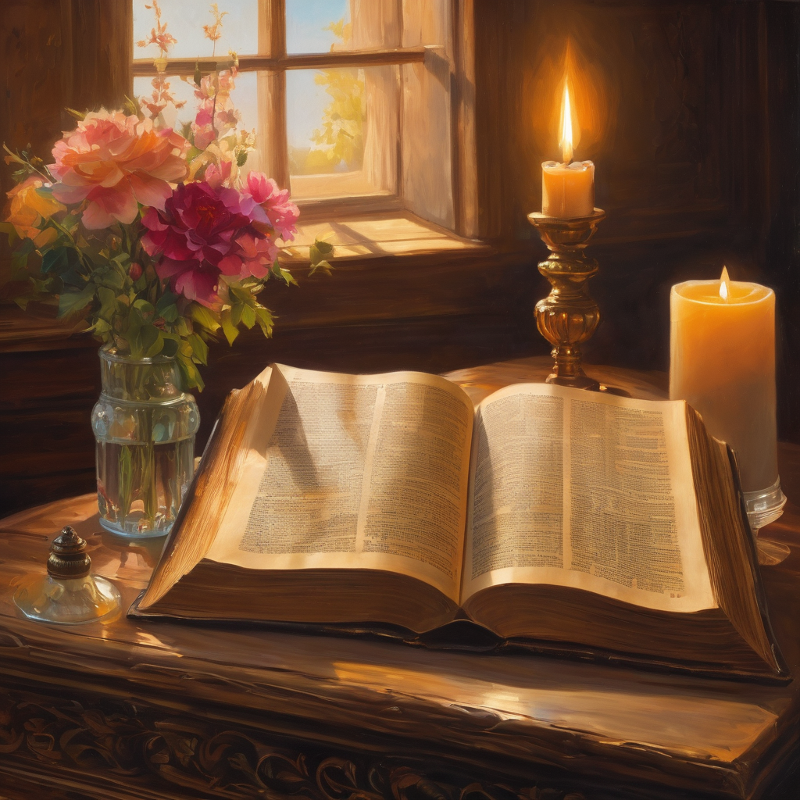
We pause
after ​the Gospel ​​

Slide 30
Leader: The Sermon is recorded to YouTube for sharing later.
Only the preacher's video and audio will be recorded.
The chat and other participants' feeds remain out of sight of the recording.
Leader and Cantor mute
Broadcaster exits screenshare
Preacher unmutes
Zoom buttons ”pins” preacher’s screen + selects “record to the cloud”
Sermon

Slide 31
Leader unmutes
Our next Hymn
O Love That Wilt Not Let Me Go
https://www.youtube.com/watch?v=Gldd_dgMsp0
We stay on mute
Leader mutes

Slide 32
The Leader and Cantor unmute
The Greeting of Peace
Leader: We are the body of Christ
All: God’s Spirit is with us
Leader: The peace of the Lord be always with you.
All: And also with you.
Leader: A sign of peace may be exchanged
You may like to type 'Peace' into the chat, use the 'raise hand’ or other reaction buttons, or just simply wave via the screen with your video turned on
(Broadcaster exits shared screen for a few moments for the exchange of peace)

Slide 33

Prayer of Thanksgiving before Intercessions
Leader: As we enter prayer, I invite the second reader to unmute to lead our intercessions following the prayer of thanksgiving on the next slide. Please feel free to change your body position as you need.
Continue…

Slide 34
Leader: Loving God,
we thank you for being a God of action and words,
of possibility and promise, of hope and healing,
of faith and fulfilment, of remembrance and renewal,
of love and liberation, of history and of here and now.
Thank you for being a God of individuals and community,
thank you for being our God,
and for calling us to be your people.
In Jesus’ name.Amen.
Notes:
Prayer of praise and thanksgiving from Roots (if it’s too long still add it and it will be sorted out ☺)

Slide 35
Intercessions
Reader 2: We pray for creation and communities we share our lives with. We pause for a few moments to name either in our hearts, or out loud, or in the chat, those environments and communities we bring to the Lord in prayer.
PAUSE…
Continue…

Slide 36
Intercessions
Reader 2: We entrust to you the community of Holy Hermits Online and our ministry partners:
Prosper the work of our hands and show us the way to your new creation.
Creator God, Hear our prayer.
St John's Cathedral Brisbane The Anglican Diocese of Southern Queensland St Gabriel’s, Carindale Benedictus Contemplative Church, Canberra Anglican Focus and Tithe.ly

Slide 37
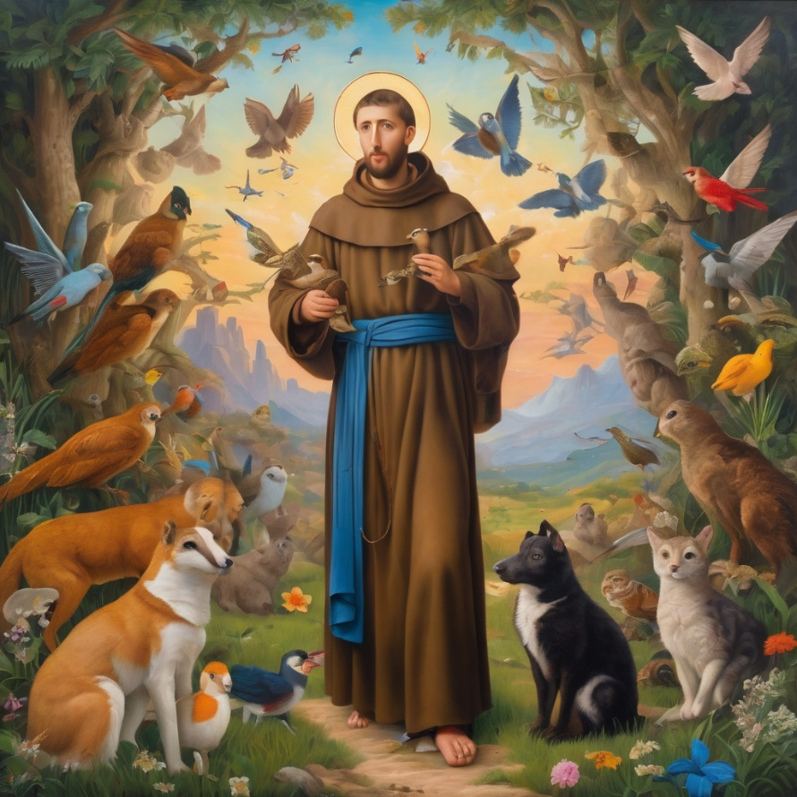
Reader 2: Loving Creator, we entrust to you all animals, especially those who are sick, anxious, ageing, lost, at risk, lonely, sad, hungry, in pain, homeless, abused, living in fear, encountering violence of any kind, in need of comfort, rehabilitation or transformation.

Slide 38
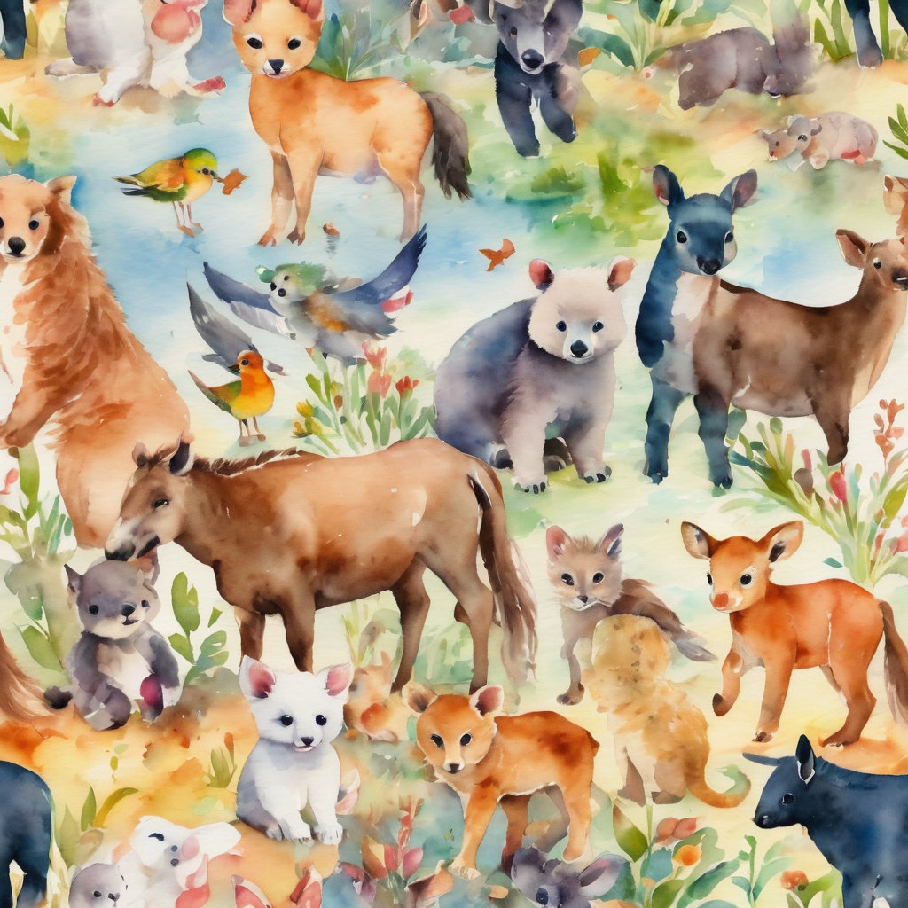
Reader 2: We invite your loving compassion for:
We name in our hearts, out loud or in the chat,
the animals we bring to the Lord in prayer. PAUSE…
Jasmine, ​
Leese(y), ​
Sid, Toots & Lulu​
Polly and Suki​
Fred, George & Percy​
Koshka ​
Jax
Lambert ​​
Kala, Nigel & Little One ​​
Toby​​
Taco​​
Paddy ​​
Rosie​

Slide 39
Reader 2: Eternal Trinity of Love, we uphold to you the people we love and carry cares for:
Kerry, Les & Jake Julie, Ray, Tracey & Shane Mark, Desley & Bob ​​ Rachel, Mervyn & Gillian ​​Rev'd Shane & Janette​​ Alecia, Martin & Aidan​​ Kirsten, Greg, Daphne & Beau Bill & Marjorie​​ Aaron & Andrea Liz’s Godchildren Matthew & Nicholas | Barry​​ Dr Julie ​​ Ruth​​ Phil​ May Susan Tanya​ Neva Kathy ​Gayanne Tina | ​​ | Alan & Gaylene​ Jess & Leah ​​ Barry & Gwen Bob & Di​ Pat & Julie Dilys & Tony, Paul & Darhon Judy & Mary Miriam Lorelei Nettie

Slide 40
Reader 2:
We name in our hearts, out loud or in the chat, those we bring to the Lord in prayer.
PAUSE…
We entrust to you those who have died, those who have died peacefully and those who have died tragically, the old and the young. Receive them into your Kingdom. Lord in your mercy, Hear our prayers. Amen.

Slide 41
Pray Daily Cycle of Prayer
Leader: Loving God, joining with the Church in our cycle of prayer, we ask your blessings on:
The Episcopal / Anglican Province of Alexandria
The Diocese of Bendigo: †Matt; Clergy and People
The Parish of Camp Hill – Norman Park – Quinn
Wolston Correctional Centre
Fraser Coast Anglican College, Hervey Bay: Principal – Joe; Chaplain – Jeff; Chair of College Council – Kirsti; members of College Council; staff & students
Notes:
anglicanfocus.org.au/category/front-page/spirituality/pray-daily/

Slide 42
Commitment Prayer of the Week
Leader: Our commitment prayer for the week is for Companion Animals
Creator God, we give thanks for your call to develop a Companion Animal Ministry at Holy Hermits Online. ​
​We ask for your grace to guide us, as we build this ministry together. ​
​Holy Spirit we ask your presence to be with us as we continue to develop resources together in this new season. ​
Continue…
Notes:
Link to prayer group ministry page for weekly commitment prayer Prayer Group | Ministries | Holy Hermits Online https://holyhermits.com.au/ministries/prayer-group

Slide 43
​Provide us with wisdom and with compassion and with a sense of fun as we celebrate our companion animals and live this mission to outreach. ​
​Alongside Holy Hermit St. Francis, we ask you Lord Jesus Christ, to enliven us in this ministry space. ​
​Amen.
Notes:
Link to prayer group ministry page for weekly commitment prayer Prayer Group | Ministries | Holy Hermits Online https://holyhermits.com.au/ministries/prayer-group

Slide 44
Leader: Let us pray together the prayer which Jesus gave us saying:
All: Our Father in heaven, hallowed be your name,
your kingdom come, your will be done, on earth as in heaven.
Give us today our daily bread.
Forgive us our sins
as we forgive those who sin against us.
Save us from the time of trial and deliver us from evil.
For the kingdom, the power, and the glory are yours
now and for ever.
Amen.

Slide 45
Devotions

Slide 46
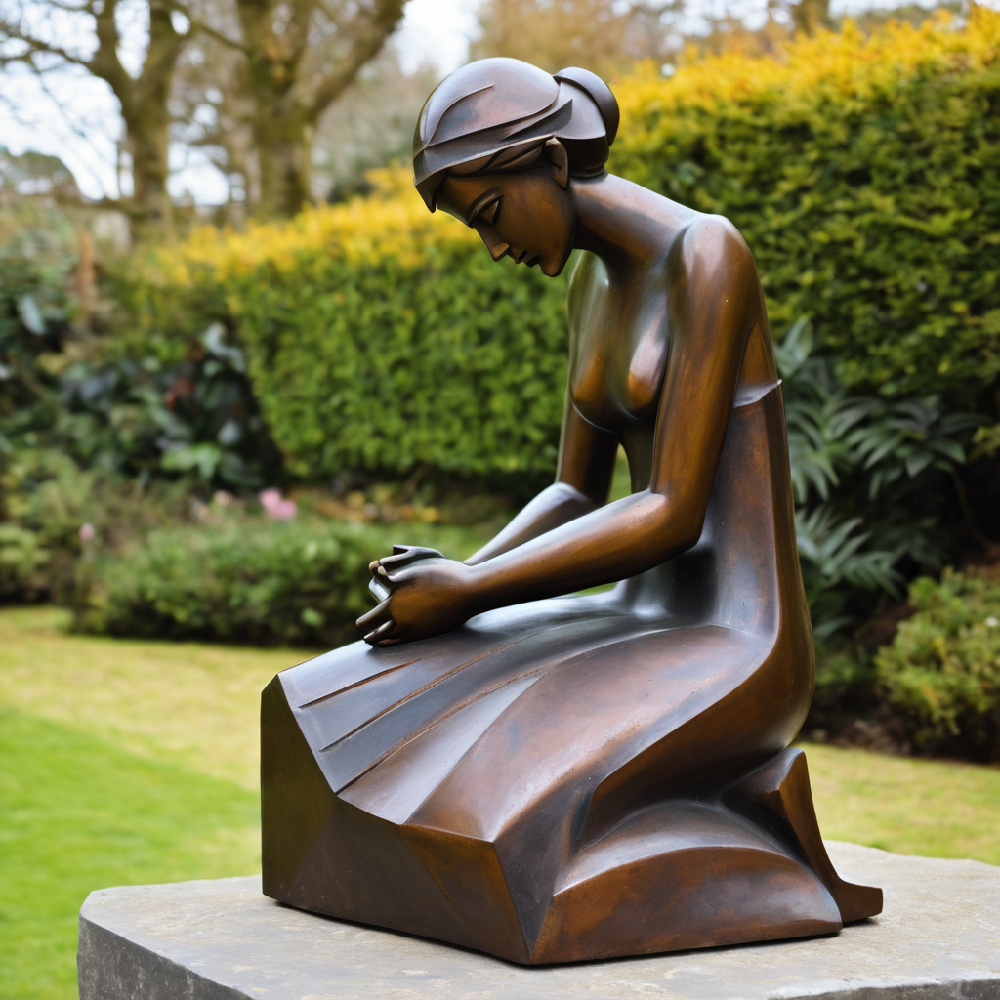
​
Leader: ​As we enter a few minutes of silence together, you are invited to pray the prayer of adoration on the next slide and/or spend this time in contemplation. ​
The Spiritual Communion prayer follows on the slide after that.
Let us be still.
Leader and Cantor Mute.
Continue…

Slide 47
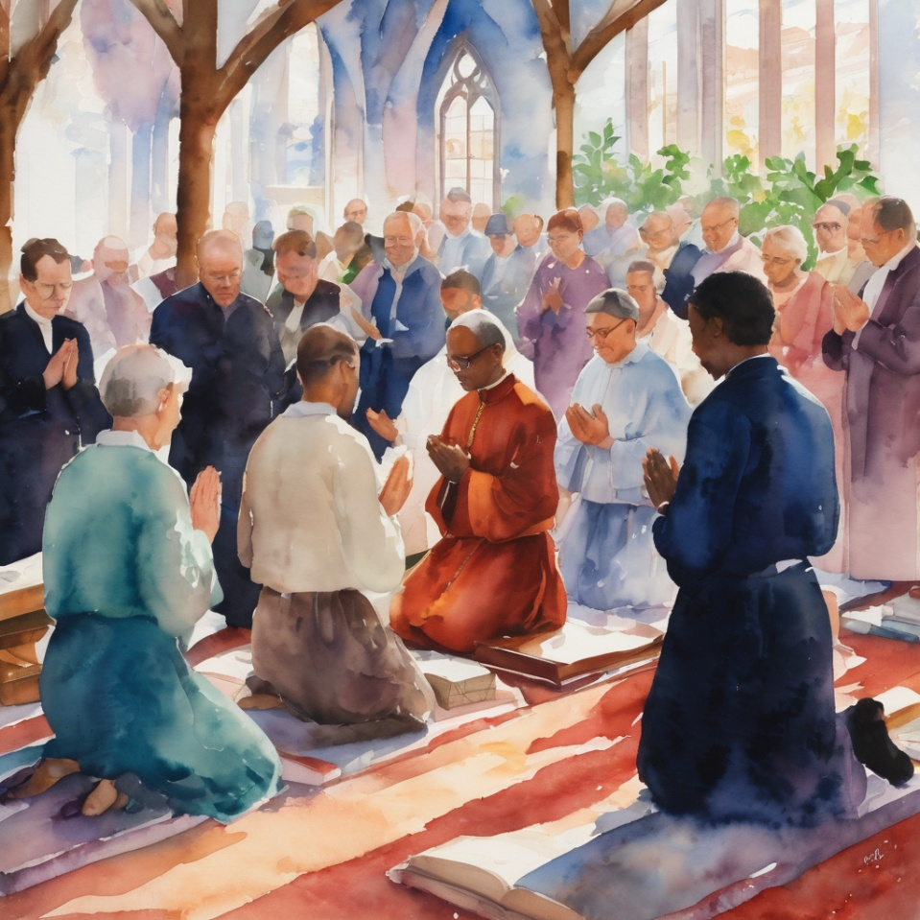
​
God of all,
help us to be ready to listen to you,
help us to be ready to follow you,
help us to be ready to see you in our world,
help us to be ready to serve you in our world.
Amen.
Notes:
Prayer for all ages from Roots

Slide 48

  Oh, my Lord Jesus I turn to you present at the Altar and in the Tabernacle. I believe that you are present in the Holy Sacrament of your most Sacred Body and Blood. I love you above all things and I desire to receive you into my Soul. I cannot at this moment receive you Sacramentally in Holy Communion. Come spiritually into my heart. Purify it, Sanctify it. Render my heart like your own heart. I embrace you as if you were already there and unite myself wholly with you. Never permit me to be separated from you. Lord, I am not worthy to receive you, but only say the word and I shall be healed. Amen
Making a Spiritual Communion
(Prayed in silence)
Notes:
Spiritual Communion Slide – Please do not change the prayer
Can change colour of background and title to match liturgical colour. You may also like to change the picture.

Slide 49
Leader unmutes
Our final song is
Praise and Thanksgiving
https://www.youtube.com/watch?v=Ef1as5GTl5k
We stay on mute
Leader mutes

Slide 50
Leader and cantor unmute
Sending Prayer
Leader: We pray our sending prayer together.
All: Lord, now we’re Ready to follow you,
we’re all Set to carry your message,
and Go out into the world,
spreading your love and peace.
Amen.
Notes:
Use Sending Prayer from Roots

Slide 51
The Benediction
Leader: Let us all invite God’s blessings together,
All: May the road rise up to meet us,
may the wind be always at our backs,
may the sun shine warm upon our faces,
and the rains fall soft upon our fields;
and until we meet again,
may God hold us in the palm of his hand. Amen.
Notes:
We have a different benediction for our birthday
The Normal Benediction:
May the Lord bless us and keep us.
May the Lord’s face shine upon us and be gracious to us.
May the Lord’s countenance be lifted upon us,
and bring us peace.
Amen

Slide 52
Notices
Earth, Our Original Monastery Wednesday @ 6pm. Continuing our contemplative prayer series. All are welcome to attend.
Prayer and Praise with our Animal Friends Thursday 6pm
Next Sunday Open Space Meeting @ 11am
See HHO Events page for further upcoming events HHO Events
Notes:
Up coming events can be added from the HHO event page/calendar

Slide 53
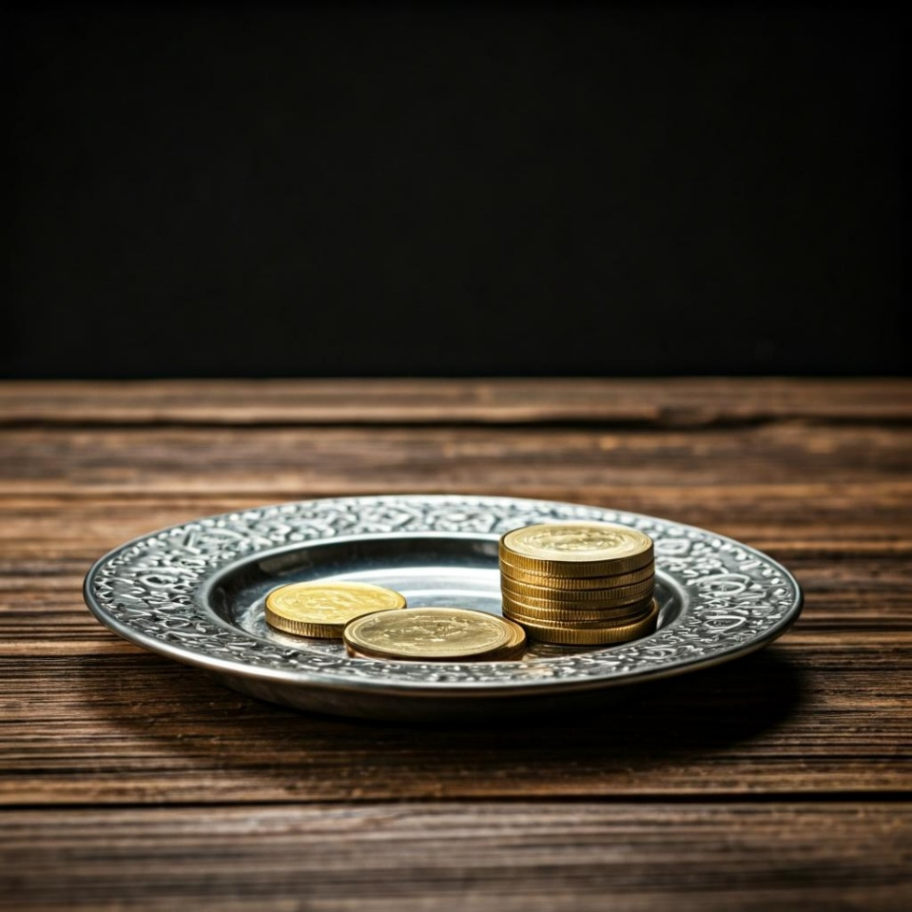
Leader: Thank you for your regular gifts to this ministry. Offerings are most welcome via:
The HHO App
Direct Debit
International Direct Debit
Please consider a one-off donation
or leaving a legacy in your Will
For further information go to HHO give page https://holyhermits.com.au/give

Slide 54
Serving next week
13 September 2026
16th Sunday after Pentecost
9:00 am AEST
Service Prep: Paul | Chat Host: Rachel | Fellowship: Lauren
Music: Paul | Welcomer: Chris | Safety Officer: Rachel
Proof-reader: Lauren | Leader: Jeremy | Attendance: Rachel
Broadcaster: Barry | Cantor: Margo | Preacher: Paul
Backup Broadcaster: Lauren | First Reader: Bob | Deacon: Lauren
Zoom Buttons: Rachel | Second Reader: Helen | Priest: N/A
Thank you for your ministry gifts
New Servers always welcome!
Please email Rev’d Lauren to get involved
holyhermits@anglicanchurchsq.org.au

Slide 55
The Dismissal
Leader: I invite everyone to unmute for the Dismissal
Leader: Go in peace to love and serve the Lord.
All: In the name of Christ, Amen.

Slide 56


Fellowship
Thank you, Julie for leading Fellowship
Please feel welcome to linger or pop a message in the chat and head off when you are ready.​
Extra resources developed
by Roots on the Web
Images from Padlet
Notes:
Please ensure high level of contrast for the fellowship text block to make it easier for people to read

