Slide 1


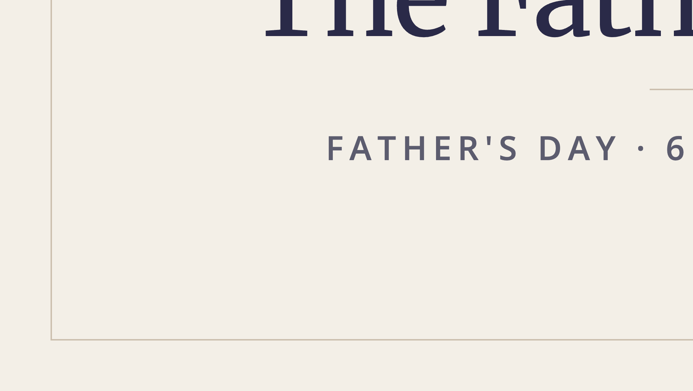
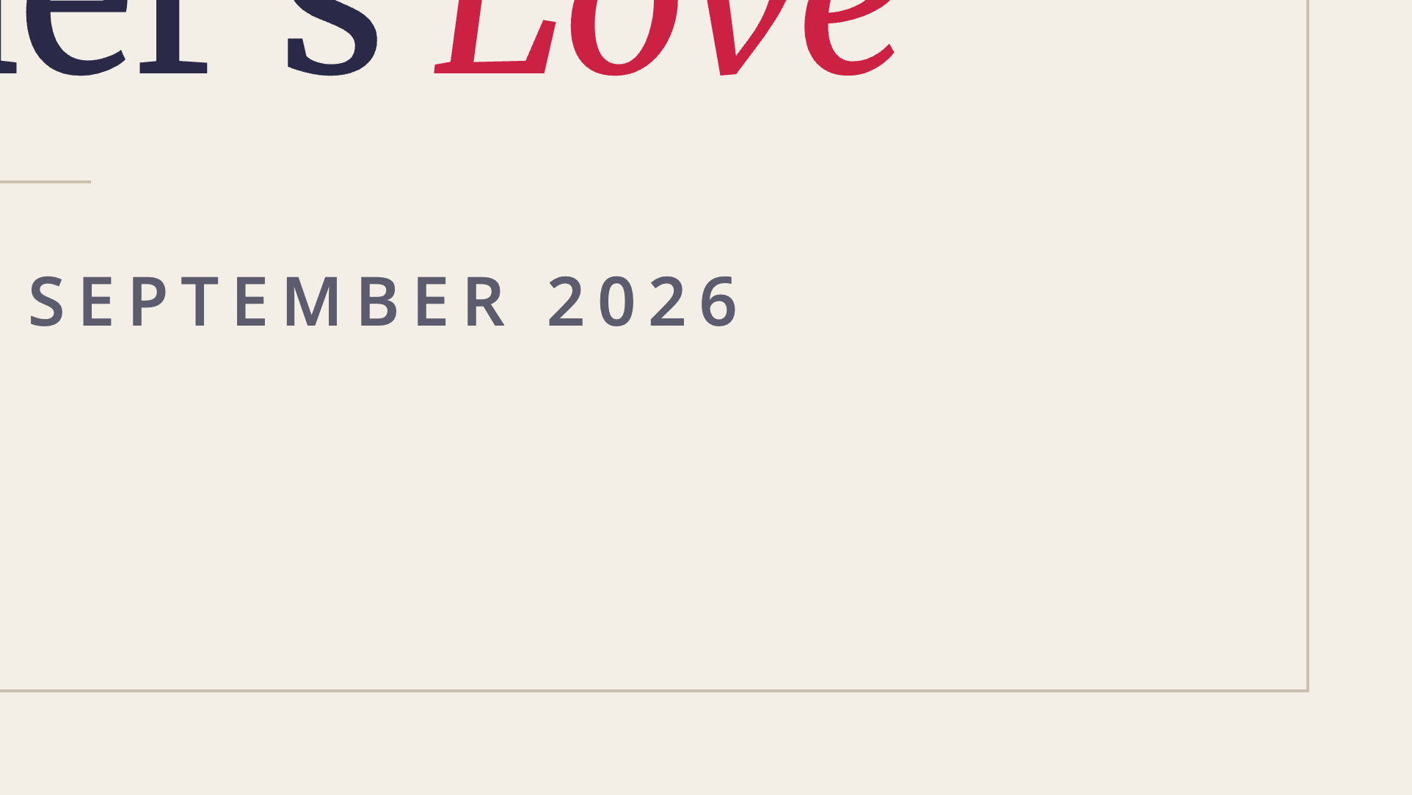
Notes:
Welcome. Happy Father's Day.

Slide 2
JOURNEY TO HOPE WORKING GROUP
Thank you.
For carrying the English Service from Fed Uni to the Hope Centre.
Hannah
Christine
Sin Kiew
Kurnia
Victor
Ps Dan
Chok Ping
Notes:
Thank the Journey to Hope Working Group — they carried the English Service from Fed Uni to the Hope Centre.

Slide 3
HOPE CENTRE INSTALLATION
Thank you.
For giving the whole of yesterday — Saturday — to get this room ready.
Adam
Raj
Kurnia
Victor
Notes:
Thank the installation crew — they gave their whole Saturday.

Slide 4
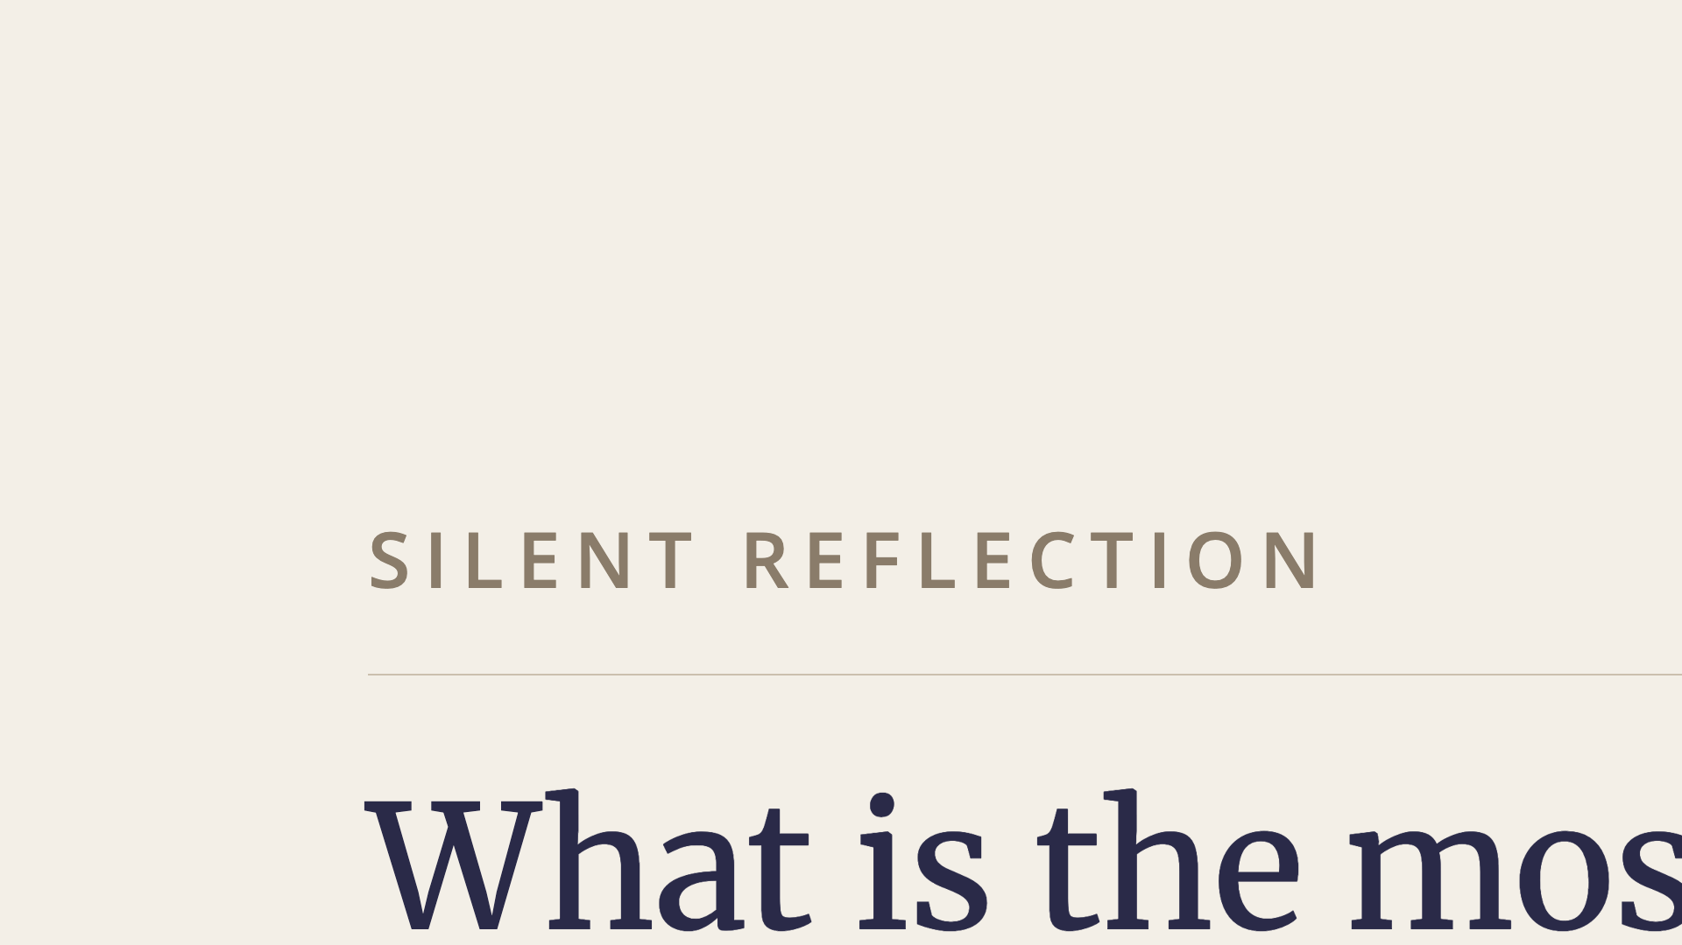
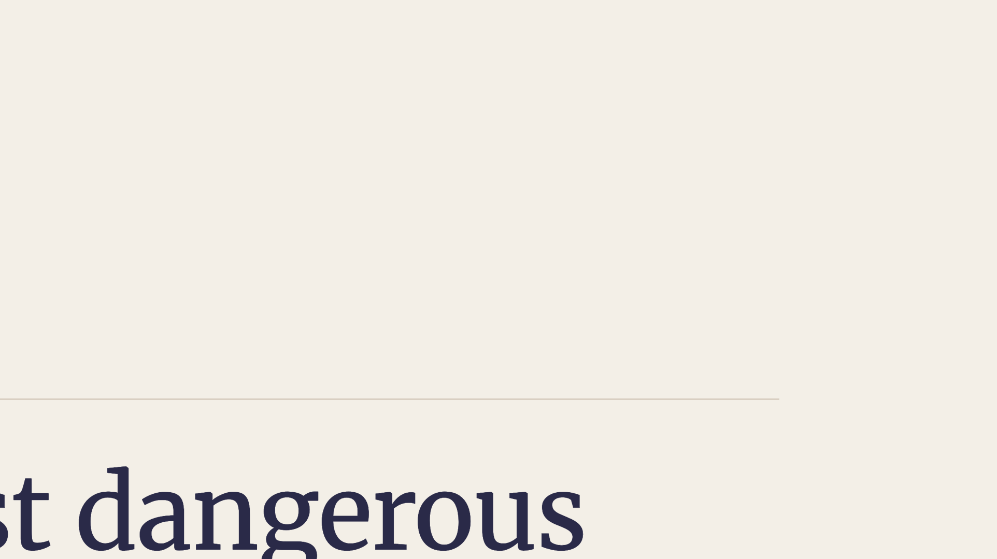
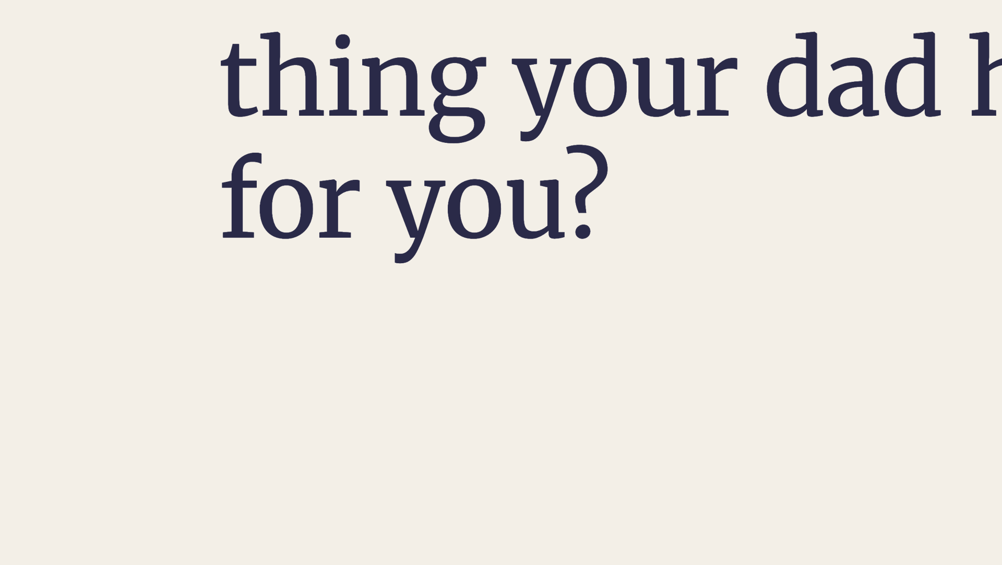
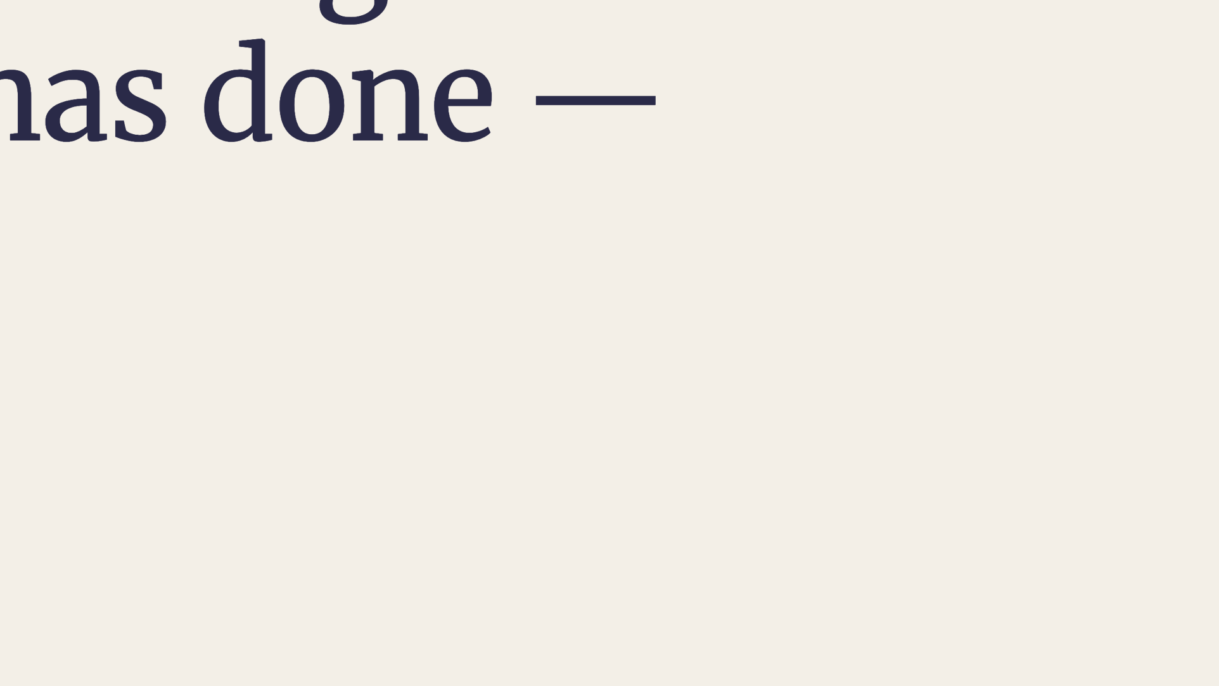
Notes:
Give them a real beat of silence.

Slide 5
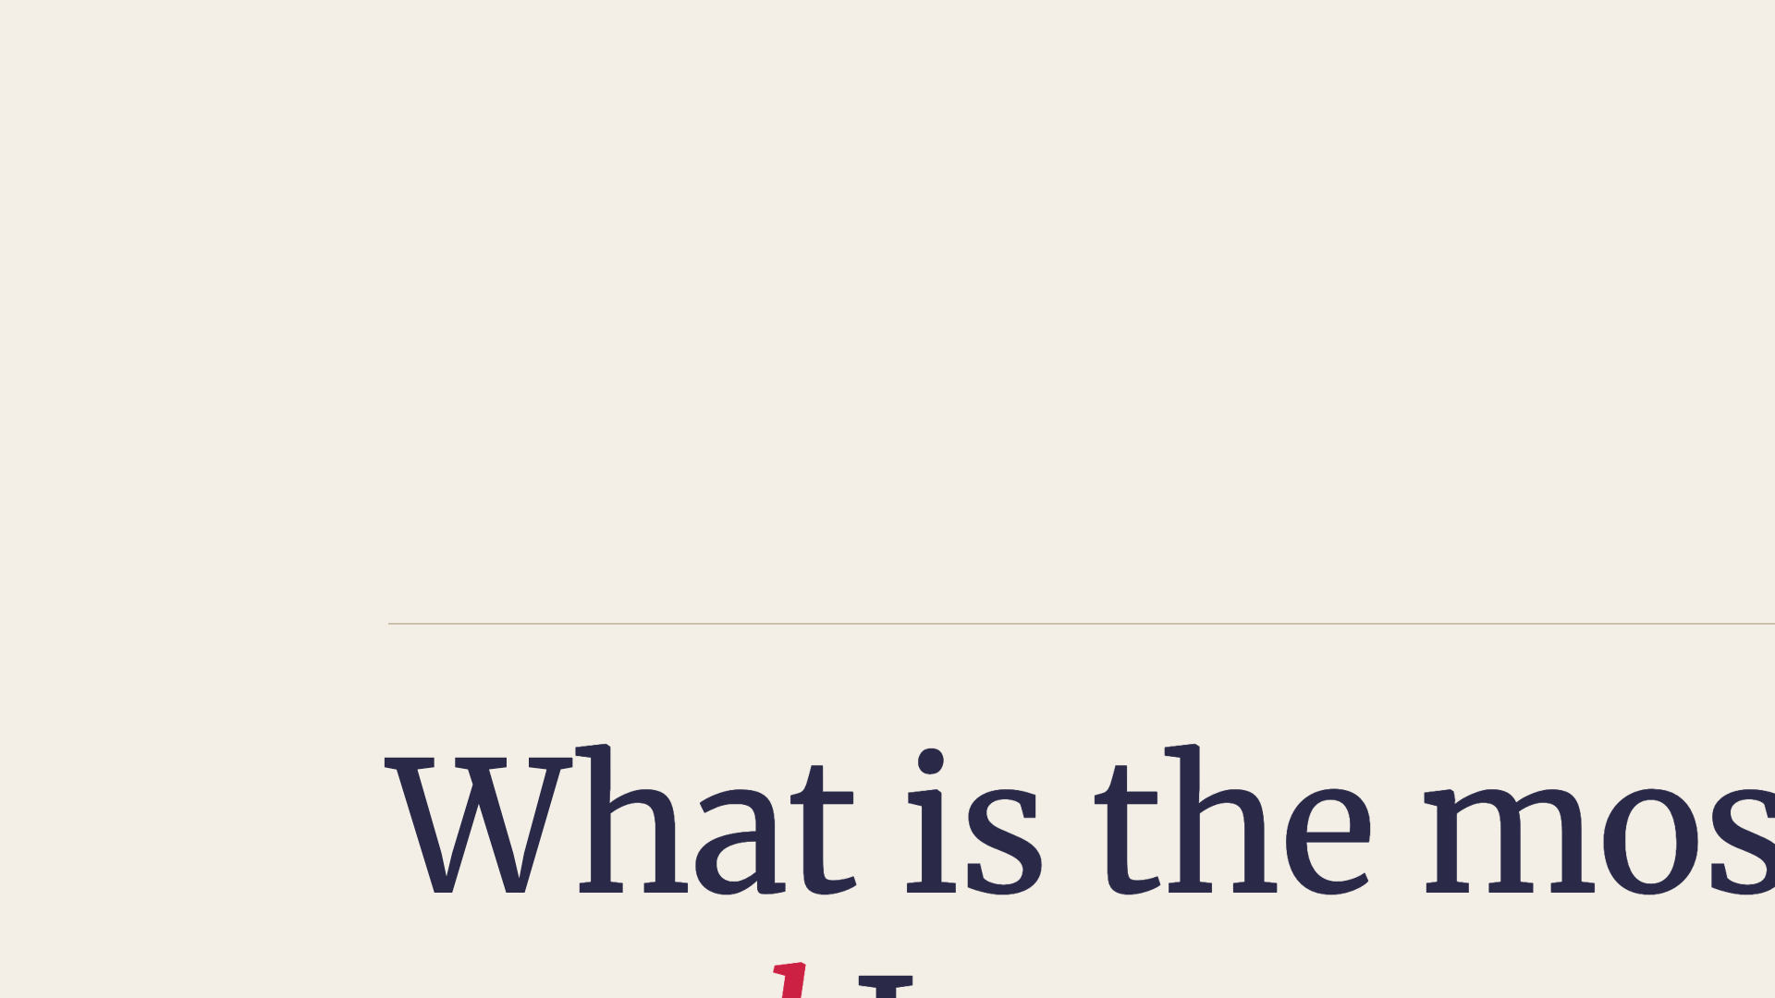
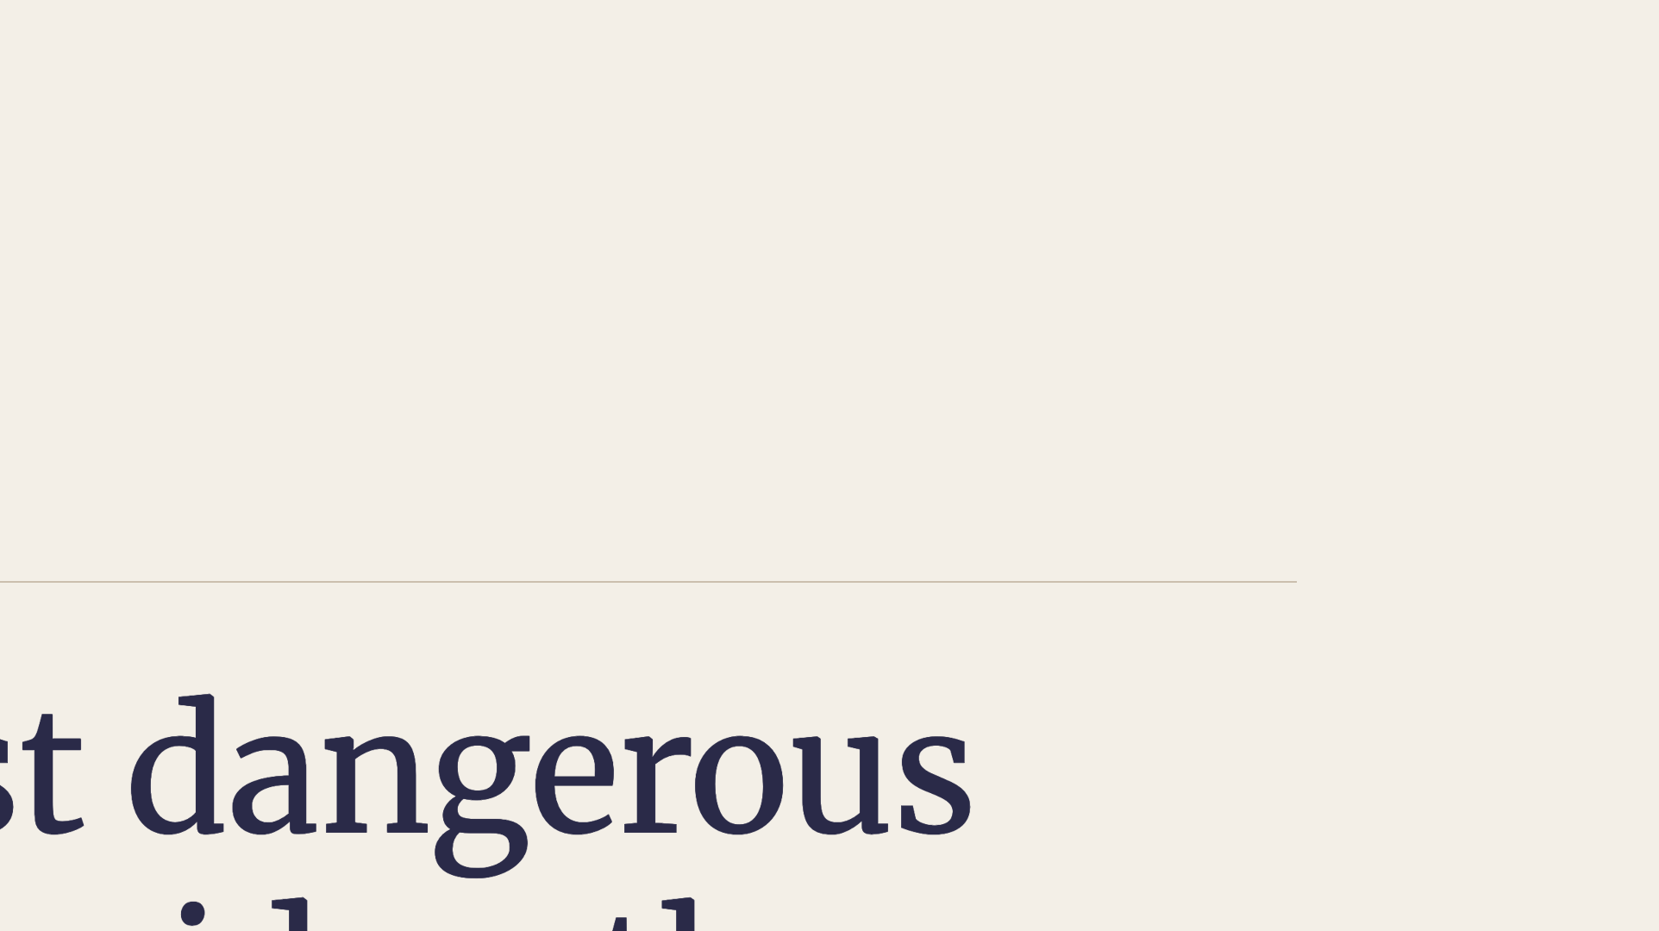
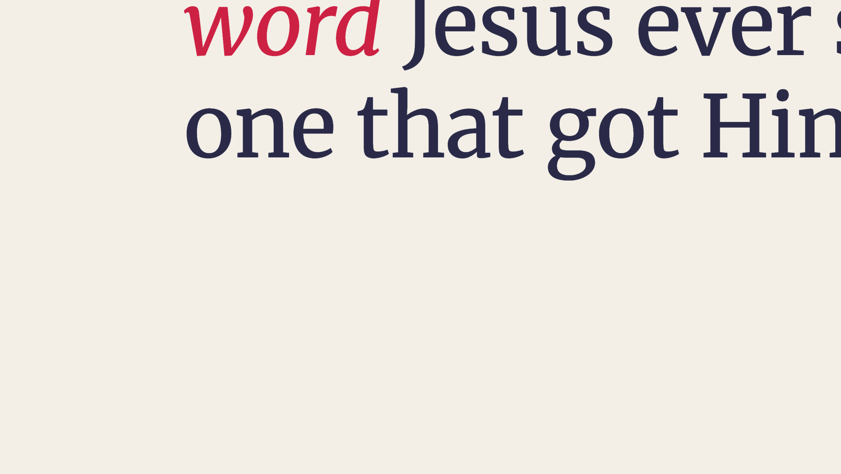
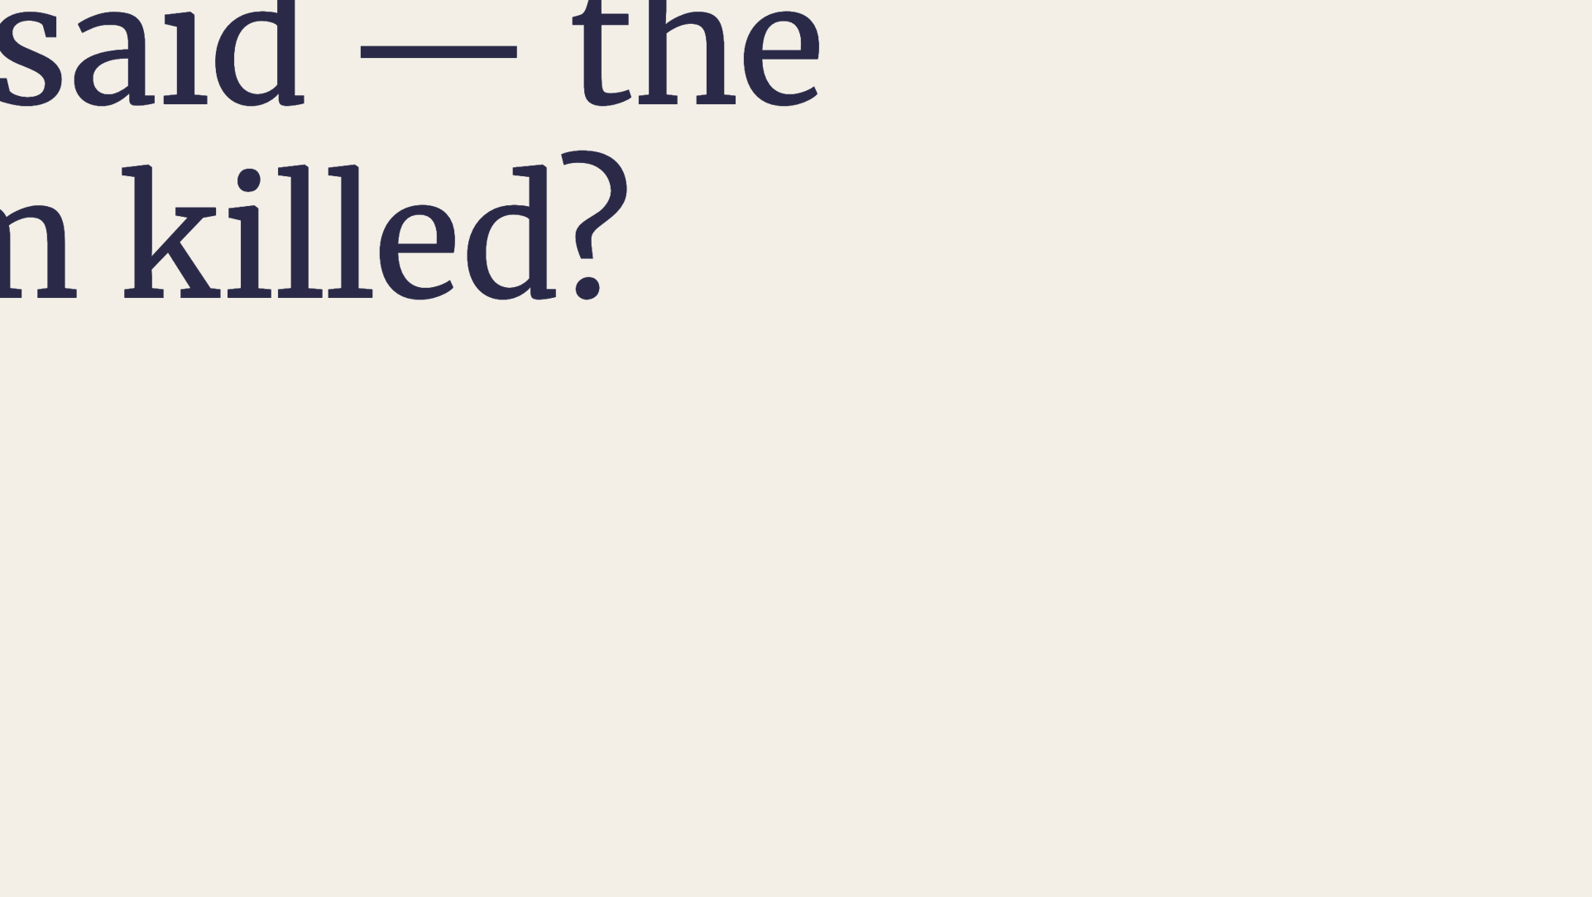
Notes:
Turn the question toward Jesus.

Slide 6
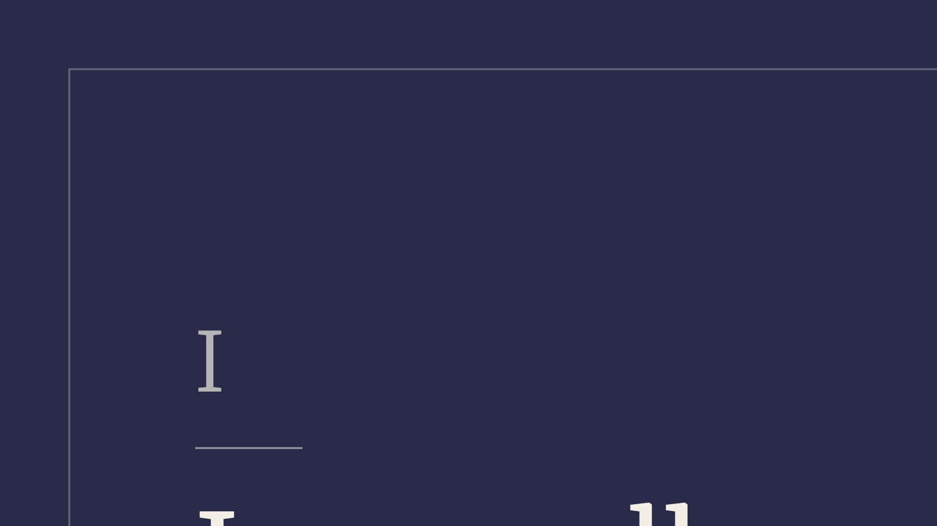
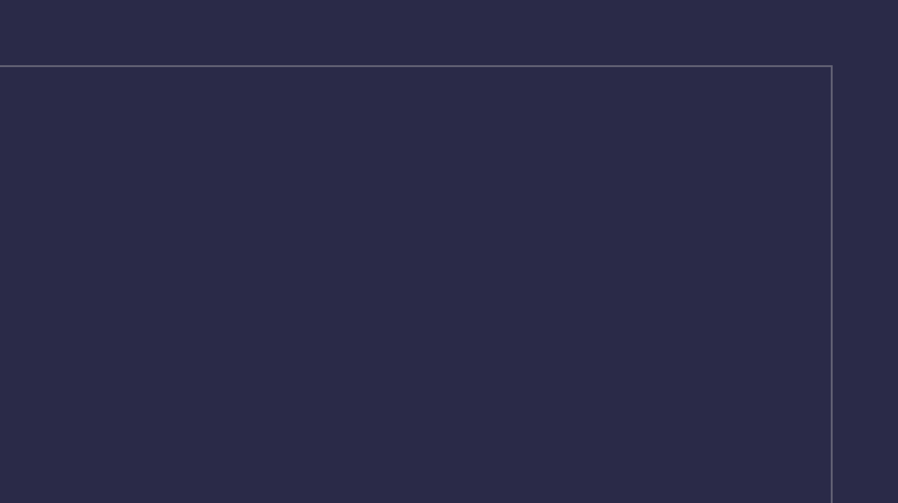
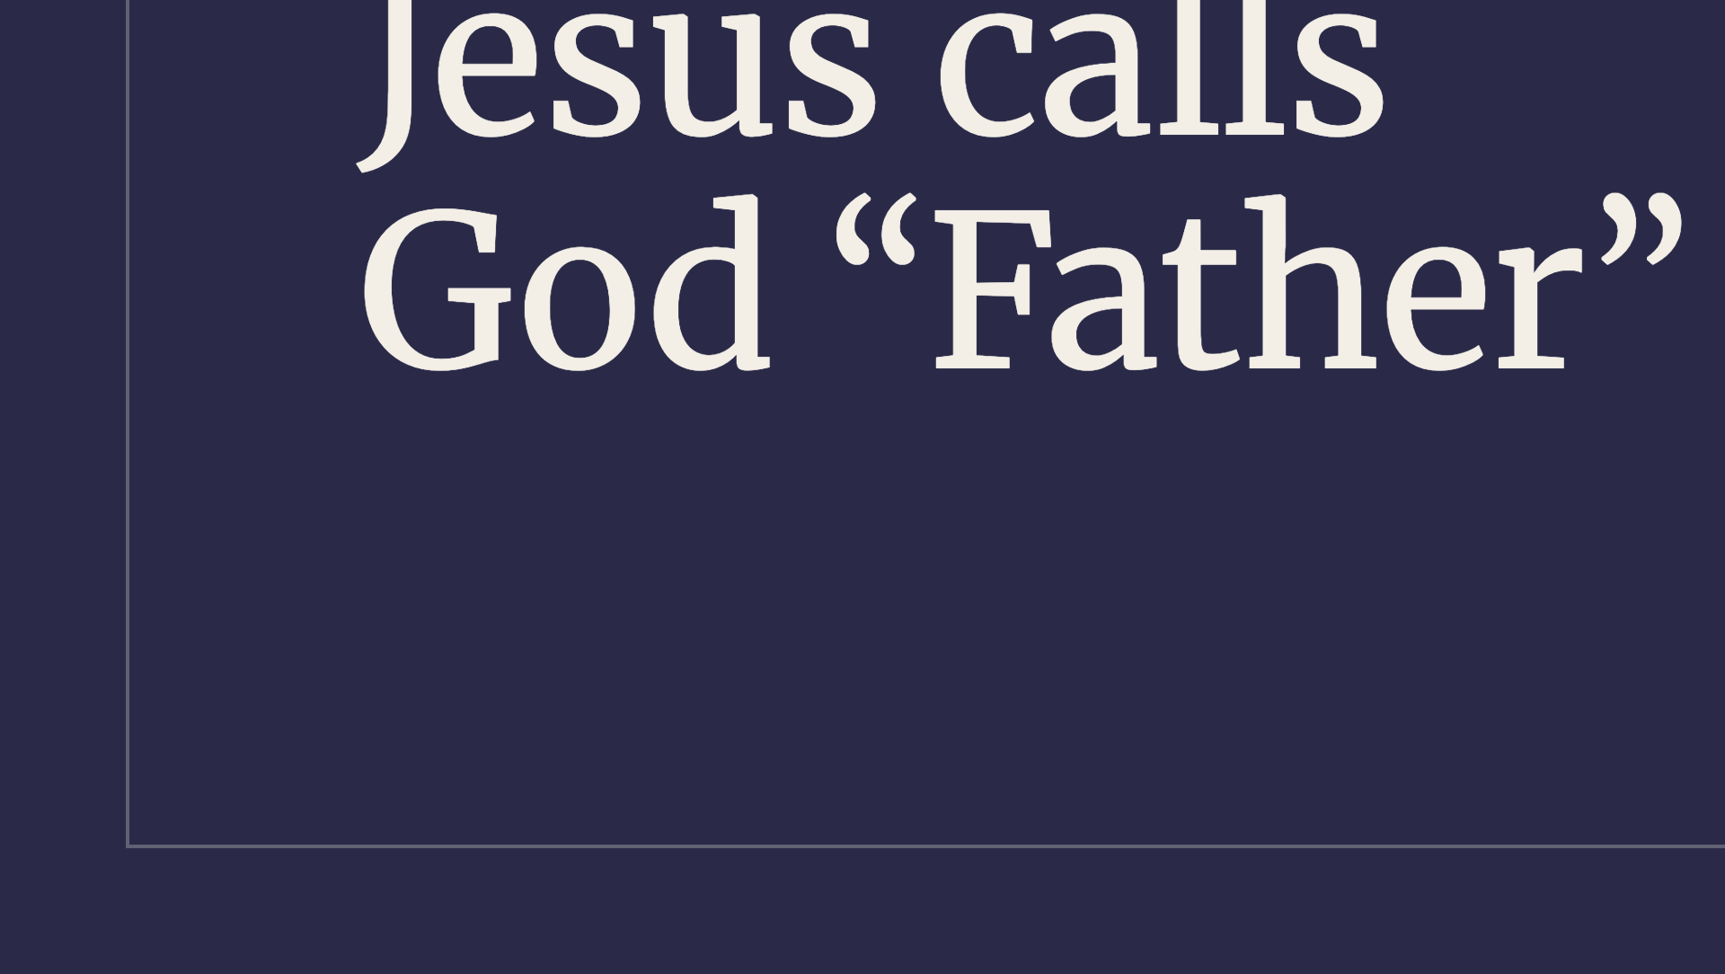
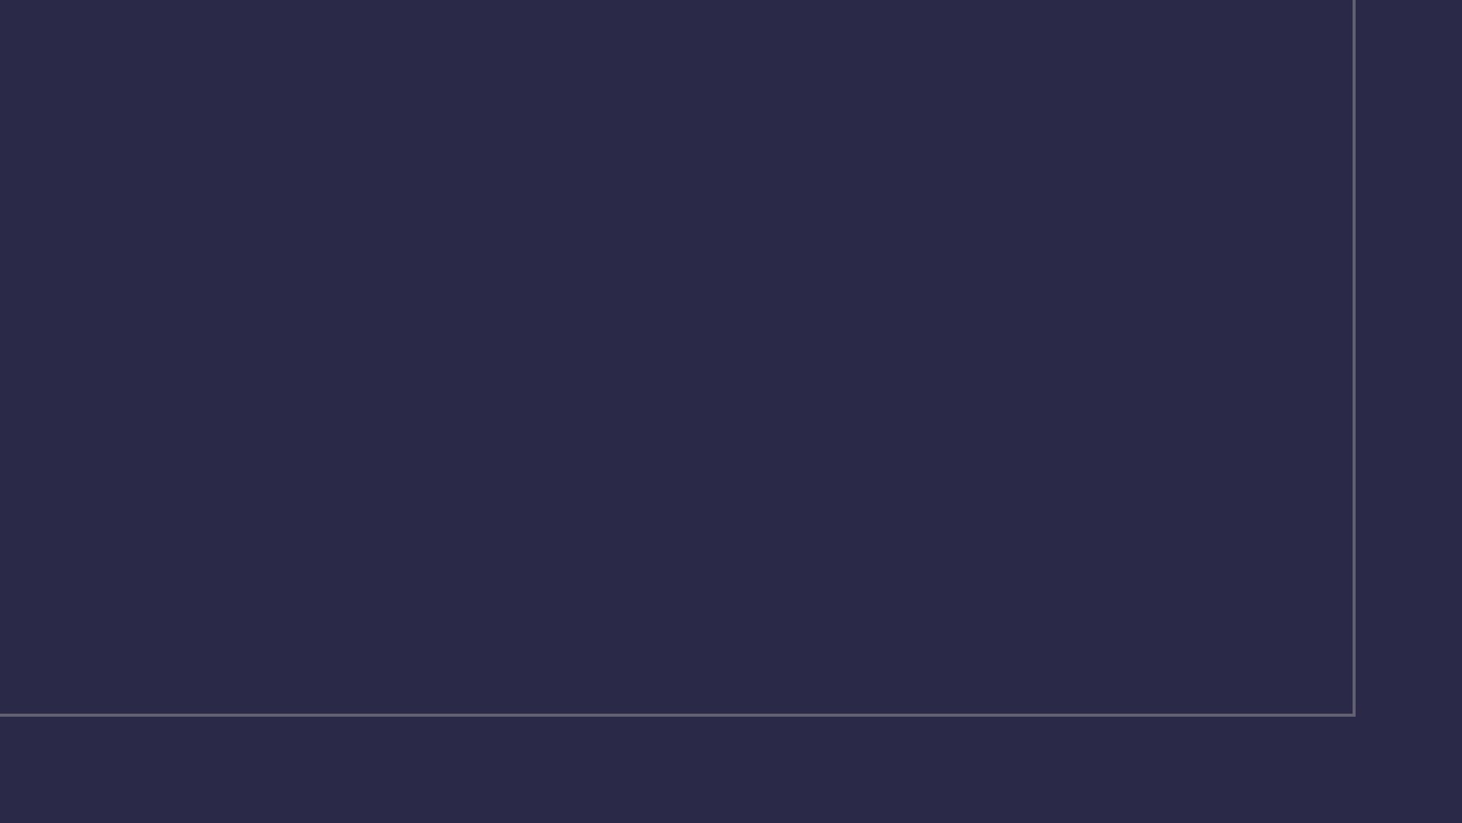
Notes:
First movement.

Slide 7
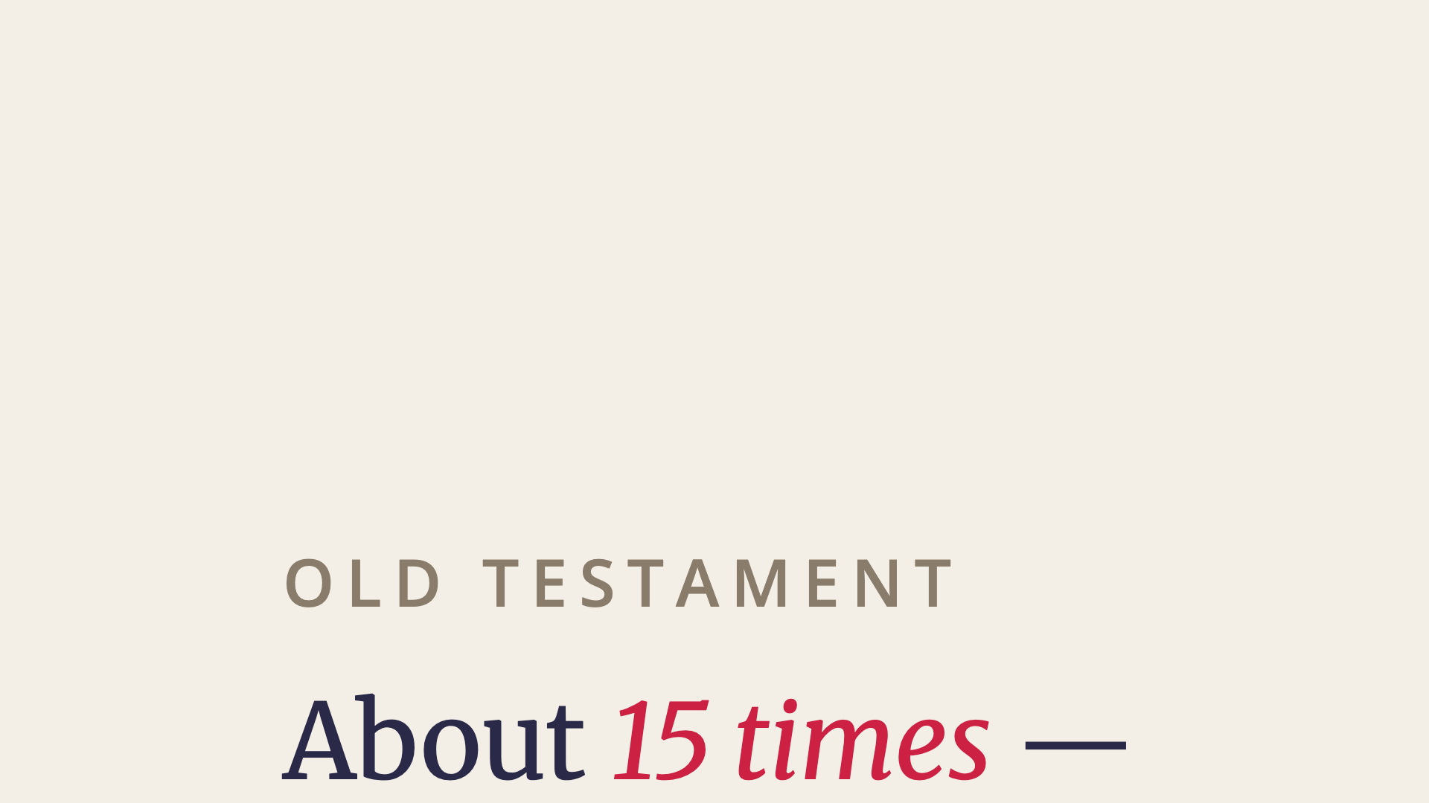
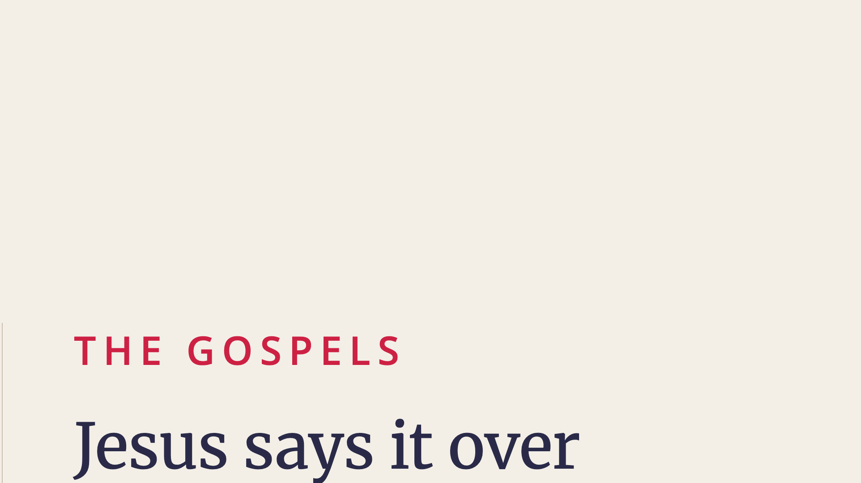
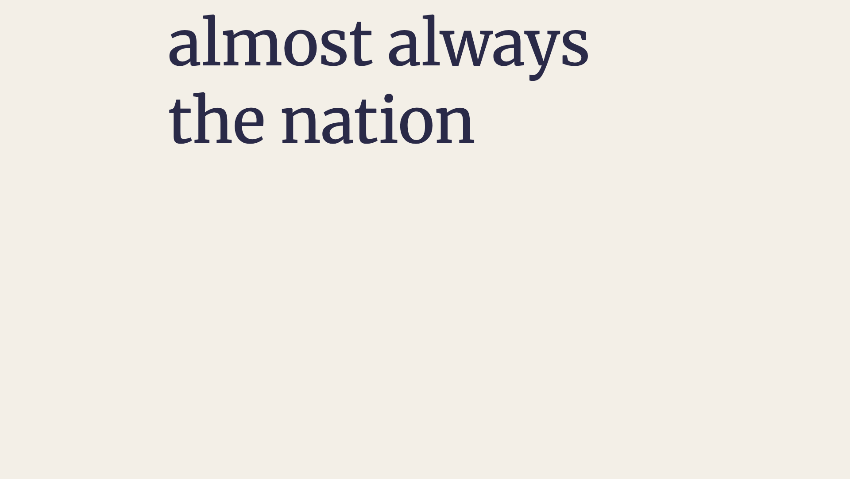
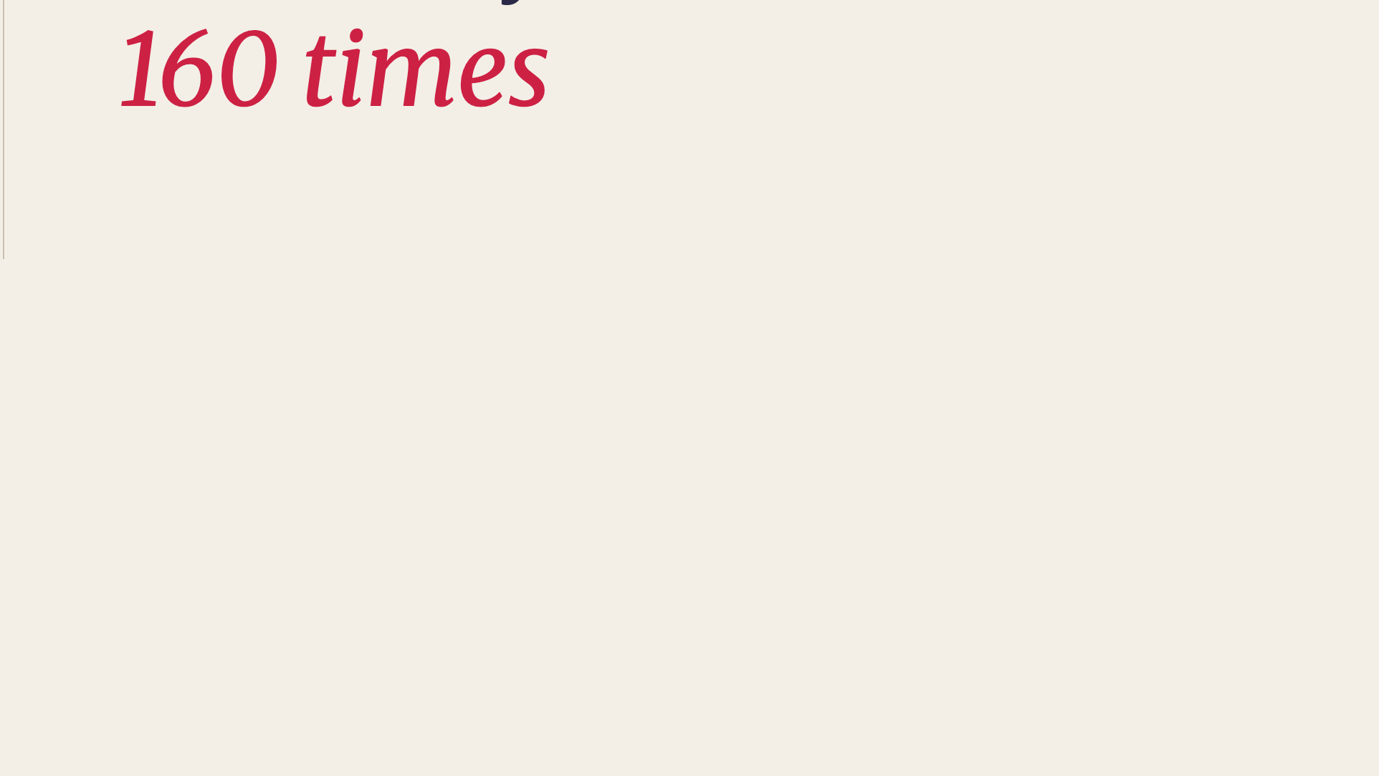
Notes:
The shift is enormous.

Slide 8
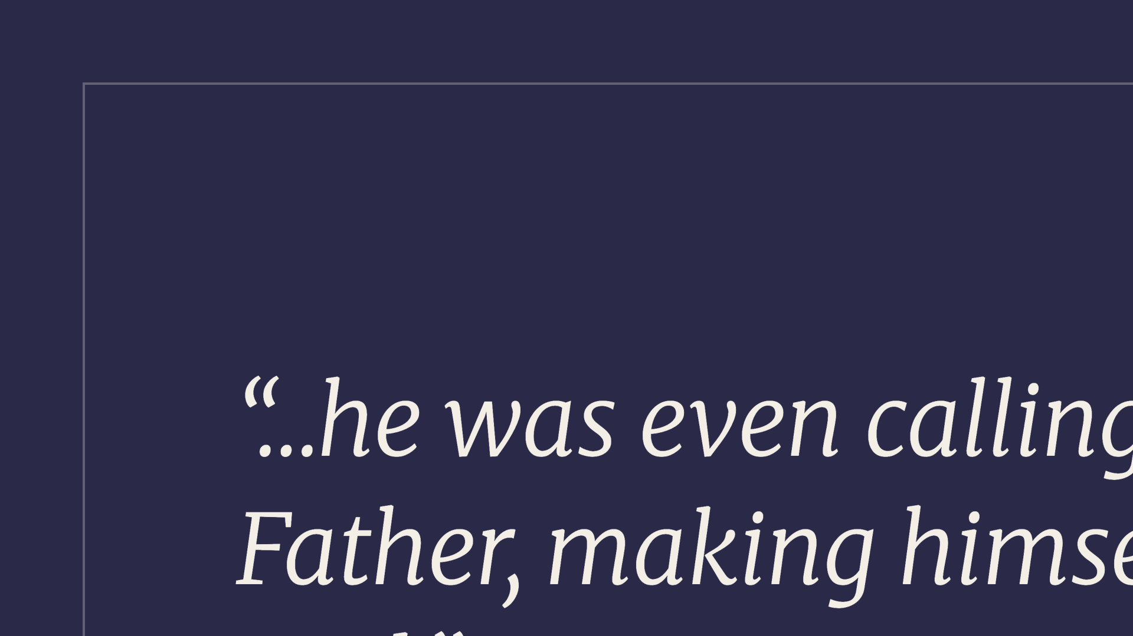
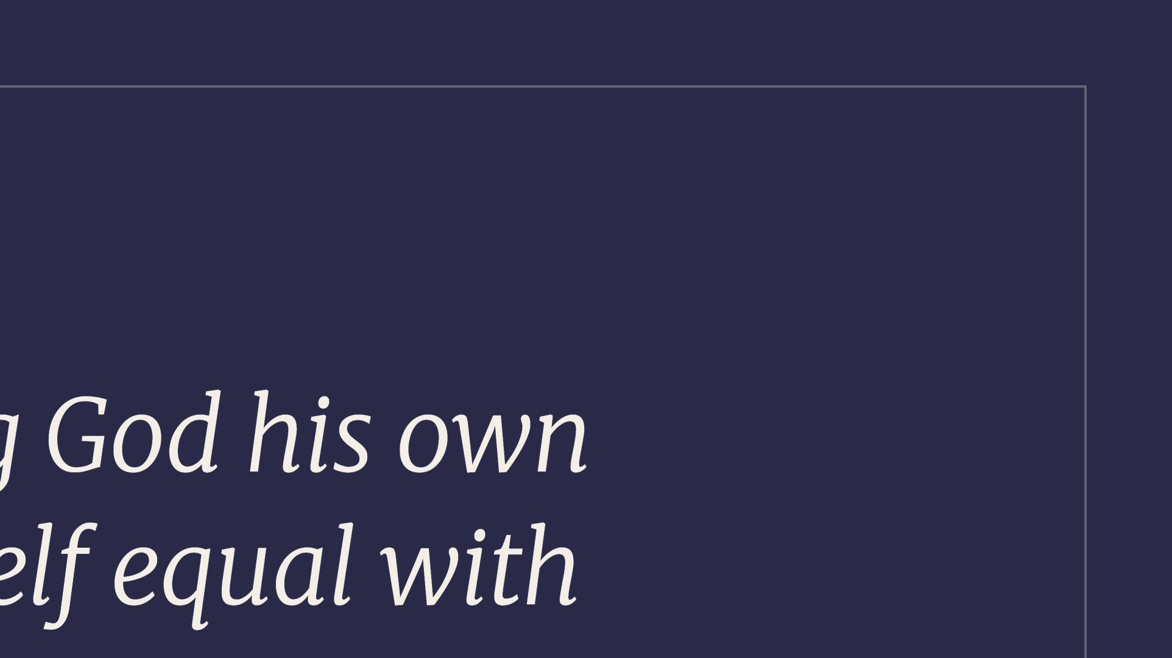
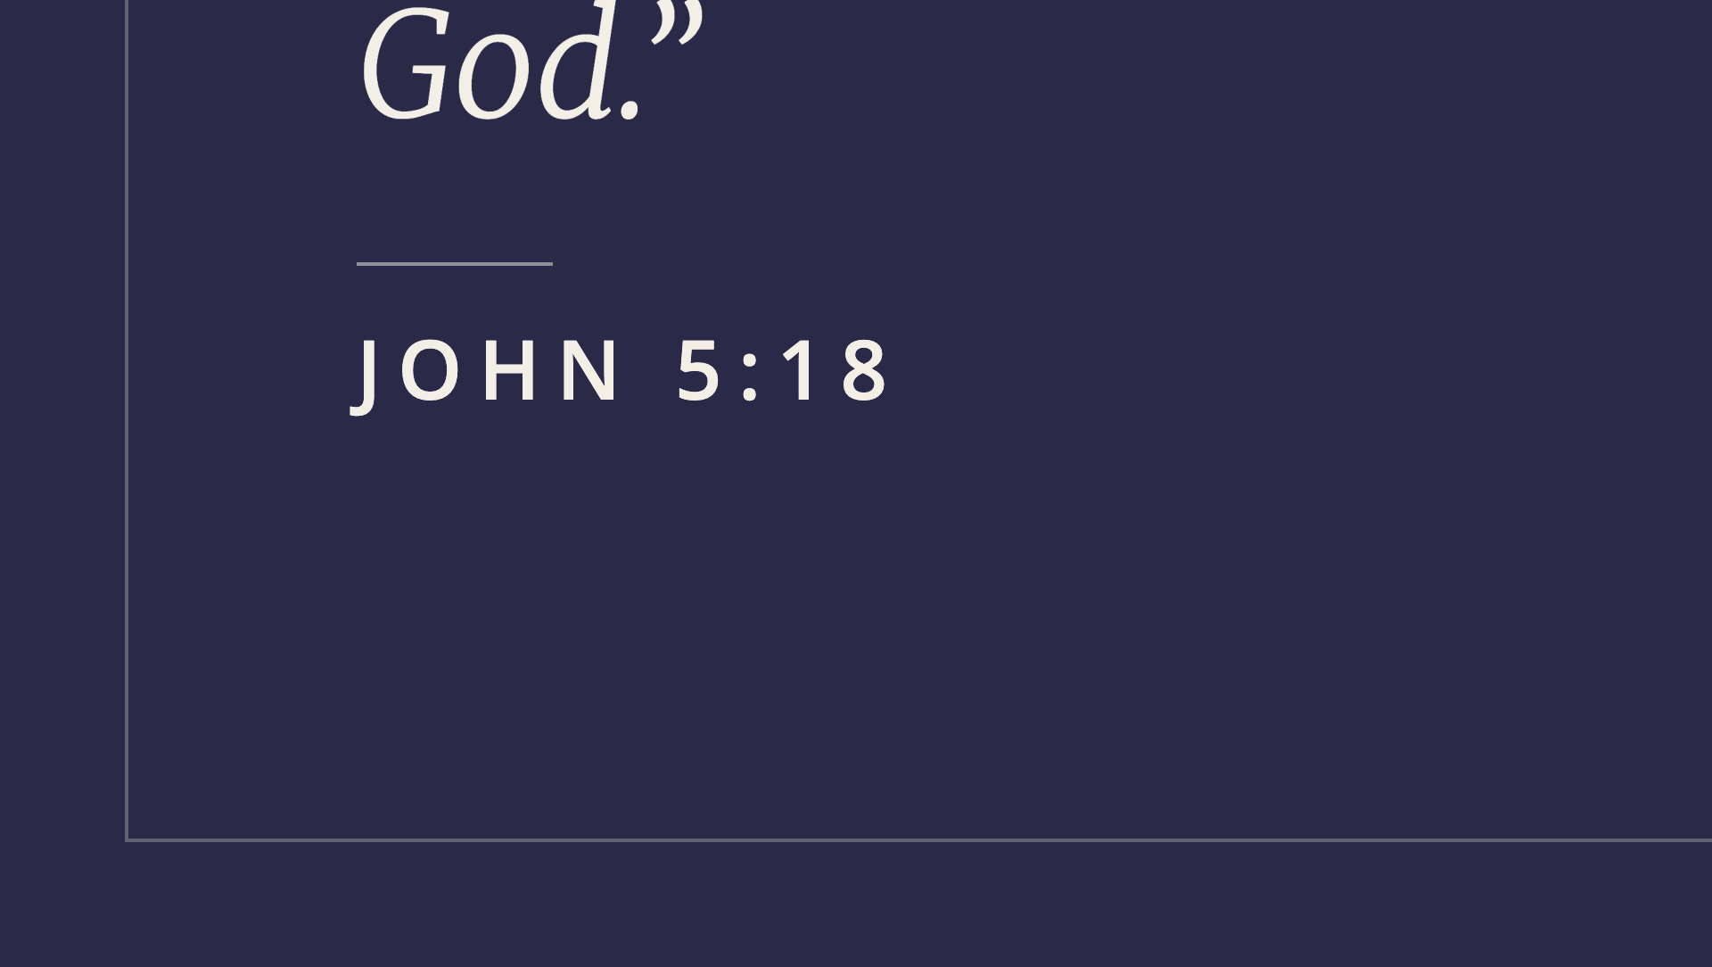
Notes:
This is what got Him killed.

Slide 9
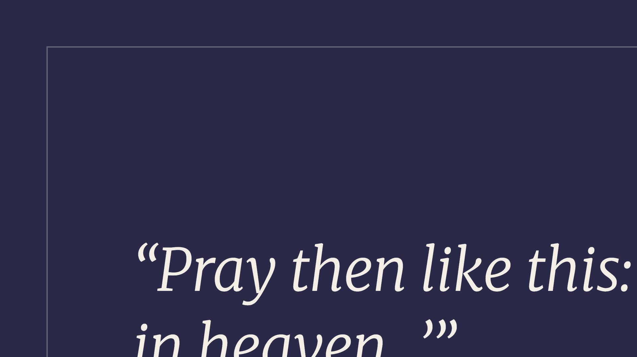
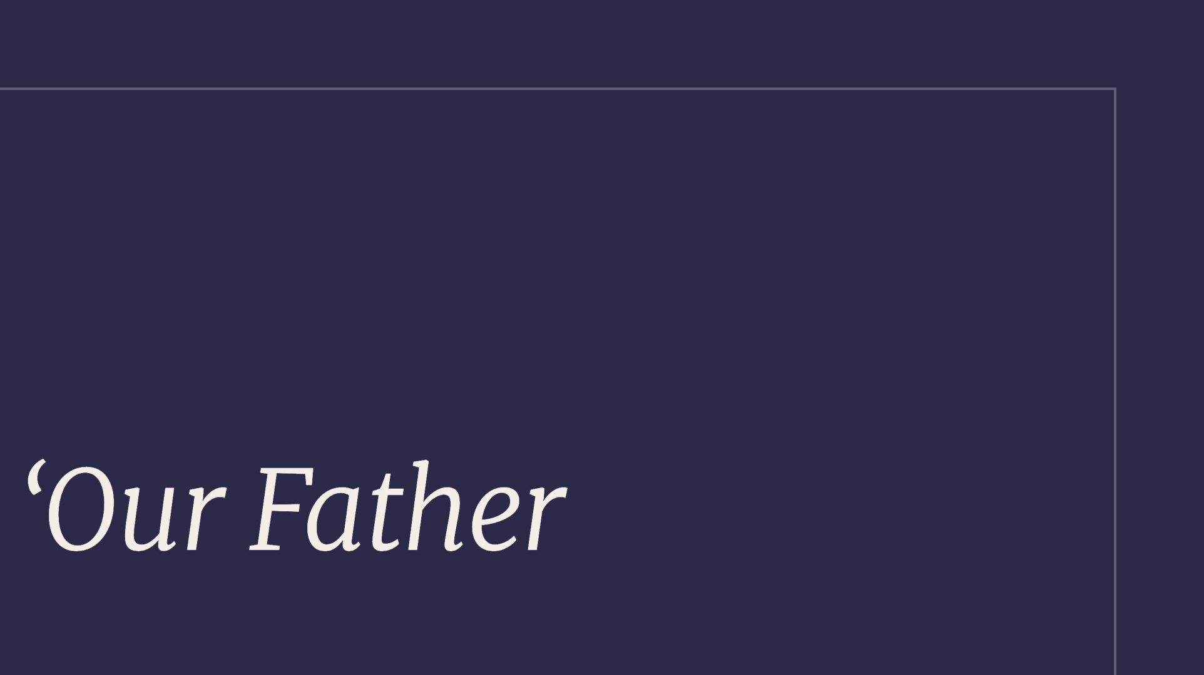
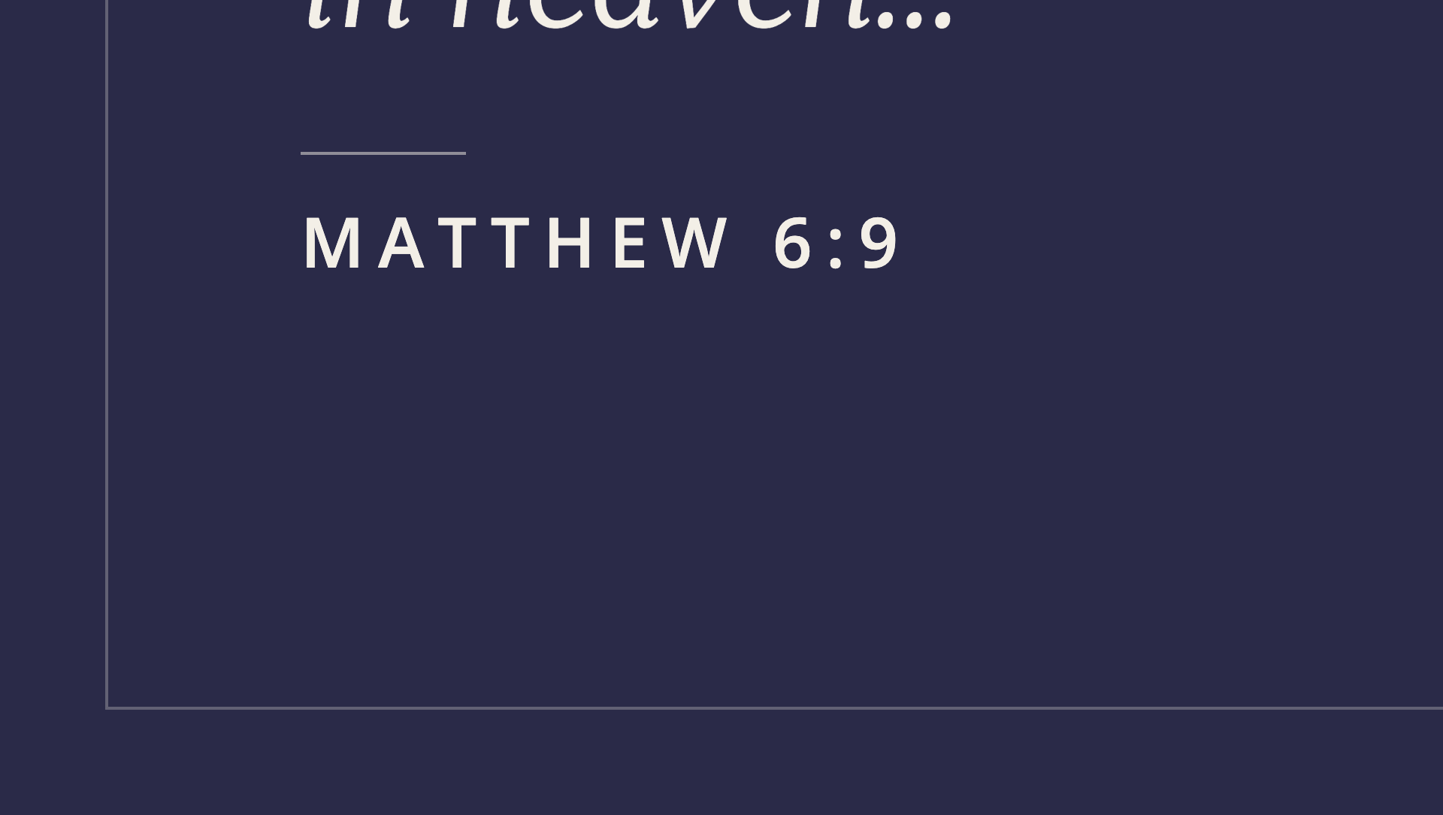
Notes:
The Lord's Prayer opens with the scandal.

Slide 10

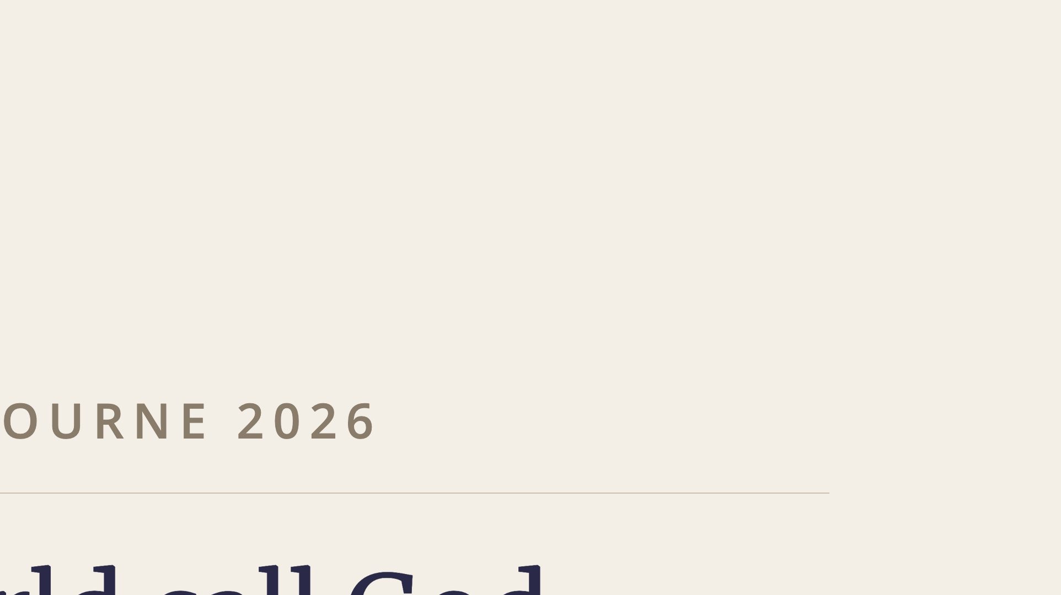
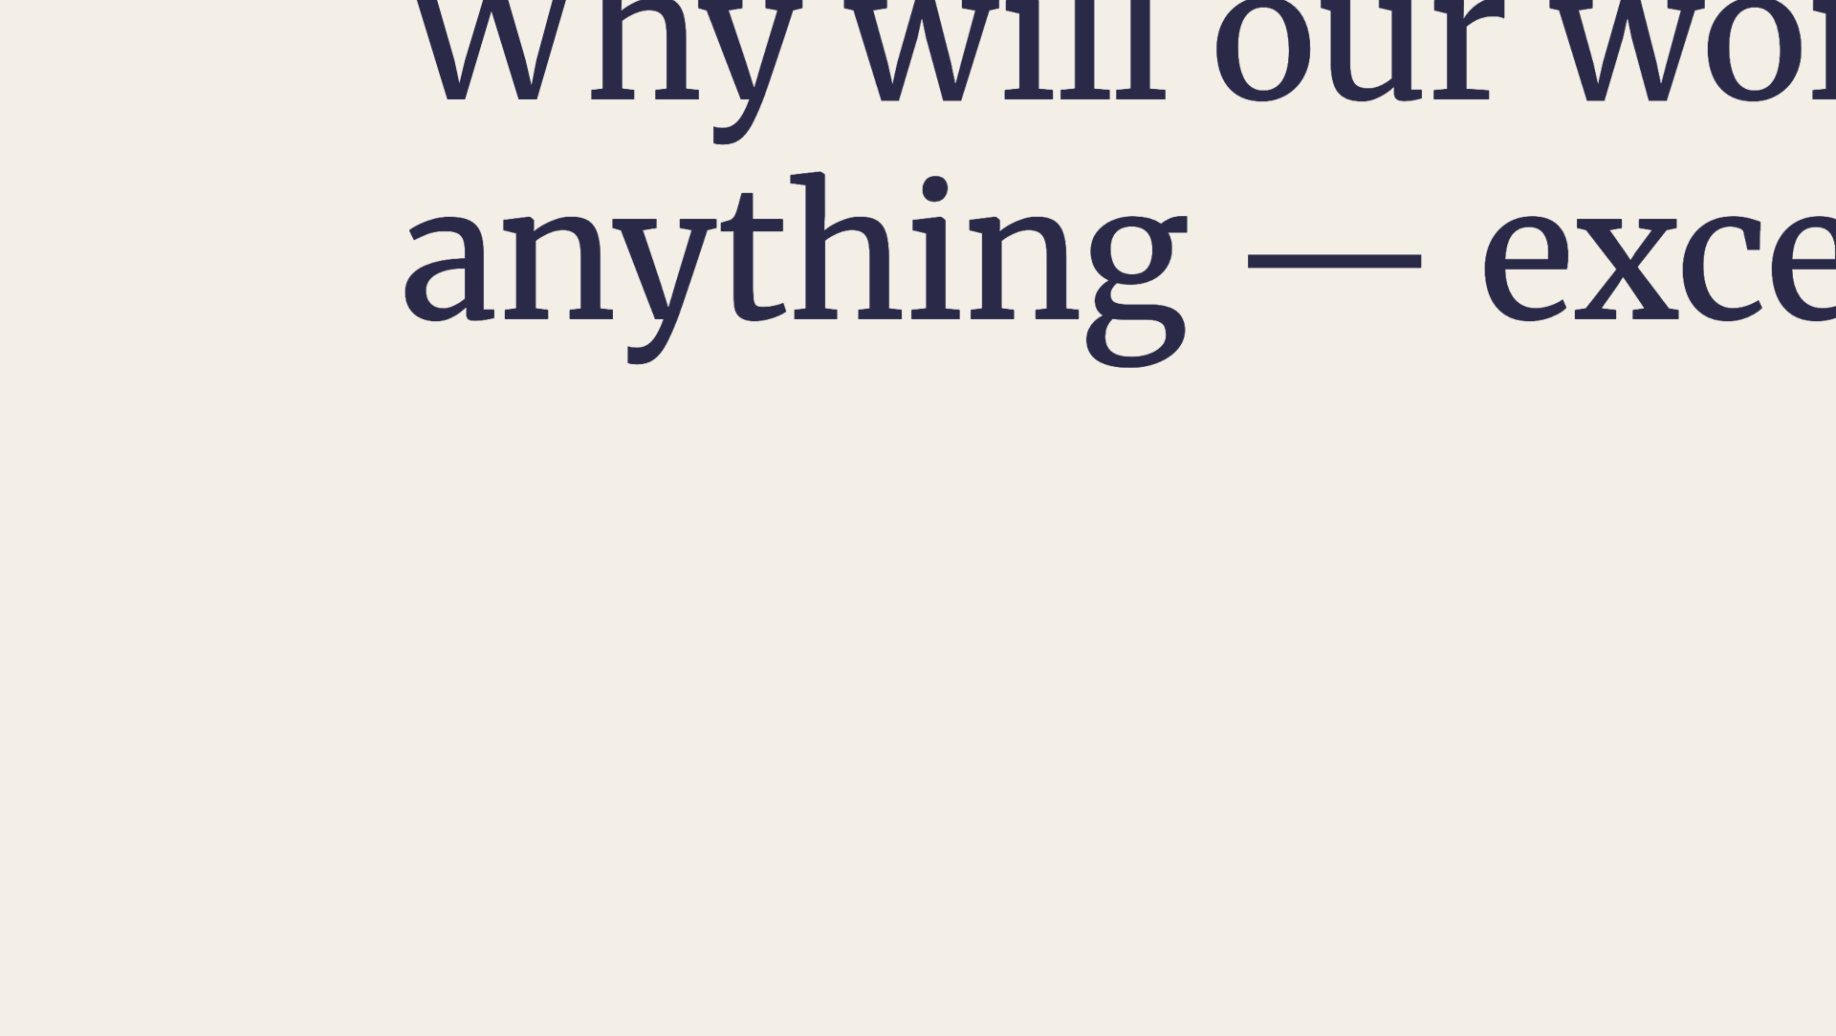
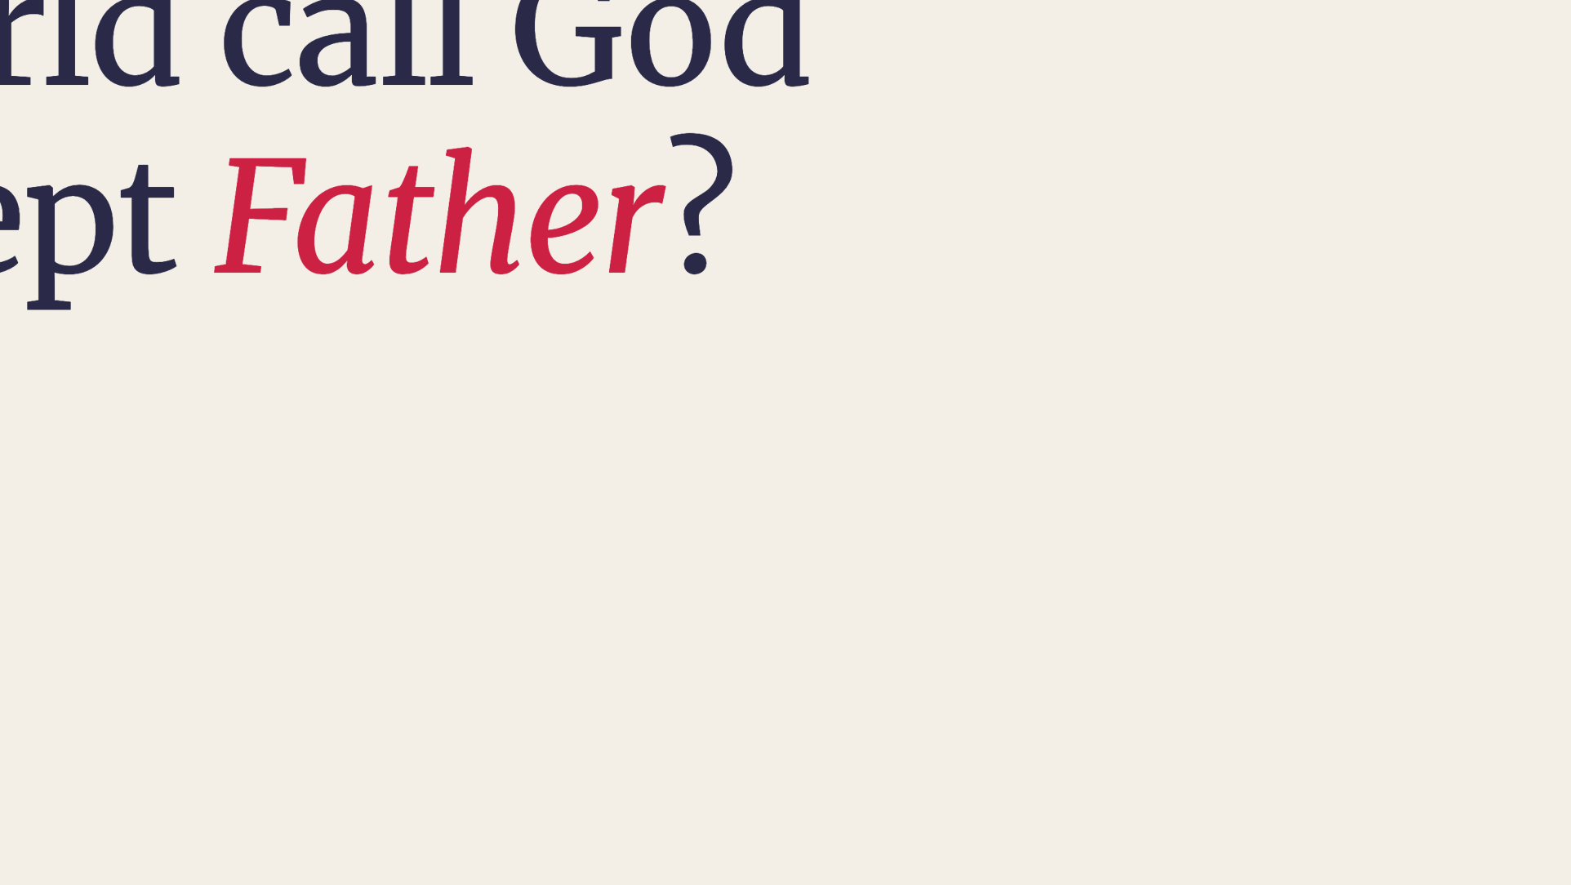
Notes:
Bring it into Melbourne, 2026.

Slide 11
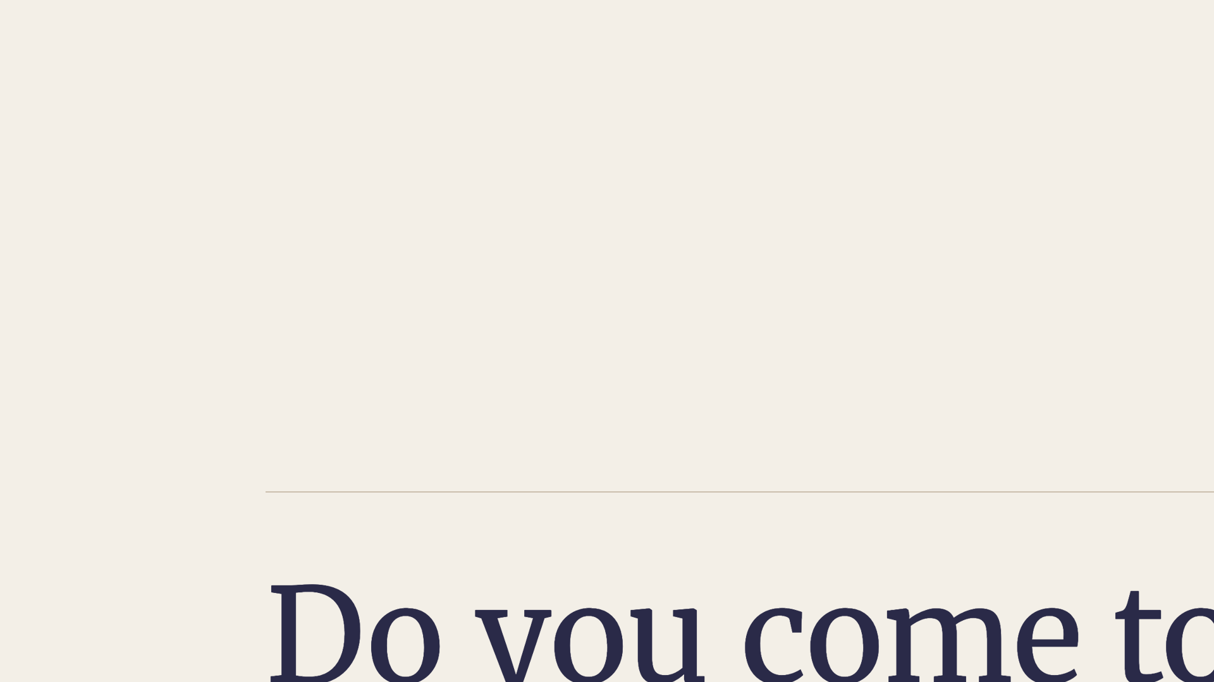
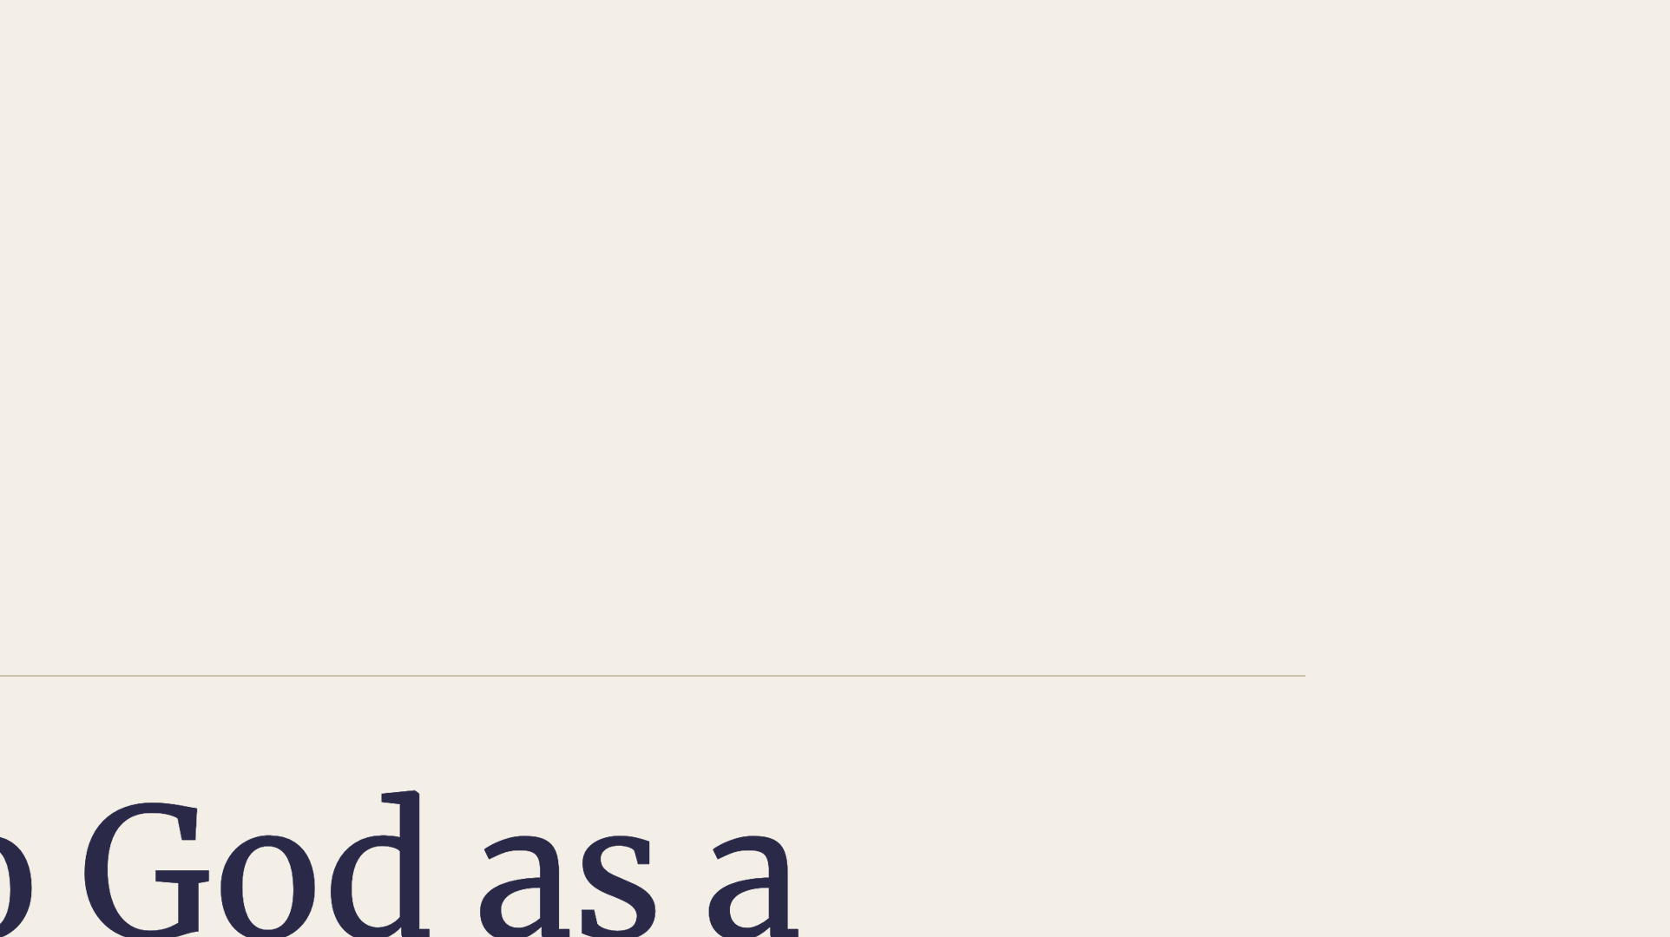
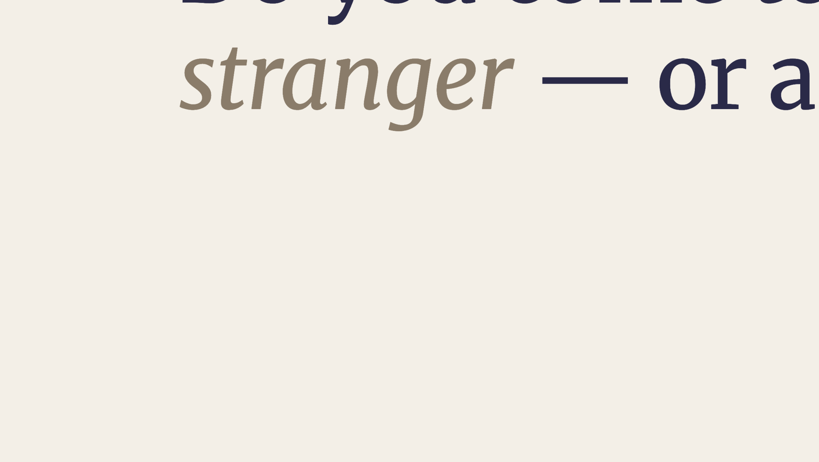
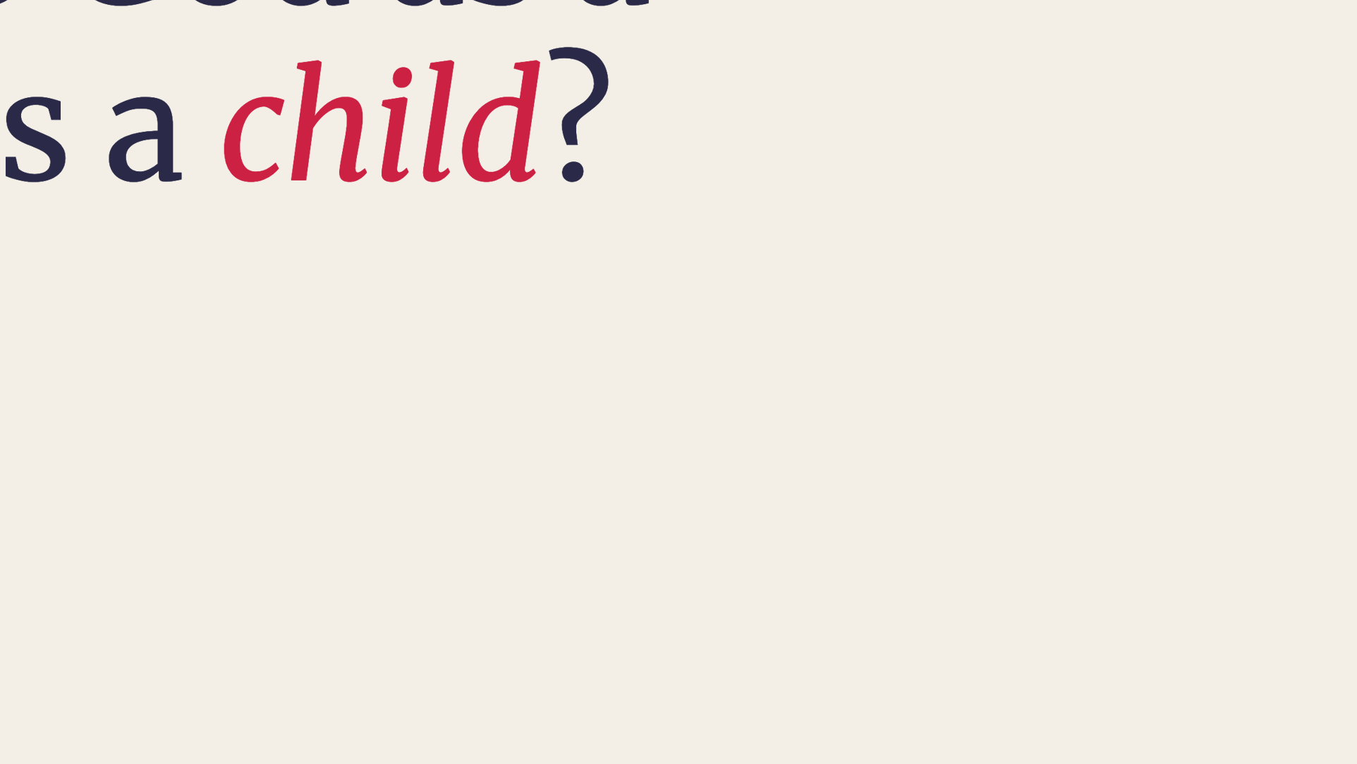
Notes:
Personal application.

Slide 12
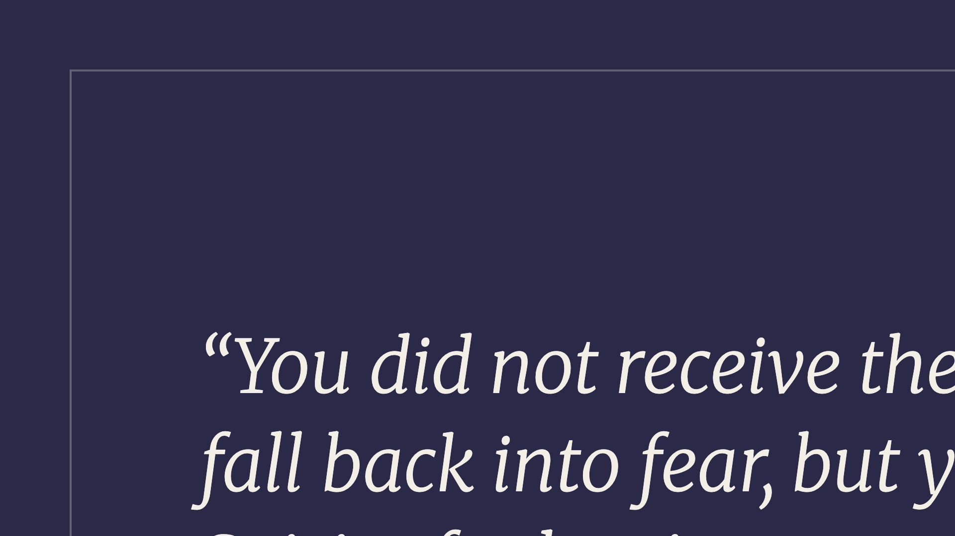
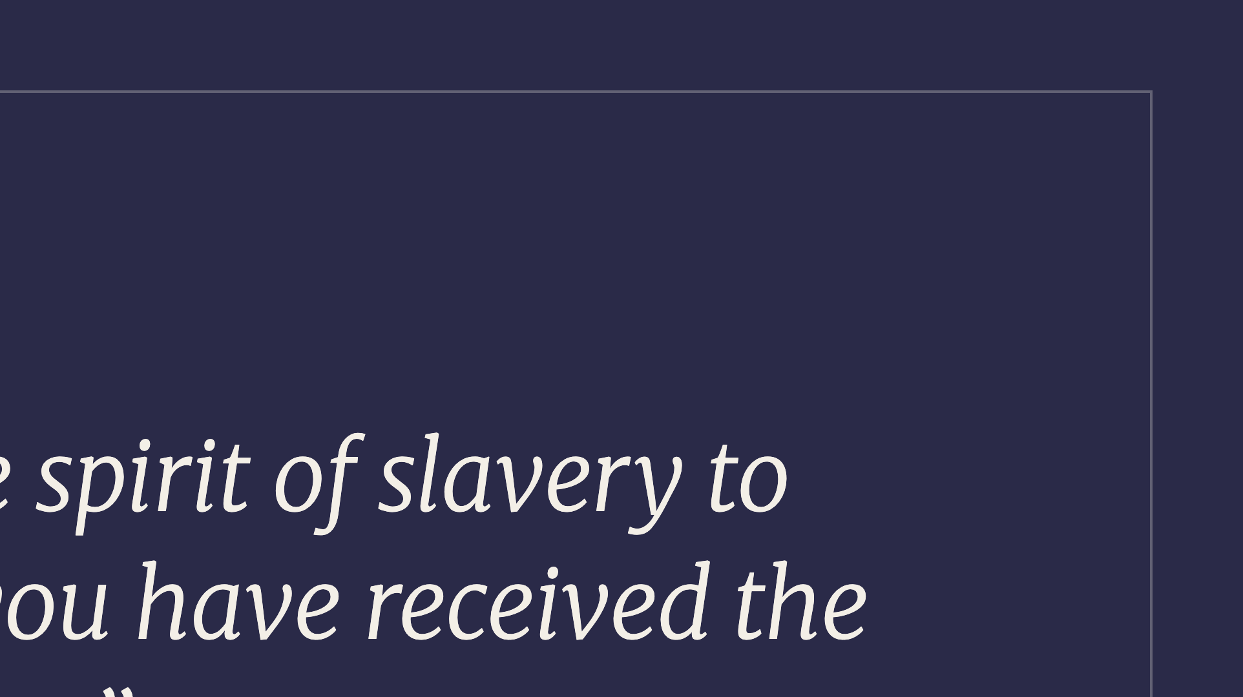
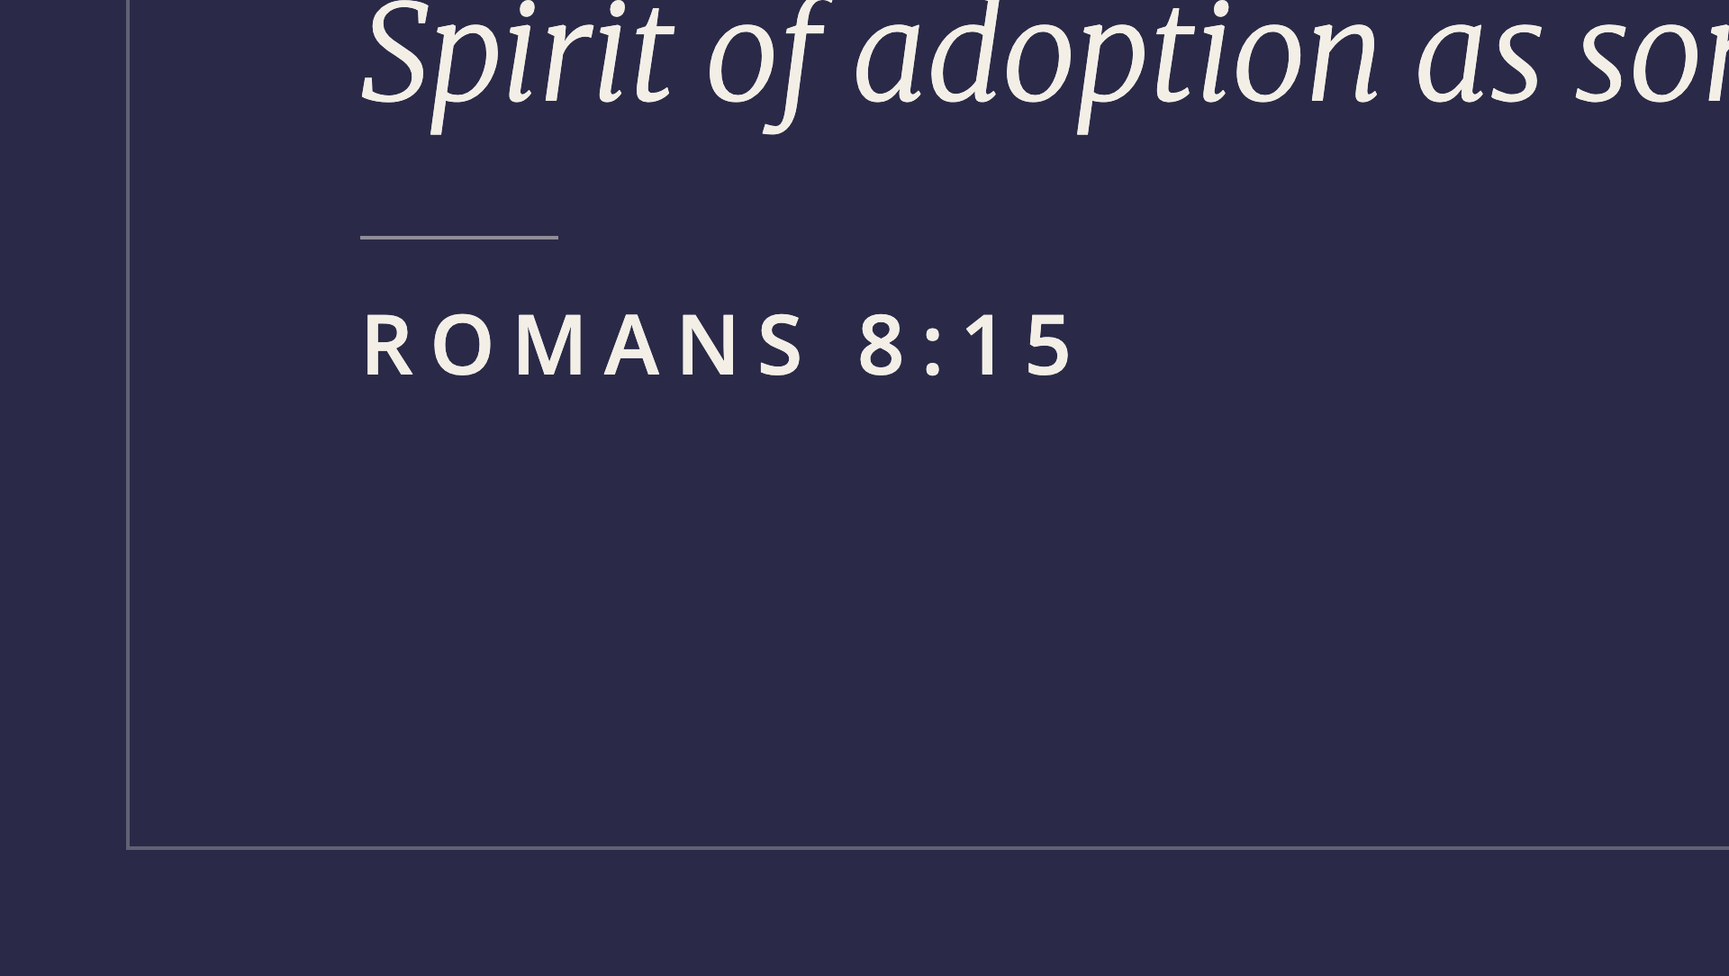
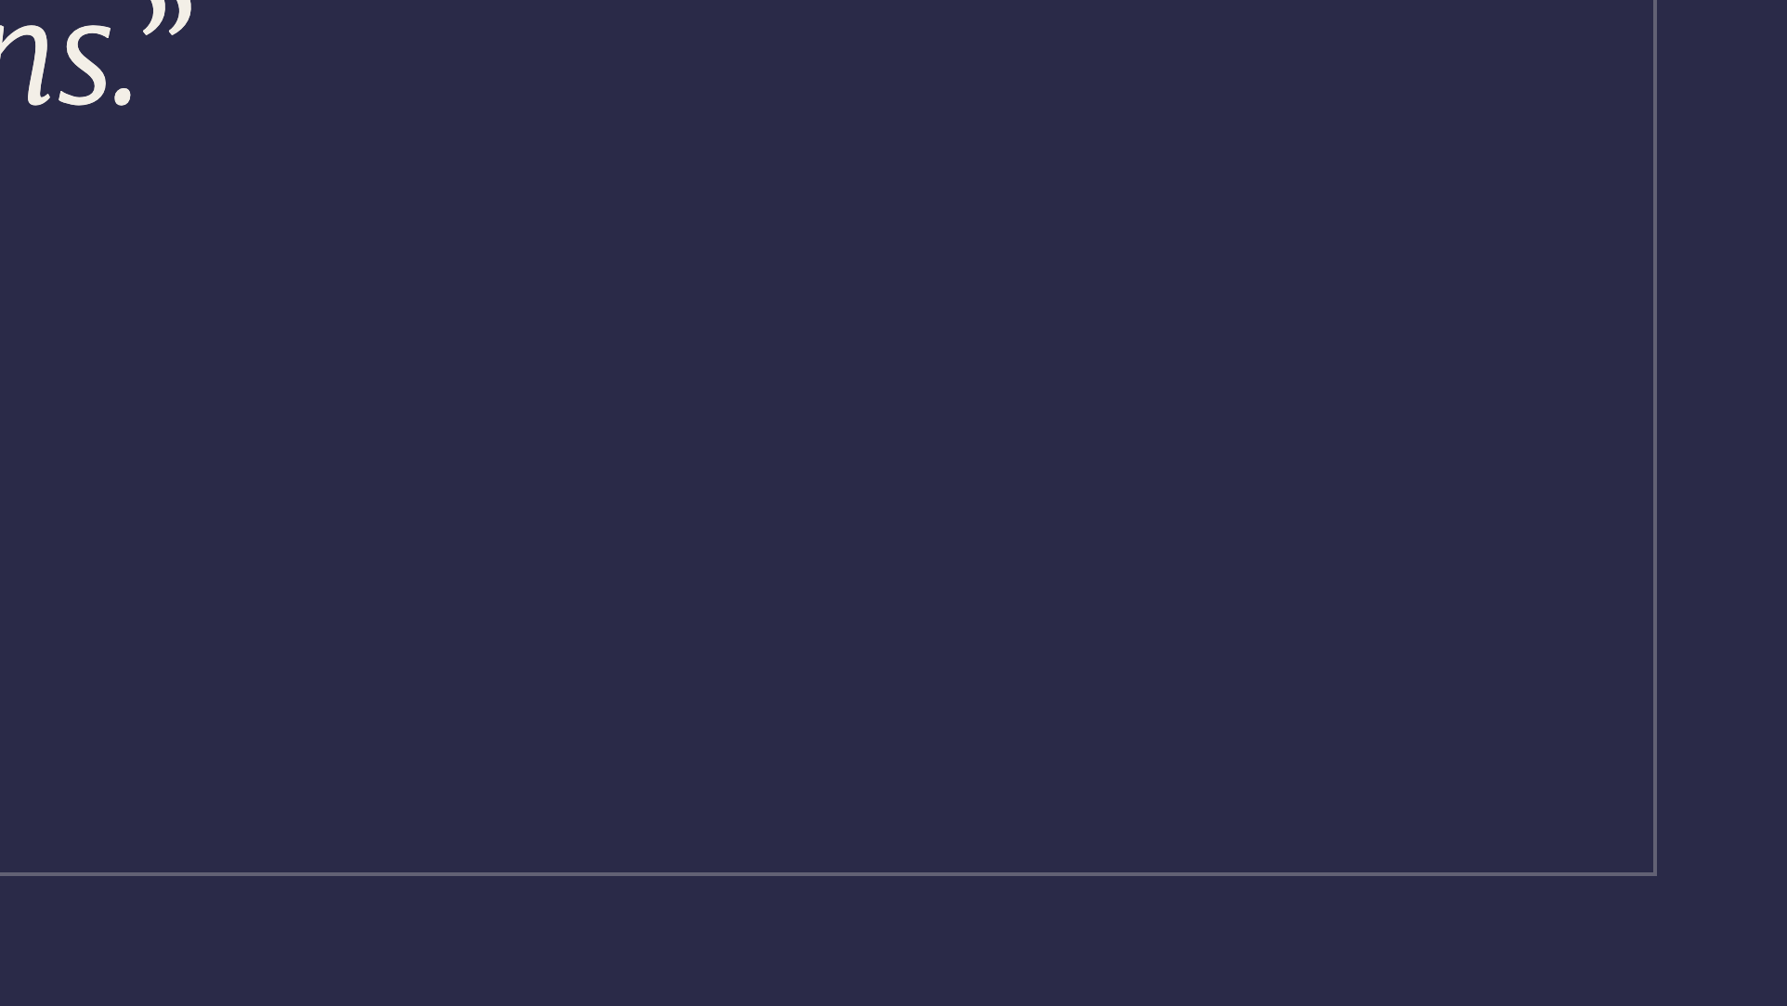
Notes:
Adoption, not slavery.

Slide 13
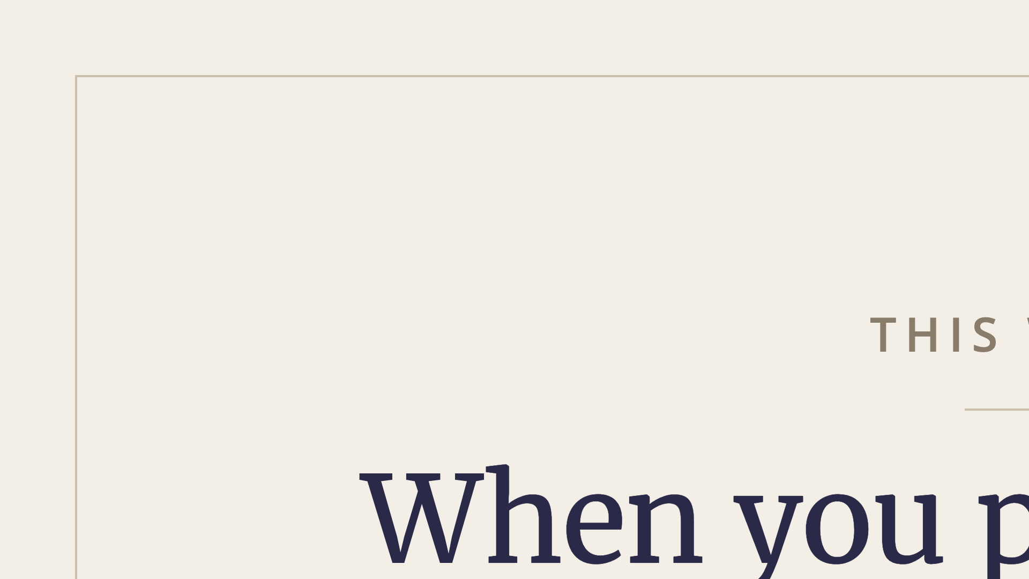
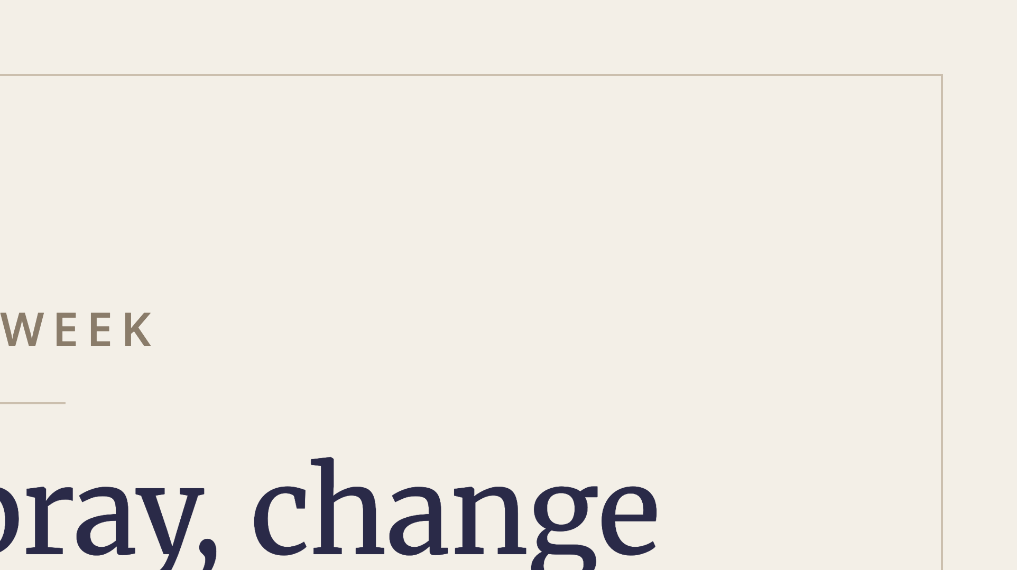
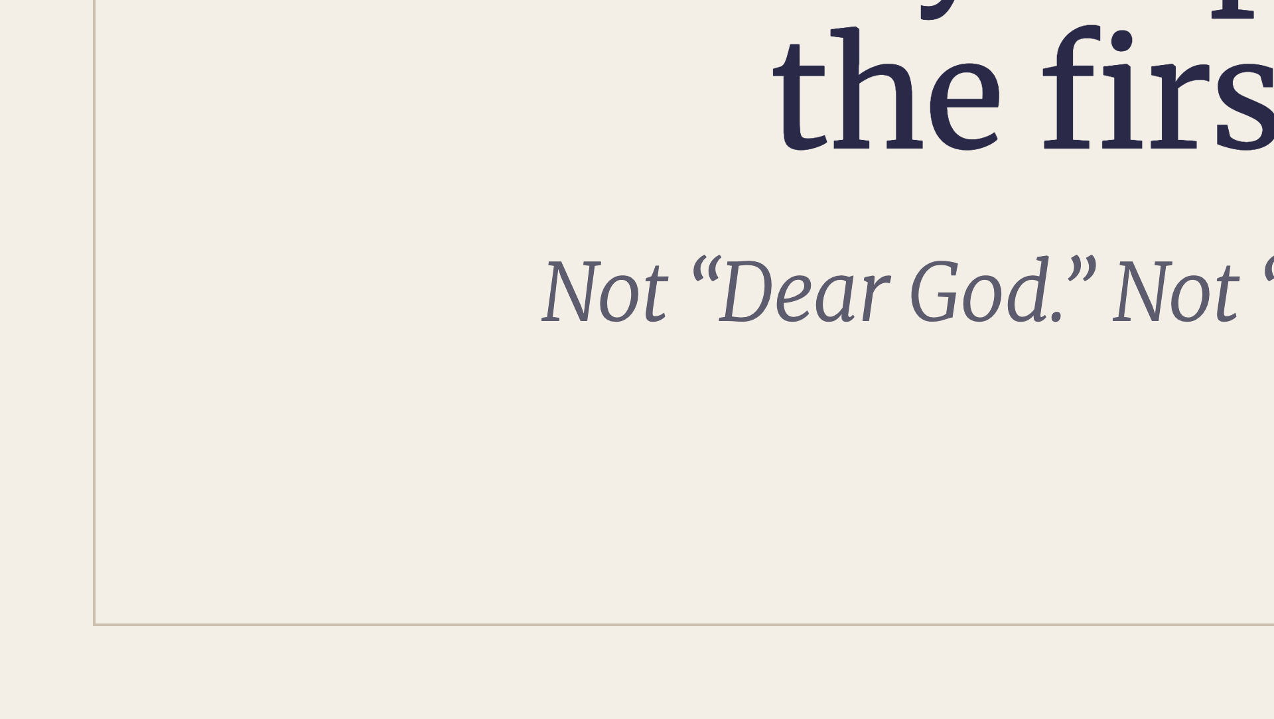
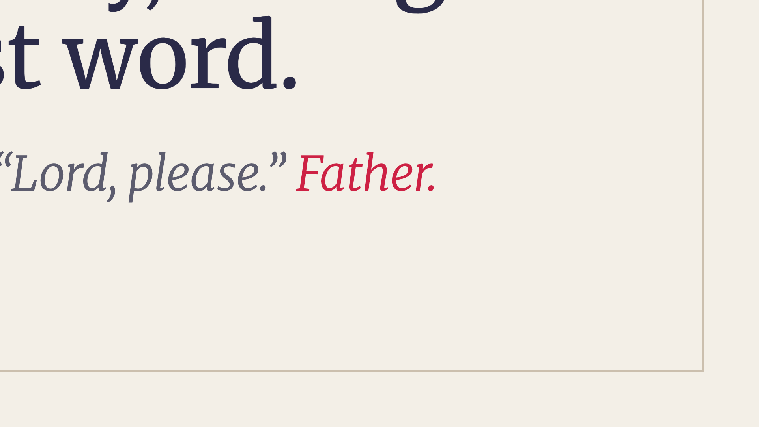
Notes:
Application 1 — 45 seconds. Change the first word when you pray this week. Then stop before the list and let it be true.

Slide 14
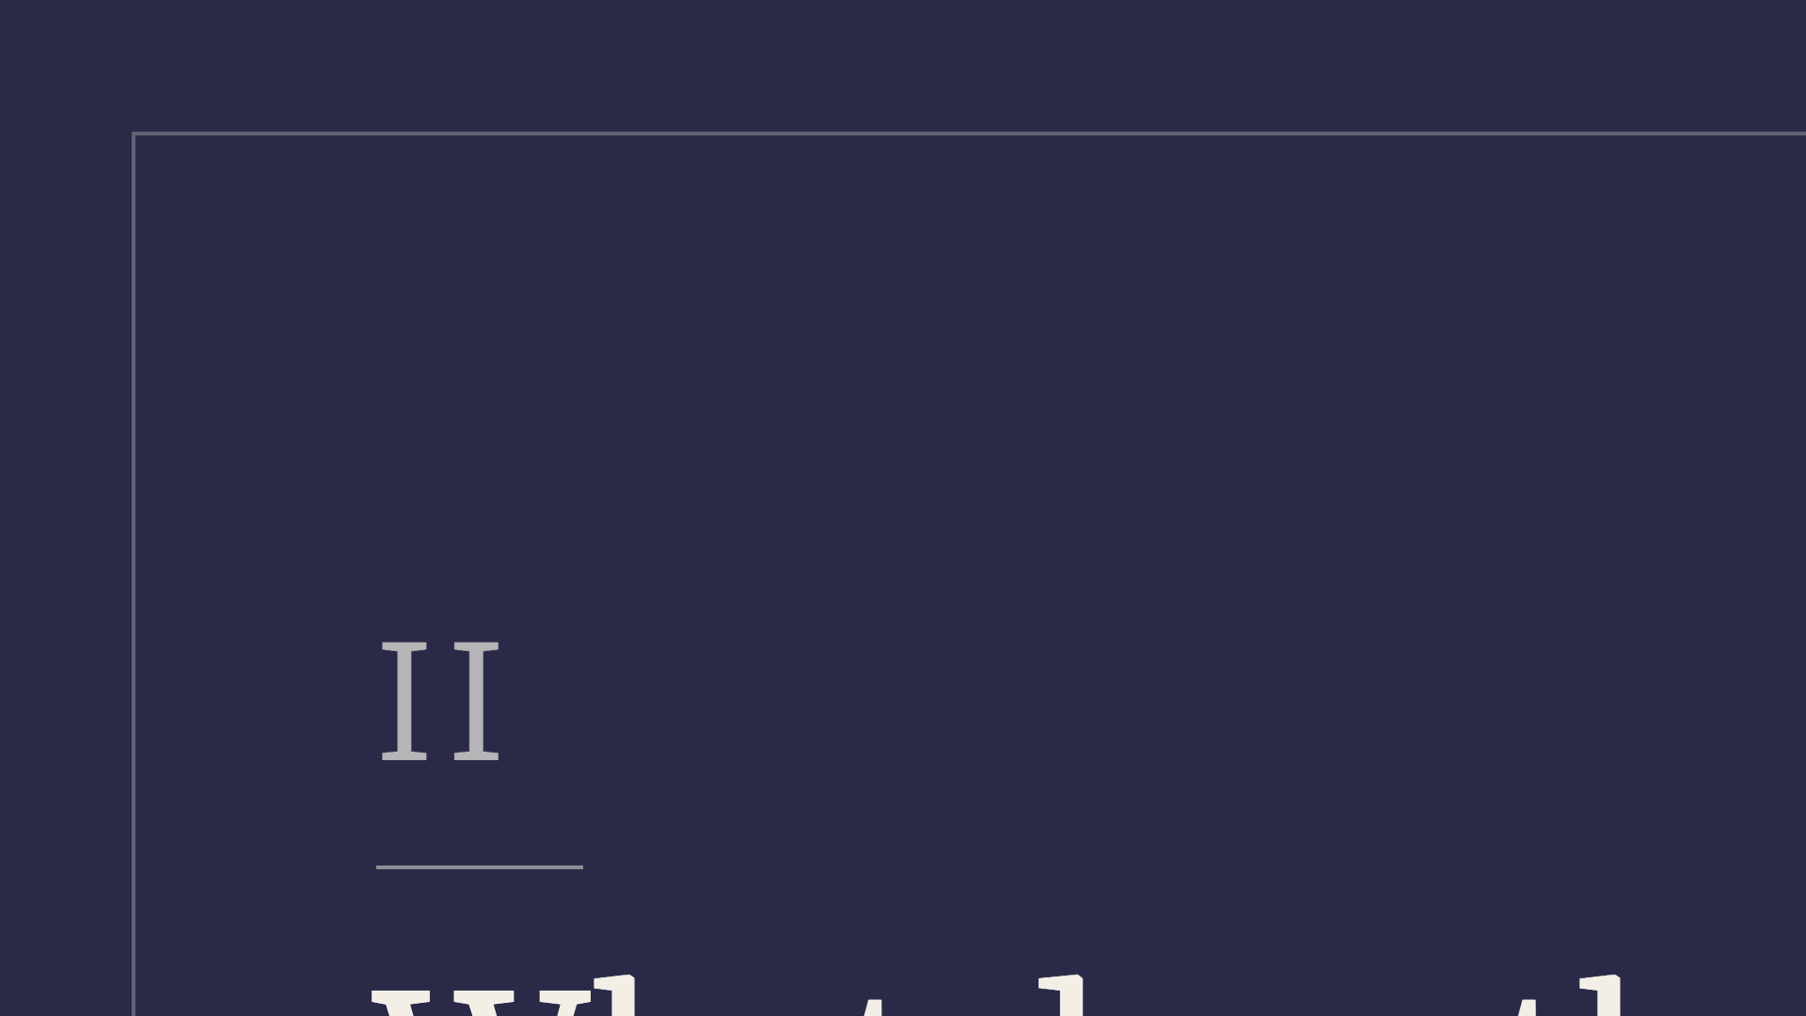
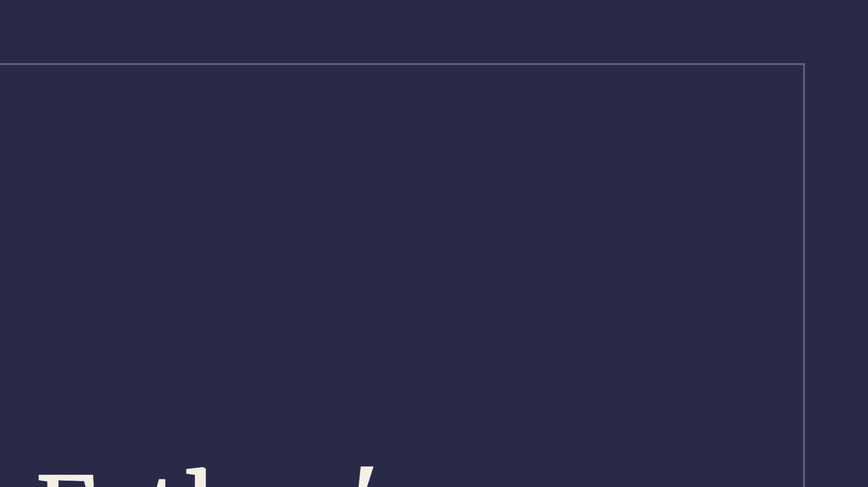
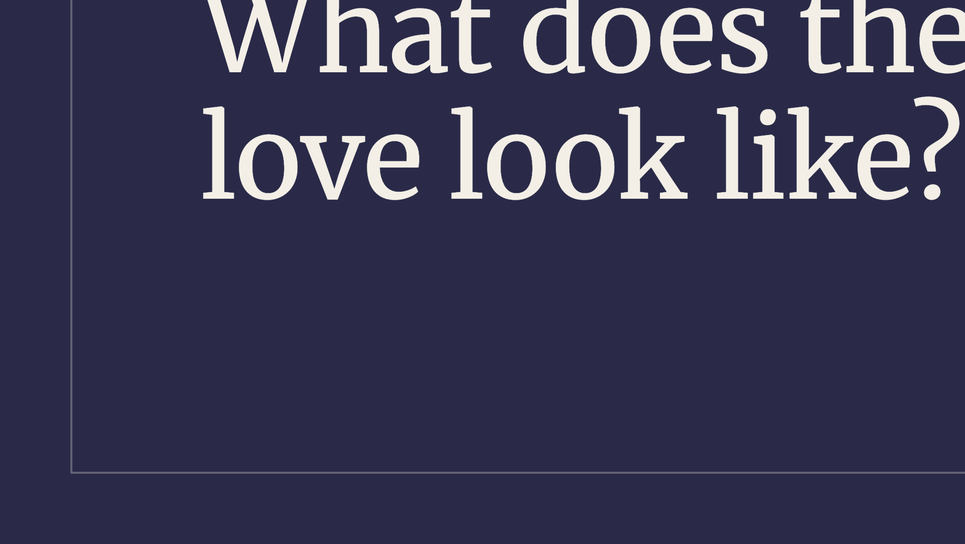
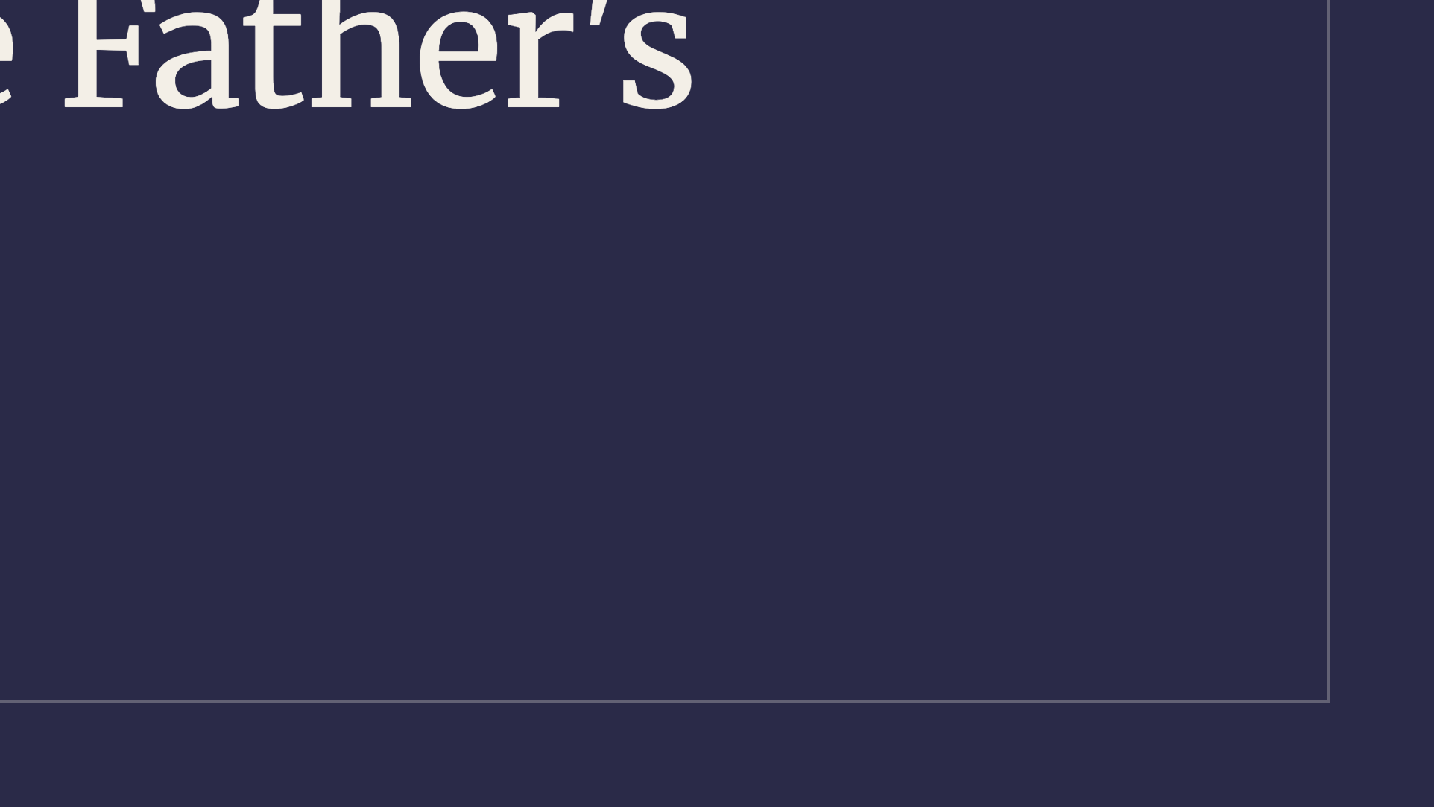
Notes:
Second movement.

Slide 15


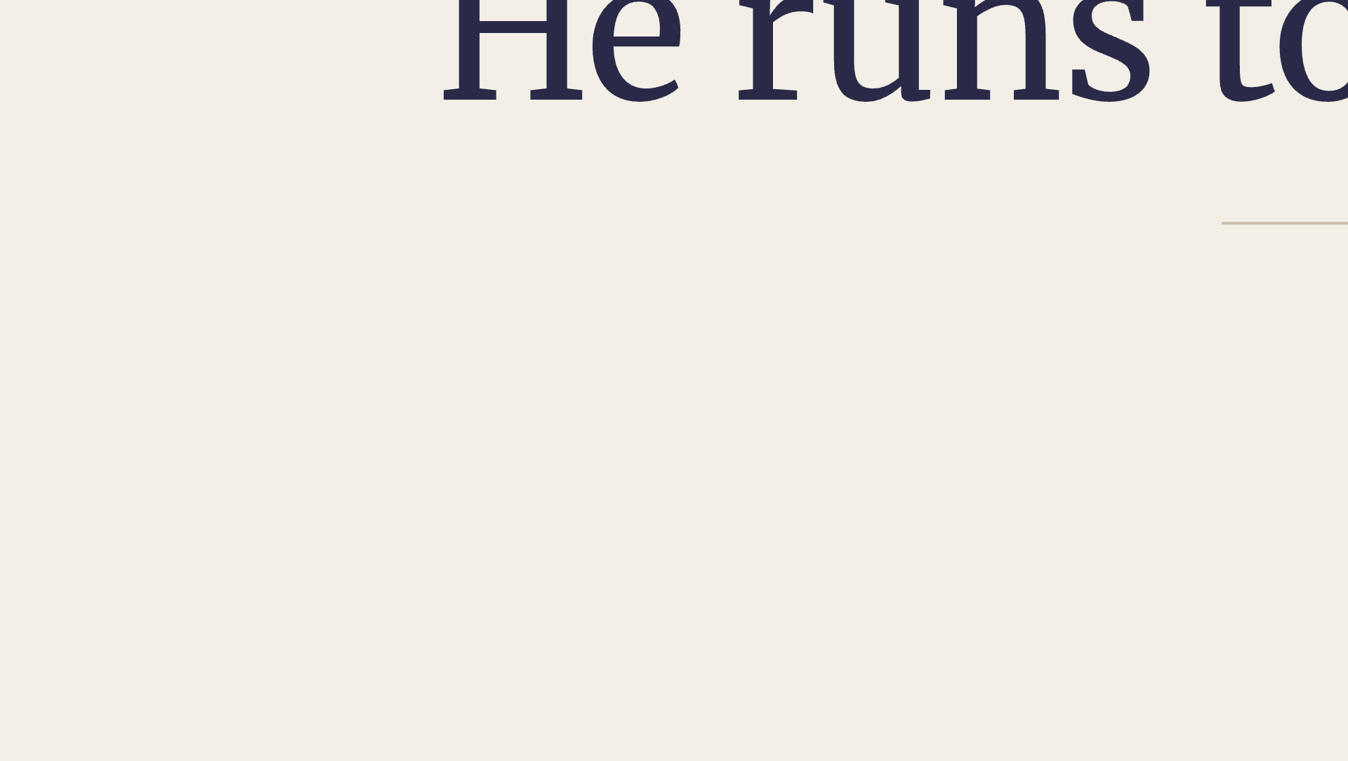
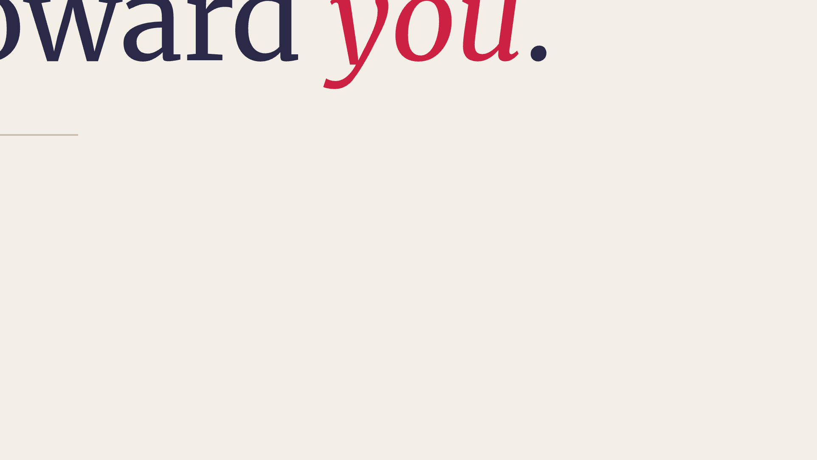
Notes:
Sub-point A.

Slide 16
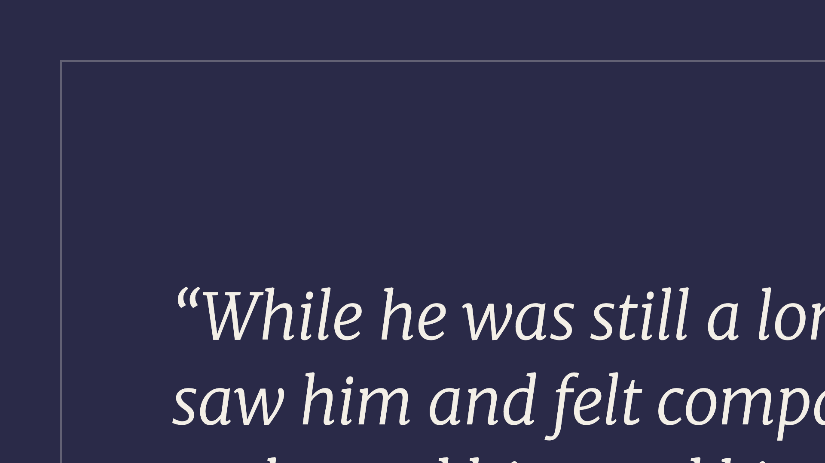
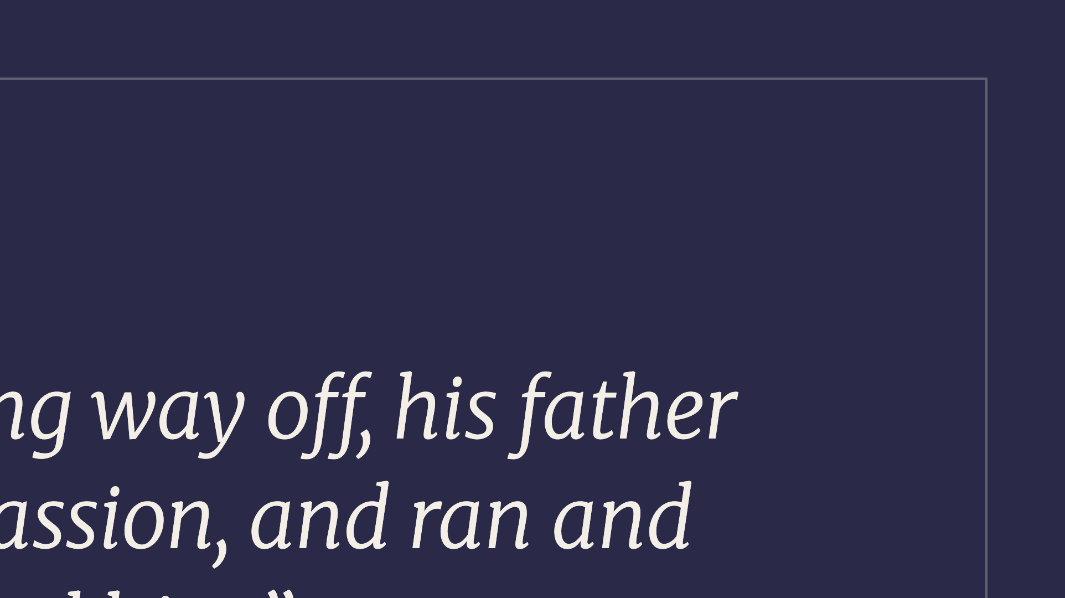
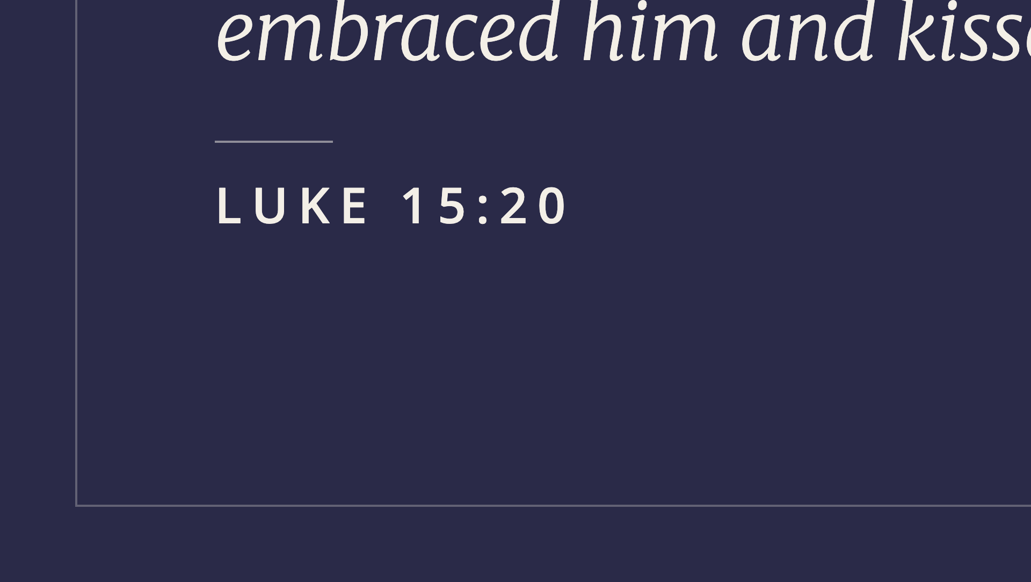
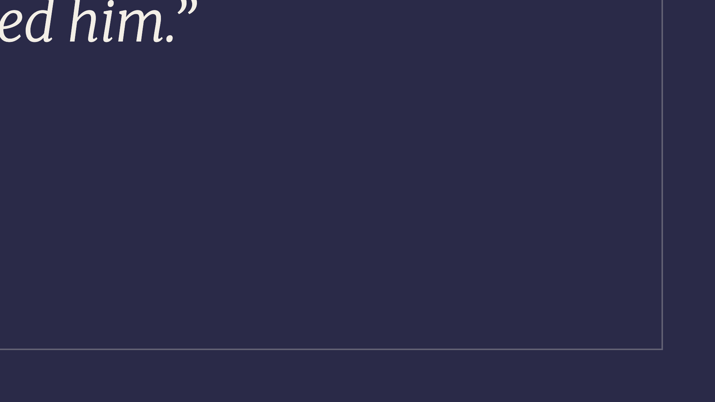
Notes:
The prodigal's father.

Slide 17
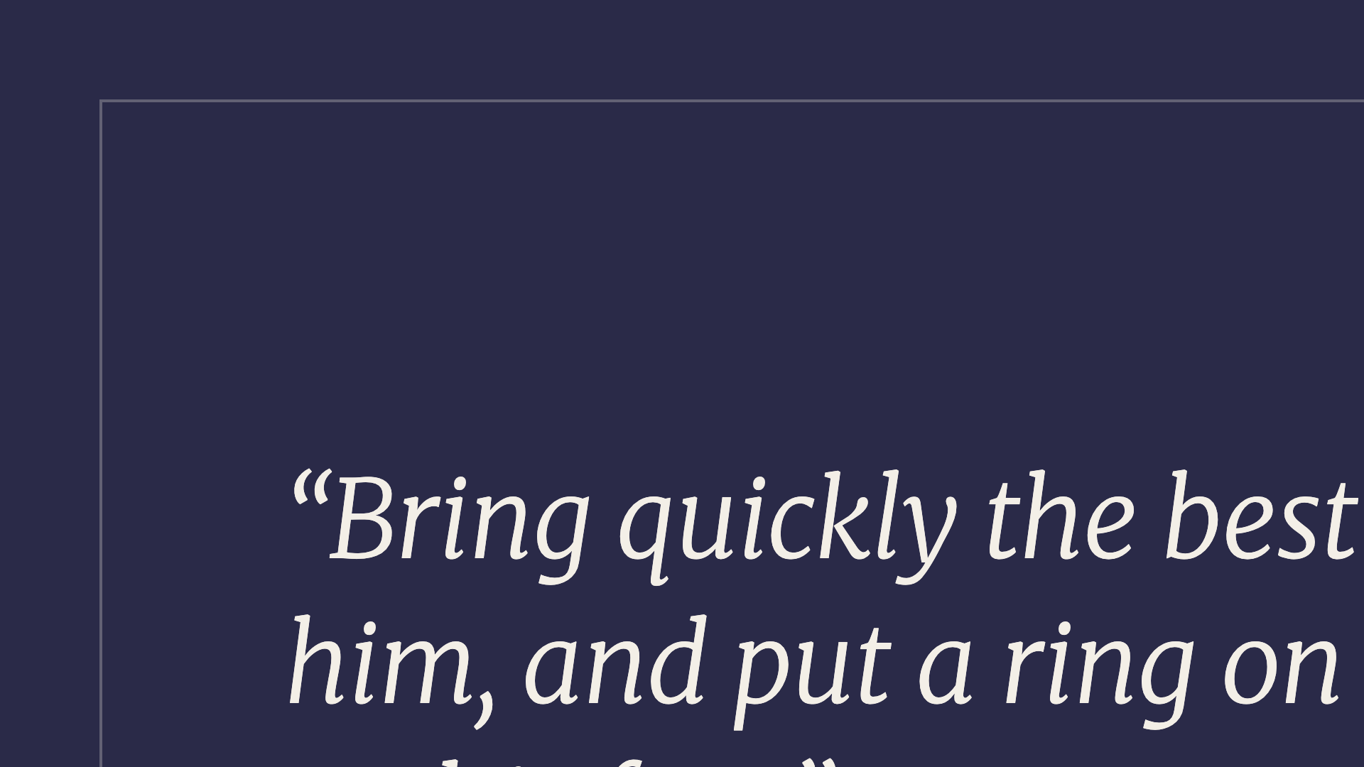


Notes:
Robe, ring, shoes — full restoration.

Slide 18



Notes:
His character.

Slide 19




Notes:
Sub-point B.

Slide 20




Notes:
He did not spare His own Son.

Slide 21




Notes:
How much more.

Slide 22




Notes:
Sub-point C.

Slide 23



Notes:
Nothing can separate us.

Slide 24




Notes:
Direct address. Kids, then dads.

Slide 25




Notes:
Everyone. If you have been living in the Father's house as staff, hand in the uniform this week. He has already put the robe on you.

Slide 26



Notes:
Third movement — the response.

Slide 27



Notes:
The right to become children of God.

Slide 28




Notes:
The two pictures: the red packet, and the child on the edge of the pool. Tell them as stories — the slide just holds the two lines.

Slide 29




Notes:
Three verbs. Walk them through slowly.

Slide 30




Notes:
Abba.

Slide 31




Notes:
Invite them to pray this aloud, line by line.

Slide 32




Notes:
Send them out.

