Slide 1

WEEK 5 OF 5 · FIVE ANCHORS OF A DISCIPLE
ROOTED
Disciple-making
What you have heard, entrust to faithful people.
CASEY LIFE INTERNATIONAL CHURCH
Notes:
Welcome. Final week of ROOTED. Energy up, but let the weight of 'final' be felt.

Slide 2
MATTHEW 28:18–20 · ESV
“All authority in heaven and on earth has been given to me. Go therefore and make disciples of all nations, baptizing them in the name of the Father and of the Son and of the Holy Spirit, teaching them to observe all that I have commanded you. And behold, I am with you always, to the end of the age.”
Notes:
Read the whole commission slowly — the room should hear all three verses together. Notice the brackets: the command sits between 'ALL AUTHORITY is mine' before it and 'I AM WITH YOU ALWAYS' after it. The commission is not a burden assigned to you; it is a life shared with you. His authority means the outcome is not on your shoulders. His presence means you never go alone. And note: 'teaching them to OBSERVE' — disciples are taught to obey, not just to know.

Slide 3
Five Anchors of a Disciple
WEEK 1
God-Loving
Loved into loving
WEEK 2
Christ-Centred
Not I, but Christ
WEEK 3
Spirit-Filled
Not by might, not by power. By His Spirit
WEEK 4
Word-Grounded
Let the word of Christ dwell in you richly
WEEK 5
Disciple-Making
A disciple makes disciples
Notes:
Quick series recap. Point at each anchor. Slow down on week 5 — 'today we finish.'

Slide 4
One God.
One Book.
One Mission.
One God — Weeks 1–3 · One Book — last Sunday · One Mission — today
Notes:
Quick verbal recap of the five anchors off this slide: God-loving, Christ-centred, Spirit-filled — One God. Word-grounded — One Book. Disciple-making — One Mission. 'Three weeks ago I gave you three phrases. Today we land the third.' Then the Wk4 hinge, spoken: God changes the world through His word — and the word travels through people.

Slide 5
No book. No building. No budget.
He left people.
There is no Plan B.
“As the Father has sent me, even so I am sending you.” — John 20:21
Notes:
Cold open, spoken build before the slide lands: when Jesus left this earth He left no book written in His own hand, no building, no budget, no organisation. He left eleven discipled people. 'As the Father has sent me, even so I am sending you' (John 20:21). Pause on the crimson line. Then the thesis, spoken: if this church could do only one thing well, it would have to be this. The radical God-idea the whole sermon sits on — and the plan runs through this room.

Slide 6
Every follower of Jesus
is a disciple of Jesus.
Not the advanced class. The only class.
Notes:
The premise that closes the escape hatch: there is no two-tier Christianity. No ordinary members plus a keen class called disciples.

Slide 7
WHAT THE FIRST CHURCH CALLED THEMSELVES
261
3
times the New Testament says disciple
times it says Christian (Acts 11:26; 26:28; 1 Peter 4:16)
“in Antioch the disciples were first called Christians.” — Acts 11:26
Word counts: mathētēs / Christianos in the Greek New Testament (Emmaus University, 2022)
Notes:
The New Testament's own vocabulary. 'Christian' was the nickname outsiders gave them. 'Disciple' was who they were.

Slide 8
THE FIRST COMMAND · THE LAST COMMAND
GENESIS 1:28 — GOD'S FIRST COMMAND TO HUMANITY
“Be fruitful and multiply and fill the earth…”
MATTHEW 28:19 — JESUS' LAST COMMAND TO HIS CHURCH
“Go therefore and make disciples of all nations…”
The Bible's first command and its last command are the same command: multiply.
Notes:
The God-idea: God's first command to humanity and Jesus' last command to His church are the SAME command — multiply. Then the word unpack, spoken (no separate slide): in the Greek, mathēteusate — make disciples — is the ONLY command in the commission; go, baptising, teaching all lean on it. And mathētēs is not a classroom student — it is an apprentice, someone who learns a life by sharing a life. Jesus did not command attendance. He commanded apprenticeship.

Slide 9
You can attend church for years
and never once be a disciple.
Notes:
Drop it plainly and let it sit. Not shame — reality. Long pause.

Slide 10

Are we following him —
or just around him?
Notes:
Movement 1. Luke 14 — the crowd around Jesus and the disciple behind him.

Slide 11
LUKE 14:25, 27 · ESV
“Now great crowds accompanied him, and he turned and said to them… ‘Whoever does not bear his own cross and come after me cannot be my disciple.’”
Notes:
The grammar carries the diagnosis: great crowds ACCOMPANIED him. He turned. Land the line off this text (no separate slide): ACCOMPANYING IS NOT FOLLOWING. John 6:66 — when the cost appeared the crowd thinned. Mark 3:14 — He appointed twelve to BE WITH him. Jesus' pattern: He kept walking away from crowds toward the few (Mark 1:37–38; Luke 5:15–16) — depth over breadth, multiplication over addition.

Slide 12
“Cheap grace is the preaching of forgiveness without requiring repentance… Cheap grace is grace without discipleship, grace without the cross, grace without Jesus Christ.”
Dietrich Bonhoeffer · The Cost of Discipleship (1937)
Grace is free. It is never cheap.
Notes:
Say the second quote from memory: 'When Christ calls a man, he bids him come and die.' Bonhoeffer was hanged at Flossenbürg in 1945, aged 39, for following Jesus. He knew the difference between admiring Christ and following him.

Slide 13
WHY WE KEEP OUR DISTANCE · 2 TIMOTHY 4:3 · ESV
“For the time is coming when people will not endure sound teaching, but having itching ears they will accumulate for themselves teachers to suit their own passions.”
We do not avoid discipleship because it asks too little. We avoid it because it sits close enough to tell us the truth.
Notes:
Same letter, two chapters after 2:2. The alternative to ENTRUSTING is ACCUMULATING — collecting voices that agree with us. Name the idols underneath (no separate slide): COMFORT — the crowd asks nothing of us; CONTROL — attendance fits my schedule, a living Lord will not stay in a time slot; COST counted without grace. For the young people: your feed is a teacher you appointed, and the algorithm only ever scratches the itch. Why do we avoid a discipleship relationship? Because a podcast can be skipped and a preacher can be ignored — but a discipler sitting across the table knows your name, and loves you enough to contradict you.

Slide 14
Why would you say yes to following Jesus?
Freedom
Joy
Not doing whatever you want. Finally being free from whatever was mastering you.
Not a mood that comes and goes. His own joy, planted in you, growing full.
“…you are truly my disciples, and the truth will set you free.” — John 8:31–32
“…that my joy may be in you, and that your joy may be full.” — John 15:11
“Whoever loses his life for my sake will find it.” — Matthew 16:25
Notes:
First the invitation itself, spoken (no separate slide): 'Come to me, all who labor and are heavy laden… take my yoke upon you and learn from me… and you will find REST for your souls; my yoke is easy and my burden is light' (Matt 11:28–30). Then answer the unspoken question after Bonhoeffer: is Jesus trying to make my life difficult? No — He is making it ALIVE. The yoke joins two animals so the stronger pulls with the weaker; He isn't adding weight, He is stepping under it beside you. Every 'no' of Jesus guards a bigger 'yes' — 'the LORD commanded us... for our good always' (Deut 10:13). Family blessing is off-slide but can be SPOKEN as the third if the moment is right: 'a hundredfold of mothers, brothers, sisters and children — with persecutions' (Mark 10:29–30, always quoted whole) — for the migrants in the room who left family across an ocean, many have literally lived the hundredfold in this church. Held in reserve for small groups: rest (Matt 11:29), life in full (John 10:10), friendship (John 15:15), becoming like Him (Luke 6:40), a life that holds (Matt 7:24–25), purpose (John 15:16).

Slide 15
Who is discipling you?
Start with God.
Notes:
Movement 2. Start with God — He disciples you before anyone else does.

Slide 16
THE ANCHOR · 2 TIMOTHY 2:1 · ESV
“You then, my child, be strengthened by the grace that is in Christ Jesus.” — 2 Timothy 2:1
Notes:
Before Paul says 'entrust', he says 'child' and 'grace'. Discipleship begins as something done TO you.

Slide 17
Jesus is discipling you right now.
Notes:
Present tense. Not a course you enrol in — a gardener already at work in your life.

Slide 18
JOHN 15:1–2 · ESV
“I am the true vine, and my Father is the vinedresser… every branch that does bear fruit he prunes, that it may bear more fruit.”
Notes:
The Father is not waiting for you to enrol in something. He is a gardener already at work. Land the line spoken over this slide: 'Jesus is discipling you RIGHT NOW.' Note who holds the knife: the vinedresser is the FATHER. Pruning is never random and never cruel.

Slide 19
SEASONS OF DISCIPLESHIP · 1 OF 4
Winter
The stripped-back season.
Branches bare. Everything looks dead. Nothing is. The Gardener prunes, and the roots go deeper in the dark.
“…he prunes, that it may bear more fruit.” — John 15:2
“The LORD is near to the brokenhearted.” — Psalm 34:18
Notes:
Open the section with the Melbourne line: sometimes discipleship feels like Melbourne weather — four seasons in one day. Then winter. WHAT WINTER LOOKS LIKE (the pruning close-up, spoken): a verse that reads you — one line in the Bible names the grudge, the habit, the thing you've been avoiding; the no you didn't want — the course you missed, the job that went to someone else, the auction lost — sometimes a closed door is the Father redirecting the branch; the year you'd never choose — stripped back in health, money, friendships, and it became the year you held God tightest. TWO GUARDRAILS: pruning is not punishment — only fruitful branches get pruned. And no formulas for suffering — someone here is in a dark valley (a diagnosis, a death). Say: 'I can't tell you why every hard thing happens — I'm not the Gardener. But nothing is wasted in His hands, and the knife is never in the hands of a stranger.'

Slide 20
SEASONS OF DISCIPLESHIP · 2 OF 4
Spring
The new-growth season.
First love. Fresh starts. The thaw after a long dry stretch. Everything is small, green and hungry.
“The winter is past… the time of singing has come.” — Song 2:11–12
“Behold, I am doing a new thing… it springs forth.” — Isaiah 43:19
Notes:
The timing gift — use it: today is the last Sunday of winter in Melbourne. Spring begins on TUESDAY. Some of you have been in a long winter — spring is coming. Honour the spring people: new believers and the young; don't despise small shoots, feed them. And the undercurrent data rhymes here: 784,000 Australians quietly moving toward Christ is what early spring looks like in a country.

Slide 21
SEASONS OF DISCIPLESHIP · 3 OF 4
Summer
The long-obedience season.
No drama. Just heat — and staying green through it. Ordinary faithfulness when nothing feels special.
“It does not fear when heat comes, for its leaves remain green.” — Jeremiah 17:8
“Let us not grow weary of doing good, for in due season we will reap.” — Galatians 6:9
Notes:
Jer 17:8 is a Wk4 callback — the room saw this verse two weeks ago on the Word-grounded Sunday; name that. Summer is most of the Christian life: school terms, work weeks, packed lunches, showing up. Nothing Instagram-worthy — and the roots drinking deep the whole time. The danger of summer is not collapse; it is drift and boredom. Staying green through heat is not automatic — it is roots by the stream.

Slide 22
SEASONS OF DISCIPLESHIP · 4 OF 4
Autumn
The harvest season.
Fruit heavy enough to feed someone else. Harvest is where being discipled turns into discipling.
“By this my Father is glorified, that you bear much fruit.” — John 15:8
“They still bear fruit in old age; they are ever full of sap and green.” — Psalm 92:14
The seasons change. The Gardener doesn't.
Notes:
Psalm 92:14 is for the older saints — read it slowly, looking at them: the Bible refuses to retire you; some of the best disciple-making in this church will be done by people over sixty. Fruit carries seeds — this is the hinge into Movement 4: harvest is where being discipled becomes discipling. Then the closing line before the question slide: the seasons change; the Gardener doesn't. He is discipling you in all four — winter is not His absence.

Slide 23
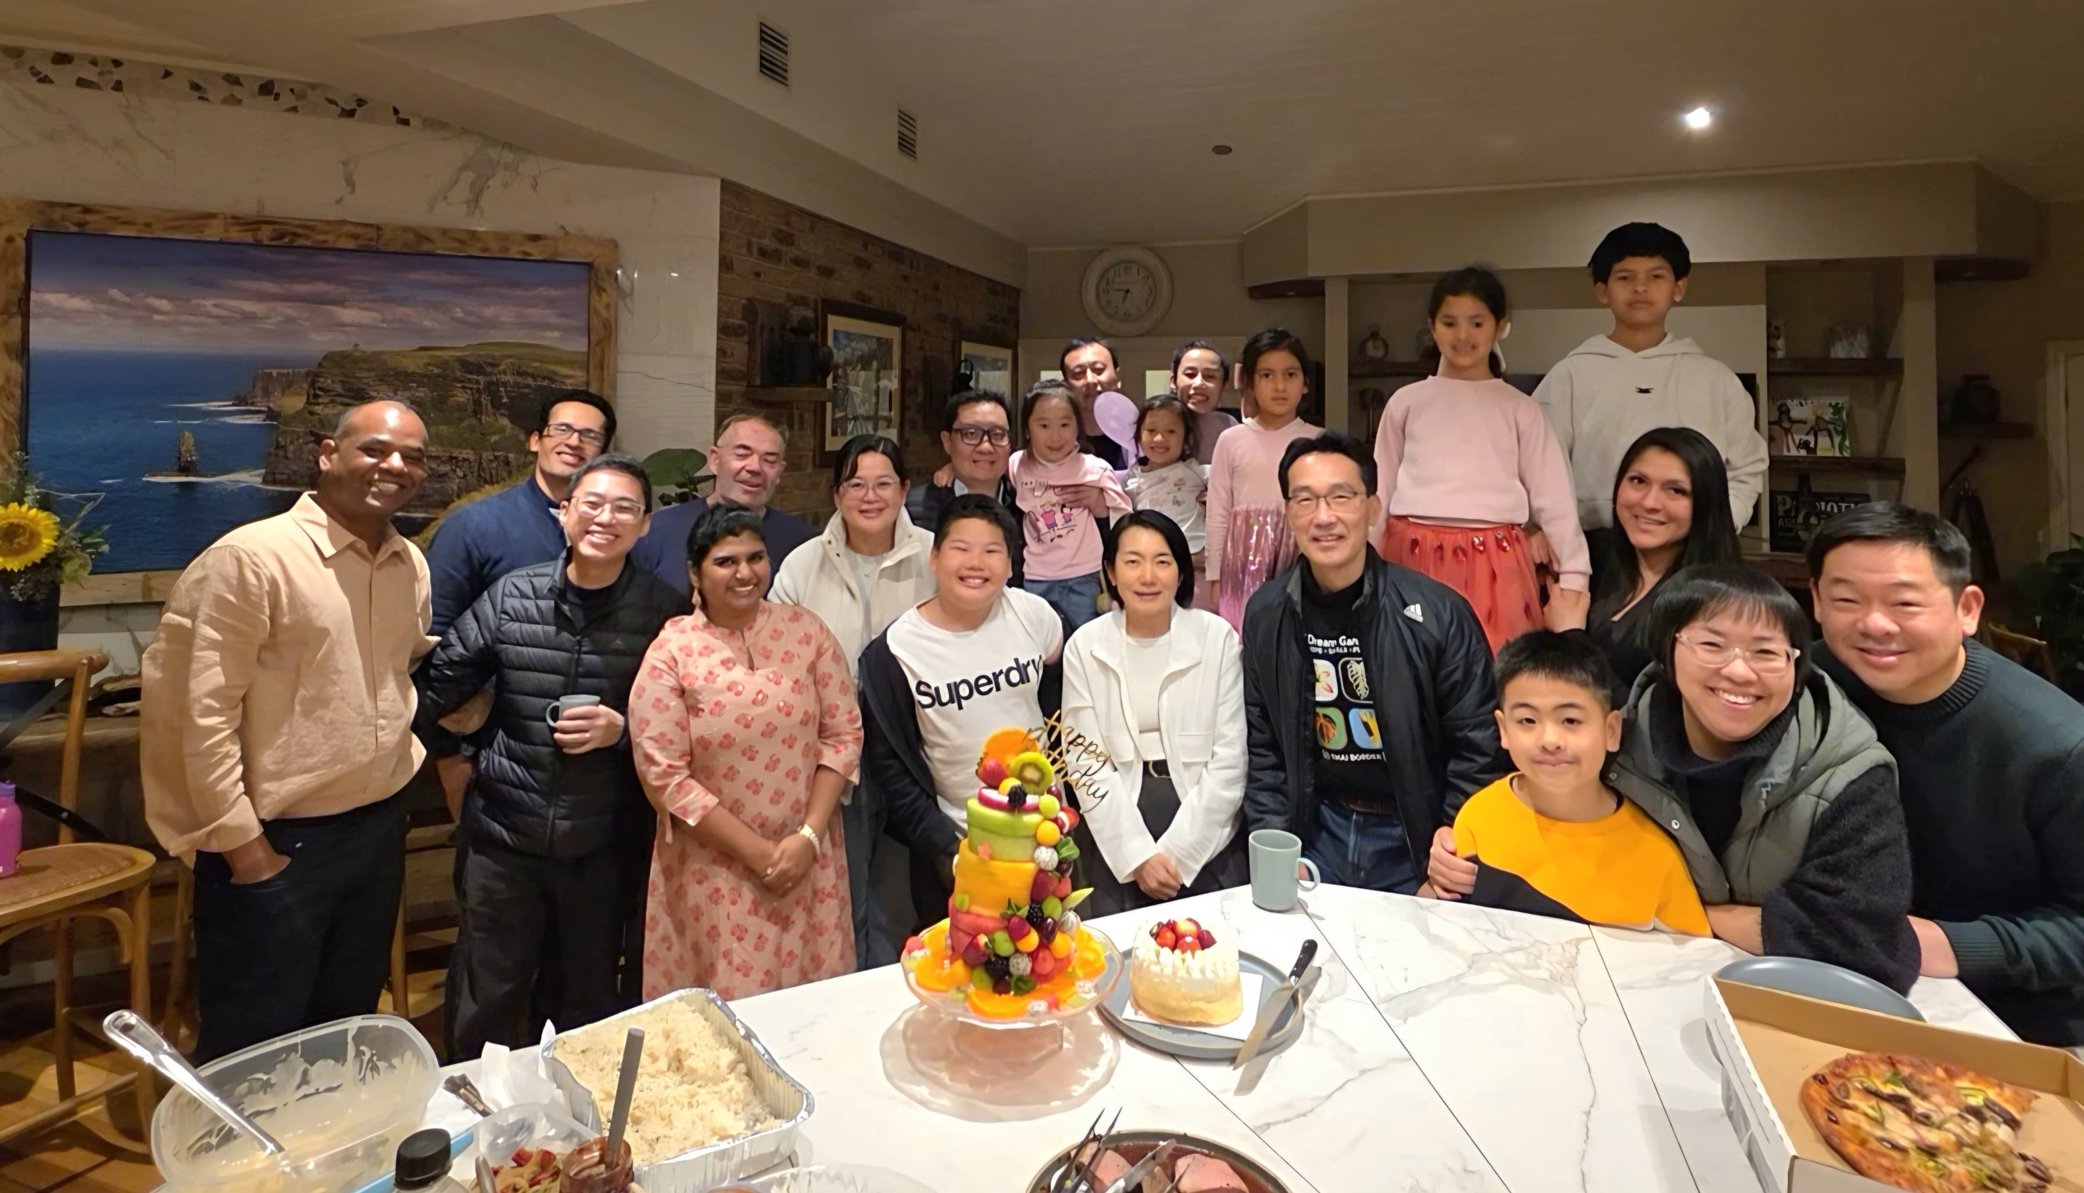

Slide 24
How do you start?
Ask someone ahead of you
Invite someone behind you
Get into a room
Name one person you respect. Ask them: “Could we meet once a month? I want to grow.”
Read a Gospel together, one chapter a week. You don't need answers. You need presence.
Join or host a group. Discipleship grows where two or three keep showing up.
“Iron sharpens iron, and one man sharpens another.” — Prov 27:17
“…ready to share with you not only the gospel of God but also our own selves.” — 1 Thess 2:8
“…consider how to stir up one another to love and good works.” — Heb 10:24
No curriculum required. Two people, an open Bible, a regular table.
Notes:
First name the two modes in a sentence (no separate slide): discipleship happens ON PURPOSE (2 Tim 2:2; Acts 5:42 'in the temple and from house to house') and ALONG THE WAY (Deut 6:7 'when you sit in your house and when you walk by the way'; 2 Tim 3:10) — not two obligations; God already runs both. Then make the first step small enough to take this week. Three doors, any one of them starts a discipleship relationship. No curriculum, no qualification — two people, an open Bible, a regular table. The ask-someone script matters: give them the exact words so nobody has to invent them.

Slide 25
Who are you discipling?
Notes:
Movement 4. The anchor itself: entrust. From being discipled to discipling.

Slide 26
THE ANCHOR · 2 TIMOTHY 2:2 · ESV
“and what you have heard from me in the presence of many witnesses entrust to faithful men, who will be able to teach others also.” — 2 Timothy 2:2
Paul → Timothy → faithful people → others also
Four generations in one sentence.
Notes:
MOVEMENT 4 OPENS HERE — spoken transition: 'Who are you discipling?' Four generations in one sentence: Paul → Timothy → faithful people → others also. Multiplication, not addition. Spoken unpacks (no separate slides): the verse asks for FAITHFUL — not gifted, trained or qualified; 'you received without paying; give without pay' (Matt 10:8). Two Greek words: endynamou (2:1) — present passive, keep on being strengthened, grace does the strengthening; parathou (2:2) — a banker's word, place a deposit for safekeeping, same root as 'guard the good deposit' (1:14) — you are a trustee, not an owner, and a deposit is kept safe by being handed to the next faithful hands.

Slide 27
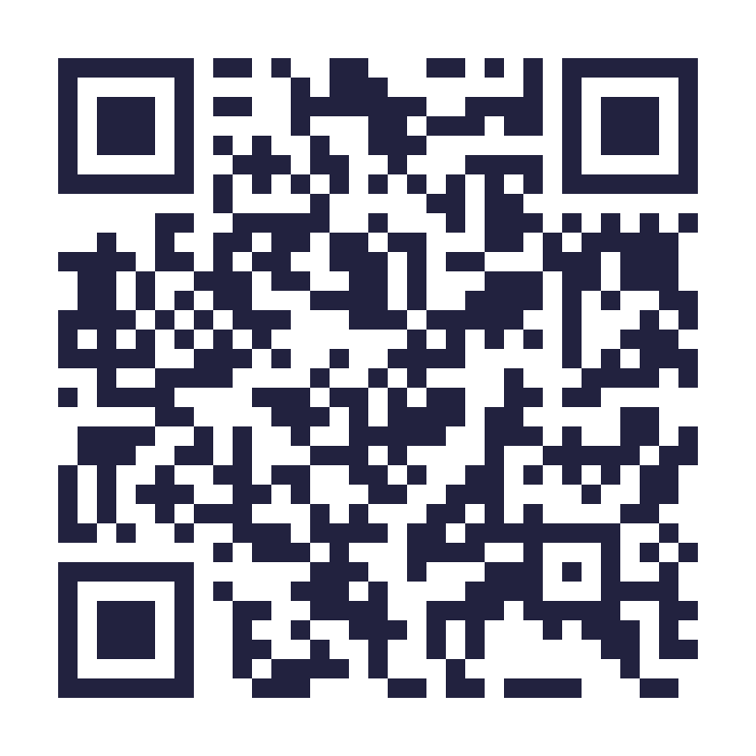
This week
1 · Who is discipling you?
2 · Who are you discipling?
Ask Jesus this week: “What are you teaching me?” Then tell one person in this church your answer. If you want company on the way, join a group.
Write down one name. Not a programme — a person. Your child, your friend, your workmate. Pray for them daily. Share one meal this month.
Groups, daily devotion and this series: app.clichurch.com
Notes:
Concrete and possible today. Door for seekers: the woman at the well started the chain after one afternoon — a first-timer can begin today. Ministry team ready at the front.

Slide 28
2 TIMOTHY 2:2
παράθου parathou — “entrust”
A banker's word: place a deposit for safekeeping — the same root as “guard the good deposit” (2 Tim 1:14). The gospel is a treasure on deposit. You are its trustee, not its owner.
A deposit is kept safe by being handed to the next faithful hands.
Notes:
Two Greek words carry the whole verse pair. ENDYNAMOU — present passive imperative: 'keep on being strengthened' — grace does the strengthening, you receive it; same root as dynamis, power. PARATHOU — a banking word: place a deposit for safekeeping. Same root as 2 Tim 1:14, 'guard the good DEPOSIT (parathēkē).' The gospel is a treasure on deposit: you are a trustee, not an owner — and a deposit is kept safe by being entrusted to the next faithful hands.

Slide 29
Come and tell me: “I want to be discipled.”
I will find someone to journey with you.
Notes:
Personal, slow, eye contact — step away from the pulpit if possible. This removes the last excuse: nobody in this room can say 'I don't know where to start.' Have a simple follow-up path ready: come to the front after service, or message through the app, and within two weeks you will have a name.

Slide 30
“Simon, son of John, do you love me?… Feed my sheep.” — John 21:17
“If we are faithless, he remains faithful…” — 2 Timothy 2:13
Notes:
The last man Jesus discipled before Pentecost had just denied him three times — and Jesus re-entrusted him three times. The chain is carried by the restored, not the strong. It holds because HE holds it.

Slide 31
MATTHEW 28:18–20 · ESV
“All authority in heaven and on earth has been given to me. Go therefore and make disciples of all nations, baptizing them in the name of the Father and of the Son and of the Holy Spirit, teaching them to observe all that I have commanded you. And behold, I am with you always, to the end of the age.”
Notes:
Read the whole commission slowly — the room should hear all three verses together. Notice the brackets: the command sits between 'ALL AUTHORITY is mine' before it and 'I AM WITH YOU ALWAYS' after it. The commission is not a burden assigned to you; it is a life shared with you. His authority means the outcome is not on your shoulders. His presence means you never go alone. And note: 'teaching them to OBSERVE' — disciples are taught to obey, not just to know.

