Slide 1

Acts 13:13-52 (Part 1)
August 12, 2026

Slide 2
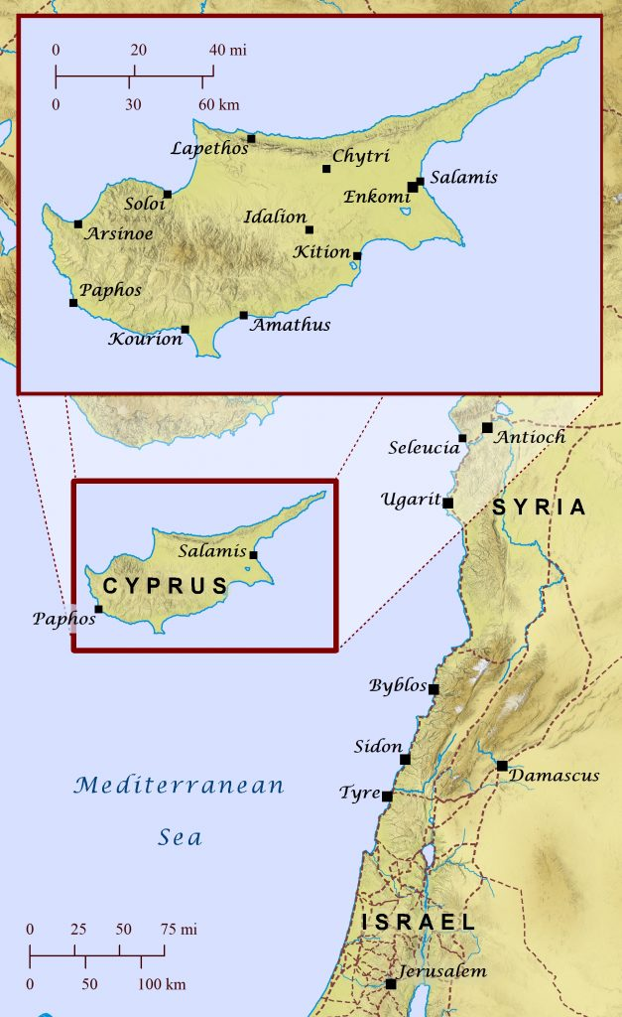

Slide 3
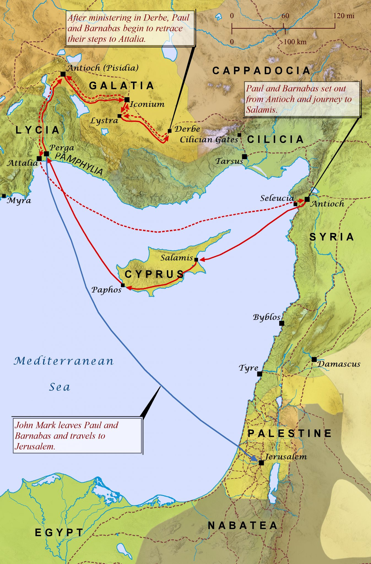

Slide 5
First mention of Pamphylia
Acts 2:10

Slide 7
About 130 – 150 mile journey
4-5 days of strenuous walking on foot through the mountainous terrain

Slide 8
What do they do on the Sabbath day?

Slide 9
Synagogue Order of Service
The Shema
Prayer by the leader
Reading of the Law and prophets
Message by a suitable member of congregation

Slide 10
Leader of Synagogue job
Take care of the building
Make the arrangements for the public service
Appoint members of the congregation to read the Scriptures
Invite a person(s) to speak

Slide 11
Who is the most famous leader of the Synagogue in the New Testament?

Slide 12
Who is the most famous leader of the Synagogue in the New Testament?
Luke 8:40

Slide 13
What “message of encouragement” does Paul give?

Slide 14
There are two groups of people in the synagogue

Slide 15

Acts 13:16-17
“Men of Israel and you who fear God, listen. ¹⁷ The God of this people Israel chose our fathers and made the people great during their stay in the land of Egypt, and with uplifted arm he led them out of it.

Slide 16
Acts 13:16-17
“Men of Israel and you who fear God, listen. ¹⁷ The God of this people Israel chose our fathers and made the people great during their stay in the land of Egypt, and with uplifted arm he led them out of it.

Slide 17
Acts 13:16-17
“Men of Israel and you who fear God, listen. ¹⁷ The God of this people Israel chose our fathers and made the people great during their stay in the land of Egypt, and with uplifted arm he led them out of it.
- Literally – extended arm

Slide 18
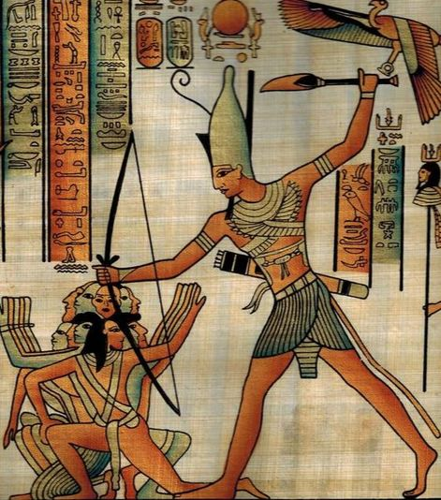

Slide 19
Acts 13:18-20
¹⁸ And for about forty years he put up with them in the wilderness. ¹⁹ And after destroying seven nations in the land of Canaan, he gave them their land as an inheritance. ²⁰ All this took about 450 years. And after that he gave them judges until Samuel the prophet.

Slide 20
Acts 13:18-20
¹⁸ And for about forty years he put up with them in the wilderness. ¹⁹ And after destroying seven nations in the land of Canaan, he gave them their land as an inheritance. ²⁰ All this took about 450 years. And after that he gave them judges until Samuel the prophet.

Slide 21
7 nations are listed in
Deuteronomy 7:1

Slide 22
7 Nations
Hittites
Girgashites
Amorites
Canaanites
Perizzites
Hivites
Jebusites

Slide 23
Acts 13:18-20
¹⁸ And for about forty years he put up with them in the wilderness. ¹⁹ And after destroying seven nations in the land of Canaan, he gave them their land as an inheritance. ²⁰ All this took about 450 years. And after that he gave them judges until Samuel the prophet.

Slide 24
Acts 13:21-22
²¹ Then they asked for a king, and God gave them Saul the son of Kish, a man of the tribe of Benjamin, for forty years. ²² And when he had removed him, he raised up David to be their king, of whom he testified and said, ‘I have found in David the son of Jesse a man after my heart, who will do all my will.’

Slide 25
The Old Testament never tells us how many years King Saul reigned in Israel

Slide 26
Who removed King Saul?

Slide 27
Acts 13:21-22
²¹ Then they asked for a king, and God gave them Saul the son of Kish, a man of the tribe of Benjamin, for forty years. ²² And when he had removed him, he raised up David to be their king, of whom he testified and said, ‘I have found in David the son of Jesse a man after my heart, who will do all my will.’

Slide 28
God removed King Saul.
God is the Sovereign LORD over all the nations

Slide 29
Acts 13:21-22
²¹ Then they asked for a king, and God gave them Saul the son of Kish, a man of the tribe of Benjamin, for forty years. ²² And when he had removed him, he raised up David to be their king, of whom he testified and said, ‘I have found in David the son of Jesse a man after my heart, who will do all my will.’

Slide 30
Acts 13:21-22
²¹ Then they asked for a king, and God gave them Saul the son of Kish, a man of the tribe of Benjamin, for forty years. ²² And when he had removed him, he raised up David to be their king, of whom he testified and said, ‘I have found in David the son of Jesse a man after my heart, who will do all my will.’

Slide 31
Psalm 89:20

Slide 32
Acts 13:21-22
²¹ Then they asked for a king, and God gave them Saul the son of Kish, a man of the tribe of Benjamin, for forty years. ²² And when he had removed him, he raised up David to be their king, of whom he testified and said, ‘I have found in David the son of Jesse a man after my heart, who will do all my will.’

Slide 33
1 Samuel 13:14

Slide 34
Acts 13:23
²³ Of this man's offspring God has brought to Israel a Savior, Jesus, as he promised.

Slide 35
Acts 13:24-25
²⁴ Before his coming, John had proclaimed a baptism of repentance to all the people of Israel. ²⁵ And as John was finishing his course, he said, ‘What do you suppose that I am? I am not he. No, but behold, after me one is coming, the sandals of whose feet I am not worthy to untie.’

Slide 36
Acts 13:25 (Literal translation)
²⁵ And as John was fulfilling his course of life, he said, ‘Who do you suppose me to be? I am not he but behold, one is coming after me, of whom I am not deserving to untie the sandals of his feet.’

Slide 37
Acts 13:26-27
²⁶ “Brothers, sons of the family of Abraham, and those among you who fear God, to us has been sent the message of this salvation. ²⁷ For those who live in Jerusalem and their rulers, because they did not recognize him nor understand the utterances of the prophets, which are read every Sabbath, fulfilled them by condemning him.

Slide 38
People in Jerusalem were ignorant of
Jesus’ identity and the prophets

Slide 39
Own people did not receive Him
John 1:9-13

Slide 40
Acts 13:26-27
²⁶ “Brothers, sons of the family of Abraham, and those among you who fear God, to us has been sent the message of this salvation. ²⁷ For those who live in Jerusalem and their rulers, because they did not recognize him nor understand the utterances of the prophets, which are read every Sabbath, fulfilled them by condemning him.

Slide 41
Acts 13:28-29
²⁸ And though they found in him no guilt worthy of death, they asked Pilate to have him executed. ²⁹ And when they had carried out all that was written of him, they took him down from the tree and laid him in a tomb.

Slide 42
Acts 13:30-32
³⁰ But God raised him from the dead, ³¹ and for many days he appeared to those who had come up with him from Galilee to Jerusalem, who are now his witnesses to the people. ³² And we bring you the good news that what God promised to the fathers, ³³ this he has fulfilled to us their children by raising Jesus,

Slide 43
Acts 13:30-32
³⁰ But God raised him from the dead, ³¹ and for many days he appeared to those who had come up with him from Galilee to Jerusalem, who are now his witnesses to the people. ³² And we bring you the good news that what God promised to the fathers, ³³ this he has fulfilled to us their children by raising Jesus,

Slide 44
Why does Paul go through Old Testament History when proclaiming the Gospel?

Slide 45
Why does Paul proclaim the Gospel of Jesus to the Jewish people?

