Slide 1
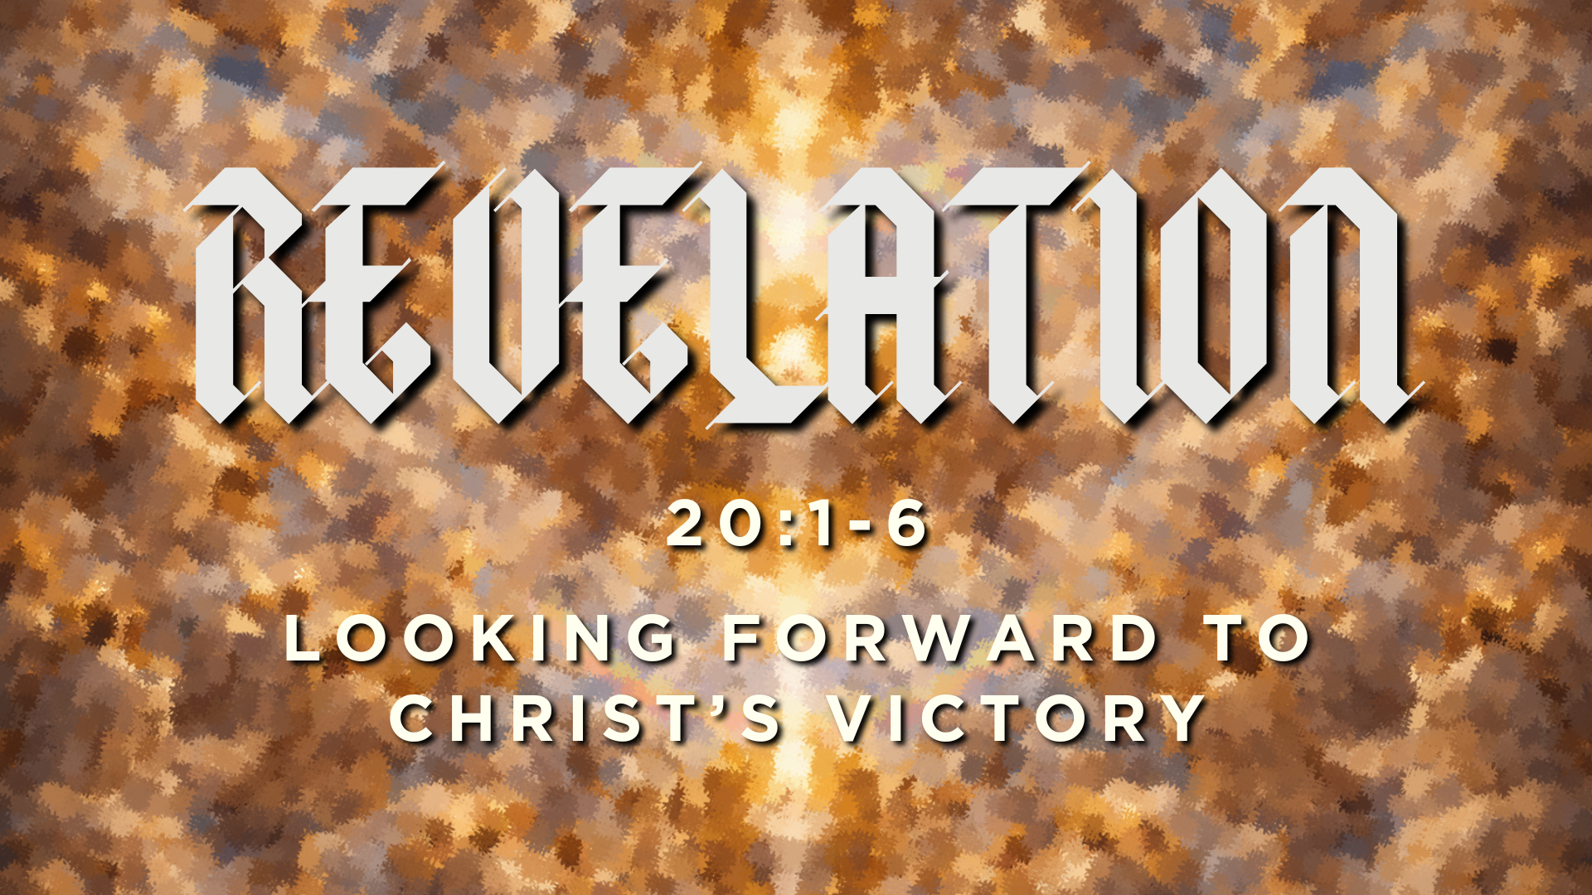

Slide 2
We interpret our present through the lens of the future.

Slide 3
Our present suffering can make it feel like pain is permanent.

Slide 4
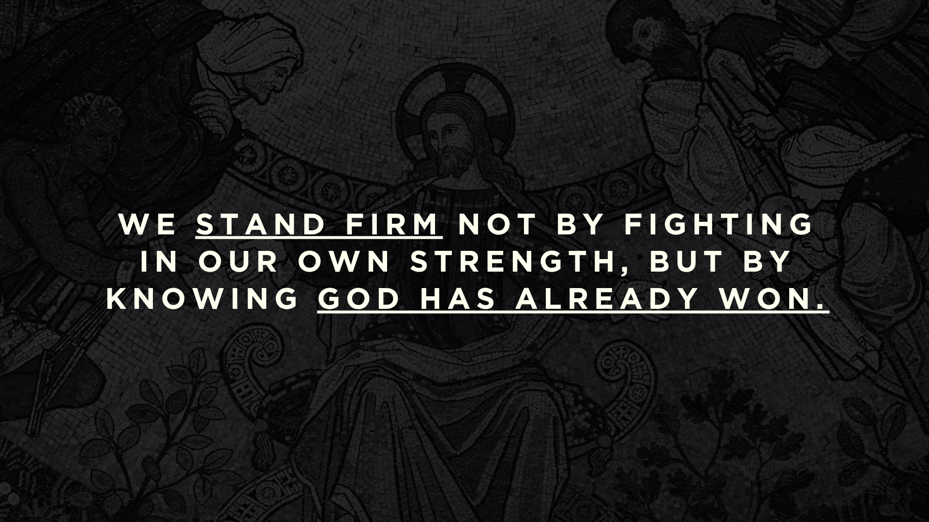

Slide 5
Q: Do we look forward to the end, when God will celebrate with us?

Slide 6
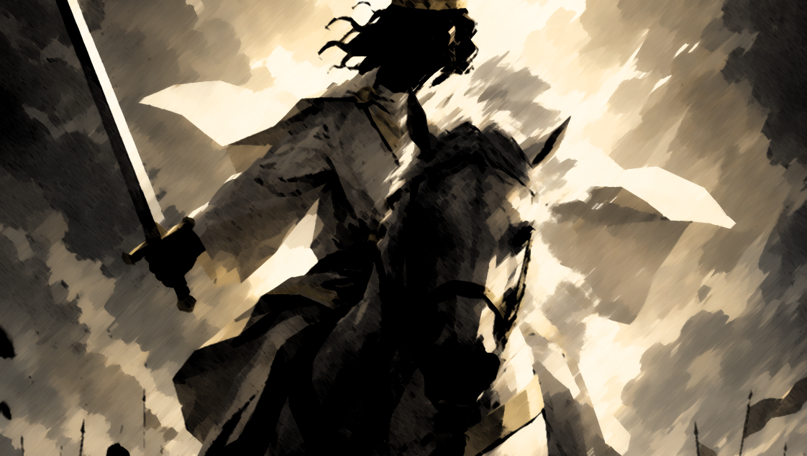
“Then I saw heaven opened, and behold, a white horse! The one sitting on it is called Faithful and True, and in righteousness he judges and makes war.”
(Revelation 19:11)

Slide 7
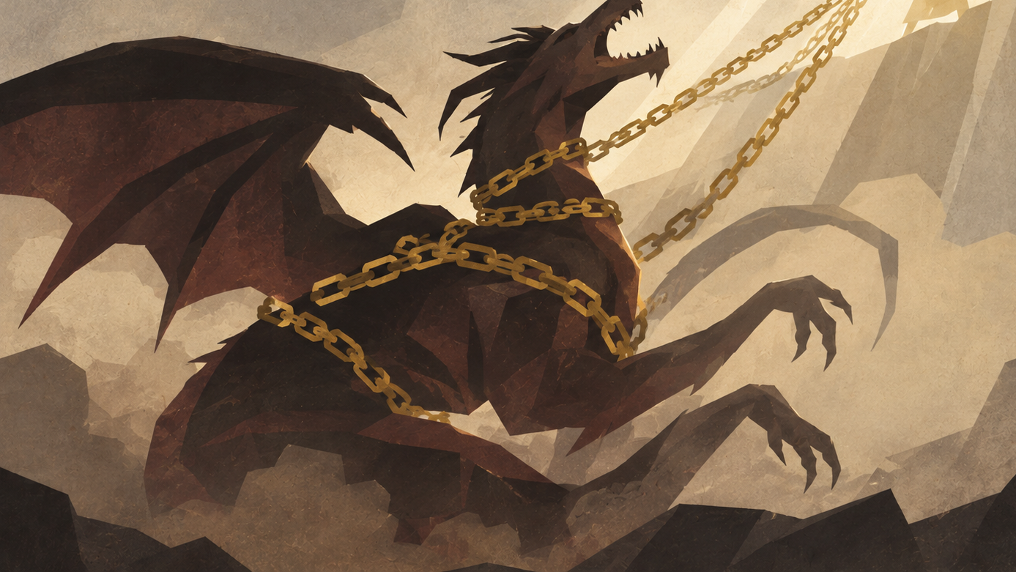
“Then I saw an angel coming down from heaven, holding in his hand the key to the bottomless pit and a great chain. And he seized the dragon, that ancient serpent, who is the devil and Satan, and bound him for a thousand years, and threw him into the pit, and shut it and sealed it over him, so that he might not deceive the nations any longer, until the thousand years were ended.”
(Revelation 20:1-3)

Slide 8
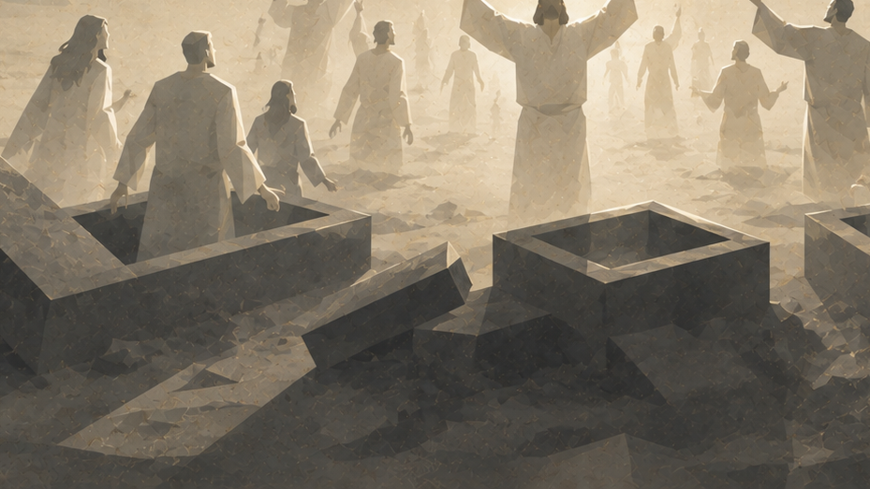
They came to life and reigned with Christ for a thousand years…This is the first resurrection.
(Revelation 20:4-5)

Slide 9
a) The 1,000-year period (Rev. 20:4)
b) Satan’s binding (Rev. 20:2)
c) The resurrection of the dead (Rev. 20:5-6)

Slide 10
Eschatos means “last” or “final.”
Eschatology means the study of last things.

Slide 11
Amillennial
Postmillennial
Premillennial

Slide 12
Amillennial
According to this view, there is no future millennium.
  The 1,000 years in Rev. 20:1-10 is figurative
  The church age (now) is the millennium that is described in the text
Satan’s binding was at the cross.
  The binding is seen as specific and limited, not complete.
  It suggests that Satan no longer has control over the nations like in the OT.
The first resurrection is spiritual, where souls reign with Christ in heaven.
  Physical resurrection comes later

Slide 13
Postmillennial
According to this view, Christ will return after the millennium.
    The progress of the gospel and the growth of the church will gradually increase
    This will lead to a “millennial age” of peace and righteousness on earth
    Christ will return at the end of this period
The binding of Satan occurs at the cross or at some point in history.
    It is a limited binding, just like in the amillennial position
The first resurrection is understood spiritually
    Just like the amillennial position, physical resurrection comes later

Slide 14
Premillennial
According to this view, the present church age will continue until a time of great tribulation and suffering, and then Christ will return to earth to establish a millennial kingdom.
  Some believe in a literal 1,000 years; some symbolically
  Christ and believers will physically reign on earth during this time until the judgment
The binding of Satan is comprehensive.
  Satan will have no influence on the earth during the millennium
  He is locked and secured until he is released at the end
The first resurrection is physical
  Bodily “coming to life” when Christ returns before the millennium.

Slide 15
Three Views of Revelation 20:
Amillennial
Postmillennial
Premillennial

Slide 16
Saint Augustine interpreted the millennium as a period between the first and second coming of Christ.
Some believed that the millennium began during the reign of Constantine.
Martin Luther rejected the premillennial position and believed that the end was near.
Jonathan Edwards of the Great Awakening was postmillennial.
In the 20th century, the postmillennial position fell out of favor because of the two World Wars.

Slide 17
Your belief about Jesus’ return shapes how you live today.

Slide 18
“Do Christians in fact eagerly long for Christ’s return? The more Christians are caught up in enjoying the good things of this life, and the more they neglect genuine Christian fellowship and their personal relationship with Christ, the less they will long for his return.”
-Wayne Grudem

Slide 19
“On the other hand, many Christians who are experiencing suffering or persecution or who are elderly and infirm, as well as those whose daily walk with Christ is vital and deep, will have a more intense longing for his return.”
-Wayne Grudem

Slide 20
“To some extent, the degree to which we actually long for Christ’s return is a measure of the spiritual condition of our lives at the moment. It also gives some measure of the degree to which we see the world as it really is, as God sees it…”
-Wayne Grudem

Slide 21
“How long, O Lord?”
(Rev. 6:10, NKJV)

Slide 22
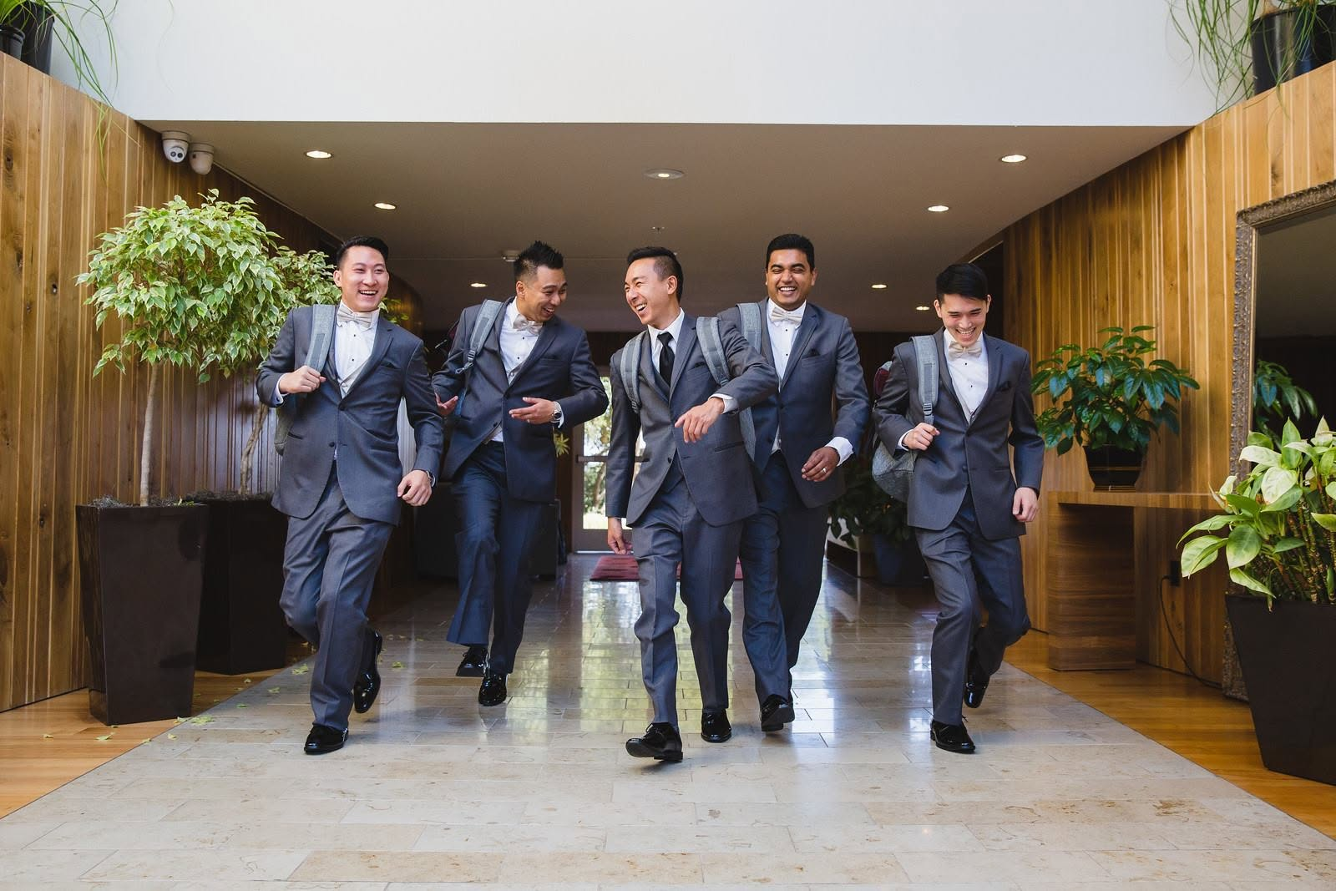

Slide 23
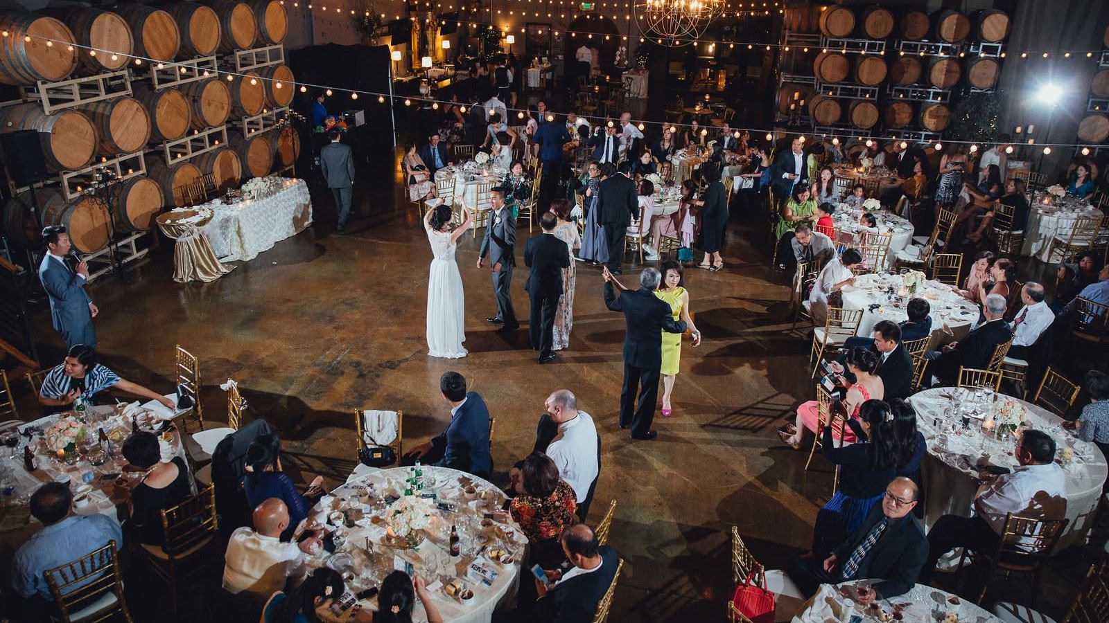

Slide 24
We can live with hope in the present when we look forward to Christ’s victory.

