Slide 1

WEEK 4 OF 5 · FIVE ANCHORS OF A DISCIPLE
ROOTED
Word-grounded
Let the word of Christ dwell in you richly.
CASEY LIFE INTERNATIONAL CHURCH
Notes:
Series title up as people are seated. Week 4 of 5 — Word-grounded.

Slide 2
Five Anchors of a Disciple
WEEK 1
God-Loving
Loved Into Loving
WEEK 2
Christ-Centred
Not I, But Christ
WEEK 3
Spirit-Filled
Not by might. Not by power. By His Spirit.
WEEK 4
Word-Grounded
Let the word of Christ dwell in you richly.
WEEK 5
Disciple-Making
Notes:
Where we are in the series. Wk1 loved into loving; Wk2 not I but Christ; Wk3 by His Spirit. Today the fourth anchor: Word-grounded.

Slide 3
OUR VISION · READ IT TOGETHER
“To be a God-loving, Christ-centred, Spirit-filled, Word-grounded, Disciple-making church.”
Notes:
INTRO beat 1. Whole room reads aloud, like we mean it. Then: today, anchor four — and I want to suggest it's the one holding up the other three.

Slide 4
IN THE COUNSELLOR’S OFFICE
Grounding
Feel your feet on the floor. Name five things you can see. Touch something solid.
Notes:
Start not in church — in a counsellor's office. The panic-attack technique. Psychology's own word: grounding. PAUSE after the word.

Slide 5
A SOCIOLOGIST’S NAME FOR OUR TIMES
Liquid modernity
“Change is the only permanence, and uncertainty the only certainty.”
Zygmunt Bauman · Liquid Modernity
Notes:
CITATION (verified): Zygmunt Bauman, Liquid Modernity (Polity, 2000); this sentence is from his Foreword to the 2012 edition. Companion line from the book, also verified: 'liquids, unlike solids, cannot easily hold their shape.' Unpack briefly in your own words: careers melt and re-form, truth updates like software, identity is a project you curate. Nothing keeps its shape long enough to stand on.

Slide 6
“To be rooted is perhaps the most important and least recognized need of the human soul.”
Simone Weil · The Need for Roots, 1949
Notes:
CITATION (verified): Simone Weil, The Need for Roots (L'Enracinement, written 1943, publ. 1949; Eng. trans. Arthur Wills, 1952), opening of Part II, 'Uprootedness'. 1949 — no internet, no smartphone. 'She hadn't seen anything yet.' Then the anxiety beat, brief and phenomenological: 'and our bodies know it — is it any wonder this is the most anxious generation on record? We saw the numbers last Sunday.' The world diagnosed the disease but prescribes techniques — feel your feet, touch the grass, breathe. The grass cannot tell you who you are. THEN THE TURN: 'But God has given us something…'

Slide 7
WHAT GOD HAS GIVEN US
Enduring.
“The grass withers, the flower fades, but the word of our God will stand forever.” — Isaiah 40:8
Notes:
THE CRESCENDO — spoken litany BEFORE advancing to the verse line, building: God has given us something PERMANENT — in a world of updates, it has never needed a patch. UNCHANGING — every other truth you were taught has been revised; this one hasn't moved a letter. TRANS-CULTURAL — it speaks Mandarin next door, English in here, Farsi in a basement in Tehran. TRANS-GENERATIONAL — your grandmother's worn Bible and the app on your phone are the same voice. TRANS-HISTORICAL — forty authors, fifteen hundred years, and it buried every empire that banned it. TRANSCENDENT — because it comes from the One who does not change. Then land the verse.

Slide 8
THE ANCHOR · COLOSSIANS 3:16 · ESV
“Let the word of Christ dwell in you richly, teaching and admonishing one another in all wisdom, singing psalms and hymns and spiritual songs, with thankfulness in your hearts to God.”
Notes:
Congregation standing. Read together, unhurried. Then be seated. (v17 is preached from the pulpit and returns on the benediction slide.)

Slide 9
BEFORE ANYTHING ELSE · TWO WORDS
Two words that change everything
ἐνοικείτω
πλουσίως
“dwell”
“richly”
en + oikos — literally, “to make a home in.” Not visit. Not lodge for the weekend. And it’s present tense: go on letting it live there.
Lavishly, abundantly — Colossians’ treasure-word (1:27; 2:2–3). A Bible can have an address in your life and no seat at your table.
The word of Christ isn’t asking for a visit. It’s asking for residence.
Notes:
PLANT THE PHRASE HERE — it returns at the data slide near the end ('dwelling vs visiting'). Paul chose a homes word: en-oikeo, oikos = house. Every other relationship you can have with a book — own it, admire it, quote it, visit it. Paul asks for the one thing a book never asks: let it MOVE IN. And 'richly' — plousios — is Colossians' own wealth vocabulary: 'the RICHES of the glory of this mystery' (1:27), 'all the TREASURES of wisdom hidden in Christ' (2:2–3). The treasure is in Christ; the word dwelling richly is how the treasure gets into the house. Grammar note (say lightly): the only verb assigned to YOU is 'let' — hospitality, not achievement.

Slide 10

Why don’t we engage with the Bible?
Nobody in this room is against the Bible. We just don’t open it.
Notes:
MOVEMENT 1. Honest, warm, zero scolding. 'You'd defend this Book. You just don't open it.'

Slide 11
AMONG CHURCHGOERS — WHAT THE RESEARCH SAYS
1 in 3
Almost 1 in 10 churchgoers say they rarely or never open it. (US)
Here in Australia: 53% of church attenders do some private devotion daily — prayer, reading, both. Which means about half of us don’t.
Fewer than one in three churchgoers read the Bible daily. (US research)
If that’s you this morning — you are not the odd one out in this room.
Lifeway Research — 2,130 US Protestant churchgoers, published Feb 2026 · NCLS Research — 2021 National Church Life Survey (Australia)
Notes:
CITATIONS (verified): (1) Lifeway Research, 'Fewer Than 1 in 3 Churchgoers Read the Bible Daily', published 10 Feb 2026 — survey of 2,130 US PROTESTANT churchgoers attending at least monthly, fielded 19–26 March 2025, MOE ±2.21%: 31% daily, 30% a few times a week, 14% once a week, 11% a few times a month, 5% once a month, 9% rarely/never. SAY 'American research' OUT LOUD — this is US data, not Australian. (2) NCLS Research, 2021 National Church Life Survey (Australia): about three quarters of church attenders keep private devotional practices at least a few times a week, 53% daily. NOTE the measure is DEVOTIONS (prayer and/or reading), broader than Bible reading — say it that way. Honest framing beats a bigger number: 'about half of us do; about half of us don't.' Do NOT claim 'you're the room' as if it were data — that's a pastoral read, so say it as one. The older Bible Society Australia '2 in 10' figure has been REMOVED: it traces to research from around 2006–2011 and is too old to state as current.

Slide 12
WHY WE DON’T OPEN IT
01
“I don’t have time.”
The word didn’t lose the argument. It never got an appointment.
Notes:
Gentle. The phone never sleeps in, never needs you in the mood. The first ten minutes of the morning already have an owner.

Slide 13
WHY WE DON’T OPEN IT
02
“I don’t understand it.”
You started in Genesis. The plan died in Leviticus. And nobody told you your experience is in the Bible…
“How can I, unless someone guides me?” — Acts 8:31
Notes:
The reading-plan joke (Genesis great, Exodus cinema, Leviticus death). Acts 8 — the Ethiopian. Not a failure; a design feature: this Book was never meant to be read alone. 'Hold that thought.'

Slide 14
WHY WE DON’T OPEN IT
03
“It feels far from my life.”
Old names. Old wars. Someone else’s mail — while your life is Monday’s deadline and Tuesday’s rent.
Notes:
Keep this one quick.

Slide 15
WHY WE DON’T OPEN IT
04
“It reads like a report card.”
Every page, another subject you’re failing. So you did the sane thing — you put it in a drawer.
Notes:
THE WOUND — slow down. CITATION: Christian Smith & Melinda Lundquist Denton, Soul Searching: The Religious and Spiritual Lives of American Teenagers (Oxford, 2005), from the National Study of Youth and Religion — coined 'moralistic therapeutic deism': God distant, God wants me good, the Bible as be-good manual. 'If that's what the Bible is, closing it isn't rebellion. It's self-protection.'

Slide 16
MORE THAN A MORAL HANDBOOK · 01
God reveals Himself in it.
Man-made rules “have an appearance of wisdom… but are of no value in stopping the flesh.” — Colossians 2:23
Notes:
FLOOR 1. Kid-level line: 'You don’t just learn ABOUT God — you meet Him.' Open with the scandal: the Bible itself mocks the book we have shrunk it into — Col 2:23, man-made rules are of NO VALUE against the flesh. A handbook can tell you what to do; it cannot introduce you to anyone. Then the two texts on the next slide.

Slide 17
HOW GOD HAS ALWAYS MADE HIMSELF KNOWN
“And the LORD appeared again at Shiloh, for the LORD revealed himself to Samuel at Shiloh by the word of the LORD.” — 1 Samuel 3:21
“Long ago, at many times and in many ways, God spoke to our fathers by the prophets, but in these last days he has spoken to us by his Son.” — Hebrews 1:1–2
Notes:
Read 1 Samuel slowly — the sentence says the LORD APPEARED, and then explains how: not fire, not a vision, but BY THE WORD. The appearing and the word are the same event. Then Hebrews gives the climax: God has always revealed Himself by speaking — and the last thing He said was a Person. 'Nobody meets God and stays the same' → hands into Floor 2.

Slide 18
MORE THAN A SELF-HELP BOOK · 02
God gives life through it.
“All Scripture is God-breathed…” — 2 Timothy 3:16 (theopneustos — breathed out by God)
Notes:
FLOOR 2 — the sermon’s power centre. Kid-level line: 'It doesn’t improve you. It raises dead things.' Self-help shrinks the Book to YOUR project — your peace, your habits, your five-year plan. But this Book claims to do what no self-help book has ever claimed: give life. Drop the volume on theopneustos — not God-approved, not inspired-in-the-greeting-card-sense: breathed OUT by God. Then trace what that breath has done.

Slide 19
MOSES · THE LAST SERMON OF HIS LIFE
“It is no empty word for you — it is your very life.”
Deuteronomy 32:47
Notes:
Land on every person in the room. SILENCE — two full seconds. Do not rush off this slide.

Slide 20
AND HERE IS WHAT HAPPENS TO THAT PERSON
“…his delight is in the law of the LORD, and on his law he meditates day and night. He is like a tree planted by streams of water that yields its fruit in its season, and its leaf does not wither. In all that he does, he prospers.” — Psalm 1:2–3
Notes:
The Bible's own promise about the word-soaked life — the ROOTED image; the series title is hiding in this psalm. GUARD (say it): 'prospers' is not health-and-wealth — Jeremiah 17:8 says the same tree still passes through drought; it just 'is not anxious in the year of drought.' The promise is not no-drought. It's roots that reach water the drought can't touch.

Slide 21
AND THE TREE SHOWS UP IN THE DATA
4+
Getting drunk 57% lower odds
Sex outside marriage 68% lower odds
Pornography 61% lower odds
days a week in the word — and life measurably changes.
Sharing their faith 228% higher odds
Discipling someone 231% higher odds
But 1–3 days a week? Statistically, almost no different from not reading at all. Remember the two words? The difference was never reading vs not reading. It’s dwelling vs visiting.
Center for Bible Engagement (Cole & Ovwigho, 2009; 40,000+ surveyed)
Notes:
CITATIONS (verified): Center for Bible Engagement, 'Understanding the Bible Engagement Challenge: Scientific Evidence for the Power of 4' — Arnold Cole & Pamela Caudill Ovwigho, Dec 2009; internet surveys of 40,000+ Americans plus a random sample of 2,967. Odds for engaging Scripture 4+ days/week vs not: drunkenness −57%, sex outside marriage −68%, porn −61%, gambling −74%; sharing faith +228%, discipling +231%, memorising +407%. THE THRESHOLD: on several behaviours, 1–3 days/week is statistically no different from zero — 'richly' shows up in the data; a visiting word changes nothing, a dwelling word changes everything. Flourishing: American Bible Society, State of the Bible 2025 ch.3 (Harvard Human Flourishing Index questions) — daily readers 7.9 vs never-readers 6.8; Scripture-engaged Gen Z/Millennials average 8.1 vs Gen Z overall 6.8 — the most anxious generation gets the biggest measured lift. HONESTY GUARD: these are correlations — say 'associated with', not 'causes'. And this is description, not prosperity promise: the tree still meets drought (Jer 17:8).

Slide 22
MORE THAN A RELIGIOUS BOOK · 03
God changes the world through it.
“So shall my word be that goes out from my mouth… it shall accomplish that which I purpose, and shall succeed in the thing for which I sent it.” — Isaiah 55:11
Notes:
FLOOR 3. Kid-level line: 'It’s not just for Sunday — it has changed history, and it isn’t finished.' THE RELEVANCE ANSWER: the objection was never that people think the Bible is untrue — it’s that they’ve filed it under RELIGION while their real life happens somewhere else. Isaiah refuses that: the word does not return empty; it ACCOMPLISHES and SUCCEEDS. Not assist you — accomplish. Then the evidence: a generation (flourishing), then civilisations (history).

Slide 23
AND THE WORLD NOTICED
“These men who have turned the world upside down have come here also.” — Acts 17:6
Notes:
This is not the church boasting — it is a HOSTILE WITNESS. A mob in Thessalonica shouting an accusation about what this message was doing to their city. Reserve illustration: Acts 19 at Ephesus — the magic books burned, the silversmiths rioted, a city’s idol trade shaken, 'so the word of the Lord continued to increase and prevail mightily.'

Slide 24
THEN — CIVILISATIONS
Translated into more languages than any book in history — second place is not close.
Taught continents to read — mass literacy exists because ordinary people wanted to read this.
Built the hospitals. Built the universities.
Kept Wilberforce awake until the slave trade fell.
Gave the West its values — equality, compassion, dignity for the weak. (Tom Holland, Dominion)
“It is not helping you cope with the world. It is remaking the world — and it’s inviting you in.”
Notes:
REFERENCES: translation claim — Wycliffe Global Alliance / United Bible Societies statistics: full Bible in 700+ languages, Scripture portions in 3,500+ — no other book is close (safe as phrased). Literacy/hospitals/universities — standard historical record of Bible translation driving vernacular literacy and church-founded institutions. Wilberforce — standard biography (e.g. Metaxas, Amazing Grace). Values claim — Tom Holland, Dominion: The Making of the Western Mind (2019); Holland was not writing as a Christian. SECOND RUNG OF FLOOR 2 — a generation (previous slide), now civilisations. Build pace through the list. 'We're living in a house this Book built, complaining it's not relevant to the house.' It opens in a garden and ends in a city — with the nations healed.

Slide 25
How do you engage with the Bible?
Notes:
MOVEMENT 3. The question just changed — no longer 'should I read a bit more.' If this is the breath of God…

Slide 26
THREE HANDLES
Get grounded
Read it
Journal it
Meditate on it
Daily — the word before the phone. And never alone: read with a buddy.
Writing slows you to the speed of hearing. A verse copied by hand lands differently.
Let it work from the inside out — become the person God has called you to be.
“How can I, unless someone guides me?” — Acts 8:31
“I have stored up your word in my heart…” — Psalm 119:11
“…then you will make your way prosperous…” — Joshua 1:8
Start with one. Ground is laid one layer at a time.
Notes:
Not a new report card — start with ONE. Name the church app devotion (live tonight) and the buddy invitation. [Optional single line: 'And some of you — don't settle for less with your whole vocation. Come talk to me about Bible college.'] Kenny's worn-Bible moment can live here — show the Book that's been lived in.

Slide 27
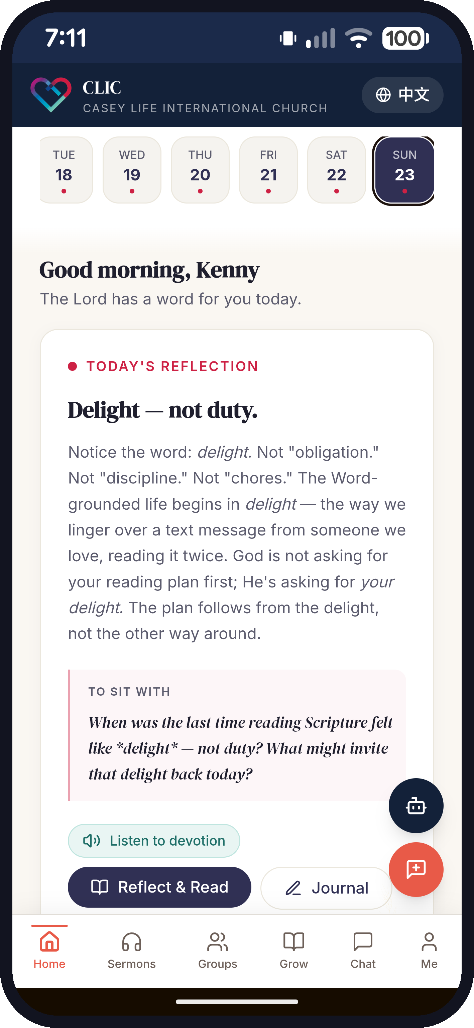
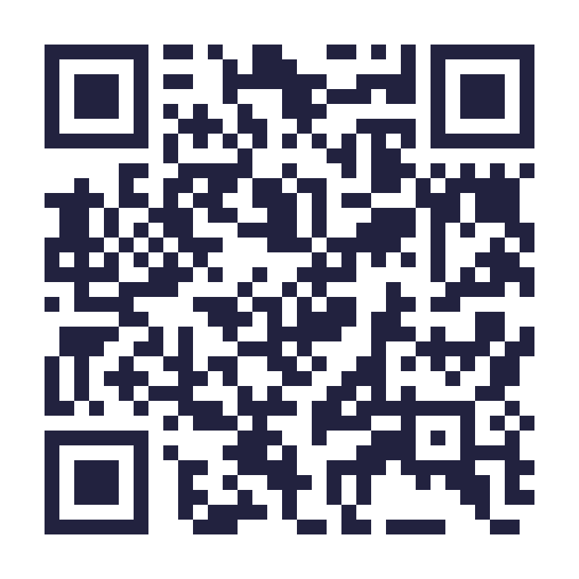
START TONIGHT
It's already in your pocket.
Our church app opens on the devotion — and it already does the three things we just said.
Read “Reflect & Read” — today's passage, already chosen
Meditate “To sit with” — one question to carry all day
Journal write down what you heard
app.clichurch.com
Type it in — or scan the code
Notes:
THE MONDAY ON-RAMP — say the address out loud and slowly, twice: app.clichurch.com. No download, no app store — it opens in a browser on any phone. It OPENS on the devotion, so there is no deciding where to start. And notice it does exactly the three things we just said: read, meditate, journal — all in one place. QR CODE is on the slide — say 'point your camera at the code, or just type the address.' LEAVE THIS SLIDE UP while people scan: give it a real 15–20 seconds of silence, and hold it up again during the response/communion set if the media team can. MAKE IT CONCRETE: 'Before you leave the car park today, put it on your home screen.' Then the buddy ask: 'And send that link to one person — do it with somebody. Remember Acts 8: how can I, unless someone guides me?' [ACTION BEFORE SUNDAY: make sure tonight's devotion is live, and decide who people talk to about finding a reading buddy.] GIFT FROM THE APP ITSELF: the reflection on screen is titled 'Delight — not duty' — which is Psalm 1's own word ('his DELIGHT is in the law of the LORD'). If it still reads that way on Sunday, say it: 'I didn't plan this — open it this morning and the first thing it says is delight, not duty. That is Psalm 1 in your pocket.' It also offers 'Listen to devotion' — name that for the drivers and the commuters. Nav: Home · Sermons · Groups · Grow · Chat · Me, and a 中文 toggle for the Mandarin congregation — worth one sentence.

Slide 28
“We are half-hearted creatures, fooling about with drink and sex and ambition when infinite joy is offered us, like an ignorant child who wants to go on making mud pies in a slum because he cannot imagine what is meant by the offer of a holiday at the sea. We are far too easily pleased.”
C.S. Lewis · “The Weight of Glory” (Oxford sermon, 1941)
Don’t settle for less.
Notes:
CITATION (verified, full sentence): C.S. Lewis, 'The Weight of Glory' — sermon preached at Oxford, 8 June 1941; published in The Weight of Glory and Other Addresses (1949). Preceding sentence available if useful: 'It would seem that Our Lord finds our desires not too strong, but too weak.' Infinite joy is offered us in this Book — and we settle for scrolling. Don't settle. (If 'drink and sex and ambition' is too sharp for the screen, elide with '…' — but Lewis said it.)

Slide 29
Imagine one year from now
the word of Christ dwelling in you richly.
Notes:
PROPHETIC IMAGINATION, circle 1 — personal. The 2am anxieties answered by memorised promises instead of the scroll. Decisions made by someone who knows the Author's voice. The person your family lives with when Scripture has worked on your temper from the inside for twelve months. Paint it slowly.

Slide 30
One God.
One Book.
One Mission.
Weeks 1–3 · Today · Next Sunday
Notes:
THE REVEAL. 'Do you see what's been happening? Three weeks — God-loving, Christ-centred, Spirit-filled: One God. Today — the Book where that God speaks: One Book. Next week — why He spoke at all: One Mission. Don't miss it. But first… the table.'

Slide 31
THE TABLE · LUKE 24
“He took the bread and blessed and broke it and gave it to them. And their eyes were opened, and they recognized him.”
“Taste and see that the LORD is good.” — Psalm 34:8
Notes:
The Emmaus shape IS this sermon: Scriptures opened — hearts burned. Bread broken — eyes opened. 'So we're not ending with a resolution. We're ending where they ended: at the table.' The Word became flesh — a Book to read AND a body to receive. Communion is served here; worship team holds gently.

Slide 32
BENEDICTION · COLOSSIANS 3:17
“And whatever you do, in word or deed, do everything in the name of the Lord Jesus, giving thanks to God the Father through him.”
Notes:
One line over the room, still holding the taste. Go in peace.

