Slide 1
Welcome to Holy Hermits Online Worship
12th Sunday after Pentecost
Today we are remembering
Hildegard von Bingen
Service Prep: Lauren | Chat Host: Viki | First Reader: Grant*
Music: Viki | Welcomer: Chris | Second Reader: Viki
Proof-reader: Kris | Priest: N/A | Preacher: Flashback
Broadcaster: Paul | Deacon: Lauren | Fellowship: Lauren
Backup Broadcaster: Lauren | Leader: Jeremy | Safety Officer: Chris
Zoom Buttons: Viki | Cantor: Kieron | Attendance: Viki

Slide 2


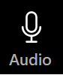



Hospitality
Leader:
Please mute for the service unless invited to offer your voice as part of the service ministry
Have the video camera on or off and turn the volume and brightness up or down on your device if things are too loud 🔉🔊or too bright🔅🔆
Our Cantor acts as our voice, offering the responses, in Bold Text, which we say together
Feel welcome to use the chat and reaction emojis 👍
🙏 Please take care of yourself in this space. 🙏 Come and go as you need
😴 It is great to take rest in this space, so falling asleep is also OK 😴
👂️ Remember, pastoral care is available to all in the community, if you'd like to speak to someone about anything spiritual. ❤️ Visit the help page at the website to reach out 🌐
Our Being Together ethos and safeguarding practices can also be accessed on the website 🫶​
🙌 Come as you are – we are all here together! 🙌
Notes:
Used Lent 2022

Slide 3
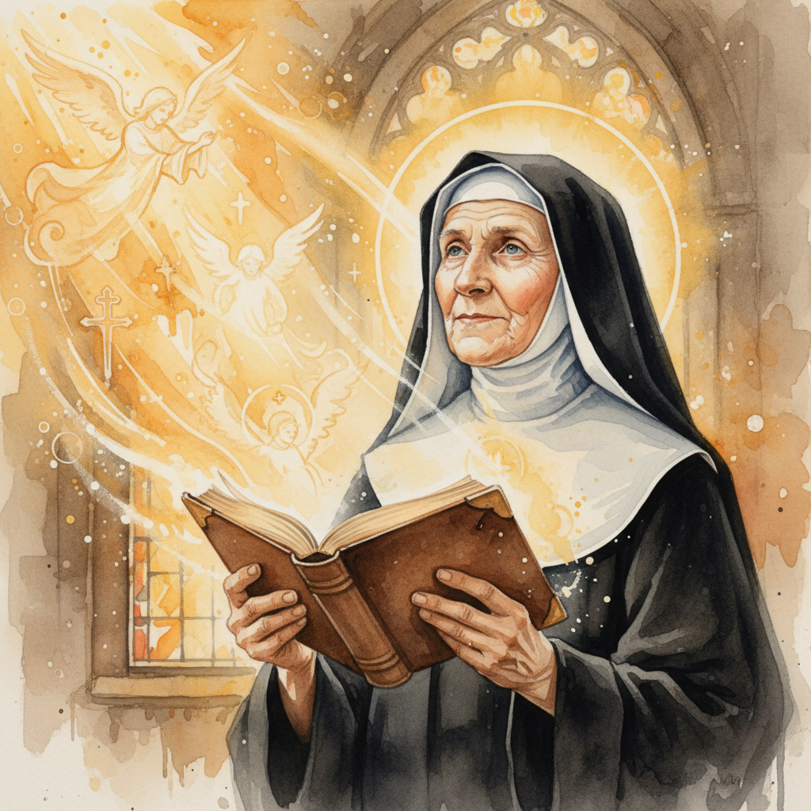
Leader: Our Holy Hermit today is Hildegard von Bingen
St. Hildegard of Bingen was a visionary Benedictine abbess, composer, healer and later a Doctor of the Church. Offered to God as a child, she was raised in a hermitage where her vivid visions began. She became abbess at Disibodenberg, later founding her own thriving communities at Bingen and Eibingen.

Slide 4
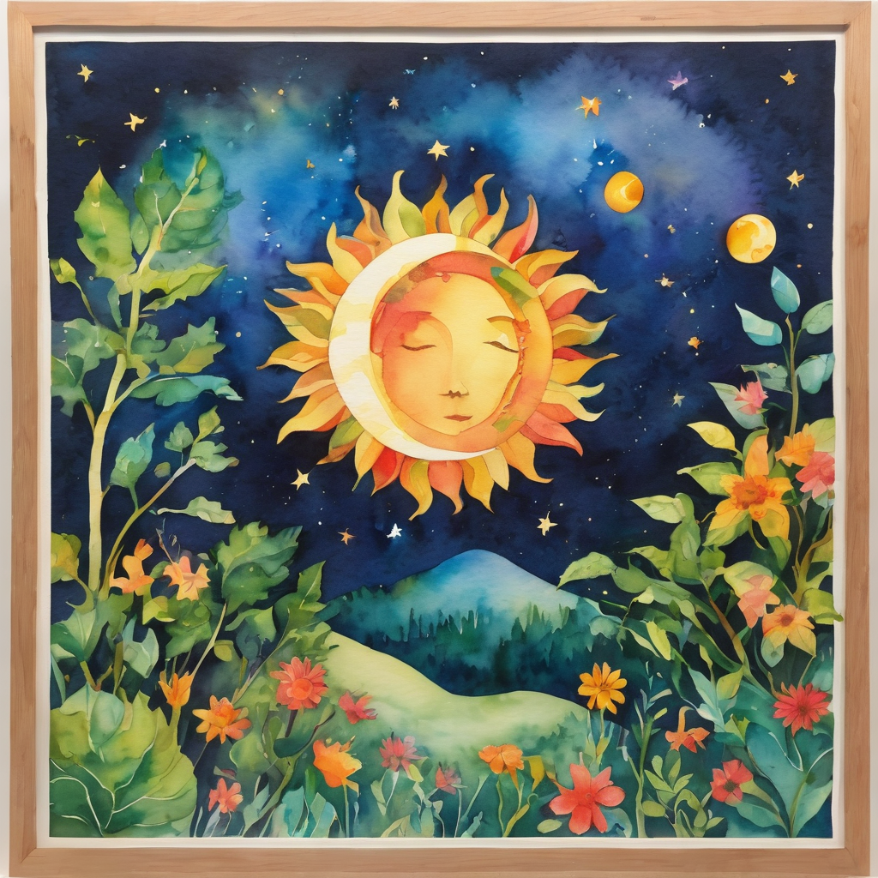
Though untrained, she produced extraordinary works on theology, medicine, music and natural science, claiming divine inspiration. Her writings, especially Scivias, spread across Europe, drawing nobles and clergy to seek her counsel. After her death, her influence only grew, culminating in her 2012 canonization and recognition as a Doctor of the Church.
To read more about our hermits click the link​​ in the send out

Slide 5
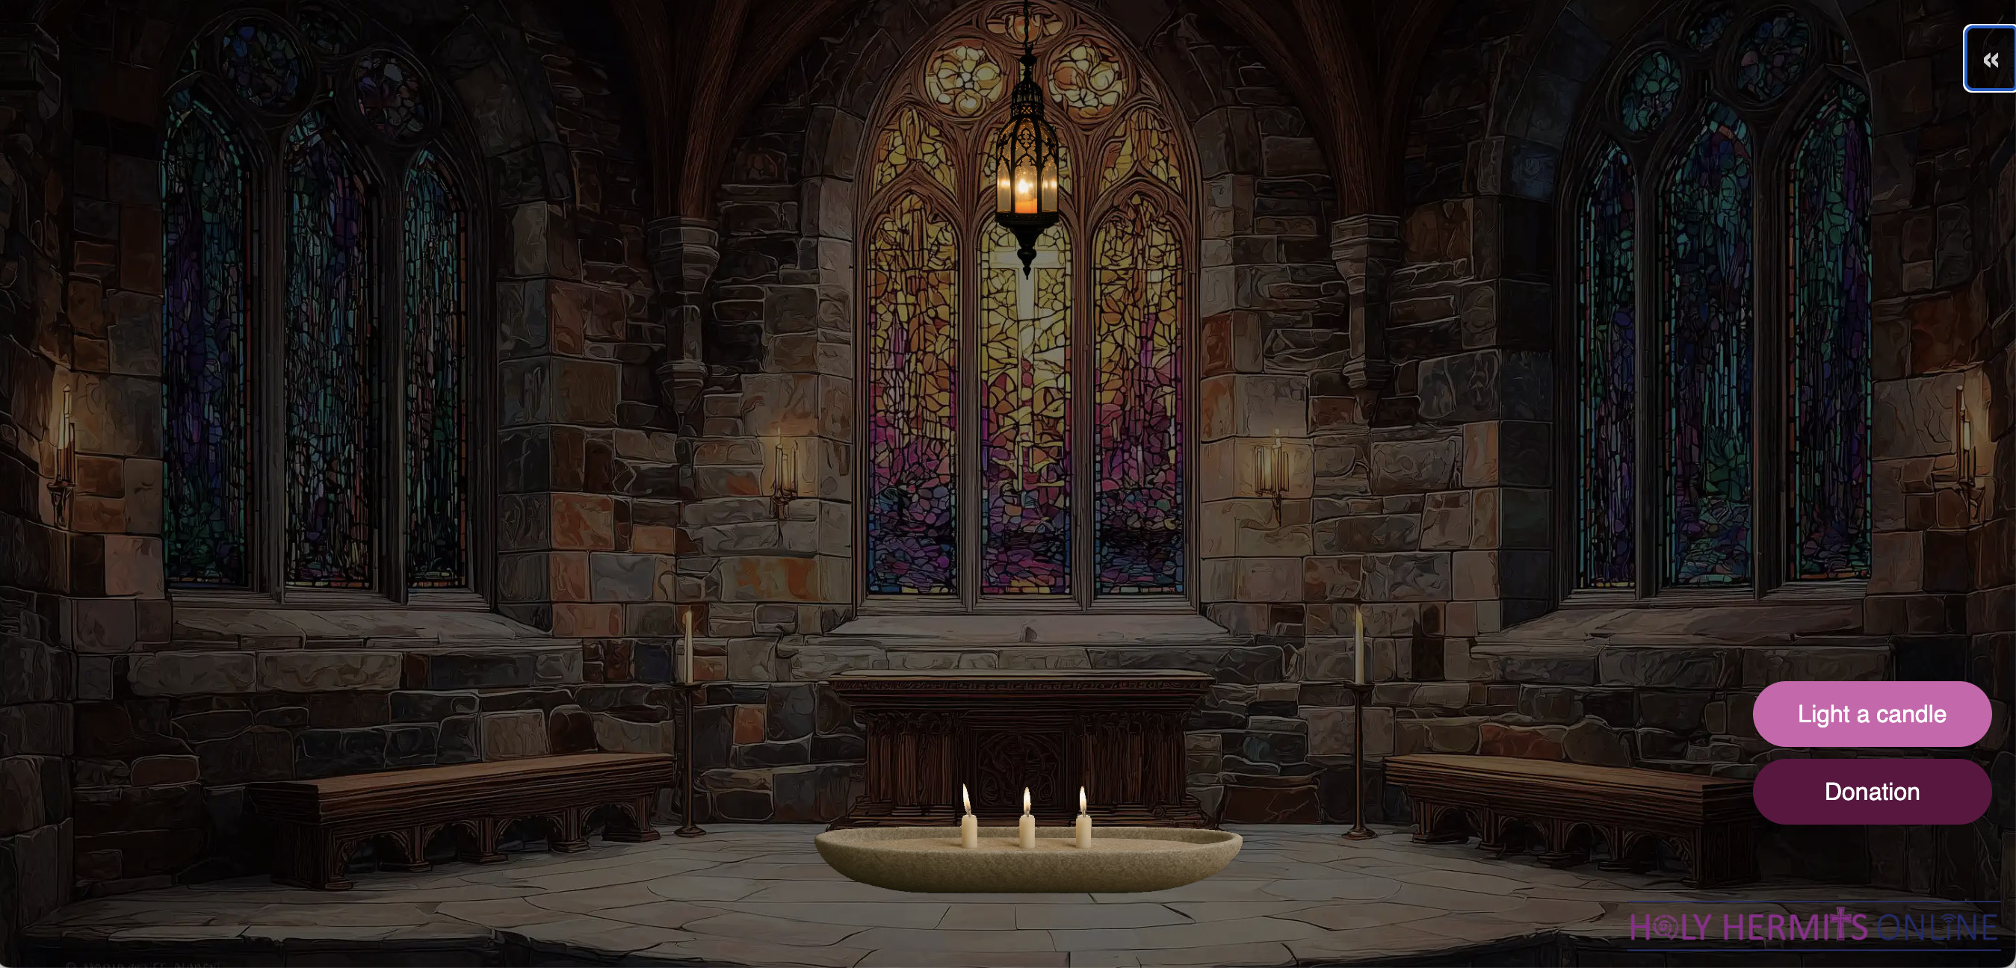
Virtual Chapel: Sanctuary Lamp of Remembrance
Leader: Thanks for 7 wonderful years Wiggles! We are so happy you retired & joined our family on August 10th, 2019. We love you 💗
https://holy-hermits-online-chapel.org/
Notes:
Link to prayer group ministry page for weekly commitment prayer https://holyhermits.com.au/ministries/prayer-group

Slide 6
Invitation
Leader: As we come into worship let’s take a few deep breaths,
Let go of anything that isn’t serving us,
And become aware of God’s presence here with us.
Opening Music: https://www.youtube.com/watch?v=vpryi72lrpo

Slide 7
Leader and Cantor unmute
The Greeting
Leader: The grace of the Lord Jesus Christ,
and the love of God,
and the fellowship of the Holy Spirit,
be with you all.
All: And also with you.

Slide 8
Gathering Prayer
Leader:
Come let’s worship God
from the very heart of our being.
Let us be open and respond to him,
with all we are,
and all we hope to be.
Notes:
Use Call to Worship Prayer

Slide 9
Gathering Prayer
All: Loving Lord, we come to you today
with open hands and hearts,
minds and ears,
to receive all you have for us.
We come in love,
we come just as we are,
we come in anticipation.
Meet with us, we pray. Amen.
Notes:
Use gathering prayer

Slide 10
Sentence
Leader: I invite our Cantor to proclaim the sentence for today.
Cantor: Thus says the Lord, ‘Maintain justice, and do what is right, for soon my salvation will come, and my deliverance be revealed.’
Isaiah 56.1

Slide 11
Prayer of Approach
Leader: We pray the prayer of approach together
All: Come, bring your needs before our Sovereign Lord.
Feel his refreshing dew fall upon our spirits
as we offer true worship from the heart.

Slide 12
Leader unmutes
Our first Hymn
I will sing the wondrous story
https://www.youtube.com/watch?v=HQLLcxbOH4A
We stay on mute
Leader mutes

Slide 13
The Deacon or LA introduces the Confession​
God is steadfast in love and infinite in mercy, welcoming sinners and inviting them to the Lord's table.
Silence may be kept.​
Let us confess our sins in penitence and faith, with a sincere and a true heart.

Slide 14
All: ​Merciful God, our maker and our judge, ​
we have sinned against you ​in thought, word, and deed, ​
and in what we have failed to do: ​
we have not loved you with our whole heart; ​
we have not loved our neighbours as ourselves; ​
we repent, and are sorry for all our sins.​
Father, forgive us. Strengthen us to love and obey you
in newness of life; ​through Jesus Christ our Lord. ​
Amen.​

Slide 15
Words of Assurance offered by the Deacon or LA
These words of assurance from the First Letter of John declare that:
If anyone sins, we have an advocate with the Father, Jesus Christ the righteous. He is the perfect offering for our sin, and not for ours only, but for the sins of the whole world.
(1 John 2: 1-2)
In this is love, not that we loved God, but that he loved us and sent his Son to be the perfect offering for our sins.
(1 John 4:10)

Slide 16
Collect
Leader: God of freedom,
you have broken the tyranny of sin
and sent the Spirit of your Son into our hearts:
give us grace to dedicate our freedom to your service,
that all people may know the glorious liberty of the children of God;
through Jesus Christ our Lord,
who lives and reigns with you and the Holy Spirit,
one God, now and for ever. Amen.

Slide 17

The 1st Reading
Leader: We will now listen to the first reading
Reader 1: The 1st Reading is from Genesis 45.1-15
¹ Then Joseph could no longer control himself before all those who stood by him, and he cried out, ‘Send everyone away from me.’ So no one stayed with him when Joseph made himself known to his brothers. ² And he wept so loudly that the Egyptians heard it, and the household of Pharaoh heard it. ³ Joseph said to his brothers, ‘I am Joseph. Is my father still alive?’
Continue…
Notes:
Please note that the first reading is recorded this week
YouTube link to the recording: https://youtu.be/msa5KXLFAUw

Slide 18
But his brothers could not answer him, so dismayed were they at his presence. ⁴ Then Joseph said to his brothers, ‘Come closer to me.’ And they came closer. He said, ‘I am your brother Joseph, whom you sold into Egypt. ⁵ And now do not be distressed, or angry with yourselves, because you sold me here; for God sent me before you to preserve life. ⁶ For the famine has been in the land these two years; and there are five more years in which there will be neither ploughing nor harvest. ⁷ God sent me before you to preserve for you a remnant on earth, and to keep alive for you many survivors.
Continue…

Slide 19
⁸ So it was not you who sent me here, but God; he has made me a father to Pharaoh, and lord of all his house and ruler over all the land of Egypt. ⁹ Hurry and go up to my father and say to him, “Thus says your son Joseph, God has made me lord of all Egypt; come down to me, do not delay. ¹⁰ You shall settle in the land of Goshen, and you shall be near me, you and your children and your children’s children, as well as your flocks, your herds, and all that you have. ¹¹ I will provide for you there—since there are five more years of famine to come—
Continue…

Slide 20
so that you and your household, and all that you have, will not come to poverty.” ¹² And now your eyes and the eyes of my brother Benjamin see that it is my own mouth that speaks to you. ¹³ You must tell my father how greatly I am honoured in Egypt, and all that you have seen. Hurry and bring my father down here.’ ¹⁴ Then he fell upon his brother Benjamin’s neck and wept, while Benjamin wept upon his neck. ¹⁵ And he kissed all his brothers and wept upon them; and after that his brothers talked with him.
For the word of the Lord. Thanks be to God.​

Slide 21
The Leader will lead the Psalm
Leader: We now say the psalm antiphonally, we will all respond with our cantor as our voice.
Psalm 133
¹ Behold how good and how lovely it is:
when families live together in unity.
² It is fragrant as oil upon the head,
that runs down over the beard:
fragrant as oil upon the beard of Aaron,
that ran down over the collar of his robe.
Continue…
Notes:
The Leader will lead the Psalm as the 1st reading is recorded

Slide 22
³ It is like a dew of Hermon:
like the dew that falls upon the hill of Zion.
⁴ For there the Lord has commanded his blessing:
which is life for evermore.

Slide 23
The 2nd reader unmutes
Leader: I invite the 2nd reader to unmute and offer the 2nd lesson when ready.
Reader 2: The 2nd Reading is from Romans 11.13-32
¹³ Now I am speaking to you Gentiles. Inasmuch then as I am an apostle to the Gentiles, I glorify my ministry ¹⁴ in order to make my own people jealous, and thus save some of them.¹⁵ For if their rejection is the reconciliation of the world, what will their acceptance be but life from the dead!
Continue…

Slide 24
¹⁶ If the part of the dough offered as first fruits is holy, then the whole batch is holy; and if the root is holy, then the branches also are holy.
¹⁷ But if some of the branches were broken off, and you, a wild olive shoot, were grafted in their place to share the rich root of the olive tree, ¹⁸ do not vaunt yourselves over the branches. If you do vaunt yourselves, remember that it is not you that support the root, but the root that supports you. ¹⁹ You will say, ‘Branches were broken off so that I might be grafted in.’
Continue…

Slide 25
²⁰ That is true. They were broken off because of their unbelief, but you stand only through faith. So do not become proud, but stand in awe. ²¹ For if God did not spare the natural branches, perhaps he will not spare you. ²² Note then the kindness and the severity of God: severity towards those who have fallen, but God’s kindness towards you, provided you continue in his kindness; otherwise you also will be cut off. ²³ And even those of Israel, if they do not persist in unbelief, will be grafted in, for God has the power to graft them in again.
Continue…

Slide 26
²⁴ For if you have been cut from what is by nature a wild olive tree and grafted, contrary to nature, into a cultivated olive tree, how much more will these natural branches be grafted back into their own olive tree.
²⁵ So that you may not claim to be wiser than you are, brothers and sisters, I want you to understand this mystery: a hardening has come upon part of Israel, until the full number of the Gentiles has come in.
Continue…

Slide 27
²⁶ And so all Israel will be saved; as it is written,
‘Out of Zion will come the Deliverer;
he will banish ungodliness from Jacob.’
^{27 ‘}And this is my covenant with them,
when I take away their sins.’
²⁸ As regards the gospel they are enemies of God for your sake; but as regards election they are beloved, for the sake of their ancestors; ²⁹ for the gifts and the calling of God are irrevocable.
Continue…

Slide 28
³⁰ Just as you were once disobedient to God but have now received mercy because of their disobedience, ³¹ so they have now been disobedient in order that, by the mercy shown to you, they too may now receive mercy. ³² For God has imprisoned all in disobedience so that he may be merciful to all.
For the word of the Lord. Thanks be to God.​

Slide 29

We pause before
​the Gospel ​​

Slide 30
Deacon: The Gospel of our Lord Jesus Christ according to St Matthew Chapter 15 beginning at the 21st verse.
All: Glory to you Lord Jesus Christ.
²¹ Jesus left that place and went away to the district of Tyre and Sidon. ²² Just then a Canaanite woman from that region came out and started shouting, ‘Have mercy on me, Lord, Son of David; my daughter is tormented by a demon.’ ²³ But he did not answer her at all. And his disciples came and urged him, saying, ‘Send her away, for she keeps shouting after us.’
Continue…

Slide 31
²⁴ He answered, ‘I was sent only to the lost sheep of the house of Israel.’ ²⁵ But she came and knelt before him, saying, ‘Lord, help me.’ ²⁶ He answered, ‘It is not fair to take the children’s food and throw it to the dogs.’ ²⁷ She said, ‘Yes, Lord, yet even the dogs eat the crumbs that fall from their masters’ table.’ ²⁸ Then Jesus answered her, ‘Woman, great is your faith! Let it be done for you as you wish.’ And her daughter was healed instantly.
This is the Gospel of the Lord. Praise to you Lord Jesus Christ.

Slide 32
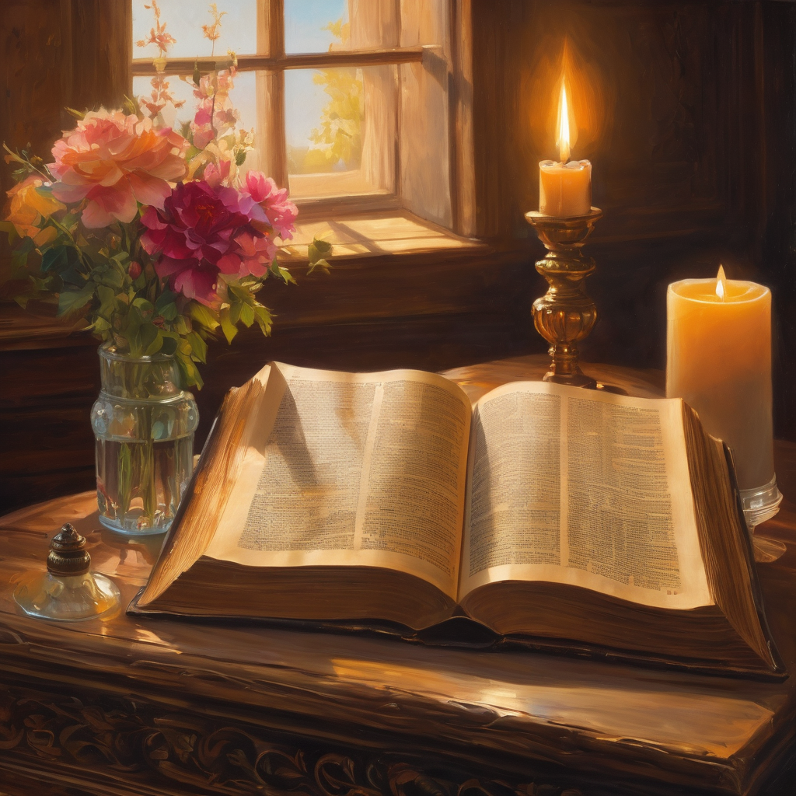
We pause
after ​the Gospel ​​

Slide 33
Leader: .
Leader and Cantor mute
Broadcaster exits screenshare
Flashback Sermon:
Open up. Speak up!
Rev. Jamee
https://www.youtube.com/watch?v=Xl58fbt9Kig
Notes:
Sermon starts 37:14 – Please let me know if the sermon is too quiet

Slide 34
Leader unmutes
Our next Hymn
Great is Thy Faithfulness
https://www.youtube.com/watch?v=TLh2utBwHhA
We stay on mute
Leader mutes

Slide 35
The Leader and Cantor unmute
The Greeting of Peace
Leader: We are the body of Christ
All: God’s Spirit is with us
Leader: The peace of the Lord be always with you.
All: And also with you.
Leader: A sign of peace may be exchanged
You may like to type 'Peace' into the chat, use the 'raise hand’ or other reaction buttons, or just simply wave via the screen with your video turned on
(Broadcaster exits shared screen for a few moments for the exchange of peace)

Slide 36
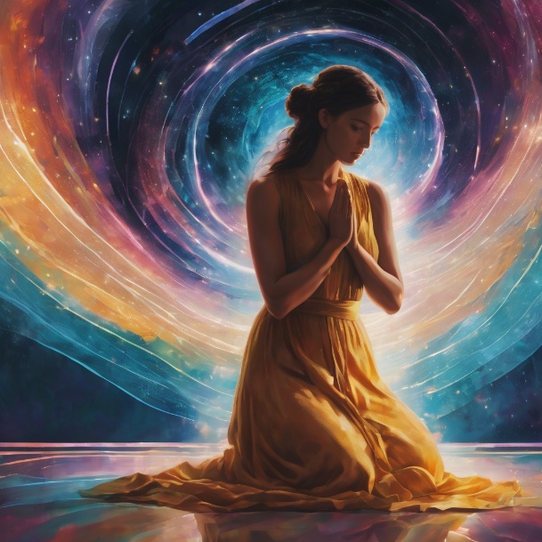
Prayer of Thanksgiving before Intercessions
Leader: As we enter prayer, I invite the second reader to unmute to lead our intercessions following the prayer of thanksgiving on the next slide. Please feel free to change your body position as you need.
Continue…

Slide 37
Leader: Lord God, we thank you for working in our lives,
righting wrongs and bringing good from bad.
Thank you for your abundant love and generosity.
Help us to be generous with all you have given us,
going the extra mile for those in need, just as you have for us.
We praise you for your grace and forgiveness,
and thank you for the change you bring in and through us.
Help us to see every opportunity to pour out your love
and give you all the glory.
From our hearts come unending thanks and praise. Amen.
Notes:
Prayer of praise and thanksgiving

Slide 38
Intercessions
Reader 2: We pray for creation and communities we share our lives with. We pause for a few moments to name either in our hearts, or out loud, or in the chat, those environments and communities we bring to the Lord in prayer.
PAUSE…
Continue…

Slide 39
Intercessions
Reader 2: We entrust to you the community of Holy Hermits Online and our ministry partners:
Prosper the work of our hands and show us the way to your new creation.
Creator God, Hear our prayer.
St John's Cathedral Brisbane The Anglican Diocese of Southern Queensland St Gabriel’s, Carindale Benedictus Contemplative Church, Canberra Anglican Focus and Tithe.ly

Slide 40
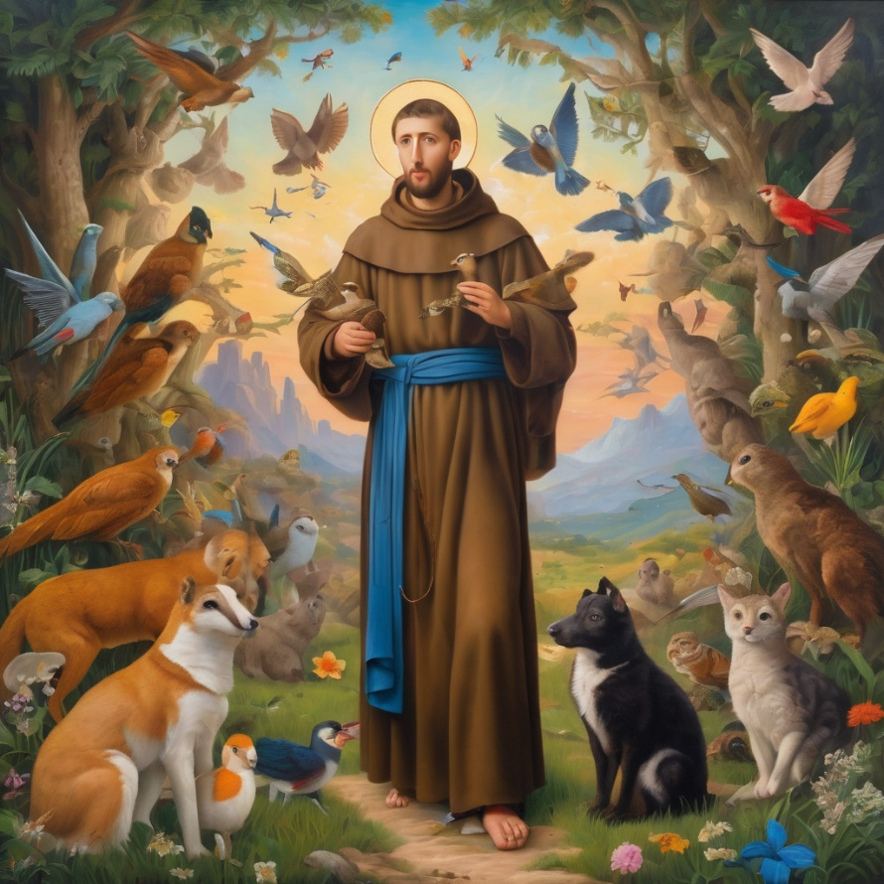
Reader 2: Loving Creator, we entrust to you all animals, especially those who are sick, anxious, ageing, lost, at risk, lonely, sad, hungry, in pain, homeless, abused, living in fear, encountering violence of any kind, in need of comfort, rehabilitation or transformation.

Slide 41
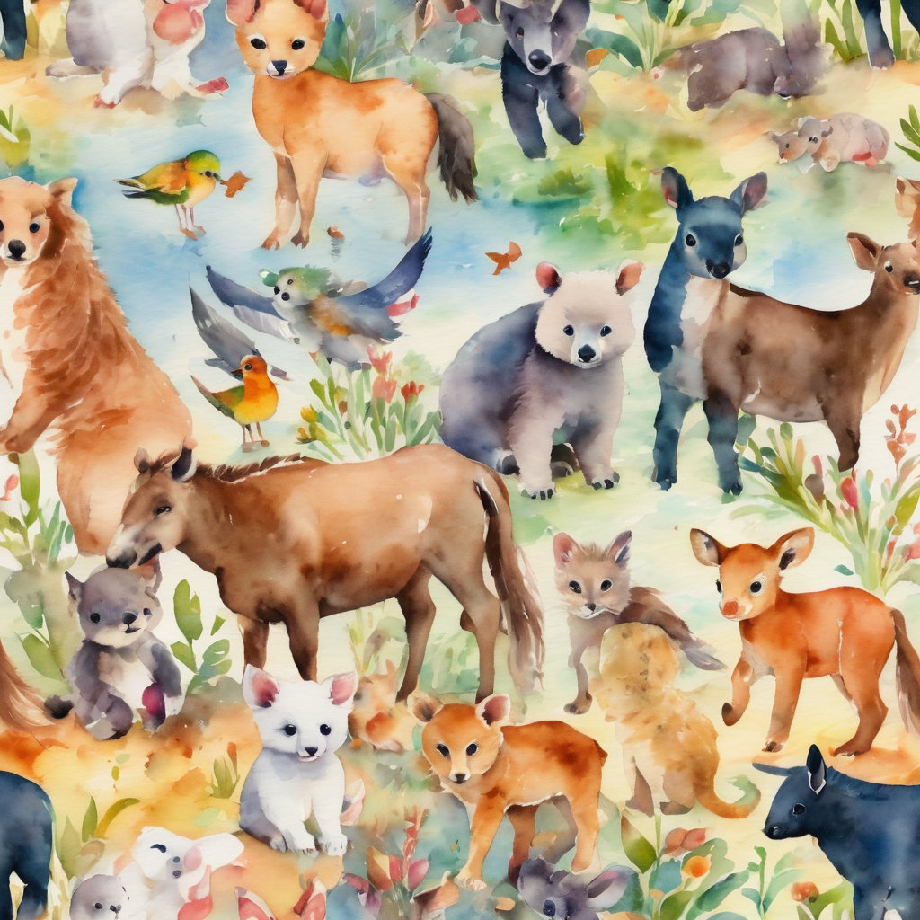
Reader 2: We invite your loving compassion for:
We name in our hearts, out loud or in the chat,
the animals we bring to the Lord in prayer. PAUSE…
Jasmine, ​
Leese(y), ​
Sid, Toots & Lulu​
Polly and Suki​
Fred, George & Percy​
Koshka ​
Jax
Lambert ​​
Kala, Nigel & Little One ​​
Toby​​
Taco​​
Paddy ​​
Rosie​
Squealer

Slide 42
Reader 2: Eternal Trinity of Love, we uphold to you the people we love and carry cares for:
Kerry, Les & Jake Julie, Ray, Tracey & Shane Mark, Desley & Bob ​​ Rachel, Mervyn & Gillian ​​Rev'd Shane & Janette​​ Alecia, Martin & Aidan​​ Kirsten, Greg, Daphne & Beau Bill & Marjorie​​ Aaron & Andrea Liz’s Godchildren Matthew & Nicholas | Barry​​ Dr Julie ​​ Ruth​​ Phil​ May Susan Tanya​ Neva Kathy ​Gayanne Tina | ​​ | Alan & Gaylene​ Jess & Leah ​​ Barry & Gwen Bob & Di​ Pat & Julie Dilys & Tony, Paul & Darhon Judy & Mary Miriam Lorelei Nettie

Slide 43
Reader 2:
We name in our hearts, out loud or in the chat, those we bring to the Lord in prayer.
PAUSE…
We entrust to you those who have died, those who have died peacefully and those who have died tragically, the old and the young. Receive them into your Kingdom. Lord in your mercy, Hear our prayers. Amen.

Slide 44
Pray Daily Cycle of Prayer
Leader: Loving God, joining with the Church in our cycle of prayer, we ask your blessings on:
The Church in Wales
The Diocese of Newcastle: †Peter; Assistant Bishops – †Sonia, †Charlie; Clergy and People
The Parish of Allora-Clifton: Courtney
Churchwardens, Parish Councillors, Parish Nominators and Synod Representatives
The Glennie School, Toowoomba: Principal – Emma; Chair of School Council – †Cameron; members of School Council; staff & students

Slide 45

Commitment Prayer of the Week
Leader: Our commitment prayer for the week is for during emergence of AI
https://www.youtube.com/watch?v=uhkBwPKHNXw
Notes:
Link to prayer group ministry page for weekly commitment prayer https://holyhermits.com.au/ministries/prayer-group

Slide 46
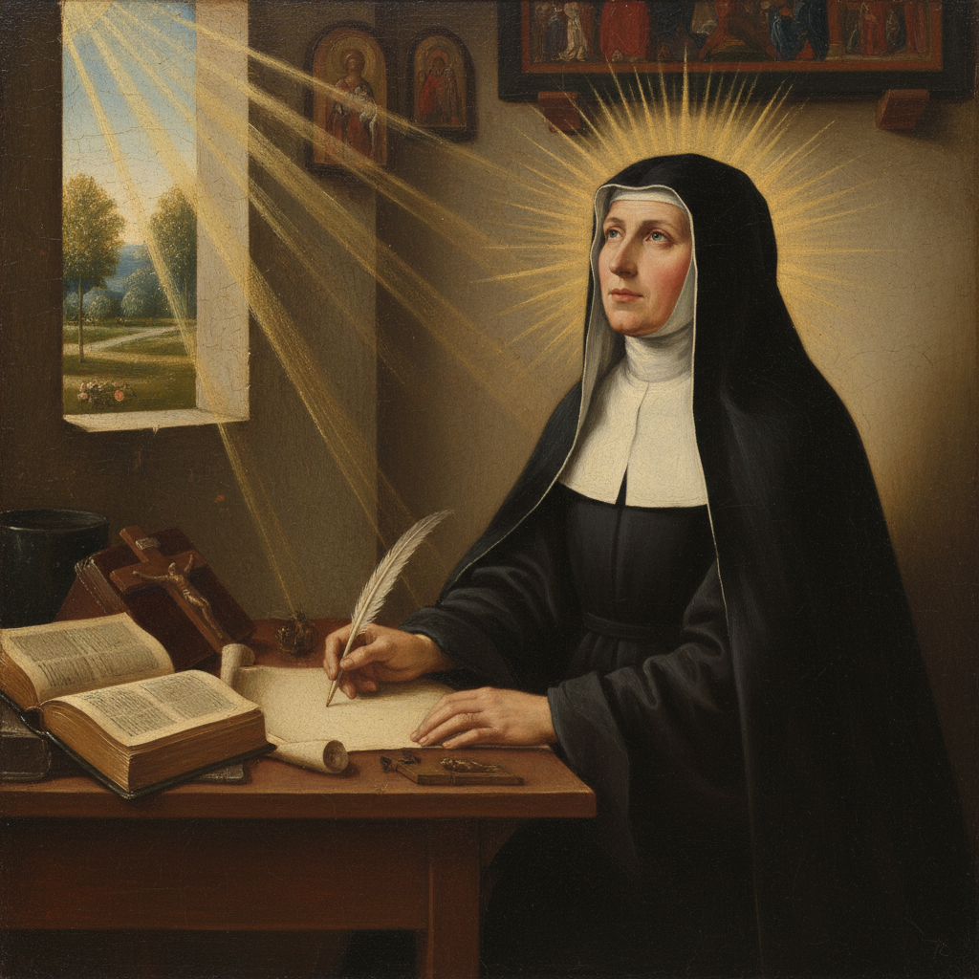
Devotions

Slide 47
Hermit Wisdom
Hildegard Von Bingen
"All of creation is a song of praise to God. Love abounds in all things, excels from the depths to beyond the stars, is lovingly disposed to all things."
"Give man a dog for the health of his soul."
“All living creatures are sparks from the radiation of God's brilliance, emerging from God like the rays of the sun.“
"The Word is living, being, spirit, all verdant greening, all creativity."

Slide 48
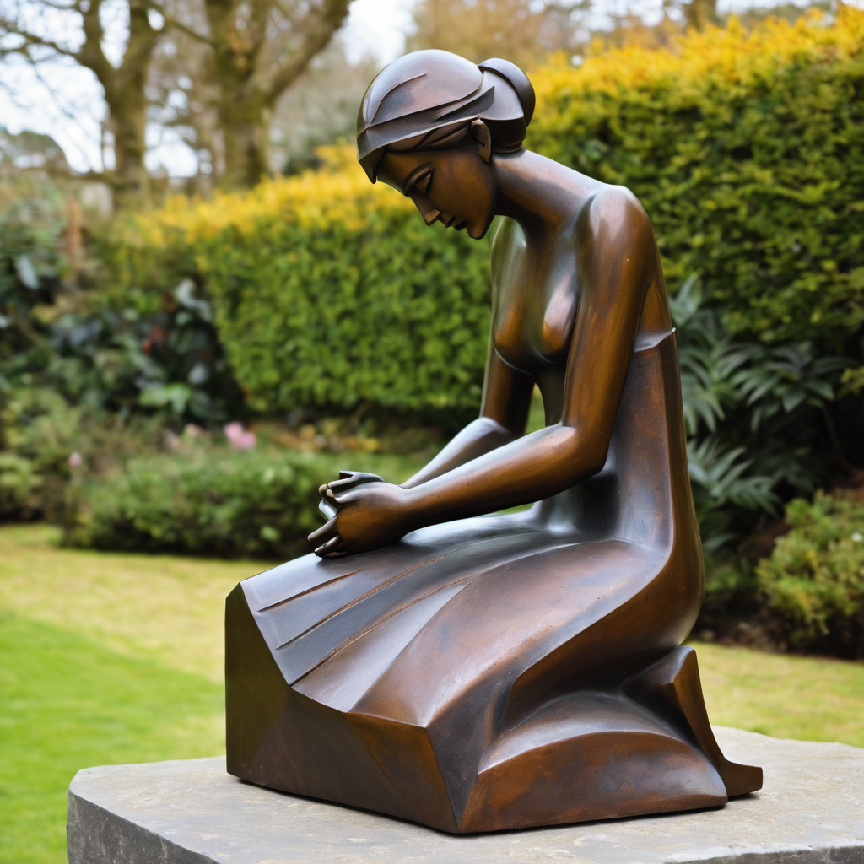
​
Leader: ​As we enter a few minutes of silence together, you are invited to pray the prayer of adoration on the next slide and/or spend this time in contemplation. ​
The Spiritual Communion prayer follows on the slide after that.
Let us be still.
Leader and Cantor Mute.
Continue…

Slide 49
​
Lord, you know our heart: the thoughts that guide our words,
the motivation that guides our actions.
We are sorry when we say things that hurt.
Help us to be motivated to say kind and truthful things.
We are sorry when we do things that hurt others.
We are sorry when we stand by doing nothing when others are hurting
Help us to be motivated to do kind actions.
Make us more like Jesus. Amen.
Notes:
Prayer for all ages

Slide 50

  Oh, my Lord Jesus I turn to you present at the Altar and in the Tabernacle. I believe that you are present in the Holy Sacrament of your most Sacred Body and Blood. I love you above all things and I desire to receive you into my Soul. I cannot at this moment receive you Sacramentally in Holy Communion. Come spiritually into my heart. Purify it, Sanctify it. Render my heart like your own heart. I embrace you as if you were already there and unite myself wholly with you. Never permit me to be separated from you. Lord, I am not worthy to receive you, but only say the word and I shall be healed. Amen
Making a Spiritual Communion
(Prayed in silence)

Slide 51
Leader unmutes
Our final song is
The Lily of the Valley
https://www.youtube.com/watch?v=yWKVt3KwEoA
​We stay on mute
Leader and Cantor mute

Slide 52
Leader and cantor unmute
Sending Prayer
Leader: We pray our sending prayer together.
All: Let us continue to hold before God
the things we care about deeply,
asking for his Spirit’s wisdom and guidance
as we act and respond
with generosity and love
Amen.

Slide 53
The Benediction
Leader: Let us all invite God’s blessings together,
All: May the Lord bless us and keep us.
May the Lord’s face shine upon us and be gracious to us.
May the Lord’s countenance be lifted upon us,
and bring us peace.
Amen

Slide 54
Notices
Rev’d Lauren away on study leave next Sunday. Weekly worship will be lay led.
Study Group meets 26th August at 6pm. We will be exploring a contemplative prayer series featuring seven poetic blessings written by Christine Valters. All are welcome to attend. Please sign up if you haven’t already and would like to receive emails.
See HHO Events page for further upcoming events HHO Events

Slide 55
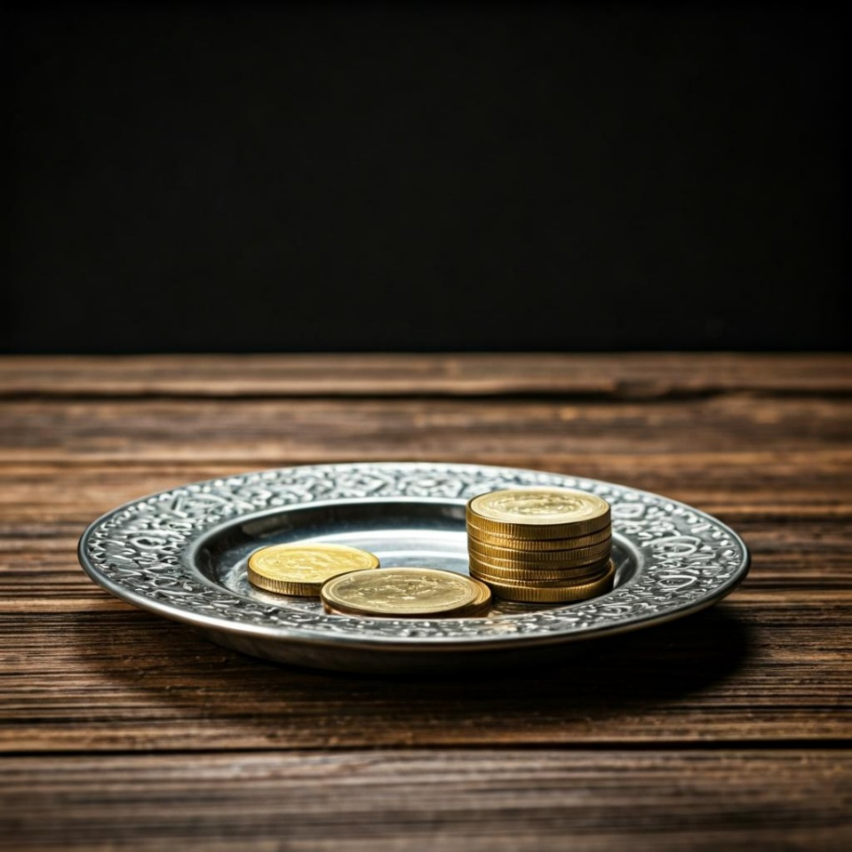
Leader: Thank you for your regular gifts to this ministry. Offerings are most welcome via:
The HHO App
Direct Debit
International Direct Debit
Please consider a one-off donation
or leaving a legacy in your Will
For further information go to HHO give page
https://holyhermits.com.au/give

Slide 56
Serving next week
23rd August 2026
13th Sunday after Pentecost
9:00 am AEST
Service Prep: Lauren | Chat Host: Rachel | First Reader: Bob
Music: Lauren | Welcomer: Chris | Second Reader: Helen
Proof-reader: Kristine | Priest: N/A | Preacher: Flashback
Broadcaster: Barry | Deacon: N/A | Fellowship: Julie
Backup Broadcaster: Paul | Leader: Julie | Safety Officer: Rachel
Zoom Buttons: Rachel | Cantor: Vanessa | Attendance: Rachel
Thank you for your ministry gifts
New Servers always welcome!
Please email Rev’d Lauren to get involved
holyhermits@anglicanchurchsq.org.au

Slide 57
The Dismissal
Leader: I invite everyone to unmute for the Dismissal
Leader: Go in peace to love and serve the Lord.
All: In the name of Christ, Amen.

Slide 58


Fellowship
Thank you, Lauren for leading Fellowship
Please feel welcome to linger or pop a message in the chat and head off when you are ready.​
This week our sanctuary lamp is lit in thanks for 7 wonderful years with Wiggles! We are so happy you retired & joined our family on August 10th 2019. We love you 💗
Extra resources developed
by Roots on the Web
Images from Padlet

