Slide 1
Psalm 133:1-3
Behold, how good and pleasant it is when brothers dwell in unity!
It is like the precious oil on the head, running down on the beard, on the beard of Aaron, running down on the collar of his robes!
It is like the dew of Hermon, which falls on the mountains of Zion! For there the Lord has commanded the blessing, life forevermore.

Slide 2
Prayer Prompts
God you are Lord! You bless and are a blessing! I praise you for the goodness you have showed me when….
I confess Lord that there have been times when I have hindered your blessing when I…
Lord, I pray your blessing on ( ) as they are facing ______.
Give me grace to live in Your blessing, especially when the enemy temps me to…

Slide 3


Slide 4
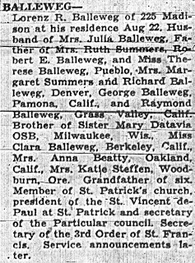
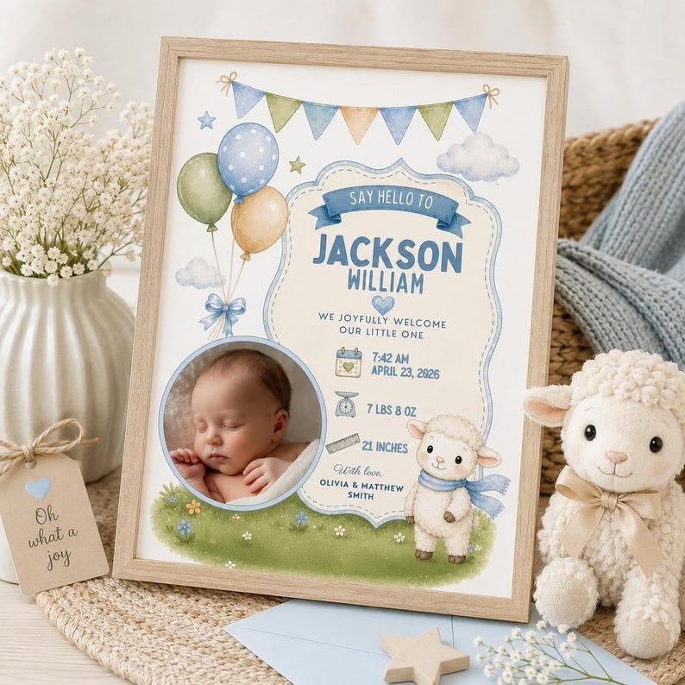
This Photo by Unknown Author is licensed under CC BY-NC-ND

Slide 5
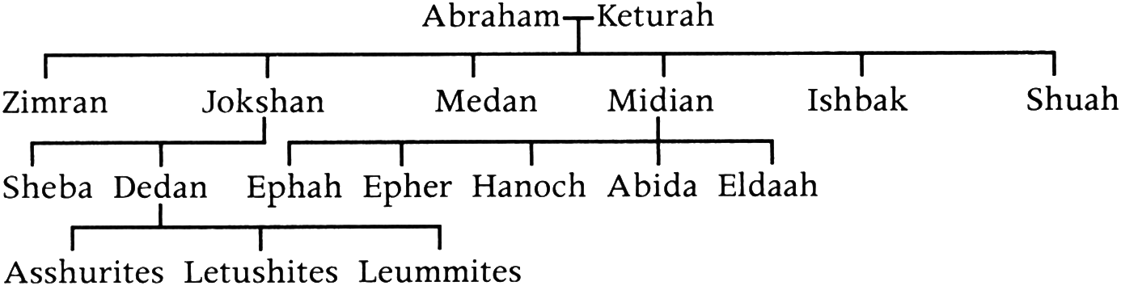

Slide 6
Concubine: a secondary wife, or wife of lower status.

Slide 7
The covenant promise did not transfer to Keturah.

Slide 8
The blessing of God’s covenant promise was not Abraham’s to give.

Slide 9
Abraham died fully satisfied with life.

Slide 10
James 2:23:
Abraham was a friend of God.

Slide 11
The life of the believer is defined not by accomplishments but by faith.

Slide 12
Issac prayed for 20 years and did not lose hope.

Slide 13
Rebekah’s prayer conveys her dependance upon the Lord.

Slide 14
Jacob, though flawed, lived by faith.

Slide 15
Christians are to play the long game.

Slide 16

This Photo by Unknown Author is licensed under CC BY-SA-NC

