Slide 1
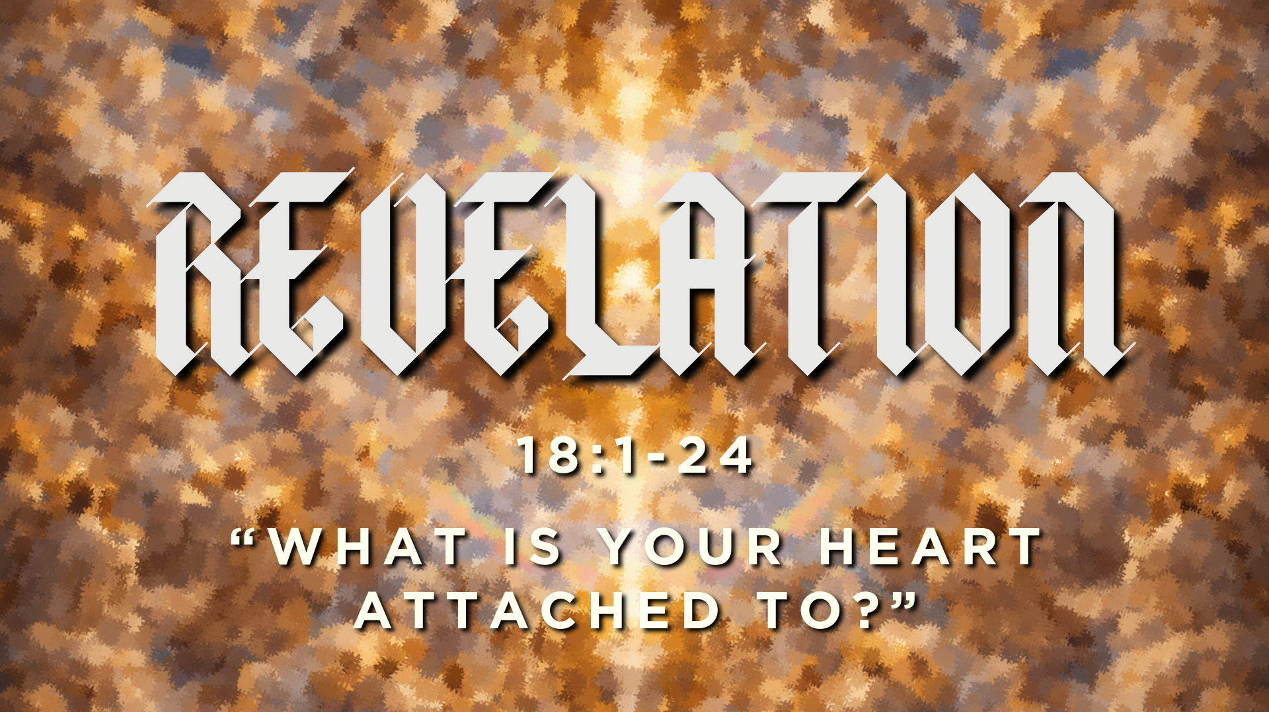

Slide 2
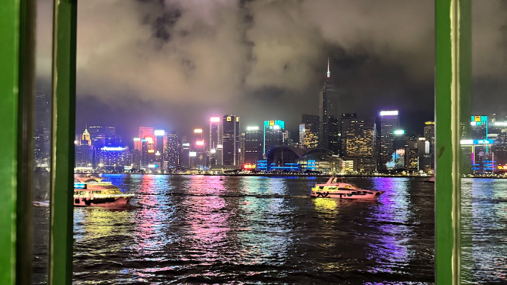

Slide 3


Slide 4


Slide 5
When I saw her (Babylon), I marveled greatly.
Revelation 17:6

Slide 6
But the angel said to me, “Why do you marvel?”
Revelation 17:7

Slide 7

We resist the currents of the world when we examine what is driving our hearts.

Slide 8
How do we know whether or not we are investing in God’s kingdom?
Are we investing in something that lasts, or are we investing in things that will ultimately be destroyed?
What is your heart attached to?

Slide 9
Revelation 18 Outline
Babylon's fall announced | 18:1–3
God's people called to come out | 18:4–8
The world mourns Babylon | 18:9–20
Babylon's final destruction | 18:21–24

Slide 10
“Fallen, fallen is Babylon the great. She has become a dwelling place for demons…”
Revelation 18:2
“…the kings of the earth have committed immorality with her, and the merchants of the earth have grown rich from the power of her luxurious living.”
Revelation 18:3

Slide 11
“Come out of her, my people, lest you take part in her sins, lest you share in her plagues; for her sins are heaped high as heaven, and God has remembered her iniquities.”
Revelation 18:4-5

Slide 12
“Fallen, fallen is Babylon the great. She has become a dwelling place for demons…”
Revelation 18:2

Slide 13
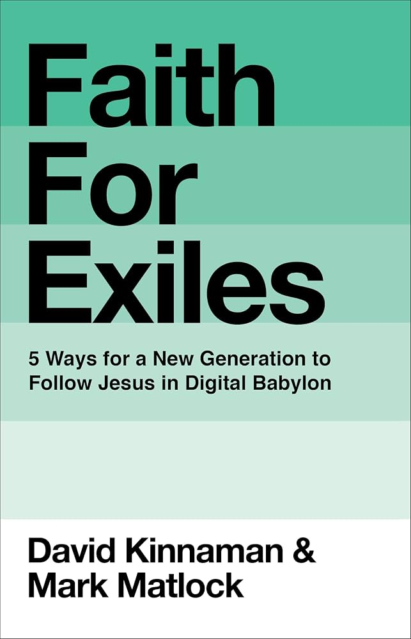

Slide 14
“The Babylon of the Bible is characterized as a culture set against the purposes of God—a human society that glories in pride, power, prestige, and pleasure. Babylon makes appearances throughout the Bible, most notably (and literally) in the story of Daniel.
David Kinnaman (Faith for Exiles)

Slide 15
But Babylon is there in the pages of Scripture from beginning to end. From the Tower of Babel, the “first city of man,” in the book of Genesis to the final act of God’s justice and restoration in Revelation, Babylon is both a place and an archetype of collective human pursuits set in opposition to God.”
David Kinnaman (Faith for Exiles)

Slide 16


Slide 17
“Alas, alas, for the great city
that was clothed in fine linen,
in purple and scarlet,
adorned with gold,
with jewels, and with pearls!
For in a single hour all this wealth has been laid waste.”
Revelation 18:16-17

Slide 18
What is your heart attached to?

Slide 19
Accordingly, two cities have been formed by two loves:
The earthly by the love of self, even to the contempt of God;
the heavenly by the love of God, even to the contempt of self.
The former, in a word, glories in itself,
the latter in the Lord.
For the one seeks glory from men;
but the greatest glory of the other is God…
Saint Augustine of Hippo

Slide 20
The one lifts up its head in its own glory;
the other says to God, "You are my glory, and the lifter of my head."
In the one, the princes and the nations it subdues are ruled by the love of ruling;
in the other, the princes and the subjects serve one another in love…
The one delights in its own strength…
the other says to God, "I will love You, O Lord, my strength.”
Saint Augustine of Hippo

Slide 21
What is your heart attached to?

Slide 22
What is your heart attached to?
Do you find your ultimate desire in loving yourself, or is your ultimate desire to love God?
Is your chief aim in life to glorify yourself, or is it to give God glory?
Do you love to overpower others to get your way, or are you a servant to people?
Do you delight in your own strength, or do you say to God, “God, you are my strength?”

