Slide 1


Slide 2
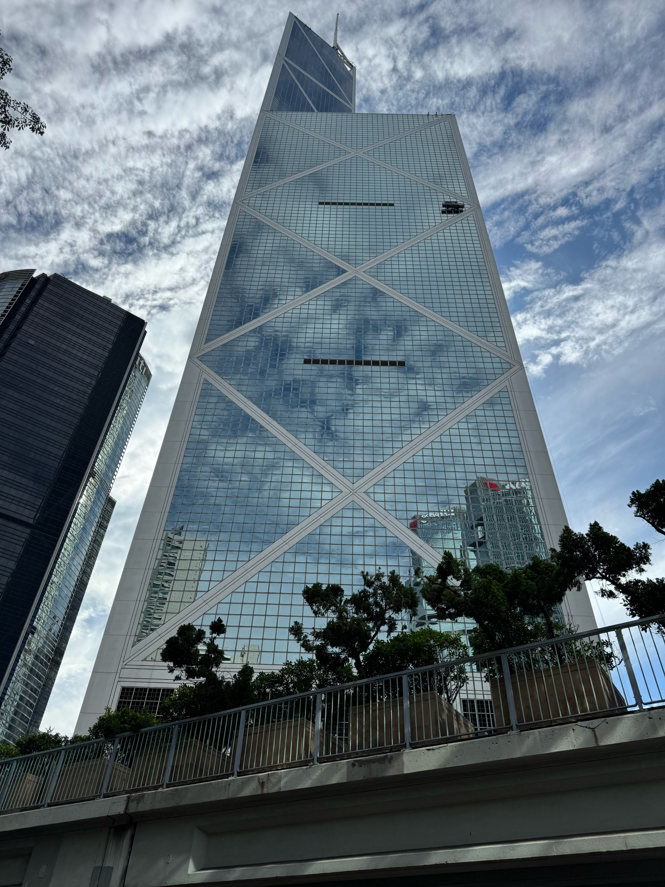

Slide 3


Slide 4
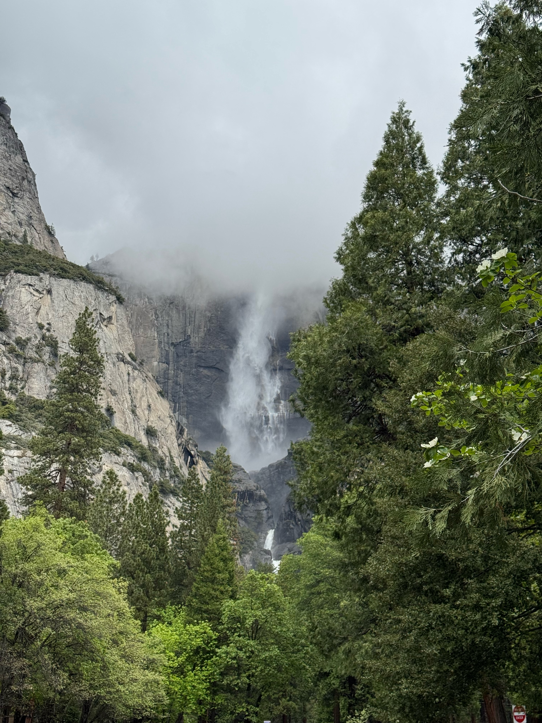

Slide 5
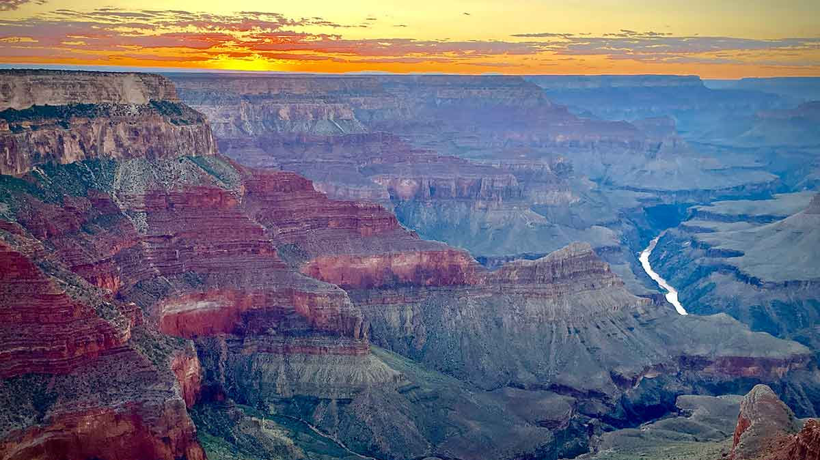

Slide 6
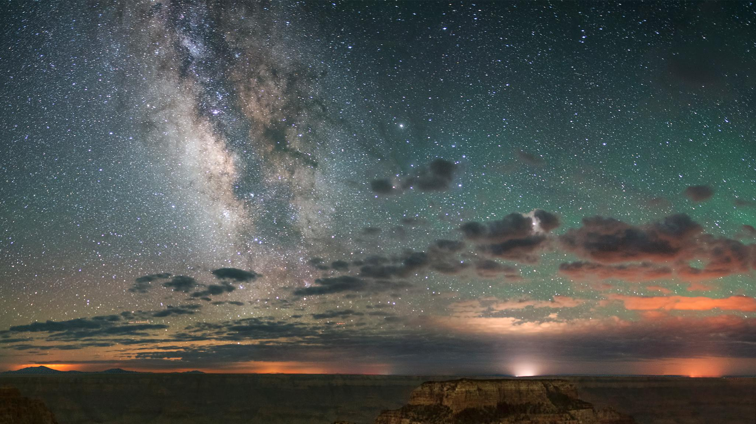

Slide 7
“Christians have always, in one degree or another, failed to notice God’s initiatives toward the world, sought to move to God under their own power, and thereby fallen into idolatry.”
William C. Placher
(The Domestication of Transcendence)

Slide 8
Then I fell down at his feet to worship him, but he said to me, “You must not do that! I am a fellow servant with you and your brothers who hold to the testimony of Jesus. Worship God.”
Revelation 19:10

Slide 9
Q: How and why should we worship God?

Slide 10
1 After this I heard what seemed to be the loud voice of a great multitude in heaven, crying out,
“Hallelujah!
Salvation and glory and power belong to our God,
2 for his judgments are true and just;
for he has judged the great prostitute
who corrupted the earth with her immorality,
and has avenged on her the blood of his servants.”
3 Once more they cried out,
“Hallelujah!
The smoke from her goes up forever and ever.”
4 And the twenty-four elders and the four living creatures fell down and worshiped God who was seated on the throne, saying, “Amen. Hallelujah!” 5 And from the throne came a voice saying,
“Praise our God,
all you his servants,
you who fear him,
small and great.”
6 Then I heard what seemed to be the voice of a great multitude, like the roar of many waters and like the sound of mighty peals of thunder, crying out,
“Hallelujah!
for the Lord our God
the Almighty reigns.
7 Let us rejoice and exult
and give him the glory,
for the marriage of the Lamb has come,
and his Bride has made herself ready;
8 it was granted her to clothe herself
with fine linen, bright and pure”—
for the fine linen is the righteous deeds of the saints.

Slide 11
1 After this I heard what seemed to be the loud voice of a great multitude in heaven, crying out,
“Hallelujah!
Salvation and glory and power belong to our God,
2 for his judgments are true and just;
for he has judged the great prostitute
who corrupted the earth with her immorality,
and has avenged on her the blood of his servants.”
3 Once more they cried out,
“Hallelujah!
The smoke from her goes up forever and ever.”
4 And the twenty-four elders and the four living creatures fell down and worshiped God who was seated on the throne, saying, “Amen. Hallelujah!” 5 And from the throne came a voice saying,
“Praise our God,
all you his servants,
you who fear him,
small and great.”
6 Then I heard what seemed to be the voice of a great multitude, like the roar of many waters and like the sound of mighty peals of thunder, crying out,
“Hallelujah!
for the Lord our God
the Almighty reigns.
7 Let us rejoice and exult
and give him the glory,
for the marriage of the Lamb has come,
and his Bride has made herself ready;
8 it was granted her to clothe herself
with fine linen, bright and pure”—
for the fine linen is the righteous deeds of the saints.

Slide 12
1 After this I heard what seemed to be the loud voice of a great multitude in heaven, crying out,
“Hallelujah!
Salvation and glory and power belong to our God,
2 for his judgments are true and just;
for he has judged the great prostitute
who corrupted the earth with her immorality,
and has avenged on her the blood of his servants.”
3 Once more they cried out,
“Hallelujah!
The smoke from her goes up forever and ever.”
4 And the twenty-four elders and the four living creatures fell down and worshiped God who was seated on the throne, saying, “Amen. Hallelujah!” 5 And from the throne came a voice saying,
“Praise our God,
all you his servants,
you who fear him,
small and great.”
6 Then I heard what seemed to be the voice of a great multitude, like the roar of many waters and like the sound of mighty peals of thunder, crying out,
“Hallelujah!
for the Lord our God
the Almighty reigns.
7 Let us rejoice and exult
and give him the glory,
for the marriage of the Lamb has come,
and his Bride has made herself ready;
8 it was granted her to clothe herself
with fine linen, bright and pure”—
for the fine linen is the righteous deeds of the saints.

Slide 13
1 After this I heard what seemed to be the loud voice of a great multitude in heaven, crying out,
“Hallelujah!
Salvation and glory and power belong to our God,
2 for his judgments are true and just;
for he has judged the great prostitute
who corrupted the earth with her immorality,
and has avenged on her the blood of his servants.”
3 Once more they cried out,
“Hallelujah!
The smoke from her goes up forever and ever.”
4 And the twenty-four elders and the four living creatures fell down and worshiped God who was seated on the throne, saying, “Amen. Hallelujah!” 5 And from the throne came a voice saying,
“Praise our God,
all you his servants,
you who fear him,
small and great.”
6 Then I heard what seemed to be the voice of a great multitude, like the roar of many waters and like the sound of mighty peals of thunder, crying out,
“Hallelujah!
for the Lord our God
the Almighty reigns.
7 Let us rejoice and exult
and give him the glory,
for the marriage of the Lamb has come,
and his Bride has made herself ready;
8 it was granted her to clothe herself
with fine linen, bright and pure”—
for the fine linen is the righteous deeds of the saints.

Slide 14


Slide 15
1 After this I heard what seemed to be the loud voice of a great multitude in heaven, crying out,
“Hallelujah!
Salvation and glory and power belong to our God,
2 for his judgments are true and just;
for he has judged the great prostitute
who corrupted the earth with her immorality,
and has avenged on her the blood of his servants.”
3 Once more they cried out,
“Hallelujah!
The smoke from her goes up forever and ever.”
4 And the twenty-four elders and the four living creatures fell down and worshiped God who was seated on the throne, saying, “Amen. Hallelujah!” 5 And from the throne came a voice saying,
“Praise our God,
all you his servants,
you who fear him,
small and great.”
6 Then I heard what seemed to be the voice of a great multitude, like the roar of many waters and like the sound of mighty peals of thunder, crying out,
“Hallelujah!
for the Lord our God
the Almighty reigns.
7 Let us rejoice and exult
and give him the glory,
for the marriage of the Lamb has come,
and his Bride has made herself ready;
8 it was granted her to clothe herself
with fine linen, bright and pure”—
for the fine linen is the righteous deeds of the saints.

Slide 16
1 After this I heard what seemed to be the loud voice of a great multitude in heaven, crying out,
“Hallelujah!
Salvation and glory and power belong to our God,
2 for his judgments are true and just;
for he has judged the great prostitute
who corrupted the earth with her immorality,
and has avenged on her the blood of his servants.”
3 Once more they cried out,
“Hallelujah!
The smoke from her goes up forever and ever.”
4 And the twenty-four elders and the four living creatures fell down and worshiped God who was seated on the throne, saying, “Amen. Hallelujah!” 5 And from the throne came a voice saying,
“Praise our God,
all you his servants,
you who fear him,
small and great.”
6 Then I heard what seemed to be the voice of a great multitude, like the roar of many waters and like the sound of mighty peals of thunder, crying out,
“Hallelujah!
for the Lord our God
the Almighty reigns.
7 Let us rejoice and exult
and give him the glory,
for the marriage of the Lamb has come,
and his Bride has made herself ready;
8 it was granted her to clothe herself
with fine linen, bright and pure”—
for the fine linen is the righteous deeds of the saints.

Slide 17
“Paul, a servant of Christ Jesus..." (Romans 1:1)
“James, a servant of God and of the Lord Jesus Christ..." (James 1:1)
“Simon Peter, a servant and apostle of Jesus Christ..." (2 Peter 1:1)
"Jude, a servant of Jesus Christ..." (Jude 1:1)
“The revelation of Jesus Christ, which God gave him to show to his servants…” (Revelation 1:1)

Slide 18
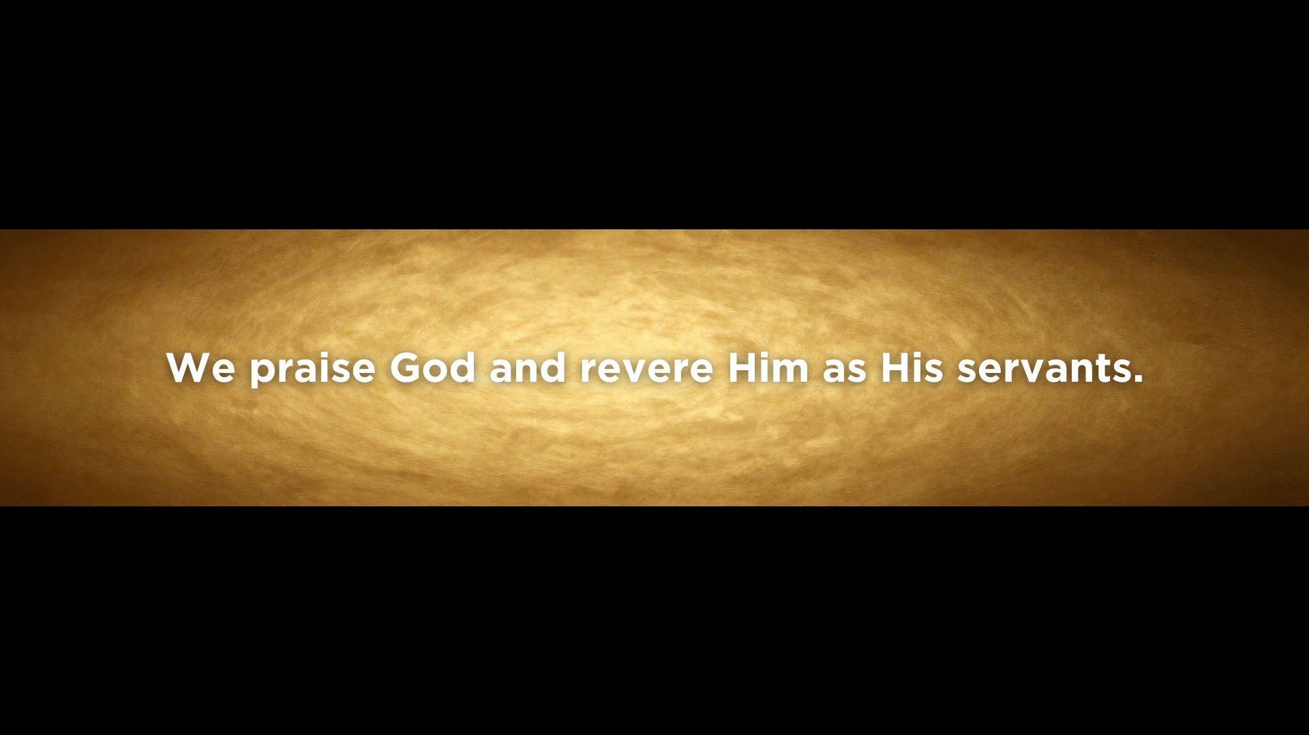

Slide 19
1 After this I heard what seemed to be the loud voice of a great multitude in heaven, crying out,
“Hallelujah!
Salvation and glory and power belong to our God,
2 for his judgments are true and just;
for he has judged the great prostitute
who corrupted the earth with her immorality,
and has avenged on her the blood of his servants.”
3 Once more they cried out,
“Hallelujah!
The smoke from her goes up forever and ever.”
4 And the twenty-four elders and the four living creatures fell down and worshiped God who was seated on the throne, saying, “Amen. Hallelujah!” 5 And from the throne came a voice saying,
“Praise our God,
all you his servants,
you who fear him,
small and great.”
6 Then I heard what seemed to be the voice of a great multitude, like the roar of many waters and like the sound of mighty peals of thunder, crying out,
“Hallelujah!
for the Lord our God
the Almighty reigns.
7 Let us rejoice and exult
and give him the glory,
for the marriage of the Lamb has come,
and his Bride has made herself ready;
8 it was granted her to clothe herself
with fine linen, bright and pure”—
for the fine linen is the righteous deeds of the saints.

Slide 20
1 After this I heard what seemed to be the loud voice of a great multitude in heaven, crying out,
“Hallelujah!
Salvation and glory and power belong to our God,
2 for his judgments are true and just;
for he has judged the great prostitute
who corrupted the earth with her immorality,
and has avenged on her the blood of his servants.”
3 Once more they cried out,
“Hallelujah!
The smoke from her goes up forever and ever.”
4 And the twenty-four elders and the four living creatures fell down and worshiped God who was seated on the throne, saying, “Amen. Hallelujah!” 5 And from the throne came a voice saying,
“Praise our God,
all you his servants,
you who fear him,
small and great.”
6 Then I heard what seemed to be the voice of a great multitude, like the roar of many waters and like the sound of mighty peals of thunder, crying out,
“Hallelujah!
for the Lord our God
the Almighty reigns.
7 Let us rejoice and exult
and give him the glory,
for the marriage of the Lamb has come,
and his Bride has made herself ready;
8 it was granted her to clothe herself
with fine linen, bright and pure”—
for the fine linen is the righteous deeds of the saints.

Slide 21
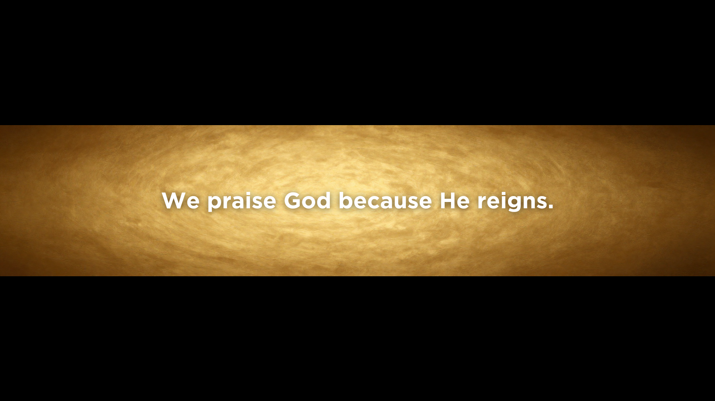

Slide 22
1 After this I heard what seemed to be the loud voice of a great multitude in heaven, crying out,
“Hallelujah!
Salvation and glory and power belong to our God,
2 for his judgments are true and just;
for he has judged the great prostitute
who corrupted the earth with her immorality,
and has avenged on her the blood of his servants.”
3 Once more they cried out,
“Hallelujah!
The smoke from her goes up forever and ever.”
4 And the twenty-four elders and the four living creatures fell down and worshiped God who was seated on the throne, saying, “Amen. Hallelujah!” 5 And from the throne came a voice saying,
“Praise our God,
all you his servants,
you who fear him,
small and great.”
6 Then I heard what seemed to be the voice of a great multitude, like the roar of many waters and like the sound of mighty peals of thunder, crying out,
“Hallelujah!
for the Lord our God
the Almighty reigns.
7 Let us rejoice and exult
and give him the glory,
for the marriage of the Lamb has come,
and his Bride has made herself ready;

Slide 23
1 After this I heard what seemed to be the loud voice of a great multitude in heaven, crying out,
“Hallelujah!
Salvation and glory and power belong to our God,
2 for his judgments are true and just;
for he has judged the great prostitute
who corrupted the earth with her immorality,
and has avenged on her the blood of his servants.”
3 Once more they cried out,
“Hallelujah!
The smoke from her goes up forever and ever.”
4 And the twenty-four elders and the four living creatures fell down and worshiped God who was seated on the throne, saying, “Amen. Hallelujah!” 5 And from the throne came a voice saying,
“Praise our God,
all you his servants,
you who fear him,
small and great.”
6 Then I heard what seemed to be the voice of a great multitude, like the roar of many waters and like the sound of mighty peals of thunder, crying out,
“Hallelujah!
for the Lord our God
the Almighty reigns.
7 Let us rejoice and exult
and give him the glory,
for the marriage of the Lamb has come,
and his Bride has made herself ready;

Slide 24
The one who has the bride is the bridegroom. The friend of the bridegroom, who stands and hears him, rejoices greatly at the bridegroom's voice. (John 3:29)
And Jesus said to them, “Can the wedding guests mourn as long as the bridegroom is with them?” (Matthew 9:15)
…since I betrothed you to one husband, to present you as a pure virgin to Christ.
(2 Corinthians 11:2)
“Therefore a man shall leave his father and mother and hold fast to his wife, and the two shall become one flesh.” This mystery is profound, and I am saying that it refers to Christ and the church. (Ephesians 5:31-32)

Slide 25


Slide 26
SUMMARY
We praise God for He will judge.
We praise God and revere Him as His servants.
We praise God because He reigns.
We praise God because He brings us into perfect union with Himself.

