Slide 1
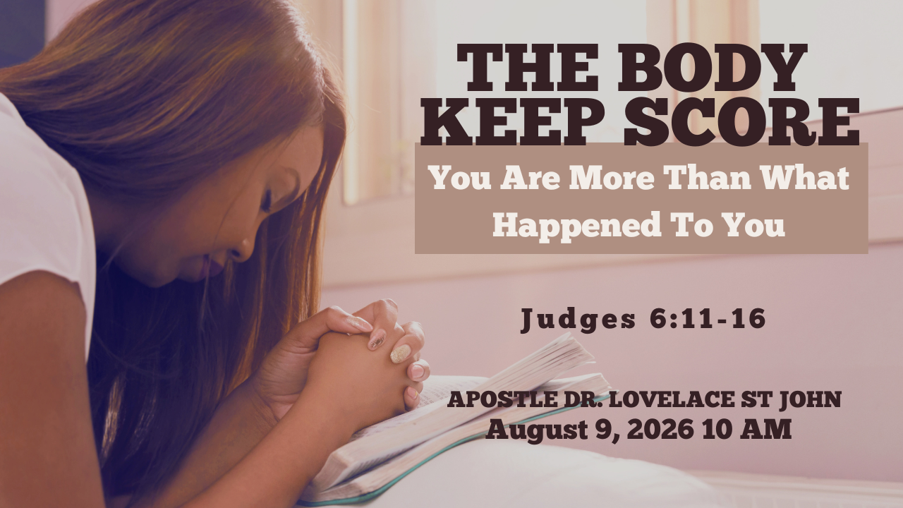

Slide 2



Scripture:
JUDGES 6: 11 – 16

Slide 3
INTRODUCTION
What has happened to us may leave a record within us, but it does not have the authority to write the conclusion of our lives.
Some experiences end outwardly but continue inwardly.
The event may be over, but the emotions remain.
The person may have left, but the words they spoke still echo.
The season may have changed, but our minds and bodies may continue responding as though the danger were still present.

Slide 4
1. Seven Years Under Midian
Judges 6:1: “Then the children of Israel did evil in the sight of the Lord. So the Lord delivered them into the hand of Midian for seven years.”
For seven years, the Midianites invaded Israel at harvest time. They did not necessarily occupy Israel permanently.
They waited until the Israelites had planted, cultivated, and prepared the harvest. Then they arrived and destroyed the increase.

Slide 5
Seven Years Under Midian (cont)
Judges 6:3–4: “So it was, whenever Israel had sown, Midianites would come up; also Amalekites and the people of the East would come up against them. Then they would encamp against them and destroy the produce of the earth.”
After experiencing this repeatedly, the people began hiding in caves, dens, and strongholds.
They were not just physically impoverished; they became emotionally conditioned to expect loss.

Slide 6
1. Seven Years Under Midian (cont)
Repeated pain can train people to expect defeat.
After enough disappointments, some people stop dreaming.
After enough rejection, they stop reaching.
After enough betrayal, they stop trusting.
After enough failure, they stop trying.

Slide 7
2. THAT IS WHERE WE MEET GIDEON.
When Gideon enters the story in Judges 6, Israel is under oppression from the Midianites.
The enemy had so harassed them that the people of God were living intimidated, exposed, and exhausted.
They seemed too weak to resist.
He is threshing wheat in a winepress to hide it from the Midianites.

Slide 8
2. THAT IS WHERE WE MEET GIDEON (cont)
A winepress was not the proper place to thresh wheat.
That is what shame does.
It relocates you.
It pushes you out of your proper place.
It teaches you to live hidden.

Slide 9
3. Shame Makes You Hide What God Intends to Use
Judges 6:11: “Now the Angel of the Lord came and sat under the terebinth tree which was in Ophrah, which belonged to Joash the Abiezrite, while his son Gideon threshed wheat in the winepress, in order to hide it from the Midianites.”
Gideon was attempting to do an open-air assignment in a hidden place.
Shame pushes us into hiding.

Slide 10
3. Shame Makes You Hide What God Intends to Use (cont)
It makes us hide our gifts.
It makes us hide our struggles.
It makes us hide our pain.
Guilt says, “I did something wrong.” Shame says, “Something is wrong with me.”

Slide 11
4. Shame Makes You Hide Even When God Is Looking For You
Judges 6:12: "The Lord is with thee, thou mighty man of valour."
Gideon does not look mighty.
He does not sound mighty.
He does not feel mighty.
Shame says, "Hide yourself."

Slide 12
4. Shame Makes You Hide Even When God Is Looking For You (cont)
Shame says, "You are what happened to you."
Shame says, "Stay small."
Many people are living in winepresses today
Emotional winepresses, relational winepresses, mental winepresses, spiritual winepresses.

Slide 13
5. Shame Keeps Count of What Happened to You
Gideon had watched his people become impoverished, humiliated, and fearful.
His nervous system had learned to associate harvest with danger.
Some of our present reactions are connected to earlier experiences.

Slide 14
5. Shame Keeps Count of What Happened to You (cont)
We may react strongly to rejection because we have felt abandoned before.
We may become defensive when corrected because correction was once accompanied by humiliation.
We may struggle to trust authority because someone in authority misused their power.

Slide 15
5. Shame Keeps Count of What Happened to You (cont)
We may sabotage healthy relationships because unhealthy relationships taught us that intimacy is dangerous.
The original event may be over, but the body may still be sounding the alarm.
This is why healing requires more than pretending nothing happened. God does not heal us through denial.

Slide 16
5. Shame Keeps Count of What Happened to You (cont)
Psalm 147:3: “He heals the brokenhearted and binds up their wounds.”
God does not shame wounded people. He binds their wounds.

Slide 17
6. God Identifies You According to Your Destiny, Not Your Damage
Judges 6:12: “And the Angel of the Lord appeared to him, and said to him, ‘The Lord is with you, you mighty man of valor!’”
Gideon was hiding, but God called him mighty.
Gideon was afraid, but God called him courageous.
Gideon felt insignificant, but God addressed his significance.
Gideon saw his condition, but God saw his calling.

Slide 18
6. God Identifies You According to Your Destiny, Not Your Damage (cont)
Judges 6:12:
There will be times when what God says about you does not agree with what shame says about you. In those moments, you must decide which voice will define you.
Shame says, “You are what happened to you.” God says, “You are Mine.”

Slide 19
6. God Identifies You According to Your Destiny, Not Your Damage (cont)
Shame says, “You will always be this way.” God says, “I am making all things new.”
Shame says, “You are disqualified.” God says, “My grace is sufficient for you.”
Shame says, “Stay in the winepress.” God says, “Go in this might of yours.”

Slide 20
7. Guilt Confuses Pain With Punishment
When the angel speaks, Gideon answers in Judges 6:13: "Oh my Lord, if the Lord be with us, why then is all this befallen us?”
This is the language of a wounded man.
Gideon is trying to interpret suffering.
He cannot reconcile his pain with God’s presence.

Slide 21
7. Guilt Confuses Pain With Punishment (cont)
That is What Guilt Often Does.
It makes people believe that every hardship is proof that God has abandoned them.
It makes them read their pain as divine rejection.
It makes them wonder whether they somehow deserve the misery they are in.
It makes them feel it’s their fault; they caused it to happen.

Slide 22
8. Unresolved Pain Can Cause Us to Blame God
“O my lord, if the Lord is with us, why then has all this happened to us? And where are all His miracles which our fathers told us about?” Judges 6:13
“If God is with us, why are we hiding?”
“If God is powerful, why are we oppressed?”
“If God performed miracles before, where is our miracle?”
Pain often searches for someone to blame.

Slide 23
8. Unresolved Pain Can Cause Us to Blame God (cont)
Sometimes we blame ourselves.
Sometimes we blame our parents.
Sometimes we blame the church.
Sometimes we blame our race, background, education, or circumstances.
Sometimes we blame God.

Slide 24
9. How You See Yourself
Judges 6:15: “O my Lord, how can I save Israel? Indeed my clan is the weakest in Manasseh, and I am the least in my father’s house.”
Gideon had developed an entire argument for his inadequacy.
“My clan is weak.” “My family is small.” “I am the least.” “How can I?”

Slide 25
9. How You See Yourself (cont)
Gideon Evaluated Himself Through Three Lenses:
A. His family history
“My clan is the weakest.”
B. His social standing
“I am the least.”
C. His personal limitations
“How can I save Israel?”

Slide 26
Conclusion: Healing Is Often a Process, Not a Single Moment
Gideon asked God for signs. He presented an offering. He asked for the fleece to be wet and the ground dry. Then he asked for the fleece to be dry and the ground wet.
God understood that years of oppression had affected Gideon’s ability to trust.
“But if you are afraid to go down, go down to the camp with Purah your servant.” Judges 7:10
God acknowledged Gideon’s fear and provided support.
There is no shame in receiving godly support while healing.

Slide 27
CONCLUSION (cont)
Gideon did not have to enter the enemy’s camp alone. Purah went with him.
Some battles require a Purah, someone safe enough to walk beside you while your courage is being restored.
Do not count only the things you lost. Count the grace that kept you alive.

Slide 28
CONCLUSION (cont)
Do not count only the people who left. Count the faithful people God placed beside you.
Do not count only your failures. Count the times God restored you.
Do not count only your weaknesses. Count the strength made available through Christ.

Slide 29
CONCLUSION (cont)
Practical Steps For Moving Forward:
1. Name what happened
Healing begins with truth.
2. Separate what happened from who you are
You experienced rejection, but you are not rejected by God.
3. Distinguish guilt from shame
If the shame belongs to what someone else did to you, stop carrying their responsibility.

Slide 30
CONCLUSION (cont)
Practical Steps For Moving Forward
4. Receive safe support
Do not fight alone. Gideon had Purah.
5. Obey God one step at a time
Gideon did not become fearless overnight. His faith grew through repeated acts of obedience.

