Slide 1
Welcome to Holy Hermits Online Worship
11th Sunday after Pentecost
Today we are remembering
Rose of Lima
Service Prep: Kris | Chat Host: Rachel | First Reader: Bob
Music: Paul | Welcomer: Julie | Second Reader: Jeremy
Proof-reader: Chris | Priest: N/A | Preacher: Lauren
Broadcaster: Barry | Deacon: Lauren | Fellowship: Julie
Backup Broadcaster: Lauren | Leader: Julie | Safety Officer: Rachel
Zoom Buttons: Rachel | Cantor: Margo | Attendance: Rachel

Slide 2






Hospitality
Leader:
Please mute for the service unless invited to offer your voice as part of the service ministry
Have the video camera on or off and turn the volume and brightness up or down on your device if things are too loud 🔉🔊or too bright🔅🔆
Our Cantor acts as our voice, offering the responses, in Bold Text, which we say together
Feel welcome to use the chat and reaction emojis 👍
🙏 Please take care of yourself in this space. 🙏 Come and go as you need
😴 It is great to take rest in this space, so falling asleep is also OK 😴
👂️ Remember, pastoral care is available to all in the community, if you'd like to speak to someone about anything spiritual. ❤️ Visit the help page at the website to reach out 🌐
Our Being Together ethos and safeguarding practices can also be accessed on the website 🫶​
🙌 Come as you are – we are all here together! 🙌
Notes:
Used Lent 2022

Slide 3
Leader: Our Holy Hermit today is Rose of Lima
Isabel Flores de Oliva was born to Spanish colonists on April 20, 1586, in Lima, Peru. Renowned for her beauty, she was nicknamed Rose after a servant had a vision of her face turning into a rose, a name she later took at her confirmation. From an early age, Rose embraced prayer, fasting, and acts of penance, longing for a religious life. To discourage admirers, she cut her hair and rubbed pepper on her face until it blistered.

Slide 4
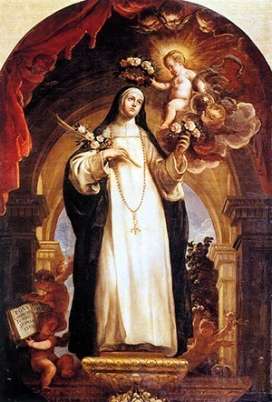
She is remembered for her ardent love of God, steadfast faith, and willingness to endure ridicule for Christ. At her death, the people of Lima gathered in great numbers to honour her, and she was loved by rich and poor alike. She is the patron saint of embroiderers, gardeners, florists, those who suffer ridicule for their piety, and those experiencing family difficulties.
To read more about our hermits click the link​​ in the send out

Slide 5
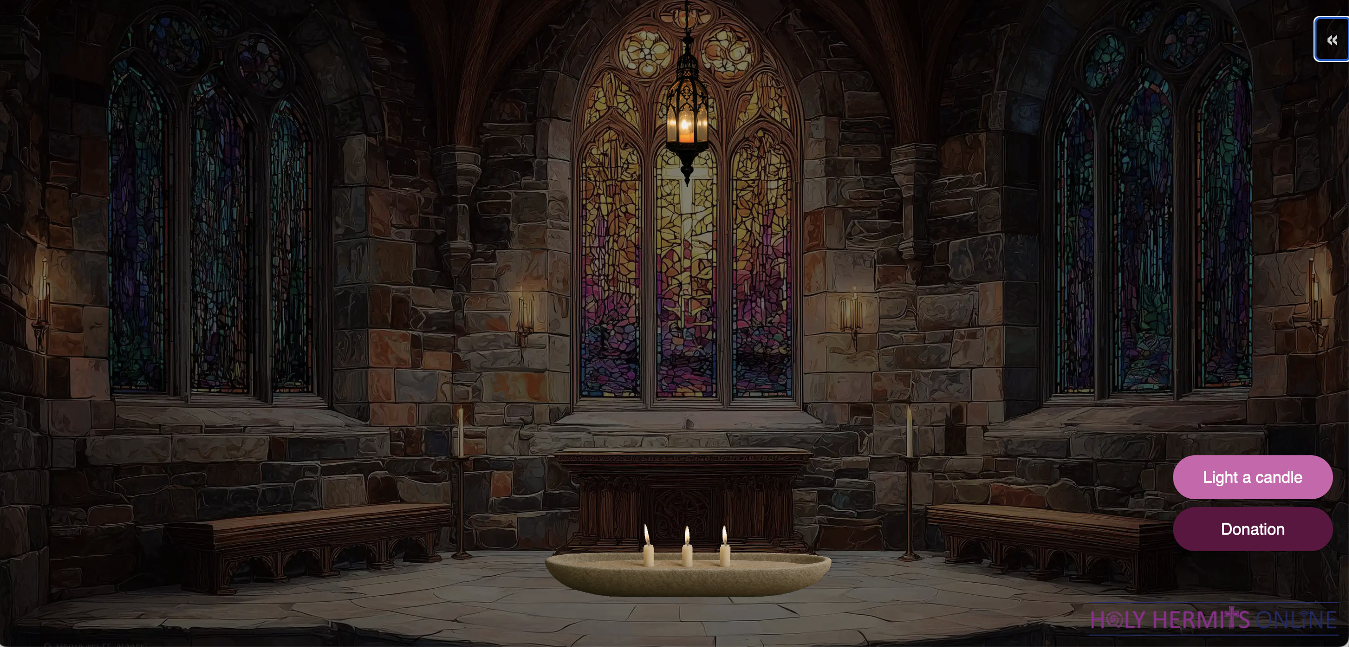
Virtual Chapel: Sanctuary Lamp of Remembrance
Leader: Our virtual chapel sanctuary lamp is lit this week in loving memory of David who has passed from dementia. Please be with Jane, her children and grandchildren.
https://holy-hermits-online-chapel.org/
Notes:
Link to prayer group ministry page for weekly commitment prayer https://holyhermits.com.au/ministries/prayer-group

Slide 6
Invitation
Leader: As we come into worship let’s take a few deep breaths,
Let go of anything that isn’t serving us,
And become aware of God’s presence here with us.
Opening Music: https://www.youtube.com/watch?v=YrJ4ohF8Du8

Slide 7
Leader and Cantor unmute
The Greeting
Leader: The grace of the Lord Jesus Christ,
and the love of God,
and the fellowship of the Holy Spirit,
be with you all.
All: And also with you.

Slide 8
Gathering Prayer
Leader:
Come to the One who is always
holding out his hands to us,
who is always ready to welcome us,
who is always longing to embrace us.
Let’s come together to God our Father
and celebrate his goodness.
Notes:
Use Call to Worship Prayer

Slide 9
Gathering Prayer
All:
Thank you, loving Lord,
that you have been holding on to us
all through this week.
Forgive us for failing to hold on to you.
Help us to let go of all that distracts us
and turn our hearts and minds to you again.
Amen.
Notes:
Use gathering prayer

Slide 10
Sentence
Leader: I invite our Cantor to proclaim the sentence for today.
Cantor: They cried out in fear, but Jesus spoke to them and said, ‘Take heart, it is I; do not be afraid.’
Matthew 14.26–27

Slide 11
Prayer of Approach
Leader: We pray the prayer of approach together
All: God of wonders and miracles,
worthy of our praises.
Let us lift our voices and our hearts,
rejoicing and singing praises to our God.

Slide 12
Leader unmutes
Our first Hymn
And Can It Be That I Should Gain
https://www.youtube.com/watch?v=dC8HSEKtuio​
We stay on mute
Leader mutes

Slide 13
The Deacon or LA introduces the Confession​
God is steadfast in love and infinite in mercy, welcoming sinners and inviting them to the Lord's table.
Silence may be kept.​
Let us confess our sins in penitence and faith, with a sincere and a true heart.

Slide 14
All: ​Merciful God, our maker and our judge, ​
we have sinned against you ​in thought, word, and deed, ​
and in what we have failed to do: ​
we have not loved you with our whole heart; ​
we have not loved our neighbours as ourselves; ​
we repent, and are sorry for all our sins.​
Father, forgive us. Strengthen us to love and obey you
in newness of life; ​through Jesus Christ our Lord. ​
Amen.​

Slide 15
Words of Assurance offered by the Deacon or LA
These words of assurance from the First Letter of John declare that:
If anyone sins, we have an advocate with the Father, Jesus Christ the righteous. He is the perfect offering for our sin, and not for ours only, but for the sins of the whole world.
(1 John 2: 1-2)
In this is love, not that we loved God, but that he loved us and sent his Son to be the perfect offering for our sins.
(1 John 4:10)

Slide 16
Collect
Leader: O Mighty God and ruler of all creation,
give new strength to our faith,
that we may recognise your presence even when all hope seems lost.
Help us to face all trials with serenity
as we walk with Christ through the stormy seas of life
and come at the last to your eternal peace.
We ask this through Jesus Christ our Lord,
who lives and reigns with you and the Holy Spirit,
one God, for ever and ever. Amen.

Slide 17
The 1st reader unmutes
Leader: I invite the 1st reader to unmute and offer the 1st lesson when ready.
Reader 1: The 1st Reading is from Genesis 37.1-4; 37.12-28
¹ Jacob settled in the land where his father had lived as an alien, the land of Canaan. ² This is the story of the family of Jacob. Joseph, being seventeen years old, was shepherding the flock with his brothers; he was a helper to the sons of Bilhah and Zilpah, his father’s wives; and Joseph brought a bad report of them to their father. ³
Continue…
Notes:
Please note that the first reading is recorded this week

Slide 18
Now Israel loved Joseph more than any other of his children, because he was the son of his old age; and he had made him a long robe with sleeves. ⁴ But when his brothers saw that their father loved him more than all his brothers, they hated him and could not speak peaceably to him. ¹² Now his brothers went to pasture their father’s flock near Shechem. ¹³ And Israel said to Joseph, ‘Are not your brothers pasturing the flock at Shechem? Come, I will send you to them.’ He answered, ‘Here I am.’ ¹⁴ So he said to him, ‘Go now, see if it is well with your brothers and with the flock;
Continue…

Slide 19
and bring word back to me.’ So, he sent him from the valley of Hebron. He came to Shechem, ¹⁵ and a man found him wandering in the fields; the man asked him, ‘What are you seeking?’ ¹⁶ ‘I am seeking my brothers,’ he said; ‘tell me, please, where they are pasturing the flock.’ ¹⁷ The man said, ‘They have gone away, for I heard them say, “Let us go to Dothan.” ’ So, Joseph went after his brothers and found them at Dothan. ¹⁸ They saw him from a distance, and before he came near to them, they conspired to kill him. ¹⁹ They said to one another, ‘Here comes this dreamer.
Continue…

Slide 20
²⁰ Come now, let us kill him and throw him into one of the pits; then we shall say that a wild animal has devoured him, and we shall see what will become of his dreams.’ ²¹ But when Reuben heard it, he delivered him out of their hands, saying, ‘Let us not take his life.’ ²² Reuben said to them, ‘Shed no blood; throw him into this pit here in the wilderness, but lay no hand on him’—that he might rescue him out of their hand and restore him to his father. ²³ So when Joseph came to his brothers, they stripped him of his robe, the long robe with sleeves that he wore;
Continue…

Slide 21
²⁴ and they took him and threw him into a pit. The pit was empty; there was no water in it. ²⁵ Then they sat down to eat; and looking up they saw a caravan of Ishmaelites coming from Gilead, with their camels carrying gum, balm, and resin, on their way to carry it down to Egypt. ²⁶ Then Judah said to his brothers, ‘What profit is there if we kill our brother and conceal his blood? ²⁷ Come, let us sell him to the Ishmaelites, and not lay our hands on him, for he is our brother, our own flesh.’ And his brothers agreed.
Continue…

Slide 22
²⁸ When some Midianite traders passed by, they drew Joseph up, lifting him out of the pit, and sold him to the Ishmaelites for twenty pieces of silver. And they took Joseph to Egypt.
For the word of the Lord. Thanks be to God.​

Slide 23
Leader: We now say the psalm antiphonally, I invite the first
reader to lead, and we will all respond with our cantor as our voice.
Psalm 105.1-6; 105.16-22
¹ O give thanks to the Lord and call upon his name:
tell among the peoples what things he has done.
² Sing to him, O sing praises:
and be telling of all his marvellous works.
³ Exult in his holy name:
and let those that seek the Lord be joyful in heart.
Continue…

Slide 24
⁴ Seek the Lord and his strength:
O seek his face continually.
⁵ Call to mind what wonders he has done:
his marvellous acts, and the judgements of his mouth,
⁶ O seed of Abraham his servant:
O children of Jacob his chosen one.
¹⁶ Then he called down a famine on the land:
and destroyed the bread that was their stay.
Continue…

Slide 25
¹⁷ But he had sent a man ahead of them:
Joseph who was sold into slavery,
¹⁸ Whose feet they fastened with fetters:
and thrust his neck into a hoop of iron.
¹⁹ Till the time that his words proved true:
he was tested by the Lord’s command.
²⁰ Then the king sent and loosed him:
the ruler of nations set him free;
Continue…

Slide 26
²¹ He made him master of his household:
and ruler over all his possessions,
²² To rebuke his officers at will:
and to teach his counsellors wisdom.

Slide 27
The 2nd reader unmutes
Leader: I invite the 2nd reader to unmute and offer the 2nd lesson when ready.
Reader 2: The 2nd Reading is from Romans 10.4-15
⁴ For Christ is the end of the law so that there may be righteousness for everyone who believes. ⁵ Moses writes concerning the righteousness that comes from the law, that ‘the person who does these things will live by them.’ ⁶ But the righteousness that comes from faith says, ‘Do not say in your heart, “Who will ascend into heaven?” ’ (that is, to bring Christ down)
Continue…

Slide 28
⁷ ‘or “Who will descend into the abyss?” ’ (that is, to bring Christ up from the dead). ⁸ But what does it say? ‘The word is near you, on your lips and in your heart’(that is, the word of faith that we proclaim); ⁹ because if you confess with your lips that Jesus is Lord and believe in your heart that God raised him from the dead, you will be saved. ¹⁰ For one believes with the heart and so is justified, and one confesses with the mouth and so is saved.
¹¹ The scripture says, ‘No one who believes in him will be put to shame.’
Continue…

Slide 29
¹² For there is no distinction between Jew and Greek; the same Lord is Lord of all and is generous to all who call on him.
¹³ For, ‘Everyone who calls on the name of the Lord shall be saved.’
¹⁴ But how are they to call on one in whom they have not believed? And how are they to believe in one of whom they have never heard? And how are they to hear without someone to proclaim him?
¹⁵ And how are they to proclaim him unless they are sent? As it is written, ‘How beautiful are the feet of those who bring good news!’
For the word of the Lord. Thanks be to God.​

Slide 30
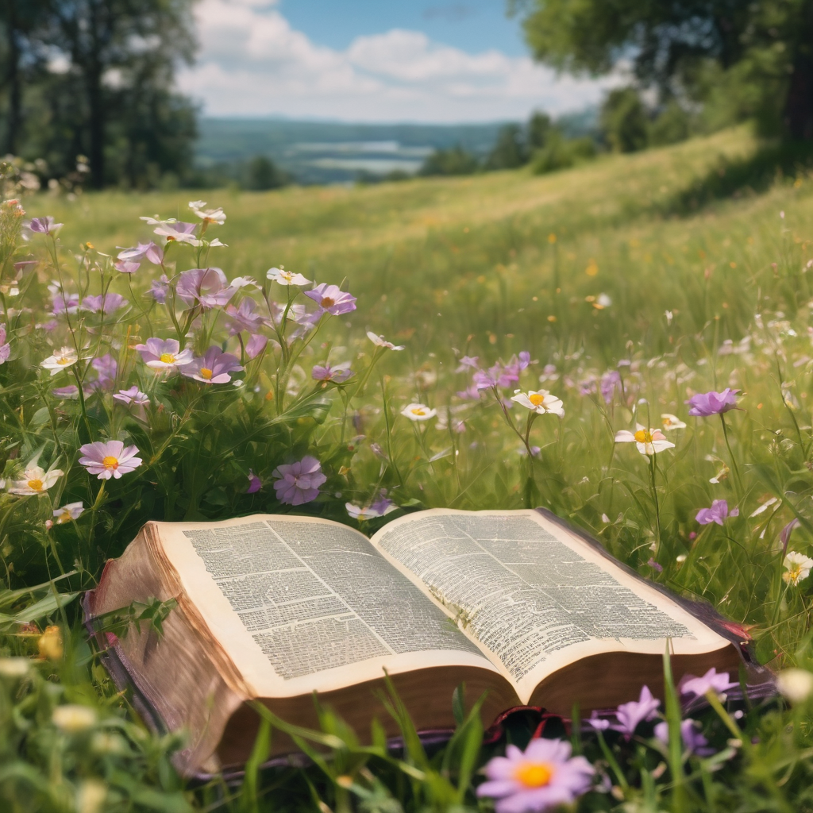
We pause before
​the Gospel ​​

Slide 31
Deacon: The Gospel of our Lord Jesus Christ according to St Matthew Chapter 14 beginning at the 22nd verse.
All: Glory to you Lord Jesus Christ.
²² Immediately he made the disciples get into the boat and go on ahead to the other side, while he dismissed the crowds. ²³ And after he had dismissed the crowds, he went up the mountain by himself to pray. When evening came, he was there alone, ²⁴ but by this time the boat, battered by the waves, was far from the land, for the wind was against them. ²⁵ And early in the morning he came walking towards them on the lake.
Continue…

Slide 32
²⁶ But when the disciples saw him walking on the lake, they were terrified, saying, ‘It is a ghost!’ And they cried out in fear. ²⁷ But immediately Jesus spoke to them and said, ‘Take heart, it is I; do not be afraid.’ ²⁸ Peter answered him, ‘Lord, if it is you, command me to come to you on the water.’ ²⁹ He said, ‘Come.’ So Peter got out of the boat, started walking on the water, and came towards Jesus. ³⁰ But when he noticed the strong wind, he became frightened, and beginning to sink, he cried out, ‘Lord, save me!’ ³¹ Jesus immediately reached out his hand and caught him, saying to him,
Continue…

Slide 33
‘You of little faith, why did you doubt?’ ³² When they got into the boat, the wind ceased. ³³ And those in the boat worshipped him, saying, ‘Truly you are the Son of God.’ ³⁴ When they had crossed over, they came to land at Gennesaret. ³⁵ After the people of that place recognized him, they sent word throughout the region and brought all who were sick to him, ³⁶ and begged him that they might touch even the fringe of his cloak; and all who touched it were healed.
This is the Gospel of the Lord. Praise to you Lord Jesus Christ.

Slide 34
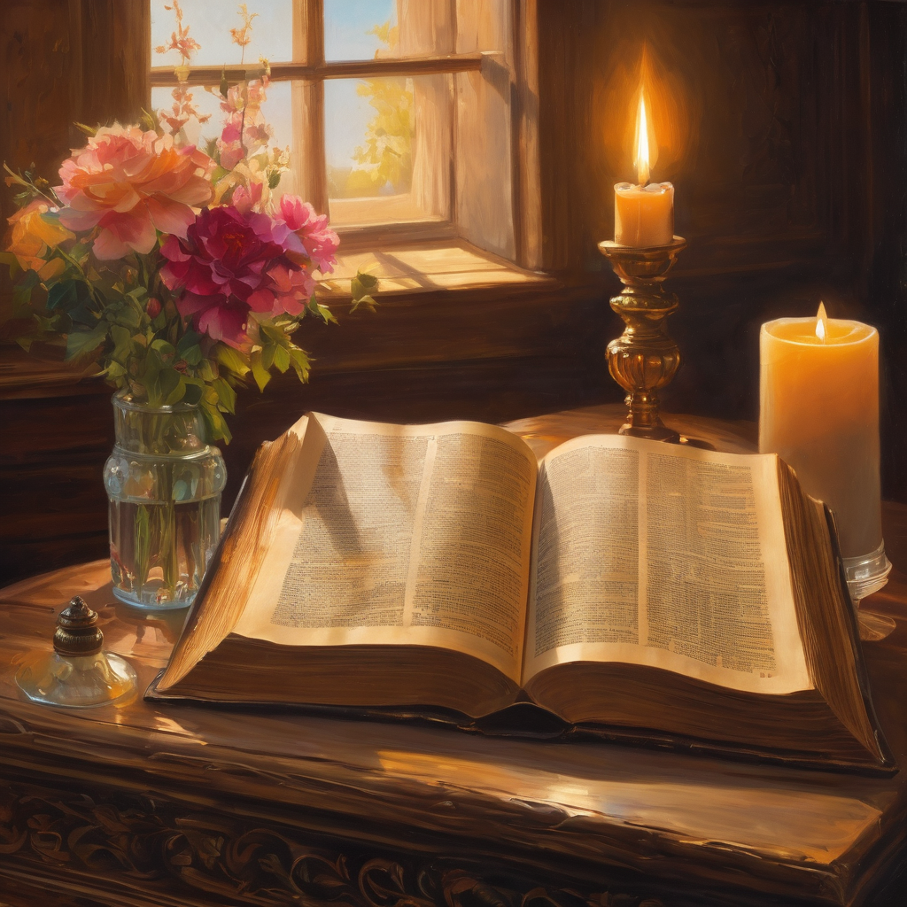
We pause
after ​the Gospel ​​

Slide 35
Leader: .
Leader and Cantor mute
Broadcaster exits screenshare
Sermon:

Slide 36
Leader unmutes
Our next Hymn
Eternal Father Strong to Save
https://www.youtube.com/watch?v=fX5Yk-gS1wk
We stay on mute
Leader mutes

Slide 37
The Leader and Cantor unmute
The Greeting of Peace
Leader: We are the body of Christ
All: God’s Spirit is with us
Leader: The peace of the Lord be always with you.
All: And also with you.
Leader: A sign of peace may be exchanged
You may like to type 'Peace' into the chat, use the 'raise hand’ or other reaction buttons, or just simply wave via the screen with your video turned on
(Broadcaster exits shared screen for a few moments for the exchange of peace)

Slide 38
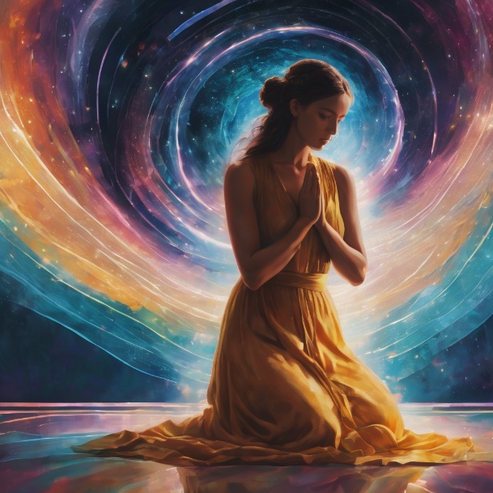
Prayer of Thanksgiving before Intercessions
Leader: As we enter prayer, I invite the second reader to unmute to lead our intercessions following the prayer of thanksgiving on the next slide. Please feel free to change your body position as you need.
Continue…

Slide 39
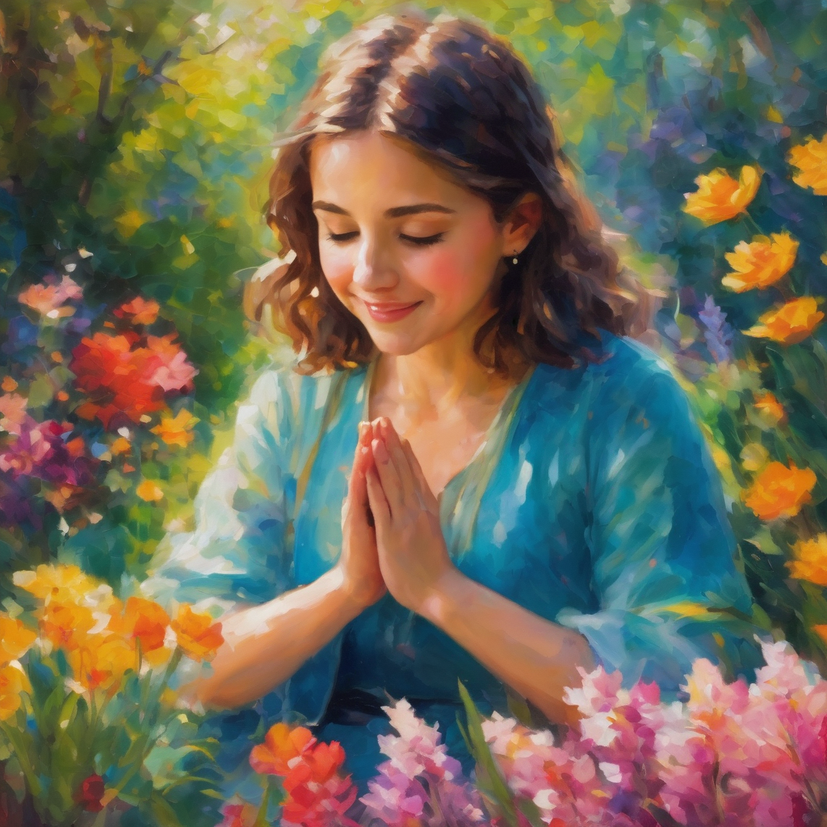
Leader:
We give glory to your Holy name,
director of our hopes and dreams.
With our lips we express adoration,
rejoicing in your wonderful acts.
Your mighty deeds work all our trials
to your purposes.
In our hearts, we praise and adore our glorious King.
Amen.
Notes:
Prayer of praise and thanksgiving

Slide 40
Intercessions
Reader 2: We pray for creation and communities we share our lives with. We pause for a few moments to name either in our hearts, or out loud, or in the chat, those environments and communities we bring to the Lord in prayer.
PAUSE…
Continue…

Slide 41
Intercessions
Reader 2: We entrust to you the community of Holy Hermits Online and our ministry partners:
Prosper the work of our hands and show us the way to your new creation.
Creator God, Hear our prayer.
St John's Cathedral Brisbane The Anglican Diocese of Southern Queensland St Gabriel’s, Carindale Benedictus Contemplative Church, Canberra Anglican Focus and Tithe.ly

Slide 42
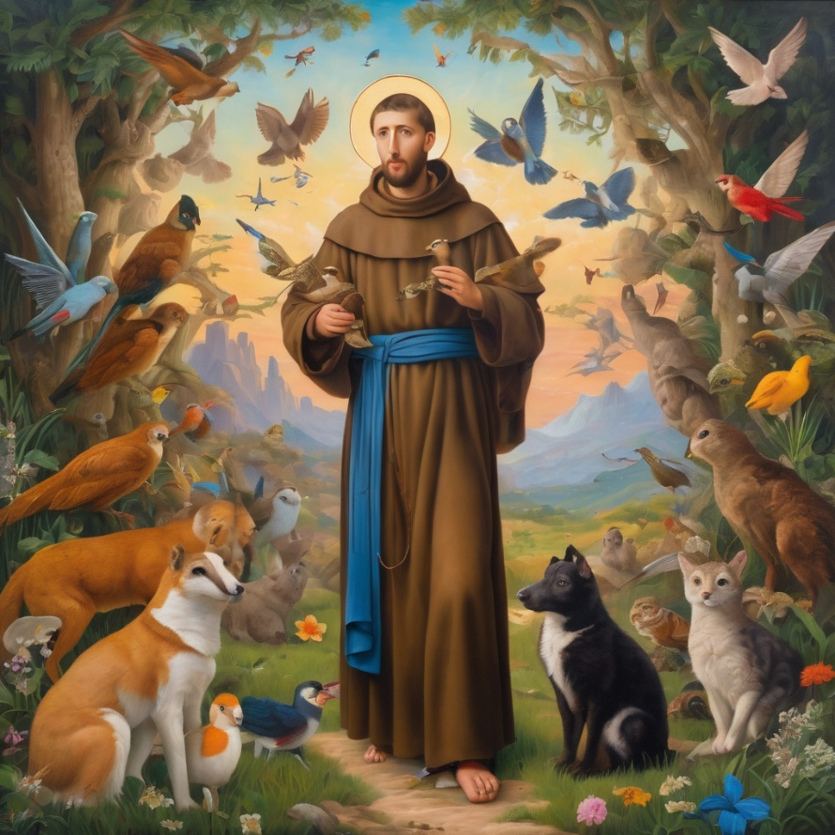
Reader 2: Loving Creator, we entrust to you all animals, especially those who are sick, anxious, ageing, lost, at risk, lonely, sad, hungry, in pain, homeless, abused, living in fear, encountering violence of any kind, in need of comfort, rehabilitation or transformation.

Slide 43
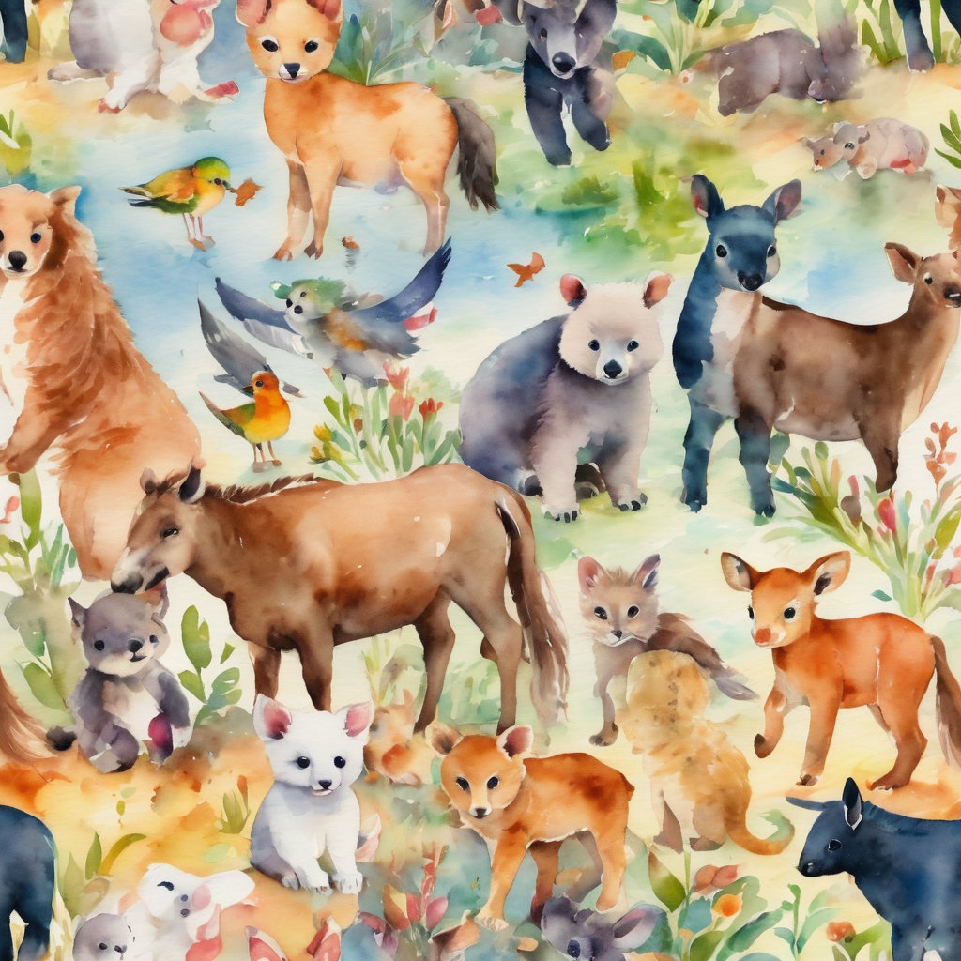
Reader 2: We invite your loving compassion for:
We name in our hearts, out loud or in the chat,
the animals we bring to the Lord in prayer. PAUSE…
Jasmine, ​
Leese(y), ​
Sid, Toots & Lulu​
Polly and Suki​
Fred, George & Percy​
Koshka ​
Jax
Lambert ​​
Kala, Nigel & Little One ​​
Toby​​
Taco​​
Paddy ​​
Rosie​
Squealer

Slide 44
Reader 2: Eternal Trinity of Love, we uphold to you the people we love and carry cares for:
Kerry, Les & Jake Julie, Ray, Tracey & Shane Mark, Desley & Bob ​​ Rachel, Mervyn & Gillian ​​Rev'd Shane & Janette​​ Alecia, Martin & Aidan​​ Kirsten, Greg, Daphne & Beau Bill & Marjorie​​ Aaron & Andrea Liz’s Godchildren Matthew & Nicholas | Barry​​ Dr Julie ​​ Ruth​​ Phil​ May Susan Tanya​ Neva Kathy ​Gayanne Tina | ​​ | Alan & Gaylene​ Jess & Leah ​​ Barry & Gwen Bob & Di​ Pat & Julie Dilys & Tony, Paul & Darhon Judy & Mary Miriam Lorelei Nettie

Slide 45
Reader 2:
We name in our hearts, out loud or in the chat, those we bring to the Lord in prayer.
PAUSE…
We entrust to you those who have died, those who have died peacefully and those who have died tragically, the old and the young. Receive them into your Kingdom. Lord in your mercy, Hear our prayers. Amen.

Slide 46
Pray Daily Cycle of Prayer
Leader: Loving God, joining with the Church in our cycle of prayer, we ask your blessings on:
The Episcopal Church
The Diocese of Canberra-Goulburn: †Mark; Assistant Bishop - †Vanessa; Clergy and People
The Parish of Woolloongabba: Rosemary
FSG (Family Support Group)
St Aidan’s Anglican Girls’ School, Corinda: Principal - Toni; Chaplain - Gillian; Assistant Chaplain – Harry, Chair of School Council - Stephen; School Council members; staff & students

Slide 47
Commitment Prayer of the Week
Leader: Our commitment prayer for the week is for the Companion Animal ministry
God, we give thanks for your call to develop a Companion Animal Ministry at Holy Hermits Online. ​
We ask for your grace to guide us, as we build this ministry together. ​
​Holy Spirit we ask your presence to be with us as we continue to develop resources together in this new season. ​
Continue…
Notes:
Link to prayer group ministry page for weekly commitment prayer https://holyhermits.com.au/ministries/prayer-group

Slide 48
Provide us with wisdom and with compassion and with a sense of fun as we celebrate our companion animals and live this mission to outreach. ​
​
Alongside Holy Hermit St. Francis, we ask you Lord Jesus Christ, to enliven us in this ministry space. ​
​
Amen .​
Notes:
Link to prayer group ministry page for weekly commitment prayer https://holyhermits.com.au/ministries/prayer-group

Slide 49
Devotions

Slide 50
Hermit Wisdom
Rose of Lima
“Apart from the cross, there is no other ladder by which we may get to heaven.”
“When we serve the poor and the sick we serve Jesus. We must not fail to help our neighbours, because in them we serve Jesus.”
“Without the struggle of afflictions, it is impossible to reach the height of grace. The gift of grace increases as the struggle increases."

Slide 51
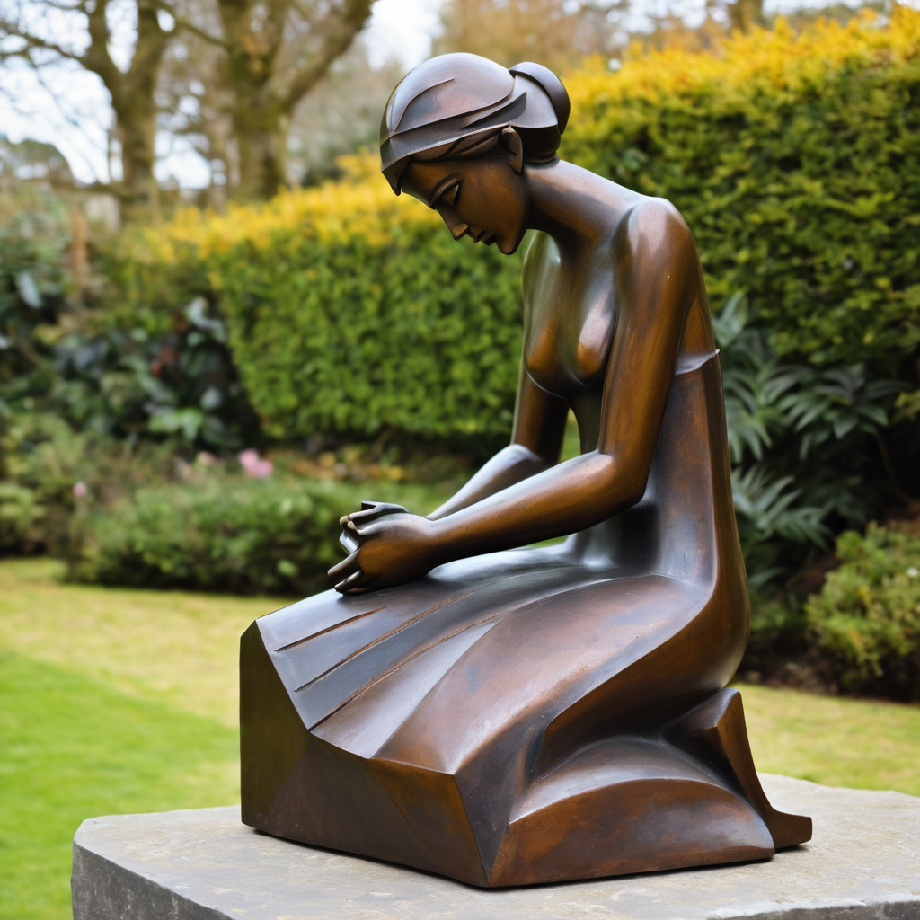
​
Leader: ​As we enter a few minutes of silence together, you are invited to pray the prayer of adoration on the next slide and/or spend this time in contemplation. ​
The Spiritual Communion prayer follows on the slide after that.
Let us be still.
Leader and Cantor Mute.
Continue…

Slide 52
​
Almighty Father God,
you know all that we have been through,
the names we have been given and those we have carried.
You know the struggles ahead of us and the worry that we hold.
Please take our worry and our fear
and bless us so that we can continue our journey towards you.
Amen.
Notes:
Prayer for all ages

Slide 53

  Oh, my Lord Jesus I turn to you present at the Altar and in the Tabernacle. I believe that you are present in the Holy Sacrament of your most Sacred Body and Blood. I love you above all things and I desire to receive you into my Soul. I cannot at this moment receive you Sacramentally in Holy Communion. Come spiritually into my heart. Purify it, Sanctify it. Render my heart like your own heart. I embrace you as if you were already there and unite myself wholly with you. Never permit me to be separated from you. Lord, I am not worthy to receive you, but only say the word and I shall be healed. Amen
Making a Spiritual Communion
(Prayed in silence)

Slide 54
Leader unmutes
Our final song is
Stand By Me
https://www.youtube.com/watch?v=Z29YZoQUVQk
​We stay on mute
Leader and Cantor mute

Slide 55
Leader and cantor unmute
Sending Prayer
Leader: We pray our sending prayer together.
All: Dear God, help us to hold on to you this week,
even when we can’t see you.
Help us to hold on through good times and bad.
Thank you that you always hold onto us,
when we remember you – and when we forget you.
Amen.

Slide 56
The Benediction
Leader: Let us all invite God’s blessings together,
All: May the Lord bless us and keep us.
May the Lord’s face shine upon us and be gracious to us.
May the Lord’s countenance be lifted upon us,
and bring us peace.
Amen

Slide 57
Notices
Prayer and Praise with our Animal Friends Thursday @6pm
Rev’d Lauren away on study leave Sunday 23rd Aug.
Wednesday night Study Group: Next Study Series starts 26th August 6pm. See Send Out or Event page for more information
See HHO Events page for further upcoming events HHO Events

Slide 58
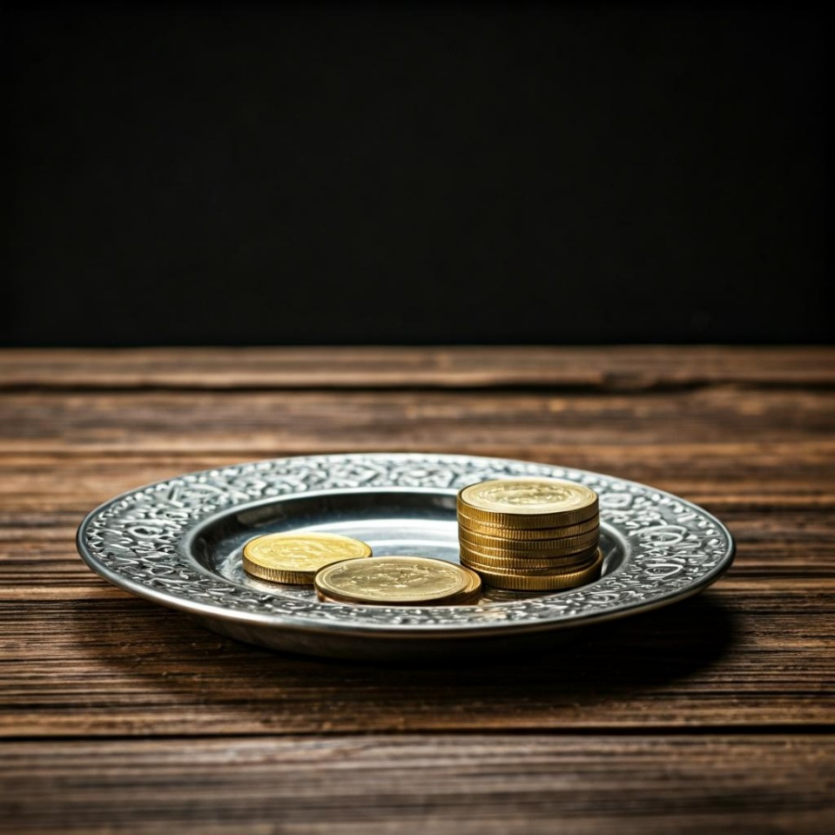
Leader: Thank you for your regular gifts to this ministry. Offerings are most welcome via:
The HHO App
Direct Debit
International Direct Debit
Please consider a one-off donation
or leaving a legacy in your Will
For further information go to HHO give page
https://holyhermits.com.au/give

Slide 59
Serving next week
16th August 2026
12th Sunday after Pentecost
9:00 am AEST
Service Prep: Lauren | Chat Host: Viki | First Reader: Grant
Music: Viki | Welcomer: Chris | Second Reader: Viki
Proof-reader: Kristine | Priest: N/A | Preacher: Lauren
Broadcaster: Paul | Deacon: Lauren | Fellowship: Lauren
Backup Broadcaster: Lauren | Leader: Jeremy | Safety Officer: Chris
Zoom Buttons: Viki | Cantor: Kieron | Attendance: Viki
Thank you for your ministry gifts
New Servers always welcome!
Please email Rev’d Lauren to get involved
holyhermits@anglicanchurchsq.org.au

Slide 60
The Dismissal
Leader: I invite everyone to unmute for the Dismissal
Leader: Go in peace to love and serve the Lord.
All: In the name of Christ, Amen.

Slide 61

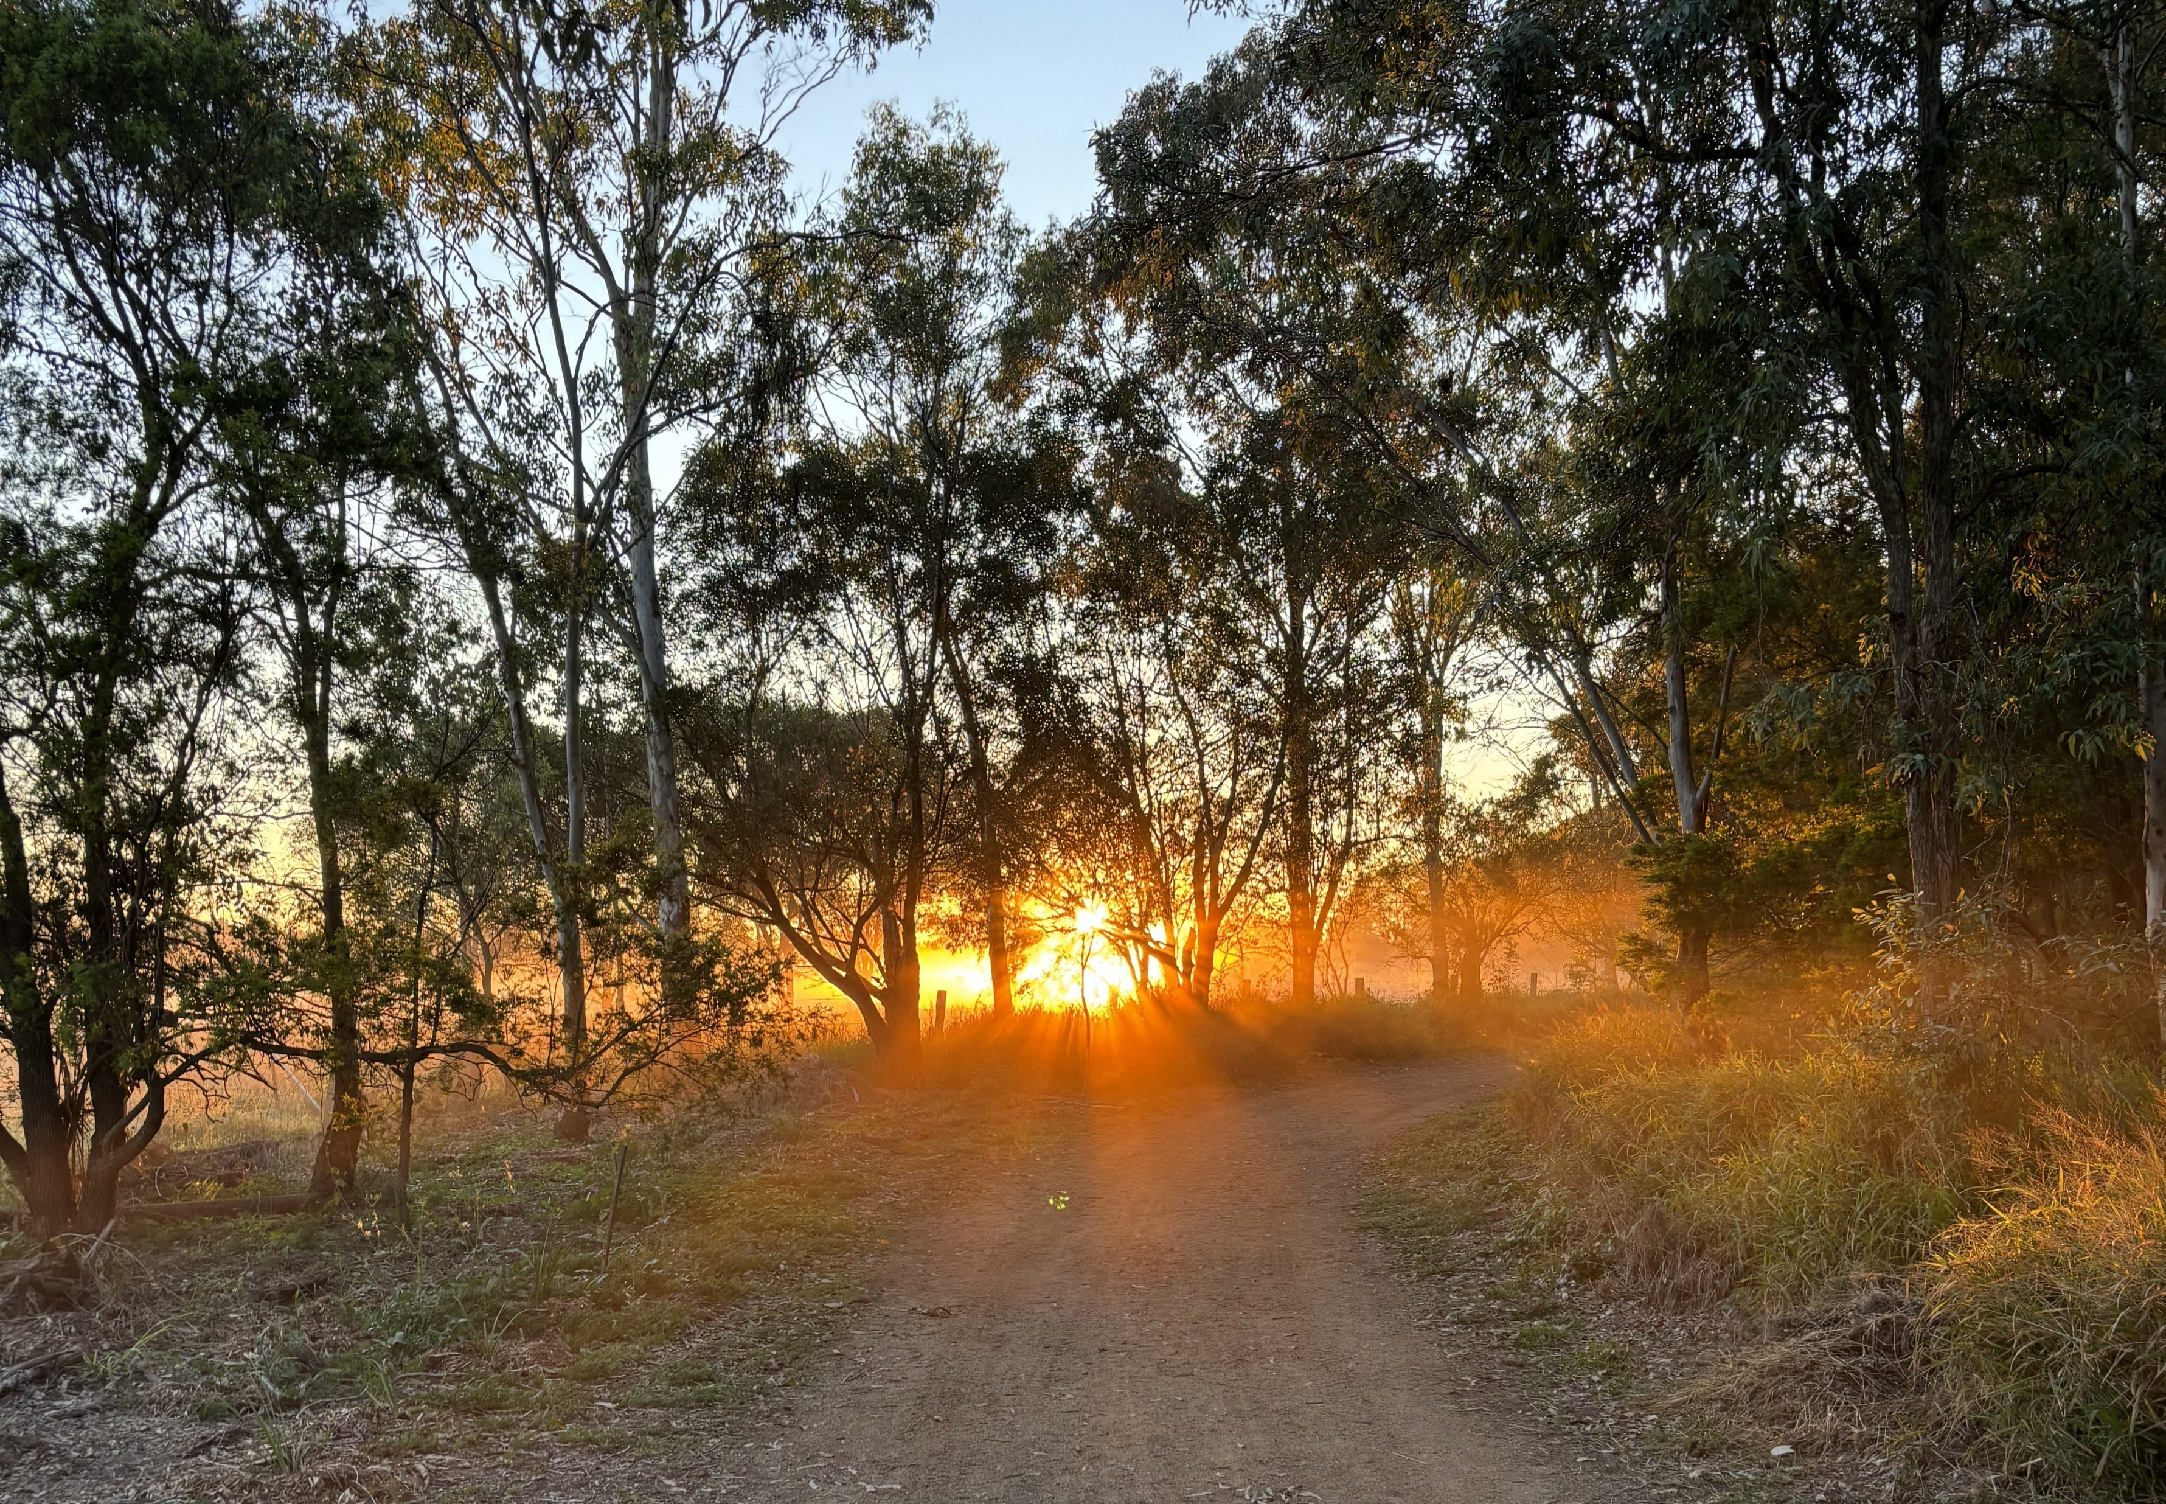
Fellowship
Thank you, Julie for leading Fellowship
Please feel welcome to linger or pop a message in the chat and head off when you are ready.​
This week our sanctuary lamp is lit in loving memory of David who has passed from dementia. Please be with Jane, her children and grandchildren.
Image shows the sunrise lighting up the track through the native bushlands at Oxley Common Nature Reserve
Extra resources developed
by Roots on the Web
Images from Padlet

