Slide 1


Slide 2
The Choice Before Us
1 Kings 11:29-39

Slide 3
²⁹ About that time Jeroboam was going out of Jerusalem, and Ahijah the prophet of Shiloh met him on the way, wearing a new cloak. The two of them were alone out in the country,
1 Kings 11:29-39 NIV

Slide 4
³⁰ and Ahijah took hold of the new cloak he was wearing and tore it into twelve pieces. ³¹ Then he said to Jeroboam,
“Take ten pieces for yourself, for this is what the Lord, the God of Israel, says:
‘See, I am going to tear the kingdom out of Solomon’s hand and
give you ten tribes.
1 Kings 11:29-39 NIV

Slide 5
³² But for the sake of my servant David
and the city of Jerusalem,
which I have chosen out of all the tribes
of Israel, he will have one tribe.
1 Kings 11:29-39 NIV

Slide 6
³³ I will do this because they have forsaken me and worshiped Ashtoreth the goddess of the Sidonians, Chemosh the god of the Moabites, and Molek the god of the Ammonites, and have not walked in obedience to me, nor done what is right in my eyes, nor kept my decrees and laws as David, Solomon’s father, did.
1 Kings 11:29-39 NIV

Slide 7
³⁴ “‘But I will not take the whole kingdom out of Solomon’s hand;
I have made him ruler all the days of his life for the sake of David my servant, whom I chose and who obeyed my commands and decrees.
1 Kings 11:29-39 NIV

Slide 8
³⁵ I will take the kingdom from his son’s hands and give you ten tribes.
1 Kings 11:29-39 NIV

Slide 9
³⁶ I will give one tribe to his son so that David my servant may always have a lamp before me in Jerusalem, the city where I chose to put my Name.
1 Kings 11:29-39 NIV

Slide 10
³⁷ However, as for you, I will take you,
and you will rule over
all that your heart desires;
you will be king over Israel.
1 Kings 11:29-39 NIV

Slide 11
³⁸ If you do whatever I command you and walk in obedience to me and do what is right in my eyes by obeying my decrees and commands, as David my servant did, I will be with you.
I will build you a dynasty
as enduring as the one I built
for David and will give Israel to you.
1 Kings 11:29-39 NIV

Slide 12
³⁹ I will humble David’s descendants because of this,
but not forever.’”
1 Kings 11:29-39 NIV

Slide 13
Choice
God Gives the Promise

Slide 14
“Take ten pieces for yourself, for this is what the Lord, the God of Israel, says:
‘See, I am going to tear the kingdom out of Solomon’s hand and
give you ten tribes.
1 Kings 11:31 NIV

Slide 15
³⁷ However, as for you, I will take you,
and you will rule over
all that your heart desires;
you will be king over Israel.
1 Kings 11:37 NIV

Slide 16
But God demonstrates his own love for us
in this:
While we were still sinners,
Christ died for us.
Romans 5:8 NIV

Slide 17
⁸ For it is by grace you have been saved, through faith—and this is not from yourselves, it is the gift of God— ⁹ not by works, so that no one can boast. ¹⁰ For we are God’s handiwork, created in Christ Jesus to do good works, which God prepared in advance for us to do.
Ephesians 2:8-10 NIV

Slide 18
¹⁹ This day I call the heavens and the earth as witnesses against you that I have set before you life and death, blessings and curses.
Now choose life,
so that you and your children
may live.
Deuteronomy 30:19 NIV

Slide 19
Choice
Fear Creates
Its Own Way

Slide 20
²⁶ Jeroboam thought to himself,
“The kingdom will now likely revert to the house of David. ²⁷ If these people go up to offer sacrifices at the temple of the Lord in Jerusalem, they will again give their allegiance to their lord, Rehoboam king of Judah.
They will kill me and
return to King Rehoboam.”
1 Kings 12:26-27 NIV

Slide 21
²⁸ After seeking advice,
the king made two golden calves.
He said to the people,
“It is too much for you to go up to Jerusalem. Here are your gods, Israel,
who brought you up out of Egypt.”
1 Kings 12:28 NIV

Slide 22
³¹ Jeroboam built shrines on high places and appointed priests
from all sorts of people,
even though they were not Levites.
1 Kings 12:31 NIV

Slide 23
Do not let your hearts be troubled.
You believe in God;
believe also in me.
John 14:1 NIV

Slide 24
²⁷ Peace I leave with you;
my peace I give you.
I do not give to you as the world gives.
Do not let your hearts be troubled
and do not be afraid.
John 14:27 NIV

Slide 25
³¹ What, then, shall we say in response to these things?
If God is for us,
who can be against us?
Romans 8:31 NIV

Slide 26
Choice
Every Generation Must Choose

Slide 27
¹⁵ But if serving the Lord seems
undesirable to you,
then choose for yourselves this day whom
you will serve,
whether the gods your ancestors served beyond the Euphrates, or the gods of the Amorites, in whose land you are living.
But as for me and my household,
we will serve the Lord.”
Joshua 24:15 NIV

Slide 28
²³ Then he said to them all:
“Whoever wants to be my disciple must deny themselves and
take up their cross daily
and follow me.
Luke 9:23 NIV

Slide 29
Conclusion:
Jeroboam already possessed God's promise.
He simply didn't believe God's promise could sustain him. The same question stands before every believer today.
Will we trust God's way or create our own?
God's promises always invite us onto His path,
but every generation must choose whether
it will trust His way
or create its own.

Slide 30
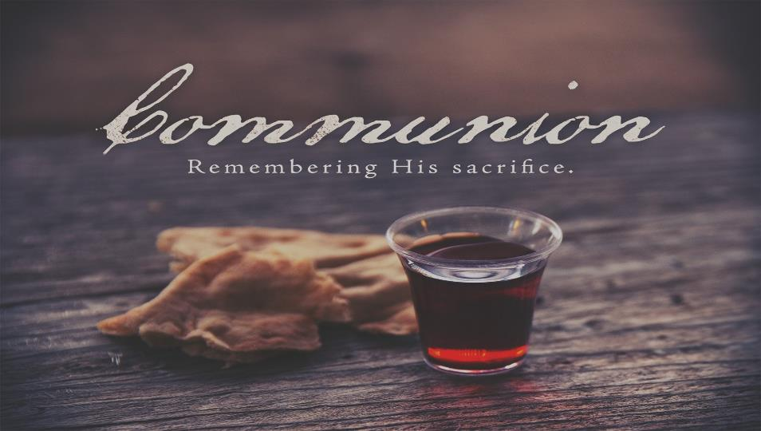

Slide 31


Slide 32


