Slide 1
Welcome to Holy Hermits Online Worship
10th Sunday after Pentecost
Today we are remembering
Holy Hermit Edith Stein
Service Prep: Lauren | Chat Host: Viki | First Reader: Phil
Music: Lauren | Welcomer: Chris | Second Reader: Helen
Proof-reader: Kris | Priest: N/A | Preacher: Flashback
Broadcaster: Barry | Deacon: Lauren | Fellowship: Lauren
Backup Broadcaster: Paul | Leader: Jeremy | Safety Officer: Chris
Zoom Buttons: Viki | Cantor: Julie | Attendance: Viki

Slide 2






Hospitality
Leader:
Please mute for the service unless invited to offer your voice as part of the service ministry
Have the video camera on or off and turn the volume and brightness up or down on your device if things are too loud 🔉🔊or too bright🔅🔆
Our Cantor acts as our voice, offering the responses, in Bold Text, which we say together
Feel welcome to use the chat and reaction emojis 👍
🙏 Please take care of yourself in this space. 🙏 Come and go as you need
😴 It is great to take rest in this space, so falling asleep is also OK 😴
👂️ Remember, pastoral care is available to all in the community, if you'd like to speak to someone about anything spiritual. ❤️ Visit the help page at the website to reach out 🌐
Our Being Together ethos and safeguarding practices can also be accessed on the website 🫶​
🙌 Come as you are – we are all here together! 🙌
Notes:
Used Lent 2022

Slide 3
Leader: Our Holy Hermit today is Edith Stein
Edith Stein (St Teresa Benedicta of the Cross) was born in 1891 to a Jewish family in Breslau, rose to prominence as a sharp‑minded philosopher before a profound encounter with Teresa of Ávila’s writings led her to Catholicism. She became a Carmelite nun, offering her life in solidarity with her persecuted people as the Nazi terror grew.

Slide 4
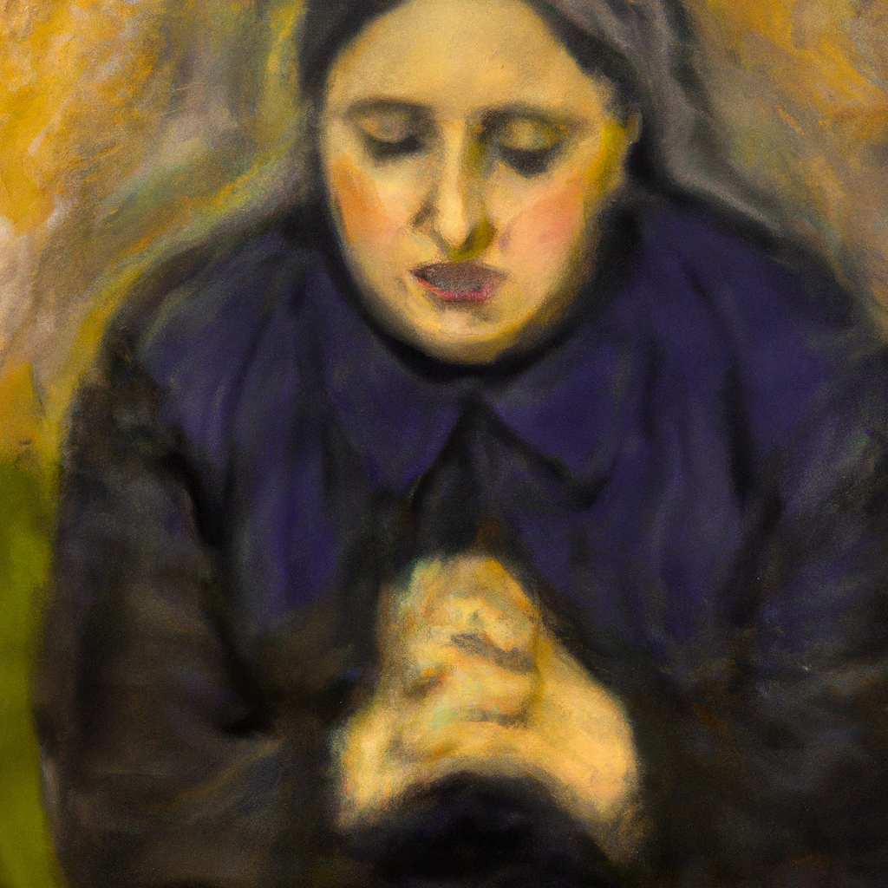
In 1942, she and her sister Rosa were seized and taken to Auschwitz, where they were killed. Her fierce intellect, spiritual courage, and unwavering compassion later earned her recognition as a martyr and patron saint of Europe.
To read more about our hermits click the link​​ in the send out

Slide 5
Invitation
Leader: As we come into worship let’s take a few deep breaths,
Let go of anything that isn’t serving us,
And become aware of God’s presence here with us.
Opening Music: https://www.youtube.com/watch?v=NDp0z-2UBPg

Slide 6
Leader and Cantor unmute
The Greeting
Leader: The grace of the Lord Jesus Christ,
and the love of God,
and the fellowship of the Holy Spirit,
be with you all.
All: And also with you.

Slide 7
Gathering Prayer
Leader:
Following God isn’t always easy,
we carry our scars and our hurts.
Let us press on, into God’s presence,
clinging onto his promises for us.
Notes:
Use Call to Worship Prayer

Slide 8
Gathering Prayer
All:
Almighty God,
you know us intimately and all we are going through this week.
Help us to meet with you today
and not leave until you have blessed us.
Amen.
Notes:
Use gathering prayer

Slide 9
Sentence
Leader: I invite our Cantor to proclaim the sentence for today.
Cantor: The Lord is near to all who call on him in truth. He fulfils the desire of all that fear him, hears their cry, and saves them.
Psalm 145.18-19

Slide 10
Prayer of Approach
Leader: We pray the prayer of approach together
All: God of wonders and miracles,
worthy of our praises.
Let us lift our voices and our hearts,
rejoicing and singing praises to our God.

Slide 11
Leader unmutes
Our first Hymn
Come, O Thou Traveler Unknown
https://www.youtube.com/watch?v=6o3c2vDFrm0
We stay on mute
Leader mutes

Slide 12
The Deacon or LA introduces the Confession​
God is steadfast in love and infinite in mercy, welcoming sinners and inviting them to the Lord's table.
Silence may be kept.​
Let us confess our sins in penitence and faith, with a sincere and a true heart.

Slide 13
All: ​Merciful God, our maker and our judge, ​
we have sinned against you ​in thought, word, and deed, ​
and in what we have failed to do: ​
we have not loved you with our whole heart; ​
we have not loved our neighbours as ourselves; ​
we repent, and are sorry for all our sins.​
Father, forgive us. Strengthen us to love and obey you
in newness of life; ​through Jesus Christ our Lord. ​
Amen.​

Slide 14
Words of Assurance offered by the Deacon or LA
These words of assurance from the First Letter of John declare that:
If anyone sins, we have an advocate with the Father, Jesus Christ the righteous. He is the perfect offering for our sin, and not for ours only, but for the sins of the whole world.
(1 John 2: 1-2)
In this is love, not that we loved God, but that he loved us and sent his Son to be the perfect offering for our sins.
(1 John 4:10)

Slide 15
Collect
Leader: O God, giver of life and health,
whose Son Jesus Christ has called us to hunger
and thirst for justice: refresh us with your grace,
that we may not be weary in well-doing,
for the sake of him who meets all our needs,
Jesus Christ our Saviour;
who lives and reigns with you and the Holy Spirit,
one God, now and for ever. Amen.

Slide 16
The 1st reader unmutes
Leader: I invite the 1st reader to unmute and offer the 1st lesson when ready.
Reader 1: The 1st Reading is from Genesis 32.22-31
²² The same night he got up and took his two wives, his two maids, and his eleven children, and crossed the ford of the Jabbok. ²³ He took them and sent them across the stream, and likewise everything that he had. ²⁴ Jacob was left alone; and a man wrestled with him until daybreak. ²⁵ When the man saw that he did not prevail against Jacob, he struck him on the hip socket; and Jacob’s hip was put out of joint as he wrestled with him.
Continue…
Notes:
Please note that the first reading is recorded this week

Slide 17
²⁶ Then he said, ‘Let me go, for the day is breaking.’ But Jacob said, ‘I will not let you go, unless you bless me.’ ²⁷ So he said to him, ‘What is your name?’ And he said, ‘Jacob.’ ²⁸ Then the man said, ‘You shall no longer be called Jacob, but Israel, for you have striven with God and with humans, and have prevailed.’ ²⁹ Then Jacob asked him, ‘Please tell me your name.’ But he said, ‘Why is it that you ask my name?’ And there he blessed him. ³⁰ So Jacob called the place Peniel, saying, ‘For I have seen God face to face, and yet my life is preserved.’ ³¹ The sun rose upon him as he passed Penuel, limping because of his hip.
For the word of the Lord. Thanks be to God.​

Slide 18
Leader: We now say the psalm antiphonally, I invite the first
reader to lead, and we will all respond with our cantor as our voice.
Psalm 17.1-7, 16
¹ Hear my just cause, O Lord, give heed to my cry:
listen to my prayer, that comes from no lying lips.
² Let judgement for me come forth from your presence:
and let your eyes discern the right.
³ Though you search my heart, and visit me in the night-time:
though you try me by fire, you will find no wickedness in me.
Continue…

Slide 19
⁴ My mouth does not transgress, like the mouth of others:
for I have kept the word of your lips.
⁵ My steps have held firm in the way of your commands:
and my feet have not stumbled from your paths.
⁶ I call upon you, O God, for you will surely answer:
incline your ear to me, and hear my words.
Continue…

Slide 20
⁷ Show me the wonders of your steadfast love,
O saviour of those who come to you for refuge:
who by your right hand deliver them
from those that rise up against them.
¹⁶ And I also shall see your face, because my cause is just:
when I awake and see you as you are, I shall be satisfied.

Slide 21
The 2nd reader unmutes
Leader: I invite the 2nd reader to unmute and offer the 2nd lesson when ready.
Reader 2: The 2nd Reading is from Romans 9.1-8
¹ I am speaking the truth in Christ—I am not lying; my conscience confirms it by the Holy Spirit— ² I have great sorrow and unceasing anguish in my heart. ³ For I could wish that I myself were accursed and cut off from Christ for the sake of my own people, my kindred according to the flesh.
Continue…

Slide 22
⁴ They are Israelites, and to them belong the adoption, the glory, the covenants, the giving of the law, the worship, and the promises; ⁵ to them belong the patriarchs, and from them, according to the flesh, comes the Messiah, who is over all, God blessed for ever. Amen. ⁶ It is not as though the word of God had failed. For not all Israelites truly belong to Israel, ⁷ and not all of Abraham’s children are his true descendants; but ‘It is through Isaac that descendants shall be named after you.’
Continue…

Slide 23
⁸ This means that it is not the children of the flesh who are the children of God, but the children of the promise are counted as descendants.
For the word of the Lord. Thanks be to God.​

Slide 24

We pause before
​the Gospel ​​

Slide 25
Deacon: The Gospel of our Lord Jesus Christ according to St Matthew Chapter 14 beginning at the 13th verse.
All: Glory to you Lord Jesus Christ.
¹³ Now when Jesus heard this, he withdrew from there in a boat to a deserted place by himself. But when the crowds heard it, they followed him on foot from the towns. ¹⁴ When he went ashore, he saw a great crowd; and he had compassion for them and cured their sick. ¹⁵ When it was evening, the disciples came to him and said, ‘This is a deserted place, and the hour is now late;
Continue…

Slide 26
send the crowds away so that they may go into the villages and buy food for themselves.’ ¹⁶ Jesus said to them, ‘They need not go away; you give them something to eat.’ ¹⁷ They replied, ‘We have nothing here but five loaves and two fish.’ ¹⁸ And he said, ‘Bring them here to me.’ ¹⁹ Then he ordered the crowds to sit down on the grass. Taking the five loaves and the two fish, he looked up to heaven, and blessed and broke the loaves, and gave them to the disciples, and the disciples gave them to the crowds.
Continue…

Slide 27
²⁰ And all ate and were filled; and they took up what was left over of the broken pieces, twelve baskets full. ²¹ And those who ate were about five thousand men, besides women and children.
This is the Gospel of the Lord. Praise to you Lord Jesus Christ.

Slide 28
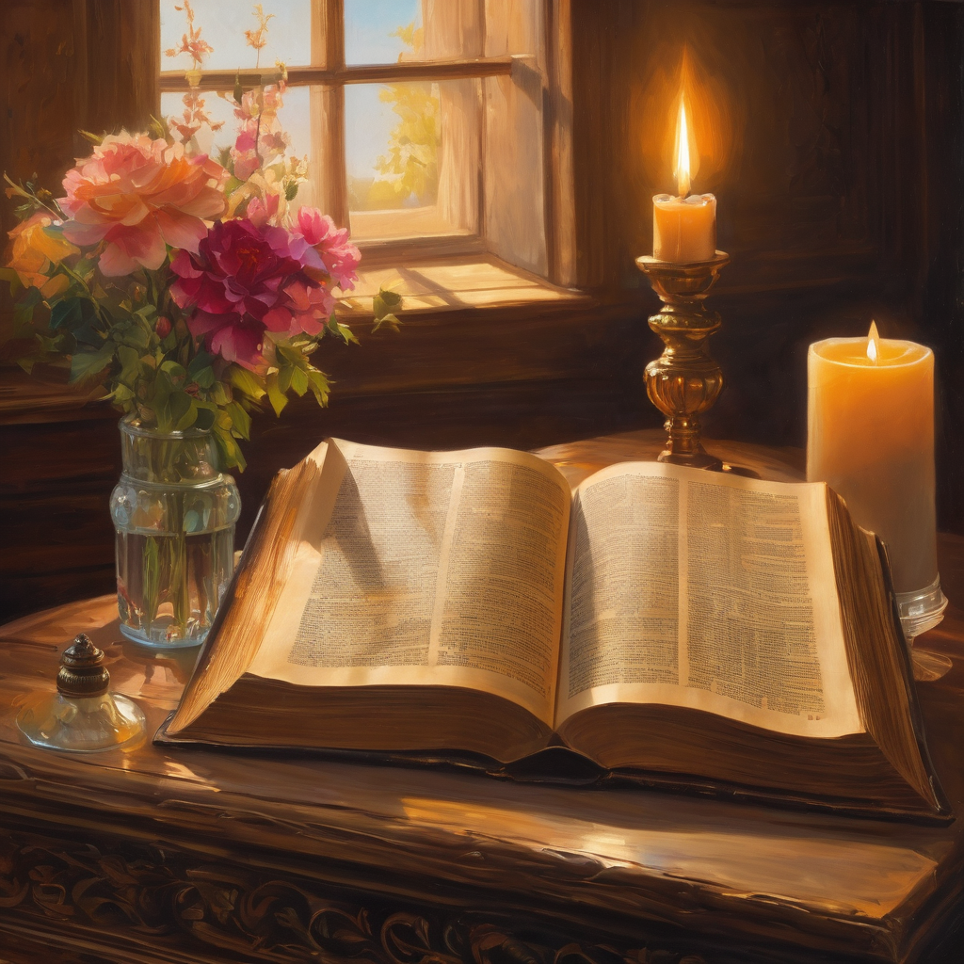
We pause
after ​the Gospel ​​

Slide 29
Leader: .
Leader and Cantor mute
Broadcaster exits screenshare
Flashback Sermon:
A Healing Limp?
Rev. Jamee
https://www.youtube.com/watch?v=aPox_i3YSAA
Notes:
Sermon starts 37:14 – Please let me know if the sermon is too quiet

Slide 30
Leader unmutes
Our next Hymn
O Love That Will Not Let Me Go
https://www.youtube.com/watch?v=gqU453Blurg
We stay on mute
Leader mutes

Slide 31
The Leader and Cantor unmute
The Greeting of Peace
Leader: We are the body of Christ
All: God’s Spirit is with us
Leader: The peace of the Lord be always with you.
All: And also with you.
Leader: A sign of peace may be exchanged
You may like to type 'Peace' into the chat, use the 'raise hand’ or other reaction buttons, or just simply wave via the screen with your video turned on
(Broadcaster exits shared screen for a few moments for the exchange of peace)

Slide 32
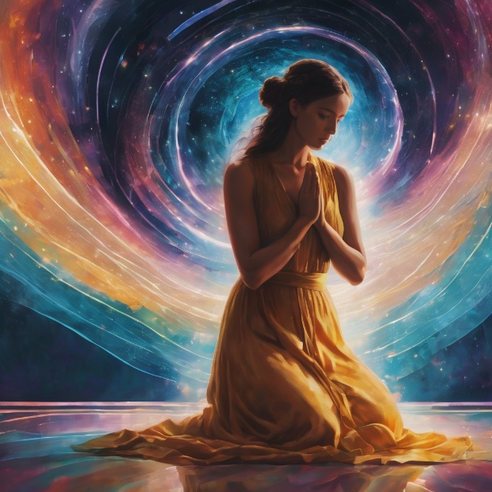
Prayer of Thanksgiving before Intercessions
Leader: As we enter prayer, I invite the second reader to unmute to lead our intercessions following the prayer of thanksgiving on the next slide. Please feel free to change your body position as you need.
Continue…

Slide 33
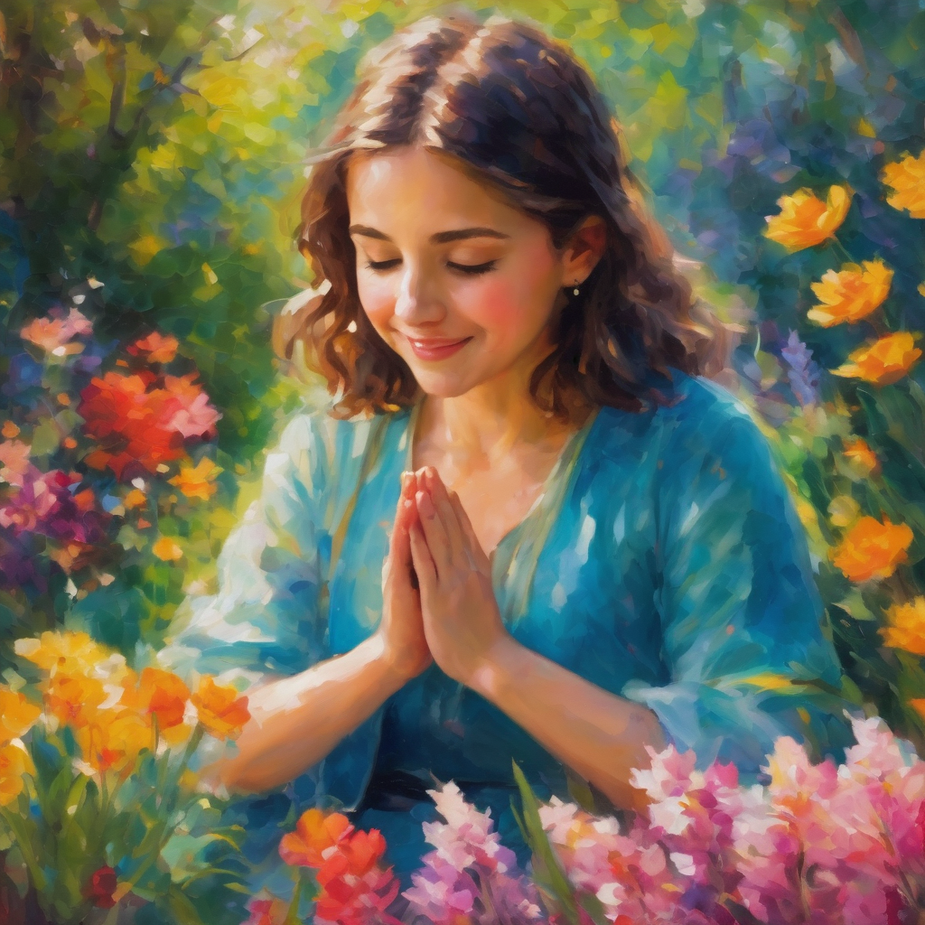
Leader:
Amazing God,
both strong and gentle,
both powerful and loving,
mighty ruler and faithful friend,
we praise you.
Amen.
Notes:
Prayer of praise and thanksgiving

Slide 34
Intercessions
Reader 2: We pray for creation and communities we share our lives with. We pause for a few moments to name either in our hearts, or out loud, or in the chat, those environments and communities we bring to the Lord in prayer.
PAUSE…
Continue…

Slide 35
Intercessions
Reader 2: We entrust to you the community of Holy Hermits Online and our ministry partners:
Prosper the work of our hands and show us the way to your new creation.
Creator God, Hear our prayer.
St John's Cathedral Brisbane The Anglican Diocese of Southern Queensland St Gabriel’s, Carindale Benedictus Contemplative Church, Canberra Anglican Focus and Tithe.ly

Slide 36
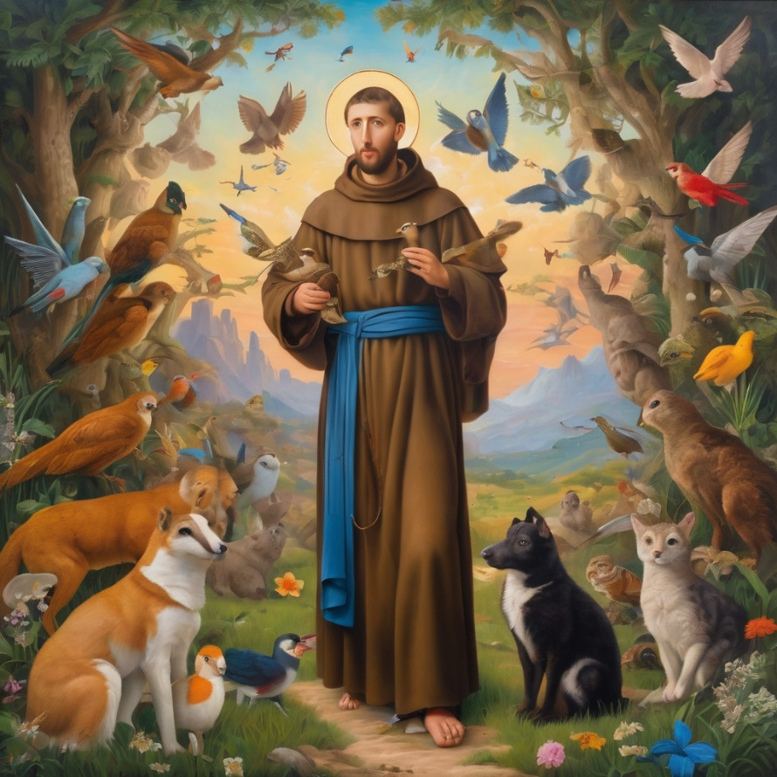
Reader 2: Loving Creator, we entrust to you all animals, especially those who are sick, anxious, ageing, lost, at risk, lonely, sad, hungry, in pain, homeless, abused, living in fear, encountering violence of any kind, in need of comfort, rehabilitation or transformation.

Slide 37
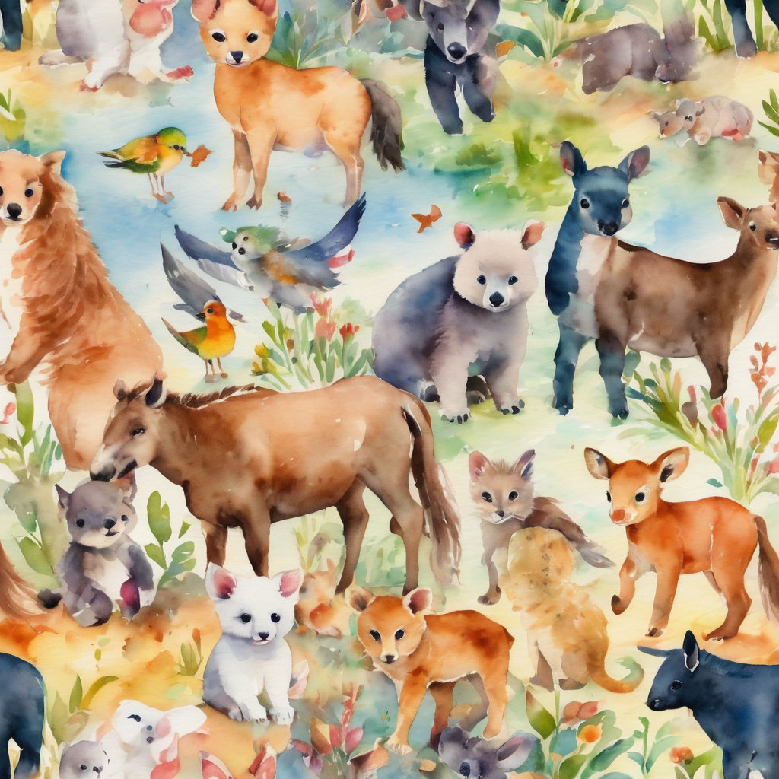
Reader 2: We invite your loving compassion for:
We name in our hearts, out loud or in the chat,
the animals we bring to the Lord in prayer. PAUSE…
Jasmine, ​
Leese(y), ​
Sid, Toots & Lulu​
Polly and Suki​
Fred, George & Percy​
Koshka ​
Jax
Lambert ​​
Kala, Nigel & Little One ​​
Toby​​
Taco​​
Paddy ​​
Rosie​
Squealer

Slide 38
Reader 2: Eternal Trinity of Love, we uphold to you the people we love and carry cares for:
Kerry, Les & Jake Julie, Ray, Tracey & Shane Mark, Desley & Bob ​​ Rachel, Mervyn & Gillian ​​Rev'd Shane & Janette​​ Alecia, Martin & Aidan​​ Kirsten, Greg, Daphne & Beau Bill & Marjorie​​ Aaron & Andrea Liz’s Godchildren Matthew & Nicholas | Barry​​ Dr Julie ​​ Ruth​​ Phil​ May Susan Tanya​ Neva Kathy ​Gayanne Tina | ​​ | Alan & Gaylene​ Jess & Leah ​​ Barry & Gwen Bob & Di​ Pat & Julie Dilys & Tony, Paul & Darhon Judy & Mary Miriam Lorelei Nettie

Slide 39
Reader 2:
We name in our hearts, out loud or in the chat, those we bring to the Lord in prayer.
PAUSE…
We entrust to you those who have died, those who have died peacefully and those who have died tragically, the old and the young. Receive them into your Kingdom. Lord in your mercy, Hear our prayers. Amen.

Slide 40
Pray Daily Cycle of Prayer
Leader: Loving God, joining with the Church in our cycle of prayer, we ask your blessings on:
The Church of the Province of Uganda
The Diocese of Adelaide: †Bradly ; Assistant Bishops – †Sophie , †Timothy & †Chris, Clergy & People
The Parish of Toowoomba, St James: Melissa , Bev , John, Garth, David, Laurel, Matthew, Graheme, David, Geoffrey, Peter
Staff of the Archbishop’s Office: Ann & Howard
Continue…

Slide 41
Pray Daily Cycle of Prayer
Anglican Church Grammar School, East Brisbane: Headmaster – Alan; Chaplain – Sharon; Lay Chaplain – Stephanie; Chair of School Council – Constantine, members of School Council; staff & students

Slide 42
Commitment Prayer of the Week
Leader: Our commitment prayer for the week is for the Deliverance Ministry Team.
Come Holy Spirit and make the hearts of your servants, Reverend Claye and the deliverance ministry team, your dwelling place and home. May darkness be dispelled by your light, and troubles calmed by your peace. ​​​
​Lord Jesus, we ask that you protect, guide and strengthen them, and all whom they encounter. ​​Give them courage, ability, wisdom and discernment
Continue…
Notes:
Link to prayer group ministry page for weekly commitment prayer https://holyhermits.com.au/ministries/prayer-group

Slide 43
Surround them with sound advice and support, that they may have insight and discretion. ​​Drawing on the Holy Spirit may they be strong in vocation and trust in you. ​​​
​We pray for those in need of healing and their ongoing relationship with you, as they journey towards the fullness and freedom of eternal life. ​May all evil and pain be transformed through the suffering of Christ and all dying glorified by your risen life. ​
Amen.
Notes:
Link to prayer group ministry page for weekly commitment prayer https://holyhermits.com.au/ministries/prayer-group

Slide 44
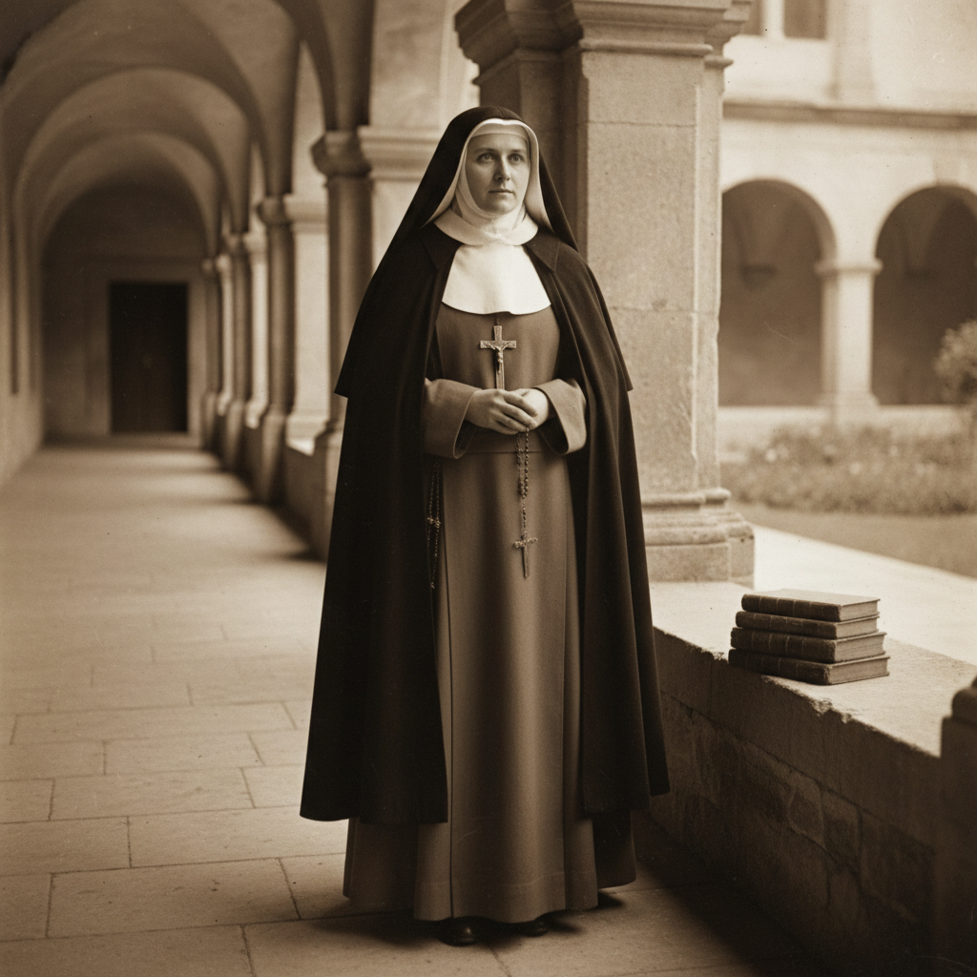
Devotions

Slide 45
Hermit Wisdom
Edith Stein
“To stand before the face of God—that is our vocation. . . . Our daily schedule ensures us of hours for solitary dialogue with the Lord, and these are the foundation of our life. . . . No human eye can see what God does in the soul during hours of inner prayer. It is grace upon grace. And all of life’s other hours are our thanks for them.”
“God is Truth. All who seek truth seek God, whether this is clear to them or not.”
“Prayer is the highest achievement of which the human spirit is capable.”

Slide 46
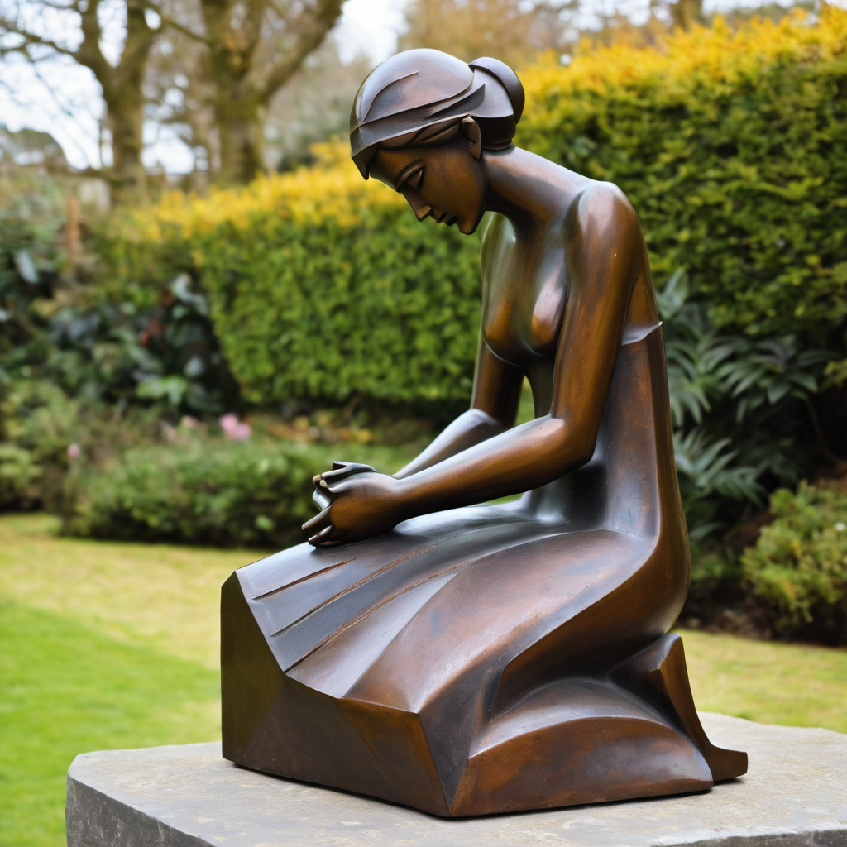
​
Leader: ​As we enter a few minutes of silence together, you are invited to pray the prayer of adoration on the next slide and/or spend this time in contemplation. ​
The Spiritual Communion prayer follows on the slide after that.
Let us be still.
Leader and Cantor Mute.
Continue…

Slide 47
​
Almighty Father God,
you know all that we have been through,
the names we have been given and those we have carried.
You know the struggles ahead of us and the worry that we hold.
Please take our worry and our fear
and bless us so that we can continue our journey towards you.
Amen.
Notes:
Prayer for all ages

Slide 48

  Oh, my Lord Jesus I turn to you present at the Altar and in the Tabernacle. I believe that you are present in the Holy Sacrament of your most Sacred Body and Blood. I love you above all things and I desire to receive you into my Soul. I cannot at this moment receive you Sacramentally in Holy Communion. Come spiritually into my heart. Purify it, Sanctify it. Render my heart like your own heart. I embrace you as if you were already there and unite myself wholly with you. Never permit me to be separated from you. Lord, I am not worthy to receive you, but only say the word and I shall be healed. Amen
Making a Spiritual Communion
(Prayed in silence)

Slide 49
Leader unmutes
Our final song is
Be Thou My Vision
https://www.youtube.com/watch?v=OOIa3eg0Xnc
​We stay on mute
Leader and Cantor mute

Slide 50
Leader and cantor unmute
Sending Prayer
Leader: We pray our sending prayer together.
All: Lord God,
we have chosen to follow you
no matter how difficult the road.
Would you bless us now
so that we can face the next steps on our journey.
Amen.

Slide 51
The Benediction
Leader: Let us all invite God’s blessings together,
All: May the Lord bless us and keep us.
May the Lord’s face shine upon us and be gracious to us.
May the Lord’s countenance be lifted upon us,
and bring us peace.
Amen

Slide 52
Notices
You may like to light a candle, send a prayer card or light the sanctuary lamp in dedication in our Virtual Chapel. Links to the chapel are available in the Send Out or you can find links on the HHO homepage
Companion Animal Ministry Workshop @ 11am, all are welcome to attend.
See HHO Events page for further upcoming events HHO Events

Slide 53
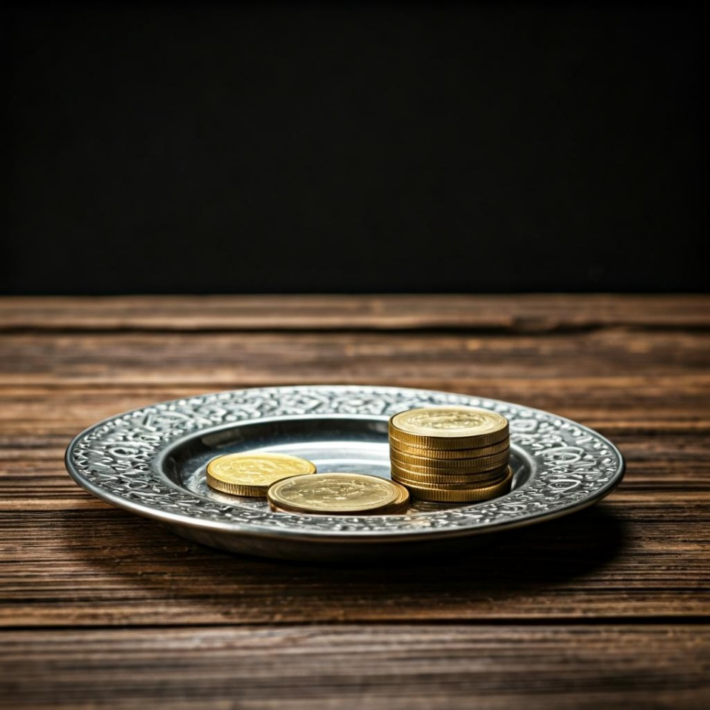
Leader: Thank you for your regular gifts to this ministry. Offerings are most welcome via:
The HHO App
Direct Debit
International Direct Debit
Please consider a one-off donation
or leaving a legacy in your Will
For further information go to HHO give page
https://holyhermits.com.au/give

Slide 54
Serving next week
9th August 2026
11th Sunday after Pentecost
9:00 am AEST
Service Prep: Kris | Chat Host: Rachel | First Reader: Bob
Music: Paul | Welcomer: Julie | Second Reader: Jeremy
Proof-reader: Chris | Priest: N/A | Preacher: Lauren
Broadcaster: Barry | Deacon: Lauren | Fellowship: Julie
Backup Broadcaster: Kieron | Leader: Julie | Safety Officer: Rachel
Zoom Buttons: Rachel | Cantor: Margo | Attendance: Rachel
Thank you for your ministry gifts
New Servers always welcome!
Please email Rev’d Lauren to get involved
holyhermits@anglicanchurchsq.org.au

Slide 55
The Dismissal
Leader: I invite everyone to unmute for the Dismissal
Leader: Go in peace to love and serve the Lord.
All: In the name of Christ, Amen.

Slide 56
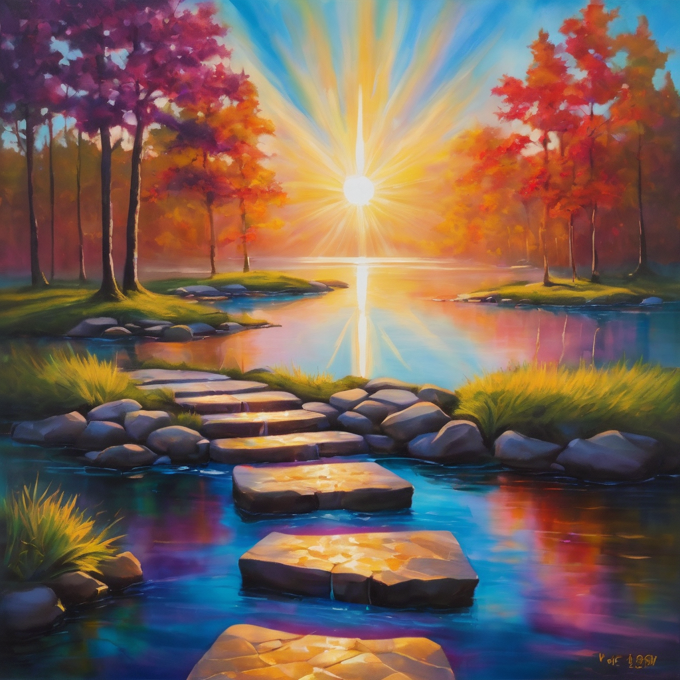
Fellowship
Thank you, Lauren for leading Fellowship
Please feel welcome to linger or pop a message in the chat and head off when you are ready.​
Extra resources developed
by Roots on the Web
Images from Padlet

