Slide 1
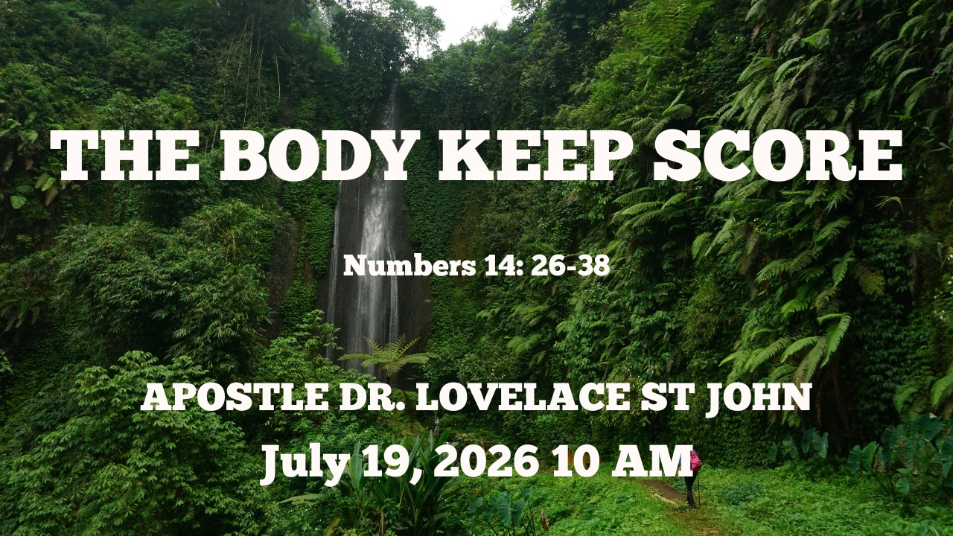

Slide 2



Scripture:
NUMBERS 14: 26 – 38

Slide 3
INTRODUCTION
Your Body Remembers What Your Mind Repeats
There is a scientific realization that your mind and your body are not separate.
If you experience trauma, stress, or prolonged fear, your brain might try to forget it, but your muscles, your nervous system, and your physical health remember.

Slide 4
INTRODUCTION (cont)
You carry the posture of your past.
Experiences of fear, trauma, chronic stress, anxiety, and unresolved emotional pain often leave lasting effects upon the body. Long after the event has passed, the body still remembers.

Slide 5
1. The Hidden Cost of a Negative Mindset
Your body eventually travels in the direction your mind continually believes.
Proverbs 23:7 "For as he thinks in his heart, so is he."

Slide 6
The Hidden Cost of a Negative Mindset (cont)
A Negative Mindset Can Delay God's Destiny Numbers 14:26 – 33
God had already promised Canaan. The promise never changed. The people changed.
God said, "You cannot enter because of what is inside you.”
The obstacle was never the Canaanites. The obstacle was Israel's unbelief.
Their bodies eventually reflected what their minds had been rehearsing.

Slide 7
The Hidden Cost of a Negative Mindset (cont)
B. The Infected Eye
Before there was a physical delay in the wilderness, there was a mental delay.
In Numbers 13, Moses sends twelve spies to scout the Promised Land. Ten return with a negative report; two return with a vision of victory. Numbers 13:31, 33
“We were like grasshoppers in our own sight, and so we were in their sight.”

Slide 8
2. Their Bodies Left Egypt, But Egypt Never Left Their Minds
One of the greatest miracles in Scripture was the Exodus. But the greater miracle never happened.
God delivered them physically. They never became free mentally.
A. Slavery had taught them:
Survive, Obey, Fear, Never take initiative, Never dream beyond your chains.
God could remove chains overnight. Changing their thinking required a journey.
Freedom is not complete until the mind is renewed.

Slide 9
2. Their Bodies Left Egypt, But Egypt Never Left Their Minds (cont)
B. The Chronic Complaint.
What happens when a negative mindset is allowed to fester? It manifests in our words.
In Numbers 14:1-4, The infection of the ten spies spreads to the entire congregation.

Slide 10
2. Their Bodies Left Egypt, But Egypt Never Left Their Minds (cont)
B. The Chronic Complaint.
Every time Israel faced a tight spot, they complained. They complained about the water; they complained about the food; they complained about the leadership.
When you do not allow God to heal your mind, you will constantly try to return to the very toxic environments He rescued you from, simply because they are familiar.

Slide 11
2. Their Bodies Left Egypt, But Egypt Never Left Their Minds (cont)
C. Egypt Became Their Reference Point
Whenever pressure came, they wanted to go back.
Exodus 16 - "We had food in Egypt.”
Numbers 11- "We remember the fish”
Numbers 14 - "Let us choose another leader and return.”
Notice the pattern. Pressure always exposed where their hearts still lived.

Slide 12
3. Complaining Was More Than Bad Attitude; It Revealed Spiritual Disease
A. Numbers are filled with complaints.
They complained about the water, the food, their leaders, their circumstances, their future, their enemies. Eventually, they even complained about God Himself.
Complaining is dangerous because it slowly reshapes our perspective.
Instead of seeing God's provision, we magnify our problems.

Slide 13
3. Complaining Was More Than Bad Attitude; It Revealed Spiritual Disease (cont)
B. Every Complaint Strengthened Their Fear
Every complaint became another rehearsal of defeat.
The more they complained, the more impossible the Promised Land appeared.
Eventually, fear became their identity.

Slide 14
4. The Ten Spies Had the Wrong Eyes
Numbers 13 - Twelve men entered.
They all saw the same grapes, the same giants, the same cities, the same land.
Only two returned with faith. The difference was not what they saw. The difference was how they interpreted what they saw.

Slide 15
4. The Ten Spies Had the Wrong Eyes (cont)
A. The Ten Focused on Obstacles
Numbers 13:31- "We are not able." Verse 32 - "It devours its inhabitants." Verse 33 - "We were like grasshoppers.”
B. Caleb and Joshua Saw God
Numbers 14:9 - "The Lord is with us."

Slide 16
5. God Could Not Entrust the Land to People Who Still Thought Like Slaves
A. Unfit for the Fight
The Promised Land was not a vacant lot; it was an active war zone. And Israel did not know how to fight.
Then it came to pass, when Pharaoh had let the people go, that God did not lead them by way of the land of the Philistines, although that was near; for God said, “Lest perhaps the people change their minds when they see war, and return to Egypt.” Exodus 13:17

Slide 17
5. God Could Not Entrust the Land to People Who Still Thought Like Slaves
God will not give you a territory you do not have the capacity to manage or defend.
If God had handed Israel the land without them fighting for it, the first enemy counter-attack would have sent them running straight back to Pharaoh.
They lacked the mental resilience to fight; God had to wait.

Slide 18
5. God Could Not Entrust the Land to People Who Still Thought Like Slaves (cont)
B. God Waited for a New Generation. The Sentence of Numbers 14
Numbers 14:31 But your little ones, whom you said would be victims, I will bring in, and they shall know the land which you have despised.
Sometimes God changes generations because He cannot build tomorrow upon yesterday's mindset.

Slide 19
5. God Could Not Entrust the Land to People Who Still Thought Like Slaves (cont)
B. God Waited for a New Generation. The Sentence of Numbers 14
Forty Days for Forty Years.
The Wilderness as a Cemetery.
The Next Generation.
Our negative mindsets do not just affect us; they map out a wilderness journey for our children.

Slide 20
CONCLUSION
The tragedy was not that Israel encountered giants. The tragedy was that they encountered their own unbelief.
The wilderness became a mirror. It revealed what had been hidden in their hearts all along.
The Promised Land required more than strong bodies; it required renewed minds.

Slide 21
CONCLUSION (cont)
The good news of the gospel is that in Christ we are not imprisoned by our past, our wounds, or even generational patterns.
Through the Holy Spirit, God renews our minds, heals our hearts, restores our identity, and equips us to walk into the future He has prepared.

