Slide 1
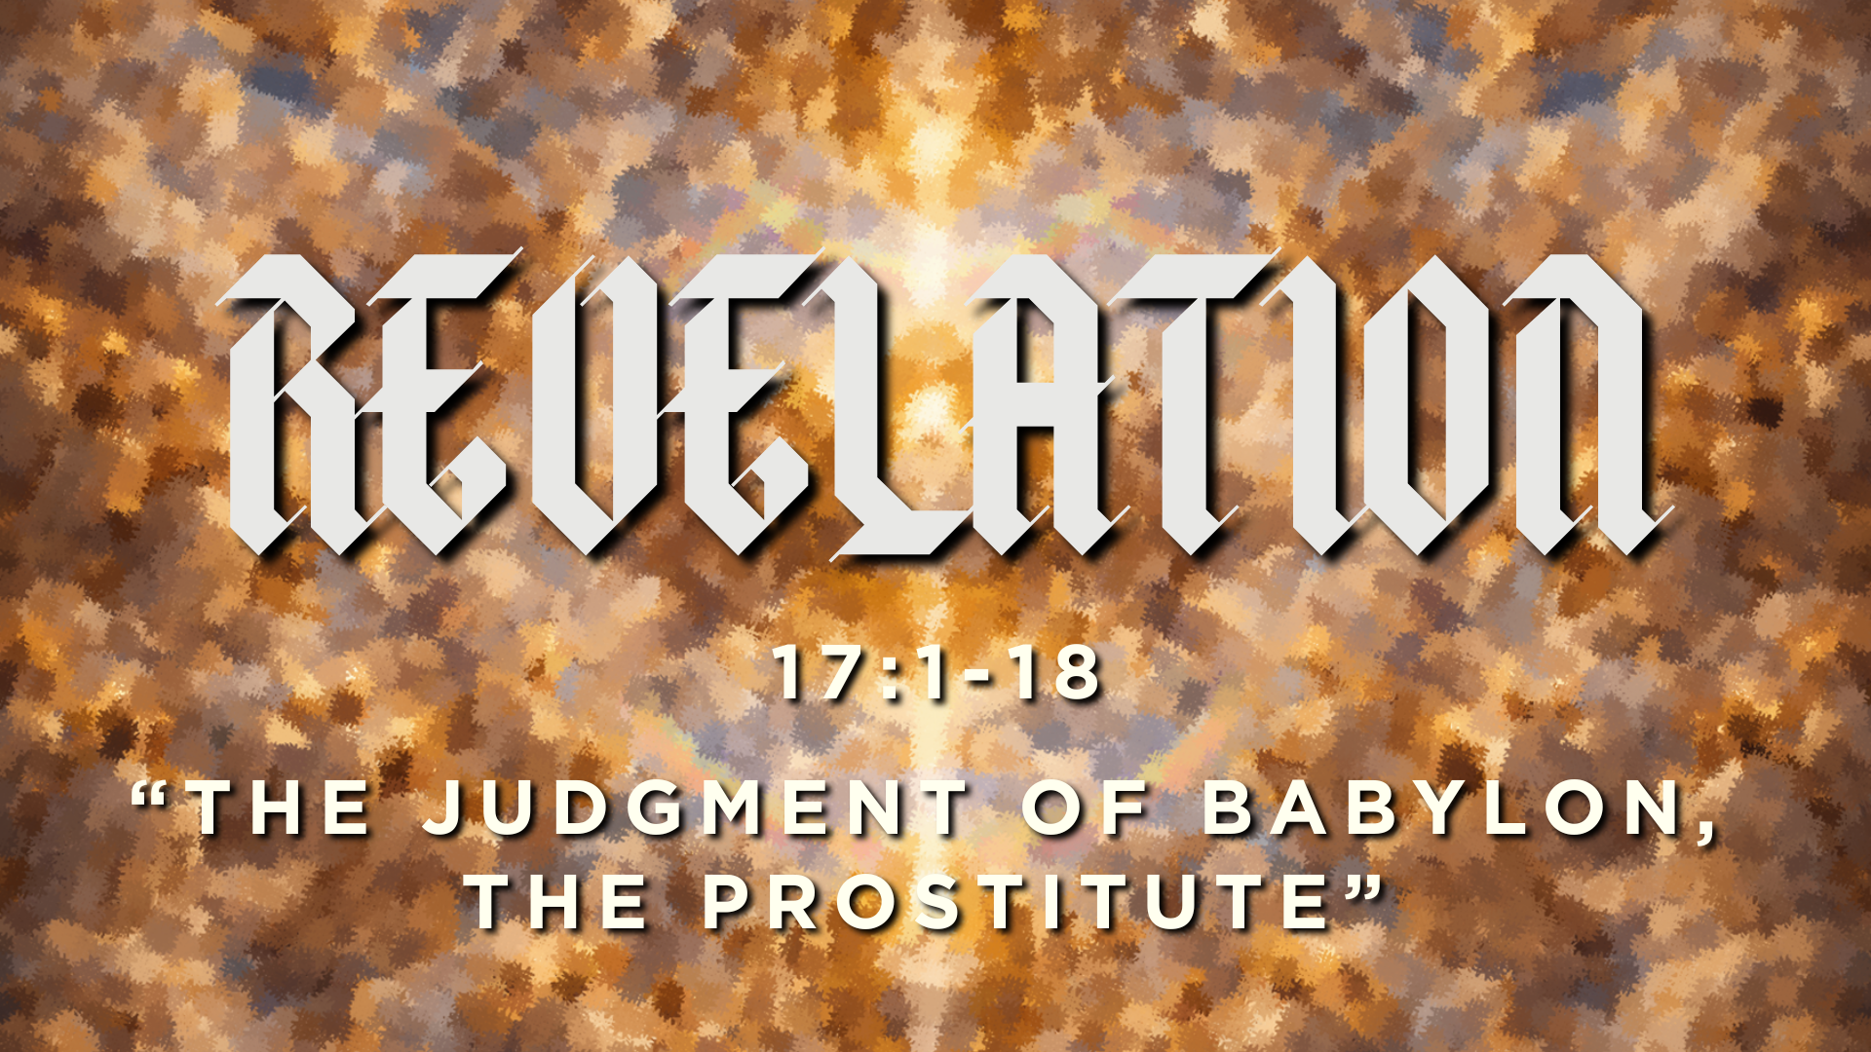

Slide 2
Big Idea
You should work hard for–participate in–whatever economic system you find yourself in.
But never become blind to the way it whispers for your ultimate trust and allegiance.
Otherwise, you will soon find yourself defending Babylon rather than witnessing to God's kingdom.

Slide 3
Outline
1. See your enemy: who is Babylon?
2. See through your enemy: Babylon will endure for just “one hour”
3. See your enemy’s demise: Babylon will be devoured by the Beast

Slide 4
Revelation 17:1-2
¹Then one of the seven angels who had the seven bowls came and said to me, “Come, I will show you the judgment of the great prostitute who is seated on many waters, ² with whom the kings of the earth have committed sexual immorality, and with the wine of whose sexual immorality the dwellers on earth have become drunk.”

Slide 5
“Whoredom, here, then, isn’t about sexual infidelity but has to do with the spiritual treachery, dalliance with other gods, through whom whoredom in these two chapters is also tied to Babylon’s oppressive economic practices… manifesting in disregard for the well-being of others.”
– Thomas Schreiner

Slide 6
“The beast and the prostitute are two different manifestations of the same spirit, two different manifestations of an anti-God spirit in the world.”
– Thomas Schreiner

Slide 7
“Rome is inebriated with her own glory and narcissistically self-absorbed with her own glory, and thus cannot tolerate the saints, who are devoted to the one true God. Rome would be satisfied if the God on the throne and the Lamb were added to the pantheon of her gods, but what could not be allowed was refusal to worship the emperor, which denied the sovereignty and rule of the emperor. The exclusivity of the early Christians enraged the sensibilities of Rome, leading the harlot to spill the blood… of the saints, of those who were ‘witnesses of Jesus’ ”
– Thomas Schreiner

Slide 8
Who is Babylon?
Babylon’s ‘spirit’ represents every nation and empire since Rome whose economic and political prowess compete for ultimate loyalty compared to the kingdom of God.

Slide 9
The Beast that Babylon Relies On
“Rome represents the earth striving heavenward. It is the symbolic city of this world that replicates the primal act of human overreach that occurs in the building of the Tower of Babel”
– James Resseguie, The Oxford Handbook of the Book of Revelation

Slide 10
Revelations 17:15-18
15 And the angel said to me, “The waters that you saw, where the prostitute is seated, are peoples and multitudes and nations and languages. 16 And the ten horns that you saw, they and the beast will hate the prostitute. They will make her desolate and naked, and devour her flesh and burn her up with fire, 17 for God has put it into their hearts to carry out his purpose by being of one mind and handing over their royal power to the beast, until the words of God are fulfilled. 18 And the woman that you saw is the great city that has dominion over the kings of the earth.”

