Slide 1
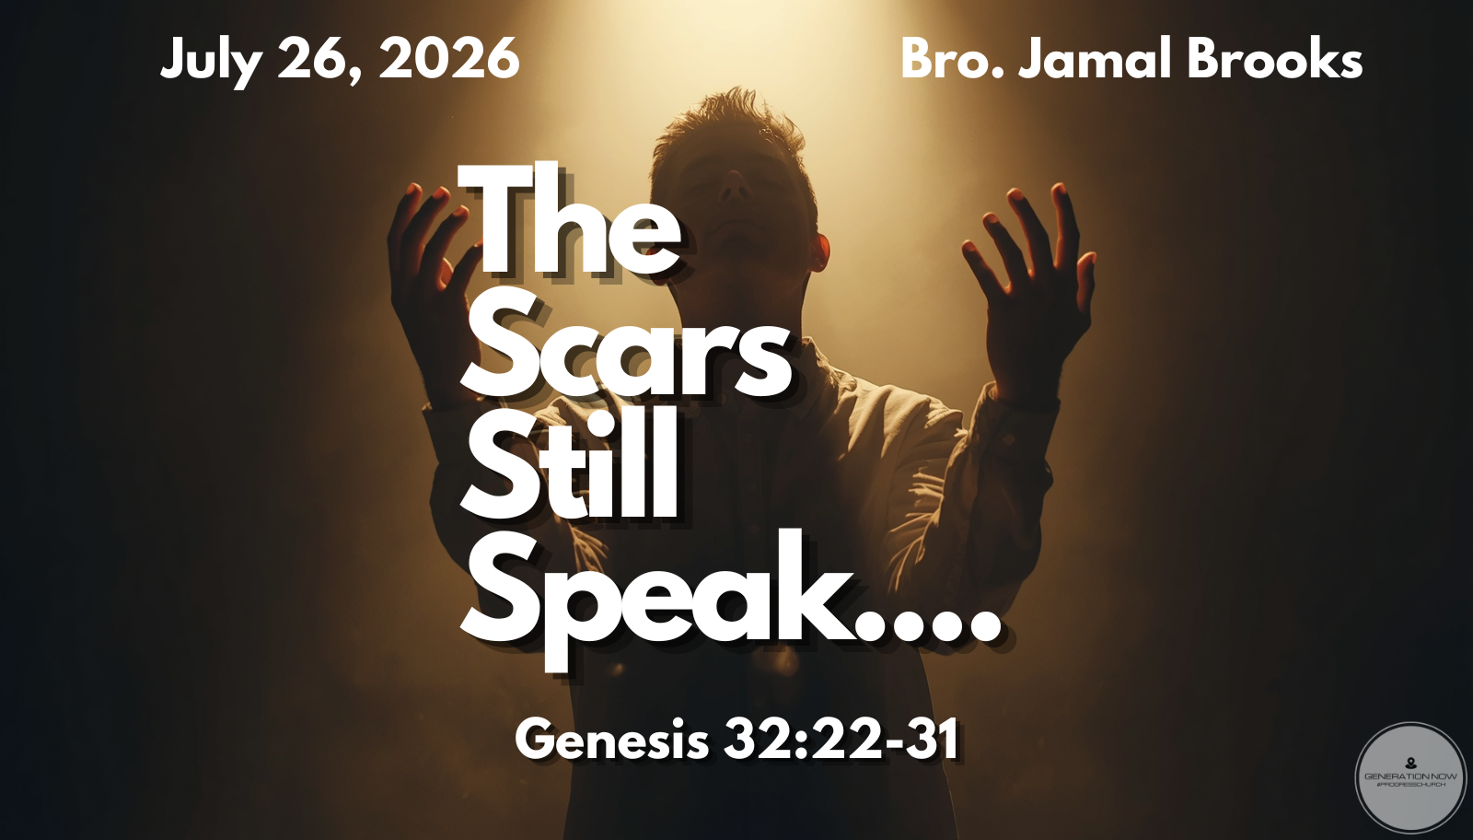

Slide 2

Genesis 32:22-31
Jacob Wrestles With God

Slide 3
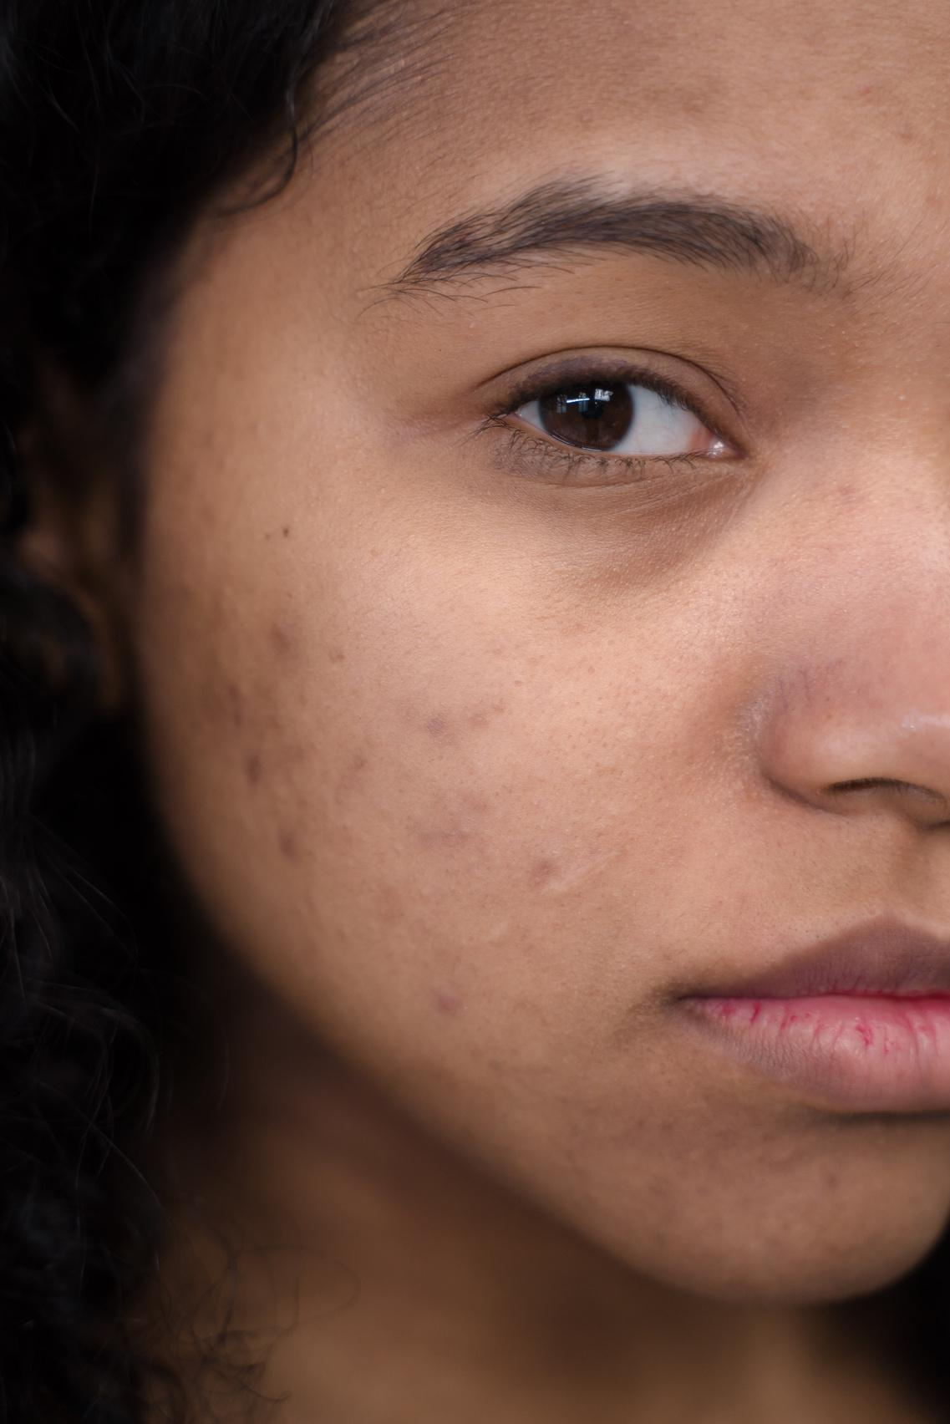
What are Scars?
  A scar is evidence that something happened
  It is a reminder that at one point there was a wound, there was pain, there was a moment that could have taken you out, but somehow, you made it through
  Some scars are visible. We can point to them and remember exactly what happened.
  But some of the deepest scars are invisible

Slide 4
What are Scars?
  The enemy takes our scars and tries to turn them into labels:
    "You're damaged."
    "You'll always be this way."
    "God can't use you."
    "Your past is too much for your purpose."
  God doesn't waste broken things, He restores them
  Scars don't disqualify you

Slide 5
Take Responsibility for What Happens Next

Slide 6
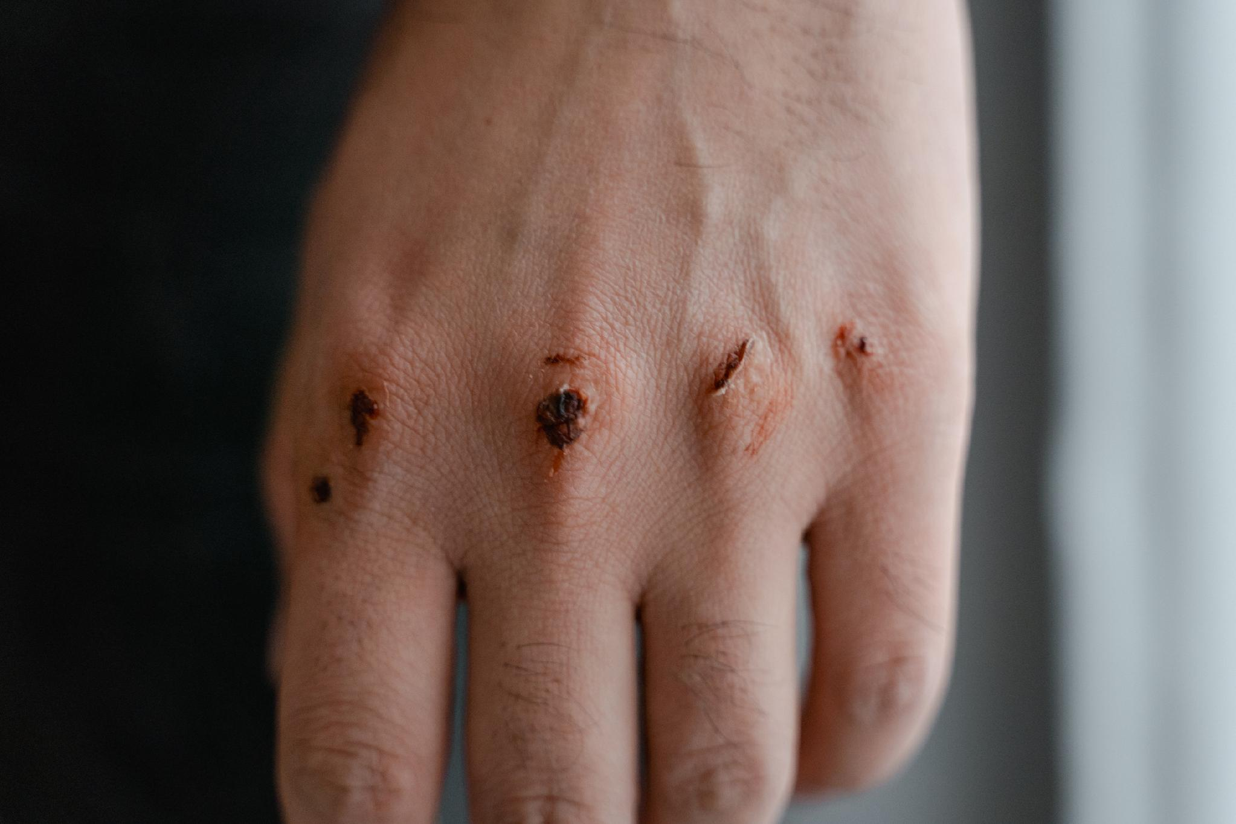
  Accountability is the birthplace of healing
    Adam blamed Eve
    Eve blamed the serpent
    Everyone had a reason
    Nobody wanted responsibility
  One of the greatest obstacles to healing is believing that because something wasn't your fault, it also isn't your responsibility

Slide 7
  You may not be responsible for:
    how you were raised
    what someone did to you
    the words spoken over you
    the trauma you experienced
  But you are responsible for what you do next

Slide 8
ASK YOURSELF:
  Am I making excuses or making progress?
  Have I become comfortable blaming instead of building?
  Am I waiting for someone else to fix what God has empowered me to confront?

Slide 9
Don't Confuse Information With Transformation

Slide 10
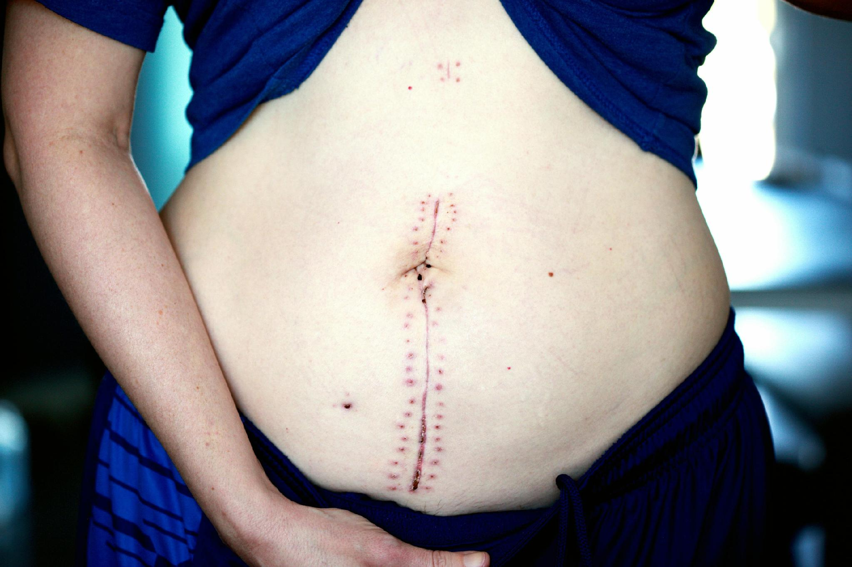
  Knowing better isn't the same as becoming better
  This generation has unprecedented access to truth
    We know Scripture
    We know sermons
    We know podcasts
    We know theology
  But knowledge without obedience creates deception

Slide 11
  Examples:
    A gym membership doesn't build muscles
    Going consistently does
    Owning a Bible doesn't build faith.
    Living it does
    Church attendance doesn't produce maturity
    Daily obedience does

Slide 12
  God isn't impressed by what we know if it never changes how we live
  Transformation prepares us to become the kind of people who break cycles instead of repeating them

Slide 13
Recognize What You've Inherited, But Refuse to Reproduce It

Slide 14
  Your Scars Don't Disqualify You
  Every generation inherits something
    Some inherit faith
    Others inherit fear
    Some inherit addiction
    Others inherit anger
    Some inherit insecurity
    Others inherit purpose
  Recognition isn't about assigning blame
  It's about accepting responsibility then pointing to Jesus

Slide 15
  Your scars tell people where you've been
  They don't determine where God can take you
  Your scar may explain your past, but it does not have the authority to cancel God's purpose

Slide 16
  The enemy says,
  "You've been through too much."
  Jesus says,
  "I'll use what you've been through."
  The enemy says,
  "Hide your scars."
  Jesus says,
  "Your healed scars can help someone else believe."

Slide 17
Recognize What You've Inherited
  anger
  addiction
  fear
  insecurity
  absent fathers
  broken marriages
  church hurt
  poverty mindset

Slide 18
Refuse To Reproduce It
  Healing requires intentionality
  Freedom requires responsibility
  You don't become different because you attend church
  You become different because you surrender daily

Slide 19
Release a Different Legacy
  Somebody after you deserves better than what you received
    Your children
    Your friends
    Your future spouse
    Your church
    Your community
  The cycle has to stop somewhere
  Why not you?

Slide 20
Two Keys to Move Forward

Slide 21
Start Walking in What God Has Spoken

Slide 22

Start Walking in What God Has Spoken
  Don't leave this service with more information
  Leave with a decision
  Healing isn't proven by what you heard today, It's revealed by how you live tomorrow
  Every day you choose forgiveness, Every day you choose obedience, Every day you choose faith
  Proving that your past no longer has the final word
  Let God's Word becomes your lifestyle, not just your language

Slide 23
Don't Waste Your Pain

Slide 24
Don't Waste Your Pain
  God comforts us so we can comfort others
  God rarely wastes suffering
    Joseph, David
    Peter, Paul
    Jesus
  Every scar became ministry
  Jesus after the resurrection His scars remained
  Why?
    Because Thomas needed to see them
  Sometimes your healed wound becomes someone else's proof that God still heals

