Slide 1

The End of the World (As we know it)
Michael Christie

Slide 2




Slide 3
There is a time for everything, and a season for every activity under the heavens: a time to be born and a time to die, a time to plant and a time to uproot...
- ECCLESIASTES 2:1-2

Slide 4
DANIEL 12:1-13
¹ “At that time Michael, the great prince who protects your people, will arise. There will be a time of distress such as has not happened from the beginning of nations until then.
But at that time your people—everyone whose name is found written in the book—will be delivered.

Slide 5
² Multitudes who sleep in the dust of the earth will awake: some to everlasting life, others to shame and everlasting contempt. ³ Those who are wise will shine like the brightness of the heavens, and those who lead many to righteousness, like the stars for ever and ever. ⁴ But you, Daniel, roll up and seal the words of the scroll until the time of the end. Many will go here and there to increase knowledge.”

Slide 6
⁵ Then I, Daniel, looked, and there before me stood two others, one on this bank of the river and one on the opposite bank.
⁶ One of them said to the man clothed in linen, who was above the waters of the river, “How long will it be before these astonishing things are fulfilled?”

Slide 7
⁷ The man clothed in linen, who was above the waters of the river, lifted his right hand and his left hand toward heaven, and I heard him swear by him who lives forever, saying,
“It will be for a time, times and half a time. When the power of the holy people has been finally broken, all these things will be completed.”

Slide 8
⁸ I heard, but I did not understand. So I asked, “My lord, what will the outcome of all this be?”
⁹ He replied, “Go your way, Daniel, because the words are rolled up and sealed until the time of the end. ¹⁰ Many will be purified, made spotless and refined, but the wicked will continue to be wicked. None of the wicked will understand, but those who are wise will understand…

Slide 9
¹³ “As for you, go your way till the end. You will rest, and then at the end of the days you will rise to receive your allotted inheritance.”

Slide 10
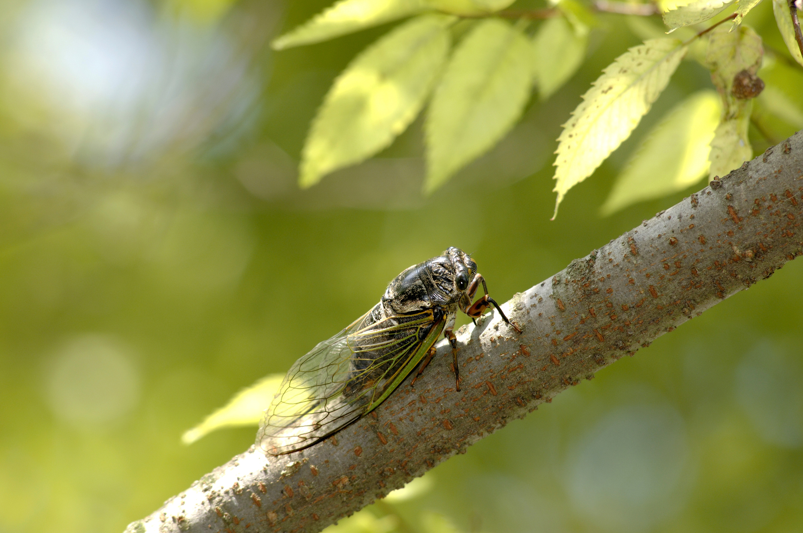

Slide 11
Distress with Defence
At that time Michael, the great prince who protects your people, will arise. There will be a time of distress such as has not happened from the beginning of nations until then.
- DANIEL 12:1a

Slide 12
Nation will rise against nation, and kingdom against kingdom. There will be famines and earthquakes in various places. All these are the beginning of birth pains… For then there will be great distress, unequalled from the beginning of the world until now—and never to be equalled again. If those days had not been cut short, no one would survive, but for the sake of the elect those days will be shortened.
- MATTHEW 24:7-8, 21-22

Slide 13
For everything that was written in the past was written to teach us, so that through the endurance taught in the Scriptures and the encouragement they provide we might have hope.
- ROMANS 15:4

Slide 14
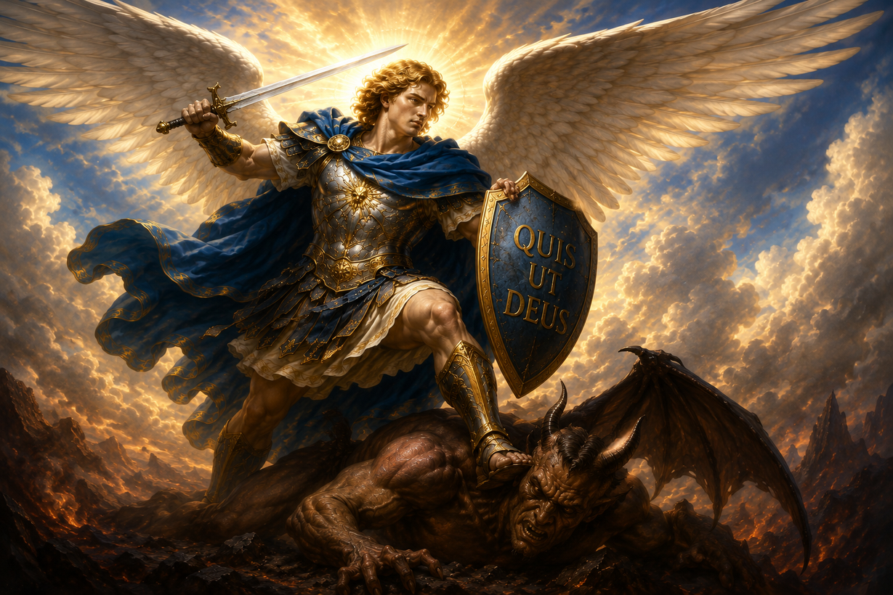

Slide 15
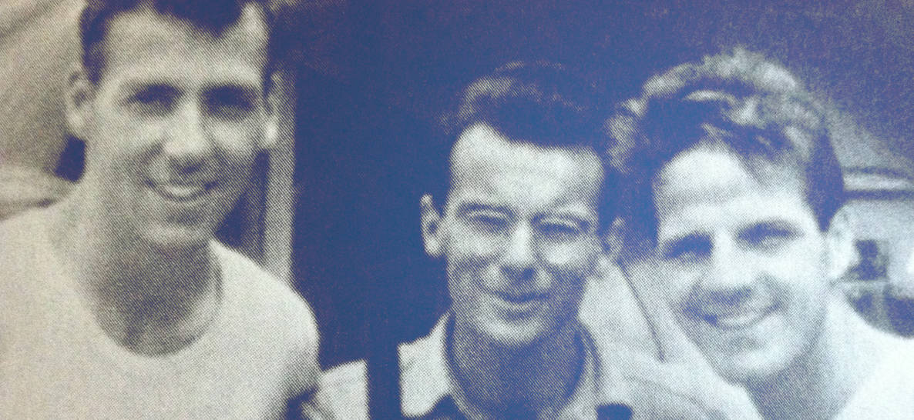
Why is it that we want every chapter to be good when God promises only that in the last chapter, he will make all the other chapters make sense?
– STEVE SAINT

Slide 16
Deliverance with Distinction
But at that time your people—everyone whose name is found written in the book—will be delivered. Multitudes who sleep in the dust of the earth will awake: some to everlasting life, others to shame and everlasting contempt. Those who are wise will shine like the brightness of the heavens, and those who lead many to righteousness, like the stars for ever and ever.
- DANIEL 12:1b-3

Slide 17


Slide 18


Slide 19
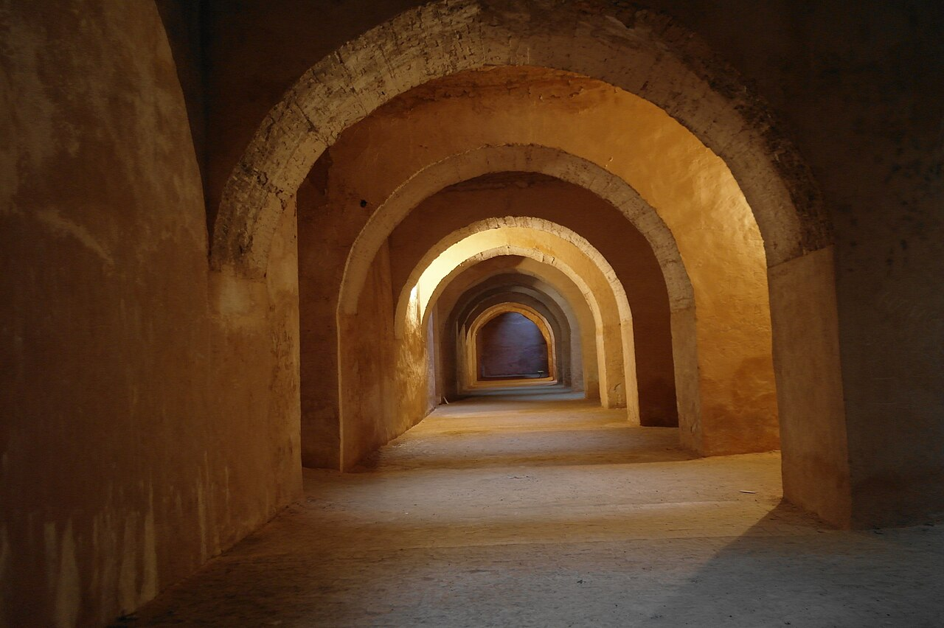

Slide 20
For my Father’s will is that everyone who looks to the Son and believes in him shall have eternal life, and I will raise them up at the last day.
- JOHN 6:40

Slide 21
The gospel is too readily heard and taken for granted, as though it contained no unsettling news and no unwelcome threat… It is a truth that has been flattened, trivialised, and rendered inane.
- WALTER BRUEGGEMANN
Finally Comes the Prophet

Slide 22
Delay with Dividend
As for you, go your way till the end. You will rest, and then at the end of the days you will rise to receive your allotted inheritance.
- DANIEL 12:13

Slide 23
So, how should we live now?
Pray for Wisdom
If any of you lacks wisdom, you should ask God, who gives generously to all without finding fault, and it will be given to you.
- JAMES 1:5

Slide 24
So, how should we live now?
Pray for Wisdom
Remain Faithful – Go Your Way
Since everything will be destroyed in this way, what kind of people ought you to be? You ought to live holy and godly lives as you look forward to the day of God and speed its coming.
- 2 PETER 3:11-12

Slide 25
Thanks be to God! He gives us the victory through our Lord Jesus Christ. Therefore, my dear brothers and sisters, stand firm. Let nothing move you. Always give yourselves fully to the work of the Lord, because you know that your labour in the Lord is not in vain.
- 1 CORINTHIANS 15:57-58

Slide 26
We should not underestimate the significance of the small group of people who have a new vision of a just and gentle world. The quality of a culture may be changed when 2 percent of its people have a new vision.
- ROBERT BELLAH

