Slide 1

The Surprising Nature of God and the Gospel
The Book of Habakkuk

Slide 2
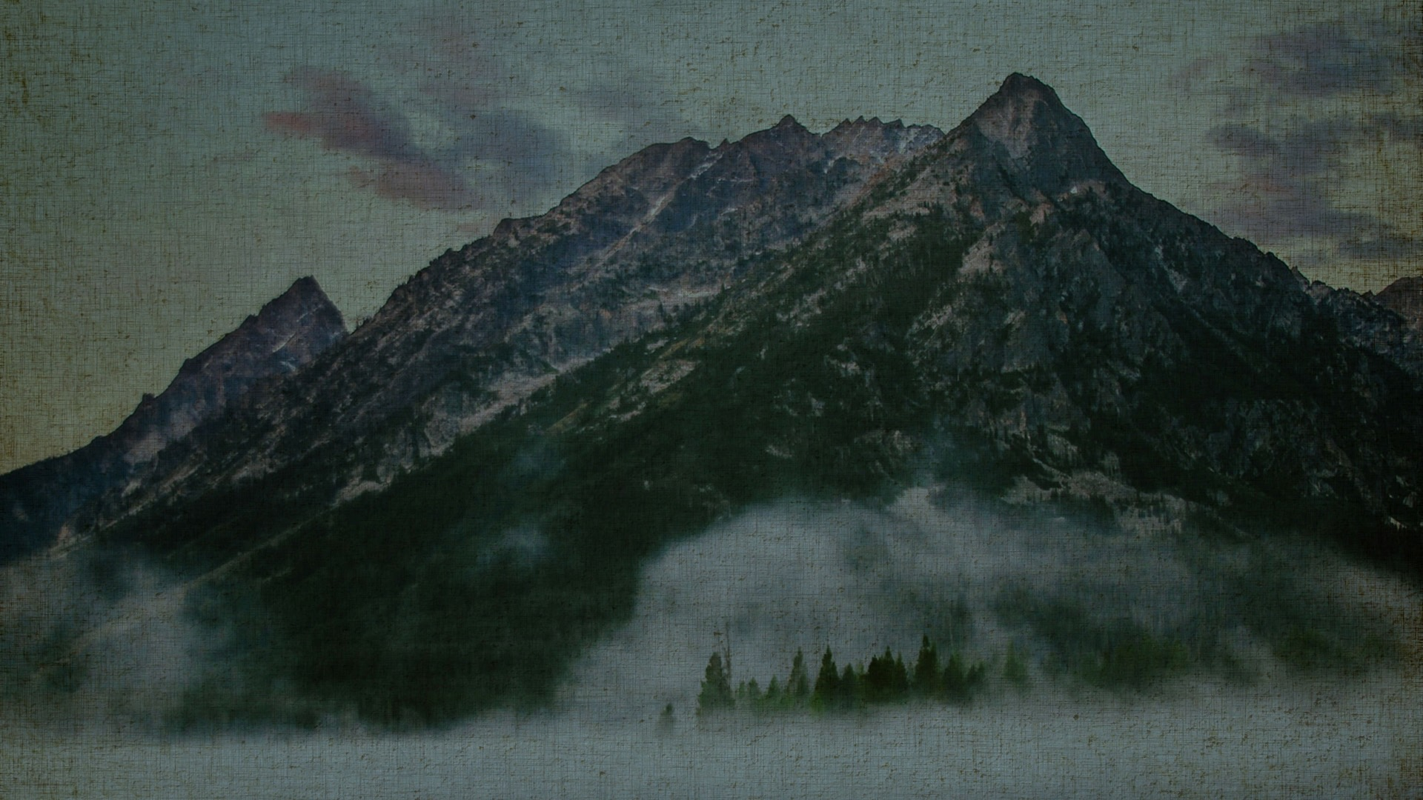
The wicked shall return to Sheol, all the nations that forget God.
Psalm 9:17
ESV

Slide 3
And since they did not see fit to acknowledge God, God gave them up to a debased mind to do what ought not to be done.
Romans 1:28
ESV

Slide 4
Look at the nations and observe — be utterly astounded! For something is taking place in your days that you will not believe when you hear about it. Look! I am raising up the Chaldeans, that bitter, impetuous nation that marches across the earth’s open spaces to seize territories not its own.
Habakkuk 1:5–6
HCSB

Slide 5
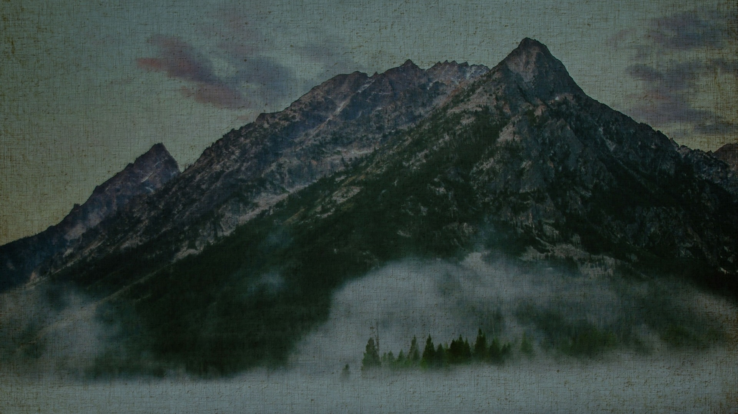
Wonder tāmah [8539] means amazed, shocked, stunned at something unexpected, in this case the judgment of God.

Slide 6
“Behold, his soul is puffed up; it is not upright within him, but the righteous shall live by his faith.
Habakkuk 2:4
ESV

Slide 7
If I had cherished iniquity in my heart, the Lord would not have listened.
Psalm 66:18
ESV

Slide 8
The Lord is far from the wicked, but he hears the prayer of the righteous.
Proverbs 15:29
ESV

Slide 9
We know that God does not listen to sinners, but if anyone is a worshiper of God and does his will, God listens to him.
John 9:31
ESV

Slide 10
Question: Why is it that the Lord allows evil to rise, to continue, to permeate society?
What is it’s purpose in His hands?
Why are the evil allowed to remain and swallow up the righteous? (Hab 1:13)

Slide 11
Answer: The righteous shall live by My faithfulness (Hab 2:4)

Slide 12
Question: What does it mean to live by God’s faithfulness? How is it that God ordains injustice and wickedness? Why?
What purpose does His allowance serve?
Why is the Lord silent at times, and remains silent?

Slide 13
The Problem: Man has become too proud (Hab 2:4) “puffed up”, arrogant.

Slide 14
Serve the Lord with fear, and rejoice with trembling.
Psalm 2:11
ESV

Slide 15
Therefore, my beloved, as you have always obeyed, so now, not only as in my presence but much more in my absence, work out your own salvation with fear and trembling,
Philippians 2:12
ESV

Slide 16
When God allows bad things to happen, we are reminded, we need faith to believe He exists (Heb 11:6).

Slide 17
And without faith it is impossible to please him, for whoever would draw near to God must believe that he exists and that he rewards those who seek him.
Hebrews 11:6
ESV

Slide 18
I’m glad for you that I wasn’t there so that you may believe. But let’s go to him.”
John 11:15
HCSB

Slide 19
If God answers prayer every time that we turn to Him, why would you need faith?

