Slide 1
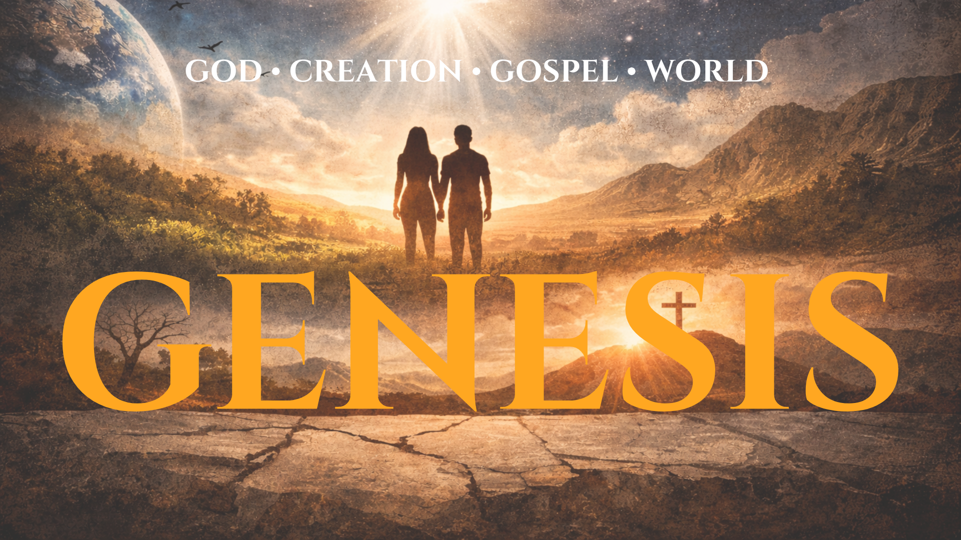

Slide 2
Psalm 150
Praise the Lord!
Praise God in his sanctuary;
praise him in his mighty heavens!^{[a]}
² Praise him for his mighty deeds;
praise him according to his excellent greatness!
³ Praise him with trumpet sound;
praise him with lute and harp!
⁴ Praise him with tambourine and dance;
praise him with strings and pipe!
⁵ Praise him with sounding cymbals;
praise him with loud clashing cymbals!
⁶ Let everything that has breath praise the Lord!
Praise the Lord!

Slide 3
Prayer Prompts
God you are worthy of never-ending praise and because you are worthy, I will praise you even when….
I surrender my will to You, Lord, even though I don’t feel like it because of…
When I am in the battle of …. Help me to keep my arms up in praise, trusting You!

Slide 4
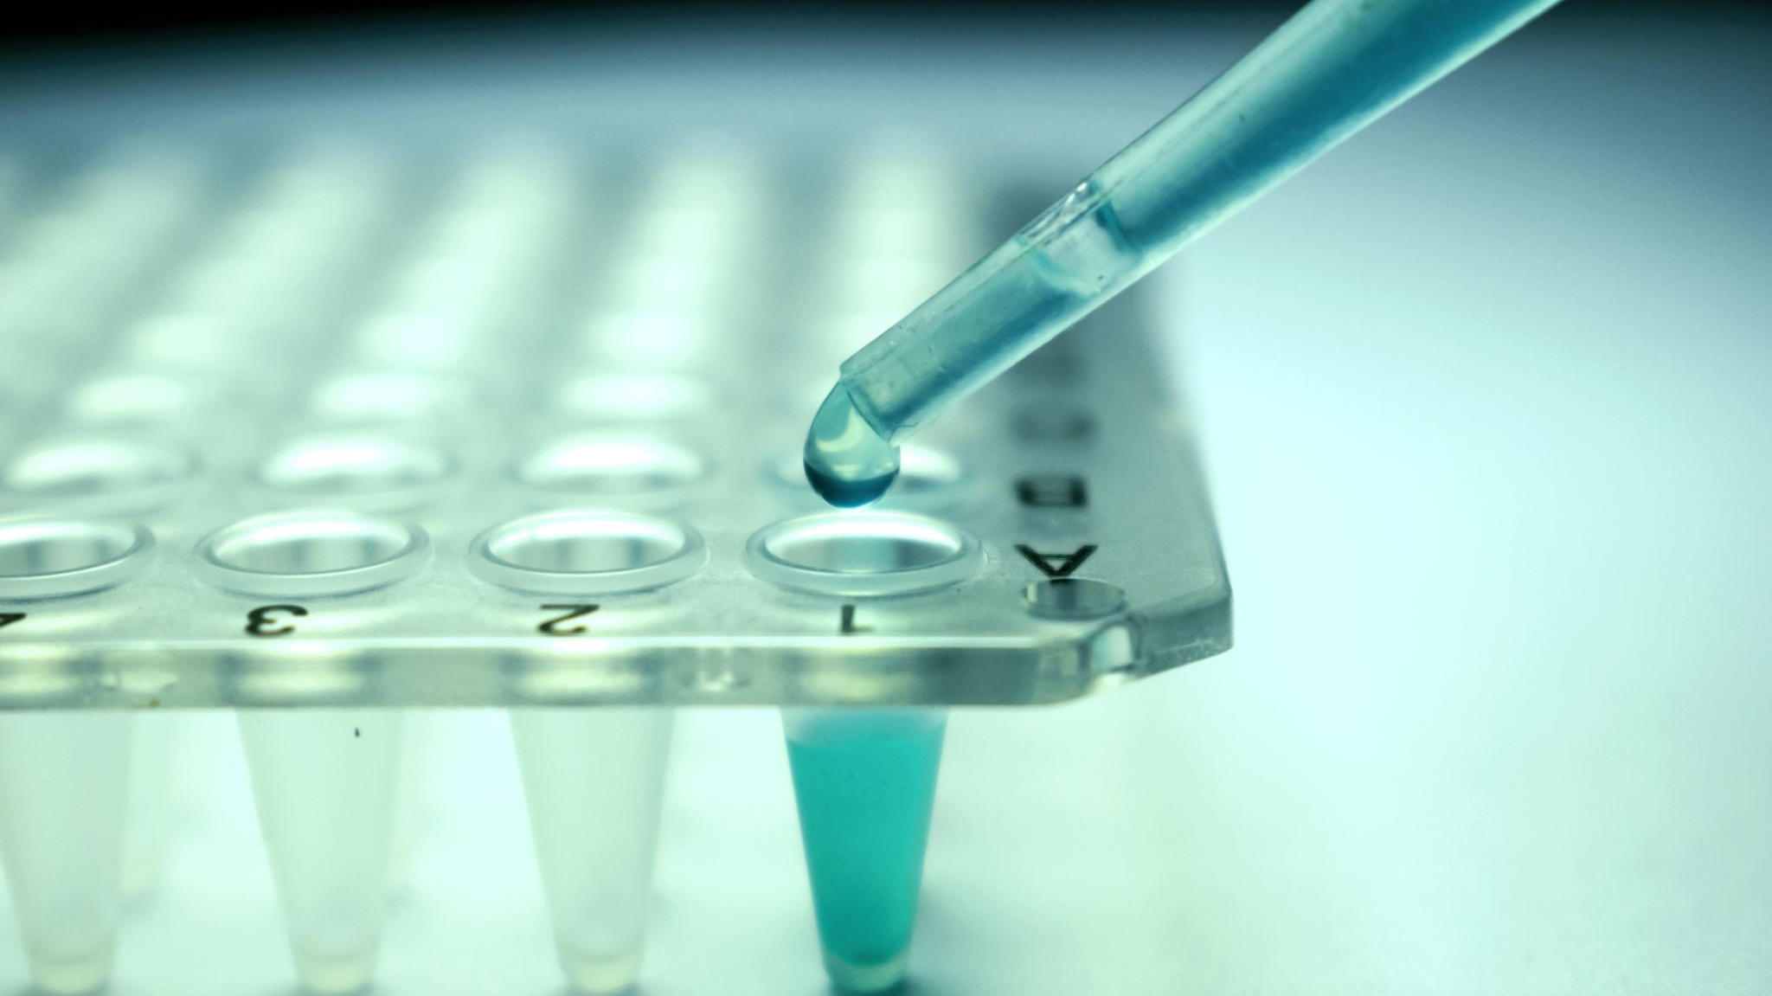
Nissah(tested): to prove the quality of.

Slide 5
Satan temps us in an effort to destroy us.
God tests us to strengthen us.

Slide 6
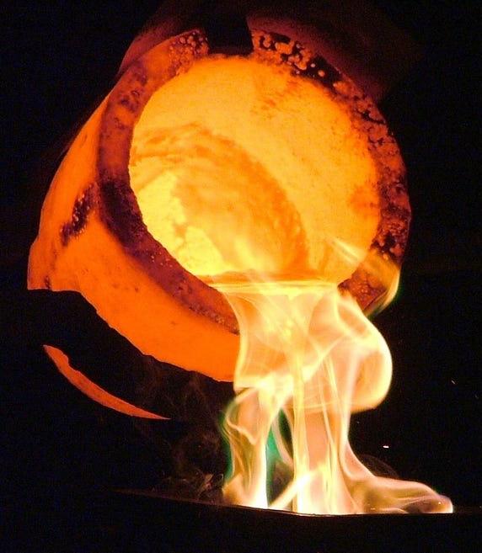
The heart of man is refined through the crucible of God’s testing.
This Photo by Unknown Author is licensed under CC BY

Slide 7

A refined faith is what God desires.

Slide 8

17 By faith Abraham, when he was tested, offered up Isaac, and he who had received the promises was in the act of offering up his only son,
18 of whom it was said, “Through Isaac shall your offspring be named.”
19 He considered that God was able even to raise him from the dead, from which, figuratively speaking, he did receive him back

Slide 9
Abraham’s trust in the power and promises of God allowed him to think imaginatively about what God might do.

Slide 10
Abraham trusted the Lord enough to leave his yes on the table.

Slide 11
It’s on the cross that God has forever proven His love for us.

Slide 12
Abraham’s actions reveal the heart of a man fully reliant on God.

Slide 13
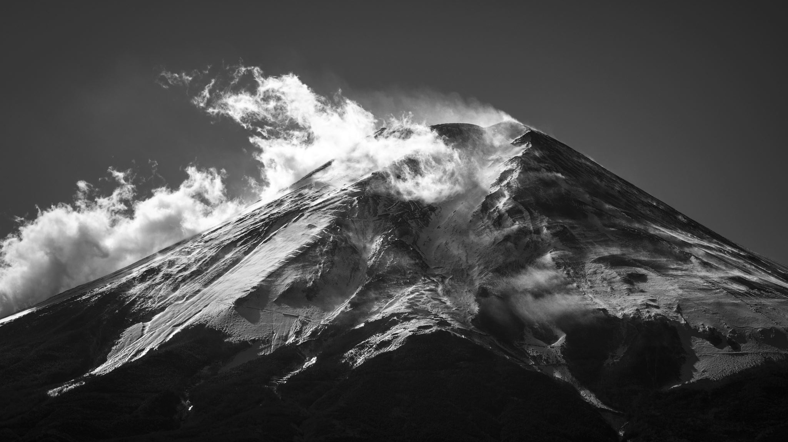
Mt Moriah represents the pinnacle of man’s faithfulness to God.

Slide 14
Faith requires radical obedience!

Slide 15
The person who lives by faith must have vision.

