Slide 1


Slide 2
Psalm 125
1 Those who trust in the Lord are like Mount Zion, which cannot be moved, but abides forever.
2 As the mountains surround Jerusalem, so the Lord surrounds his people, from this time forth and forevermore.
3 For the scepter of wickedness shall not rest on the land allotted to the righteous, lest the righteous stretch out their hands to do wrong.
4 Do good, O Lord, to those who are good, and to those who are upright in their hearts!
5 But those who turn aside to their crooked ways the Lord will lead away with evildoers! Peace be upon Israel!

Slide 3
Prayer Prompts
God we are so grateful that you surround us always and that you reward the faithful!
Lord, I will trust Your securing presence as I struggle with….
God, may your peace prevail in my life as I trust You to…

Slide 4
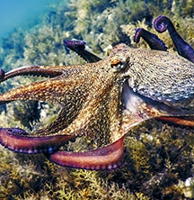
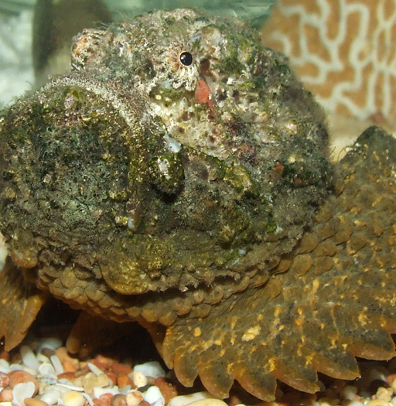

This Photo by Unknown Author is licensed under CC BY

Slide 5
God’s people are not excused from experiencing the grief and sorrow of death.

Slide 6
God is faithful to walk with us and comfort in the seasons of grief and sorrow.

Slide 7
All life belongs to God.

Slide 8
God’s goodness and God’s promises are not valid because of our experiences. They are valid because of who he is.

Slide 9
Abraham’s faithful lifestyle had earned him the respect of the people.

Slide 10
True generosity is giving of your time, talent, or treasure without expecting anything in return.

Slide 11
Live a life that represents where your going, and not where you are.

Slide 12


