Slide 1
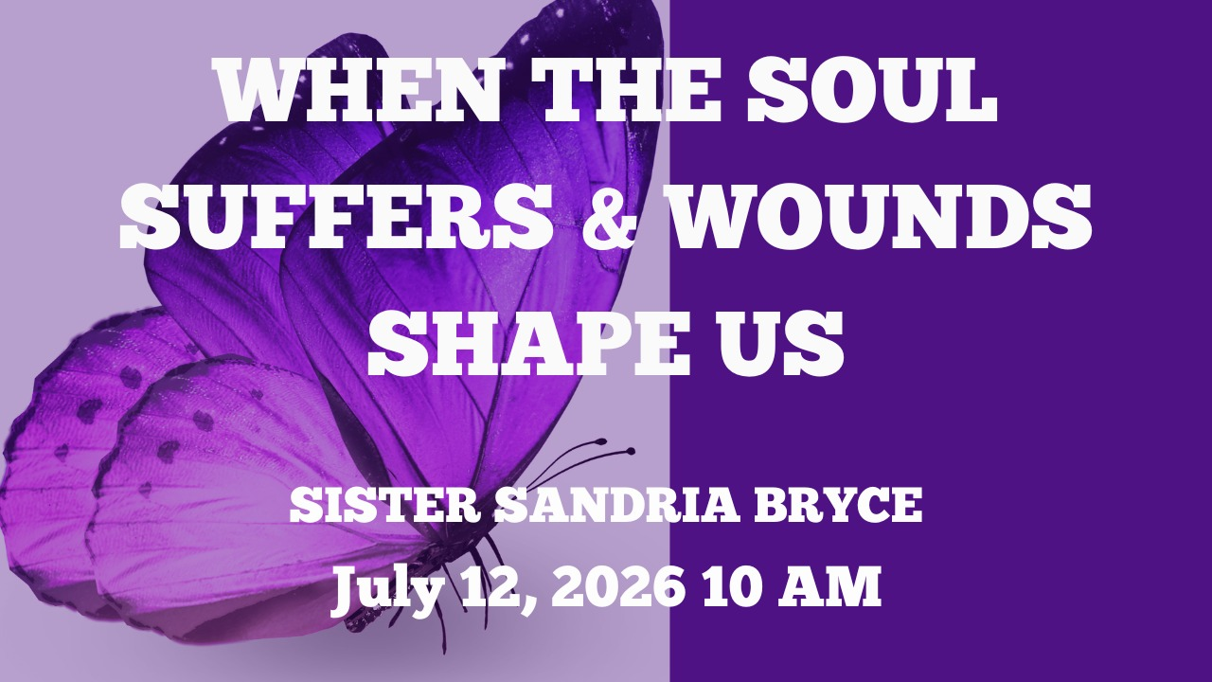

Slide 2



Scripture:
Psalm 147:3
Psalm 34:18-19
Psalm 57:1
Isaiah 61:1

Slide 3
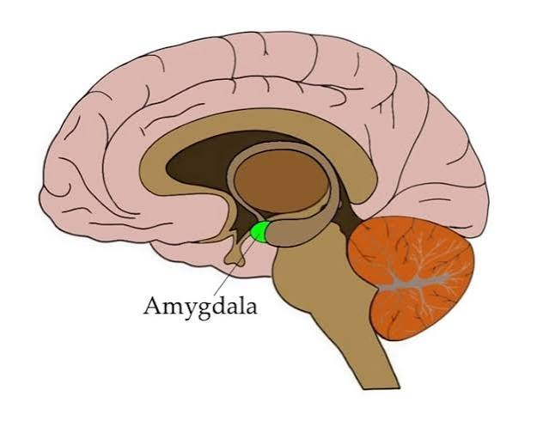

Slide 4
INTRODUCTION
TRAUMA:
Emotional, psychological and physical response to a distressing, overwhelming or life threatening event.
Occurs when an experience is too difficult for the brain to process.
Alters how our brain processes danger, resulting in maladaptive behaviors:

Slide 5
INTRODUCTION cont
MALADAPTIVE BEHAVIORS:
Withdrawal/Avoidance
Aggression/Anger
Hypervigilance & fear
Reckless behaviors
Trust issues & Defensiveness
Continuous negative thinking
Stress

Slide 6
INTRODUCTION cont
TRAUMA
Is a modern term
Bible addresses trauma by identifying human experiences:
Deep emotional suffering caused by brokenheartedness (Psalm 147:3, Isaiah 61;1)
Calamity & Disaster (Psalm 57:1)
Affliction & Tribulation (Psalm 34: 18-19)

Slide 7
TRAUMA LEAVES MARKS
Emotional trauma affects the body, mind, relationships, and spiritual life
Pain ignored does not disappear
Unhealed wounds often shape behavior

Slide 8
DEEP PAIN OF THE HEART
Loss and Grief
Betrayal
Trauma
Shame/Guilt
Emotional Wounds

Slide 9
GOD SEES HIDDEN PAIN
HAGAR’S STORY (Genesis 16)
Powerlessness and Displacement
Abuse and Banishment
Hagar called God “El Roi” — the God who sees
Jesus consistently notices wounded people whom others ignored

Slide 10
TAMAR’S STORY (2 Samuel:13)
Deception
Abuse of Power
Rejection
Societal Stigma & Isolation
Silence & Suffering

Slide 11
SILENCE CAN DEEPEN SUFFERING
Tamar remained desolate in her brother’s house
Shame often causes isolation
The enemy wants pain hidden

Slide 12
SPIRTUAL BATTLES
Deep wounds caused by trauma can:
Open the door to spiritual oppression
Open the doors to fear
Open the doors to despair

Slide 13
REDEMPTION & HEALING
God is intimately close to the brokenhearted; He offers:
Ultimate healing
Restoration
The promise of a redeemed story (e.g Genesis 50:20).

Slide 14
GOD- El- ROI:
Sees your hidden pain
Hears your silent cries
Knows your shame
Cares about you
Heals wounded people

Slide 15
CONCLUSION
HEALING IS BOTH SPIRTUAL & PRACTICAL
Prayer
Community
Wise counsel
Emotional support
Healthy boundaries
Rest and restoration

