Slide 1

耶穌不包容?
Jesus Was Intolerant?
約翰福音 John 14:1-7

Slide 2

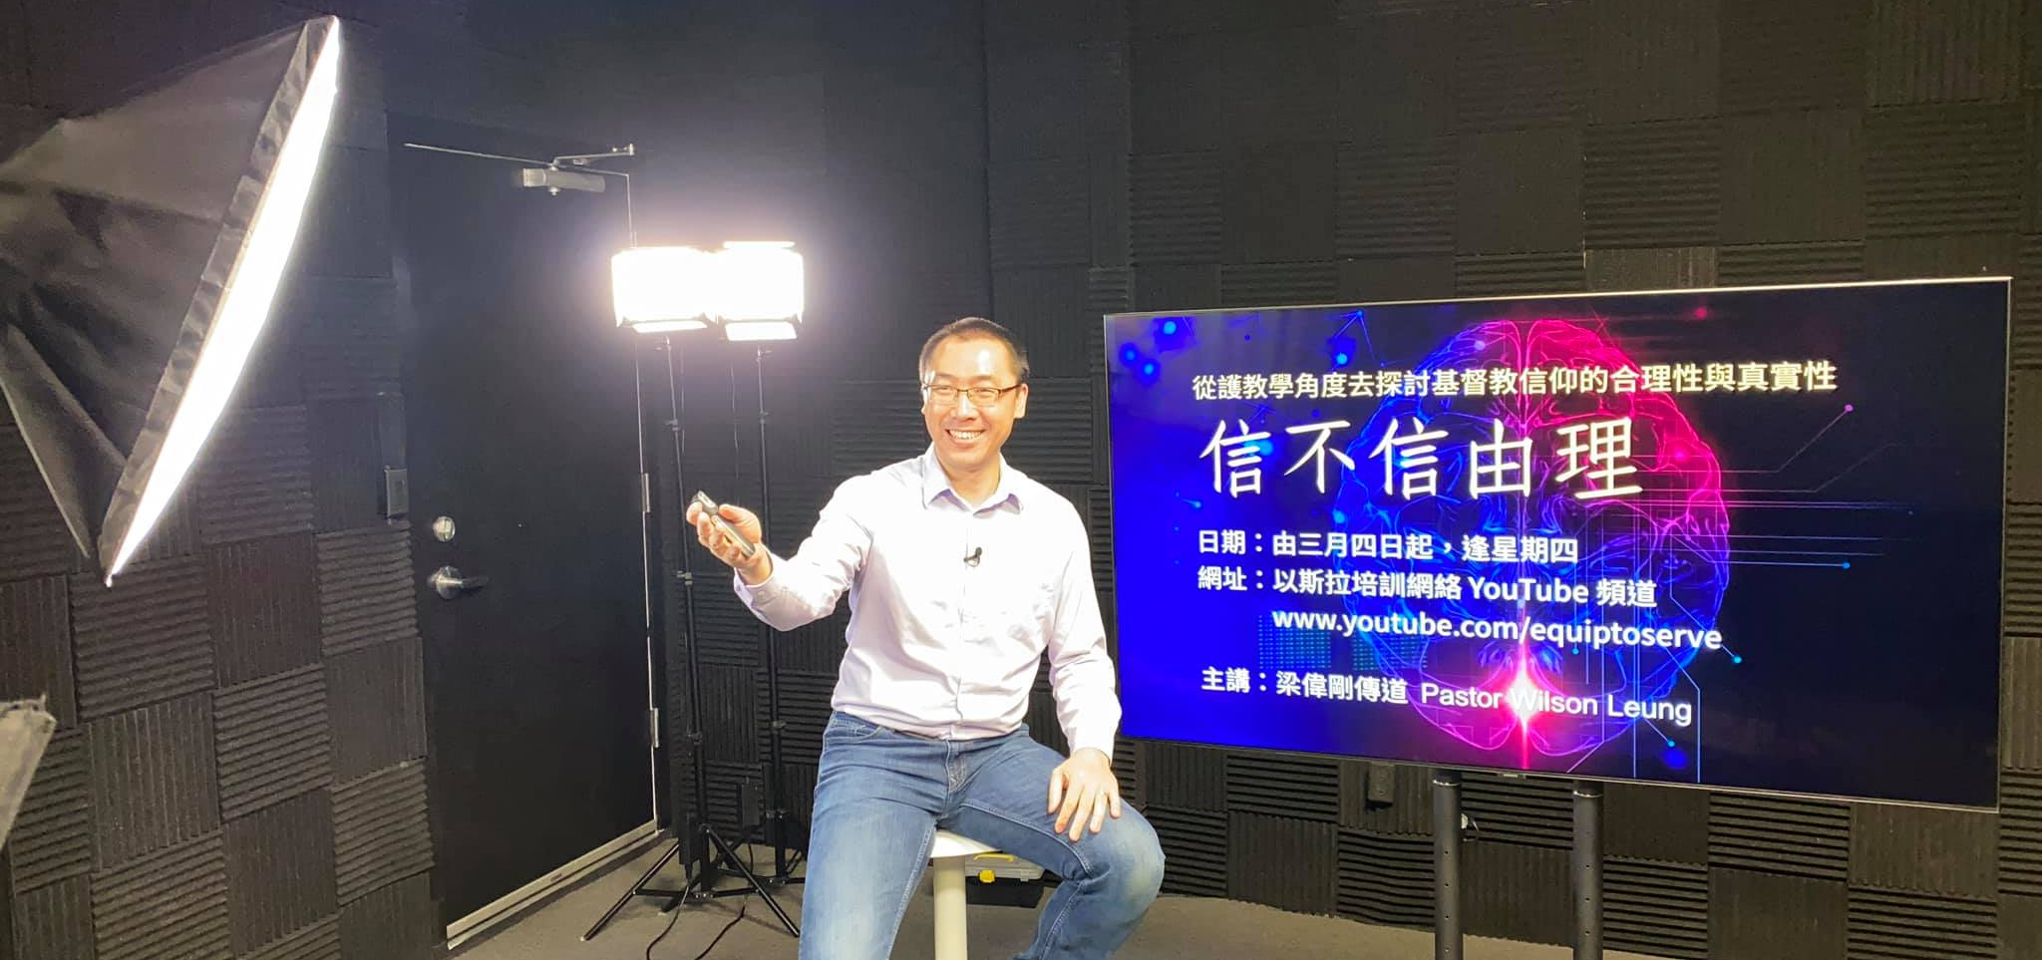

www.youtube.com/equiptoserve

Slide 3












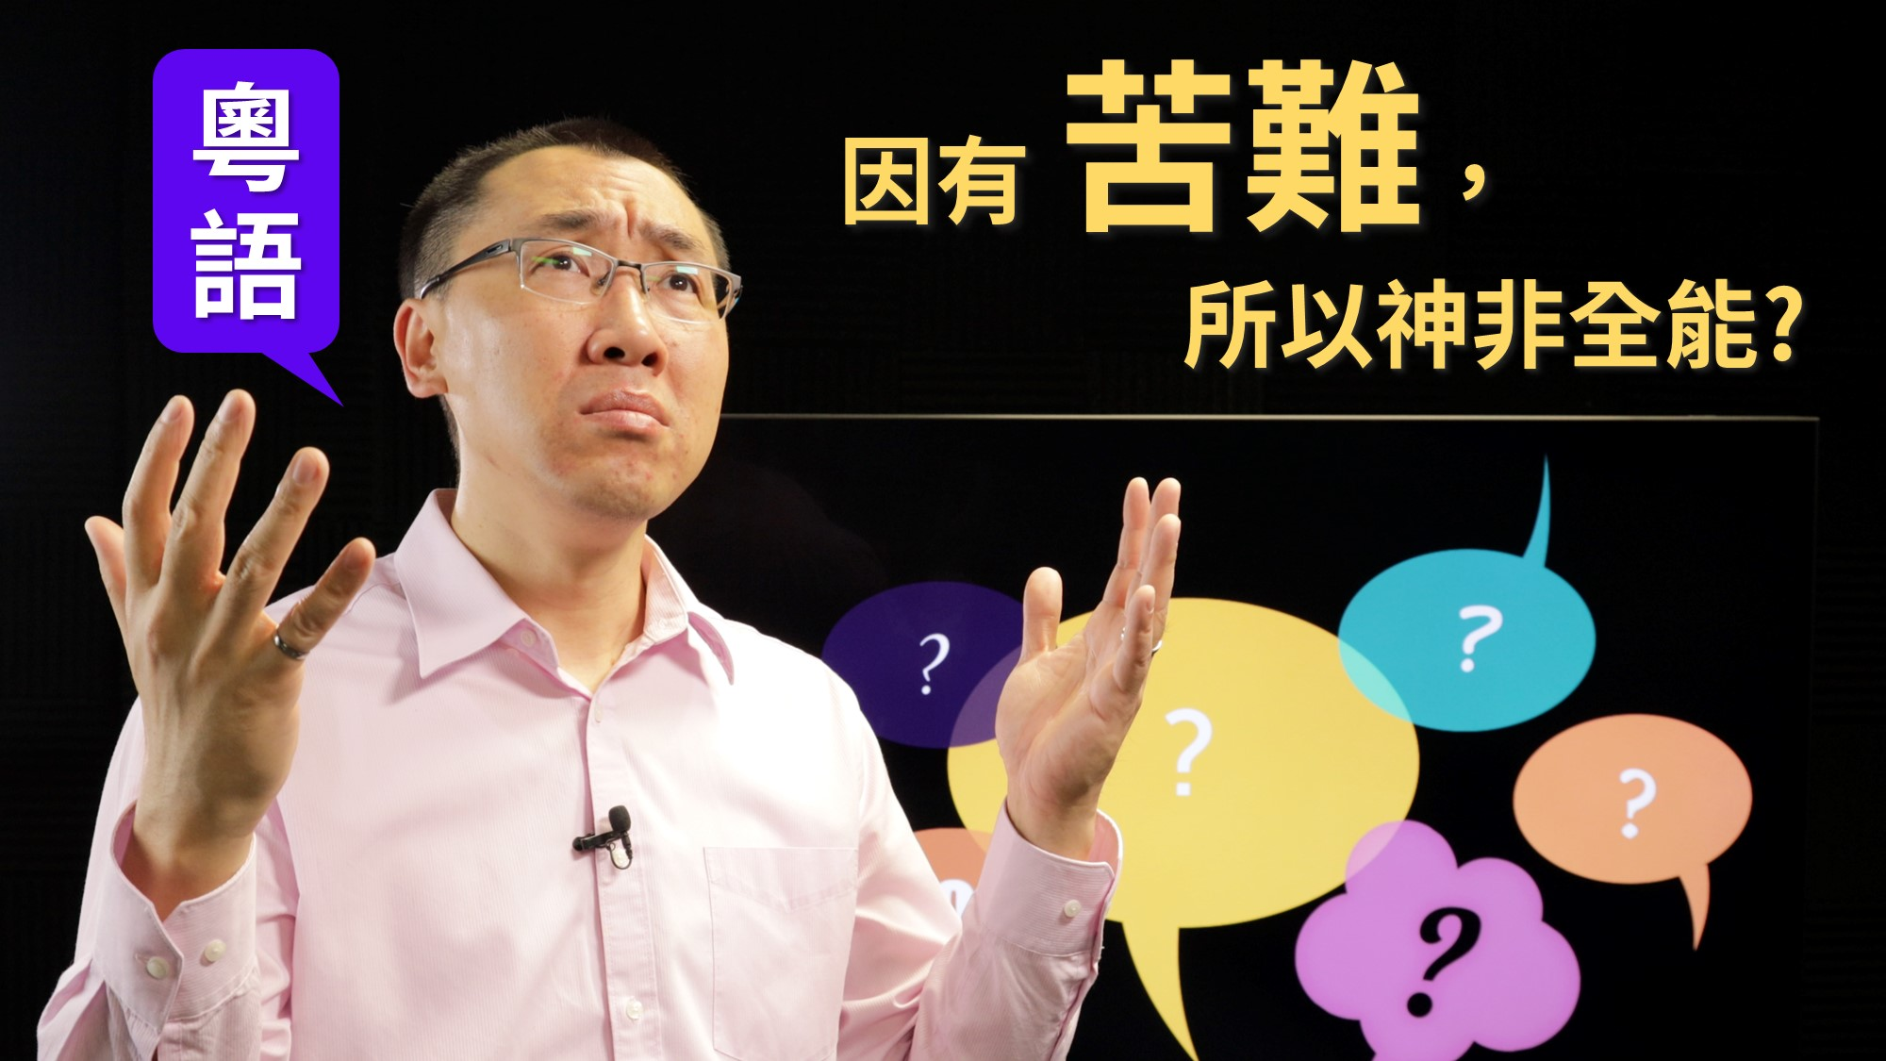







【信不信由理】Ep1-Ep20 (粵語/華語)

Slide 4








【知己知彼分真假】Ep1-Ep9 (粵語/中文字幕)
www.youtube.com/equiptoserve

Slide 5

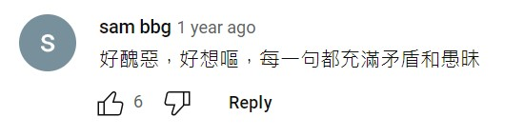
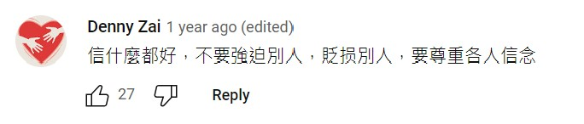

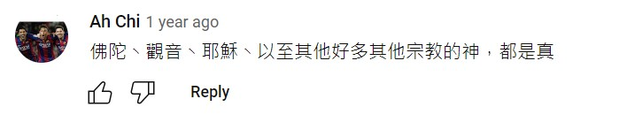

Slide 6

通告：我們不會包容一些不包容的人

Slide 7


Slide 8
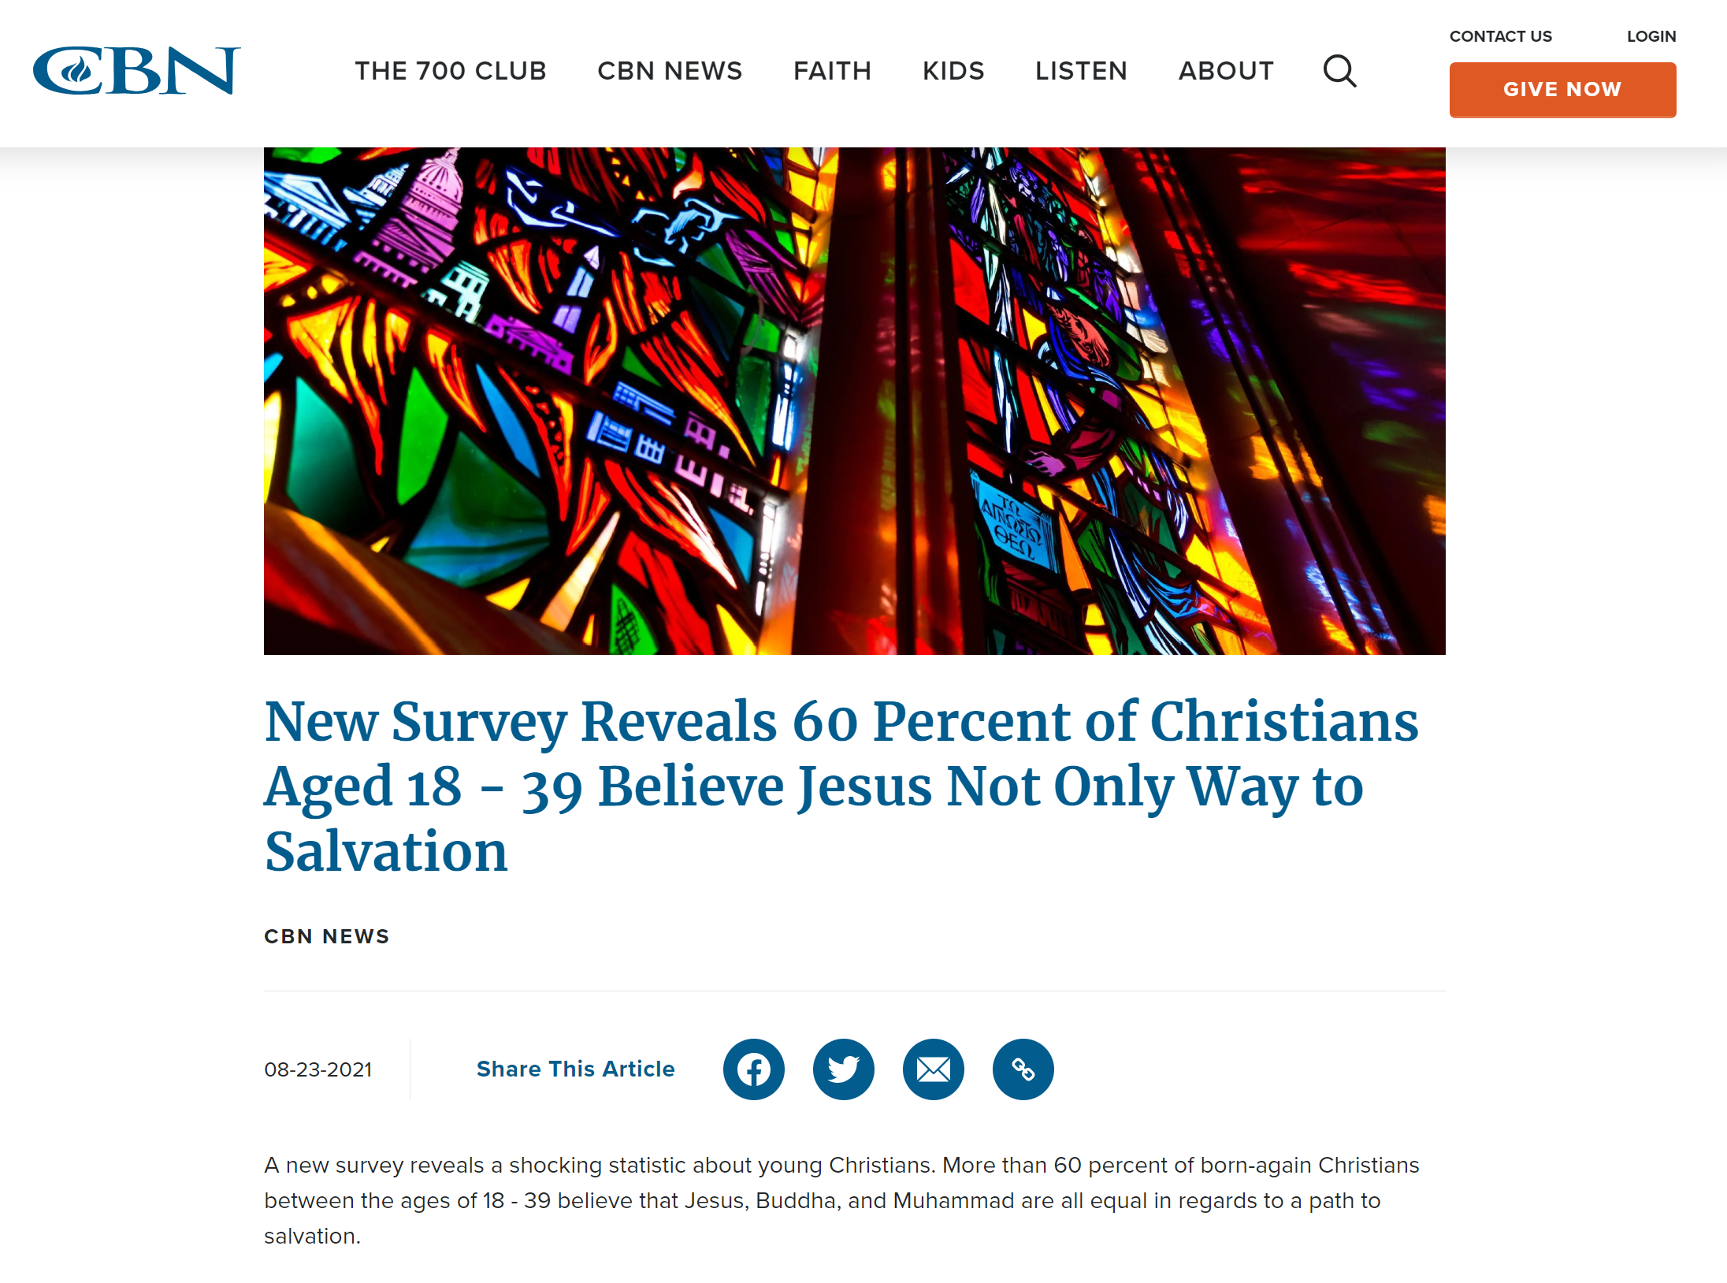

Slide 9

「基督徒傲慢、心胸狭窄、不包容！」
“Christians are arrogant, narrow-minded, intolerant!”

Slide 10
耶穌不包容?
Jesus Was Intolerant?
約翰福音 John 14:1-7

Slide 11

約翰福音 John 14:1
「你們心裏不要憂愁；你們信神，也當信我。
“Do not let your hearts be troubled. You believe in God; believe also in me.

Slide 12

約翰福音 John 14:2
在我父的家裏有許多住處；若是沒有，我就早已告訴你們了。我去原是為你們預備地方去。
My Father’s house has many rooms; if that were not so, would I have told you that I am going there to prepare a place for you?

Slide 13

約翰福音 John 14:3
我若去為你們預備了地方，就必再來接你們到我那裏去，我在哪裏，叫你們也在那裏。
And if I go and prepare a place for you, I will come back and take you to be with me that you also may be where I am.

Slide 14

約翰福音 John 14:4
我往哪裏去，你們知道；那條路，你們也知道。」
You know the way to the place where I am going.”

Slide 15

約翰福音 John 14:5
多馬對他說：「主啊，我們不知道你往哪裏去，怎麼知道那條路呢？」
Thomas said to him, “Lord, we don’t know where you are going, so how can we know the way?”

Slide 16

約翰福音 John 14:6
耶穌說：「我就是道路、真理、生命；若不藉著我，沒有人能到父那裏去。
Jesus answered, “I am the way and the truth and the life. No one comes to the Father except through me.

Slide 17

約翰福音 John 14:7
你們若認識我，也就認識我的父。從今以後，你們認識他，並且已經看見他。」
If you really know me, you will know my Father as well. From now on, you do know him and have seen him.”

Slide 18
耶穌不包容?
Jesus Was Intolerant?
約翰福音 John 14:1-7

Slide 19

現今社會文化更改了「包容」的定義
Today’s culture has redefined “tolerance”

Slide 20



真正的包容：觀點存異，待人平等
True tolerance: treat ideas differently, treat all people equally

Slide 21



變質的包容：觀點平等，待人存異
False tolerance: treat all ideas equally, treat people differently

Slide 22
真正的包容：觀點存異，待人平等
True tolerance: treat ideas differently, treat all people equally
變質的包容：觀點平等，待人存異
False tolerance: treat all ideas equally, treat people differently

Slide 23
耶穌不包容?
Jesus Was Intolerant?
約翰福音 John 14:1-7

