Slide 1
Welcome to Holy Hermits Online Worship
8th Sunday after Pentecost
Today we are remembering
Holy Hermit Amma Sarah of the Desert
Service Prep: Lauren | Chat Host: Viki | First Reader: Grant*
Music: Lauren | Welcomer: Lauren | Second Reader: Kieron
Proof-reader: Kris | Priest: N/A | Preacher: Flashback
Broadcaster: Barry | Deacon: Lauren | Fellowship: Lauren
Backup Broadcaster: Lauren | Leader: Jeremy | Safety Officer: Rachel
Zoom Buttons: Viki | Cantor: Margo | Attendance: Viki

Slide 2






Hospitality
Leader:
Please mute for the service unless invited to offer your voice as part of the service ministry
Have the video camera on or off and turn the volume and brightness up or down on your device if things are too loud 🔉🔊or too bright🔅🔆
Our Cantor acts as our voice, offering the responses, in Bold Text, which we say together
Feel welcome to use the chat and reaction emojis 👍
🙏 Please take care of yourself in this space. 🙏 Come and go as you need
😴 It is great to take rest in this space, so falling asleep is also OK 😴
👂️ Remember, pastoral care is available to all in the community, if you'd like to speak to someone about anything spiritual. ❤️ Visit the help page at the website to reach out 🌐
Our Being Together ethos and safeguarding practices can also be accessed on the website 🫶​
🙌 Come as you are – we are all here together! 🙌
Notes:
Used Lent 2022

Slide 3
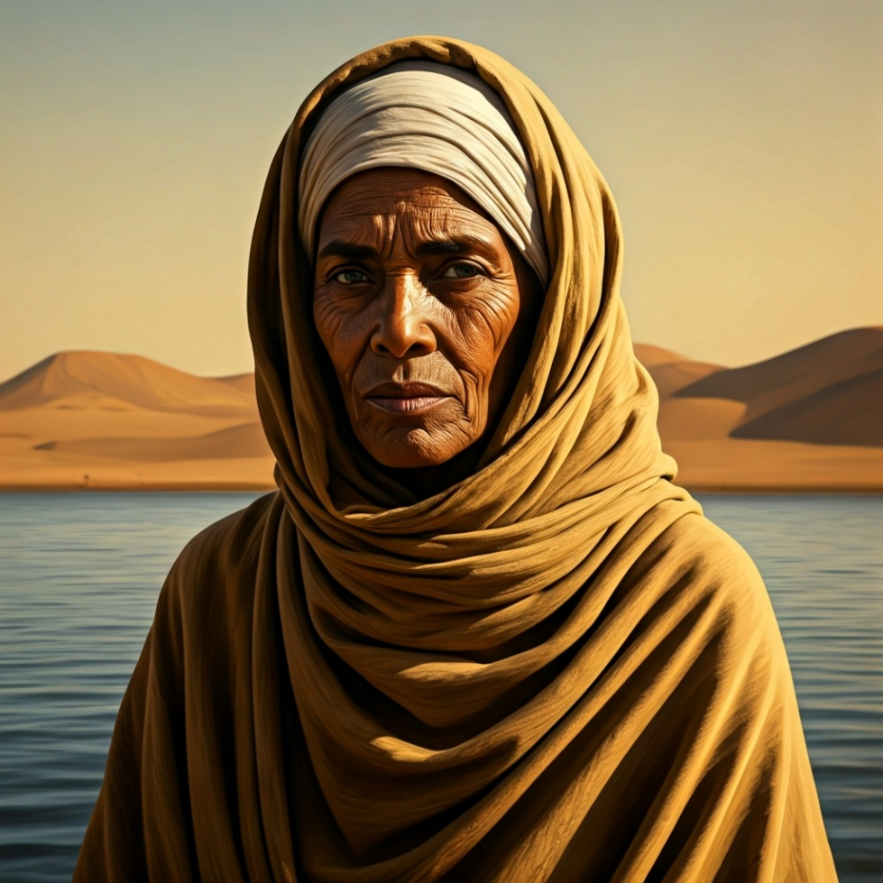
Leader: Our Holy Hermit today is Amma Sarah of the Desert
Amma Sarah of the Desert blazed her own fierce, clear path through 5th‑century ascetic life. For sixty years, she lived as a hermit by the Nile, battling temptation with stubborn courage and seeking only God’s approval. Her recorded sayings show a woman who defied gender expectations, urged charity even from imperfect motives, and refused to be diminished by anyone.

Slide 4
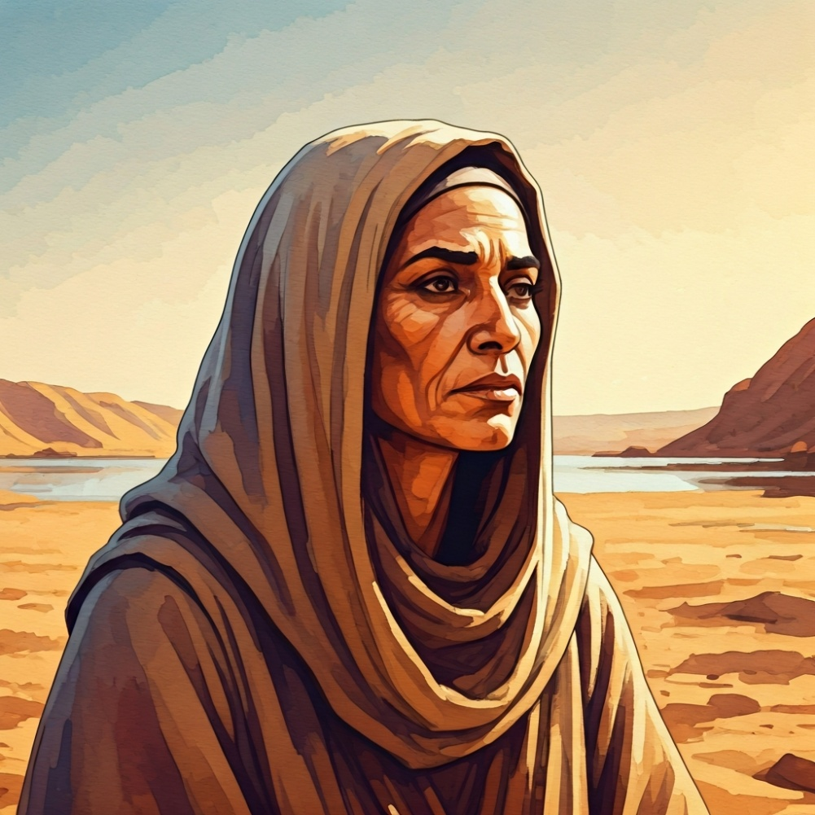
She taught that purity of heart comes through vigilance, humility, and relentless trust in Christ’s strength rather than one’s own. Though little is known of her life, her sharp wit, spiritual toughness, and uncompromising integrity made her one of the desert’s most compelling voices.
To read more about our hermits click the link​​ in the send out

Slide 5
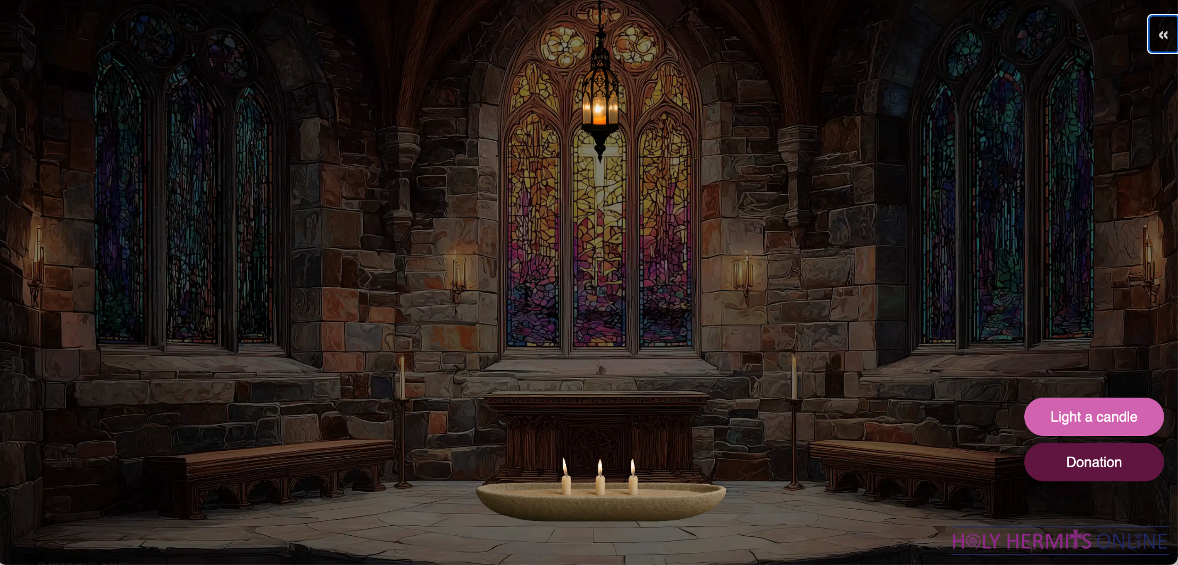
Digital Chapel: Sanctuary Lamp of Remembrance
Leader: Our digital chapel sanctuary lamp is lit this week in loving memory of David, now at peace and pain free
https://holy-hermits-online-chapel.org/
Notes:
Link to prayer group ministry page for weekly commitment prayer https://holyhermits.com.au/ministries/prayer-group

Slide 6
Invitation
Leader: As we come into worship let’s take a few deep breaths,
Let go of anything that isn’t serving us,
And become aware of God’s presence here with us.
Opening Music:
https://www.youtube.com/watch?v=yGGDWdXOF-E

Slide 7
Leader and Cantor unmute
The Greeting
Leader: The grace of the Lord Jesus Christ,
and the love of God,
and the fellowship of the Holy Spirit,
be with you all.
All: And also with you.

Slide 8
Gathering Prayer
Leader:
Our God is awesome!
By his word, he brought heaven and earth into being,
by his Spirit, he sustains them.
Whatever we have been through in the past week,
we have come today into God’s house;
let us recognise God’s worth and give him praise.
Notes:
Use Call to Worship Prayer

Slide 9
Gathering Prayer
All:
Mighty God,
you are powerful beyond our imagining.
Help us to recognise your presence here with us today,
to listen for your voice and to give you the glory that is yours.
Amen.
Notes:
Use gathering prayer

Slide 10
Sentence
Leader: I invite our Cantor to proclaim the sentence for today.
Cantor: You, O Lord, are a God merciful and gracious, slow to anger and abounding in steadfast love and faithfulness.
Psalm 86.15

Slide 11
Prayer of Approach
Leader: We pray the prayer of approach together
All: Let us draw near and climb the stairway to heaven.
Let us meet with our Awesome Lord in this place;
the One who searches and knows us,
whose presence lights up our life.

Slide 12
Leader unmutes
Our first Hymn
Praise to the Lord, the Almighty
https://www.youtube.com/watch?v=_vegvb1u5s4
We stay on mute
Leader mutes

Slide 13
The Deacon or LA introduces the Confession​
God is steadfast in love and infinite in mercy, welcoming sinners and inviting them to the Lord's table.
Silence may be kept.​
Let us confess our sins in penitence and faith, with a sincere and a true heart.

Slide 14
All: ​Merciful God, our maker and our judge, ​
we have sinned against you ​in thought, word, and deed, ​
and in what we have failed to do: ​
we have not loved you with our whole heart; ​
we have not loved our neighbours as ourselves; ​
we repent, and are sorry for all our sins.​
Father, forgive us. Strengthen us to love and obey you
in newness of life; ​through Jesus Christ our Lord. ​
Amen.​

Slide 15
Words of Assurance offered by the Deacon or LA
These words of assurance from the First Letter of John declare that:
If anyone sins, we have an advocate with the Father, Jesus Christ the righteous. He is the perfect offering for our sin, and not for ours only, but for the sins of the whole world.
(1 John 2: 1-2)
In this is love, not that we loved God, but that he loved us and sent his Son to be the perfect offering for our sins.
(1 John 4:10)

Slide 16
Collect
Leader: Saving God,
in Jesus Christ you opened for us a new and living way into your presence: give us pure hearts
and constant wills to worship you in spirit and in truth;
through Jesus Christ our Lord,
who lives and reigns with you and the Holy Spirit,
one God, now and for ever.
Amen.

Slide 17

The 1st Reading
Leader: We will now listen to the first reading
Reader 1: The 1st Reading is from Genesis 28.10-19a
¹⁰ Jacob left Beer-sheba and went towards Haran. ¹¹ He came to a certain place and stayed there for the night, because the sun had set. Taking one of the stones of the place, he put it under his head and lay down in that place. ¹² And he dreamed that there was a ladder set up on the earth, the top of it reaching to heaven; and the angels of God were ascending and descending on it.
Continue…
Notes:
Please note that the first reading is recorded this week

Slide 18
¹³ And the Lord stood beside him and said, ‘I am the Lord , the God of Abraham your father and the God of Isaac; the land on which you lie I will give to you and to your offspring; ¹⁴ and your offspring shall be like the dust of the earth, and you shall spread abroad to the west and to the east and to the north and to the south; and all the families of the earth shall be blessed in you and in your offspring. ¹⁵ Know that I am with you and will keep you wherever you go, and will bring you back to this land; for I will not leave you until I have done what I have promised you.’
Continue…

Slide 19
¹⁶ Then Jacob woke from his sleep and said, ‘Surely the Lord is in this place—and I did not know it!’ ¹⁷ And he was afraid, and said, ‘How awesome is this place! This is none other than the house of God, and this is the gate of heaven.’
¹⁸ So Jacob rose early in the morning, and he took the stone that he had put under his head and set it up for a pillar and poured oil on the top of it. ¹⁹ He called that place Bethel; but the name of the city was Luz at the first.
For the word of the Lord. Thanks be to God.​

Slide 20
The leader will lead the Psalm
Leader: We now say the psalm antiphonally, we will all respond with our cantor as our voice.
Psalm 139.
1-11; 23-24
¹ O Lord, you have searched me out and known me:
you know when I sit or when I stand,
you comprehend my thoughts long before.
² You discern my path and the places where I rest:
you are acquainted with all my ways.
Continue…

Slide 21
³ For there is not a word on my tongue:
but you, Lord, know it altogether.
⁴ You have encompassed me behind and before:
and have laid your hand upon me.
⁵ Such knowledge is too wonderful for me:
so high that I cannot endure it.
⁶ Where shall I go from your spirit:
or where shall I flee from your presence?
Continue…

Slide 22
⁷ If I ascend into heaven you are there:
if I make my bed in the grave you are there also.
⁸ If I spread out my wings towards the morning:
or dwell in the uttermost parts of the sea,
⁹ Even there your hand shall lead me:
and your right hand shall hold me.
¹⁰ If I say ‘Surely the darkness will cover me:
and the night will enclose me’,
Continue…

Slide 23
11 The darkness is no darkness with you,
but the night is as clear as the day:
the darkness and the light are both alike.
²³ Search me out, O God, and know my heart:
put me to the proof and know my thoughts.
²⁴ Look well lest there be any way of wickedness in me:
and lead me in the way that is everlasting.

Slide 24
The 2nd reader unmutes
Leader: I invite the 2nd reader to unmute and offer the 2nd lesson when ready.
Reader 2: The 2nd Reading is from Romans 8.12-25
¹² So then, brothers and sisters, we are debtors, not to the flesh, to live according to the flesh— ¹³ for if you live according to the flesh, you will die; but if by the Spirit you put to death the deeds of the body, you will live. ¹⁴ For all who are led by the Spirit of God are children of God. ¹⁵ For you did not receive a spirit of slavery to fall back into fear, but you have received a spirit of adoption.
Continue…

Slide 25
When we cry, ‘Abba! Father!’ ¹⁶ it is that very Spirit bearing witness with our spirit that we are children of God, ¹⁷ and if children, then heirs, heirs of God and joint heirs with Christ—if, in fact, we suffer with him so that we may also be glorified with him.
¹⁸ I consider that the sufferings of this present time are not worth comparing with the glory about to be revealed to us. ¹⁹ For the creation waits with eager longing for the revealing of the children of God; ²⁰ for the creation was subjected to futility, not of its own will but by the will of the one who subjected it, in hope
Continue…

Slide 26
²¹ that the creation itself will be set free from its bondage to decay and will obtain the freedom of the glory of the children of God. ²² We know that the whole creation has been groaning in labour pains until now; ²³ and not only the creation, but we ourselves, who have the first fruits of the Spirit, groan inwardly while we wait for adoption, the redemption of our bodies. ²⁴ For in hope we were saved. Now hope that is seen is not hope. For who hopes for what is seen? ²⁵ But if we hope for what we do not see, we wait for it with patience.
For the word of the Lord. Thanks be to God.​

Slide 27
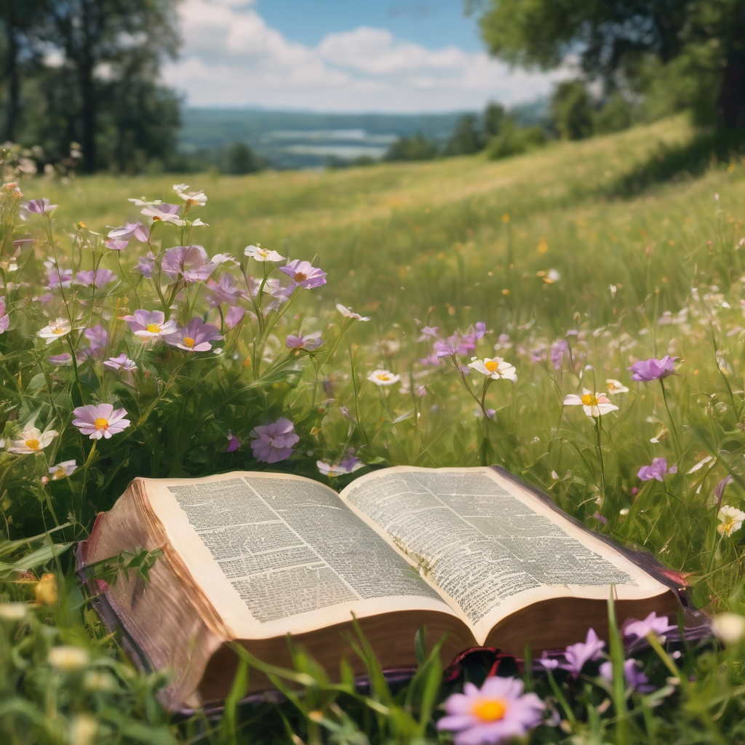
We pause before
​the Gospel ​​

Slide 28
Deacon: The Gospel of our Lord Jesus Christ according to St Matthew Chapter 13 beginning at the 24th verse
All: Glory to you Lord Jesus Christ.
²⁴ He put before them another parable: ‘The kingdom of heaven may be compared to someone who sowed good seed in his field; ²⁵ but while everybody was asleep, an enemy came and sowed weeds among the wheat, and then went away. ²⁶ So when the plants came up and bore grain, then the weeds appeared as well. ²⁷ And the slaves of the householder came and said to him,
Continue…

Slide 29
“Master, did you not sow good seed in your field? Where, then, did these weeds come from?” ²⁸ He answered, “An enemy has done this.” The slaves said to him, “Then do you want us to go and gather them?” ²⁹ But he replied, “No; for in gathering the weeds you would uproot the wheat along with them. ³⁰ Let both of them grow together until the harvest; and at harvest time I will tell the reapers, Collect the weeds first and bind them in bundles to be burned, but gather the wheat into my barn.” ’
Continue…

Slide 30
³⁶ Then he left the crowds and went into the house. And his disciples approached him, saying, ‘Explain to us the parable of the weeds of the field.’ ³⁷ He answered, ‘The one who sows the good seed is the Son of Man; ³⁸ the field is the world, and the good seed are the children of the kingdom; the weeds are the children of the evil one, ³⁹ and the enemy who sowed them is the devil; the harvest is the end of the age, and the reapers are angels. ⁴⁰ Just as the weeds are collected and burned up with fire, so will it be at the end of the age.
Continue…

Slide 31
⁴¹ The Son of Man will send his angels, and they will collect out of his kingdom all causes of sin and all evildoers, ⁴² and they will throw them into the furnace of fire, where there will be weeping and gnashing of teeth. ⁴³ Then the righteous will shine like the sun in the kingdom of their Father. Let anyone with ears listen!
This is the Gospel of the Lord. Praise to you Lord Jesus Christ.

Slide 32

We pause
after ​the Gospel ​​

Slide 33
Leader: .
Leader and Cantor mute
Broadcaster exits screenshare
Flashback Sermon:
Grace Roots
Rev. Steve Granaas-Holmes
https://www.youtube.com/watch?v=QsqpF7Xn7DA
Notes:
Sermon starts 37:14 – Please let me know if the sermon is too quiet

Slide 34
Leader unmutes
Our next Hymn
O God, You Search Me
https://www.youtube.com/watch?v=F4ScBPE9v_I
We stay on mute
Leader mutes

Slide 35
The Leader and Cantor unmute
The Greeting of Peace
Leader: We are the body of Christ
All: God’s Spirit is with us
Leader: The peace of the Lord be always with you.
All: And also with you.
Leader: A sign of peace may be exchanged
You may like to type 'Peace' into the chat, use the 'raise hand’ or other reaction buttons, or just simply wave via the screen with your video turned on
(Broadcaster exits shared screen for a few moments for the exchange of peace)

Slide 36

Prayer of Thanksgiving before Intercessions
Leader: As we enter prayer, I invite the second reader to unmute to lead our intercessions following the prayer of thanksgiving on the next slide. Please feel free to change your body position as you need.
Continue…

Slide 37
Leader:
Thank you, Father, Son, and Holy Spirit,
for your ever-with-us presence.
You are with us in this place, we cannot go anywhere without you.
Happy or sad, you are beside us.
Waking or sleeping, you are with us.
Lost or found, you direct us.
Thank you for your ever-present help and everlasting love.
We praise you. Amen.
Notes:
Prayer of praise and thanksgiving

Slide 38
Intercessions
Reader 2: We pray for creation and communities we share our lives with. We pause for a few moments to name either in our hearts, or out loud, or in the chat, those environments and communities we bring to the Lord in prayer.
PAUSE…
Continue…

Slide 39
Intercessions
Reader 2: We entrust to you the community of Holy Hermits Online and our ministry partners:
Prosper the work of our hands and show us the way to your new creation.
Creator God, Hear our prayer.
St John's Cathedral Brisbane The Anglican Diocese of Southern Queensland St Gabriel’s, Carindale Benedictus Contemplative Church, Canberra Anglican Focus and Tithe.ly

Slide 40

Reader 2: Loving Creator, we entrust to you all animals, especially those who are sick, anxious, ageing, lost, at risk, lonely, sad, hungry, in pain, homeless, abused, living in fear, encountering violence of any kind, in need of comfort, rehabilitation or transformation.

Slide 41

Reader 2: We invite your loving compassion for:
We name in our hearts, out loud or in the chat,
the animals we bring to the Lord in prayer. PAUSE…
Jasmine, ​
Leese(y), ​
Sid, Toots & Lulu​
Polly and Suki​
Fred, George & Percy​
Koshka ​
Jax
Lambert ​​
Kala, Nigel & Little One ​​
Toby​​
Taco​​
Paddy ​​
Rosie​
Squealer

Slide 42
Reader 2: Eternal Trinity of Love, we uphold to you the people we love and carry cares for:
Kerry, Les & Jake Julie, Ray, Tracey & Shane Mark, Desley & Bob ​​ Rachel, Mervyn & Gillian ​​Rev'd Shane & Janette​​ Alecia, Martin & Aidan​​ Kirsten, Greg, Daphne & Beau Bill & Marjorie​​ Aaron & Andrea Liz’s Godchildren Matthew & Nicholas | Barry​​ Dr Julie ​​ Ruth​​ Phil​ May Susan Tanya​ Neva Kathy ​Gayanne Tina | ​​ | Alan & Gaylene​ Jess & Leah ​​ Barry & Gwen Bob & Di​ Pat & Julie Dilys & Tony, Paul & Darhon Judy & Mary Miriam Lorelei Nettie

Slide 43
Reader 2:
We name in our hearts, out loud or in the chat, those we bring to the Lord in prayer.
PAUSE…
We entrust to you those who have died, those who have died peacefully and those who have died tragically, The old and the young. Receive them into your Kingdom. Lord in your mercy, Hear our prayers. Amen.

Slide 44
Pray Daily Cycle of Prayer
Leader: Loving God, joining with the Church in our cycle of prayer, we ask your blessings on:
The Province of the Episcopal Church of Sudan
The Diocese of Perth: †Kay; Assistant Bishops – †Kate, †David, †Hans; Clergy and People
Little Angels ELC, Salisbury
Toowoomba Anglican School, Toowoomba: Principal – Nick; Chaplaincy team; members of School Council; staff & students
Continue…

Slide 45
Pray Daily Cycle of Prayer
The Parish of St John’s Cathedral: Peter, Julia, Jessica, Ann, Gemma, Jamee, Ray, John, Mary, Alwyn, Alan, Libbie, Linda, Bruce, Nicole, Ann, Paul, Stewart, George, †Bill, †Doug, Eleanor, Ros, Marian, Ross, Greg, Gary, Daniel, Brian, Cheryl, Lauren, Carol, Tim, Tania, Pauline, Gillian, Eron, David, John, Bruce, Ruth

Slide 46
Commitment Prayer of the Week
Leader: Our commitment prayer for the week is for people in need
God who gives shelter, we give thanks for opportunities to offer support and prayers for those that are struggling at this time to put a permanent roof over their heads and to shelter those they love.​​​​
Please shine a light on homelessness for the people and animals experiencing this and provide a way for homes to be found and others to help, especially governments and churches.​​​​
Continue…
Notes:
Link to prayer group ministry page for weekly commitment prayer https://holyhermits.com.au/ministries/prayer-group

Slide 47
Please protect all living rough and give safety and security to families and young people, and those who are supporting them.​​​​
Please help us channel and inspire the hospitality that Jesus and his followers sought and encouraged in their day, and especially strengthen those already offering this ministry.​​​​
Awaken compassion in the hearts of all people to reach out with a loving hand.
Continue…
Notes:
Link to prayer group ministry page for weekly commitment prayer https://holyhermits.com.au/ministries/prayer-group

Slide 48
When we feel disheartened by this unfolding situation, please refocus our energies to keep praying and finding small ways to help so we don't feel so overwhelmed.​​​​
Usher in a wave of change for systems to be transformed and ways made for large scale transformation. Amen.​​
Notes:
Link to prayer group ministry page for weekly commitment prayer https://holyhermits.com.au/ministries/prayer-group

Slide 49
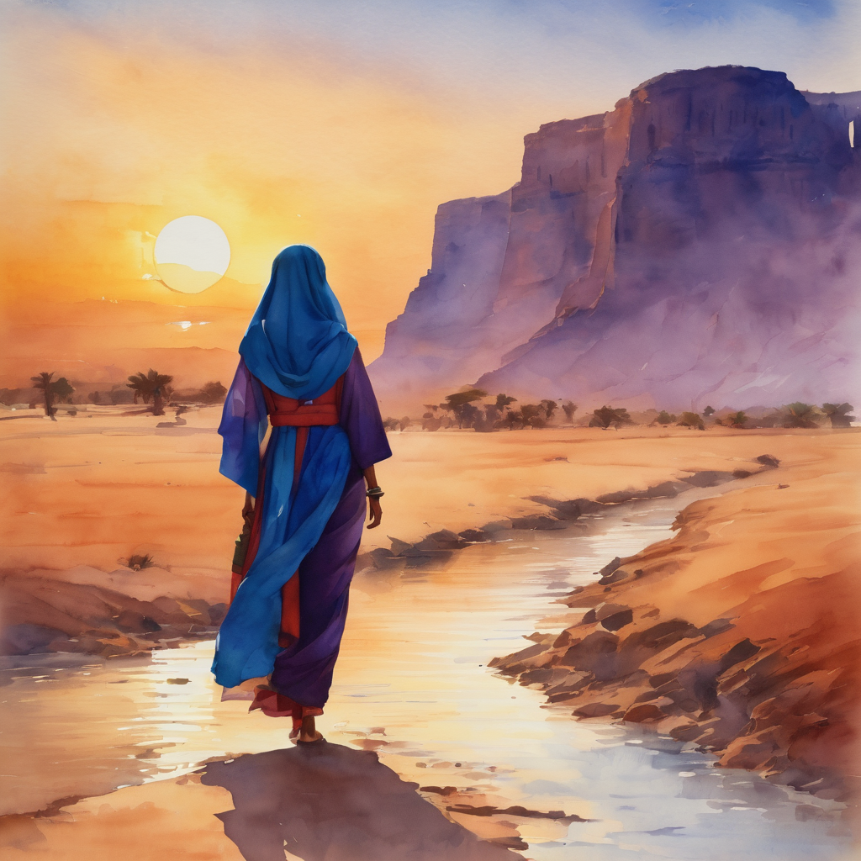
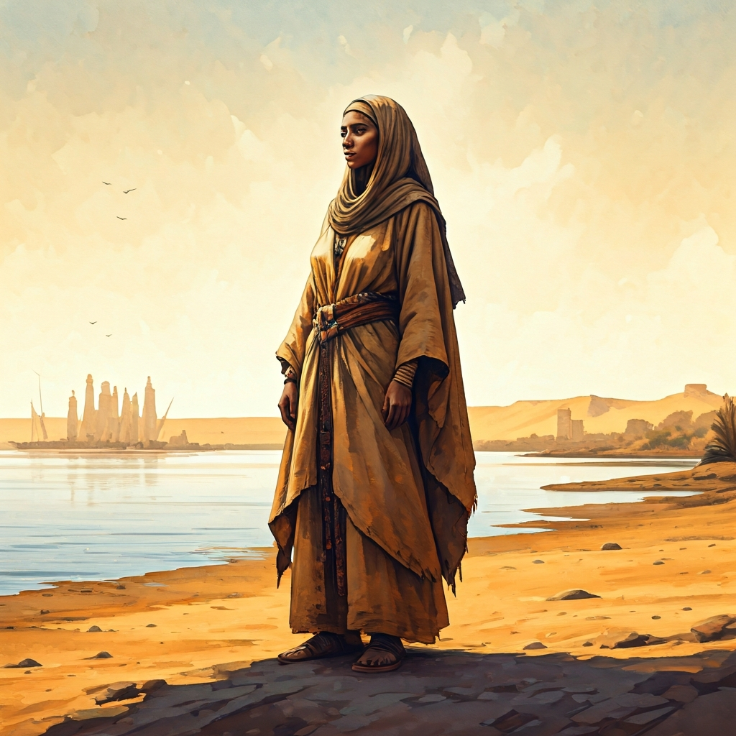
Devotions

Slide 50
Hermit Wisdom
A prayer that Amma Sarah wrote for the Sixth Hour, that is noon:
O Lord, You who have measured the heights and the earth in the hollow of your hand and created the six-wing Seraphim to cry out to you with an unceasing voice Holy, Holy, Holy, Glory to your name. Deliver me from the mouth of the evil one, O Master. Forget my many evil deeds and through the multitude of your compassions grant me daily forgiveness, for you are blessed unto the ages. Amen.

Slide 51

​
Leader: ​As we enter a few minutes of silence together, you are invited to pray the prayer of adoration on the next slide and/or spend this time in contemplation. ​
The Spiritual Communion prayer follows on the slide after that.
Let us be still.
Leader and Cantor Mute.
Continue…

Slide 52
​
Lord God,
we thank you that you are in this place.
Help us to know that you are with us,
whether we feel tired and anxious,
or peaceful and content.
May each of us encounter your presence.
Father, Son and Holy Spirit.
Amen.
Notes:
Prayer for all ages

Slide 53
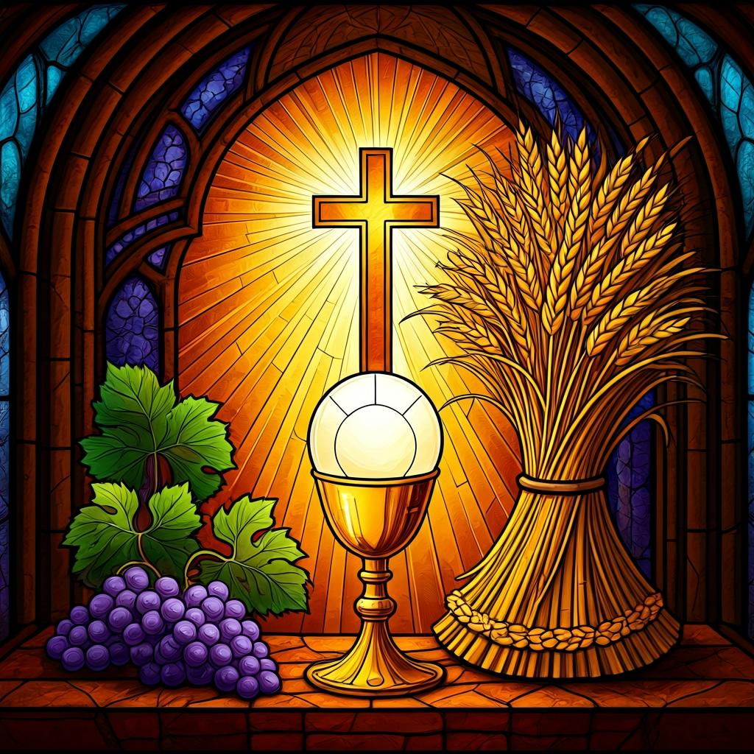
Oh, my Lord Jesus I turn to you present at the Altar and in the Tabernacle. I believe that you are present in the Holy Sacrament of your most Sacred Body and Blood. I love you above all things and I desire to receive you into my Soul. I cannot at this moment receive you Sacramentally in Holy Communion. Come spiritually into my heart. Purify it, Sanctify it. Render my heart like your own heart. I embrace you as if you were already there and unite myself wholly with you. Never permit me to be separated from you. Lord, I am not worthy to receive you, but only say the word and I shall be healed. Amen
Making a
Spiritual Communion
(Prayed in silence)

Slide 54
Leader unmutes
Our final song is
Father, Lord of All Creation
https://www.youtube.com/watch?v=P5fqJaLg3ug
​We stay on mute
Leader and Cantor mute

Slide 55
Leader and cantor unmute
Sending Prayer
Leader: We pray our sending prayer together.
All: Almighty God,
you know us and all that we will face this coming week.
Help us to recognise your presence and your voice in our
everyday lives.
May we know that, wherever we will be,
our God will be in that place.
Amen.

Slide 56
The Benediction
Leader: Let us all invite God’s blessings together,
All: May the Lord bless us and keep us.
May the Lord’s face shine upon us and be gracious to us.
May the Lord’s countenance be lifted upon us,
and bring us peace.
Amen

Slide 57
Notices
If there is anything you would like to pray for please post a prayer to the HHO App Prayer Wall so we can hold each other in our prayers
We continue our July Sabbath month of rest
See HHO Events page for further upcoming events HHO Events

Slide 58
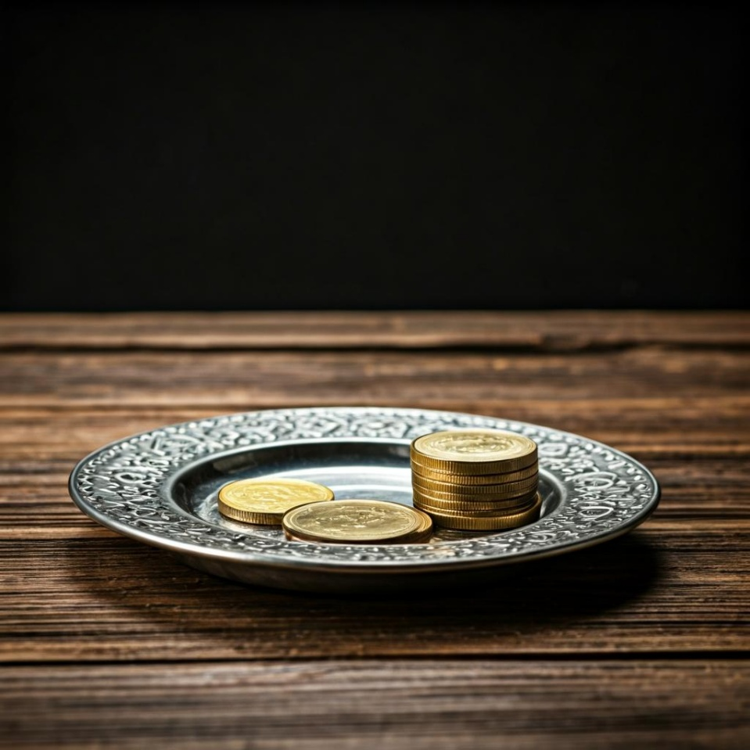
Leader: Thank you for your regular gifts to this ministry. Offerings are most welcome via:
The HHO App
Direct Debit
International Direct Debit
Please consider a one-off donation
or leaving a legacy in your Will
For further information go to HHO give page
https://holyhermits.com.au/give

Slide 59
Serving next week
26th July 2026
9th Sunday after Pentecost
9:00 am AEST
Service Prep: Kris | Chat Host: Rachel | First Reader: Margo
Music: Wiggles | Welcomer: Julie | Second Reader: Vanessa
Proof-reader: Chris | Priest: N/A | Preacher: Lauren
Broadcaster: Kieron | Deacon: Lauren | Fellowship: Julie
Backup Broadcaster: Lauren | Leader: Julie | Safety Officer: Rachel
Zoom Buttons: Rachel | Cantor: Jeremy | Attendance: Rachel
Thank you for your ministry gifts
New Servers always welcome!
Please email Rev’d Lauren to get involved
holyhermits@anglicanchurchsq.org.au

Slide 60
The Dismissal
Leader: I invite everyone to unmute for the Dismissal
Leader: Go in peace to love and serve the Lord.
All: In the name of Christ, Amen.

Slide 61

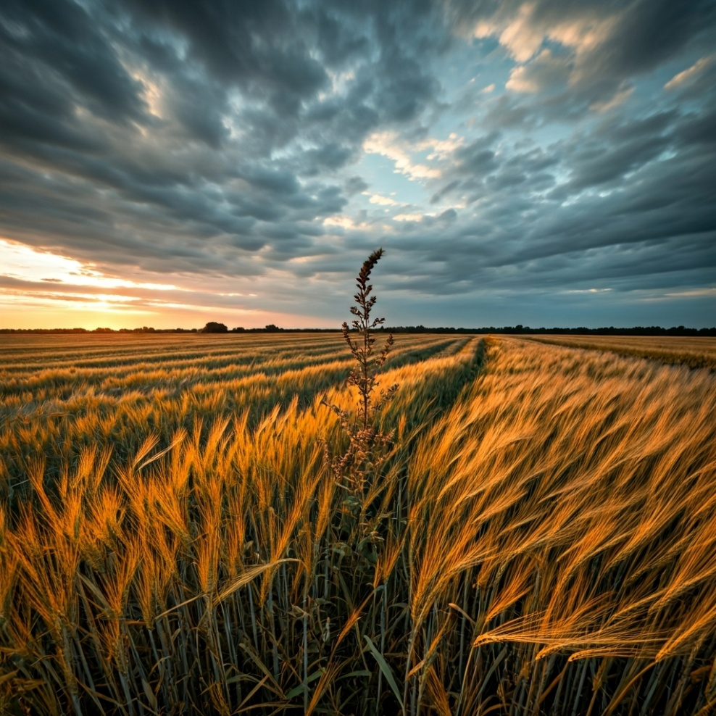
Fellowship
Thank you, Lauren for leading Fellowship
Please feel welcome to linger or pop a message in the chat and head off when you are ready.​
This week our sanctuary lamp is lit in loving memory of David, now at peace and pain free
Extra resources developed
by Roots on the Web
Images from Padlet

