Slide 1


Slide 2


6:30pm Tuesdays
Starting 21 JULY

Slide 3
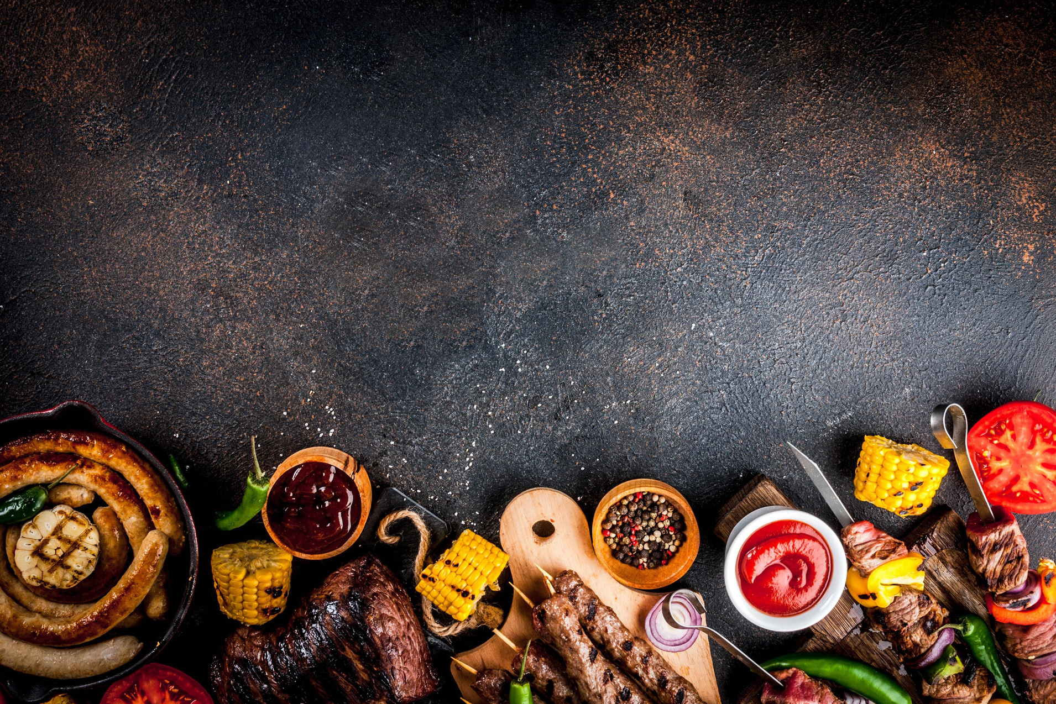
CHURCH FAMILY LUNCH
Sunday, 19 July after the Service
Feel free to bring a dessert to share.

Slide 4


Slide 5

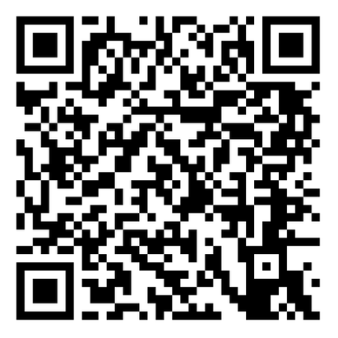

Scan & Register Here
?

Slide 6

Be Reconciled to God
Michael Christie

Slide 7

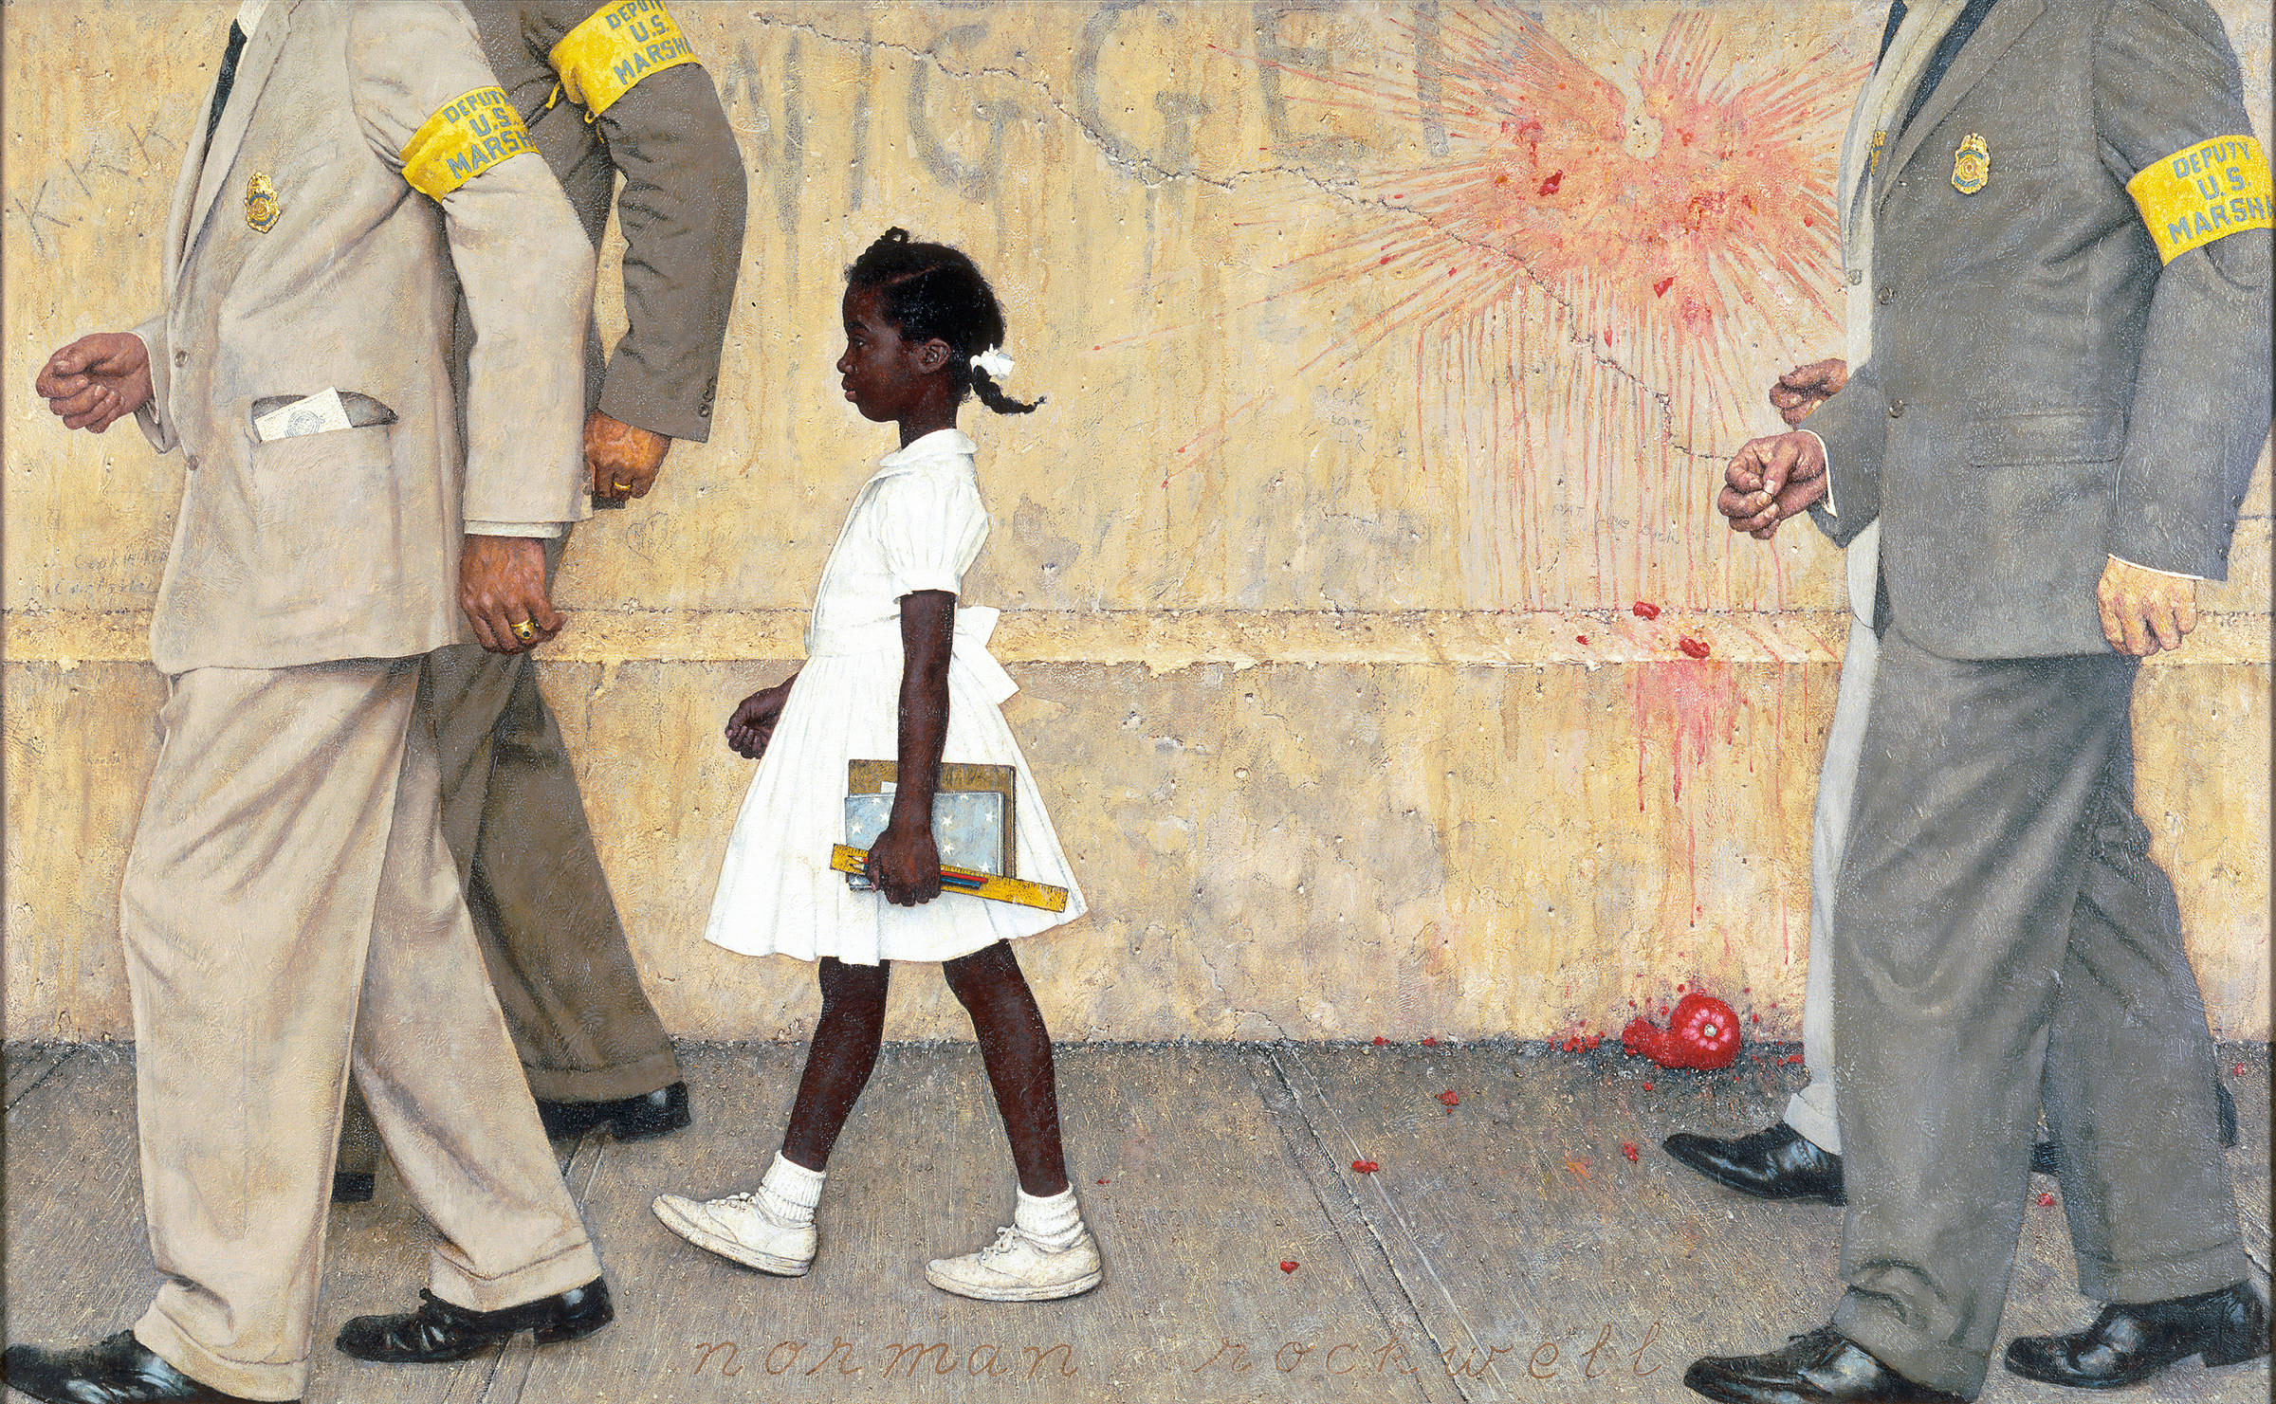
The Problem We All Live With
https://www.kennedy-center.org/education/resources-for-educators/classroom-resources/media-and-interactives/media/visual-arts/norman-rockwell--the-problem-we-all-live-with/Norman Rockwell, The Problem We All Live With, 1963, oil on canvas, 36 x 58 inches. Illustration for LOOK, January 14, 1964. Norman Rockwell Museum Collections. ©NRELC, Niles, IL.

Slide 8
God was reconciling the world to himself in Christ, not counting people’s sins against them. And he has committed to us the message of reconciliation… We implore you on Christ’s behalf: Be reconciled to God.
- 2 CORINTHIANS 5:19-20

Slide 9
DANIEL 9:1-7; 17-23
¹ In the first year of Darius son of Xerxes (a Mede by descent), who was made ruler over the Babylonian kingdom… I, Daniel, understood from the Scriptures, according to the word of the Lord given to Jeremiah the prophet, that the desolation of Jerusalem would last seventy years.

Slide 10
³ So I turned to the Lord God and pleaded with him in prayer and petition, in fasting, and in sackcloth and ashes.
⁴ I prayed to the Lord my God and confessed: “Lord, the great and awesome God, who keeps his covenant of love with those who love him and keep his commandments, ⁵ we have sinned and done wrong. We have been wicked and have rebelled; we have turned away from your commands and laws.

Slide 11
⁶ We have not listened to your servants the prophets, who spoke in your name to our kings, our princes and our ancestors, and to all the people of the land.
⁷ “Lord, you are righteous, but this day we are covered with shame—the people of Judah and the inhabitants of Jerusalem and all Israel, both near and far, in all the countries where you have scattered us because of our unfaithfulness to you.

Slide 12
¹⁷ “Now, our God, hear the prayers and petitions of your servant. For your sake, Lord, look with favour on your desolate sanctuary.
¹⁸ Give ear, our God, and hear; open your eyes and see the desolation of the city that bears your Name.
We do not make requests of you because we are righteous, but because of your great mercy.

Slide 13
¹⁹ Lord, listen! Lord, forgive! Lord, hear and act! For your sake, my God, do not delay, because your city and your people bear your Name.”
²⁰ While I was speaking and praying, confessing my sin and the sin of my people Israel and making my request to the Lord my God for his holy hill - ²¹ while I was still in prayer, Gabriel, the man I had seen in the earlier vision, came to me in swift flight about the time of the evening sacrifice.

Slide 14
²² He instructed me and said to me, “Daniel, I have now come to give you insight and understanding.
²³ As soon as you began to pray, a word went out, which I have come to tell you, for you are highly esteemed.”

Slide 15
Inspiration to Pray
I, Daniel, understood from the Scriptures, according to the word of the Lord given to Jeremiah the prophet, that the desolation of Jerusalem would last seventy years.
- DANIEL 9:2

Slide 16
Inspiration comes from two sources:
Hope from His Word
The Lord says: “When seventy years are completed for Babylon, I will come to you and fulfill my good promise to bring you back to this place. For I know the plans I have for you,” declares the Lord, “plans to prosper you and not to harm you, plans to give you hope and a future. Then you will call on me and come and pray to me, and I will listen to you.”
- JEREMIAH 29:10-14

Slide 17
If you remain in me and my words remain in you, ask whatever you wish, and it will be done for you.
- JOHN 17:5

Slide 18
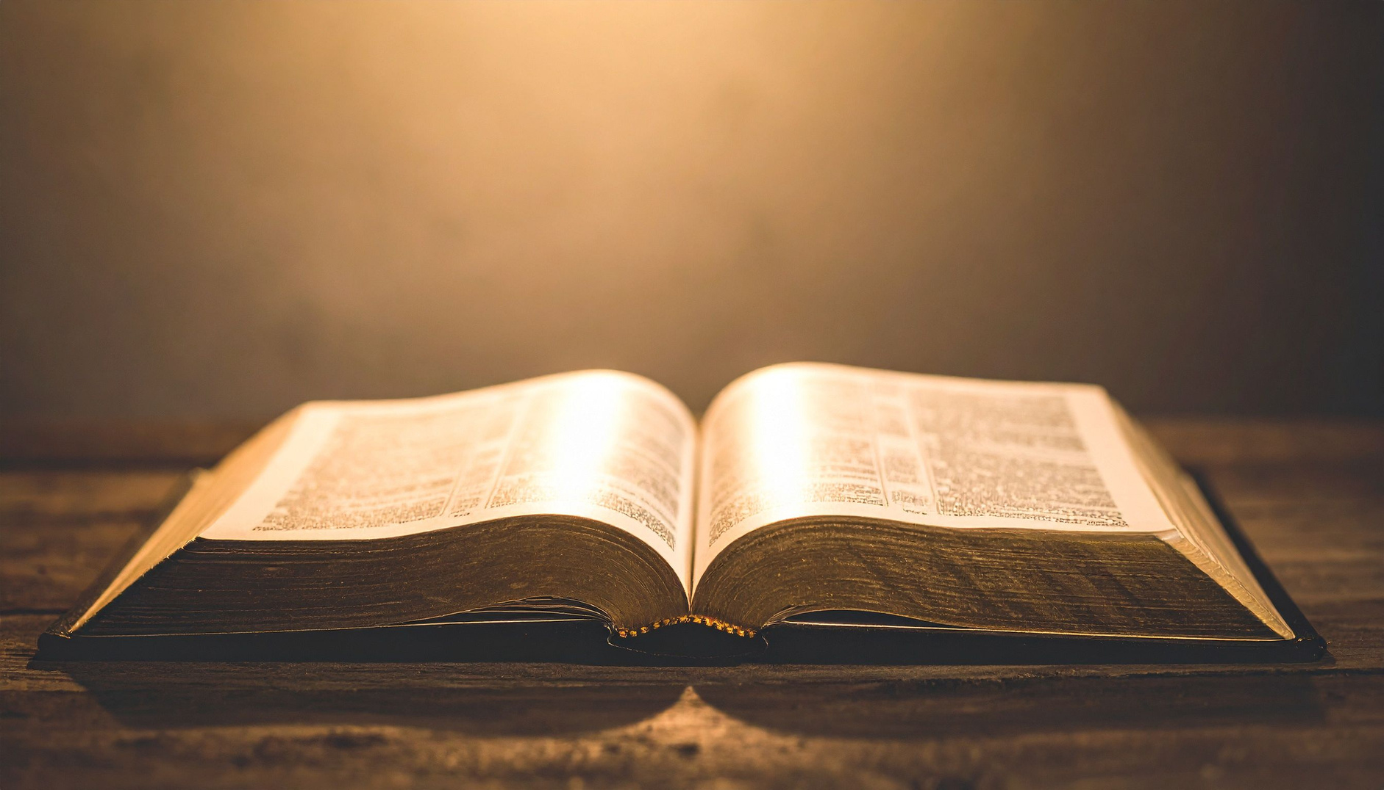

Slide 19
Inspiration to Pray from two sources:
Hope from His Word
Humility in His Presence
So, I turned to the Lord God and pleaded with him in prayer and petition, in fasting, and in sackcloth and ashes.
– Daniel 9:3.

Slide 20
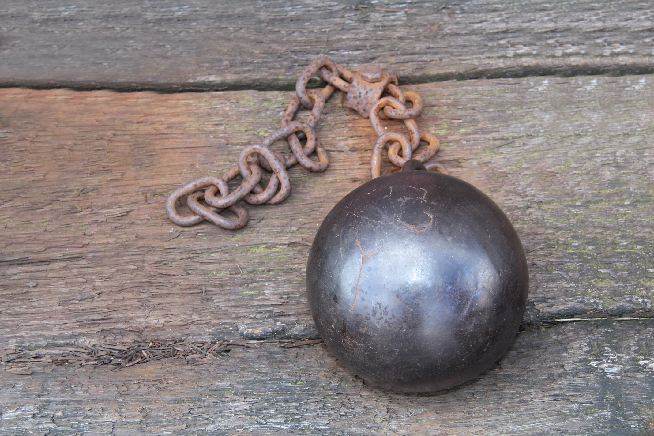

Slide 21
Interaction with Prayer
I prayed to the Lord my God and confessed: “Lord, the great and awesome God, who keeps his covenant of love with those who love him and keep his commandments, we have sinned and done wrong… We do not make requests of you because we are righteous, but because of your great mercy. Lord, listen! Lord, forgive! Lord, hear and act!”
- DANIEL 9:4, 17-19

Slide 22
The Examen Prayer
A process to examine our lives and pray:
  Replay

Slide 23
The Examen Prayer
A process to examine our lives and pray:
  Replay
  Rejoice

Slide 24
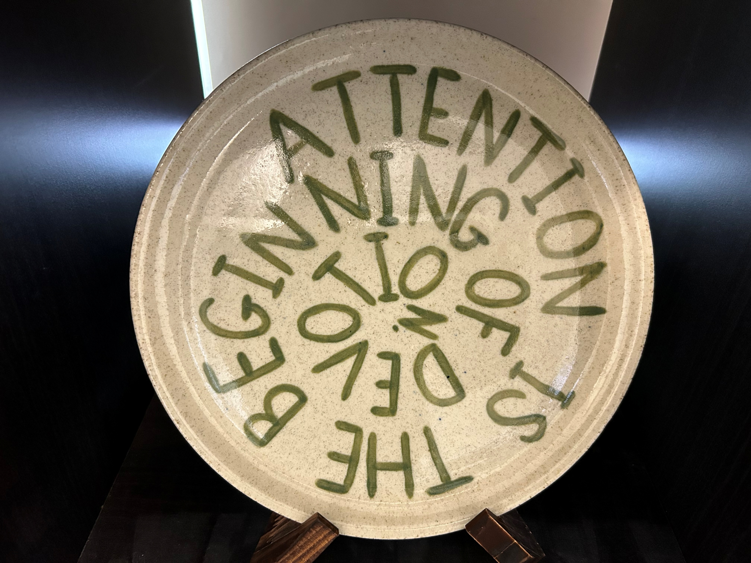

Slide 25
The Examen Prayer
A process to examine our lives and pray:
  Replay
  Rejoice
  Repent

Slide 26
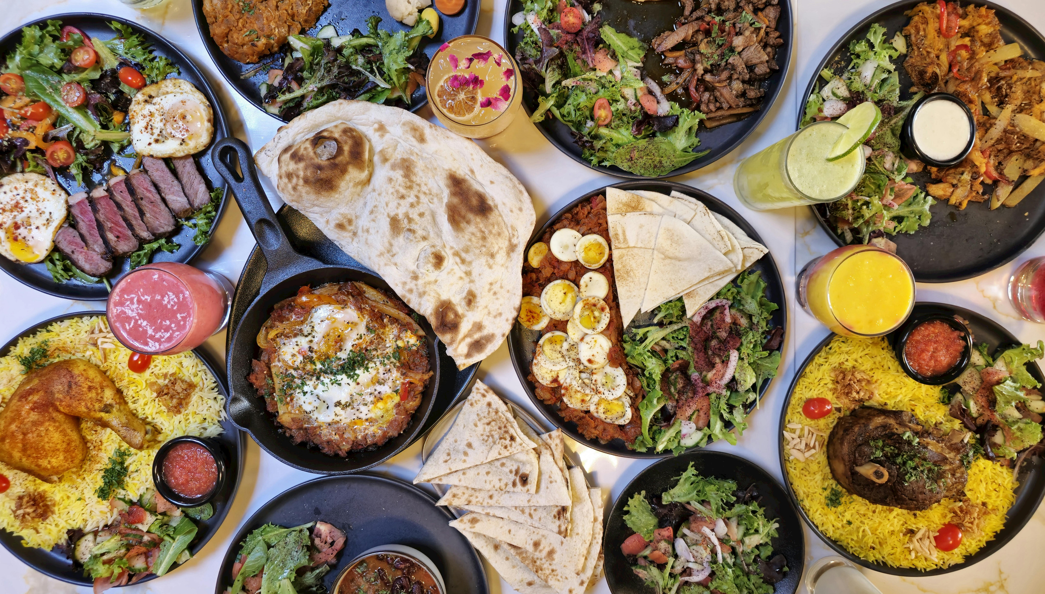

Slide 27
The Examen Prayer
A process to examine our lives and pray:
  Replay
  Rejoice
  Repent
  Reboot

Slide 28
The Intimacy of Prayer
while I was still in prayer, Gabriel, the man I had seen in the earlier vision, came … and said to me, “Daniel, I have now come to give you insight and understanding. As soon as you began to pray, a word went out, which I have come to tell you, for you are highly esteemed.
- DANIEL 9:21-23

Slide 29


Slide 30
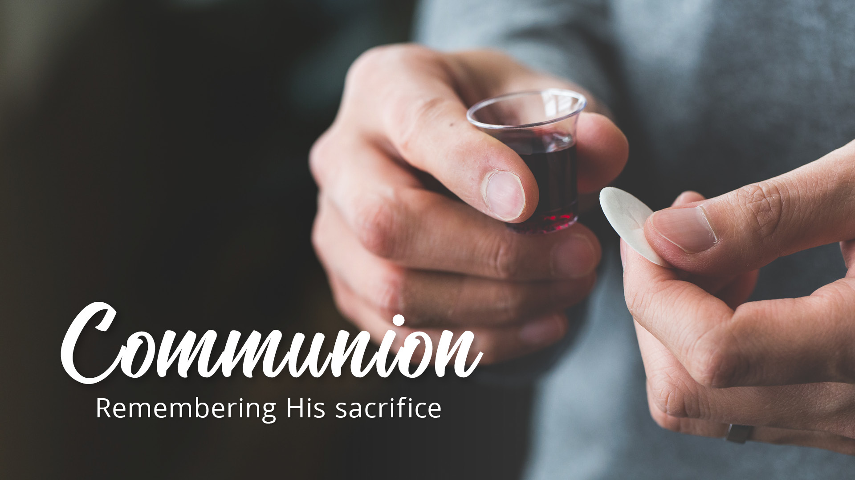

Slide 31


Slide 32


Slide 33
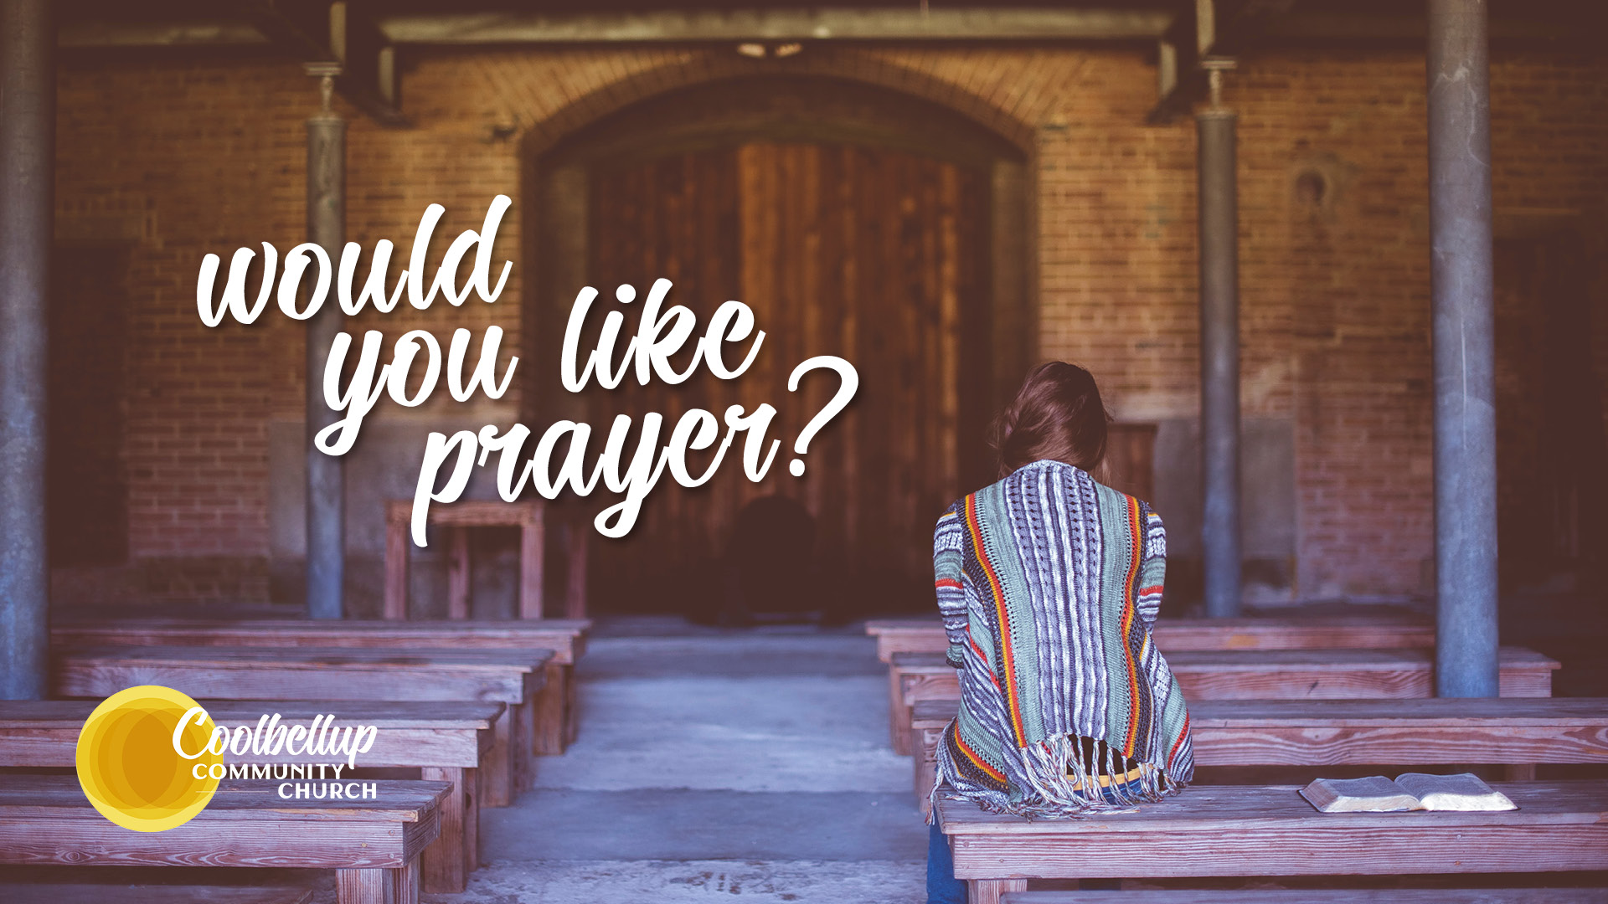

Slide 34
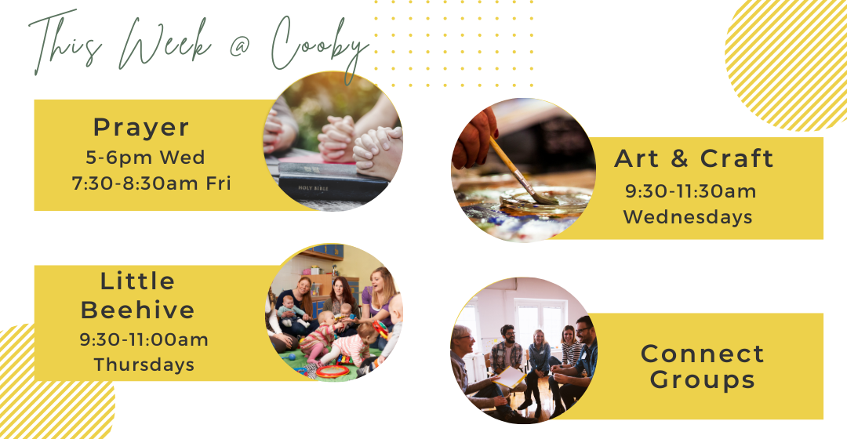
During School Term
During School Term

Slide 35


