Slide 1


Slide 2
Free to Worship
2 Samuel 6:12-23

Slide 3
¹² Now King David was told,
“The Lord has blessed the household of Obed-Edom and everything he has, because of the ark of God.” So David went to bring up the ark of God from the house of Obed-Edom to the City of David with rejoicing. ¹³ When those who were carrying the ark of the Lord had taken six steps, he sacrificed a bull and a fattened calf.
2 Samuel 6:12-23 NIV

Slide 4
¹⁴ Wearing a linen ephod,
David was dancing before the Lord
with all his might,
¹⁵ while he and all Israel were bringing up the ark of the Lord with shouts and
the sound of trumpets.
2 Samuel 6:12-23 NIV

Slide 5
¹⁶ As the ark of the Lord was entering
the City of David,
Michal daughter of Saul watched from a window. And when she saw King David
leaping and dancing before the Lord,
she despised him in her heart.
2 Samuel 6:12-23 NIV

Slide 6
¹⁷ They brought the ark of the Lord and
set it in its place inside the tent that David
had pitched for it,
and David sacrificed burnt offerings and fellowship offerings before the Lord.
2 Samuel 6:12-23 NIV

Slide 7
¹⁸ After he had finished sacrificing the burnt offerings and fellowship offerings,
he blessed the people in the name of the Lord Almighty.
¹⁹ Then he gave a loaf of bread, a cake of dates and a cake of raisins to each person in the whole crowd of Israelites, both men and women.
And all the people went to their homes.
2 Samuel 6:12-23 NIV

Slide 8
²⁰ When David returned home to bless his household, Michal daughter of Saul came out to meet him and said,
“How the king of Israel has distinguished himself today, going around half-naked in full view of the slave girls of his servants
as any vulgar fellow would!”
2 Samuel 6:12-23 NIV

Slide 9
²¹ David said to Michal,
“It was before the Lord, who chose me rather than your father or anyone from his house when he appointed me ruler over the Lord’s people Israel—I will celebrate before the Lord.
2 Samuel 6:12-23 NIV

Slide 10
²² I will become even more undignified than this, and I will be humiliated in my own eyes.
But by these slave girls you spoke of,
I will be held in honor.
2 Samuel 6:12-23 NIV

Slide 11
²³ And Michal daughter of Saul
had no children to the day of her death.
2 Samuel 6:12-23 NIV

Slide 12
Free to Worship
Freedom
Centers on God

Slide 13
¹² Now King David was told,
“The Lord has blessed the household of Obed-Edom and everything he has,
because of the ark of God.”
So David went to bring up the ark of God from the house of Obed-Edom to the City of David with rejoicing.
2 Samuel 6:12 NIV

Slide 14
Then Moses said to him,
“If your Presence does not go with us,
do not send us up from here.
Exodus 33:15 NIV

Slide 15
You make known to me the path of life;
you will fill me with joy in your presence,
with eternal pleasures at your right hand.
Psalm 16:11 NIV

Slide 16
²⁶ My flesh and my heart may fail,
but God is the strength of my heart
and my portion forever.
Psalm 73:26 NIV

Slide 17
Free to Worship
Freedom
Worships Boldly

Slide 18
¹⁴ Wearing a linen ephod,
David was dancing before the Lord
with all his might,
¹⁵ while he and all Israel were bringing up the ark of the Lord
with shouts and
the sound of trumpets.
2 Samuel 6:14-15 NIV

Slide 19
²⁰ When David returned home to bless his household, Michal daughter of Saul came out to meet him and said,
“How the king of Israel has distinguished himself today, going around half-naked in full view of the slave girls of his servants
as any vulgar fellow would!”
2 Samuel 6:20 NIV

Slide 20
It is for freedom that Christ has set us free.
Stand firm, then,
and do not let yourselves be burdened again
by a yoke of slavery.
Galatians 5:1 NIV

Slide 21
³⁶ So if the Son sets you free,
you will be free indeed.
John 8:36 NIV

Slide 22
¹⁷ Now the Lord is the Spirit,
and where the Spirit of the Lord is,
there is freedom.
2 Corinthians 3:17 NIV

Slide 23
Free to Worship
Freedom
Fears God,
Over People

Slide 24
²¹ David said to Michal,
“It was before the Lord, who chose me rather than your father or anyone from his house when he appointed me ruler over
the Lord’s people Israel—
I will celebrate before the Lord.
2 Samuel 6:21 NIV

Slide 25
²² I will become even more
undignified than this,
and I will be humiliated in my own eyes.
2 Samuel 6:22 NIV

Slide 26
¹⁰ Am I now trying to win the approval of human beings, or of God?
Or am I trying to please people?
If I were still trying to please people,
I would not be a servant of Christ.
Galatians 1:10 NIV

Slide 27
Conclusion:
The greatest expression of freedom is not
doing whatever we want;
it is delighting in the God who
has made His dwelling among us.

Slide 28
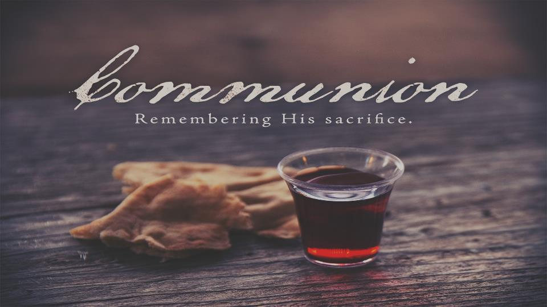

Slide 29


Slide 30


Slide 31


