Slide 1
Welcome to Holy Hermits Online Worship
^{7th} Sunday After Pentecost
Today we are remembering
Holy Hermit David the Dendrite
Service Prep: Lauren | Chat Host: Rachel | First Reader: Helen
Music: Lauren | Welcomer: Julie | Second Reader: Barry
Proof-reader: Chris | Priest: N/A | Preacher: Lauren
Broadcaster: Lauren | Deacon: Lauren | Fellowship: Julie
Backup Broadcaster: Barry | Leader: Julie | Safety Officer: Rachel
Zoom Buttons: Rachel | Cantor: Jeremy | Attendance: Rachel

Slide 2






Hospitality
Leader:
Please mute for the service unless invited to offer your voice as part of the service ministry
Have the video camera on or off and turn the volume and brightness up or down on your device if things are too loud 🔉🔊or too bright🔅🔆
Our Cantor acts as our voice, offering the responses, in Bold Text, which we say together
Feel welcome to use the chat and reaction emojis 👍
🙏 Please take care of yourself in this space. 🙏 Come and go as you need
😴 It is great to take rest in this space, so falling asleep is also OK 😴
👂️ Remember, pastoral care is available to all in the community, if you'd like to speak to someone about anything spiritual. ❤️ Visit the help page at the website to reach out 🌐
Our Being Together ethos and safeguarding practices can also be accessed on the website 🫶​
🙌 Come as you are – we are all here together! 🙌
Notes:
Used Lent 2022

Slide 3
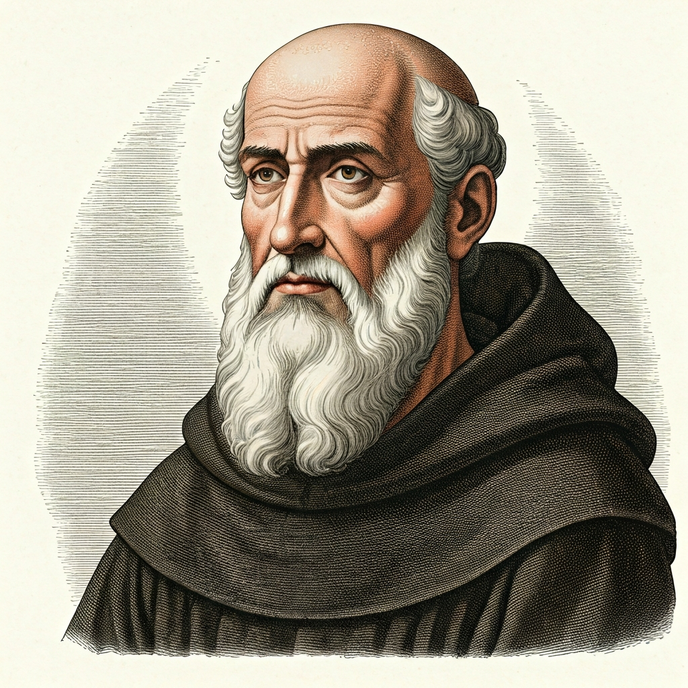
Leader: Our Holy Hermit today is St Benedict of Nursia
Benedict of Nursia, born in 480, left Rome’s moral chaos for a hermit’s cave where the monk Romanus supported him. His holiness drew followers, though his early reforms met resistance—including an attempted poisoning.

Slide 4
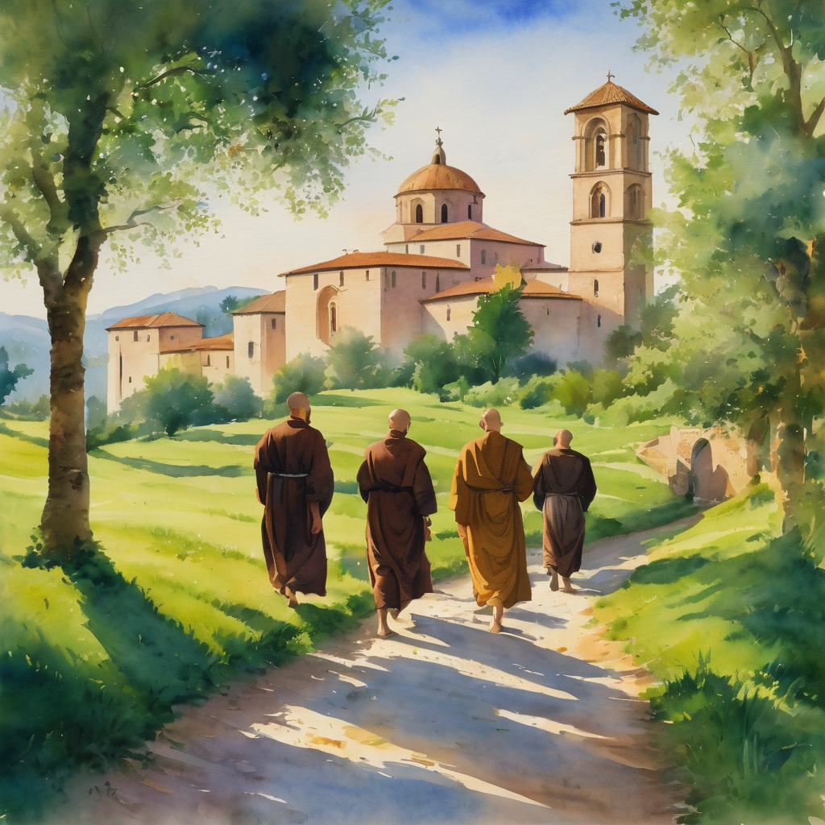
He later founded twelve monasteries, then settled at Monte Cassino. His Rule shaped Western monasticism with its balance of prayer, work, humility and moderation, while his twin sister Scholastica led a nearby community of nuns.
To read more about our hermits click the link​​ in the send out

Slide 5
Invitation
Leader: As we come into worship let’s take a few deep breaths,
Let go of anything that isn’t serving us,
And become aware of God’s presence here with us.
Opening Music: https://www.youtube.com/watch?v=ljFYrRiJH8I

Slide 6
Leader and Cantor unmute
The Greeting
Leader: The grace of the Lord Jesus Christ,
and the love of God,
and the fellowship of the Holy Spirit,
be with you all.
All: And also with you.

Slide 7
Gathering Prayer
Leader:
God has called us here today; we’ve chosen to come.
God calls us to come closer;
God invites us to be present to his presence… [pause]
May we choose to say ‘Yes’ to God today.
Notes:
Use Call to Worship Prayer

Slide 8
Gathering Prayer
All:
Father God, you knew us and loved us before we were born;
you have known us and loved us every moment of our lives.
Forgive us for failing you and forgetting you,
and help us to know you more and love you more today.
Amen.
Notes:
Use gathering prayer

Slide 9
Sentence
Leader: I invite our Cantor to proclaim the sentence for today.
Cantor: The words you have spoken are spirit and life, O Lord; you have the words of eternal life.
John 6.63, 68

Slide 10
Prayer of Approach
Leader: We pray the prayer of approach together
All: God’s lamp lights up our path,
allowing us to tread with confidence.
No need to hesitate.
Come, let us choose to draw ever nearer,
to worship and wait on him.
Amen.

Slide 11
Leader unmutes
Our first Hymn
Jesus, Jesus, Holy and Anointed One
https://www.youtube.com/watch?v=VDYvYUJizgg
We stay on mute
Leader mutes

Slide 12
The Deacon or LA introduces the Confession​
God is steadfast in love and infinite in mercy, welcoming sinners and inviting them to the Lord's table.
Silence may be kept.​
Let us confess our sins in penitence and faith, with a sincere and a true heart.

Slide 13
All: ​Merciful God, our maker and our judge, ​
we have sinned against you ​in thought, word, and deed, ​
and in what we have failed to do: ​
we have not loved you with our whole heart; ​
we have not loved our neighbours as ourselves; ​
we repent, and are sorry for all our sins.​
Father, forgive us. Strengthen us to love and obey you
in newness of life; ​through Jesus Christ our Lord. ​
Amen.​

Slide 14
Words of Assurance offered by the Deacon or LA
These words of assurance from the First Letter of John declare that:
If anyone sins, we have an advocate with the Father, Jesus Christ the righteous. He is the perfect offering for our sin, and not for ours only, but for the sins of the whole world.
(1 John 2: 1-2)
In this is love, not that we loved God, but that he loved us and sent his Son to be the perfect offering for our sins.
(1 John 4:10)

Slide 15
Collect
Leader: Bountiful God,
we thank you for planting in us the seed of your word:
by your Holy Spirit,
help us to receive it with joy, and to live according to it,
that we may grow in faith and hope and love;
through Jesus Christ our Lord,
who lives and reigns with you in the unity of the Holy Spirit,
one God, for ever and ever. Amen.

Slide 16
The 1st reader unmutes
Leader: I invite the 1st reader to unmute and offer the 1st lesson when ready.
Reader 1: The 1st Reading is from Genesis 25.19-34
¹⁹These are the descendants of Isaac, Abraham’s son: Abraham was the father of Isaac, ²⁰ and Isaac was forty years old when he married Rebekah, daughter of Bethuel the Aramean of Paddan-aram, sister of Laban the Aramean. ²¹ Isaac prayed to the Lord for his wife, because she was barren; and the Lord granted his prayer, and his wife Rebekah conceived.
Continue…

Slide 17
²² The children struggled together within her; and she said, ‘If it is to be this way, why do I live?’ So she went to inquire of the Lord .
²³ And the Lord said to her,
‘Two nations are in your womb,
and two peoples born of you shall be divided;
one shall be stronger than the other,
the elder shall serve the younger.’
²⁴ When her time to give birth was at hand, there were twins in her womb. ²⁵ The first came out red, all his body like a hairy mantle; so they named him Esau.
Continue…

Slide 18
²⁶ Afterwards his brother came out, with his hand gripping Esau’s heel; so he was named Jacob. Isaac was sixty years old when she bore them.
²⁷ When the boys grew up, Esau was a skilful hunter, a man of the field, while Jacob was a quiet man, living in tents. ²⁸ Isaac loved Esau, because he was fond of game; but Rebekah loved Jacob.
²⁹ Once when Jacob was cooking a stew, Esau came in from the field, and he was famished.
Continue…

Slide 19
³⁰ Esau said to Jacob, ‘Let me eat some of that red stuff, for I am famished!’ (Therefore he was called Edom.) ³¹ Jacob said, ‘First sell me your birthright.’ ³² Esau said, ‘I am about to die; of what use is a birthright to me?’ ³³ Jacob said, ‘Swear to me first.’ So he swore to him, and sold his birthright to Jacob. ³⁴ Then Jacob gave Esau bread and lentil stew, and he ate and drank, and rose and went his way. Thus Esau despised his birthright.
For the word of the Lord. Thanks be to God.​

Slide 20
Leader: We now say the psalm antiphonally, I invite the first
reader to lead, and we will all respond with our cantor as our voice.
Psalm 119.
105-112
¹⁰⁵ Your word is a lantern to my feet:
and a light to my path.
¹⁰⁶ I have vowed and sworn an oath:
to keep your righteous judgements.
¹⁰⁷ I have been afflicted beyond measure:
Lord, give me life according to your word.
Continue…

Slide 21
¹⁰⁸ Accept, O Lord, the freewill offerings of my mouth:
and teach me your judgements.
¹⁰⁹ I take my life in my hands continually:
yet I do not forget your law.
¹¹⁰ The wicked have laid a snare for me:
but I have not strayed from your precepts.
Continue…

Slide 22
¹¹¹ Your commands are my inheritance for ever:
they are the joy of my heart.
¹¹² I have set my heart to fulfil your statutes:
always, even to the end.

Slide 23
The 2nd reader unmutes
Leader: I invite the 2nd reader to unmute and offer the 2nd lesson when ready.
Reader 2: The 2nd Reading is from Romans 8.1-11
¹ There is therefore now no condemnation for those who are in Christ Jesus. ² For the law of the Spirit of life in Christ Jesus has set you free from the law of sin and of death. ³ For God has done what the law, weakened by the flesh, could not do: by sending his own Son in the likeness of sinful flesh, and to deal with sin, he condemned sin in the flesh,
Continue…

Slide 24
⁴ so that the just requirement of the law might be fulfilled in us, who walk not according to the flesh but according to the Spirit. ⁵ For those who live according to the flesh set their minds on the things of the flesh, but those who live according to the Spirit set their minds on the things of the Spirit. ⁶ To set the mind on the flesh is death, but to set the mind on the Spirit is life and peace. ⁷ For this reason the mind that is set on the flesh is hostile to God; it does not submit to God’s law—indeed it cannot, ⁸ and those who are in the flesh cannot please God.
Continue…

Slide 25
⁹ But you are not in the flesh; you are in the Spirit, since the Spirit of God dwells in you. Anyone who does not have the Spirit of Christ does not belong to him. ¹⁰ But if Christ is in you, though the body is dead because of sin, the Spirit is life because of righteousness. ¹¹ If the Spirit of him who raised Jesus from the dead dwells in you, he who raised Christ from the dead will give life to your mortal bodies also through his Spirit that dwells in you.
For the word of the Lord. Thanks be to God.​

Slide 26

We pause before
​the Gospel ​​

Slide 27
Deacon: The Gospel of our Lord Jesus Christ according to St Matthew Chapter 13 beginning at the 1st verse
All: Glory to you Lord Jesus Christ.
¹ That same day Jesus went out of the house and sat beside the lake. ² Such great crowds gathered around him that he got into a boat and sat there, while the whole crowd stood on the beach. ³ And he told them many things in parables, saying: ‘Listen! A Sower went out to sow. ⁴ And as he sowed, some seeds fell on the path, and the birds came and ate them up.
Continue…

Slide 28
⁵ Other seeds fell on rocky ground, where they did not have much soil, and they sprang up quickly, since they had no depth of soil. ⁶ But when the sun rose, they were scorched; and since they had no root, they withered away. ⁷ Other seeds fell among thorns, and the thorns grew up and choked them. ⁸ Other seeds fell on good soil and brought forth grain, some a hundredfold, some sixty, some thirty. ⁹ Let anyone with ears listen!’
Continue…

Slide 29
¹⁸ ‘Hear then the parable of the sower. ¹⁹ When anyone hears the word of the kingdom and does not understand it, the evil one comes and snatches away what is sown in the heart; this is what was sown on the path. ²⁰ As for what was sown on rocky ground, this is the one who hears the word and immediately receives it with joy; ²¹ yet such a person has no root, but endures only for a while, and when trouble or persecution arises on account of the word, that person immediately falls away.
Continue…

Slide 30
²² As for what was sown among thorns, this is the one who hears the word, but the cares of the world and the lure of wealth choke the word, and it yields nothing. ²³ But as for what was sown on good soil, this is the one who hears the word and understands it, who indeed bears fruit and yields, in one case a hundredfold, in another sixty, and in another thirty.’
This is the Gospel of the Lord. Praise to you Lord Jesus Christ.

Slide 31

We pause
after ​the Gospel ​​

Slide 32
Leader: The Sermon is recorded to YouTube for sharing later.
Only the preacher's video and audio will be recorded.
The chat and other participants' feeds remain out of sight of the recording.
Leader and Cantor mute
Broadcaster exits screenshare
Preacher unmutes
Zoom buttons ”pins” preacher’s screen + selects “record to the cloud”
Sermon

Slide 33
Leader unmutes
Our next Hymn
To Christ, the Seed
https://www.youtube.com/watch?v=qVO2fM8dPe0
We stay on mute
Leader mutes

Slide 34
The Leader and Cantor unmute
The Greeting of Peace
Leader: We are the body of Christ
All: God’s Spirit is with us
Leader: The peace of the Lord be always with you.
All: And also with you.
Leader: A sign of peace may be exchanged
You may like to type 'Peace' into the chat, use the 'raise hand’ or other reaction buttons, or just simply wave via the screen with your video turned on
(Broadcaster exits shared screen for a few moments for the exchange of peace)

Slide 35

Prayer of Thanksgiving before Intercessions
Leader: As we enter prayer, I invite the second reader to unmute to lead our intercessions following the prayer of thanksgiving on the next slide. Please feel free to change your body position as you need.
Continue…

Slide 36
Leader:
Lord God, we give you thanks.
Even when we are bruised by poor life choices,
thank you, that you do not condemn.
Your love and blessings soothe and heal.
You help us to remember what’s important:
to cherish the things we’ve been given, which
root us in your love and guide us by your light.
Thank you, our loving Lord God.
Amen.
Notes:
Prayer of praise and thanksgiving

Slide 37
Intercessions
Reader 2: We pray for creation and communities we share our lives with. We pause for a few moments to name either in our hearts, or out loud, or in the chat, those environments and communities we bring to the Lord in prayer.
PAUSE…
Continue…

Slide 38
Intercessions
Reader 2: We entrust to you the community of Holy Hermits Online and our ministry partners:
Prosper the work of our hands and show us the way to your new creation.
Creator God, Hear our prayer.
St John's Cathedral Brisbane The Anglican Diocese of Southern Queensland St Gabriel’s, Carindale Benedictus Contemplative Church, Canberra Anglican Focus and Tithe.ly

Slide 39

Reader 2: Loving Creator, we entrust to you all animals, especially those who are sick, anxious, ageing, lost, at risk, lonely, sad, hungry, in pain, homeless, abused, living in fear, encountering violence of any kind, in need of comfort, rehabilitation or transformation.

Slide 40

Reader 2: We invite your loving compassion for:
We name in our hearts, out loud or in the chat,
the animals we bring to the Lord in prayer. PAUSE…
Jasmine, ​
Leese(y), ​
Sid, Toots & Lulu​
Polly and Suki​
Fred, George & Percy​
Koshka ​
Jax
Lambert ​​
Kala, Nigel & Little One ​​
Toby​​
Taco​​
Paddy ​​
Rosie​
Squealer

Slide 41
Reader 2: Eternal Trinity of Love, we uphold to you the people we love and carry cares for:
Kerry, Les & Jake Julie, Ray, Tracey & Shane Mark, Desley & Bob ​​ Rachel, Mervyn & Gillian ​​Rev'd Shane & Janette​​ Alecia, Martin & Aidan​​ Kirsten, Greg, Daphne & Beau Bill & Marjorie​​ Aaron & Andrea Liz’s Godchildren Matthew & Nicholas | Barry​​ Dr Julie ​​ Ruth​​ Phil​ May Susan Tanya​ Neva Kathy ​Gayanne Tina | ​​ | Alan & Gaylene​ Jess & Leah ​​ Barry & Gwen Bob & Di​ Pat & Julie Dilys & Tony, Paul & Darhon Judy & Mary Miriam Lorelei Nettie

Slide 42
Reader 2:
We name in our hearts, out loud or in the chat, those we bring to the Lord in prayer.
PAUSE…
We entrust to you those who have died, those who have died peacefully and those who have died tragically, The old and the young. Receive them into your Kingdom. Lord in your mercy, Hear our prayers. Amen.

Slide 43
Pray Daily Cycle of Prayer
Leader: Loving God, joining with the Church in our cycle of prayer, we ask your blessings on:
The Province of the Episcopal Church of South Sudan
The Diocese of Grafton: †Murray & †Tiffany; Clergy and People
The Parish of Samford: Robert, Jan
All Diocesan Committees
St John’s Anglican College, Forest Lake: Principal – Maria; Chaplain – Juliana; Chair of College Council – Carla; members of College Council; staff & students

Slide 44
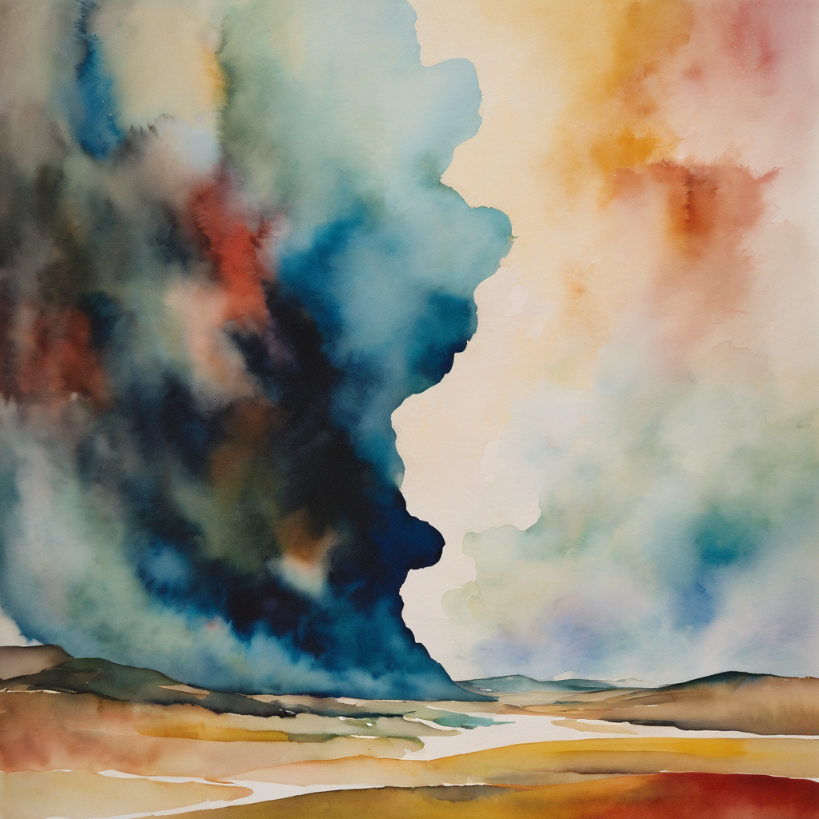
Commitment Prayer of the Week
Leader: Our commitment prayer for the week is a prayer of lament
https://www.youtube.com/watch?v=d8tLRZWOAcw&t=2s
Notes:
Link to prayer group ministry page for weekly commitment prayer https://holyhermits.com.au/ministries/prayer-group

Slide 45
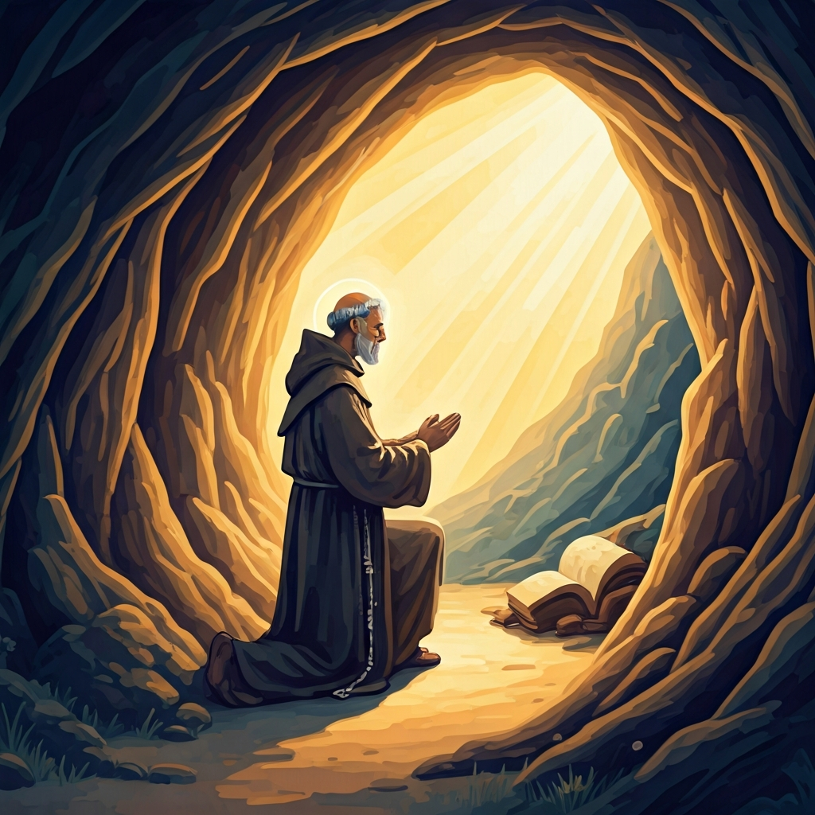
Devotions

Slide 46
Hermit Wisdom St Benedict
A prayer inspired by St Benedict;
Eternal God, who made Benedict a wise master in the school of your service and a guide to many called into community to follow the rule of Christ: Grant that we may put your love before all else and seek with joy the way of your commandments. May we see the coming of your Kingdom alongside Benedict and all the other Hermits we remember. Amen.

Slide 47

​
Leader: ​As we enter a few minutes of silence together, you are invited to pray the prayer of adoration on the next slide and/or spend this time in contemplation. ​
The Spiritual Communion prayer follows on the slide after that.
Let us be still.
Leader and Cantor Mute.
Continue…

Slide 48

Dear God, when it’s easy to choose, help us to choose well.
When it’s hard to choose, help us to choose well.
When we have time to choose, help us to choose well.
When we have to choose quickly, help us to choose well.
Every time we have to choose, help us to choose well.
Amen.
​
Notes:
Prayer for all ages

Slide 49

Making a
Spiritual Communion
(Prayed in silence)
Oh, my Lord Jesus I turn to you present at the Altar and in the Tabernacle. I believe that you are present in the Holy Sacrament of your most Sacred Body and Blood. I love you above all things and I desire to receive you into my Soul. I cannot at this moment receive you Sacramentally in Holy Communion. Come spiritually into my heart. Purify it, Sanctify it. Render my heart like your own heart. I embrace you as if you were already there and unite myself wholly with you. Never permit me to be separated from you. Lord, I am not worthy to receive you, but only say the word and I shall be healed. Amen

Slide 50
Leader unmutes
Our final song is
Oh God Our Help in Ages Past
https://www.youtube.com/watch?v=rsHIwXTjAOU
​We stay on mute
Leader and Cantor mute

Slide 51
Leader and cantor unmute
Sending Prayer
Leader: We pray our sending prayer together.
All: Guide us, O thou great Redeemer:
guide us in our thinking,
guide us in our speaking,
guide us in our doings,
guide us always to choose what pleases you.
God is our hope.
Amen.

Slide 52
The Benediction
Leader: Let us all invite God’s blessings together,
All: May the Lord bless us and keep us.
May the Lord’s face shine upon us and be gracious to us.
May the Lord’s countenance be lifted upon us,
and bring us peace. Amen

Slide 53
Notices
If there is anything you would like to pray for please post a prayer to the HHO App Prayer Wall so we can hold each other in our prayers
We continue our July Sabbath month of rest
See HHO Events page for further upcoming events HHO Events

Slide 54

Leader: Thank you for your regular gifts to this ministry. Offerings are most welcome via:
The HHO App
Direct Debit
International Direct Debit
Please consider a one-off donation
or leaving a legacy in your Will
For further information go to HHO give page
https://holyhermits.com.au/give

Slide 55
Serving next week
19th July 2026
8th Sunday after Pentecost
9:00 am AEST
Service Prep: Lauren | Chat Host: Viki | First Reader: Grant*
Music: Lauren | Welcomer: Lauren | Second Reader: Kieron
Proof-reader: Kris | Priest: N/A | Preacher: Lauren
Broadcaster: Barry | Deacon: Lauren | Fellowship: Lauren
Backup Broadcaster: Lauren | Leader: Jeremy | Safety Officer: Rachel
Zoom Buttons: Viki | Cantor: Margo | Attendance: Viki
Thank you for your ministry gifts
New Servers always welcome!
Please email Rev’d Lauren to get involved
holyhermits@anglicanchurchsq.org.au

Slide 56
The Dismissal
Leader: I invite everyone to unmute for the Dismissal
Leader: Go in peace to love and serve the Lord.
All: In the name of Christ, Amen.

Slide 57
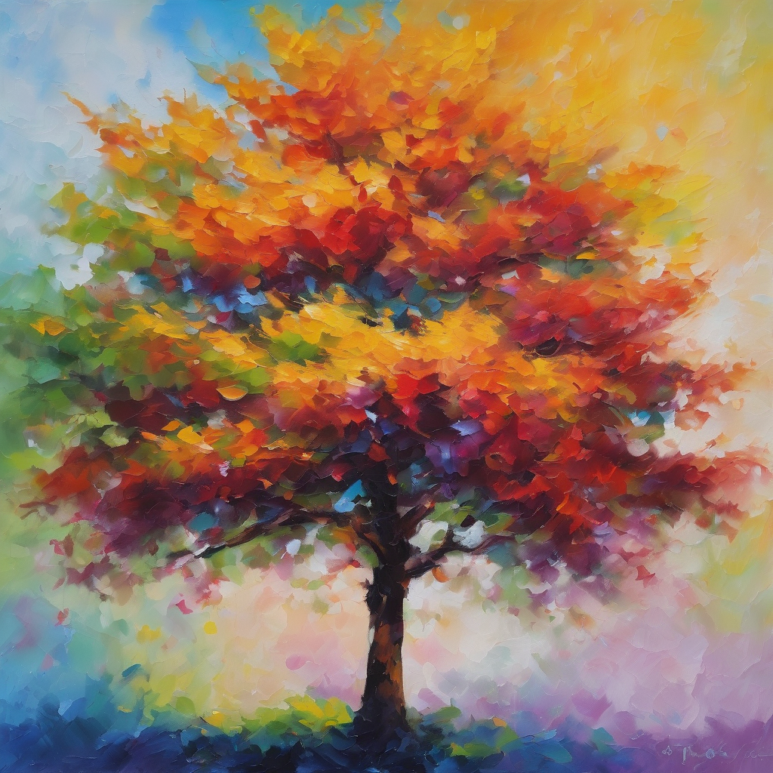
Fellowship
Thank you, Julie for leading Fellowship
Please feel welcome to linger or pop a message in the chat and head off when you are ready.​
Extra resources developed
by Roots on the Web
Images from Padlet

