Slide 1
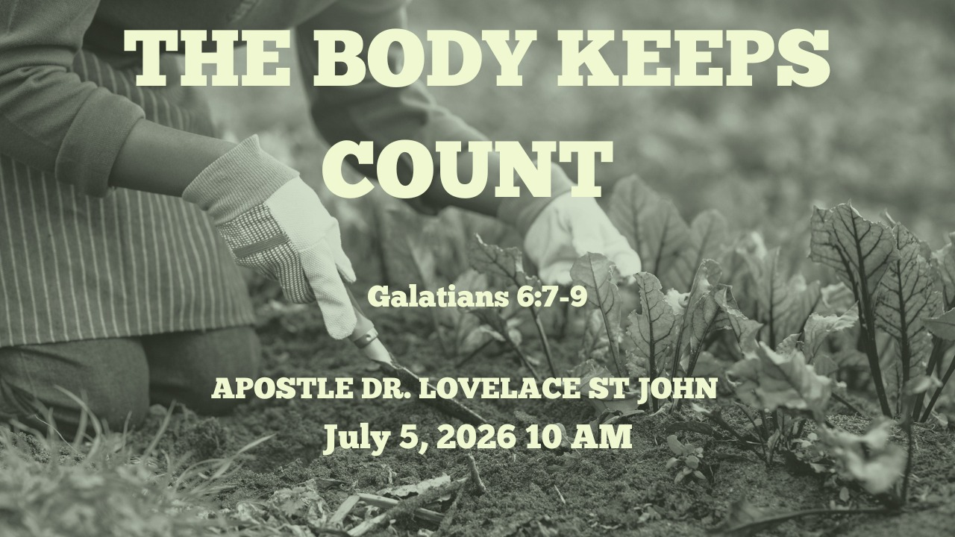

Slide 2



Scripture:
GALATIANS 6: 7 – 9

Slide 3
INTRODUCTION
The body often reveals what the soul has been carrying.
Some harvests are physical, some emotional, some relational, and some financial.
The body is not an enemy to punish; it is a gift to steward.
Grace does not erase the principle of sowing and reaping, but it does give us power to sow differently.
Your past may explain your condition, but it does not have to dictate your destiny.

Slide 4
1. The body keeps score.
This is not a statement of doom. It is a call to awareness.
Sometimes the answer is spiritual.
Sometimes the answer is emotional.
Sometimes the answer is physical.
Sometimes the answer is all three.
What happens to one part of us often affects the others.

Slide 5
2. THE LAW OF SOWING AND REAPING
Galatians 6:7 "Whatever a man sows, that he will also reap."
Seeds become harvests.
This principle not only for finances; It applies to every area of life.
If we sow bitterness, we often reap broken relationships.
If we sow wisdom, we often reap stability.
If we sow discipline, we often reap strength.

Slide 6
2. THE LAW OF SOWING AND REAPING (cont)
Galatians 6:7 "Whatever a man sows, that he will also reap."
This principle not only for finances; It applies to every area of life.
If we sow discipline, we often reap strength.
If we sow neglect, we often reap weakness.
If we sow healthy habits, we often reap vitality.
The body records years of habits.
The mind records years of thoughts.
The heart records years of experiences.

Slide 7
3. The body often carries unhealed pain
Sometimes what shows up in adulthood is not only rebellion or bad choices. Sometimes it is trauma, grief, fear, chronic stress, survival patterns, or emotional pain that was never safely processed.
A child who grew up in fear may carry anxiety in the body. A young person who was neglected may develop destructive coping habits. A person who lived under constant stress may later struggle physically, mentally, and emotionally.
Some people are not just fighting bad habits. They are carrying old wounds in their present bodies.

Slide 8
4. THE PRODIGAL SON – LUKE 15: 11 – 32
In his younger years.
He wasted what he had.
His choices.
Unchecked living.
Promises liberty but produces bondage. It advertises pleasure but often leaves pain.

Slide 9
4. THE PRODIGAL SON – LUKE 15: 11 – 32 (cont)
Unchecked living.
What begins as a decision can become a lifestyle, and what becomes a lifestyle can finally show up in the body, the mind, the relationships, and the future.
Some people have bodies shaped by fear, grief, survival, neglect, and prolonged stress.

Slide 10
5. THE TURNING POINT
He came to himself.
He woke up. He became honest. He stopped blaming, stopped pretending, and recognized where his life had gone.
From that revelation, he decided to return to his father.
That is where healing begins for many of us too.
It begins when we tell the truth: this habit is hurting me.

Slide 11
5. THE TURNING POINT (cont)
This pattern is draining me.
This unresolved pain is affecting my body.
This bitterness is poisoning my peace.
This lifestyle cannot continue.

Slide 12
CONCLUSION
THE STORY OF JOHN MARK: WHEN YESTERDAY SHOWS UP TODAY
Acts 13:13 - Now when Paul and his party set sail from Paphos, they came to Perga in Pamphylia; and John, departing from them, returned to Jerusalem.
He quit. He walked away.
What appeared to be one bad decision left consequences.

Slide 13
CONCLUSION (cont)
THE STORY OF JOHN MARK: WHEN YESTERDAY SHOWS UP TODAY
His internal condition became visible externally.
Undealt-with fears show up in leadership.
Unresolved anger shows up in relationships.
Trauma shows up in emotional responses.

Slide 14
CONCLUSION (cont)
The Story Doesn't End There
Years later, Paul writes: "Get Mark and bring him with you, for he is useful to me for ministry." (2 Timothy 4:11)
Your past may explain your struggles. It does not have to define your future.

