Slide 1


Slide 2
Psalm 86:7-10
7 In the day of my trouble I call upon you, for you answer me.
8 There is none like you among the gods, O Lord, nor are there any works like yours.
9 All the nations you have made shall come and worship before you, O Lord, and shall glorify your name.
10 For you are great and do wondrous things; you alone are God

Slide 3
Prayer Prompts
God, you alone are God and worthy of your glory!
Thank you, Lord, that you have preserved me in the midst of…
I confess that I am often unteachable and fail to walk in Your truth when…
Lord, open my mouth to recount your wondrous love to…..

Slide 4
God did what he said he would do!

Slide 5
The goodness on the other side of God’s promises is far greater than anything else we have deemed worth the wait.

Slide 6
Abraham’s response to God’s faithfulness is obedience.

Slide 7
God, in His faithfulness, turned Sarah’s doubting laughter to joyful laughter.

Slide 8
God’s faithfulness should produce both joy and dependance in the life of the believer.

Slide 9
What God was asking of Abraham was hard, painful, unpleasant, but necessary.

Slide 10
Our old nature and the new nature cannot exist in harmony with one another.

Slide 11
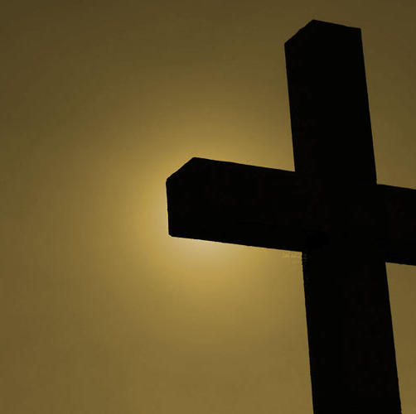
The cross is brutal and painful, but effective in putting things to death.
This Photo by Unknown Author is licensed under CC BY-SA-NC

Slide 12
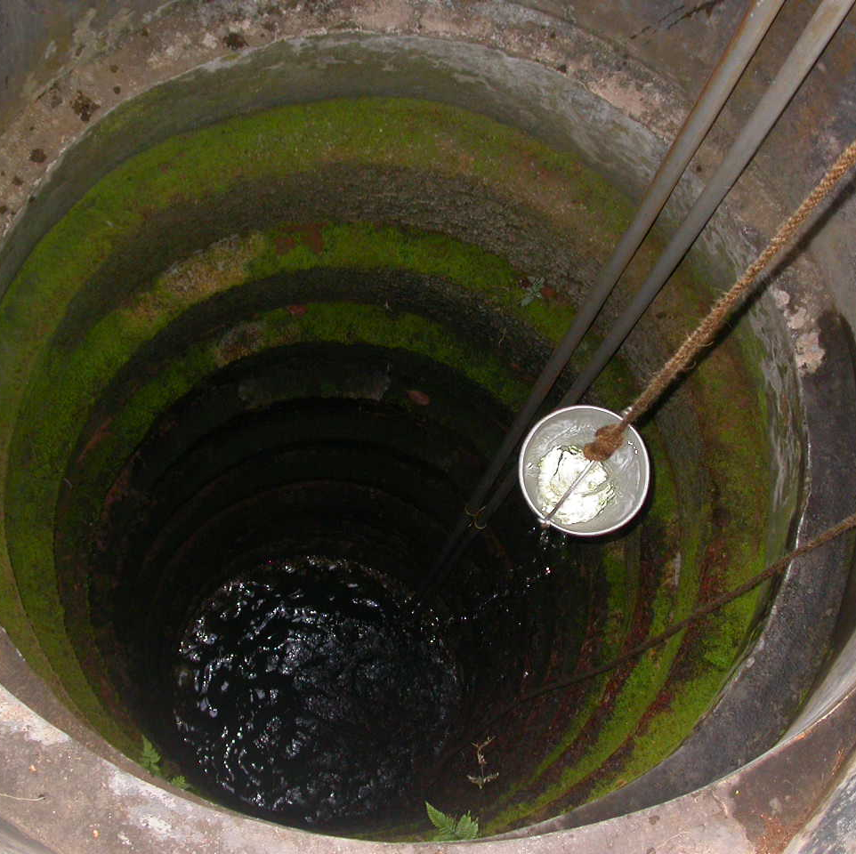
The well of human provision will eventually run out, but the well of God will never run dry.
This Photo by Unknown Author is licensed under CC BY-SA

Slide 13
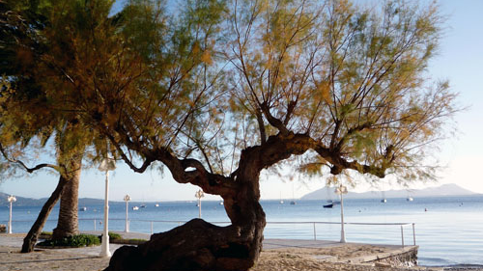
Tamarisk Tree
This Photo by Unknown Author is licensed under CC BY-NC-ND

Slide 14
"I fed you with milk, not solid food, for you were not yet ready for it. Indeed, you are still not ready. For you are still worldly…” 1 Cor 3:2-3

Slide 15
We will be unable to move from spiritual milk to solid spiritual food as long as we remain unwilling to crucify the old self.

