Slide 1
Welcome to Holy Hermits Online Worship
4th Sunday After Pentecost
Today we are remembering
Holy Hermit Kevin of Glendalough
Service Prep: Lauren | Chat Host: Viki | First Reader: Vanessa
Music: Lauren | Welcomer: Chris | Second Reader: Bob
Proof-reader: Kris | Priest: N/A | Preacher: Lauren
Broadcaster: Barry | Deacon: Lauren | Fellowship: Lauren
Backup Broadcaster: Lauren | Leader: Jeremy | Safety Officer: Chris
Zoom Buttons: Viki | Cantor: Margo | Attendance: Viki

Slide 2






Hospitality
Leader:
Please mute for the service unless invited to offer your voice as part of the service ministry
Have the video camera on or off and turn the volume and brightness up or down on your device if things are too loud 🔉🔊or too bright🔅🔆
Our Cantor acts as our voice, offering the responses, in Bold Text, which we say together
Feel welcome to use the chat and reaction emojis 👍
🙏 Please take care of yourself in this space. 🙏 Come and go as you need
😴 It is great to take rest in this space, so falling asleep is also OK 😴
👂️ Remember, pastoral care is available to all in the community, if you'd like to speak to someone about anything spiritual. ❤️ Visit the help page at the website to reach out 🌐
Our Being Together ethos and safeguarding practices can also be accessed on the website 🫶​
🙌 Come as you are – we are all here together! 🙌
Notes:
Used Lent 2022

Slide 3
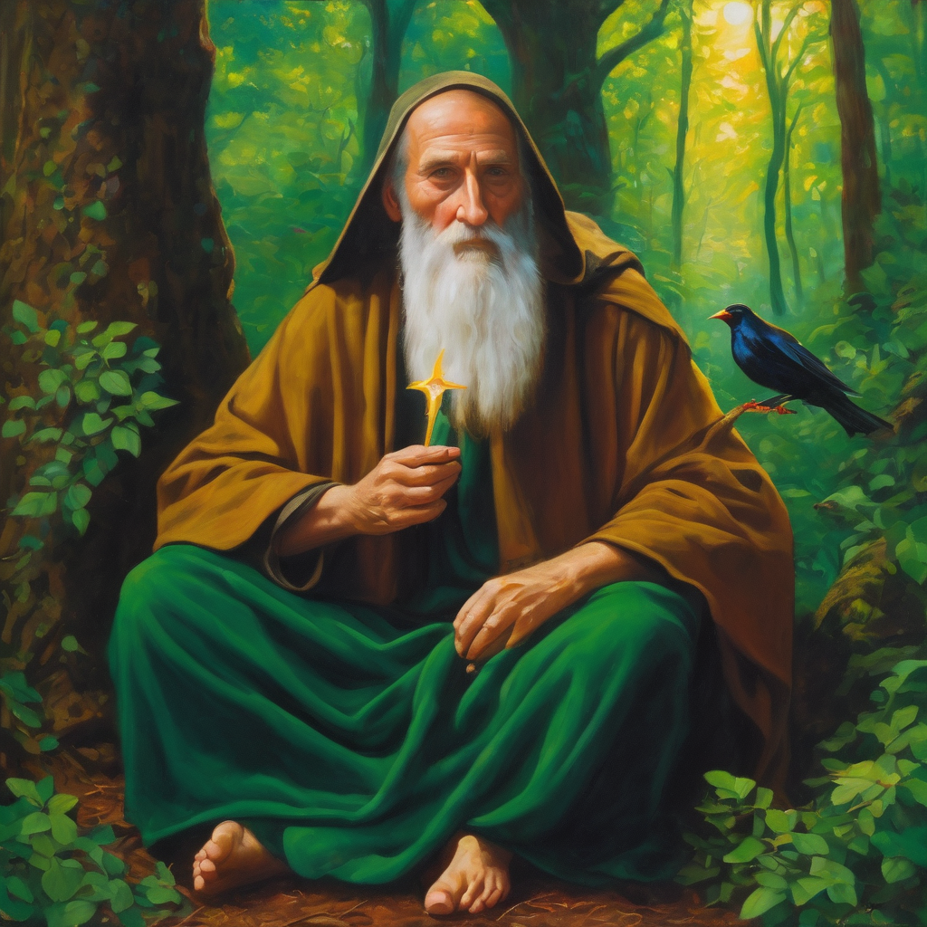
Leader: Our Holy Hermit today is Kevin of Glendalough
St Kevin of Glendalough began life marked by wonder—an angel named him, a white cow fed him, and miracles followed his compassion. Trained by monks from childhood, he later withdrew to a tiny cliffside cave where he lived barefoot among animals, praying and surviving on herbs. His holiness drew followers, and Glendalough blossomed into a great monastic centre.

Slide 4
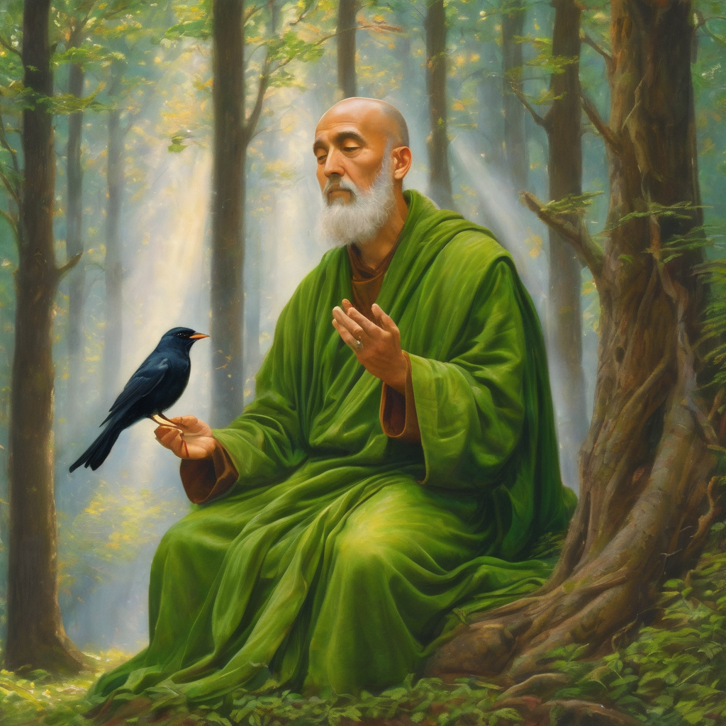
Legends surround him: a blackbird nested in his hand through Lent, otters rescued books and delivered salmon, and a willow tree bore apples at his command. Kevin’s story blend wild solitude, gentleness toward creation, and a quiet power that still captivates hearts.
To read more about our hermits click the link​​ in the send out

Slide 5
Invitation
Leader: As we come into worship let’s take a few deep breaths,
Let go of anything that isn’t serving us,
And become aware of God’s presence here with us.
Opening Music: https://www.youtube.com/watch?v=nKwW45O8Iao

Slide 6
Leader and Cantor unmute
The Greeting
Leader: The grace of the Lord Jesus Christ,
and the love of God,
and the fellowship of the Holy Spirit,
be with you all.
All: And also with you.

Slide 7
Gathering Prayer
Leader: Wherever you are from,
whoever you are,
come and follow Jesus.
Come as you are,
come ready to serve,
come and follow Jesus.
Come with determination,
come with all your heart,
come and follow Jesus.
Notes:
Use Call to Worship Prayer

Slide 8
Gathering Prayer
All: Lord, you went to the cross for us.
You did not change your mind on the way.
Lead us to know you and trust you so deeply
that we do not change our minds
when we choose to follow you.
Amen.
Notes:
Use gathering prayer

Slide 9
Sentence
Leader: I invite our Cantor to proclaim the sentence for today.
Cantor: Those who find their life will lose it, and those who lose their life for Jesus’ sake will find it.
Matthew 10.39

Slide 10
Prayer of Approach
Leader: We pray the prayer of approach together
All: Lord God, as we come to you today,
we will hear difficult words.
Words we might not expect from you.
You warn us that the way ahead might not always be easy.
We need to look closely at ourselves.
Make sure we are ready for whatever comes:
not frightened to trust in you, whatever you ask us to do;
not frightened to take up our cross as we walk your way.
Make us ready, Lord. Amen.

Slide 11
Leader unmutes
Our first Hymn
God, We Gather as Your People
https://www.youtube.com/watch?v=3fabRJfD_dM
We stay on mute
Leader mutes

Slide 12
The Deacon or LA introduces the Confession​
God is steadfast in love and infinite in mercy, welcoming sinners and inviting them to the Lord's table.
Silence may be kept.​
Let us confess our sins in penitence and faith, with a sincere and a true heart.

Slide 13
All: ​Merciful God, our maker and our judge, ​
we have sinned against you ​in thought, word, and deed, ​
and in what we have failed to do: ​
we have not loved you with our whole heart; ​
we have not loved our neighbours as ourselves; ​
we repent, and are sorry for all our sins.​
Father, forgive us. Strengthen us to love and obey you
in newness of life; ​through Jesus Christ our Lord. ​
Amen.​

Slide 14
Words of Assurance offered by the Deacon or LA
These words of assurance from the First Letter of John declare that:
If anyone sins, we have an advocate with the Father, Jesus Christ the righteous. He is the perfect offering for our sin, and not for ours only, but for the sins of the whole world.
(1 John 2: 1-2)
In this is love, not that we loved God, but that he loved us and sent his Son to be the perfect offering for our sins.
(1 John 4:10)

Slide 15
Collect
Leader: Gracious God, we who were baptised into Christ Jesus were baptised into his death:
we pray that, as you raised him from death,
so by the power of the Holy Spirit we may live the new life to your glory, knowing ourselves to be dead in sin but alive for you in Jesus Christ;
who lives and reigns with you and the Holy Spirit,
one God, now and for ever. Amen.

Slide 16
The 1st reader unmutes
Leader: I invite the 1st reader to unmute and offer the 1st lesson when ready.
Reader 1: The 1st Reading is from Genesis 21.8-21
⁸ The child grew, and was weaned; and Abraham made a great feast on the day that Isaac was weaned. ⁹ But Sarah saw the son of Hagar the Egyptian, whom she had borne to Abraham, playing with her son Isaac. ¹⁰ So she said to Abraham, ‘Cast out this slave woman with her son; for the son of this slave woman shall not inherit along with my son Isaac.’
Continue…

Slide 17
¹¹ The matter was very distressing to Abraham on account of his son. ¹² But God said to Abraham, ‘Do not be distressed because of the boy and because of your slave woman; whatever Sarah says to you, do as she tells you, for it is through Isaac that offspring shall be named after you. ¹³ As for the son of the slave woman, I will make a nation of him also, because he is your offspring.’ ¹⁴ So Abraham rose early in the morning, and took bread and a skin of water, and gave it to Hagar, putting it on her shoulder, along with the child, and sent her away.
Continue…

Slide 18
And she departed, and wandered about in the wilderness of Beer-sheba. ¹⁵ When the water in the skin was gone, she cast the child under one of the bushes. ¹⁶ Then she went and sat down opposite him a good way off, about the distance of a bowshot; for she said, ‘Do not let me look on the death of the child.’ And as she sat opposite him, she lifted up her voice and wept. ¹⁷ And God heard the voice of the boy; and the angel of God called to Hagar from heaven, and said to her, ‘What troubles you, Hagar? Do not be afraid; for God has heard the voice of the boy where he is.
Continue…

Slide 19
¹⁸ Come, lift up the boy and hold him fast with your hand, for I will make a great nation of him.’ ¹⁹ Then God opened her eyes, and she saw a well of water. She went, and filled the skin with water, and gave the boy a drink. ²⁰ God was with the boy, and he grew up; he lived in the wilderness, and became an expert with the bow. ²¹ He lived in the wilderness of Paran; and his mother got a wife for him from the land of Egypt.
For the word of the Lord. Thanks be to God.​

Slide 20
Leader: We now say the psalm antiphonally, I invite the first
reader to lead, and we will all respond with our cantor as our voice.
Psalm
86.1-10; 16-17
¹ Incline your ear to me, O God, and answer me:
for I am poor and in misery.
² Preserve my life, for I am faithful:
My God, save your servant who trusts in you.
³ Be merciful to me, O Lord:
for I call to you all the day long.
Continue…

Slide 21
⁴ O make glad the soul of your servant:
for I put my hope in you, O Lord.
⁵ For you, Lord, are good and forgiving:
of great and continuing kindness
to all who call upon you.
⁶ Hear my prayer, O Lord:
and give heed to the voice of my supplication.
⁷ In the day of my trouble I call upon you:
for you will surely answer.
Continue…

Slide 22
⁸ Among the gods there is none like you, O Lord:
nor are there any deeds like yours.
⁹ All the nations you have made
shall come and worship before you:
O Lord, they shall glorify your name.
¹⁰ For you are great and do marvellous things:
and you alone are God.
Continue…

Slide 23
¹⁶ Turn to me and be merciful,
give your strength to your servant:
and save the child of your handmaid.
¹⁷ Show me some token of your goodness:
that those who hate me may see it and be ashamed,
because you, Lord, are my helper and my comforter.

Slide 24
The 2nd reader unmutes
Leader: I invite the 2nd reader to unmute and offer the 2nd lesson when ready.
Reader 2: The 2nd Reading is from Romans 6.1-11
¹ What then are we to say? Should we continue in sin in order that grace may abound? ² By no means! How can we who died to sin go on living in it? ³ Do you not know that all of us who have been baptized into Christ Jesus were baptized into his death? ⁴ Therefore we have been buried with him by baptism into death, so that,
Continue…

Slide 25
just as Christ was raised from the dead by the glory of the Father, so we too might walk in newness of life. ⁵ For if we have been united with him in a death like his, we will certainly be united with him in a resurrection like his. ⁶ We know that our old self was crucified with him so that the body of sin might be destroyed, and we might no longer be enslaved to sin. ⁷ For whoever has died is freed from sin. ⁸ But if we have died with Christ, we believe that we will also live with him. ⁹ We know that Christ, being raised from the dead, will never die again; death no longer has dominion over him.
Continue…

Slide 26
¹⁰ The death he died, he died to sin, once for all; but the life he lives, he lives to God. ¹¹ So you also must consider yourselves dead to sin and alive to God in Christ Jesus.
For the word of the Lord. Thanks be to God.​

Slide 27

We pause before
​the Gospel ​​

Slide 28
Deacon: The Gospel of our Lord Jesus Christ according to St Matthew Chapter 10 beginning at the 24th verse
All: Glory to you Lord Jesus Christ.
²⁴ ‘A disciple is not above the teacher, nor a slave above the master;
²⁵ it is enough for the disciple to be like the teacher, and the slave like the master. If they have called the master of the house Beelzebul, how much more will they malign those of his household!
²⁶ ‘So have no fear of them; for nothing is covered up that will not be uncovered, and nothing secret that will not become known.
Continue…

Slide 29
²⁷ What I say to you in the dark, tell in the light; and what you hear whispered, proclaim from the housetops.
²⁸ Do not fear those who kill the body but cannot kill the soul; rather fear him who can destroy both soul and body in hell.
²⁹ Are not two sparrows sold for a penny? Yet not one of them will fall to the ground unperceived by your Father.
³⁰ And even the hairs of your head are all counted.
³¹ So do not be afraid; you are of more value than many sparrows.
Continue…

Slide 30
³² ‘Everyone therefore who acknowledges me before others, I also will acknowledge before my Father in heaven;
³³ but whoever denies me before others, I also will deny before my Father in heaven.
³⁴ ‘Do not think that I have come to bring peace to the earth; I have not come to bring peace, but a sword.
³⁵ For I have come to set a man against his father,
and a daughter against her mother,
and a daughter-in-law against her mother-in-law;
Continue…

Slide 31
³⁶ and one’s foes will be members of one’s own household.
³⁷ Whoever loves father or mother more than me is not worthy of me; and whoever loves son or daughter more than me is not worthy of me;
³⁸ and whoever does not take up the cross and follow me is not worthy of me.
³⁹ Those who find their life will lose it, and those who lose their life for my sake will find it.
This is the Gospel of the Lord. Praise to you Lord Jesus Christ.

Slide 32

We pause
after ​the Gospel ​​

Slide 33
Leader: .
Leader and Cantor mute
Broadcaster exits screenshare
Flashback Sermon:
Messy Families and God
https://www.youtube.com/watch?v=haQSZM_EzPY
Notes:
Sermon starts 37:14 – Please let me know if the sermon is too quiet

Slide 34
Leader unmutes
Our next Hymn
How Firm a Foundation
https://www.youtube.com/watch?v=vXcgQL0SQ40
We stay on mute
Leader mutes

Slide 35
The Leader and Cantor unmute
The Greeting of Peace
Leader: We are the body of Christ
All: God’s Spirit is with us
Leader: The peace of the Lord be always with you.
All: And also with you.
Leader: A sign of peace may be exchanged
You may like to type 'Peace' into the chat, use the 'raise hand’ or other reaction buttons, or just simply wave via the screen with your video turned on
(Broadcaster exits shared screen for a few moments for the exchange of peace)

Slide 36

Prayer of Thanksgiving before Intercessions
Leader: As we enter prayer, I invite the second reader to unmute to lead our intercessions following the prayer of thanksgiving on the next slide. Please feel free to change your body position as you need.
Continue…

Slide 37
Leader: We thank you, Lord Jesus,
that we are a people of your Word.
We have the blueprint for how to live our lives.
We have the promise that
if we lose our life for your sake we will find it.
It’s difficult to understand, but we are ready to trust you.
We share in fellowship together and go forth strengthened.
Help us to know when to speak words of peace.
And when to refuse to compromise. Amen.
Notes:
Prayer of praise and thanksgiving

Slide 38
Intercessions
Reader 2: We pray for creation and communities we share our lives with. We pause for a few moments to name either in our hearts, or out loud, or in the chat, those environments and communities we bring to the Lord in prayer.
PAUSE…
Continue…

Slide 39
Intercessions
Reader 2: We entrust to you the community of Holy Hermits Online and our ministry partners:
Prosper the work of our hands and show us the way to your new creation.
Creator God, Hear our prayer.
St John's Cathedral Brisbane The Anglican Diocese of Southern Queensland St Gabriel’s, Carindale Benedictus Contemplative Church, Canberra Anglican Focus and Tithe.ly

Slide 40

Reader 2: Loving Creator, we entrust to you all animals, especially those who are sick, anxious, ageing, lost, at risk, lonely, sad, hungry, in pain, homeless, abused, living in fear, encountering violence of any kind, in need of comfort, rehabilitation or transformation.

Slide 41

Reader 2: We invite your loving compassion for:
We name in our hearts, out loud or in the chat,
the animals we bring to the Lord in prayer. PAUSE…
Jasmine, ​
Leese(y), ​
Sid, Toots & Lulu​
Polly and Suki​
Fred, George & Percy​
Koshka ​
Jax
Lambert ​​
Kala, Nigel & Little One ​​
Toby​​
Taco​​
Paddy ​​
Rosie​
Squealer

Slide 42
Reader 2: Eternal Trinity of Love, we uphold to you the people we love and carry cares for:
Kerry, Les & Jake Julie, Ray, Tracey & Shane Mark, Desley & Bob ​​ Rachel, Mervyn & Gillian ​​Rev'd Shane & Janette​​ Alecia, Martin & Aidan​​ Kirsten, Greg, Daphne & Beau Bill & Marjorie​​ Aaron & Andrea Liz’s Godchildren Matthew & Nicholas​ | Barry​​ Dr Julie ​​ Ruth​​ Phil​ May Susan Tanya​ Neva Kathy ​Gayanne Tina | ​​ | Alan & Gaylene​ Jess & Leah ​​ Barry & Gwen Bob & Di​ Pat & Julie Dilys & Tony, Paul & Darhon Judy & Mary Miriam Lorelei Nettie

Slide 43
Reader 2:
We name in our hearts, out loud or in the chat, those we bring to the Lord in prayer.
PAUSE…
We entrust to you those who have died, those who have died peacefully and those who have died tragically, The old and the young. Receive them into your Kingdom. Lord in your mercy, Hear our prayers. Amen.

Slide 44
Pray Daily Cycle of Prayer
Leader: Loving God, joining with the Church in our cycle of prayer, we ask your blessings on:
The Church of South India (United)
The Diocese of Rockhampton: †Peter; Clergy and People
The Parish of Moggill-Mt Crosby: Rob, Angela
AnglicareSQ Out of Home Care, Southeast Region – Gold Coast Foster & Kinship Care
All Saints Anglican School, Merrimac: Headmaster – Matthew; Chaplain – Ann; Chair of School Council – John; members of School Council; staff & students

Slide 45

Commitment Prayer of the Week
Leader: Our commitment prayer for the week is for during emergence of AI
https://www.youtube.com/watch?v=uhkBwPKHNXw
Notes:
Link to prayer group ministry page for weekly commitment prayer https://holyhermits.com.au/ministries/prayer-group

Slide 46
Leader: Let us pray together the prayer which Jesus gave us saying:
All: Our Father in heaven, hallowed be your name,
your kingdom come, your will be done, on earth as in heaven.
Give us today our daily bread.
Forgive us our sins
as we forgive those who sin against us.
Save us from the time of trial and deliver us from evil.
For the kingdom, the power, and the glory are yours
now and for ever.
Amen.

Slide 47
Devotions

Slide 48
Hermit Wisdom Kevin of Glendalough
A prayer inspired by Kevin of Glendalough:
Loving God, we pray that all who follow the way of St Kevin, may be inspired to draw closer to you in nature and to attend to all that you surround us with in a spirit of gentleness and gratitude. We thank you for people like Holy Hermit Kevin who inspire us as they communicate their love for you in music and poetry. May we respond with deeper devotion to our Lord Jesus Christ, and in loving service of our neighbours. In the name of Jesus, Amen.

Slide 49

​
Leader: ​As we enter a few minutes of silence together, you are invited to pray the prayer of adoration on the next slide and/or spend this time in contemplation. ​
The Spiritual Communion prayer follows on the slide after that.
Let us be still.
Leader and Cantor Mute.
Continue…

Slide 50
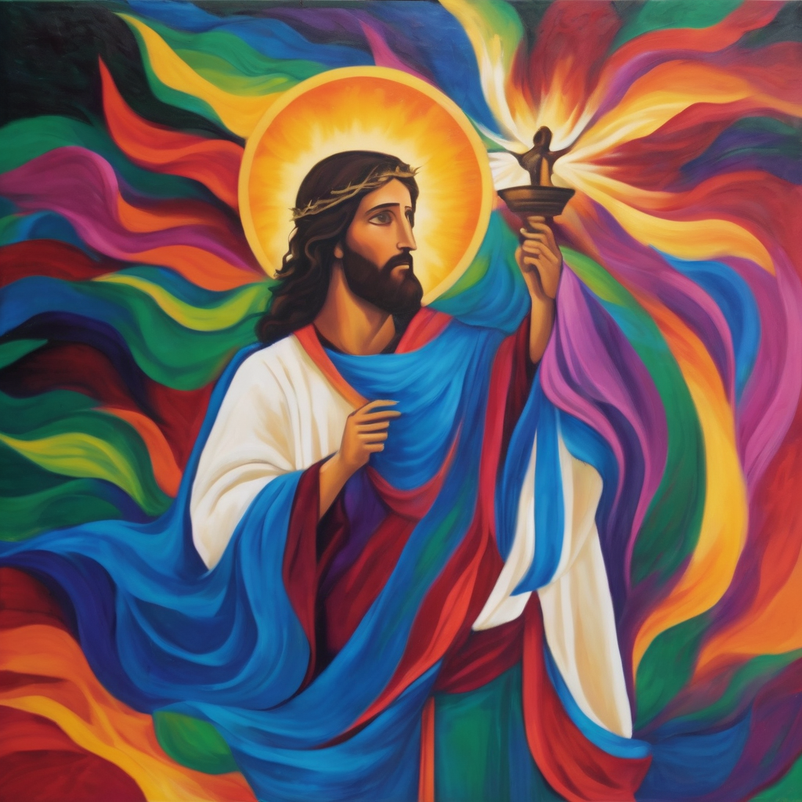
​
Jesus loves us…
He died for us all…
So, we will love our Lord…
We will follow our God…
We will stand up for Jesus…
Amen.
Notes:
Prayer for all ages

Slide 51

Oh, my Lord Jesus I turn to you present at the Altar and in the Tabernacle. I believe that you are present in the Holy Sacrament of your most Sacred Body and Blood. I love you above all things and I desire to receive you into my Soul. I cannot at this moment receive you Sacramentally in Holy Communion. Come spiritually into my heart. Purify it, Sanctify it. Render my heart like your own heart. I embrace you as if you were already there and unite myself wholly with you. Never permit me to be separated from you. Lord, I am not worthy to receive you, but only say the word and I shall be healed. Amen
Making a
Spiritual Communion
(Prayed in silence)

Slide 52
Leader unmutes
Our final song is
Where Cross the Crowded Ways of Life
https://www.youtube.com/watch?v=SbuN9Cq5zCY
​We stay on mute
Leader and Cantor mute

Slide 53
Leader and cantor unmute
Sending Prayer
Leader: We pray our sending prayer together.
All: Jesus, you call us to follow.
You send us out in your power to preach the good news.
You challenge us to put you first in our lives.
Give us the courage to respond wholeheartedly to this call.
To follow you wherever you call us to go.
No compromise.
Amen.

Slide 54
The Benediction
Leader: Let us all invite God’s blessings together,
All: May the Lord bless us and keep us.
May the Lord’s face shine upon us and be gracious to us.
May the Lord’s countenance be lifted upon us,
and bring us peace. Amen

Slide 55
Notices
Wednesday @6pm is our final study on the Trinity; Embracing The Divine Flow: Trinitarian Love and a Transformed Cross
Synod is this week, please hold everyone in prayer as we gather together
July we enter our Sabbath month of rest
See HHO Events page for further upcoming events HHO Events

Slide 56
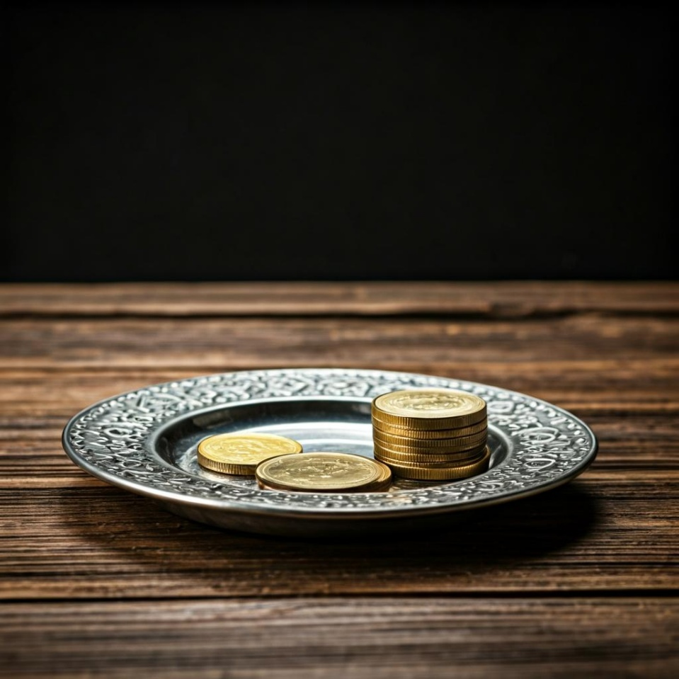
Leader: Thank you for your regular gifts to this ministry. Offerings are most welcome via:
The HHO App
Direct Debit
International Direct Debit
Please consider a one-off donation
or leaving a legacy in your Will
For further information go to HHO give page
https://holyhermits.com.au/give

Slide 57
Serving next week
28th June 2026
5th Sunday after Pentecost
9:00 am AEST
Service Prep: Kris | Chat Host: Rachel | First Reader: Phil
Music: Wiggles 🐶 | Welcomer: Chris | Second Reader: Viki
Proof-reader: Lauren | Priest: N/A | Preacher: Lauren
Broadcaster: Lauren | Deacon: Lauren | Fellowship: Julie
Backup Broadcaster: Barry | Leader: Julie | Safety Officer: Rachel
Zoom Buttons: Rachel | Cantor: Barry | Attendance: Rachel
Thank you for your ministry gifts
New Servers always welcome!
Please email Rev’d Lauren to get involved
holyhermits@anglicanchurchsq.org.au

Slide 58
The Dismissal
Leader: I invite everyone to unmute for the Dismissal
Leader: Go in peace to love and serve the Lord.
All: In the name of Christ, Amen.

Slide 59
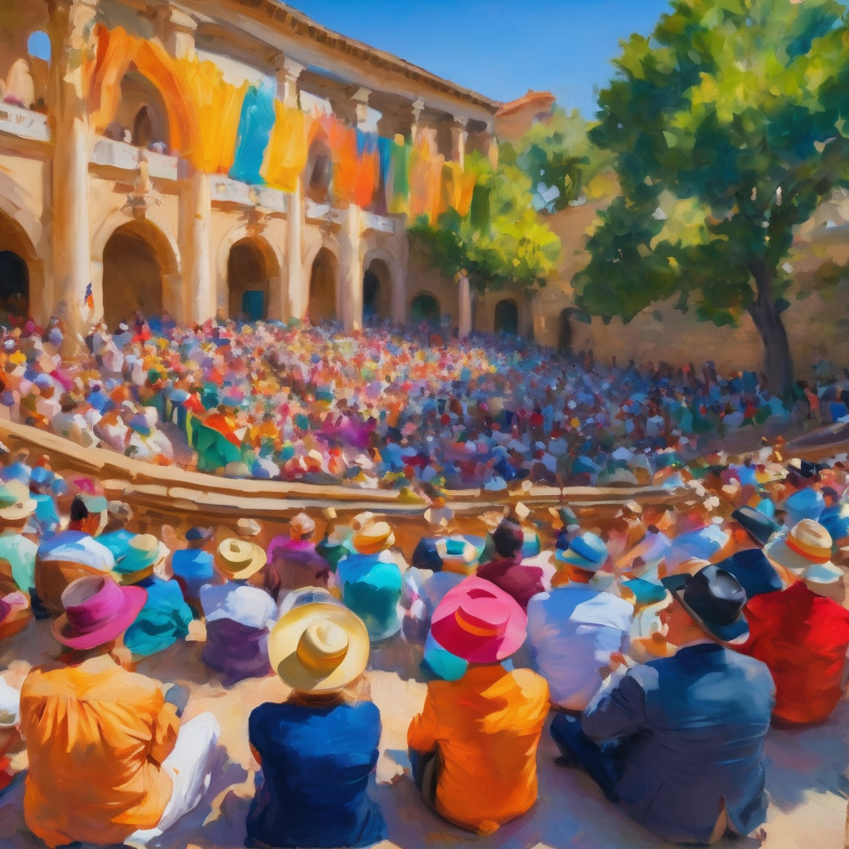
Fellowship
Thank you, Lauren for leading Fellowship
Please feel welcome to linger or pop a message in the chat and head off when you are ready.​
Extra resources developed
by Roots on the Web

