Slide 1
Welcome to Holy Hermits Online Worship
6th Sunday After Pentecost
Today we are remembering
Holy Hermit David the Dendrite
Service Prep: Lauren | Chat Host: Viki | First Reader: Phil
Music: Wiggles 🐶 | Welcomer: Chris | Second Reader: Bob
Proof-reader: Viki | Priest: N/A | Preacher: Lauren
Broadcaster: Barry | Deacon: Lauren | Fellowship: Lauren
Backup Broadcaster: Lauren | Leader: Jeremy | Safety Officer: Chris
Zoom Buttons: Viki | Cantor: Kieron | Attendance: Viki

Slide 2






Hospitality
Leader:
Please mute for the service unless invited to offer your voice as part of the service ministry
Have the video camera on or off and turn the volume and brightness up or down on your device if things are too loud 🔉🔊or too bright🔅🔆
Our Cantor acts as our voice, offering the responses, in Bold Text, which we say together
Feel welcome to use the chat and reaction emojis 👍
🙏 Please take care of yourself in this space. 🙏 Come and go as you need
😴 It is great to take rest in this space, so falling asleep is also OK 😴
👂️ Remember, pastoral care is available to all in the community, if you'd like to speak to someone about anything spiritual. ❤️ Visit the help page at the website to reach out 🌐
Our Being Together ethos and safeguarding practices can also be accessed on the website 🫶​
🙌 Come as you are – we are all here together! 🙌
Notes:
Used Lent 2022

Slide 3
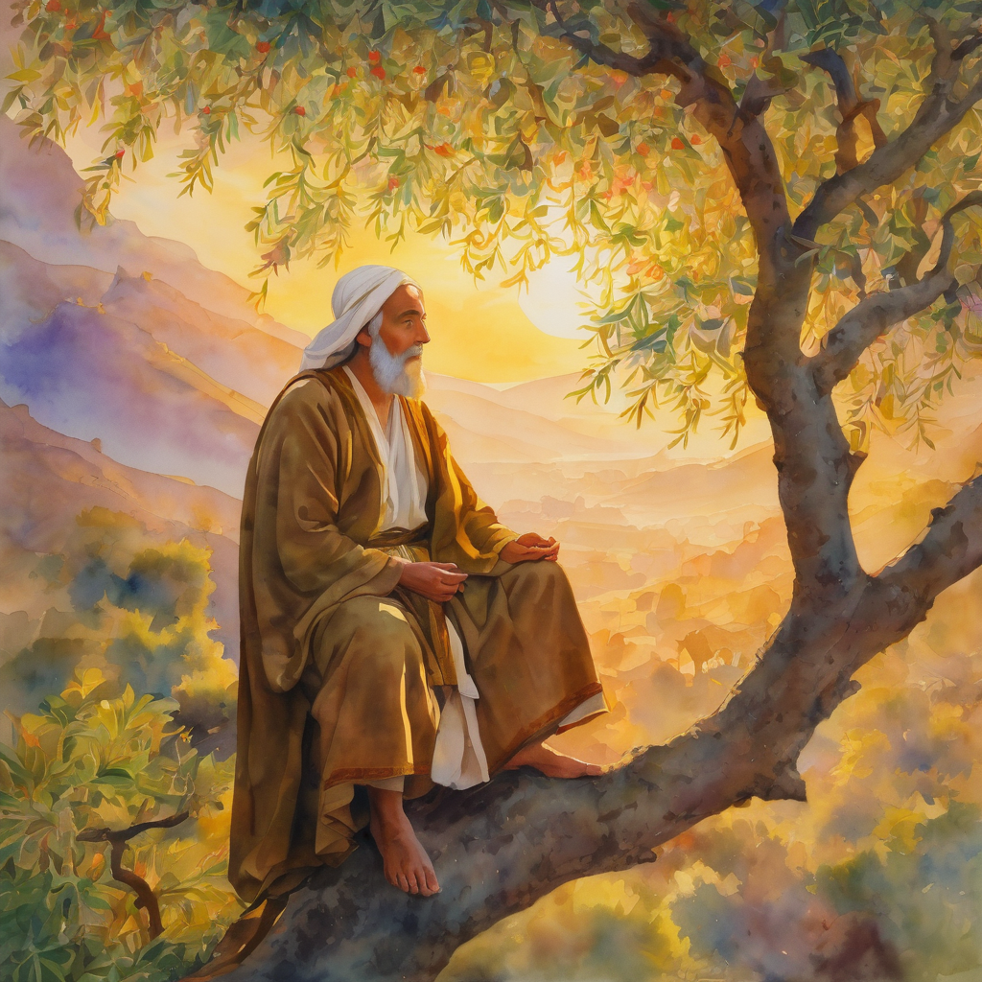
Leader: Our Holy Hermit today is David the Dendrite
David the Dendrite, a monk from northern Mesopotamia, sought solitude after crowds pursued him for spiritual guidance. Between 465–470 he climbed an almond tree outside Thessaloniki, living there for three harsh years of prayer and exposure.

Slide 4
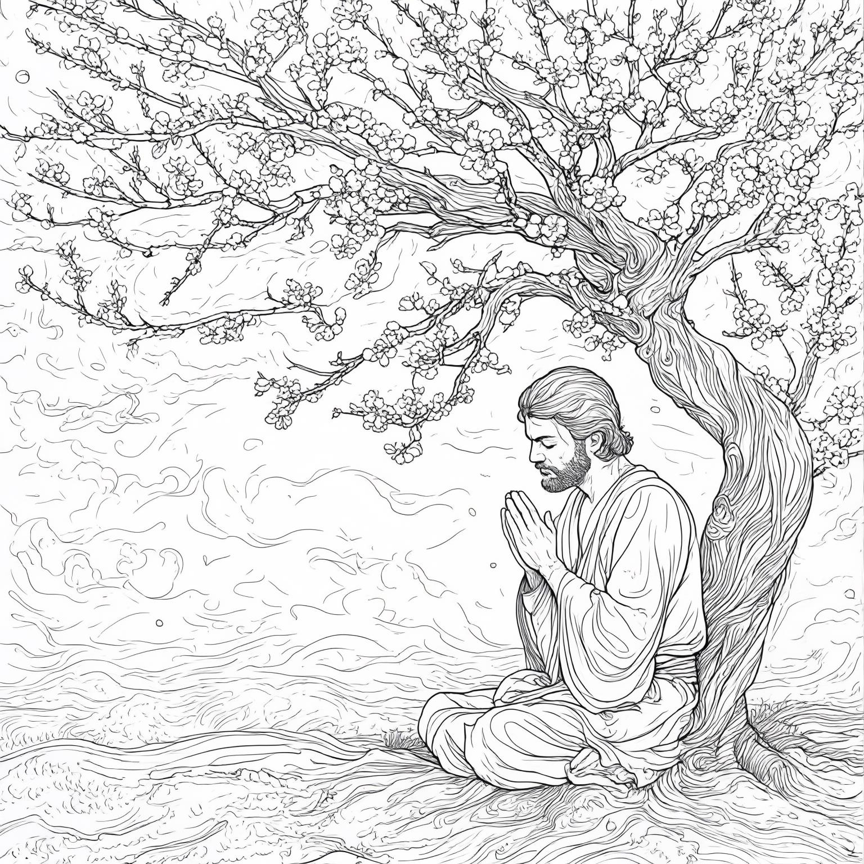
After decades as a hermit, he travelled to Constantinople around 520, where he famously held burning incense without injury while petitioning Emperor Justinian to defend Thessaloniki. David died on his return journey and was buried at the Monastery of Saints Theodore and Mercurius. His feast day is celebrated on 26 June.
To read more about our hermits click the link​​ in the send out

Slide 5
Invitation
Leader: As we come into worship let’s take a few deep breaths,
Let go of anything that isn’t serving us,
And become aware of God’s presence here with us.
Opening Music: https://www.youtube.com/watch?v=wSptQ-xyFF8

Slide 6
Leader and Cantor unmute
The Greeting
Leader: The grace of the Lord Jesus Christ,
and the love of God,
and the fellowship of the Holy Spirit,
be with you all.
All: And also with you.

Slide 7
Gathering Prayer
Leader: Jesus says, ‘I am the way, and the truth, and the life.’
Let us come to him today, to learn to walk in his ways;
let us come to him today, to discover more of his truth;
let us come to him today, to be filled with his life.
Let us come together now, to rejoice in him:
the way, the truth and the life.
Notes:
Use Call to Worship Prayer

Slide 8
Gathering Prayer
All: Lord Jesus, we thank you
that you came to reveal the
Father’s love,
and you will never turn us away.
Touch us now with your grace and mercy,
and fill our hearts with the joy of your salvation.
Amen.
Notes:
Use gathering prayer

Slide 9
Sentence
Leader: I invite our Cantor to proclaim the sentence for today.
Cantor: ‘Come to me, all you that are weary and are carrying heavy burdens, and I will give you rest,’ says the Lord. ‘Take my yoke upon you, and learn from me; for I am gentle and humble in heart.’
Matthew 11.28–29

Slide 10
Prayer of Approach
Leader: We pray the prayer of approach together
All: Come all who wish to journey forward with our Creator God.
Come near and draw from his refreshing well.
Allow him to guide our way.

Slide 11
Leader unmutes
Our first Hymn
My Faith Has Found a Resting Place
https://www.youtube.com/watch?v=awRdzFzeUPg
We stay on mute
Leader mutes

Slide 12
The Deacon or LA introduces the Confession​
God is steadfast in love and infinite in mercy, welcoming sinners and inviting them to the Lord's table.
Silence may be kept.​
Let us confess our sins in penitence and faith, with a sincere and a true heart.

Slide 13
All: ​Merciful God, our maker and our judge, ​
we have sinned against you ​in thought, word, and deed, ​
and in what we have failed to do: ​
we have not loved you with our whole heart; ​
we have not loved our neighbours as ourselves; ​
we repent, and are sorry for all our sins.​
Father, forgive us. Strengthen us to love and obey you
in newness of life; ​through Jesus Christ our Lord. ​
Amen.​

Slide 14
Words of Assurance offered by the Deacon or LA
These words of assurance from the First Letter of John declare that:
If anyone sins, we have an advocate with the Father, Jesus Christ the righteous. He is the perfect offering for our sin, and not for ours only, but for the sins of the whole world.
(1 John 2: 1-2)
In this is love, not that we loved God, but that he loved us and sent his Son to be the perfect offering for our sins.
(1 John 4:10)

Slide 15
Collect
Leader: Almighty God,
your Son Jesus Christ has taught us that what we do for the least of his brothers and sisters we do also for him:
give us the will to serve others
as he was the servant of all,
who gave up his life and died for us;
yet lives and reigns with you and the Holy Spirit,
one God, now and for ever. Amen.

Slide 16
The 1st reader unmutes
Leader: I invite the 1st reader to unmute and offer the 1st lesson when ready.
Reader 1: The 1st Reading is from Genesis 24.34-38, 42-49, 58-67
³⁴ So he said, ‘I am Abraham’s servant.
³⁵ The Lord has greatly blessed my master, and he has become wealthy; he has given him flocks and herds, silver and gold, male and female slaves, camels and donkeys.
³⁶ And Sarah my master’s wife bore a son to my master when she was old; and he has given him all that he has.
Continue…

Slide 17
³⁷ My master made me swear, saying, “You shall not take a wife for my son from the daughters of the Canaanites, in whose land I live;
³⁸ but you shall go to my father’s house, to my kindred, and get a wife for my son.”
⁴² ‘I came today to the spring, and said, “O Lord , the God of my master Abraham, if now you will only make successful the way I am going! ⁴³ I am standing here by the spring of water; let the young woman who comes out to draw, to whom I shall say, ‘Please give me a little water from your jar to drink,’
Continue…

Slide 18
⁴⁴ and who will say to me, ‘Drink, and I will draw for your camels also’—let her be the woman whom the Lord has appointed for my master’s son.”
⁴⁵ ‘Before I had finished speaking in my heart, there was Rebekah coming out with her water-jar on her shoulder; and she went down to the spring, and drew. I said to her, “Please let me drink.”
⁴⁶ She quickly let down her jar from her shoulder, and said, “Drink, and I will also water your camels.” So I drank, and she also watered the camels.
Continue…

Slide 19
⁴⁷ Then I asked her, “Whose daughter are you?” She said, “The daughter of Bethuel, Nahor’s son, whom Milcah bore to him.” So I put the ring on her nose, and the bracelets on her arms.
⁴⁸ Then I bowed my head and worshipped the Lord , and blessed the Lord , the God of my master Abraham, who had led me by the right way to obtain the daughter of my master’s kinsman for his son.
⁴⁹ Now then, if you will deal loyally and truly with my master, tell me; and if not, tell me, so that I may turn either to the right hand or to the left.’
Continue…

Slide 20
⁵⁸ And they called Rebekah, and said to her, ‘Will you go with this man?’ She said, ‘I will.’
⁵⁹ So they sent away their sister Rebekah and her nurse along with Abraham’s servant and his men.
⁶⁰ And they blessed Rebekah and said to her,
‘May you, our sister, become
thousands of myriads;
may your offspring gain possession
of the gates of their foes.’
Continue…

Slide 21
⁶¹ Then Rebekah and her maids rose up, mounted the camels, and followed the man; thus the servant took Rebekah, and went his way.
⁶² Now Isaac had come from Beer-lahai-roi, and was settled in the Negeb.
⁶³ Isaac went out in the evening to walk in the field; and looking up, he saw camels coming. ⁶⁴ And Rebekah looked up, and when she saw Isaac, she slipped quickly from the camel, ⁶⁵ and said to the servant, ‘Who is the man over there, walking in the field to meet us?’ The servant said, ‘It is my master.’
Continue…

Slide 22
So she took her veil and covered herself.
⁶⁶ And the servant told Isaac all the things that he had done.
⁶⁷ Then Isaac brought her into his mother Sarah’s tent. He took Rebekah, and she became his wife; and he loved her. So Isaac was comforted after his mother’s death.
For the word of the Lord. Thanks be to God.​

Slide 23
Leader: We now say the psalm antiphonally, I invite the first
reader to lead, and we will all respond with our cantor as our voice.
Psalm 45.10-17
¹⁰ Hear, O daughter, consider and incline your ear:
forget your own people and your father’s house.
¹¹ The king desires your beauty:
he is your lord, therefore bow down before him.
¹² The richest among the people, O daughter of Tyre:
shall entreat your favour with gifts.
Continue…

Slide 24
¹³ The king’s daughter is all glorious within:
her clothing is embroidered cloth-of-gold.
¹⁴ In robes of many colours she is led to you, O king:
and, after her, the virgins that are with her.
¹⁵ They are led with gladness and rejoicing:
they enter the palace of the king.
Continue…

Slide 25
¹⁶ In place of your fathers you shall have sons:
and make them princes over all the land.
¹⁷ And I will make known your name to every generation:
therefore the peoples shall give you praise for ever.

Slide 26
The 2nd reader unmutes
Leader: I invite the 2nd reader to unmute and offer the 2nd lesson when ready.
Reader 2: The 2nd Reading is from Romans 7.14-25
¹⁴ For we know that the law is spiritual; but I am of the flesh, sold into slavery under sin. ¹⁵ I do not understand my own actions. For I do not do what I want, but I do the very thing I hate. ¹⁶ Now if I do what I do not want, I agree that the law is good. ¹⁷ But in fact it is no longer I that do it, but sin that dwells within me. ¹⁸ For I know that nothing good dwells within me, that is, in my flesh.
Continue…

Slide 27
I can will what is right, but I cannot do it. ¹⁹ For I do not do the good I want, but the evil I do not want is what I do. ²⁰ Now if I do what I do not want, it is no longer I that do it, but sin that dwells within me. ²¹ So I find it to be a law that when I want to do what is good, evil lies close at hand. ²² For I delight in the law of God in my inmost self, ²³ but I see in my members another law at war with the law of my mind, making me captive to the law of sin that dwells in my members. ²⁴ Wretched man that I am! Who will rescue me from this body of death?
Continue…

Slide 28
²⁵ Thanks be to God through Jesus Christ our Lord! So then, with my mind I am a slave to the law of God, but with my flesh I am a slave to the law of sin.
For the word of the Lord. Thanks be to God.​

Slide 29

We pause before
​the Gospel ​​

Slide 30
Deacon: The Gospel of our Lord Jesus Christ according to St Matthew Chapter 11 beginning at the 15th verse
All: Glory to you Lord Jesus Christ.
¹⁵ Let anyone with ears listen!
¹⁶ ‘But to what will I compare this generation? It is like children sitting in the market-places and calling to one another,
¹⁷ “We played the flute for you, and you did not dance;
we wailed, and you did not mourn.”
¹⁸ For John came neither eating nor drinking, and they say, “He has a demon”;
Continue…

Slide 31
¹⁹ the Son of Man came eating and drinking, and they say, “Look, a glutton and a drunkard, a friend of tax-collectors and sinners!” Yet wisdom is vindicated by her deeds.’
²⁵ At that time Jesus said, ‘I thank you, Father, Lord of heaven and earth, because you have hidden these things from the wise and the intelligent and have revealed them to infants;
²⁶ yes, Father, for such was your gracious will.
Continue…

Slide 32
²⁷ All things have been handed over to me by my Father; and no one knows the Son except the Father, and no one knows the Father except the Son and anyone to whom the Son chooses to reveal him.
²⁸ ‘Come to me, all you that are weary and are carrying heavy burdens, and I will give you rest.
²⁹ Take my yoke upon you, and learn from me; for I am gentle and humble in heart, and you will find rest for your souls.
³⁰ For my yoke is easy, and my burden is light.’
This is the Gospel of the Lord. Praise to you Lord Jesus Christ.

Slide 33

We pause
after ​the Gospel ​​

Slide 34
Leader: The Sermon is recorded to YouTube for sharing later.
Only the preacher's video and audio will be recorded.
The chat and other participants' feeds remain out of sight of the recording.
Leader and Cantor mute
Broadcaster exits screenshare
Preacher unmutes
Zoom buttons ”pins” preacher’s screen + selects “record to the cloud”
Sermon

Slide 35
Leader unmutes
Our next Hymn
Come To Me
https://www.youtube.com/watch?v=9yqbwTzF9-A
We stay on mute
Leader mutes

Slide 36
The Leader and Cantor unmute
The Greeting of Peace
Leader: We are the body of Christ
All: God’s Spirit is with us
Leader: The peace of the Lord be always with you.
All: And also with you.
Leader: A sign of peace may be exchanged
You may like to type 'Peace' into the chat, use the 'raise hand’ or other reaction buttons, or just simply wave via the screen with your video turned on
(Broadcaster exits shared screen for a few moments for the exchange of peace)

Slide 37

Prayer of Thanksgiving before Intercessions
Leader: As we enter prayer, I invite the second reader to unmute to lead our intercessions following the prayer of thanksgiving on the next slide. Please feel free to change your body position as you need.
Continue…

Slide 38
Leader: Lord God,
thank you for the stories of people
who followed you through the years.
Thank you for sending Jesus
to show us how to live your way.
Help us live as your disciples and follow you
every day.
Amen.
Notes:
Prayer of praise and thanksgiving

Slide 39
Intercessions
Reader 2: We pray for creation and communities we share our lives with. We pause for a few moments to name either in our hearts, or out loud, or in the chat, those environments and communities we bring to the Lord in prayer.
PAUSE…
Continue…

Slide 40
Intercessions
Reader 2: We entrust to you the community of Holy Hermits Online and our ministry partners:
Prosper the work of our hands and show us the way to your new creation.
Creator God, Hear our prayer.
St John's Cathedral Brisbane The Anglican Diocese of Southern Queensland St Gabriel’s, Carindale Benedictus Contemplative Church, Canberra Anglican Focus and Tithe.ly

Slide 41

Reader 2: Loving Creator, we entrust to you all animals, especially those who are sick, anxious, ageing, lost, at risk, lonely, sad, hungry, in pain, homeless, abused, living in fear, encountering violence of any kind, in need of comfort, rehabilitation or transformation.

Slide 42

Reader 2: We invite your loving compassion for:
We name in our hearts, out loud or in the chat,
the animals we bring to the Lord in prayer. PAUSE…
Jasmine, ​
Leese(y), ​
Sid, Toots & Lulu​
Polly and Suki​
Fred, George & Percy​
Koshka ​
Jax
Lambert ​​
Kala, Nigel & Little One ​​
Toby​​
Taco​​
Paddy ​​
Rosie​
Squealer

Slide 43
Reader 2: Eternal Trinity of Love, we uphold to you the people we love and carry cares for:
Kerry, Les & Jake Julie, Ray, Tracey & Shane Mark, Desley & Bob ​​ Rachel, Mervyn & Gillian ​​Rev'd Shane & Janette​​ Alecia, Martin & Aidan​​ Kirsten, Greg, Daphne & Beau Bill & Marjorie​​ Aaron & Andrea Liz’s Godchildren Matthew & Nicholas | Barry​​ Dr Julie ​​ Ruth​​ Phil​ May Susan Tanya​ Neva Kathy ​Gayanne Tina | ​​ | Alan & Gaylene​ Jess & Leah ​​ Barry & Gwen Bob & Di​ Pat & Julie Dilys & Tony, Paul & Darhon Judy & Mary Miriam Lorelei Nettie

Slide 44
Reader 2:
We name in our hearts, out loud or in the chat, those we bring to the Lord in prayer.
PAUSE…
We entrust to you those who have died, those who have died peacefully and those who have died tragically, The old and the young. Receive them into your Kingdom. Lord in your mercy, Hear our prayers. Amen.

Slide 45
Pray Daily Cycle of Prayer
Leader: Loving God, joining with the Church in our cycle of prayer, we ask your blessings on:
The Church of South America
The Diocese of Bathurst: †Mark; Clergy and People
The Parish of Pittsworth: Tony
St Francis College – Formation students: Paul, Naomi, Stephen, Alison, Juliet, Troy, Elise, Keith, Fionn, Hilda, Kevin, Rachel, Simon
Coomera Anglican College, Coomera: Principal – Patrick; Lay Chaplaincy Team: Dom and Rachael; Chair of School Council – Michael; members of College Council; staff & students

Slide 46
Commitment Prayer of the Week
Leader: Our commitment prayer for the week is for sustainability
Generous God, We hold before you the financial stability and future sustainability of Holy Hermits Online. Guide us as we seek to grow our community’s giving, so we may continue the work you have called us to—being together in this digital space. Show us where to place our energy as we explore new funding sources and fresh opportunities. Be present with us and those we meet as we reach out to charitable trusts and foundations, inviting their support for our outreach—especially to those unable to get to Church in person. ​
Continue…
Notes:
Link to prayer group ministry page for weekly commitment prayer https://holyhermits.com.au/ministries/prayer-group

Slide 47
Stir the hearts of all who believe in this mission to greater generosity, creativity, and commitment. We thank you for the partnerships you have already blessed us with, especially our home base at St John’s Cathedral.​
We pray in the name of Jesus, who lived on mission and said, ​
If in my name you ask me for anything, I will do it.​
Amen.
Continue…
Notes:
Link to prayer group ministry page for weekly commitment prayer https://holyhermits.com.au/ministries/prayer-group

Slide 48
Leader: Let us pray together the prayer which Jesus gave us saying:
All: Our Father in heaven, hallowed be your name,
your kingdom come, your will be done, on earth as in heaven.
Give us today our daily bread.
Forgive us our sins
as we forgive those who sin against us.
Save us from the time of trial and deliver us from evil.
For the kingdom, the power, and the glory are yours
now and for ever.
Amen.

Slide 49
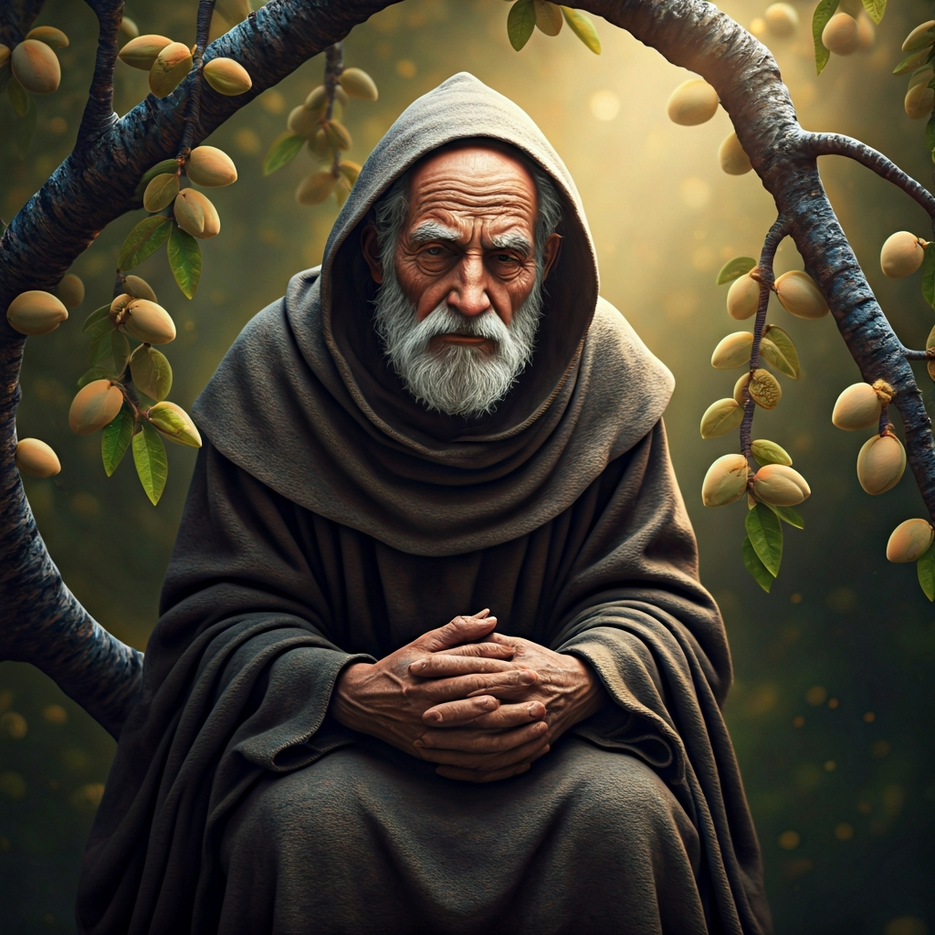
Devotions

Slide 50
Hermit Wisdom David the Dendrite
God of creation, we give you thanks for the sanctuary we find in the natural world and all that you have made in nature. As we remember David the Dendrite and his need for time spent in solitude with you, may we be inspired to bravely advocate for our retreat spaces and serve our communities with faithfulness and wisdom. We ask your Spirit to help us discern when to withdraw and when to be active in communion with others in faith. May we see the coming of your Kingdom alongside David and all the other Hermits we remember. Amen.
Continue…

Slide 51

​
Leader: ​As we enter a few minutes of silence together, you are invited to pray the prayer of adoration on the next slide and/or spend this time in contemplation. ​
The Spiritual Communion prayer follows on the slide after that.
Let us be still.
Leader and Cantor Mute.
Continue…

Slide 52

​
Thank you, Lord, for showing us your way.
Thank you, Lord, for leading us in your way.
Thank you, Lord, for blessing us in your way.
Wherever we go, whatever we’re doing, however we feel,
today and always, help us to keep going your way.
Amen.
Notes:
Prayer for all ages

Slide 53
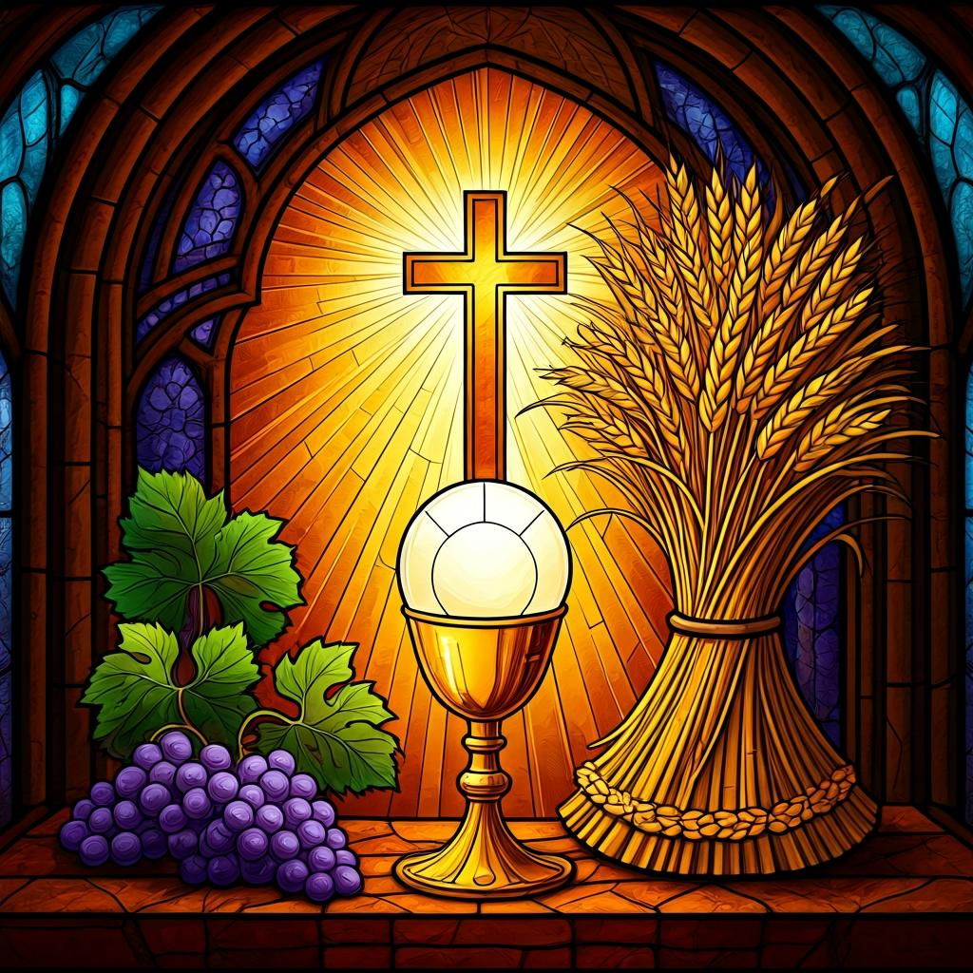
Making a
Spiritual Communion
(Prayed in silence)
Oh, my Lord Jesus I turn to you present at the Altar and in the Tabernacle. I believe that you are present in the Holy Sacrament of your most Sacred Body and Blood. I love you above all things and I desire to receive you into my Soul. I cannot at this moment receive you Sacramentally in Holy Communion. Come spiritually into my heart. Purify it, Sanctify it. Render my heart like your own heart. I embrace you as if you were already there and unite myself wholly with you. Never permit me to be separated from you. Lord, I am not worthy to receive you, but only say the word and I shall be healed. Amen

Slide 54
Leader unmutes
Our final song is
Find Your Rest
https://www.youtube.com/watch?v=p31B0aHsr8Y
​We stay on mute
Leader and Cantor mute

Slide 55
Leader and cantor unmute
Sending Prayer
Leader: We pray our sending prayer together.
All: Dear Lord, as we go out today,
help us to go in your way and in your time.
Watch over us in all our goings out and comings in,
until, in your time, we see you face to face.
Amen.

Slide 56
The Benediction
Leader: Let us all invite God’s blessings together,
All: May the Lord bless us and keep us.
May the Lord’s face shine upon us and be gracious to us.
May the Lord’s countenance be lifted upon us,
and bring us peace. Amen

Slide 57
Notices
May you find rest and renewal as we enter our sabbath month of rest
If there is anything you would like to pray for (such as events, animals or people) please post a prayer to the HHO App Prayer Wall so we can hold each other in our prayers
See HHO Events page for further upcoming events HHO Events

Slide 58
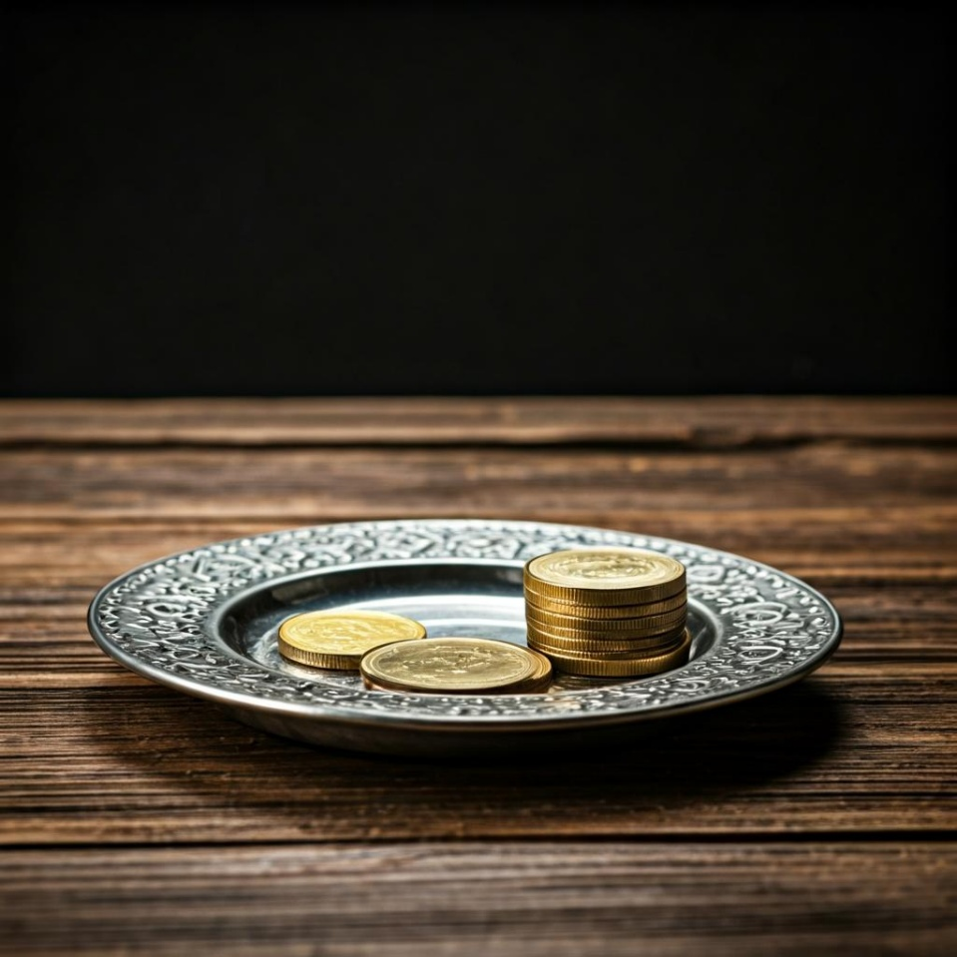
Leader: Thank you for your regular gifts to this ministry. Offerings are most welcome via:
The HHO App
Direct Debit
International Direct Debit
Please consider a one-off donation
or leaving a legacy in your Will
For further information go to HHO give page
https://holyhermits.com.au/give

Slide 59
Serving next week
12th July 2026
7th Sunday after Pentecost
9:00 am AEST
Service Prep: Lauren | Chat Host: Rachel | First Reader: Helen
Music: Lauren | Welcomer: Julie | Second Reader: Barry
Proof-reader: Chris | Priest: N/A | Preacher: Lauren
Broadcaster: Lauren | Deacon: Lauren | Fellowship: Julie
Backup Broadcaster: Barry | Leader: Julie | Safety Officer: Rachel
Zoom Buttons: Rachel | Cantor: Jeremy | Attendance: Rachel
Thank you for your ministry gifts
New Servers always welcome!
Please email Rev’d Lauren to get involved
holyhermits@anglicanchurchsq.org.au

Slide 60
The Dismissal
Leader: I invite everyone to unmute for the Dismissal
Leader: Go in peace to love and serve the Lord.
All: In the name of Christ, Amen.

Slide 61

Fellowship
Thank you, Lauren for leading Fellowship
Please feel welcome to linger or pop a message in the chat and head off when you are ready.​
Images from Padlet
Extra resources developed
by Roots on the Web

